Slide 1

Software Engineering 2
Mattia Piccinato, Jacopo Piazzalunga, Gabriele Puglisi
Prof. Matteo Camilli
A.Y. 2023/2024

Slide 2
RASD - Goals
G1 Allows registered Students who enrolled according to the right modalities to participate in a Tournament of Code Kata Battles and take part in its Battles.
G2 Allows registered Educators to manage Tournaments for which they have been granted permission.
G3 Allows registered Students who participate in a Tournament of Code Kata Battles to be rewarded of different achievements.
G4 Allows registered Users to visualize information for which they have granted permission.
G5 Automates code evaluation process using GitHub Actions and some static analysis tools.

Slide 3
RASD - Definitions
Battle: A Code Kata, that is, a challenge in which teams of players need to solve a problem in a specific coding language and submit their code to get a score according to the rules of the Battle.
Tournament: A competition composed of many Battles in which participants' overall score is the sum of all the scores obtained in every Battle they participated in, individually or in team with other players.
Student: The User which takes part into the Tournaments of Battles.
Educator: The User which organizes Tournaments of Battles to which the Students can participate and who manages every aspect about them.
Consolidation stage: The Consolidation Stage is the phase of a Battle which starts as soon as the submission deadline expires, during which the Educators who manage the Tournament can eventually assign an additional score to every team, which will be summed to the score previously assigned by the platform.
Badge: A Badge is an achievement marker related to a certain Tournament, obtained by Students if they satisfied the specific conditions defined by the Educator during the creation process of the Tournament.

Slide 4
RASD - Product Functions
F1 - Battles and Tournaments Creation
F2 - Student Participation
F3 - GitHub Integration
F4 - Automated Evaluation
F5 - Scoring and Ranking
F6 - Badges and Recognition
F7 - Manual Optional Evaluation

Slide 5
Assumptions
H1 - The students who participate in a Battle properly set up the GitHub Action for code submissions.
H2 - Educators will provide permission to manage the Tournaments they are creating during the creation process.
H3 - Students will form their teams as they try to enroll in a Battle. They will invite other Students, up to the maximum number allowed in a team for the Battle minus one. If not enough Students among the invited ones accept the invite as the subscription deadline expires, the Students in the team will not actually be enrolled in the Battle.
H4 - Battles can only be created when the Tournament subscription deadline has expired, that is, the Tournament is ongoing. Tournaments do not have a fixed duration. They must be closed by an Educator while all the Battles which were created have ended, that is, no Battle is neither ongoing or in Consolidation Stage.
H5 - Every Battle enters the Consolidation Stage as the submission deadline expires. Battles end when an Educator closes them. Before closing a Battle, Educators can make manual corrections.
H6 - Notifications are only meant to be sent to the Students.

Slide 6
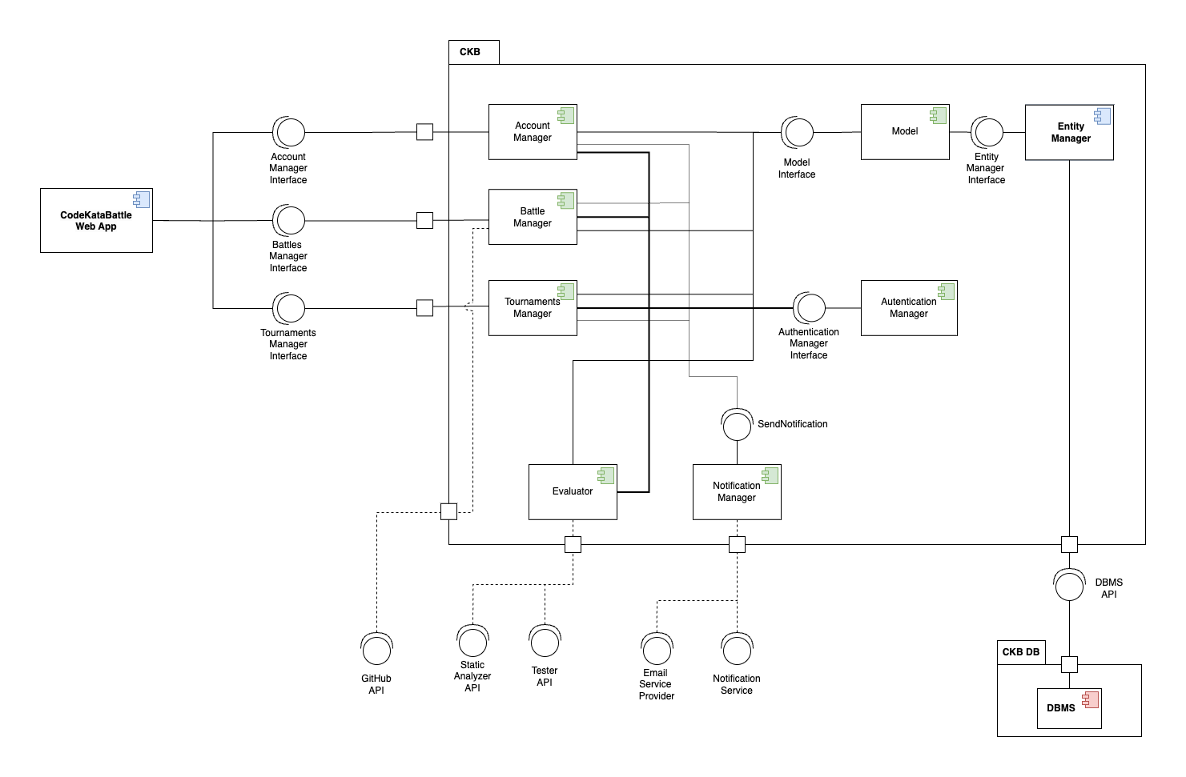
DD - Component View

Slide 7
DD - Architecture
Three-Tier Architecture
a. Modern interpretation of the 3-tier architecture, utilizing contemporary technologies.
b. Nginx serves static content (React app) to the browser.
c. The rest of the Presentation layer and the Application layer implemented by our Spring application.
d. The Data layer is managed by a relational database hosted on DigitalOcean's cloud infrastructure.
RESTful APIs
a. The client retrieves the resources by sending HTTP requests to our server.
On-Cloud
a. Our system is entirely hosted on Cloud.

Slide 8
DD - Architecture
Why not Microservices?
a. Pointless overhead
b. The system is small
Why RESTful APIs?
a. Simplicity
b. Standardization
On-Cloud
a. Availability
b. Scalability

Slide 9
DD - Other design choices
Relational Database
a. ACID
b. Widespread Language Support Token-Based Authentication and Authorization
Compatibility with REST
Performance (Reducing database load)
Cookies complicate scalability
Distributed MVC
Compatibility with 3-tier
Maintainability

Slide 10
DD - Other design choices
Relational Database
a. ACID
b. Widespread Language Support Token-Based Authentication and Authorization
Compatibility with REST
Performance (Reducing database load)
Cookies complicate scalability
Distributed MVC
Compatibility with 3-tier
Maintainability

Slide 11
Implementation
We were asked to provide the implementation of some of the product functions of the application, ignoring the gamification aspects.
In the end, we decided to provide the implementation of almost all the product functions and requirements of the application.
The only features which we did not entirely implement are:
The automated evaluation. The prototype offers automated functional evaluation exclusively for Java programs and does not implement static analysis.
The manual optional evaluation. The prototype only implements the backend method to handle the HTTP request. The frontend does not let the User perform the manual optional evaluation although.

Slide 12
ITD - Frontend
Java Spring to handle the HTTP requests.
React for the User Interface.

Slide 13
ITD - Backend
Java Spring to implement the business logic.
Java Persistence API (JPA) for object-mapping with Hibernate.
Java Database Connectivity (JDBC) for connectivity.

Slide 14
ITD - Frontend
Java Spring to handle the HTTP requests.
React for the User Interface using JSX.

Slide 15
ITD - Deadlines
1. Java Spring Task Scheduler to trigger transactions on the DB.
2. DB for persistency.
3. Strategy Pattern for reusability.
4. Spring Application Events for asynchrony.

Slide 16
ITD - JWT
JSON Web Tokens (JWT) were used for:
Authentication and authorization of HTTP requests.
Authentication and authorization of GitHub commits.
Team invite links.

Slide 17
ITD - Notifications
Jakarta Mail API was used for:
Sending platform notifications to the Students.
Sending team invites to the Students.
We used SMTP2GO to send emails from our platform email address.

Slide 18
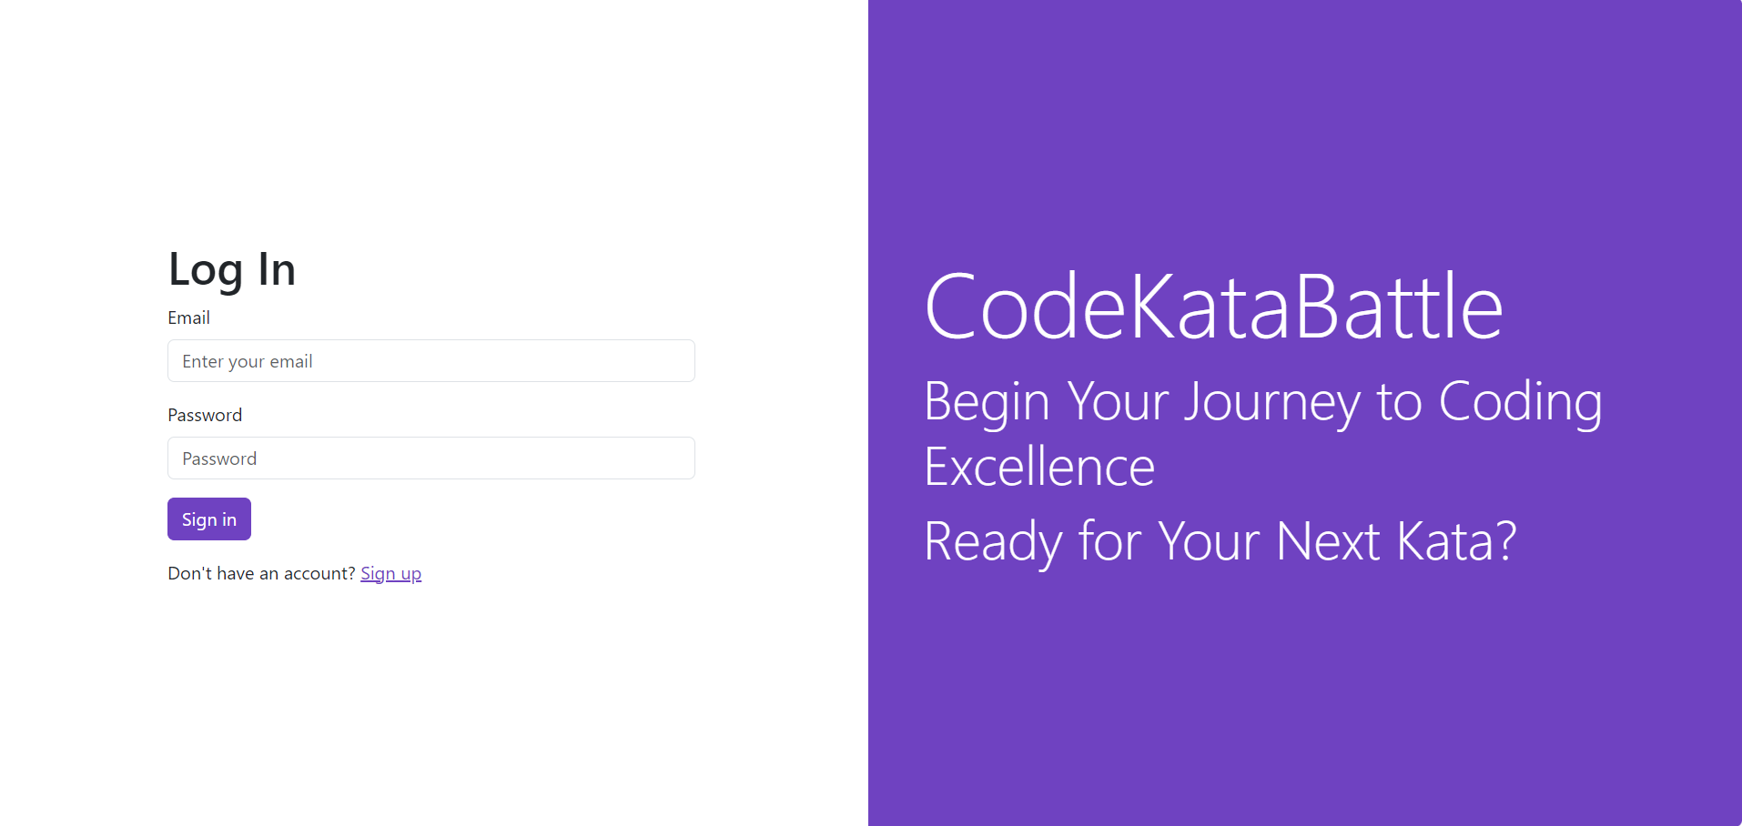
User Interface - Login

Slide 19
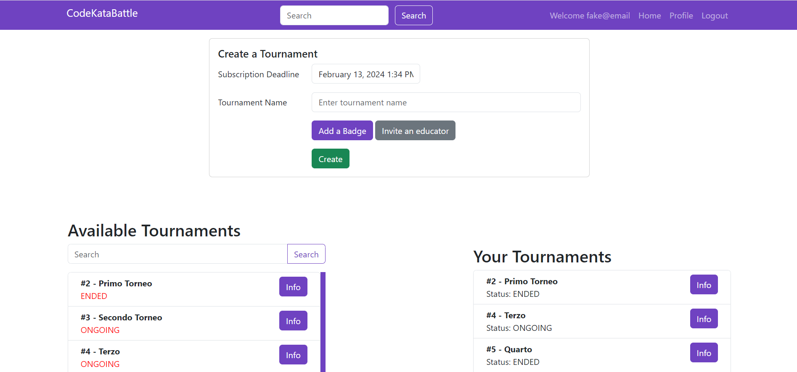
User Interface - Educator Home Page

Slide 20
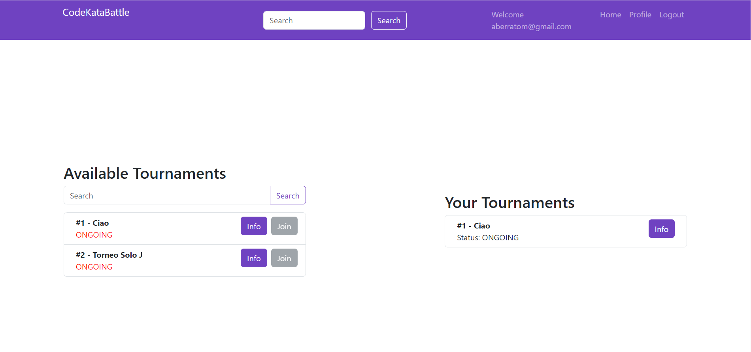
User Interface - Student Home Page

