Slide 1

Software Engineering 2
Mattia Piccinato, Jacopo Piazzalunga, Gabriele Puglisi
Prof. Matteo Camilli
A.Y. 2023/2024

Slide 2
RASD

Slide 3
RASD - Goals
G1 Allows registered Students who enrolled according to the right modalities to participate in a Tournament of Code Kata Battles and take part in its Battles.
G2 Allows registered Educators to manage Tournaments for which they have been granted permission.
G3 Allows registered Students who participate in a Tournament of Code Kata Battles to be rewarded of different achievements.
G4 Allows registered Users to visualize information for which they have granted permission.
G5 Automates code evaluation process using GitHub Actions and some static analysis tools.

Slide 4
RASD - Definitions
Battle: A Code Kata, that is, a challenge in which teams of players need to solve a problem in a specific coding language and submit their code to get a score according to the rules of the Battle.
Tournament: A competition composed of many Battles in which participants' overall score is the sum of all the scores obtained in every Battle they participated in, individually or in team with other players.
Student: The User which takes part into the Tournaments of Battles.
Educator: The User which organizes Tournaments of Battles to which the Students can participate and who manages every aspect about them.
Consolidation Stage: The Consolidation Stage is the phase of a Battle which starts as soon as the submission deadline expires, during which the Educators who manage the Tournament can eventually assign an additional score to every team, which will be summed to the score previously assigned by the platform.
Badge: A Badge is an achievement marker related to a certain Tournament, obtained by Students if they satisfied the specific conditions defined by the Educator during the creation process of the Tournament.

Slide 5
RASD - Product Functions
F1 - Battles and Tournaments Creation
F2 - Student Participation
F3 - GitHub Integration
F4 - Automated Evaluation
F5 - Scoring and Ranking
F6 - Badges and Recognition
F7 - Manual Optional Evaluation

Slide 6
Assumptions - 1
Here are the assumptions we made trying to take the most reasonable choice in several aspects:
A1. Proper set up of GitHub Actions (Domain Assumption)
A2. Tournaments' management rights are guaranteed during the creating process.
A3. Educators can "fully manage" a Tournament or they cannot at all.
A4. Students can only invite members for their time when joining a Battle.
A5. Students who entered a team accepting an invite cannot invite other members.

Slide 7
Assumptions - 2
Here are the assumptions we made trying to take the most reasonable choice in several aspects:
A6. Battles can be in SUBSCRIPTION, ONGOING, CONSOLIDATION or ENDED Stage.
A7. Tournaments can be in SUBSCRIPTION, ONGOING or ENDED Stage.
A8. Battles can only be created when the Tournament is ONGOING.
A9. Tournaments do not have a fixed deadline.
A10. Every Battle enters the Consolidation Stage.
A11. Notifications are only meant to be sent to the Students.

Slide 8
DD

Slide 9
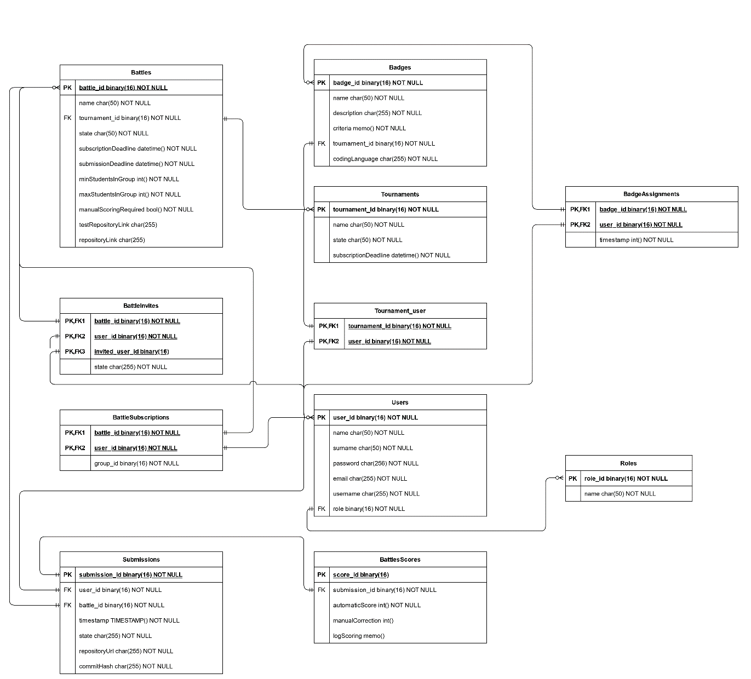
DD - ER Diagram

Slide 10
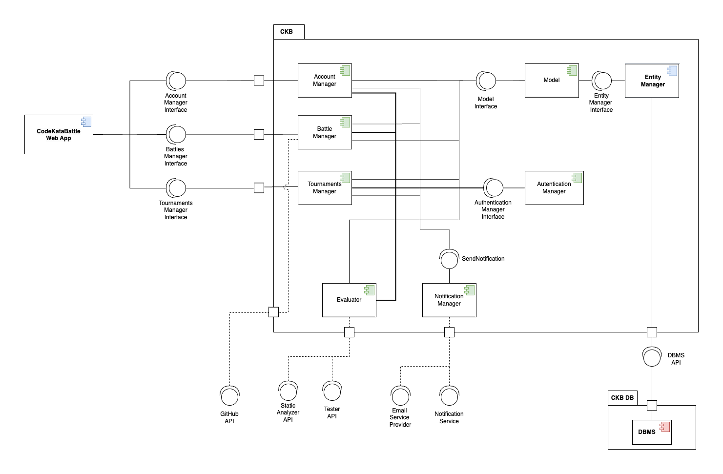
DD - Component View

Slide 11
DD - Architecture
Three-Tier Architecture
Modern interpretation of the 3-tier architecture, utilizing contemporary technologies.
Nginx serves static content (React app) to the browser.
The rest of the Presentation layer and the Application layer implemented by our Spring application.
The Data layer is managed by a relational database hosted on DigitalOcean's cloud infrastructure.
RESTful APIs
The client retrieves the resources by sending HTTP requests to our server.
Stateless.
On-Cloud
Our system is entirely hosted on Cloud.

Slide 12
DD - Architecture
Why not Microservices?
Steep learning curve
The system is small
Why RESTful APIs?
Simplicity
Standardization
On-Cloud
Availability
Scalability

Slide 13
DD - Other design choices
Relational Database
ACID
Widespread language support
Token-Based Authentication and Authorization
Compatibility with REST
Scalability
Distributed MVC
Compatibility with 3-tier
Maintainability
HTTPS
Security

Slide 14
I&T

Slide 15
Implementation
We were asked to provide partial implementation of the application, ignoring the gamification aspects.
We provide the implementation of almost all the product functions of the application.
The only features which we did not entirely implement are:
The automated evaluation. The prototype offers automated functional evaluation exclusively for Java programs and does not implement static analysis.
The manual optional evaluation. The prototype only implements the backend method to handle the HTTP request. The frontend does not let the User perform the manual optional evaluation although.
The Battles closure. The frontend does not let the User close a Battle.

Slide 16
ITD - Frontend
For the frontend we used:
Spring Framework to handle the HTTP requests.
React for the User Interface.
JSX
Vite.js

Slide 17
ITD - Backend
For the backend we used:
Spring Framework to implement the business logic.
Spring security for simplifying authorization
Spring data for simplifying data access
Spring validation for simplifying integrity checks
Java Persistence API (JPA) for object-mapping with Hibernate.
Mockito, JUnit and Postman for testing.

Slide 18
ITD - Deadlines
We handle the deadlines with:
Spring Task Scheduler to trigger transactions on the DB.
Deadlines are stored on the DB for resiliency to system failure.
Strategy Pattern for reusability.
Spring Application Events for asynchronous communication between threads.

Slide 19
ITD - JWT
We used JSON Web Tokens (JWT) for:
Authentication and authorization of HTTP requests.
Authentication and authorization of GitHub commits.
Team invite links.
They were generated with jjwt library and digitally signed with 2048-bit RSA keys.

Slide 20
ITD - Interacting with GitHub
Two key aspects to highlight regarding our application's interactions with GitHub are:
Handling repositories for Battles.
Authenticating commit authors.
We utilized the GitHub API library for Java, leveraging its integration with GitHub's REST APIs.

Slide 21
ITD - Notifications
Jakarta Mail API was used for:
Sending platform notifications to the Students.
Sending team invites to the Students.
We used SMTP2GO to send emails from our platform email address.

