Slide 1

Software Engineering 2
Mattia Piccinato, Jacopo Piazzalunga, Gabriele Puglisi
Prof. Matteo Camilli
A.Y. 2023/2024

Slide 2
RASD

Slide 3
RASD - Goals
G1 Allows registered Students who enrolled according to the right modalities to participate in a Tournament of Code Kata Battles and take part in its Battles.
G2 Allows registered Educators to manage Tournaments for which they have been granted permission.
G3 Allows registered Students who participate in a Tournament of Code Kata Battles to be rewarded of different achievements.
G4 Allows registered Users to visualize information for which they have granted permission.
G5 Automates code evaluation process using GitHub Actions and some static analysis tools.

Slide 4
RASD - Product Functions
F1 Battles and Tournaments Management
F2 Student Participation
F3 GitHub Integration
F4 Automated Evaluation
F5 Scoring and Ranking
F6 Badges and Recognition
F7 Manual Optional Evaluation

Slide 5
RASD - Domain Assumptions
D1 The User must have a working Internet connection.
D2 The Students who participate to a Battle properly set up the GitHub Action for code submissions.
D3 The Users always receive every notification which is sent by the system.
D4 The availability of the static analysis tools utilized for the code evaluation process is consistent.
D5 The availability of GitHub Actions service is consistent.

Slide 6
DD

Slide 7
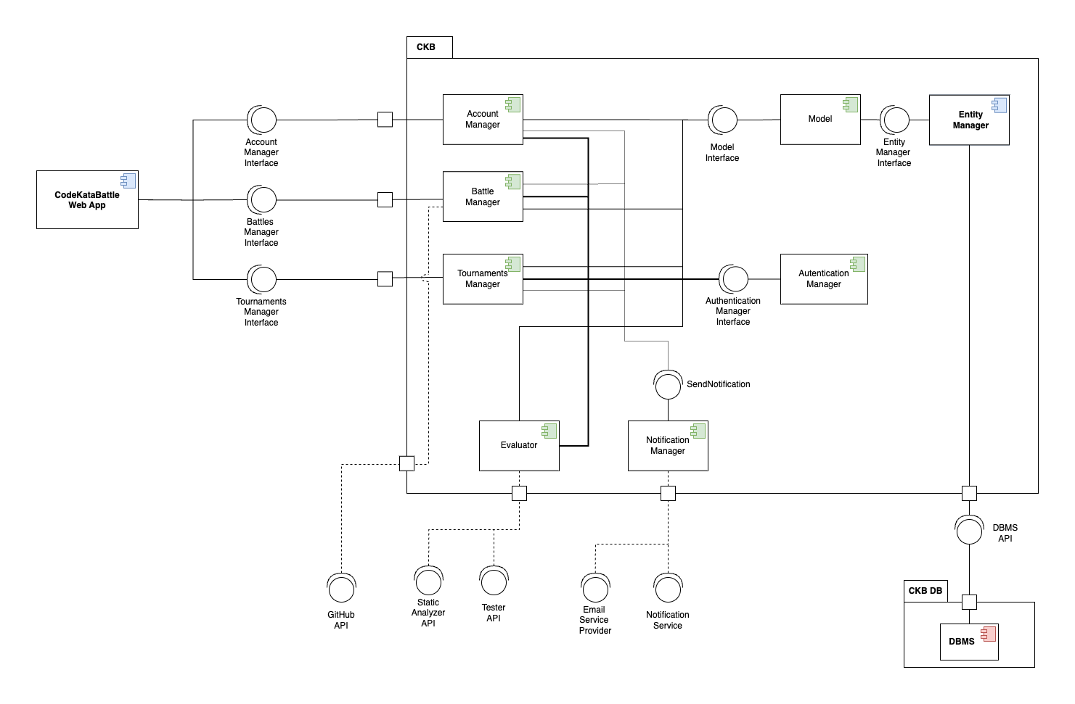
DD - Component View

Slide 8
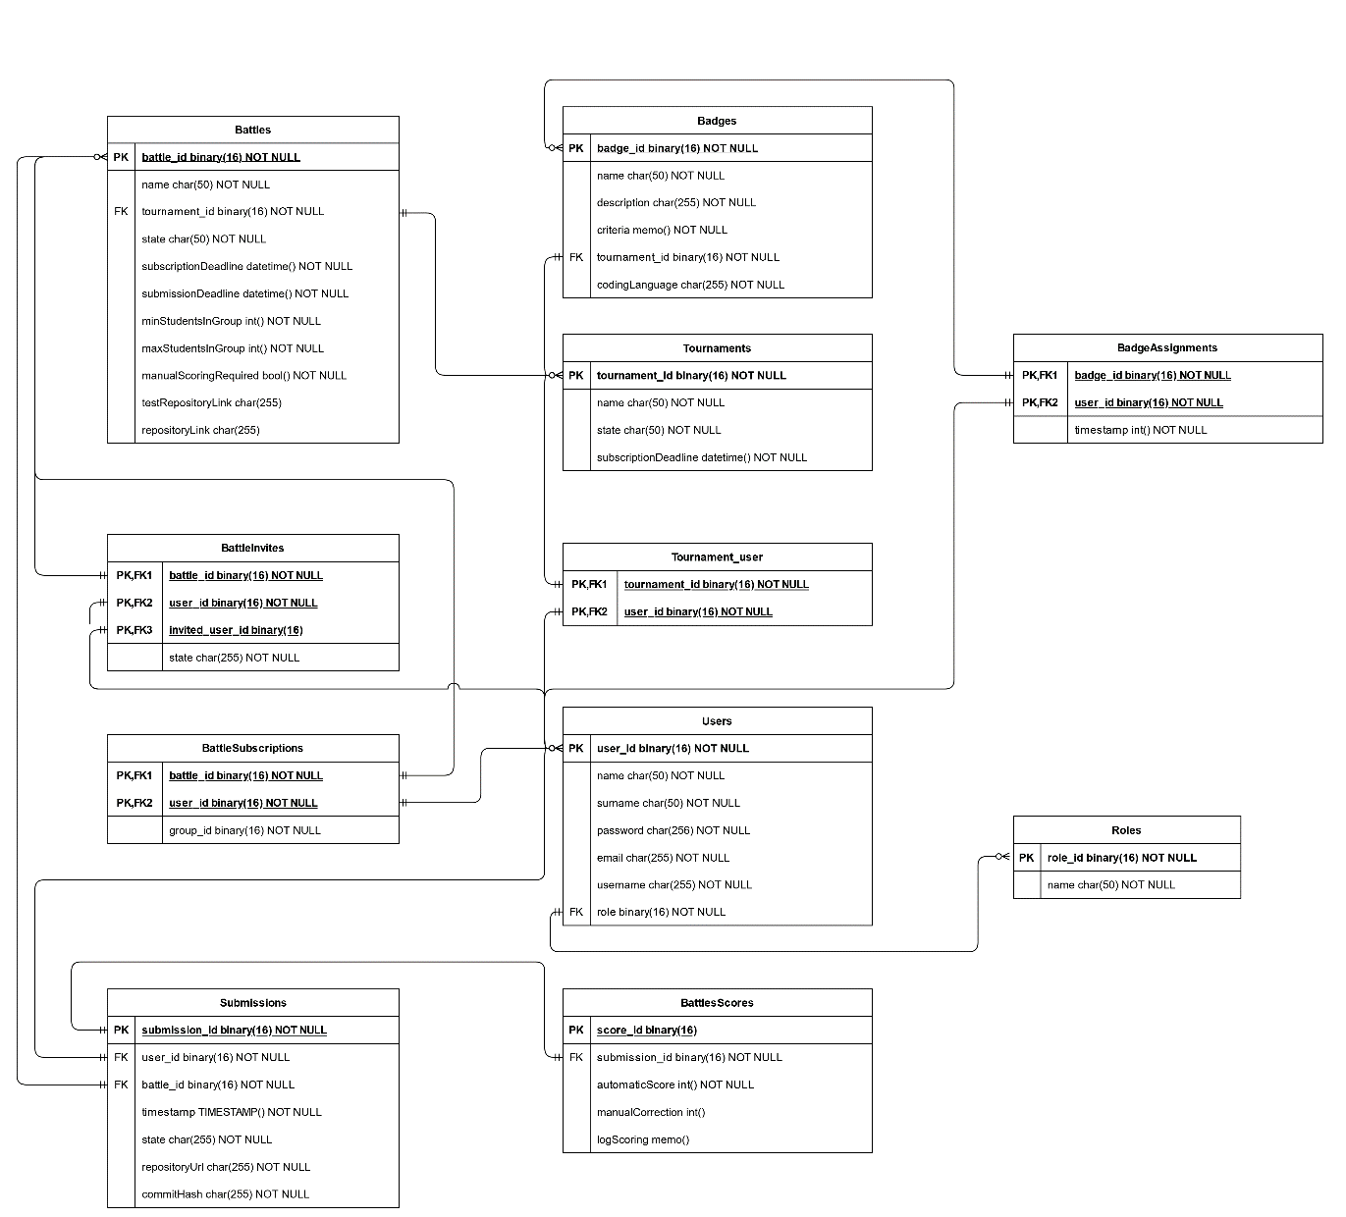
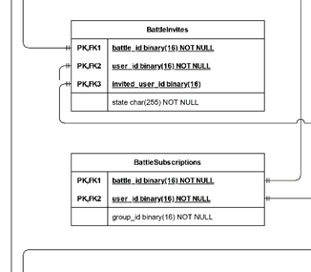
DD - ER Diagram

Slide 9
DD - Architecture
Three-Tier Architecture
Modern interpretation of the 3-tier architecture, utilizing contemporary technologies.
nginx serves static content (React app) to the browser.
The rest of the Presentation layer and the Application layer implemented by our Spring application.
The Data layer is managed by a relational database hosted on DigitalOcean's cloud infrastructure.
RESTful APIs
The client retrieves the resources by sending HTTP requests to our server.
Stateless.
On-Cloud
Our system is entirely hosted on Cloud.

Slide 10
DD - Other design choices
Relational Database
ACID
Widespread language support
Token-Based Authentication and Authorization
Compatibility with REST
Scalability
Distributed MVC
Compatibility with 3-tier
Maintainability
HTTPS
Security

Slide 11
I&T

Slide 12
Implementation
We were asked to provide partial implementation of the application, ignoring the gamification aspects.
We provide the implementation of almost all the product functions of the application.
The only features which we did not entirely implement are:
The automated evaluation. The prototype offers automated functional evaluation exclusively for Java programs and does not implement static analysis.
The manual optional evaluation. The prototype only implements the backend method to handle the HTTP request. The frontend does not let the User perform the manual optional evaluation although.

Slide 13
ITD - Frontend
For the frontend we used:
Spring Framework to handle the HTTP requests.
React for the User Interface.
JSX
Vite.js
nginx

Slide 14
ITD - Backend
For the backend we used:
Spring Framework to implement the business logic.
Spring security for simplifying authorization
Spring data for simplifying data access
Spring validation for simplifying integrity checks
Java Persistence API (JPA) for object-mapping with Hibernate.
Mockito, JUnit and Postman for testing.

Slide 15
ITD - Deadlines
We handle the deadlines with:
Spring Task Scheduler to trigger transactions on the DB.
Deadlines are stored on the DB for resiliency to system failure.
Strategy Pattern for reusability.
Spring Application Events for asynchronous communication between threads.

Slide 16
ITD - JWT
We used JSON Web Tokens (JWT) for:
Authentication and authorization of HTTP requests.
Authentication and authorization of GitHub commits.
Team invite links.
They were generated with jjwt library and digitally signed with 2048-bit RSA keys.

Slide 17
ITD - Interacting with GitHub
Two key aspects to highlight regarding our application's interactions with GitHub are:
Handling repositories for Battles.
Authenticating commit authors.
We utilized the GitHub API library for Java, leveraging its integration with GitHub's REST APIs.

Slide 18
ITD - Notifications
Jakarta Mail API was used for:
Sending platform notifications to the Students.
Sending team invites to the Students.
We used SMTP2GO to send emails from our platform email address.

