Slide 1

Pricing Strategies for Online Dating Platforms
Titing Cui, Michael L. Hamilton
CORS 2022
Notes:
Self introduction: Hello everyone, my name is Titing Cui. I’m a third PhD student from Katz Graduate School of Business, University of Pittsburgh. Today, I’m going present our paper, pricing strategies for online dating platforms. This is a joint work with my advisor Michael Hamilton.

Slide 2
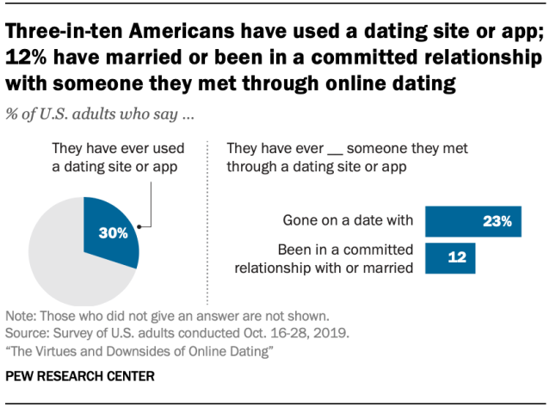
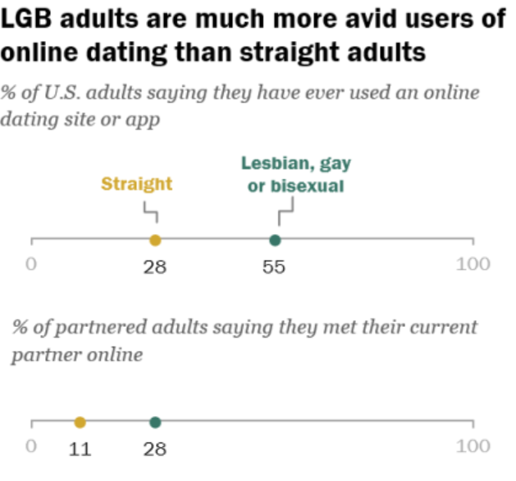

Online Dating
Online dating platform has displaced conventional mediums such as family, school, or the workplace, to become the most common way for new couples to meet.
Notes:
Nowadays, online dating platform has become more and more popular, and replaced the conventional mediums, such as family, school, or the workplace, to be the most common way for new couples to meet each other, especially during the pandemic.
According to the research conducted by Pew Research Center in 2019, about 30% U.S. adults say they have used a dating site or app before.
The percentage goes even higher for the LGBT people, a full two-thirds of lesbian, gay, or bisexual Americans report using dating apps

Slide 3
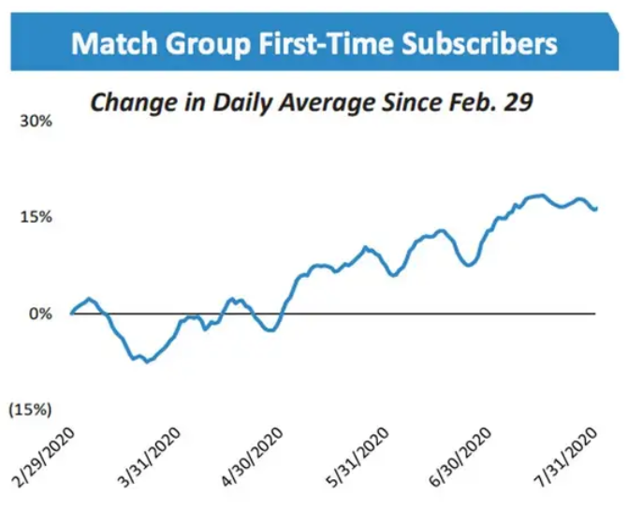
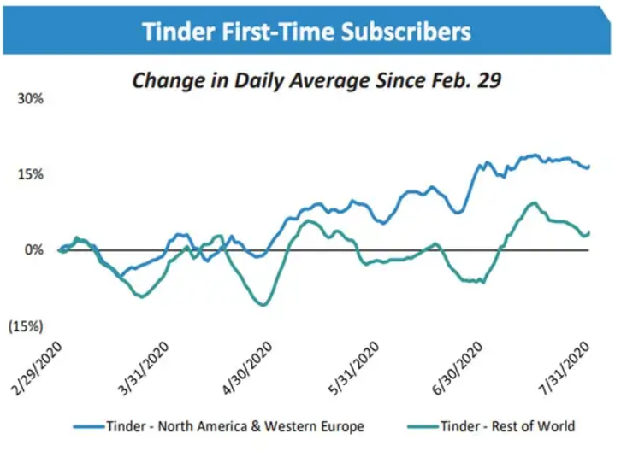
Online Dating
Online dating platform has displaced conventional mediums such as family, school, or the workplace, to become the most common way for new couples to meet.
Notes:
The dating services industry has swelled over the last five years, with an annualized growth rate of 12.9%. After the pandemic, the first-time subscribers for match group and Tinder had a significant growth.

Slide 4
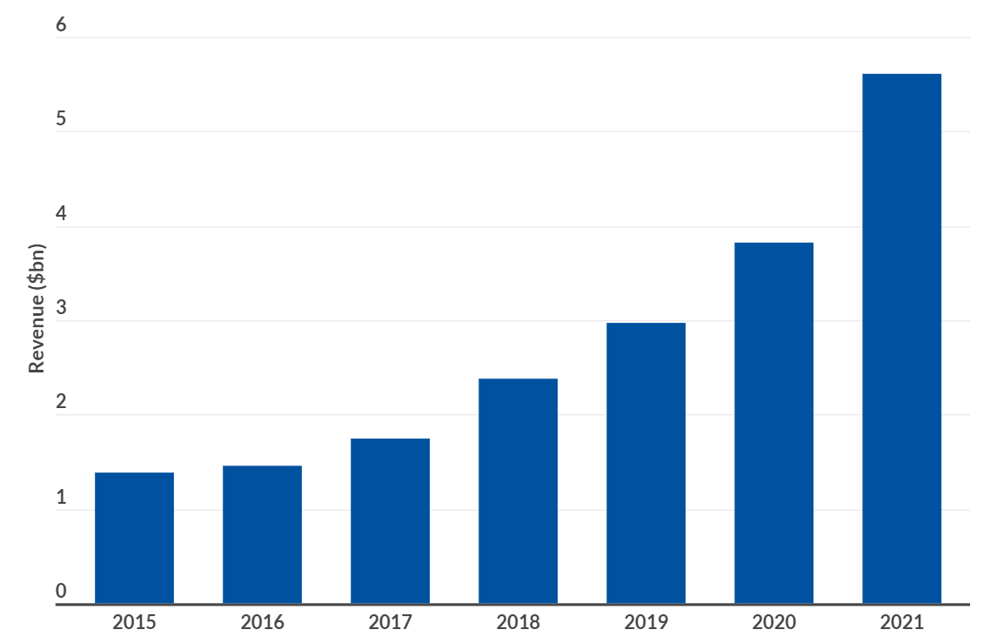
Online Dating
Online dating platform has displaced conventional mediums such as family, school, or the workplace, to become the most common way for new couples to meet.
Notes:
We can also see the significant growth in revenue for the last six years.
We can also see the growth from other apps, like the global download of Hinge. And the ARPU (average revenue per user) keeps the same, meaning the increasing subscribers bring a big amount money in total.
Replace the graph with revenue.

Slide 5
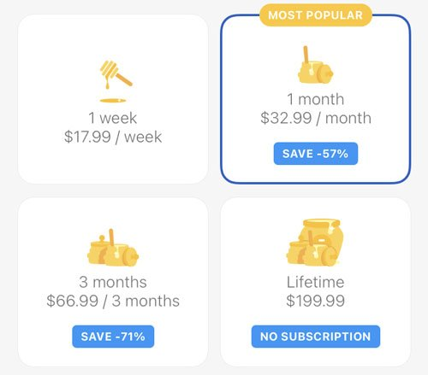
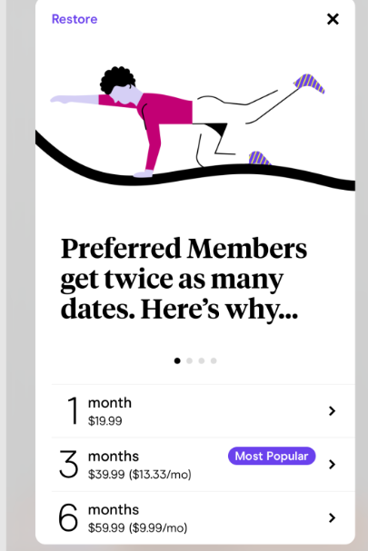
Online Dating in Practice
Notes:
Let’s talk about the price of online dating apps. In practice, The majority of dating apps earn revenue by subscription-based pricing, where subscriptions for access to the app are sold at a fixed price.
Subscription based pricing is a ubiquitous way to monetize mobile apps, however in the context of online dating is controversial as it potentially misaligns the incentives of the platform and its users. The platform wants its users to stay on the platform as long as possible, while the users want to get a match as soon as possible, especially for short subscription periods. For most of platforms, they offer different subscription periods, one month, 3 months, even 6 month.
Another, less popular is the contract based model, in which the dating app is contracted by the user to facilitate a search for a partner at some agreed upon one time price. Like selective search, users will pay for once, the platform will provide complex search service for one year. In this paper, we want to compare these strategies. Contracted pricing can also be viewed as a long subscription period.
Free, (SP), lifetime (Bumble lifetime plan)

Slide 6
Contributions
C1: Characterize lower bound for subscription model (Thm. 1).
We give a novel model to describe the pricing for online dating platforms and prove bounds on the profit ratio of (FP) to the optimal achievable profits.
C2: Fine-grained analysis for cost and matching proportion (Thm. 2 & 3).
We study when the marginal operating cost, c, is small, and show larger payment periods are better for both profit and welfare.
C3: Extensions to heterogenous matching rate (Thm 4).
When the platform strategically varies the match rate, (FP) has the incentive to offer users the worst matches while (CP)’s incentive is to match the user as quickly as possible.
Today
Notes:
First, we give a novel model to describe the pricing for online dating platforms and prove bounds on the profit ratio of (SP) to the optimal achievable profits.
Next, We study the impact of marginal operating cost. when the marginal operating cost, c, is small, and show larger payment periods are better for both profit and welfare.
Finally, we look at heterogenous matching rates. But today, I’m only going to discuss the first two results.

Slide 7
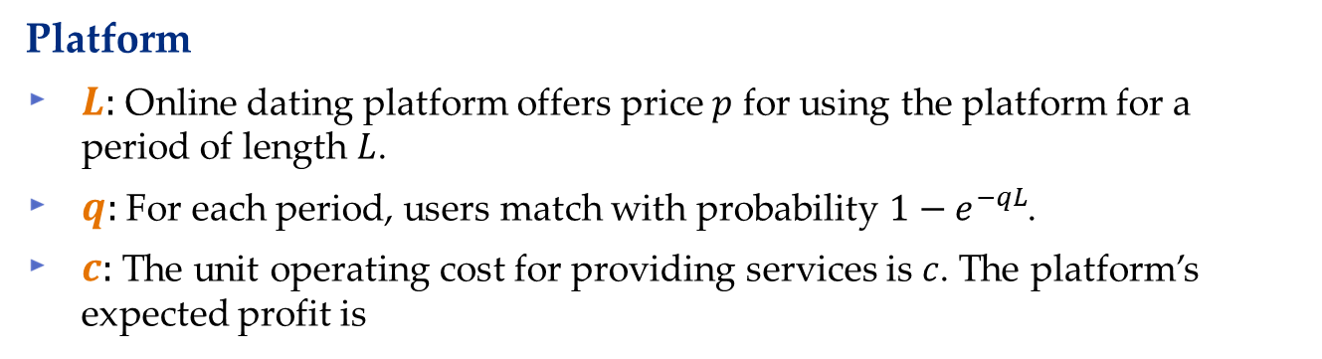
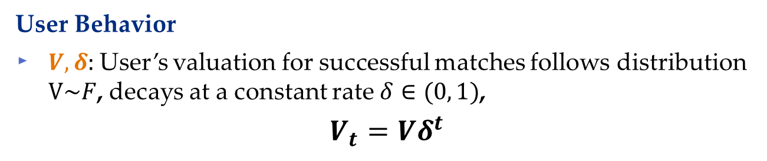
Model: ODP
User Behavior
$V,δ:$User’s valuation for successful matches follows distribution $V\sim F$, decays at a constant rate $δ∈(0, 1)$,
$$V_{t}=Vδ^{t}$$
Platform
$L:$Online dating platform offers price $p$ for using the platform for a period of length $L$.
$q:$For each period, users match with probability $1−e^{−qL}$.
$c:$The unit operating cost for providing services is $c$. The platform’s expected profit is
$$R\left(p, c, L, F\right)=pE\left[Periods on platform\right]−cE[Time on platform]$$
Notes:
First of all, let’s look at the model for online dating pricing. In our model, we assume the users are looking long-term relationship. If they get matched, they will leave the platform forever
We assume user’s valuation for a successful match follows a distribution F, and decays at a constant rate delta. The platform offers price for using the platform for a period of length $L$. Users will pay price $p$ if their expected valuation of successful matches in the period is greater or equal than the price $p.$ For each period, users match with probability $1−e^{−qL}$, the success of matching follows an exponential distribution. They can stay on the platform at most $T$. $T$ denotes the size of candidate pool. The marginal cost for providing the services is c. The platform’s expected profit equals to price times how many periods customers will pay minus the total operating cost.

Slide 8

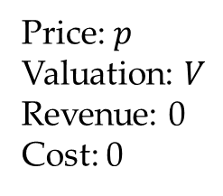
Online Dating Platform Example
1
2
Price: $p$
Valuation: $V$
Revenue: 0
Cost: 0
Notes:
We use the Bumble as an example to demonstrate the operations of dating platform. Suppose Mr. Smith on the left side is a user of Bumble. Bumble will show possible dates for Mr. Smith. If Mr. Smith doesn’t like the recommendation, he swipe left or right to see other recommendations. Otherwise, Mr. Smith can initiate a conversation. We focus on swipe app, only recommendations by the platform, no active search.

Slide 9

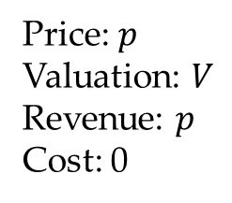
Online Dating Platform Example
1
2
Price: $p$
Valuation: $V$
Revenue: $p$
Cost: 0
Notes:
Suppose Mr. Smith on the left side is a user of Bumble. Bumble will show possible dates for Mr. Smith. If Mr. Smith doesn’t like the recommendation, he swipe left or right to see other recommendations. Otherwise, Mr. Smith can initiate a conversation. We focus on swipe app, only recommendations by the platform, no active search.

Slide 10
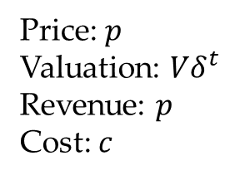
Online Dating Platform Example
1
2
Price: $p$
Valuation: $Vδ^{t}$
Revenue: $p$
Cost: $c$
Notes:
Suppose Mr. Smith on the left side is a user of Bumble. Bumble will show possible dates for Mr. Smith. If Mr. Smith doesn’t like the recommendation, he swipe left or right to see other recommendations. Otherwise, Mr. Smith can initiate a conversation. We focus on swipe app, only recommendations by the platform, no active search.

Slide 11

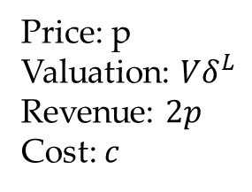
Online Dating Platform Example
1
2
Price: p
Valuation: $Vδ^{L}$
Revenue: $2p$
Cost: $c$
Notes:
Suppose Mr. Smith on the left side is a user of Bumble. Bumble will show possible dates for Mr. Smith. If Mr. Smith doesn’t like the recommendation, he swipe left or right to see other recommendations. Otherwise, Mr. Smith can initiate a conversation. We focus on swipe app, only recommendations by the platform, no active search.

Slide 12
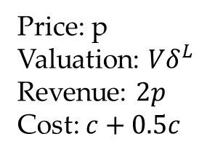
Online Dating Platform Example
1
2
Price: p
Valuation: $Vδ^{L}$
Revenue: $2p$
Cost: $c+0.5c$
Notes:
Suppose Mr. Smith on the left side is a user of Bumble. Bumble will show possible dates for Mr. Smith. If Mr. Smith doesn’t like the recommendation, he swipe left or right to see other recommendations. Otherwise, Mr. Smith can initiate a conversation. We focus on swipe app, only recommendations by the platform, no active search.

Slide 13
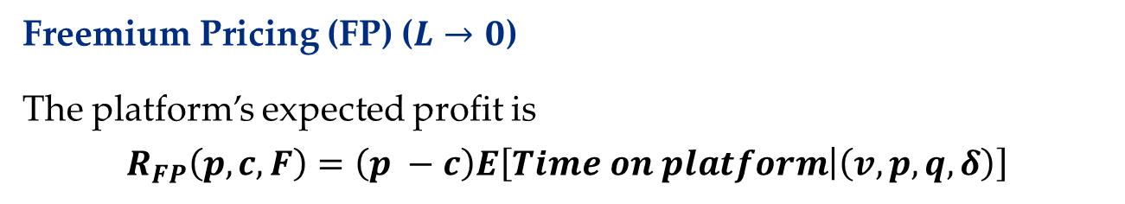
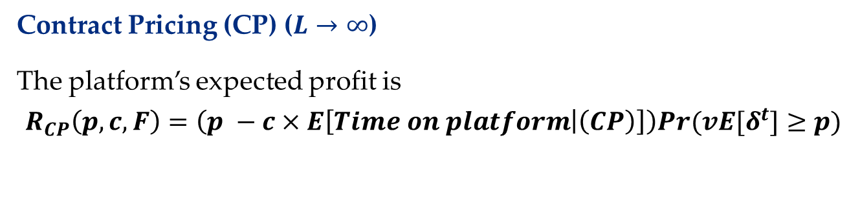
Model: ODP
Freemium Pricing (FP) ($L→0$)
The platform’s expected profit is
$$R_{FP}\left(p, c, F\right)=\left(p −c\right)E\left[Time on platform | \left(v, p, q, δ\right)\right]$$
Contract Pricing (CP) ($L→∞$)
The platform’s expected profit is
$$R_{CP}\left(p, c, F\right)=\left(p −c×E\left[Time on platform | \left(CP\right)\right]\right)Pr(vE[δ^{t}]≥p)$$
Notes:
In this paper, we emphasize two pricing strategies, (SP) and (CP). (SP) and (CP) represents two ends of the pricing spectrum. For the (SP)

Slide 14

Q1: Why Short Subscriptions?
Theorem [$R_{FP}$ is Approximately Optimal].
For all positive valued distributions $F,$parameters $c, q, T > 0$, and $δ∈ (0,1)$, then:
$$\frac{R_{FP}(c,F)}{\max_{L}{R(c,L,F)}}≥{\left(1−\frac{q}{\log\left(δ\right)}\right)}^{\log\left(δ\right)/q}$$
Taking the minimum over $−q/\log\left(δ\right)$, yields a constant factor approximation
$$\frac{R_{FP}(c,F)}{\max_{L}{R(c,L,F)}}≥\frac{1}{e}$$
Takeaway
No other period length achieves constant factor for all market params.
Freemium pricing is robust, guarantees a substantial fraction of optimal profit the platform can achieve.
Notes:
The first questions, why short period? We show that (SP) is approximately optimal. The ratio between (SP) and the optimal achievable revenue is bounded by a factor of q over log(delta). If we take the minimum -q/log(delta), the ratio is actually bounded by 1/e. No other subscription period can achieve a constant bound like (SP).

Slide 15
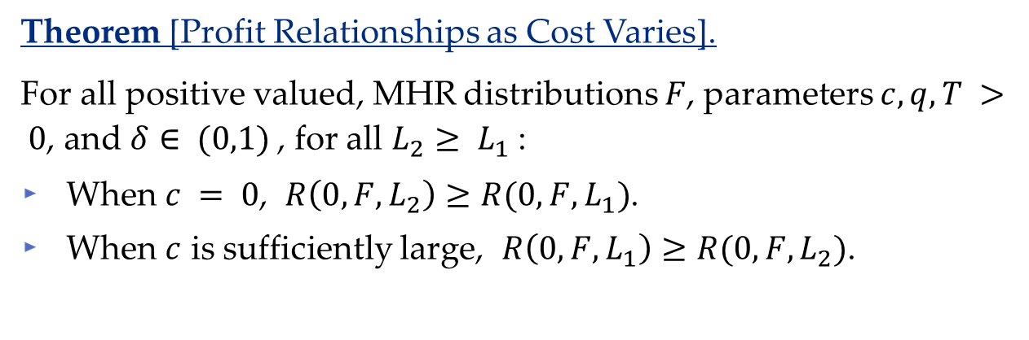
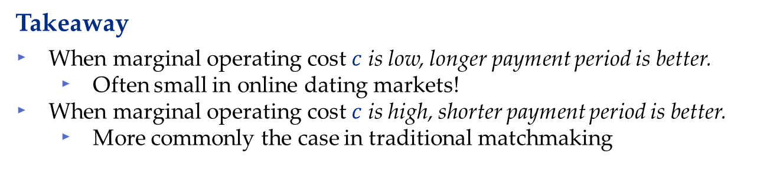
Q2: Impacts of Costs?
Theorem [Profit Relationships as Cost Varies].
For all positive valued, MHR distributions $F$, parameters $c, q, T > 0$, and $δ∈ (0,1)$, for all $L_{2}≥ L_{1}$:
When $c = 0$, $R\left(0, F, L_{2}\right)≥R(0, F, L_{1})$.
When $c$ is sufficiently large, $R\left(0, F, L_{1}\right)≥R(0, F, L_{2})$.
Takeaway
When marginal operating cost $c$ is low, longer payment period is better.
Often small in online dating markets!
When marginal operating cost $c$ is high, shorter payment period is better.
More commonly the case in traditional matchmaking
Notes:
Next, we consider the impacts of marginal operating cost. For MHR distribution F, we show that when c = 0, the revenue for larger periods is always better than smaller periods. While when the marginal operating cost is high, the revenue for larger periods becomes always less than smaller periods.

Slide 16
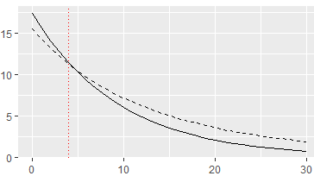
Q2: Impacts of Costs?
Example of Theorem [Profit Relationships as Cost Varies].
(CP)
--- (FP)
Revenue (R)
Cost (c)
$$δ=0.8, q=0.2, F=Exp(100)$$
Notes:
We also use the exponential distribution with mean 100 to do the simulation. Consider the case when T = infinity, customer’s valuation decays at delta = 0.8, and the match rate is 0.2, When, c is less than 4, (CP) is better than (SP).

Slide 17
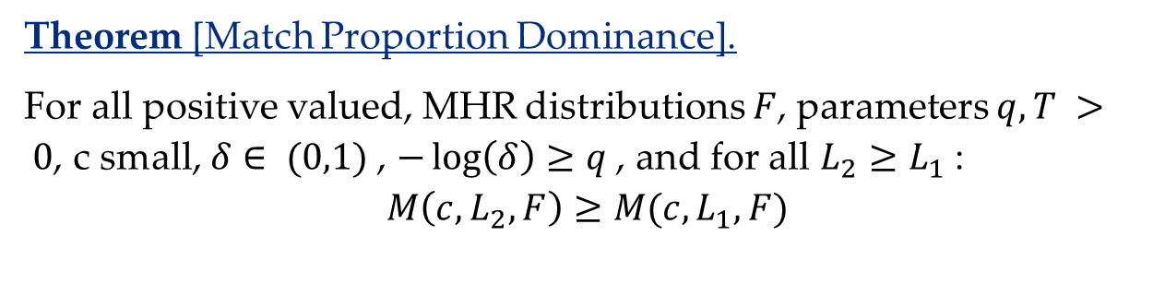

Q2: Matching Proportion?
Definition: Let $M(c,L,F)$ be the proportion of the market that ultimately gets matched.
Theorem [Match Proportion Dominance].
For all positive valued, MHR distributions $F$, parameters $q, T > 0$, c small, $δ∈ (0,1)$, $−\log\left(δ\right)≥q$, and for all $L_{2}≥L_{1}$:
$$M\left(c,L_{2},F\right)≥M(c,L_{1},F)$$
Takeaway
When marginal cost is low, longer payment period also benefits users.
Low cost means more profit AND more welfare (match proportion) from longer payment periods
Notes:
The dominance is not only for revenue, but also for user’s welfare. Now consider the matching proportion, the percentage of users leave the platform getting matched, is also going to be larger for longer periods.
$c^{∗}\left(L_{1},L_{2}\right)$ is the cost such that the profit of payment period $L_{1}$ is the same as the profit of $L_{2}$.
$,$ there exists $c^{∗}\left(L_{1},L_{2}\right)$ such that when $c≤$ $c^{∗}\left(L_{1},L_{2}\right)$

Slide 18
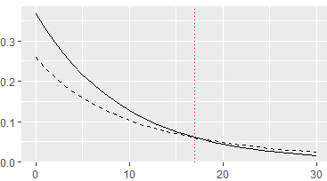
Q2: Matching Proportion?
Example of Theorem [Match Proportion Dominance]
(CP)
--- (FP)
Match Proportion (M)
Cost (c)
$$δ=0.8, q=0.2, F=Exp(100)$$
Notes:
We also use the same parameters to do the simulation for matching proportion. When, c is less than 15 , (CP) is better than (SP) in terms of matching proportion.

Slide 19
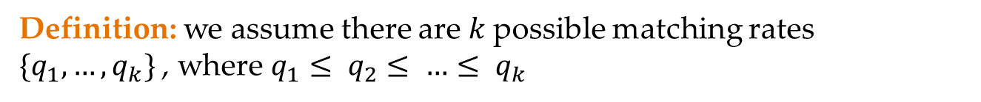
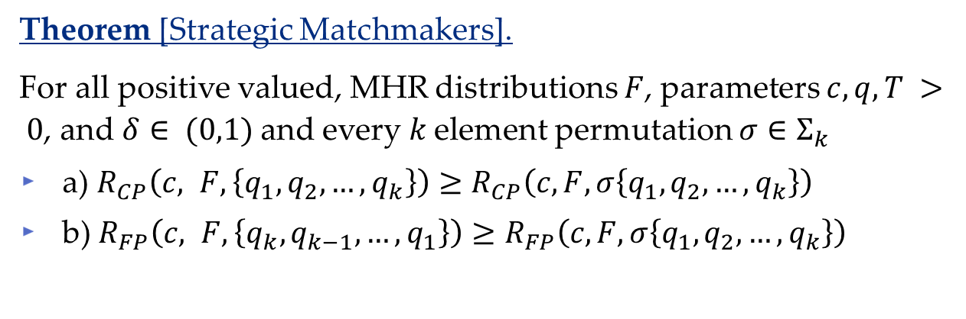
Q3: Heterogenous Matching Rates?
Definition: we assume there are $k$possible matching rates $\{q_{1},…, q_{k}\}$, where $q_{1}≤ q_{2}≤ …≤ q_{k}$
Theorem [Strategic Matchmakers].
For all positive valued, MHR distributions $F$, parameters $c, q, T > 0$, and $δ∈ (0,1)$and every $k$element permutation $σ∈Σ_{k}$
a) $R_{CP}\left(c, F,\left\{q_{1},q_{2},…,q_{k}\right\}\right)≥R_{CP}\left(c, F, σ\left\{q_{1},q_{2},…,q_{k}\right\}\right)$
b) $R_{FP}\left(c, F,\left\{q_{k},q_{k−1},…,q_{1}\right\}\right)≥R_{FP}\left(c, F, σ\left\{q_{1},q_{2},…,q_{k}\right\}\right)$
Takeaway
(CP) aligns the incentives of platforms and users.
(FP) misaligns the incentives of platforms and users.

Slide 20
Conclusions
We propose a novel, natural model to describe the operations of an online dating platform..
We showed (FP) can achieve at least 1/e of the optimal achievable profits over all possible pricing strategies.
We also showed when marginal operating cost is low, longer payment period is better. Under some condition, longer payment period matches more users.
For heterogenous matching rates, (FP) has incentive to keep users by offering worst possible matches on the platform.
Notes:
Let me conclude our contribution here. In this paper, we propose a novel model to describe the operations of an online dating platform.

Slide 21
Thank you!
https://papers.ssrn.com/sol3/papers.cfm?abstract_id=4032735
Comments, questions @ tic54@pitt.edu
More papers: https://tcui-pitt.github.io/, https://mhamilton-pitt.github.io/
Notes:
Thank you all for listening. Here are my contact information, more papers can be found in my and my advisor’s website. The paper is also available online. You can download it on ssrn for more details. Do you have any questions?

