Slide 1
3D Reconstruction from Multiple Images
Ahmed Elgabaly
861054818
Raj Kumar
861139625

Slide 2
What is 3D Reconstruction
3D reconstruction is the process of capturing the shape and appearance of real objects
3D Reconstruction Methods:
Active methods where the method actively interferes with the reconstructed object, either mechanically or radio metrically, example is moving light sources, Colored Visible Light, Time-of-flight lasers to Microwaves or Ultra sounds.
Passive methods where the method does not interfere with the reconstructed object, example is an image sensor

Slide 3
Approach
Find interest points using SURF
Match interest points
Compute fundamental matrix F
Compute camera matrices P and P’ from F
For each matching image points x and x’, Compute point X in scene using triangulation

Slide 4
Speeded Up Robust Features (SURF)
Find image interest points using determinant of Hessian Matrix
Find feature direction
Generate feature vectors

Slide 5
Finding image interest points using Hessian Matrix
Hessian matrix is a 2x2 matrix containing second order partial derivatives
The determinant is equal to the product of its eigen values.
For a Hessian matrix the eigen vectors form an orthogonal basis giving the direction of the curve
If both eigen values are positive then it is a local min
If both eigen values are negative then it is a local max

Slide 6
Finding image interest points using Hessian Matrix
Therefore if the product is positive we are at a local extremum, which is an interest point.
By using a threshold we can detect the major features.

Slide 7
Find Feature Direction
For each feature look at the pixels in a circle of radius 6σ.
Compute the x and y Haar transform for each pixel.
Use the x and y values in the Cartesian space.
Rotate a wedge of pi/3 around the circle.

Slide 8
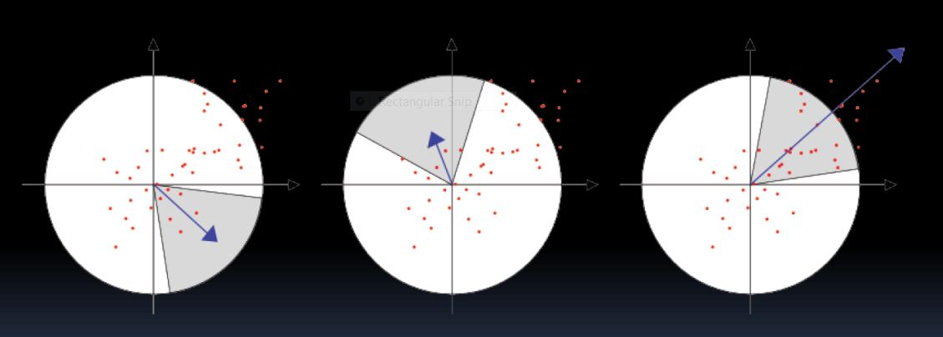
Find Feature Direction
Similar to RANSAC!

Slide 9
Generate feature vectors
A square window of size 20σ is centered on each interest point with orientation based on the direction.
Divide the window into 4x4 sub regions.
For each sub-region compute the following
Sum of dx
Sum of dy
Sum of abs(dx)
Sum of abs(dy)

Slide 10
Generate feature vectors
Therefore SURF has a 64D feature vector consisting of the above 4 values for each of the 16 sub-regions.

Slide 11
Why SURF?
There are other feature detectors like Harris corner detectors
We chose SURF because our dataset did not have much of corners to detect, and corner detectors gave us a poor response.
3D reconstruction essentially needs a lot of point clouds to get a good model, which is done by SURF.

Slide 12
Match interest points
Find the SURF feature in the image i.
Find the SURF feature in the image i+1.
Compare both of them for similar features.

Slide 13
Computing the projection matrix
Our dataset was provided with the camera parameters and rotation and translation vectors for the images.
We need to calculate the intrinsic matrix and extrinsic matrix.

Slide 14

Computing the projection matrix
Intrinsic matrix is given by
f_{x} and f_{y} are the co-ordinates of the focal length.
C_{x} and C_{y} are the co-ordinates of the principal points.

Slide 15

Computing the projection matrix
Extrinsic matrix is given by [r|t]
[r] is the rotation matrix
[t] is the translational vector

Slide 16

Computing the projection matrix
Multiplying the intrinsic matrix and extrinsic matrix gives the projection matrix.

Slide 17
Triangulation
The process of determining a point in 3D space given its projections onto two, or more images.
It is necessary to know the parameters of the camera projection function from 3D to 2D for the cameras involved, represented by the Camera Matrices
Each point in an image corresponds to a line in 3D space
All points on the line are projected to the point in the image.
If a pair of corresponding points in two, or more images, can be found then they are the projection of a common 3D point X.

Slide 18
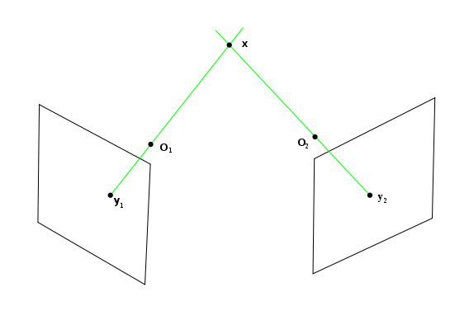
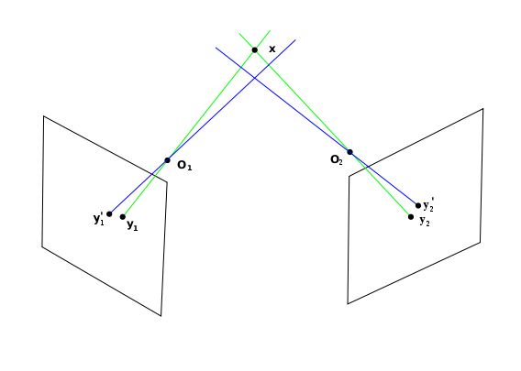
Ideal Case VS Practical Case
The ideal case of Epi polar geometry. A 3D point x is projected onto two camera images through lines (green) which intersect with each camera's focal point, O1 and O2. The resulting image points are y1 and y2. The green lines intersect at x.
In practice, the image points y1 and y2 cannot be measured with arbitrary accuracy. Instead points y'1 and y'2 are detected and used for the triangulation. The corresponding projection lines (blue) do not, in general, intersect in 3D space and may also not intersect with point x.

Slide 19
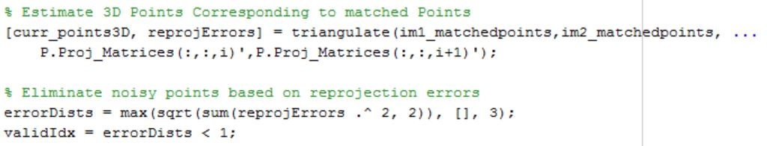
Re projection Errors & Valid Points
The triangulation function in MATLAB finds an optimal intersection point for the projection lines.
Then it computes the Euclidean distance between the Optimal point and the other intersection points from the Epi polar projection lines
The one with the least distance is taken as the valid 3D point

Slide 20
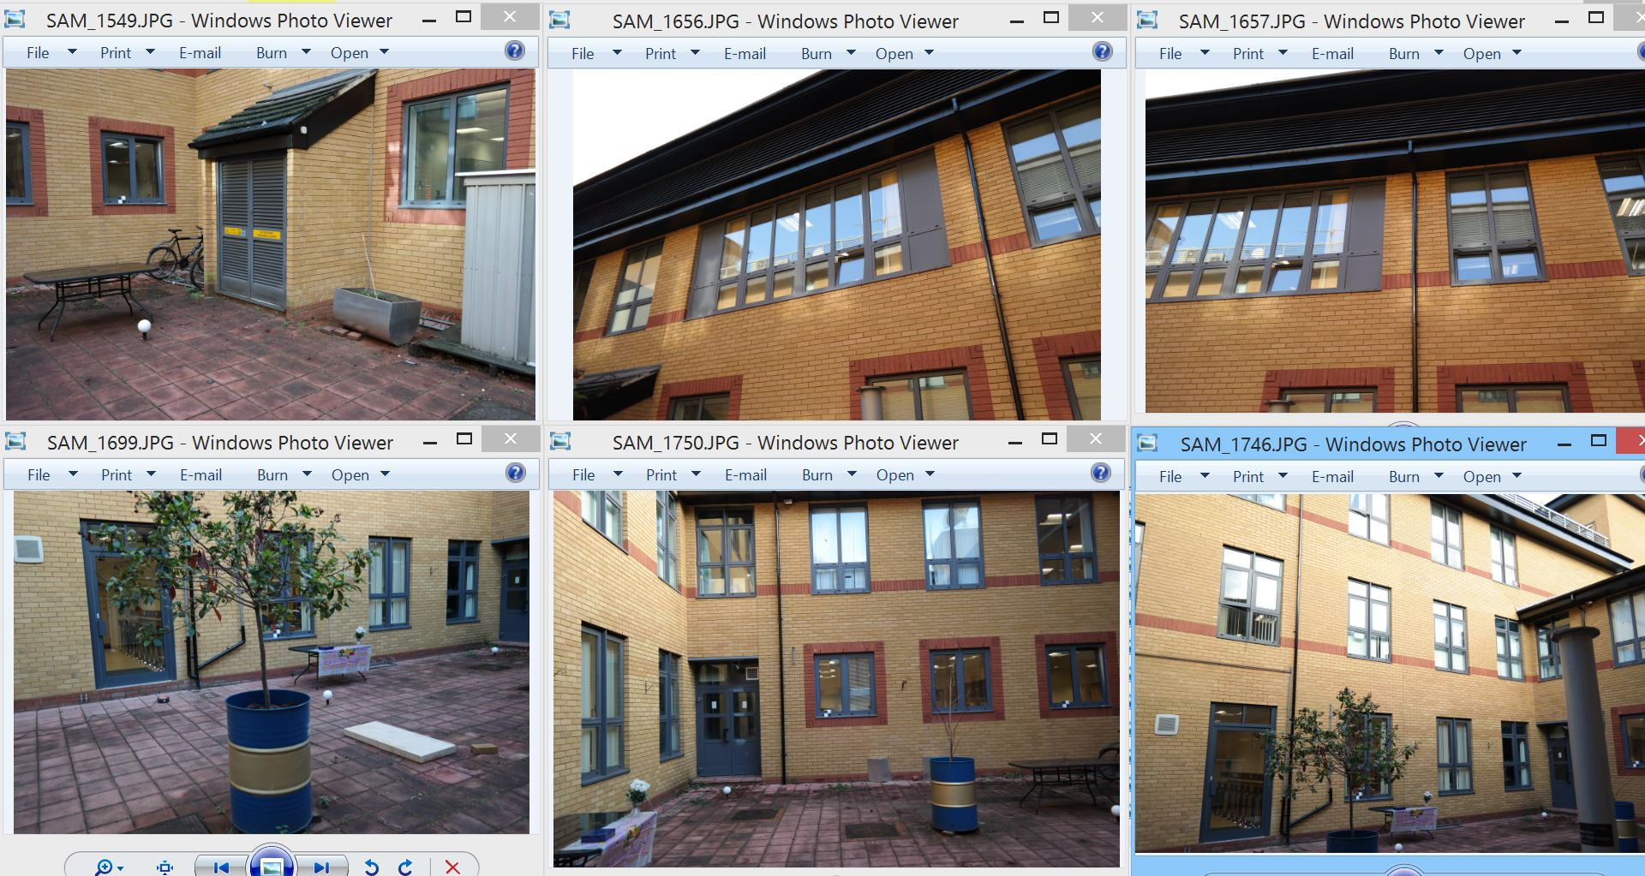
The Data Set

Slide 21
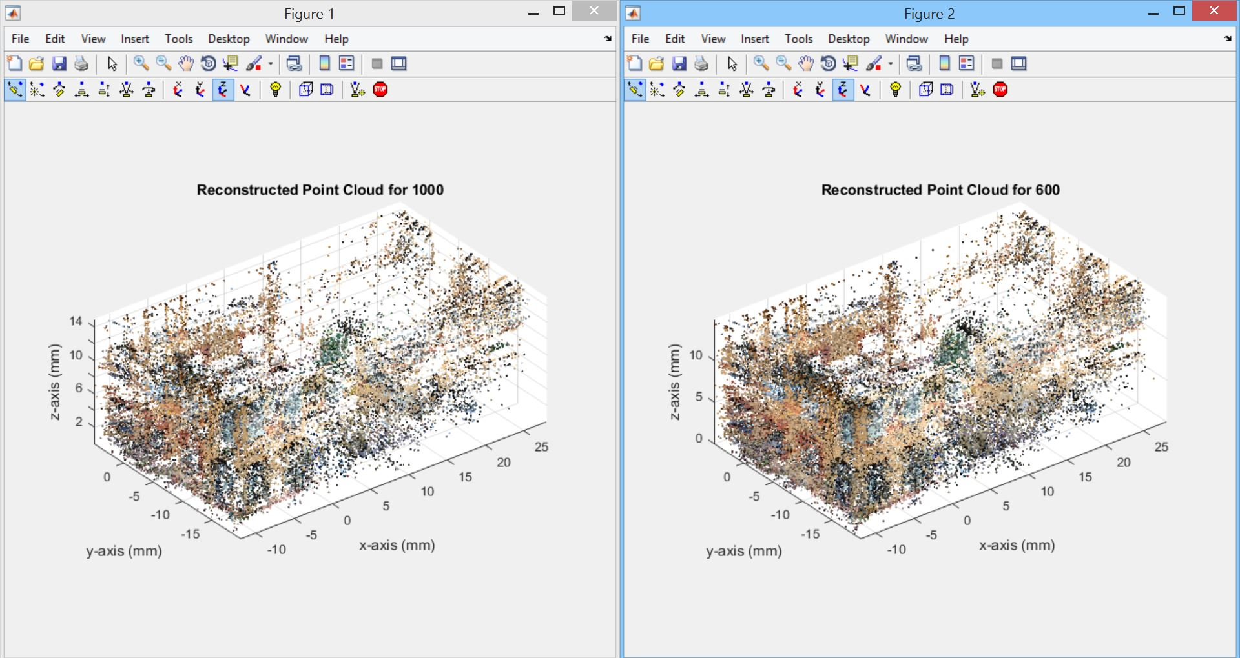
Results

Slide 22
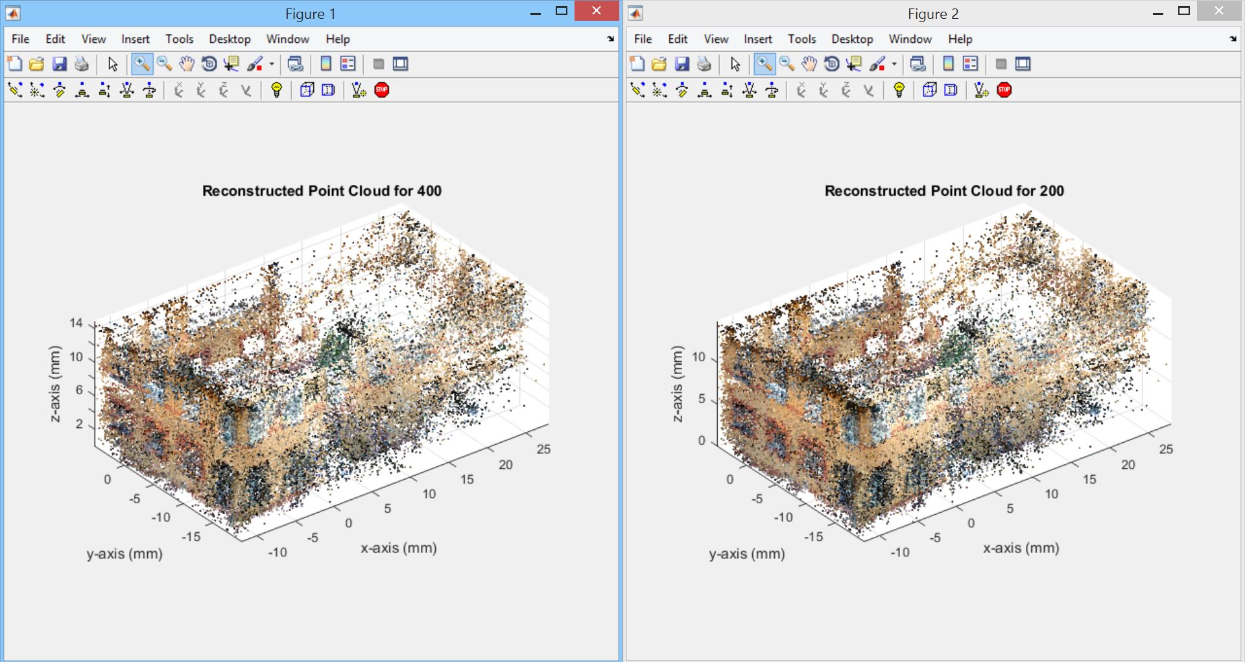
Results

Slide 23
Conclusion & Improvements
Full 3D reconstruction needs more points
Using a SURF metric threshold less than 200 can give a lot more points
GPU implementation to get faster results
Combine surf with other feature descriptors while using maximum thresholds for all of them

Slide 24
Questions ?

