Slide 1
Anger Release
Cylia, Jiahua & Gabbie

Slide 2
Marketing
&
Looking For
problem

Slide 3
Market and looking for problems
Therapy Toy Market, belong toy industry.
The global toy market is expected to exceed $90 billion in sales in 2016(ICTI)
Focusing on America therapy toy market.
Stress level go up about 44% compared with 5 years ago
Anger Management

Slide 4
People still Suffering from this psychological stress problem.
Target group
Why?

Slide 5
Solution

Slide 6
a fun therapy toy
a punching surface with
chatbot function
in your own private space
Stress relief solution:
-physical expression:
exercise,hitting punching bag
-mental expression
listener, know your emotion
stimulate, cheer you up

Slide 7
Technology

Slide 8
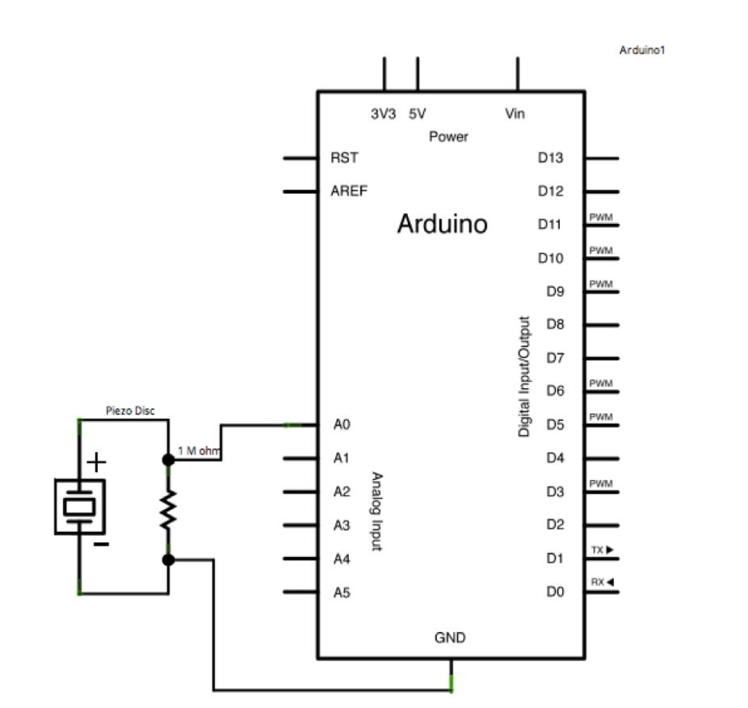
arduino
Arduino
Piezo Disc or
Impact sensor
Megohm resistor

Slide 9
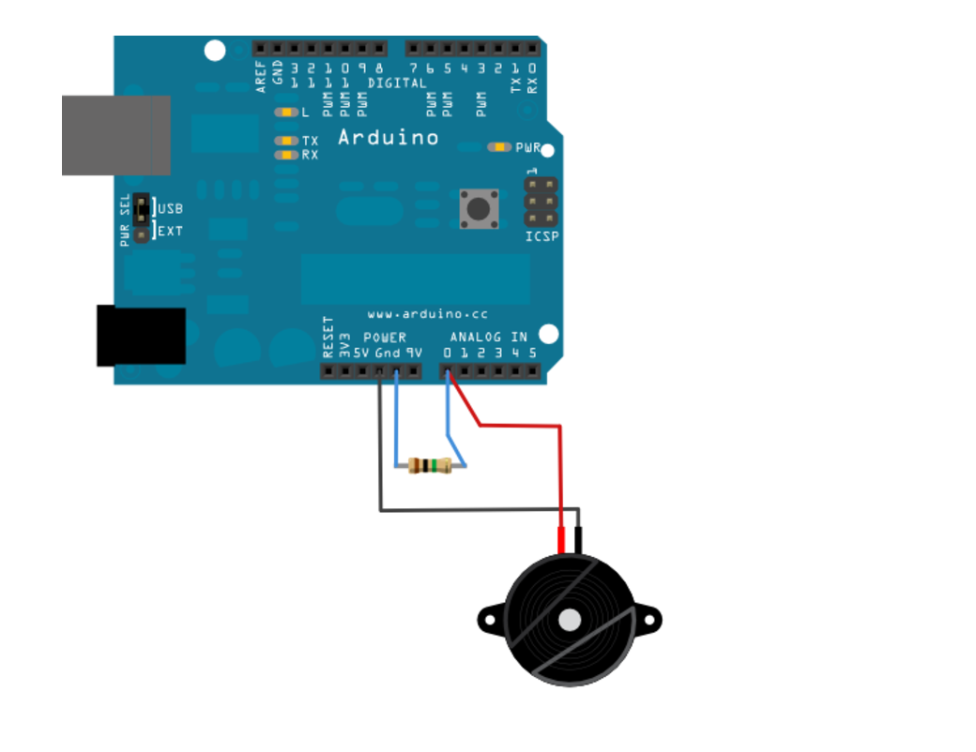

Slide 10
Competition

Slide 11
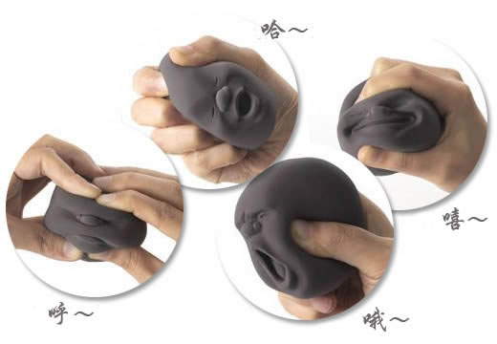
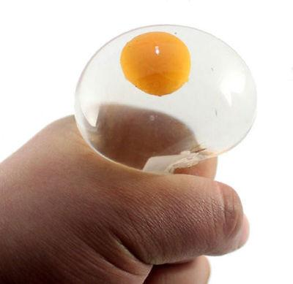
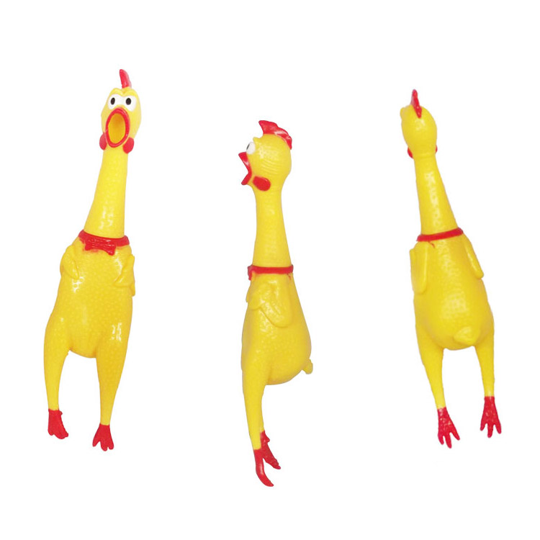
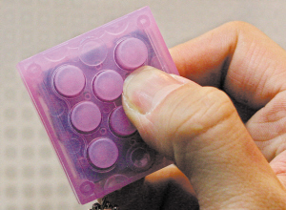
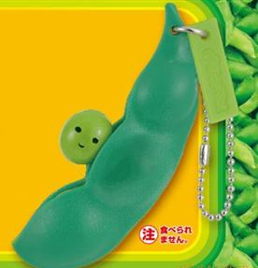

Slide 12
Thank you!

