Slide 1

AI SYSTEMS FINAL PROJECT
HalalScan
Hybrid ML + knowledge-based reasoning for halal food screening.
Team: Paclibar, Nebrija, Ibrahim
67
21/21
3
KB RULES
BACKEND TESTS
VERDICT STATES
canonical rule base
all passing
halal, haram, review
01
Notes:
Speaker 1 / Leader: Good day. We are presenting HalalScan. It is an AI system that helps screen food ingredients for halal compliance. My part is simple: I introduce the project and close it. Our project combines machine learning, a halal rule base, and reasoning so the final answer can be explained.

Slide 2
PROBLEM
Food labels are hard to judge quickly.
Users need a simple answer. The professor needs proof of how the answer was produced.
Hidden risks
Manual checks
Project goal
Pork derivatives, alcohol carriers, gelatin, enzymes, and E-numbers can be hard to identify.
People may not know ingredient terms or certifying body reliability.
Return a verdict plus the rules, reason, and recommendation.
Simple user label. Clear grading evidence.
Project Proposal | Problem and goal
02
Notes:
Speaker 1 / Leader: The problem is that food labels can include ingredients that are not obvious. A normal user may not know if those are halal, haram, or need review. HalalScan gives a clear result and also explains the reason. Handoff: Speaker 2 will explain the AI approach.

Slide 3

AI APPROACH
One API handles every scan type.
Input
>
ML
>
Knowledge Base
>
Reasoning
>
Result
text, barcode, OCR
RapidAPI + fallback
67 rules
priority logic
why + verdict
/api/analyze
Stable final decision path
System Integration | Main API contract
03
Notes:
Speaker 2: The project uses one main API contract: /api/analyze. The user can paste ingredients, scan a barcode, or use OCR from an image. The same path connects ML, knowledge base lookup, and deterministic reasoning.

Slide 4
ML IMPLEMENTATION
ML works live, but demos still work offline.
Primary classifier
Fallback model
RapidAPI Halal
Food Checker
TF-IDF
Naive Bayes
Used when RAPIDAPI_KEY exists.
Reproducible for classroom tests.
58
36/36
cached
TRAINING SAMPLES
HOLDOUT CASES
LOOKUPS
local fallback
ML evaluation
stable scans
ML Model Implementation | RapidAPI + fallback evidence
04
Notes:
Speaker 2: For ML, the primary classifier is RapidAPI Halal Food Checker. If the key is missing, the app still works with a local TF-IDF Naive Bayes fallback. That makes the demo and tests reproducible.

Slide 5
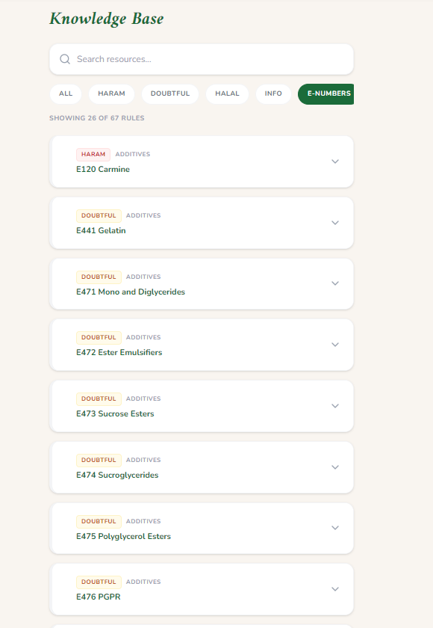
KNOWLEDGE BASE
The knowledge base is the rule source of truth.
67
STRUCTURED RULES
Rule contains:
halal_rules.json
status
5
category
CERTIFIERS
keywords
JAKIM, MUI, IFANCA, HFA, ESMA
E-number
reason
E
source
NUMBER TRIGGERS
E120 and more
Knowledge Base Design | Rules, keywords, sources, certifiers
05
Notes:
Speaker 2: The knowledge base is the source of truth. It has 67 rules, recognized certifying bodies, E-number triggers, keywords, reasons, and sources. This is why the system can explain the result.

Slide 6
RULE EXAMPLES
Examples show how rules become evidence.
R001
E120 / carmine
HARAM
forces non-compliant
R002
gelatin
DOUBTFUL
source warning shown
R047
sugar / salts
HALAL
supports compliant result
Certifiers
JAKIM, MUI, IFANCA
INFO
recognized evidence
Certifier recognition helps, but haram evidence still wins.
Knowledge Base Design | Rule examples
06
Notes:
Speaker 2: Here are simple examples. E120 is haram. Gelatin is doubtful if the source is unknown. Clean ingredients support halal. Recognized certifiers are useful evidence, but they do not override a haram ingredient. Handoff: Speaker 3 will explain the reasoning engine.

Slide 7
REASONING ENGINE
Product verdict is binary; ingredient warnings stay visible.
1
HARAM
NON-COMPLIANT
2
NO HARAM
HALAL COMPLIANT
3
WARNINGS
HALAL COMPLIANT
4
HALAL
HALAL COMPLIANT
Product priority: HARAM > HALAL; DOUBTFUL/UNKNOWN stay as ingredient evidence
Reasoning Engine | Correct inference
07
Notes:
Speaker 3: The reasoning engine is deterministic. It follows the priority: haram, doubtful, unknown, halal. If E120 is found, the result becomes non-compliant even if the certifier is recognized.

Slide 8
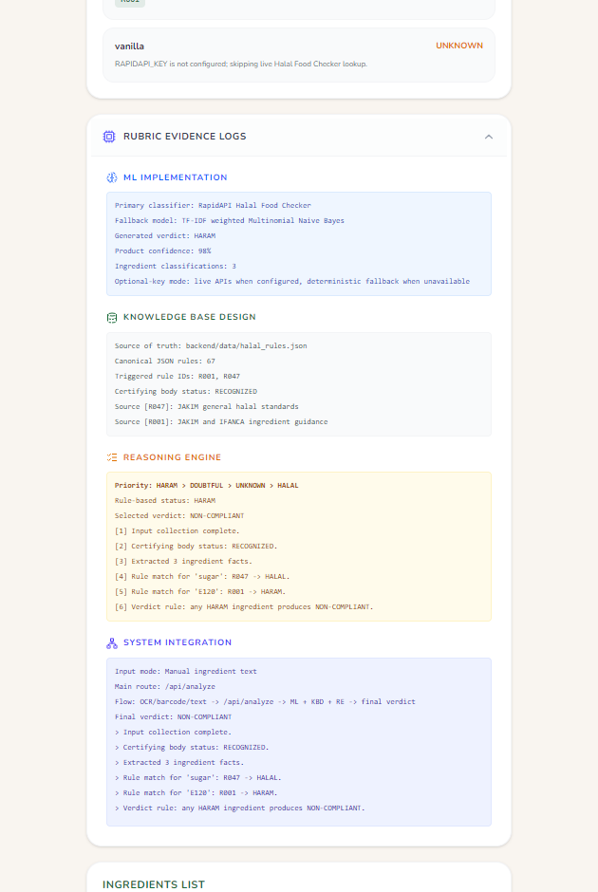
SYSTEM INTEGRATION
All parts work together in one flow.
React App
>
Vercel API
>
Flask API
>
ML + KB
>
Result
scanner + pages
serverless routes
local backend
classification + rules
saved history
System Integration | ML + KBD + RE together
08
Notes:
Speaker 3: The React frontend, Vercel serverless routes, Flask backend, external APIs, knowledge base, and history all work together. The evidence logs show ML, knowledge base, reasoning, and integration in one result.

Slide 9
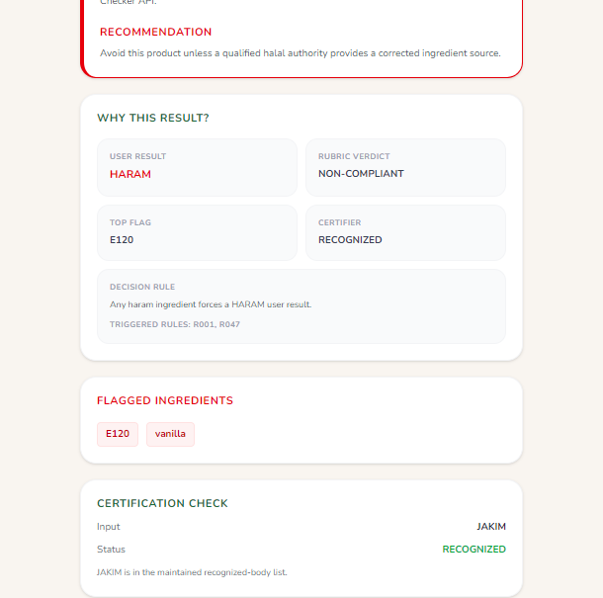
DEMO CASES
Demo these three cases.
HALAL
HARAM
WARNINGS
rice + oil + salt
sugar + E120
gelatin + flavors
JAKIM
JAKIM
IFANCA
HALAL COMPLIANT
NON-COMPLIANT
HALAL COMPLIANT
Demo | HALAL, HARAM, and ingredient warnings
09
Notes:
Speaker 3: The demo has three easy cases. Clean ingredients plus JAKIM gives halal. E120 gives haram. Gelatin and natural flavors gives mashbooh or requires review.

Slide 10
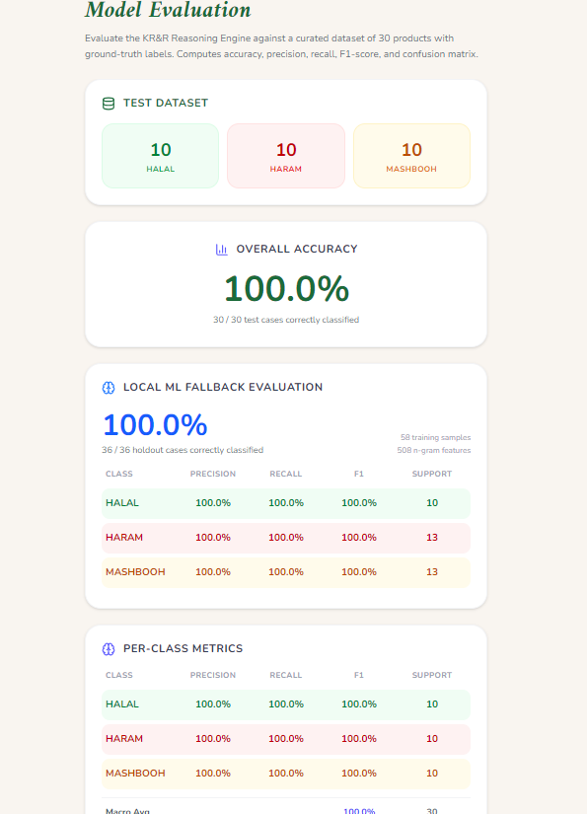
EVALUATION
The project is test-backed.
30/30
KR&R CASES
Also passed:
rule engine
lint
36/36
vercel-api
ML HOLDOUT
badge visual
fallback model
production build
21/21
BACKEND TESTS
all passing
These scores are curated classroom tests, not production certification guarantees.
Technical Report + Results
10
Notes:
Speaker 3: The project has reproducible evidence. The rule engine passed 30 out of 30 curated cases. The ML fallback passed 36 out of 36 holdout cases. Backend tests passed 21 out of 21. The limitation is that this is classroom evaluation, not a production guarantee.

Slide 11
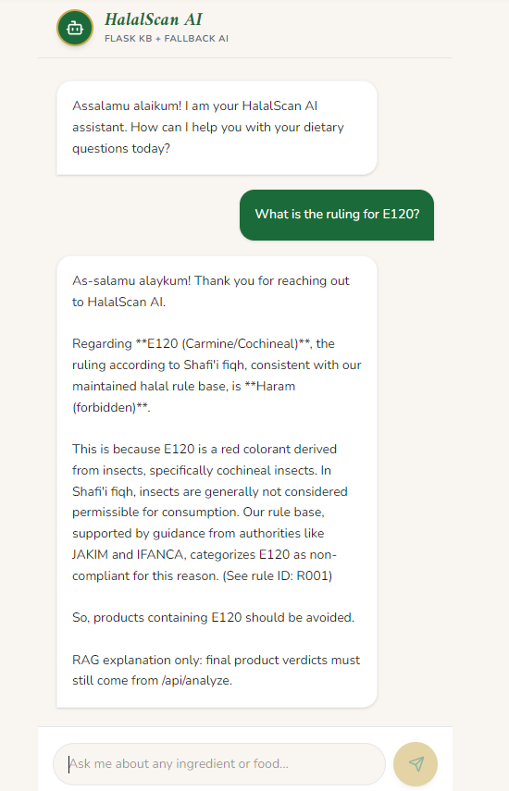
LIMITATIONS
Clear limits make the project more credible.
Live APIs
Google Vision and RapidAPI need credentials for real external calls.
Certifiers
The system recognizes names, but does not authenticate official certificates.
RAG chat
RAG explains rules only. /api/analyze makes final verdicts.
Technical Report | Limitations and future work
11
Notes:
Speaker 3: The project is ready, but we are honest about limits. Live APIs need credentials. Certifier matching does not authenticate a real certificate. RAG is only for explanation. Future work can add certificate lookup, more languages, and larger real-world evaluation. Handoff: The leader will close.

Slide 12
CLOSING
HalalScan meets the rubric.
ML + Knowledge Base + Reasoning + Integration
OK
Project proposal
OK
ML implementation
Final takeaway
OK
Knowledge base
The answer is not just a label. The system shows why.
OK
Reasoning engine
OK
System integration
OK
Report + presentation
Thank you.
Leader: final rubric summary and closing
12
Notes:
Speaker 1 / Leader: To conclude, HalalScan satisfies the project rubric because it has a clear proposal, ML implementation, knowledge base, reasoning engine, system integration, and report evidence. The most important point is that the system does not only say halal or haram. It explains why. Thank you.

