Slide 1
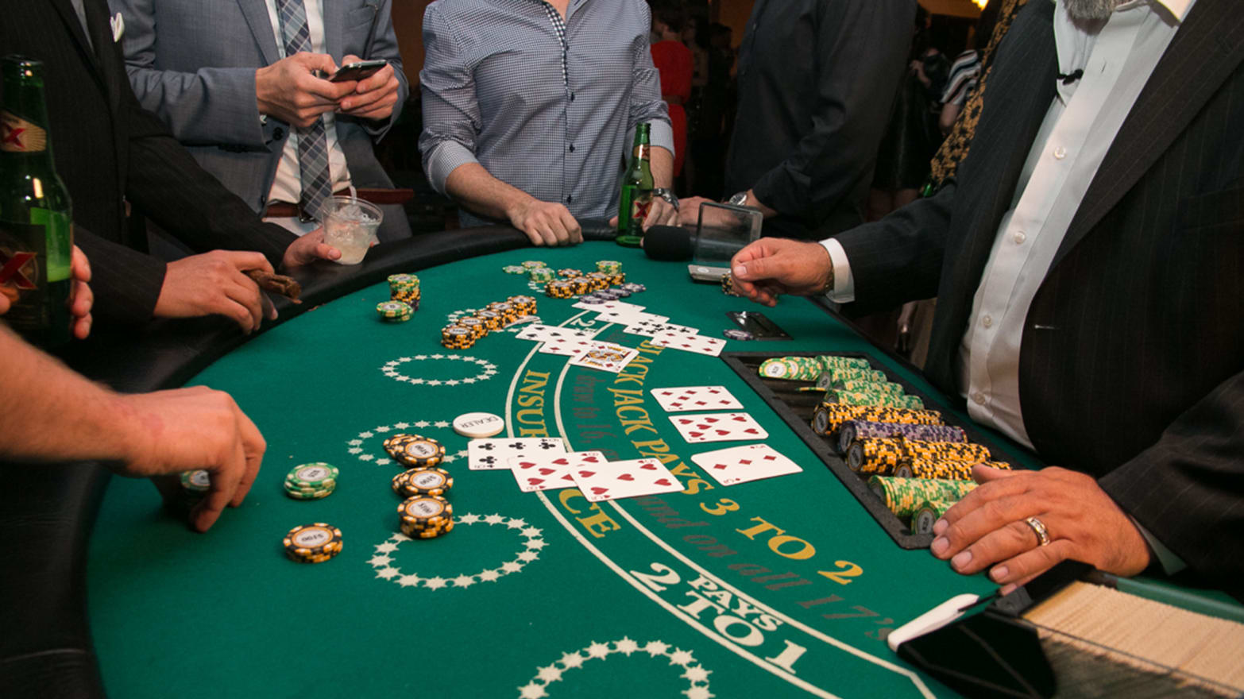
Evaluating AI Agents to Solve the Blackjack Problem
Jake Seracino ,
Gabriel Camilleri,
Jacob Cassar Ellis,
David Vella

Slide 2
INTRO
ALGORITHMS
How the game of blackjack is played!
What Algorithms we implemented and used.
GAMEPLAY
RESULTS
The different playing styles available to play.
Limitations we faced during the implementation of this project.

Slide 3
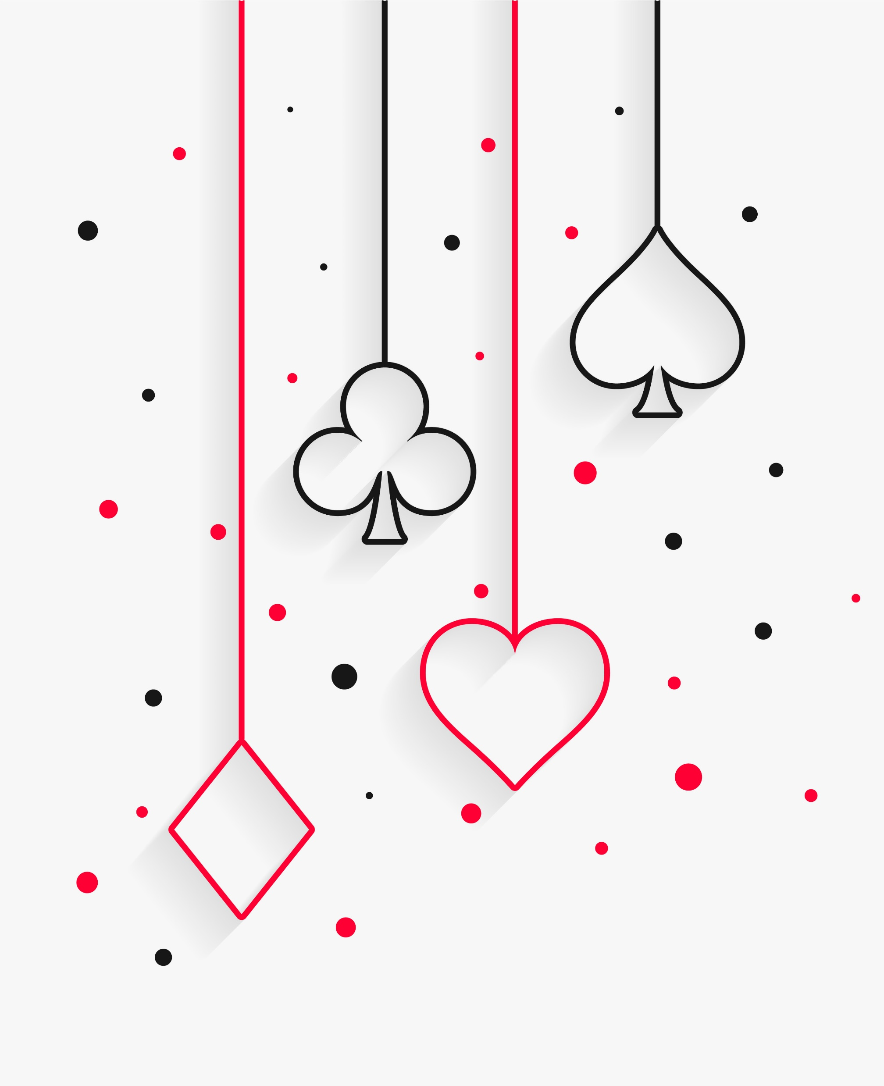
Intro.
Notes:
Blackjack
Player vs Dealer
Compare value of player’s hand vs that of the dealer
If hand value exceeds 21, the player is said to have busted – likewise for dealer
All cards are taken at face value
Picture cards have value of 10
Ace has value of 1 or 11 at the player’s discretion

Slide 4
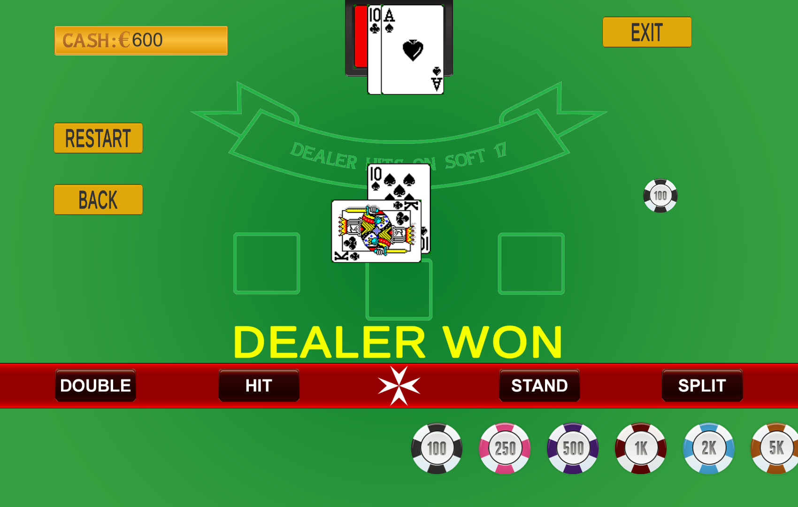
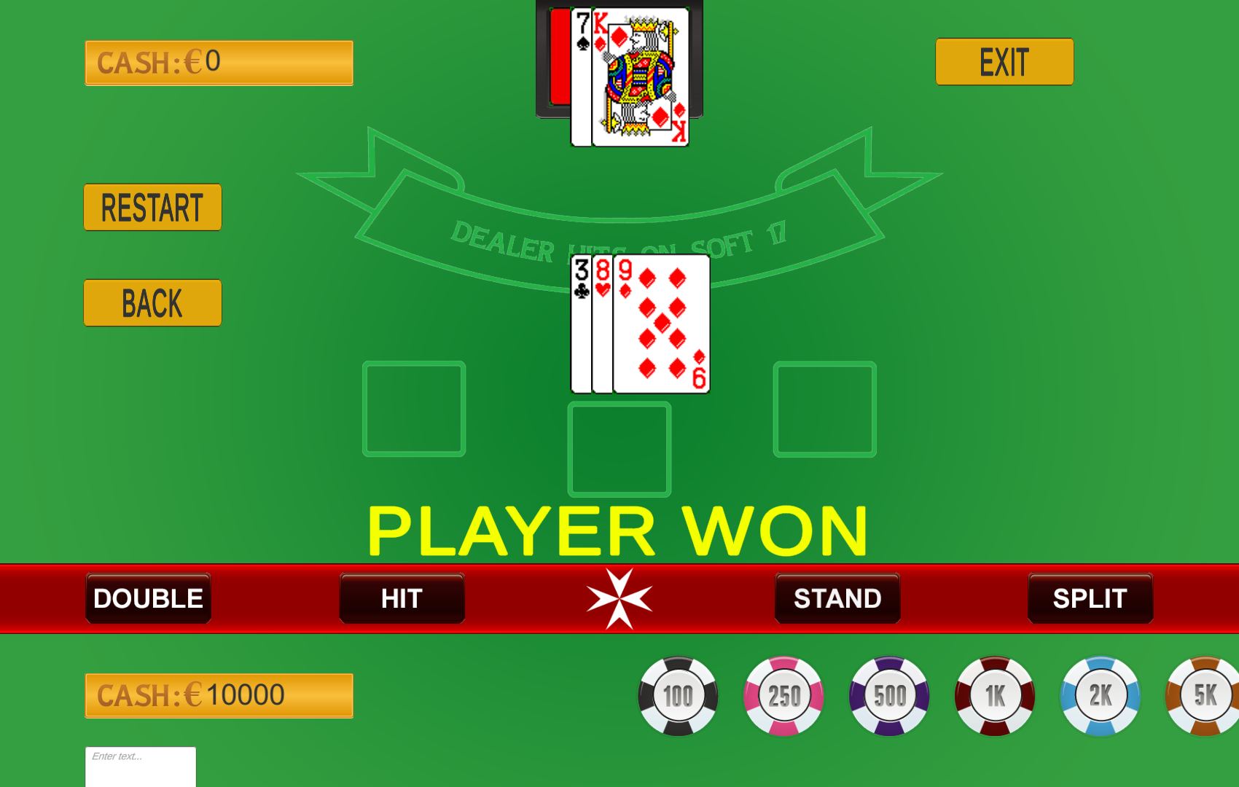
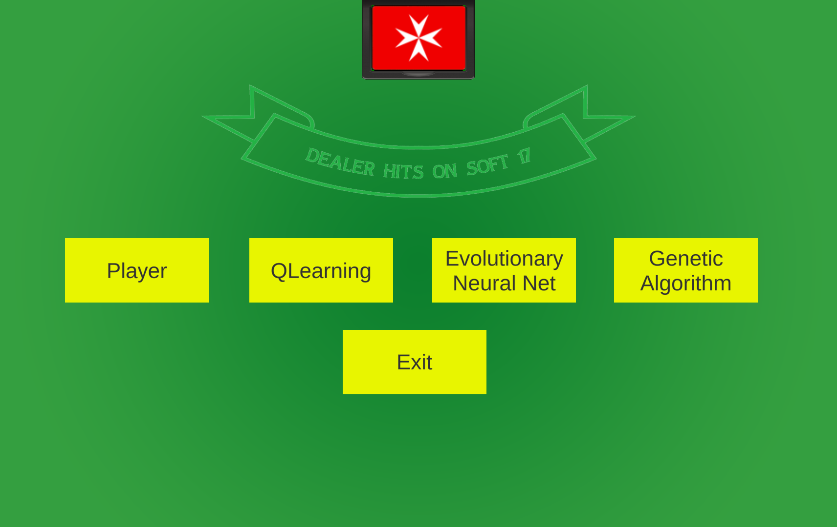
MOVES & RULES
Notes:
Moves
Hit - Prompts the dealer to give a new card to the player
Stand - Ends the turn of the player so that the house can play its turn
Double-Down - Adds an amount equal to the original bet to the bet, performs a hit and afterwards stands – Can only be performed as the first move on the hand
Split - Splits the current hand into two distinct hands and adds an amount equal to his bet on the original hand to act as the bet on the second hand – Can only be performed as the first move on the hand and requires two cards of the same face i.e. pairs
Rules
8 Decks – Shuffled every 50 rounds
Dealer hits on Soft 17
Double down allowed after splitting
No re-split limit
No surrender nor insurance
Natural blackjack pays 1:1
Aspects
Blackjack is stochastic in nature
It can be analysed statistically and therefore, AI can be applied
All algorithms were trained under the same conditions
Algorithms implemented were Q-Learning, Genetic Algorithms and Evolutionary Neural Network

Slide 5
Q-Learning
Q-Learning is a form of model-free reinforcement learning based upon temporal difference. At each time step, given a particular state, the agent tries an action and evaluates its immediate consequence.
We also consider an ε which acts as the rate at which the agent decides to not take the greedy approach when playing the game
Notes:
Alpha is the learning rate
Gamma is the discount factor
R is the reward given during this iteration
Q(s, a) is the value of the of the action a in state s
Q*(s’,a’) is the value of the best action to take in the next state

Slide 6
Implementation
We needed to apply the reward function after the end of the turn because of splits⎯-which put us in two distinct states⎯but the equation is applied in the same manner exactly.
α -- 0.1, 0.01, 0.001
γ -- 0.7, 0.8, 0.9
ε -- 0.05, 0.1, 0.2
Notes:
So, we first calculate the reward function for the first next state and then for the second one for splits
We trained 27 different q learning agents. Each agent is a combination of alpha, gamma and epsilon for those provided.

Slide 7
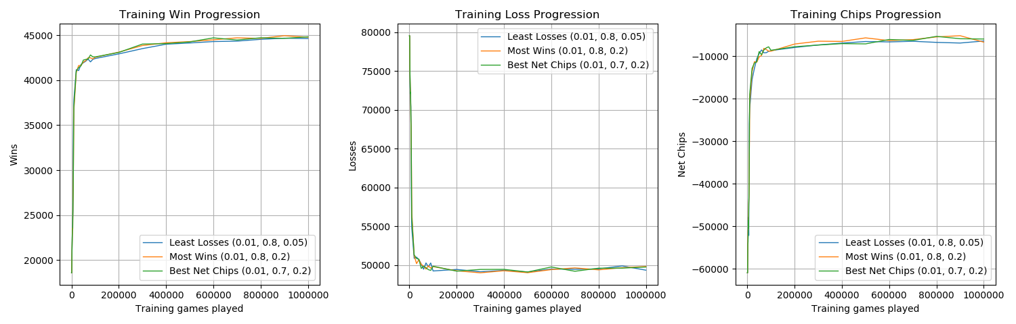
Most Wins–α: 0.01, γ: 0.8, ε: 0.2
Least Losses–α: 0.01, γ: 0.8, ε: 0.05
Best Net Chips–α: 0.01, γ: 0.7, ε: 0.2
Results
Notes:
Say that we considered three different criteria for best; the agent with the most wins, the agent with the least losses and the agent with the best net amount of chips.
All yielded different ‘best’ agents but exhibited similar behaviour – point to graphs.
Finally say we considered the best one to be the one which yields best chips because that is the goal of all casino goers

Slide 8
Genetic Algorithm
A genetic algorithm aims to model the collective learning process within a given population through the processes of selection, crossover and mutation.
Notes:
Defs.
Selection = the process of selecting individuals from the population for breeding
Crossover = also known as recombination, is the process of combining the genetic information of two parents to generate an offspring
Mutation = the process of altering genes of a given individual so as to maintain genetic diversity

Slide 9
Implementation
We trained a genetic algorithm for 200 generations for each combination of the following hyperparameters:
Population Size -- 200, 300, 400
Mutation Rate -- 0.005, 0.01
Selection Method -- Rank, Tournament
Tournament Size -- 3, 5 (Relevant only when selection method is set to Tournament)
Elitism was not considered for this problem
Notes:
Just like with the Q-Learning agents we have trained a number of agents with each agent being a combination of the attributes above.
We wanted to train more but the computation expense and the time constraints we had did not allow us to do so.
Nevertheless, as will be shown later on the presentation, our agents converged to very good results.

Slide 10
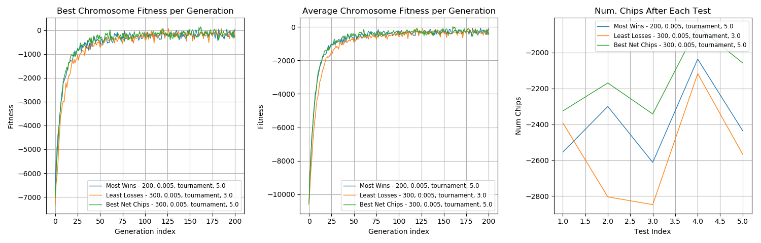
Most Wins -- Pop. Size: 200, Mut. Rate: 0.005, Sel. Method: Tournament, Tour. Size: 5
Least Losses -- Pop. Size: 300, Mut. Rate: 0.005, Sel. Method: Tournament, Tour. Size: 3
Best Net Chips -- Pop. Size: 300, Mut. Rate: 0.005, Sel. Method: Tournament, Tour. Size: 5
Results
Notes:
Same criteria as for Q-Learning – Most Wins, Least Losses and best net chips
Same situation with three conflicting ‘best’ algorithms.
Point out that with tournament size 3, the algorithm converged slower.
Say that algorithms of the most wins and best net chips exhibited similar performance – convergence, net chips.
Say that another test was conducted on these three agents whereby they played 5 iterations of 100,000 testing rounds to check how their net chips varied – Point to third graph.
Consistent results were observed.
Once again, we took the one with the best net chips

Slide 11
Evolutionary Neural Network
A simplex neural network (3 layered)
Assigned with a matrix of random weights
Uses a cost function for supervised learning
Trained with backpropogation
Returns how much the player object will bet
A genetic algorithm
Generate a number of player / neural networks
Performs mutation
Uses cost function to return the best performing network
Metric measured by cost

Slide 12
Strategy
The strategy is built over a number of epochs
With every 10 epochs the highest performing player inputs their moves according to which rounds they had won and stores them in the blackjack strategy table
The algorithm always picks the one neural network that had performed the best till that current epoch
Actions in a state may change if another better performing player shows up with new actions.
Notes:
Improvements on this would be: (Slide)
Use multiple neural networks each with different architecture, to handle complicated moves and consider other winning factors

Slide 13
Overall
Baselines
Mimic-the-Dealer
Never-Bust
Random
Gold Standard
Basic Strategy
Notes:
Baselines
Mimic-the-Dealer - play using the same strategy as the player, i.e. stand on all hard-17+ and soft-18+, otherwise hit
Never-Bust - strategy which ensures that the player never busts. This involves standing on all hands with value greater than or equal to 12
Random - this baseline is not a strategy in reality. It simply involves the player picking a random action which is valid at that state
Gold Standard
Basic Strategy - the mathematically proven optimal strategy for blackjack

Slide 14
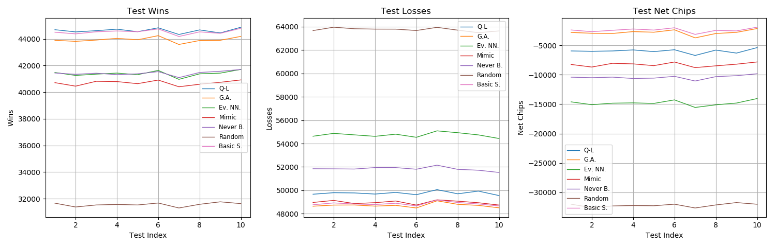
Results
Notes:
Say we did 10 successive tests of 100,000 blackjack rounds to ensure that any presence of variation is capture.
Point to graph and say that this was minimal and all results were consistent.
Say that the Q-Learning and GA agents all outperformed the three baselines but the ENN only managed comparable performance with them.
Say that the Q-learning took a more aggressive strategy with the most wins but a greater number of losses as well.
Say that the genetic algorithm almost managed to replicate the performance of the basic strategy gold standard but was slightly less nevertheless.
Finally conclude that the GA approximated the best strategy for blackjack

Slide 15
Future Work
Integrate card counting
Implement more algorithms
Notes:
Integrate card counting
say that this gives an idea to the agent what cards are going to be drawn from the shoe but it dramatically increases the search space – for example adding a new field to the state tuple in q learning
Implement more algorithms
so that the comparisons done in this research may be extended – There may be a better algorithm for approximating a blackjack strategy out there

Slide 16
Unity
Feeding a strategy to unity via a CSV file.
Notes:
This strategy dictates what actions an agent should perform given a particular state

Slide 17
Finish

