Slide 1

Workplace Assistant Augmented Reality (waar)
Gabriel Camilleri
Supervisor: Dr. vanessa Camilleri

Slide 2

Content
Introduction
Aim and Objectives
Literature Review
Methodology
Tests, Results and Evaluation
Future Work
Conclusion

Slide 3
Introduction
Starting a new job can be stressful
Job-stress
Adjustment of the new workplace environment
“a period of learning how to ‘ﬁt in’ and adjusting to how things work in the new setting”[1]
Assistant AR application
Combination of AI techniques
Object and image recognition
User profiling

Slide 4

Aim and Objective
Aim
Combine user profiling techniques with image and object recognition
Tailor made for the workplace
Objectives
Perform image and object detection techniques using Vuforia
Apply AR techniques to overlay augmentations
Develop user profiling techniques
Apply and evaluate through quality and quantity testing the aforementioned techniques

Slide 5
Literature Review
Workplace Augmented Reality
On the job
Off the job
Not every workplace necessitates AR
Presentable information tailor made for the trainee
Recommendation Systems for Augmented Reality
Collaborative Filtering has been widely adapted in recommender systems
SVD++ performed best when applied to the MovieLens Dataset [11]
Visibility, Location and Distance based filtering commonly used in AR

Slide 6
Literature Review (Cont.)
Computer Vision Approaches in Augmented Reality
Deep Neural Networks ensure High Accuracy
Marker-based main driving force to apply AR
Occlusion is problematic to Marker-Based AR
Several Approaches in solving the problem:
Tracking-By Detection
Tracking frame features during runtime and compare and match with a database
S-G Hybrid
SURF and GOLAY Error code detection
6-DOF tracking method
Solves angle, rotation distance, color and occlusion variance problems

Slide 7
Methodology (3 Main Components)
The User
The Augmented Reality System
The User Recommendation System

Slide 8
Methodology Process
Data Handling
Gathering Images
3D Models of those images
Generating the User-Rating Datasets
Feature Extraction
Choosing the markers
Extracting Image Target Features
Extracting Model Target Features
Extracting User –Rating features

Slide 9
Methodology Process
User Query Modelling
Building an intern user-query model
UI and System Architecture Implementation
Building a friendly User Interface that allows the user to be flexible with their requirements
Building a stable architecture that allows the user to view augmented information about offices and workplace machinery and be given directions towards offices. However, all within the bounds of the user-profiler recommended information as well as the system’s limitations.
Building a visitor-query model
Applying a combination of Collaborative and Similarity based filtering

Slide 10
Test, Results and Evaluation
Quantity Testing
01
AR Component
RS Component
Quality Testing
02
Survey

Slide 11
Test, results and evaluation- ar component quantity testing
Tested on 4 variances
Colour
Black and White 100% accurate
Distance
Mean
130cm and 150cm (Image and Model)
Rotation
Handles 360 Degrees of Rotation
Occlusion
Handles 55% and 64% of occlusion (Image and Model)

Slide 12
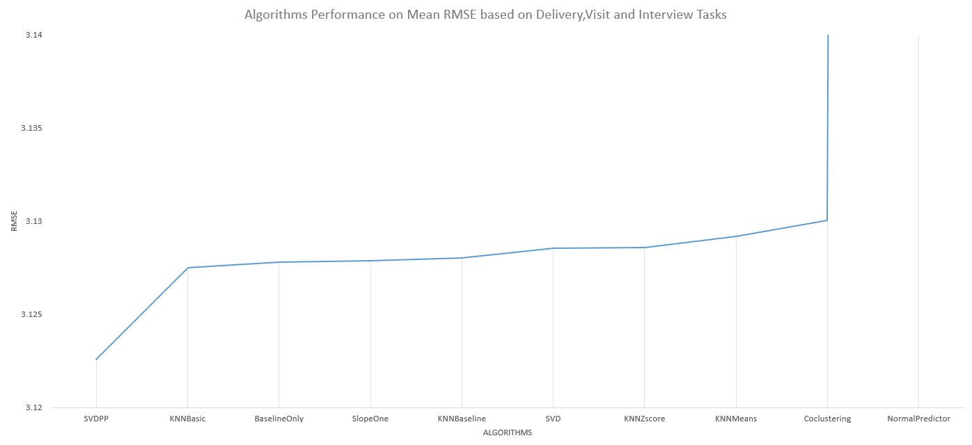
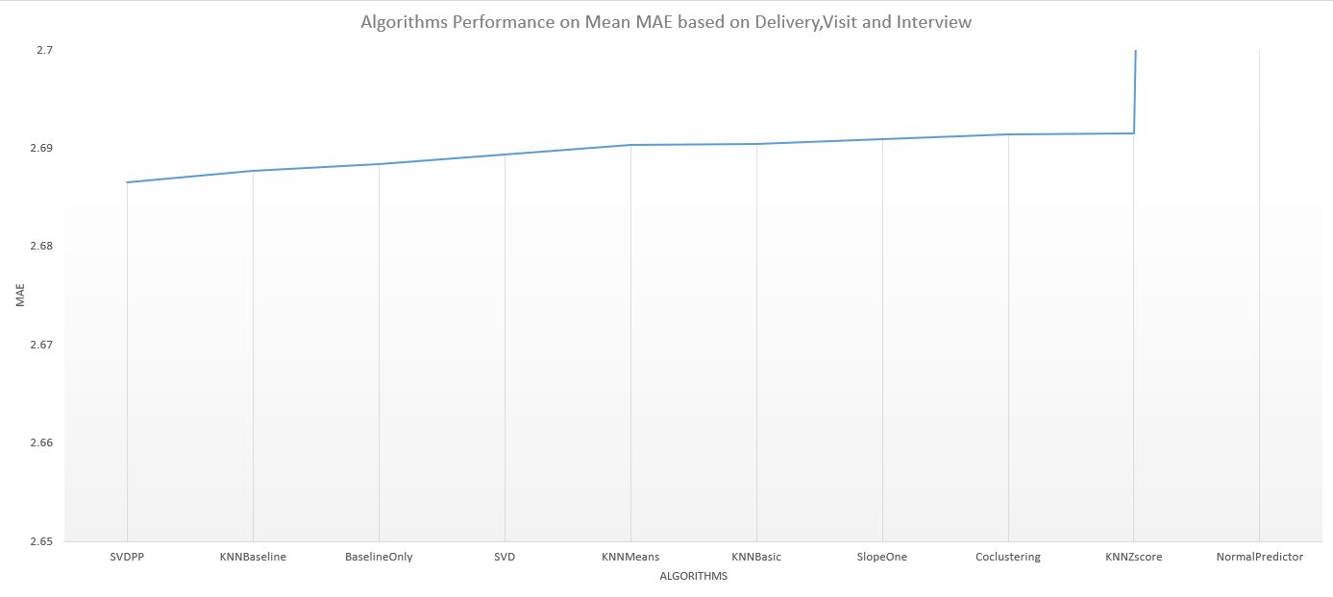
Test, results and evaluation- RS component quantity testing
SVD++ achieved the lowest Mean Absolute Error and Root Mean Square Error on Average
Baseline Comparison
SVD++
KNNBaseline
Baseline
SVD
KNNMeans
KNNBasic
SlopeOne
CoClustering
KNNZscore
NormalPredictor

Slide 13
Test, results and evaluation- Quality testing
Survey
30 Participants
Employees
Non-Employees
On average promising results
Users on average found the AR app assisting (100%)
Mostly participants found the application as helpful
On average most participants found the application as not troubled by occlusion much
Some participants found the recommendation confusing as to how it worked yet still helpful.

Slide 14

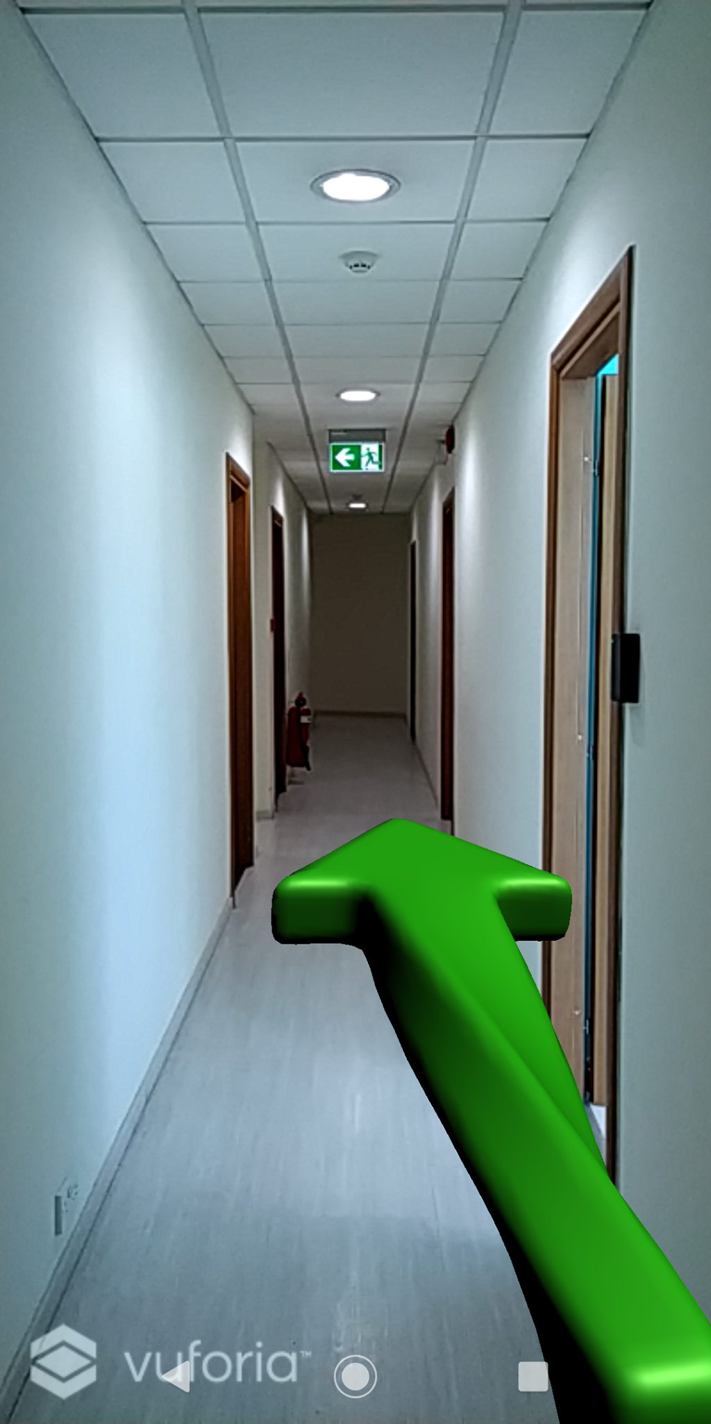
Future Work
Improve UI
Apply Deep Learning for User Profiling
Include Smart Navigation
Include Location Based AR for corridor augmentations
Include Explainable AI

Slide 15
To Conclude
Have presented a procedure on how one can apply Marker-Based AR.
The methodology used is backed up by relevant research and evaluations to further test the techniques applied and implemented.
The results obtained are not surprising and are indeed promising for augmented reality to be applied to support and facilitate assistance in different workplace environments.

Slide 16

Thank You!
Acknowledgements GO towards my supervisor and CCBill for complete assistance throughout the whole fyp project

