Slide 1


Workplace Assistant Augmented Reality (waar)
Gabriel Camilleri
Supervisor: Dr. vanessa Camilleri
Notes:
Good morning everyone, so for my final year project I conducted a research called Workplace Assistant Augmented Reality with Collaboration with CCBill under the supervision of Dr.Camilleri.

Slide 2
Content
Introduction
Aim and Objectives
Literature Review
Methodology
Tests, Results and Evaluation
Future Work
Conclusion
Notes:
Here is the layout of my following presentation: 5 sec

Slide 3
Introduction
Starting a new job can be stressful
Job-stress
Adjustment of the new workplace environment
“a period of learning how to ‘ﬁt in’ and adjusting to how things work in the new setting”[1]
Assistant AR application
Combination of AI techniques
Object and image recognition
User profiling
Notes:
Starting a new job in an office can to some extent be stressful especially on one’s first day there/ Job-stress is an existing problem commonly found in many employees. The employees would generally need to go through a phase of learning the ropes within their new work. So providing an assistant AR application can facilitate in providing the tool necessary in making their first day and the rest more easier to adjust especially if an employee might suffer from shyness for example.

Slide 4
Aim and Objective
Aim
Combine user profiling techniques with image and object recognition
Tailor made for the workplace
Objectives
Perform image and object detection techniques using Vuforia
Apply AR techniques to overlay augmentations
Develop user profiling techniques
Apply and evaluate through quality and quantity testing the aforementioned techniques
Notes:
The aim of my final year project was to combine user profiling techniques with image and object recognition to tailor make an AR application suitable for a workplace for the employees and even the visitors to make use of, in adjusting to a new environment.
Therefore the objectives were:
Perform image and object detection techniques using the Vuforia library
Applying AR techniques to overlay augmentation and provide information about offices, devices in this case their coffee machine for prototyping, and provide directions
To develop user profiling techniques allow the system to show the user relevant information
Finally to evaluate the system and techniques applied using quantity and quality testing.

Slide 5
Literature Review
Workplace Augmented Reality
On the job
Off the job
Not every workplace necessitates AR
Presentable information tailor made for the trainee
Recommendation Systems for Augmented Reality
Collaborative Filtering has been widely adapted in recommender systems
SVD++ performed best when applied to the MovieLens Dataset [2]
Visibility, Location and Distance based filtering commonly used in AR
Notes:
To go through some research I personally carried out. I initially researched about Workplace AR technology. The technology presented would generally provide on the job or off the job training and sometimes both. However it is notable that not every workplace might necessitate AR technology. Secondly I looked into recommendation systems in connection to AR technology. One must mention Collaborative filtering is widely adapted as a recommendation system. However, for AR technology, visibility, location and distance based filtering, is commonly adapted. Hence I was interested in applying a combination of the two aforementioned techniques.

Slide 6
Literature Review (Cont.)
Computer Vision Approaches in Augmented Reality
Deep Neural Networks ensure High Accuracy
Marker-based main driving force to apply AR
Occlusion is problematic to Marker-Based AR
Several Approaches in solving the problem:
Tracking-By Detection
Tracking frame features during runtime and compare and match with a database
S-G Hybrid
SURF and GOLAY Error code detection
6-DOF tracking method
Solves angle, rotation distance, color and occlusion variance problems
Notes:
Finally I researched about computer vision approaches in AR specifically with regards to deep learning. We can all agree if applied properly in the right context Deep NN ensure high accuracy. Marker-based AR is a main driving force, however normally Traditional CV techniques are generally applied yet the are very limited to occlusion for example. So I personally looked into the provided technologies which solve this problem by applying deep learning such as Tracking by detection, S-G Hybrid approach and 6-DOF tracking method.

Slide 7
Methodology (3 Main Components)
The User
The Augmented Reality System
The User Recommendation System
Notes:
So to give you a basic idea the system was decided to encompass three components these being , the user which is highly essential the AR system and the RS system.

Slide 8
Methodology Process
Data Handling
Gathering Images
3D Models of those images
Generating the User-Rating Datasets
Feature Extraction
Choosing the markers
Extracting Image Target Features
Extracting Model Target Features
Extracting User –Rating features
Notes:
So the first step was gathering all images of the workplace, generating 3D models myself from the images and generating the user-rating datasets. Then the markers were chosen whereby I used Vuforia to extract the feature using CV techniques and Deep Learning techniques provided by Vuforia. Finally features from the user rating datasets were also extracted using an SVD++ model.

Slide 9
Methodology Process
User Query Modelling
Building an intern user-query model
UI and System Architecture Implementation
Building a friendly User Interface that allows the user to be flexible with their requirements
Building a stable architecture that allows the user to view augmented information about offices and workplace machinery and be given directions towards offices. However, all within the bounds of the user-profiler recommended information as well as the system’s limitations.
Building a visitor-query model
Applying a combination of Collaborative and Similarity based filtering
Notes:
The third step was building two user query models one for the intern and the other for the visitor. Last but not least the UI and system architecture were designed and implemented within unity to provide the end product for the user to use according to their needs within the workplace.

Slide 10
Test, Results and Evaluation
Quantity Testing
01
AR Component
RS Component
Quality Testing
02
Survey
Notes:
Two sets of tests were carried out that being quantity and quality testing.

Slide 11
Test, results and evaluation- ar component quantity testing
Tested on 4 variances
Colour
Black and White 100% accurate
Distance
Mean
130cm and 150cm (Image and Model)
Rotation
Handles 360 Degrees of Rotation
Occlusion
Handles 55% and 64% of occlusion (Image and Model)
Notes:
For the AR component I quantity tested using variance tests to test the AR components ability and extent to recognise the markers provided. It was notable that model targets due to using deep learning were generally more successful than image targets however this was not always the case as one can see.

Slide 12
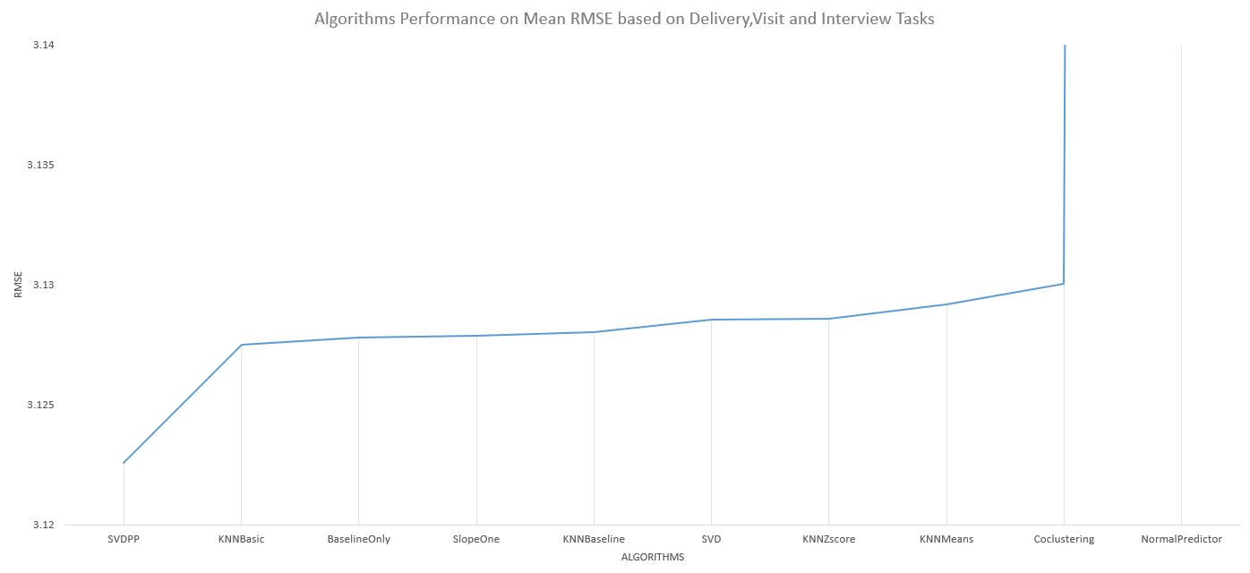
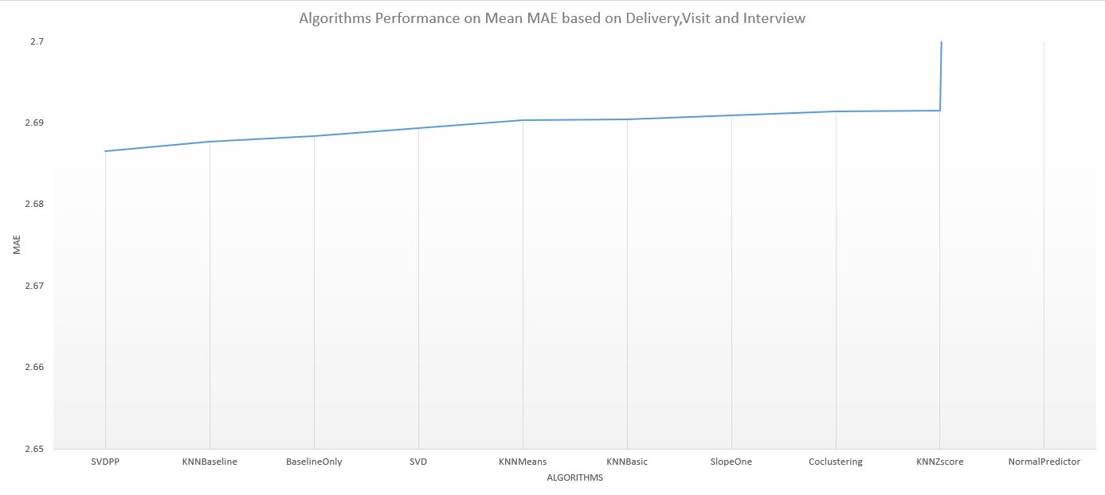
Test, results and evaluation- RS component quantity testing
SVD++ achieved the lowest Mean Absolute Error and Root Mean Square Error on Average
Baseline Comparison
SVD++
KNNBaseline
Baseline
SVD
KNNMeans
KNNBasic
SlopeOne
CoClustering
KNNZscore
NormalPredictor
Notes:
For the RS component the SVD++ was compared using precision accuracy by baseline comparison using a 5 cross validation process with 9 other machine learning algorithms. The models performed on avg best both on RMSE and MAE values. The best hyperparameters were also extracted.

Slide 13
Test, results and evaluation- Quality testing
Survey
30 Participants
Employees
Non-Employees
On average promising results
Users on average found the AR app assisting (100%)
Mostly participants found the application as helpful
On average most participants found the application as not troubled by occlusion much
Some participants found the recommendation confusing as to how it worked yet still helpful.
Notes:
Finally quality testing was performed to extract user feedback on the overall system and its components. 30 participants took part half of which were CCBill employees. On average users found the app as assisting, mostly they found it as helpful from the RS and AR side. However, it is quite notable that some participants found the recommendation as confusing yet still helpful.

Slide 14
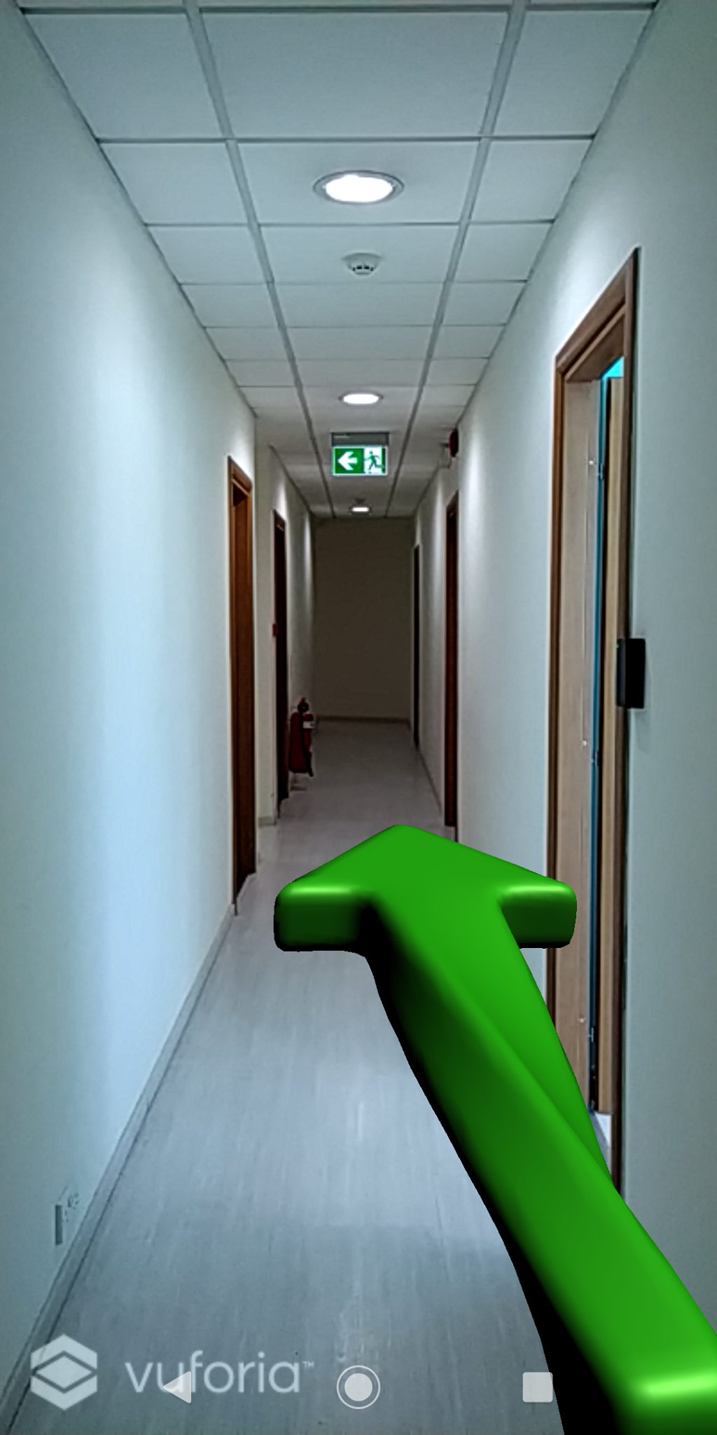
Future Work
Improve UI
Apply Deep Learning for User Profiling
Include Smart Navigation
Include Location Based AR for corridor augmentations
Include Explainable AI
Notes:
Future work involving improving the UI, applying deep learning to the RS side, include smart nav via an indoor positioning system, including location based tracking for corridor augmentation as well as explainable ai to keep a level of transparency.

Slide 15
To Conclude
Have presented a procedure on how one can apply Marker-Based AR.
The methodology used is backed up by relevant research and evaluations to further test the techniques applied and implemented.
The results obtained are not surprising and are indeed promising for augmented reality to be applied to support and facilitate assistance in different workplace environments.
Notes:
To conclude In the FYP it has been presented the methods and procedures necessary on how one can achieve a marker-based ar for a workplace using the aforementioned procedure. The methodology used is backed up by relevant research and evaluations. The results obtained show that marker based AR can be provided using the mentioned AI techniques to facilitate assistance withing a workplace environment.

Slide 16

Thank You!
Acknowledgements GO towards my supervisor and CCBill for complete assistance throughout the whole fyp project

Slide 17
References
[1] P. Moita, “Adjustment to the work place by new recruits in libraries,” vol. Vol.5(2), pp. 71–85, 04 2015.
[2] F. Cacheda, V. Carneiro, D. Ferna´ndez, and V. Formoso, “Comparison of collaborative ﬁltering algorithms: Limitations of current techniques and proposals for scalable, high performance recommender systems,” TWEB, vol. 5, p. 2, 01 2011.

