Slide 1

How to tell your stories in a few lines

Slide 2
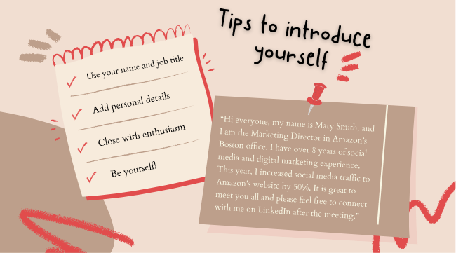
Network with colleagues
Notes:
Not just personal details,
Share your passion (or frustration)
Who you’d like to help (volunteer at WIDS)
personal details like a cat person

Slide 3
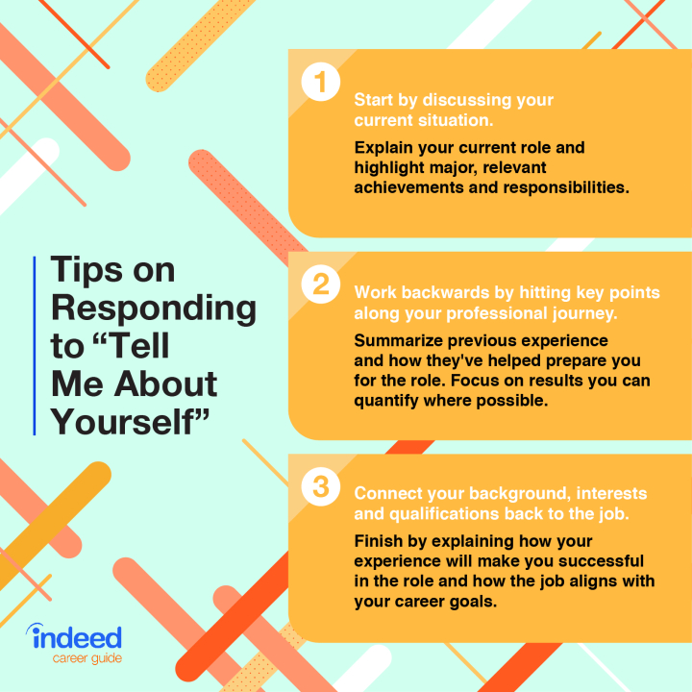
To future employees

Slide 4


Slide 5
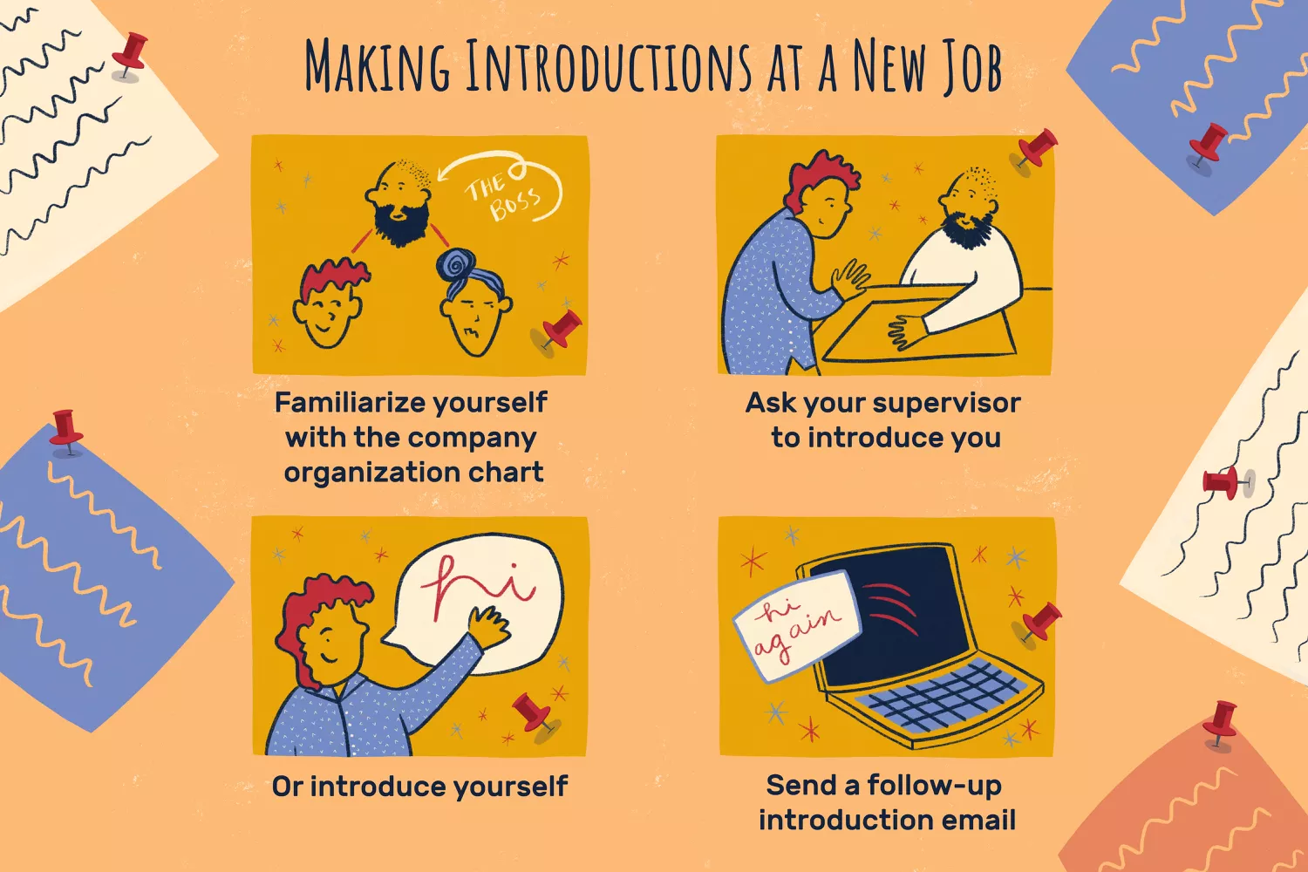
Make your impressions on First Day

Slide 6
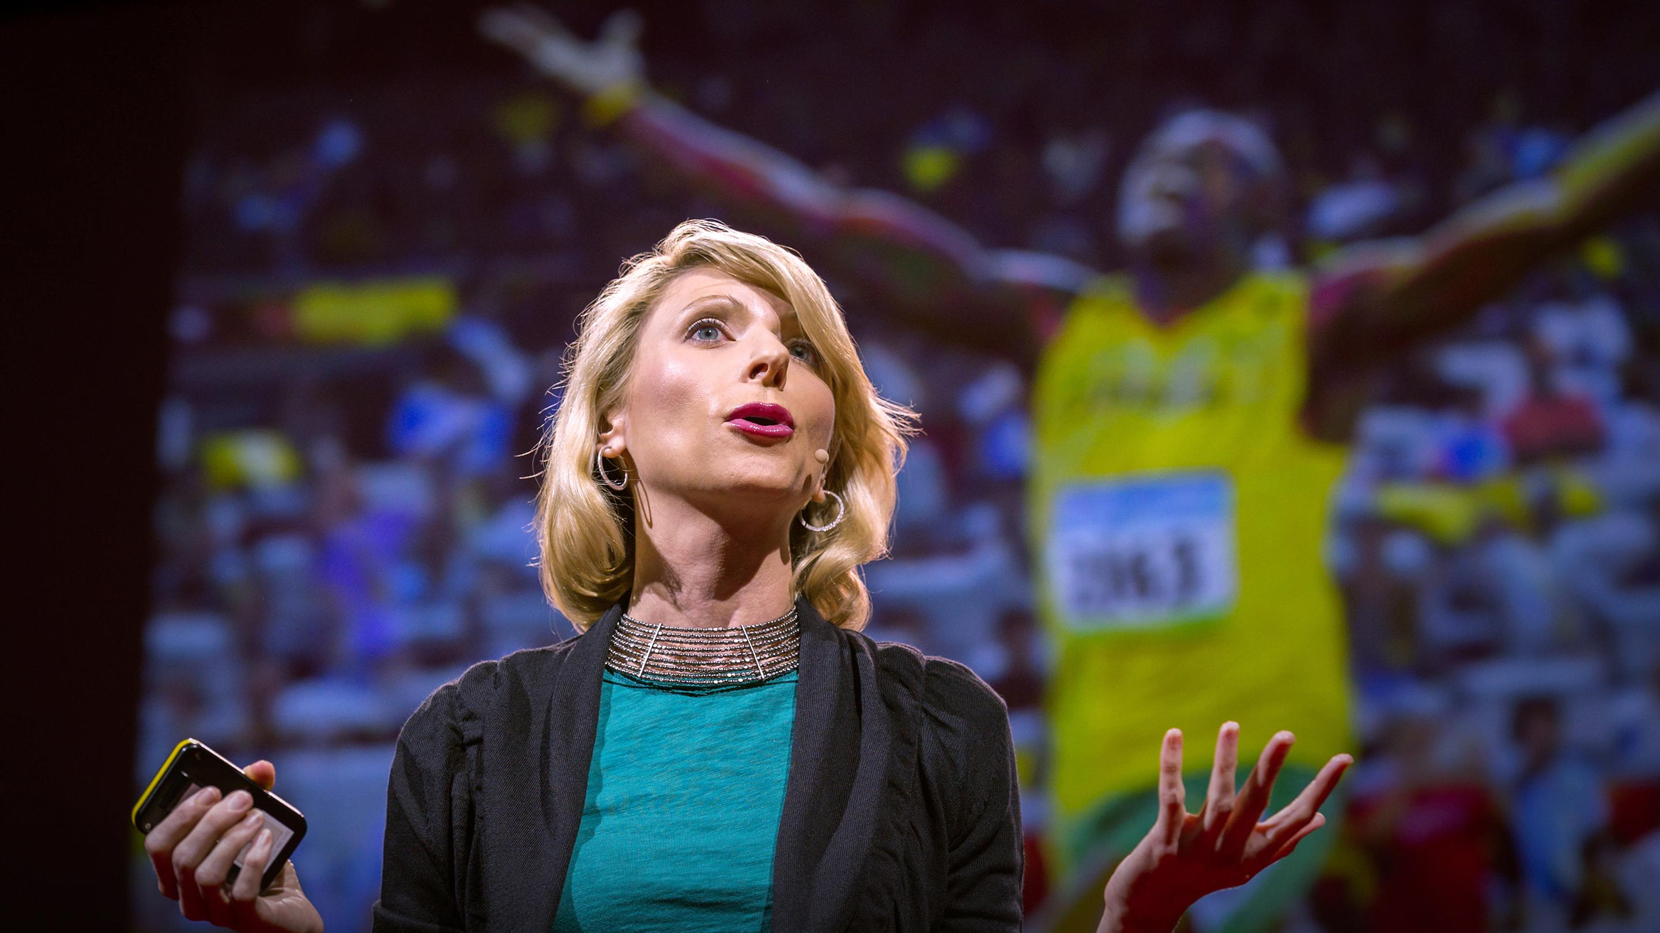
Actions Matter, Too
Be early
Be confident
Present yourself professionally
Powerful positions

Slide 7
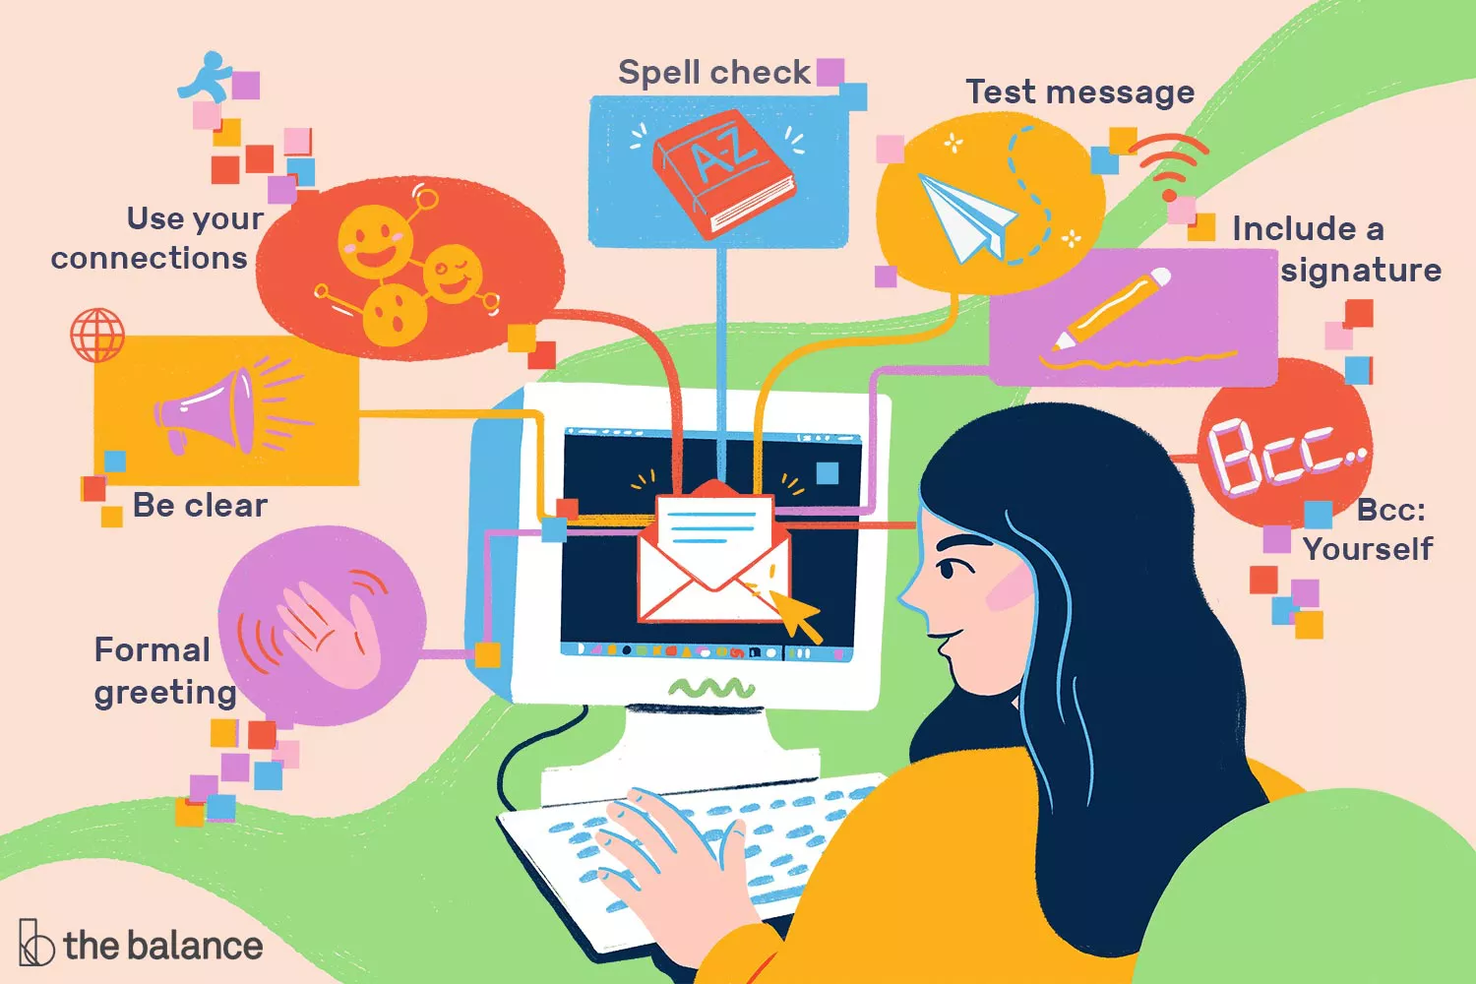
Notes:
Alison Czinkota / The Balance

Slide 8


