Slide 1

How to tell your stories in a few lines
CBWT Monthly Meetings

Slide 2
Networking with colleagues
"My name is Sheryl Townsend, and I'm the marketing lead at Global Markets. We're developing some innovative marketing campaigns designed to engage new customers. I've been recruiting local businesses that want to get involved in trying new features and promotions. I also volunteer at local meetups, where I teach young entrepreneurs and small businesses how to market their products."
Use your name and job title
Add personal details
Close with enthusiasm

Slide 3

To future employers
Notes:
The first sentence of your self-introduction should include your name, job title or experience. If you're unemployed and seeking a job, you might mention your educational degree, certification level or current place in your job search.
Keep it short and in a well structure
Practice and don’t memorize

Slide 4

Notes:
Not necessarily memorizing, no name necessary
Swicth into a new role

Slide 5


Slide 6
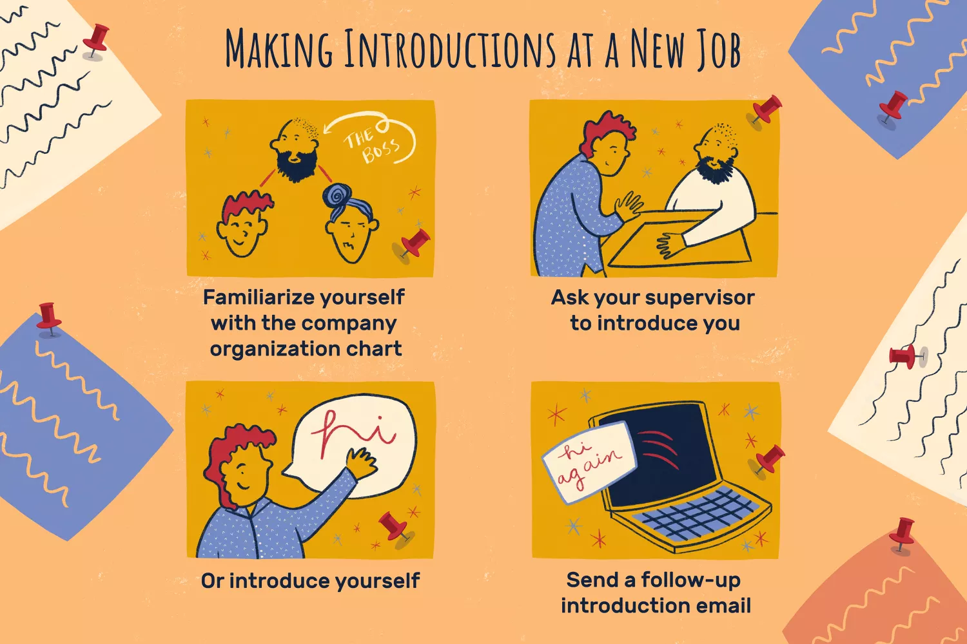
Make your impressions on First Day

Slide 7
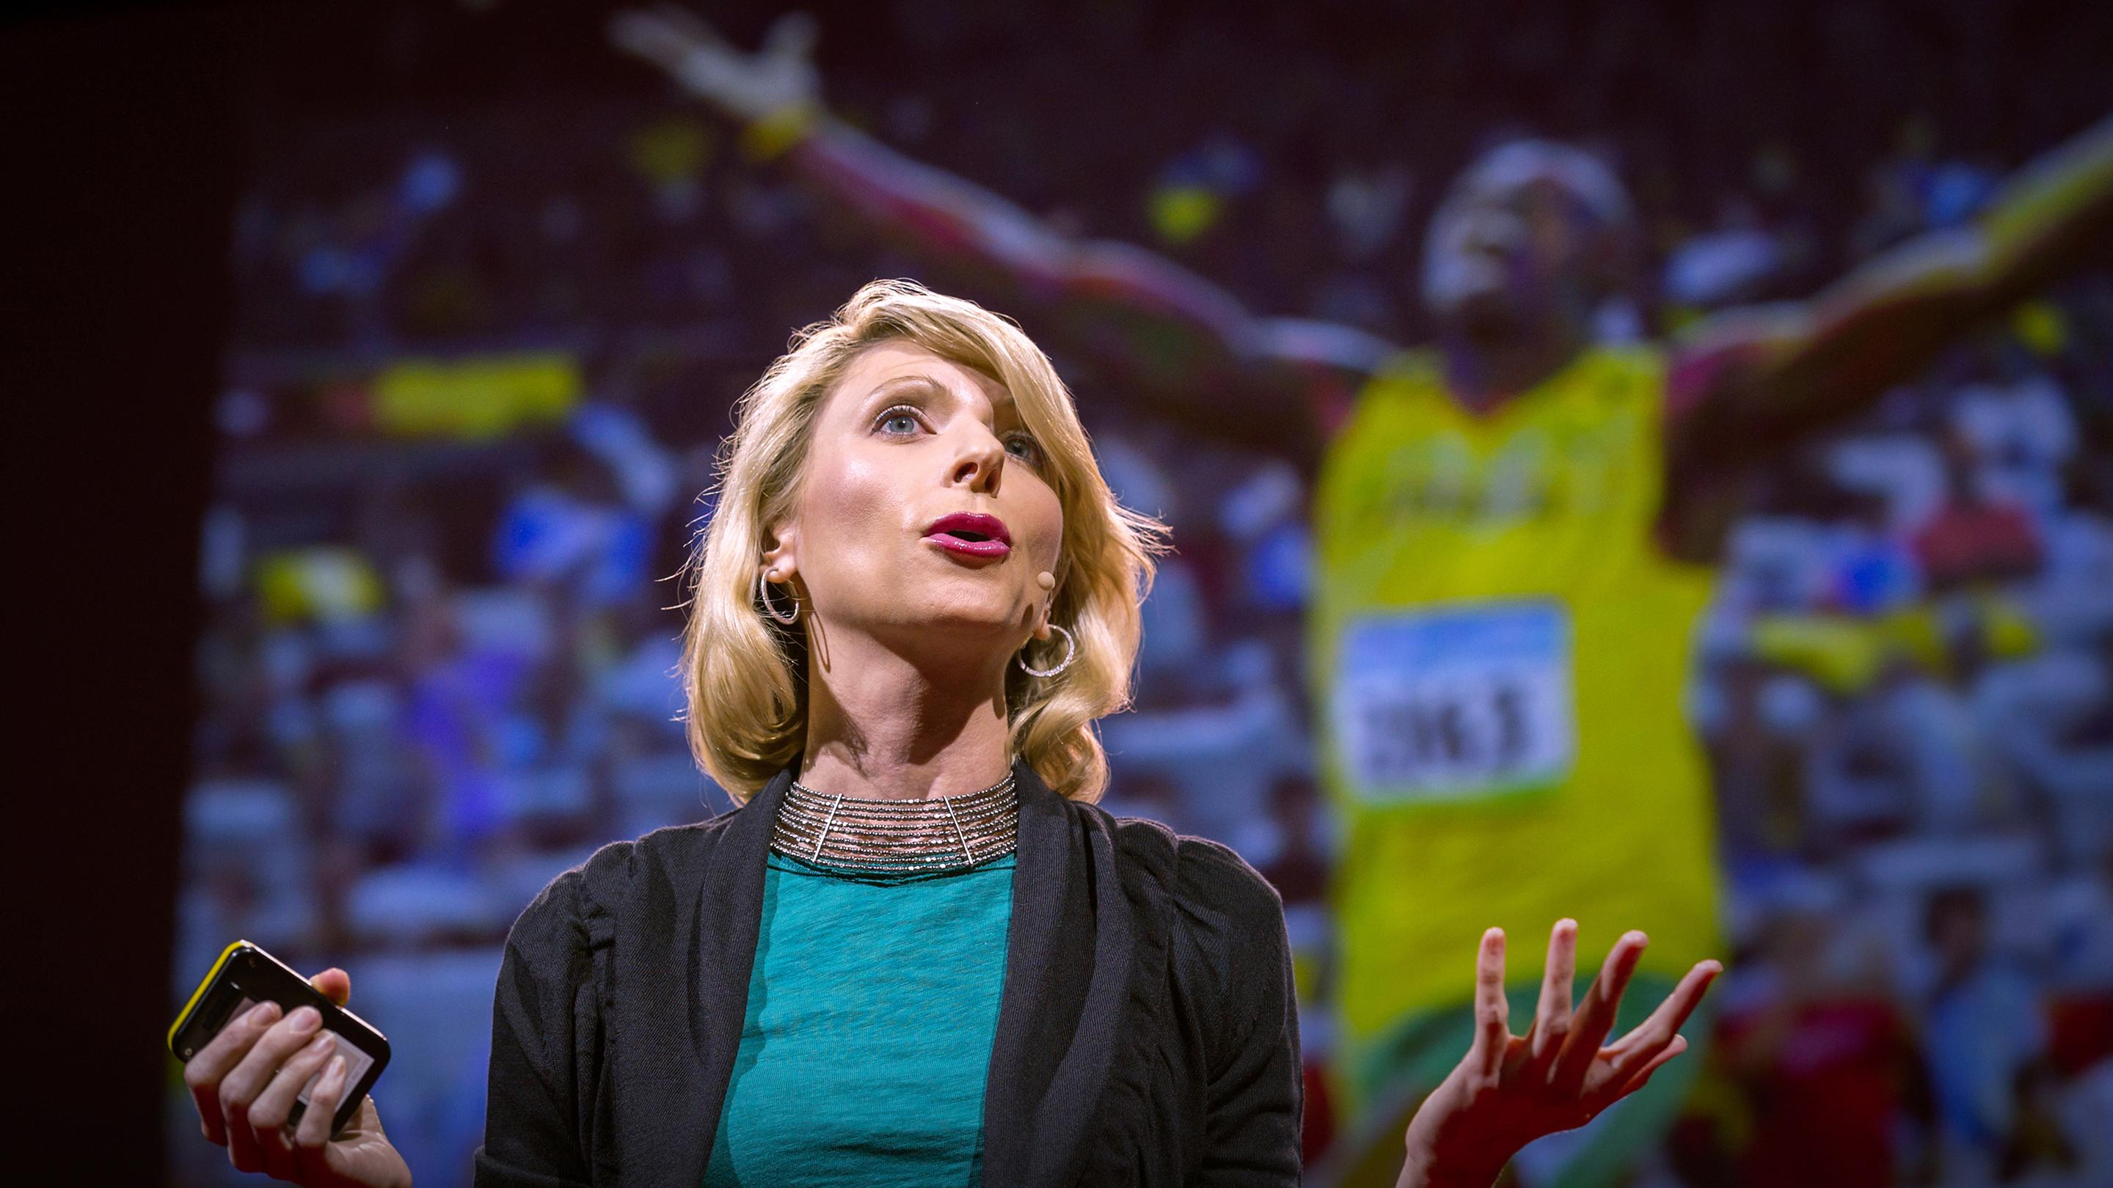
Actions Matter, Too
Arrive early
Be confident
Be prepared
Present yourself professionally
Powerful positions, if needed

Slide 8

Notes:
Alison Czinkota / The Balance

Slide 9


Slide 11
Meet new colleagues
At network events/happy hour/all hands/cultural events etc.
Conference presentations
While giving a presentation
When meeting people at a trade show or conference
Future employees – during interviews
First impression at new jobs

Slide 12
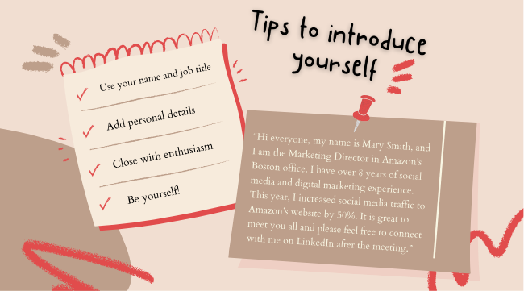
Networking with colleagues
Notes:
Not just personal details,
Share your passion (or frustration)
Who you’d like to help (volunteer at WIDS)
personal details like a cat person
A strong self-introduction includes who you are, what you do and what others need to know about you. When you deliver a powerful self-introduction, you can make a lasting positive impression.

