Slide 1
Prompt engineering
Purpose: how to communicate to an LLM your intention for a task without fine-tune or train our models
Direct the right and consistent behaviors from the LLM in your model in any RAG applications
LLM: know whether it’s foundational models or chat or instruct models
Include instructions, context, heuristics, examples
Where it’s useful: match the tone, style, format, control the output, reduce hallucinations
Text understanding: given large documents of various formats and complex information, distill it down to a concise and understandable format, with precise information, specifically tailored to the questions you asked, for the purposes of benefiting our clients and internal associates
Notes:
https://www.wandb.courses/courses/take/prompting/lessons/55452509-elements-of-a-prompt
https://github.com/wandb/edu/tree/main/prompting

Slide 2
Prompting bot
Instruct model or chat models:
Models that were trained to speak like human when prompted by a human
Instructions:
External information not known by the model
Suppress the knowledge in the model

Slide 3
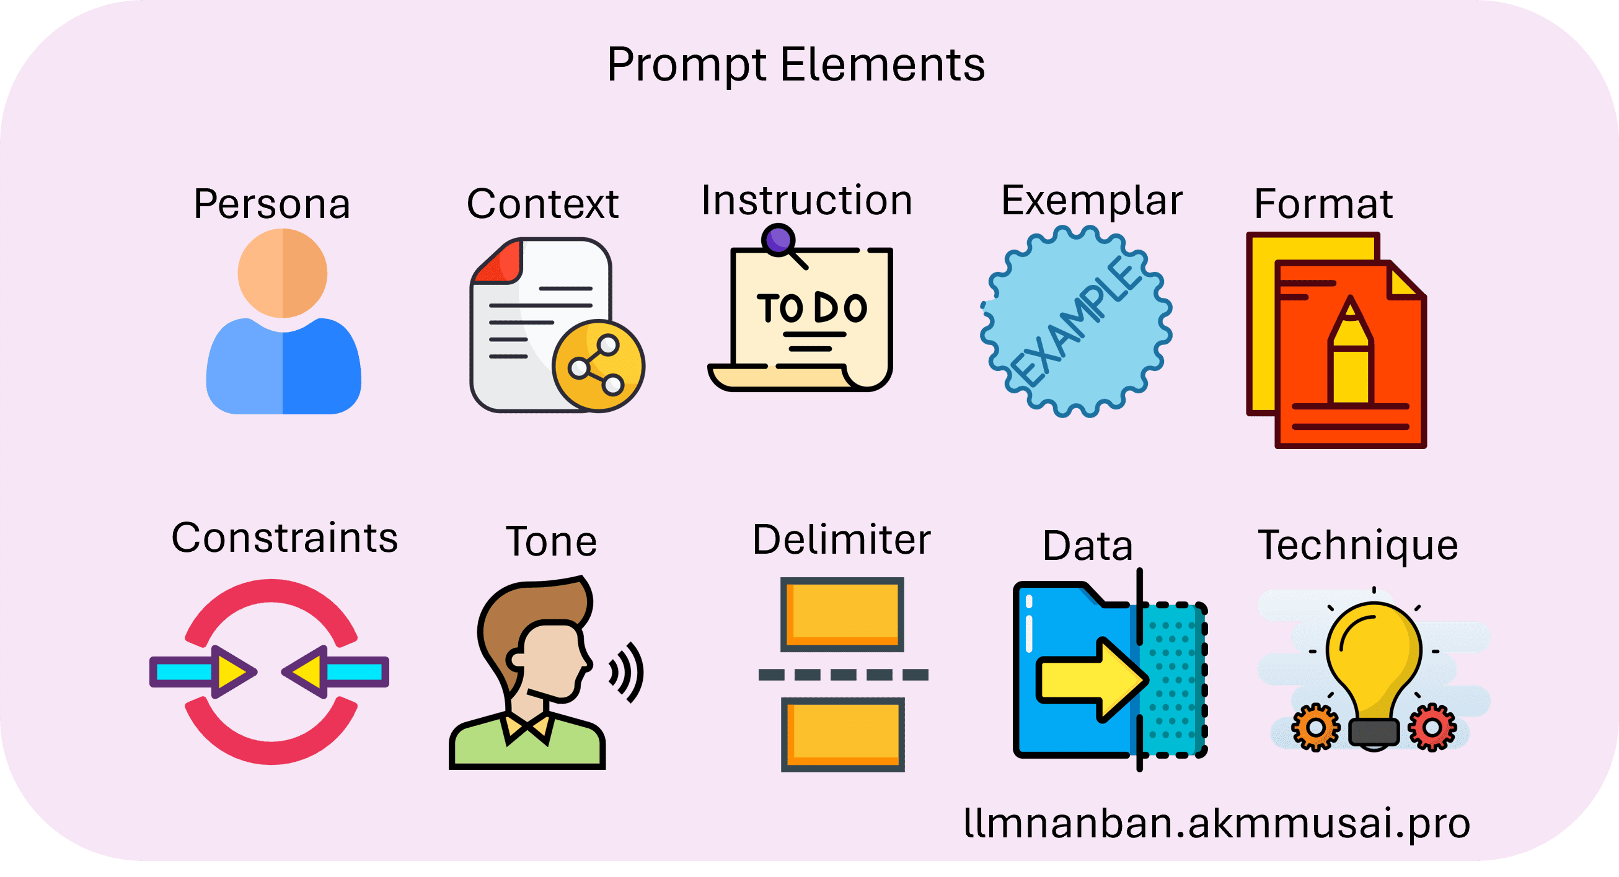
Elements of a prompt
Notes:
https://llmnanban.akmmusai.pro/Introductory/Prompt-Elements/

Slide 4
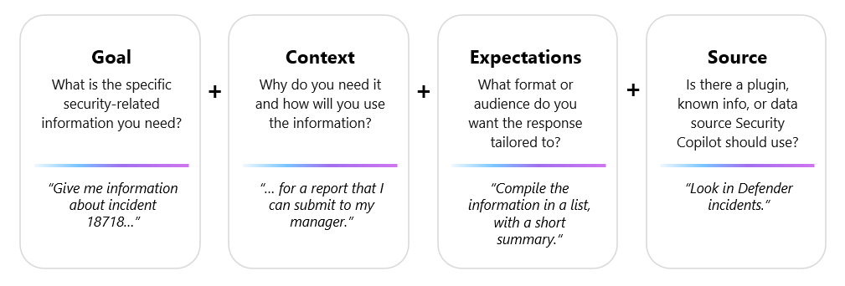
Notes:
https://learn.microsoft.com/en-us/copilot/security/prompting-tips

Slide 5
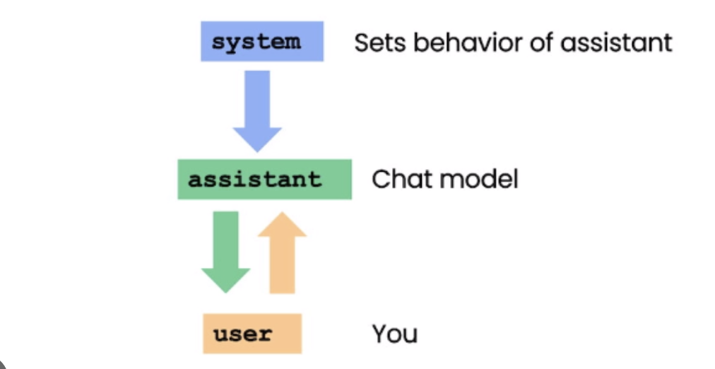
Notes:
https://github.com/wandb/edu/blob/main/prompting/prompt_engineering.ipynb

Slide 6
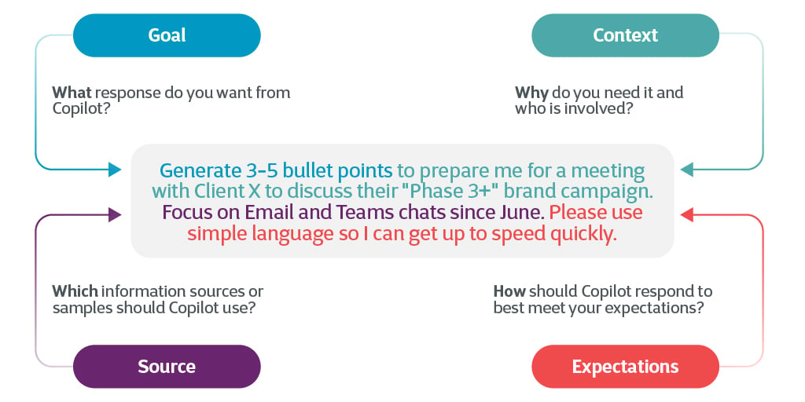
Notes:
https://www.cegeka.com/en/blogs/microsoft-365-copilot-art-of-the-prompt

Slide 7
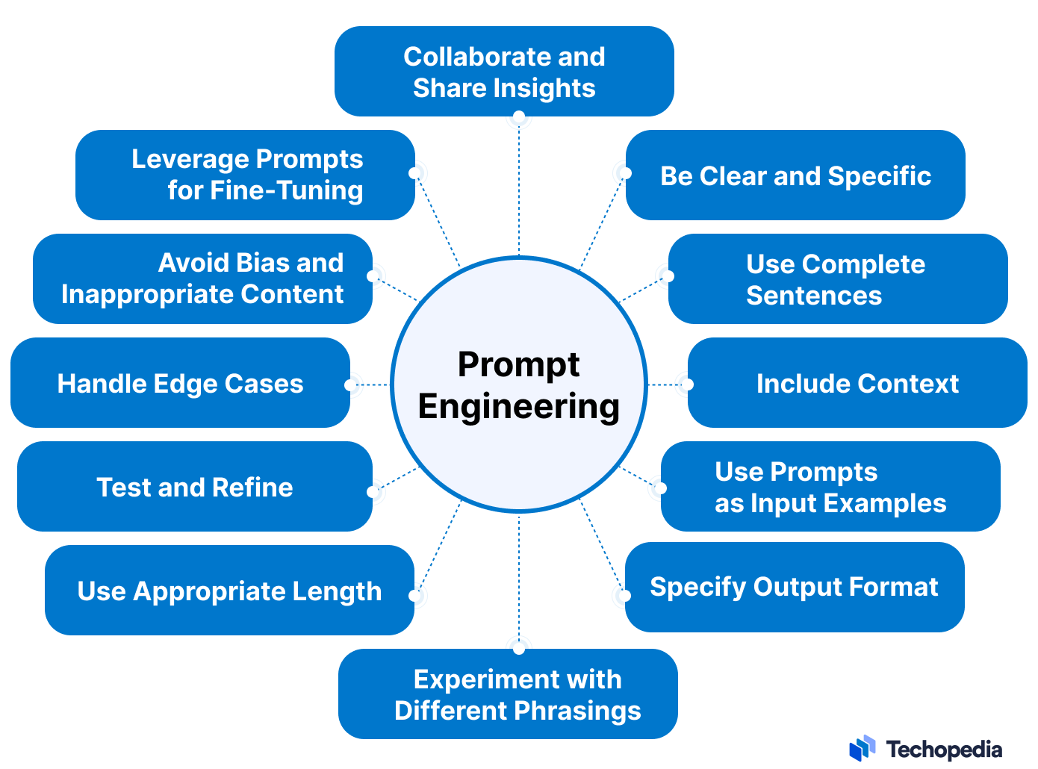

Slide 8
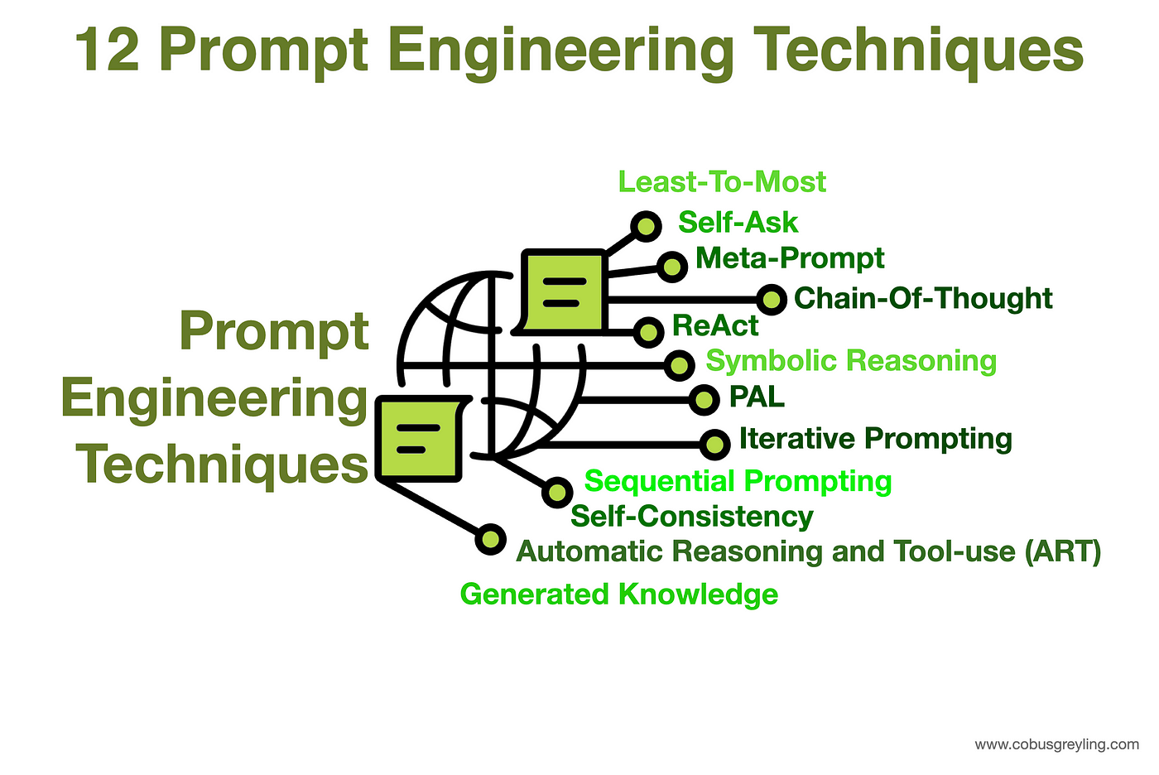

Slide 9
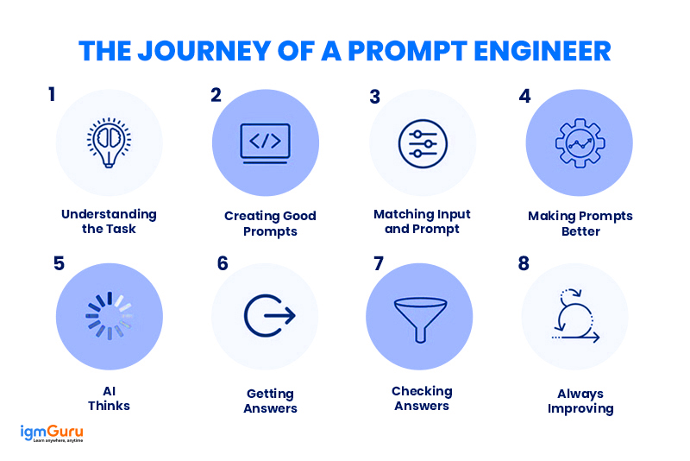

Slide 10
Iterations
Question
+context (RAG, in-context learning)
Getting answers, but give too much/too little, or not in the format or tone
+system instructions
+examples (zero-shot, few-shots)
+advanced prompting techniques (CoT, ToT, GoT)
Made feasible by increasingly long context windows of LLM
W&B: Tracking purposes
Notes:
By passing on information, this comes from a LLM that previously says it doesn’t know anything

Slide 11
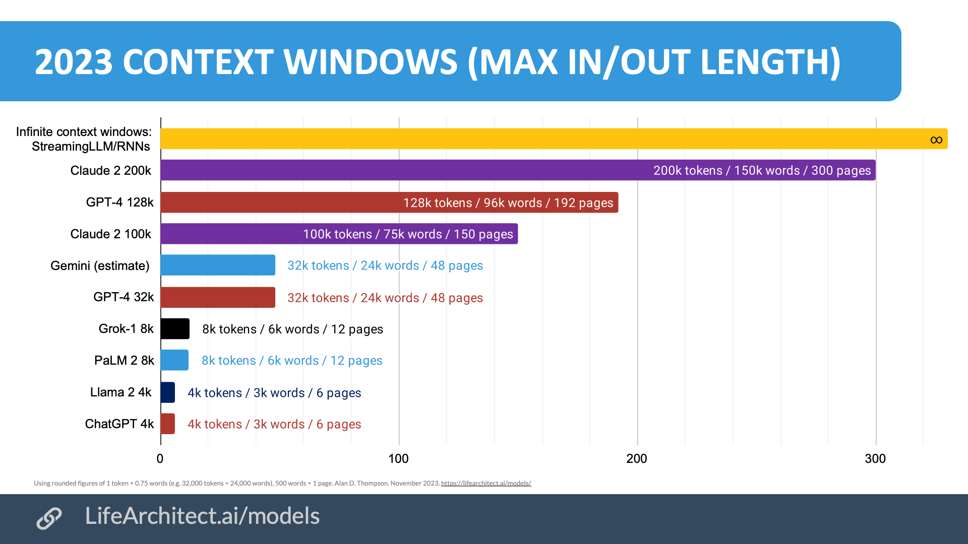

Slide 12
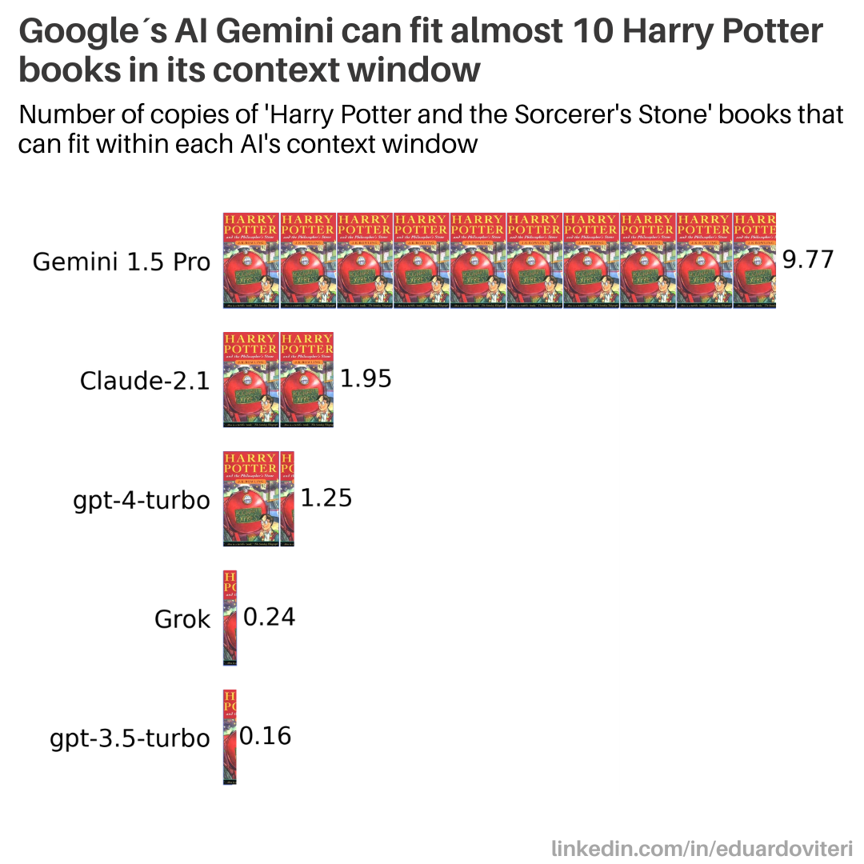

Slide 13
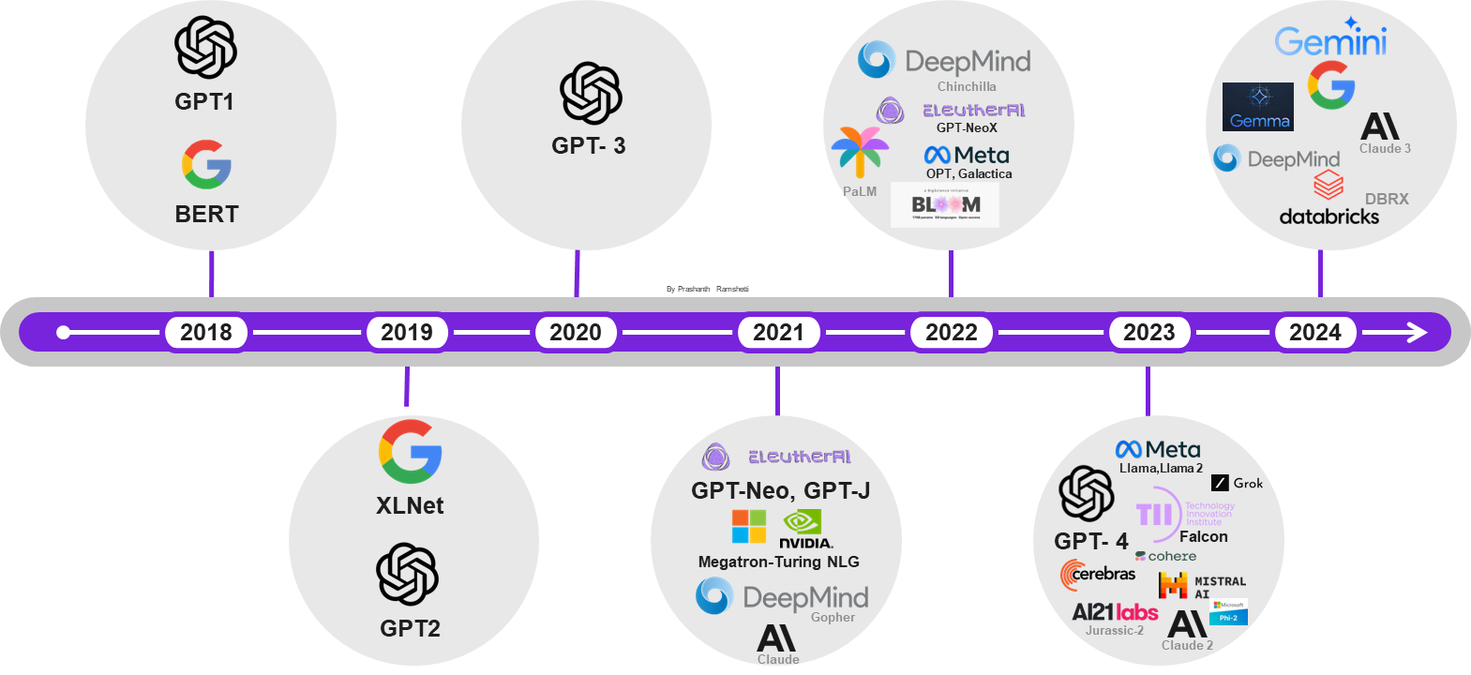

Slide 14
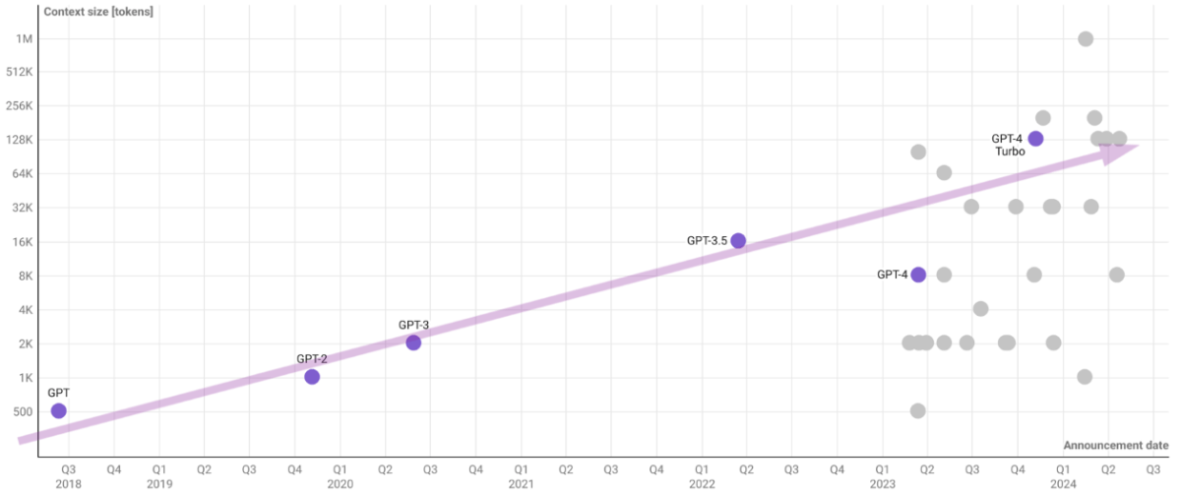

Slide 15
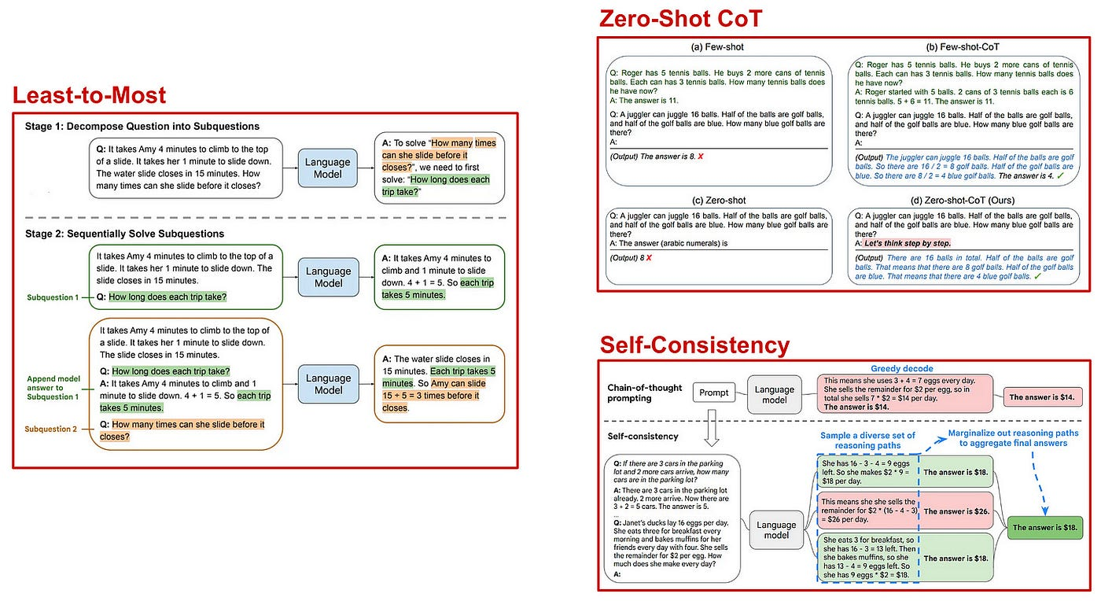
Notes:
Few shots
https://towardsdatascience.com/advanced-prompt-engineering-f07f9e55fe01

Slide 16
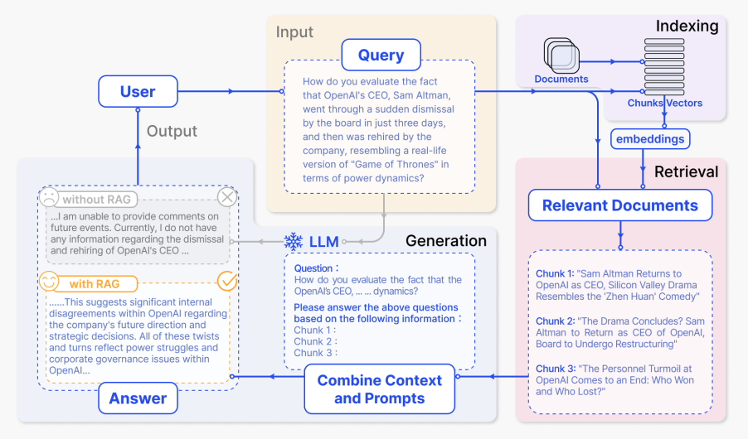
Notes:
Prompt in a RAG system

Slide 17
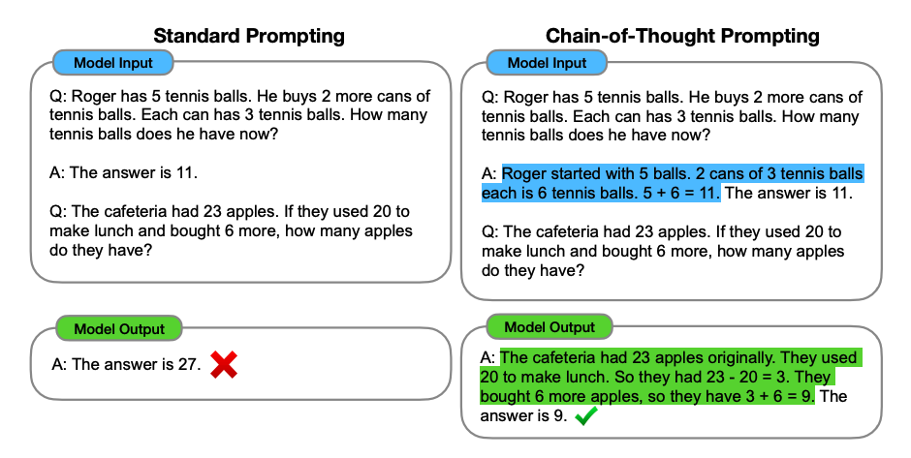

Slide 18
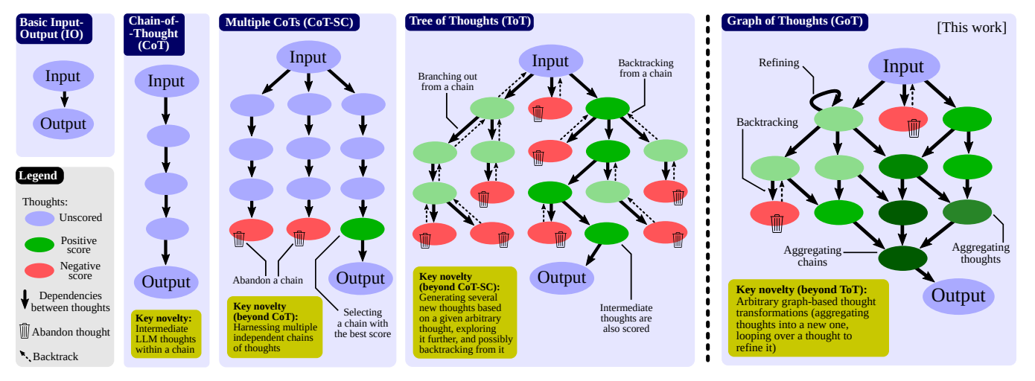
Notes:
https://wandb.ai/sauravmaheshkar/prompting-techniques/reports/Chain-of-thought-tree-of-thought-and-graph-of-thought-Prompting-techniques-explained---Vmlldzo4MzQwNjMx

