Slide 1



The shift cipher
Consider encrypting English text
Associate a with 0;
b with 1;
…;
z with 25
k ∈ {0, …, 25}
To encrypt using key k, shift every letter of the
plaintext by k p nd)
ositions (with wraparou
tion just does the reverse
helloworldz
ccccccccccc
jgnnqyqtnfb
Decryp

Slide 2
Modular arithmetic
x = x’ mod N if and only if N divides x-x’
• [x mod N] = The remainder when x is divided by N
• I.e., The unique value x’∈{0, …, N-1} such that
x = x’ mod N
25 = 35 mod 10
25 ≠ [35 mod 10]
5 = [35 mod 10]

Slide 3
The shift cipher, formally
M = {strings over lowercase English alphabet}
Gen: choose uniform k∈{0, …, 25}
Enc_{k}(m₁…m_{t}): output c₁…c_{t}, where
^{c}i ^{:= [m}i ^{+ k mod 26]}
Dec_{k}(c₁…c_{t}): output m₁…m_{t}, where
^{m}i ^{:= [c}i ^{- k mod 26]}
Can verify that correctness holds…

Slide 4
Is the shift cipher secure?
No -- only 26 possible keys!
• Given a ciphertext, try decrypting with every possible key
• If ciphertext is long enough (and plaintext is normal
English), only one possibility will “make sense”

Slide 5
Example
Ciphertext uryybjbeyq
Try every possible key…
• tqxxaiadxp
• spwwzhzcwo
• …
• helloworld

Slide 6
Kerckhoffs’s principle
The encryption scheme is not secret
•
•
The only secret is the key
The key must be chosen at random,
kept secret
Some
•
•
•
arguments in favor of this principle
Easier to keep secret key than secret algorithm Easier to change key than to change algorithm Standardization
• Ease of deployment
• Public validation

Slide 7
Sufficient key space principle
The key space should be large enough to prevent
“brute-force,” exhaustive-search attacks

Slide 8
Sufficient key space principle
If an encryption scheme has a key space that is too
small, then it will be vulnerable to exhaustive-
search attacks

Slide 9

The Vigenère cipher
The key is now a string, not just a character
To encrypt, shift each character in the plaintext by the amount dictated by the next character of the key
• Wrap around in the key as needed
Decryption just reverses the process
tellhimaboutme
cafecafecafeca
veqpjiredozxoe

Slide 10
The Vigenère cipher
Size of key space?
• If keys are 14-character strings; then key
space
has size
26¹⁴
≈
2⁶⁶
• Brute-force search expensive/impossible
Is the Vigenère cipher secure?
(Believed secure for many years…)

Slide 11


Attacking the Vigenère cipher
(Assume a 14-character
key)
character
Observation:
same shift
every
14th
is
“encrypted”
using
the
at every 14th character is
st) like looking at ciphertext
pted with the shift cipher
ough brute-force attack from
veqpjiredozxoeualpcmsdjqu
iqndnossoscdcusoakjqmxpqr
hyycjqoqqodhjcciowieii
Looking
(almo
encry
• Th
veqpjiredozxoeualpcmsdjqu
iqndnossoscdcusoakjqmxpqr
hyycjqoqqodhjcciowieii
before
doesn’t work…

Slide 12
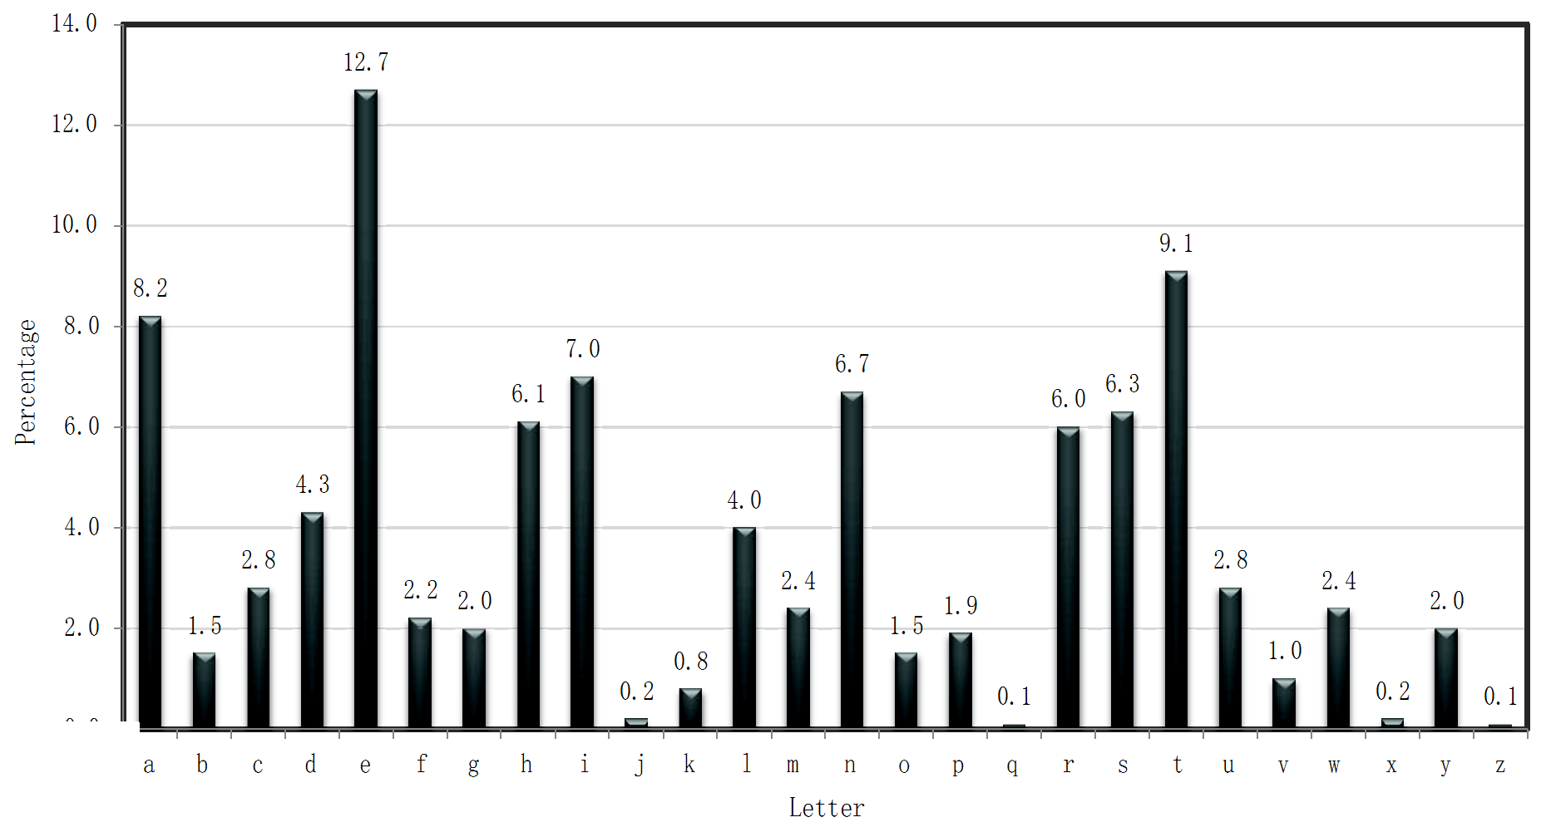
Using plaintext letter frequencies

Slide 13
Attacking the Vigenère cipher
Look at every
the first
14th
character of the ciphertext, starting with
Let α be the most common character appearing in this
portion of the ciphertext
Most likely, this character corresponds to the most common
plaintext character (‘e’)
• Guess the first character of the key is α - ’e’
Repeat for all other positions
Better (more complicated) attacks also possible

Slide 14
Back to the drawing board…
So far: “ad hoc” constructions;
construct, break, repeat, …
Can we prove that some encryption
is secure?
scheme
First need to define what we mean by “secure”
place…
in the first

Slide 15
Cryptography
characterize cryptographic system by:
• type of encryption operations used
• substitution / transposition / product
• number of keys used
• single-key or private / two-key or public
• way in which plaintext is processed
• block cipher, in/out is one block of elements
• Stream cipher, in/out is one continuous element

Slide 16
Cryptanalysis
objective is to recover key
general approaches:
• cryptanalytic attack
not just message
•
•
•
rely on the nature of the algorithm
plus general characteristics of the plaintext
or some sample pairs of plaintext-ciphertext.
• brute-force attack
• try every possible key

Slide 17
Cryptanalytic Attacks
ciphertext only
• only know algorithm & ciphertext, know or can identify plaintext
known plaintext
is statistical,
• know/suspect plaintext & ciphertext
chosen plaintext
• select plaintext and obtain ciphertext
chosen ciphertext
• select ciphertext and obtain plaintext
chosen text
• select plaintext or ciphertext to en/decrypt

Slide 18
More Definitions
unconditional security
• no matter how much computer power or time is available, the cipher cannot be broken since the ciphertext provides insufficient information to uniquely determine the corresponding plaintext
computational security
• given limited computing resources (eg time needed for calculations is greater than age of universe), the cipher cannot be broken

Slide 19

Brute Force Search
always possible to simply try every key
most basic attack, proportional to key size assume either know / recognise plaintext
Key Size (bits)
Number of Alternative
Keys
Time required at 1 decryption/µs
Time required at 10⁶
decryptions/µs
32
2³² = 4.3 × 10⁹
2³¹ µs = 35.8 minutes
2.15 milliseconds
56
2⁵⁶ = 7.2 × 10¹⁶
2⁵⁵ µs = 1142 years
10.01 hours
128
2¹²⁸ = 3.4 × 10³⁸
2¹²⁷ µs = 5.4 × 10²⁴ years
5.4 × 10¹⁸ years
168
2¹⁶⁸ = 3.7 × 10⁵⁰
2¹⁶⁷ µs = 5.9 × 10³⁶ years
5.9 × 10³⁰ years
26 characters
(permutation)
26! = 4 × 10²⁶
2 × 10²⁶ µs = 6.4 × 10¹² years
6.4 × 10⁶ years

Slide 20
Summary
Symmetric encryption
Public encryption
Digital Signature

Slide 21
Private-key cryptography
Private-key cryptography allows two users who share a
secret key to establish a “secure channel”
The need to share a secret key incurs several
drawbacks…

Slide 22
The key-distribution problem
How do users share a key in the first place?
•
Need to share the key using a secure channel…
This
•
•
problem can be solved in some settings…
E.g., physical proximity, trusted courier
(Note: this does not make private-key cryptography useless)
…but not others (or at least not cheaply)

Slide 23
The key-management problem
Imagine an organization with N employees, where
pair of employees might need to communicate
securely
each
Solution using private-key cryptography:
• Each user shares a key with all other users
⇒ Each user must store/manage N-1 secret keys!
⇒ O(N²) keys overall!

Slide 24
Lack of support for “open systems”
Say two users who have no prior relationship want to
communicate securely
• When would they ever have shared a key?
This is not at all far-fetched!
• Customer sending credit-card data to merchant
• Sending an email to a colleague

Slide 25
“Classical” cryptography
offers no solution
to these problems!

Slide 26
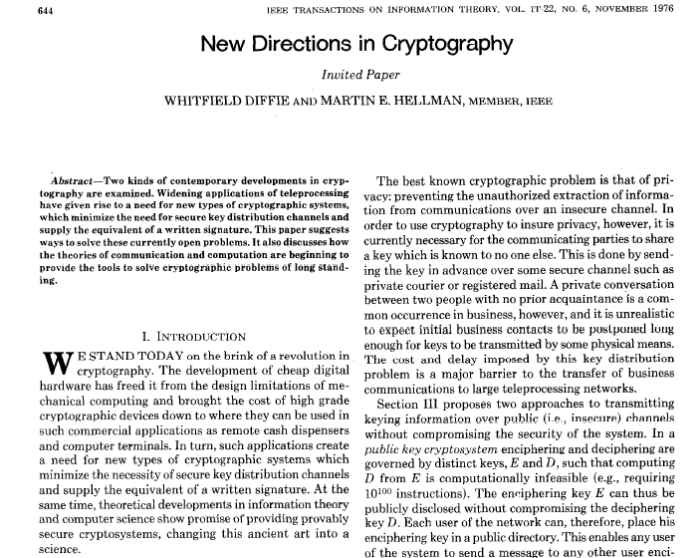

Slide 27
New directions…
Key ideas:
• Some problems exhibit asymmetry – easy to
compute, but hard to invert (think factoring)
• Use this asymmetry to enable two parties to agree on a shared secret key using public discussion(!)
• Key exchange

Slide 28
Public-Key Cryptography
probably most significant advance in the 3000 year
history of cryptography
uses two keys – a public & a private key
asymmetric since parties are not equal
uses clever application of number theoretic concepts
to function
complements rather than replaces private key crypto

Slide 29



The
language of
cryptography
Alice’s
encryption
key
Bob’s
decryption
key
K
K
A
B
encryption
algorithm
ciphertext
decryption algorithm
plaintext
plaintext
symmetric
public-key
key crypto: sender, receiver
keys
identical
crypto: encryption key public, decryption key
secret
(private)

Slide 30
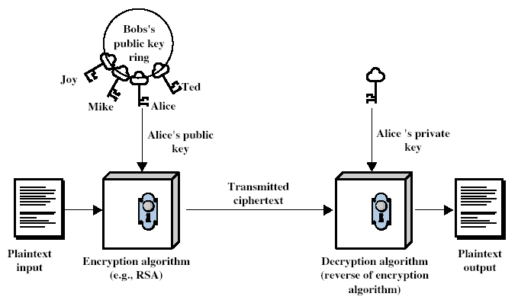
Public-Key Cryptography

Slide 31
Summary
Symmetric encryption
Public encryption
Digital Signature

Slide 32
Digital Signatures
Cryptographic technique analogous to hand-written signatures.
sender (Bob) digitally signs document,
establishing he is document owner/creator.
verifiable, nonforgeable:
prove to someone that (including Alice), must document
recipient (Alice) can
Bob, and no one else have signed

Slide 33
Digital Signatures
Simple digital signature for message m:
Bob₋ signs m by encrypting with₋ his private key K_{B}, creating “signed” message, K_{B}(m)
Bob’s message, m
-
K
Bob’s private
-
K (m)
B
key
B
Dear Alice
Oh, how I have missed you. I think of you all the time! …(blah blah blah)
Bob
Bob’s message, m, signed (encrypted) with his private key
Public key encryption algorithm

