Slide 1
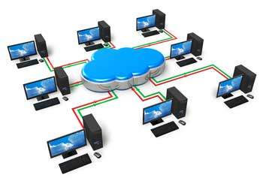
Unix Systems Administration and Security (Linux)
Networking
hardware, basic network
protocols

Slide 2
What is “Networking”?
The method of connecting multiple autonomous computers
Why?
  Share information
  Providing a “service” to other computers or the people using them
  Provide access to information in other locations
  Some clustering applications to increase computational power
The internet is the largest “network of networks”
Notes:
A network as a collection of hosts that are able to communicate with each other, often by relying on the services of a number of dedicated hosts that relay data between the participants
Hosts are often computers, but need not be; one can also think of X terminals or intelligent printers as hosts.

Slide 3
What defines a network?
You need at least the following
  Two or more computers with Ethernet Card
  Some equipment to connect them together. Eg:
    Ethernet switch
    Ethernet cable
  Network protocol software on host. Eg
    TCP/IP, IPX, etc.
  Network application software. Eg.
    Apache, ssh, Web browser, etc.
Notes:
Communication is impossible without some sort of language or code. In computer networks, these languages are collectively referred to as protocols
The approach that a large number of modern networking protocols uses is called packet-switching. A packet is a small chunk of data that is transferred from one machine to another across the network. The switching occurs as the datagram is carried across each link in the network. A packet-switched network shares a single network link among many users by alternately sending packets from one user to another across that link.

Slide 4
Ethernet Networking
Ethernet is a contention media access method that allows all hosts on a network to share the same bandwidth of a link.
Ethernet networking uses Carrier Sense Multiple Access with Collision Detect (CSMA/CD), a protocol that helps devices share the bandwidth evenly without having two devices transmit at the same time on the network medium.

Slide 5
lateef@ubuntu]$ cat /proc/net/dev
Inter-| Receive | Transmit
face |packets errs drop fifo frame|packets errs drop fifo colls carrier
lo: 91 0 0 0 0 91 0 0 0 0 0
eth0: 0 0 0 0 0 60 0 0 0 0 60
CSMA/CD was created to overcome the problem of those collisions that occur when packets are transmitted simultaneously from different nodes.

Slide 6
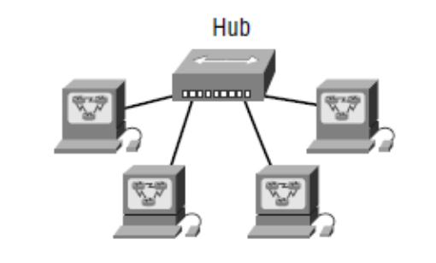
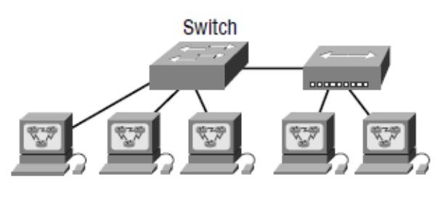
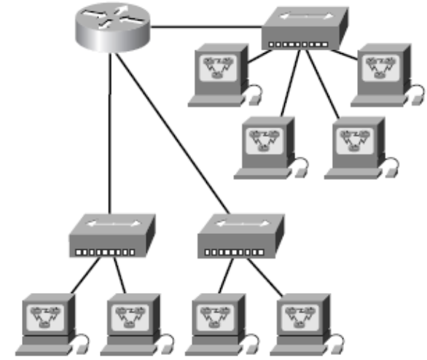
Example of Networking Devices
Identifying the number of collision and broadcast domains

Slide 7
Ethernet addresses
Which of the following belongs to the same Manufacturer (OUI)?
00:00:0C:03:79:2F
00:40:F6:60:4D:A4
00:20:AF:A4:55:87
00:20:AF:A4:55:7B

Slide 8
Address Resolution Protocol
The mapping of ethernet addresses into Internet addresses is performed by the Address Resolution Protocol (ARP).
ARP maintains a table that contains the translation between IP address and ethernet address.
arp -a will display the entire table on Unix machine

Slide 9
Dotted Quad to Binary
132.22.42.1 = 10000100 00010110 00101010 00000001
132 = 10000100
22 = 00010110
42 = 00101010
1 = 00000001

Slide 10
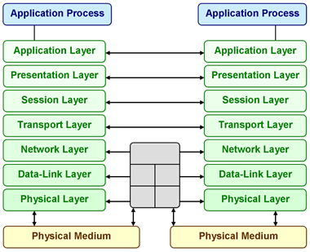
OSI Reference model

Slide 11
Networking Protocols
A variety of protocols are/were available
They can generally co-exist on the same networking hardware
Examples:
  NetBEUI – Designed by IBM and Microsoft for Peer-to-peer networking (Not routable)
  IPX – Developed by Novell for older versions of Netware
  SNA – “Blue Glue” IBM protocol for linking mainframes, PC’s and terminals
  DECNet – Digital’s network protocol

Slide 12
Networking Protocols (2)
TCP/IP
  Evolved from protocols used in experimental ARPA/DARPA networks
  Originally composed of 100 protocols. Not all are used, however.
  Revision (IPv6) in progress, but is stalling
    Larger address range (128 bits vs 32 bits)
    Some provisions for security
    Advent of NAT has slowed demand for completion
Appletalk – Apple peer-to-peer protocol

Slide 13
IP
Internet Protocol
  Native protocol of the internet
  Defacto standard for most networks
  Native networking model on Unix, but also implemented on all other OS’es.
Advantages
  Easily routable
  Can shape network traffic
Disadvantages
  Quite complex

Slide 14
ifconfig
Network interfaces are configured using the ifconfig command and has the standard format for turning a device on.
  ifconfig device_name IP_address netmask netmask up
  ifconfig eth0 138.77.37.26 netmask 255.255.255.0 up
  Configures the first ethernet address with the IP address of 138.77.37.26 and the netmask of 255.255.255.0.
up and down
These parameters are used to take the device up and down (turn it on and off). ifconfig eth0 down will disable the eth0 interface and will require an ifconfig command like the first example above to turn it back on.
-arp
Will turn on/off the address resolution protocol for the specified interface

Slide 15
Using ifconfig
Setting up an interface:
  ifconfig int ip.ad.dr.es netmask ne.tm.as.k
  Ifconfig eth0 192.168.0.1 netmask 255.255.255.0
Enabling and disabling an interface:
  ifconfig eth0 up
  ifconfig eth0 down
Showing configuration:
  ifconfig int

Slide 16
Dynamic Host Control Protocol
(DHCP)
Used to automatically assign IP address information to an interface that asks for it.
Works by “loaning out” the IP address for a period of time
Simplifies configuration in large environments
Can set the following information:
  IP address
  Default router
  DNS information
  WINS information for windows hosts

Slide 17
DHCPCD – DHCP Client daemon
Unix service to manage DHCP information
Simplest usage:
  dhcpcd interface
    If no interface provided, assumes eth0
Stores local state information in /etc/dhcpcd
  Which interface(s)
  What is set
  Storage spot for scripts to run when the IP address changes

Slide 18
IP Aliasing
A Linux computer can have more than one IP address for a single interface. Eg.
  ifconfig eth0 192.168.11.1
  ifconfig eth0:0 192.168.11.2
Hardware bound to eth0 now responds to both IP addresses
Since the address is in each packet, it is easy to treat them separately.
  Eg. Apache can run multiple different websites based on IP address

Slide 19
Routing
Impractical to have all machines on one single network
  Load limits
  Even with switching, there are limits
  There is a theoretical limit on the number of machines on a network
Best practice is to split the network into “sub-nets” and route traffic between networks
  Requires a router
  Clients need to know where the router is

Slide 20
Routing – Static routes
Not the best solution – harder to change information around later
Most IP implementations include a method of route discovery (if routers are advertising)
Can be useful for a “default route”
  Packets go to the default router if there is no idea where to send them
  Set up default router:
    # route add –net 0.0.0.0/0 gw 192.168.0.254

Slide 21
The /etc/hosts file
Simple mapping between IP addresses and hostname
Flat text file with the following format:
  Ip-addr FQ-hostname alias1 alias2 …
For example:
  127.0.0.1 localhost
  192.168.1.2 trix.gh.com trix
  192.168.1.3 cscit.gh.com www

Slide 22
Useful debugging tools
Netstat
Ethereal, tcpdump, etc.
Ntop
Ngrep
Nc

Slide 23
Netstat – Network statistics
Network connections
Routing tables
Interface statistics
Masquerade connections
Netlink messages
Multicast information

Slide 24

Sample netstat

Slide 25
Tcpdump
Text-based packet filter
Packets stream past on terminal
Can put output to a file
  File can be interpreted by Ethereal

Slide 26
Netcat, ntop and ngrep
Netcat is designed as a debugging tool for IP based protocols
  Dummy server to output what a client sends
  Can communicate with TCP and UDP services
  Not commonly installed by default
Ntop provides graphical representation of traffic in network
Ngrep provides an interface similar to grep for network traffic

Slide 27
Networks and hosts
An IP address actually consists of two parts
  a network portion used to identify the network that the machine belongs to.
    Hosts on the same network will have this portion of the IP address in common.
  the host portion: This is the part which uniquely identifies the host on the network.
The size of the network and host portions of an IP address is specified by another 32 bit number called the netmask (also known as the subnet mask)

Slide 28
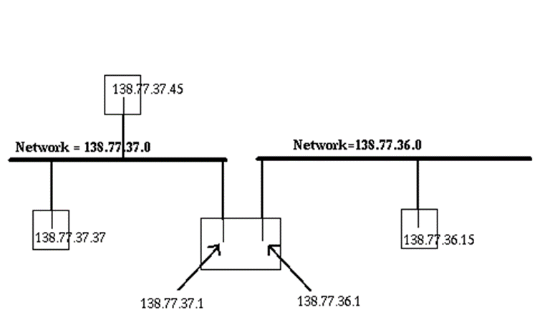
For example
IP address 138.77.37.21
netmask 255.255.255.0
IP addr: 10001010 01001101 00100101 00010101
Nmask: 11111111 11111111 11111111 00000000
network addr 138.77.37.0 10001010 01001101 00100101 00000000
host address 0.0.0.21 00000000 00000000 00000000 00010101

Slide 29
Assigning IP addresses
Some IP addresses are reserved for specific purposes and you should not assign these addresses to a machine.
Address | Purpose
xx.xx.xx.0 | network address
xx.xx.xx.1 | gateway address *
xx.xx.xx.255 | broadcast address
127.0.0.1 | loopback address

Slide 30
Network Classes
Class | First byte value | Netmask | Number of hosts
A | 1 to 126 | 255.0.0.0 | 16 million
B | 128 to 191 | 255.255.0.0 | 64,000
C | 192 to 223 | 255.255.255.0 | 254
Multicast | 224 – 239 | 240.0.0.0

Slide 31
Networks reserved for private networks
Network class | Addresses
A | 10.0.0.0 - 10.255.255.255
B | 172.16.0.0 - 172.31.255.255
C | 192.168.0.0 - 192.168.255.255

Slide 32
Subnets
Subnets break available IP addresses into further networks
Why subnet?
  Security reasons: Using Ethernet, all hosts on the same network can see all the packets on the network.
  physical reasons: Networking hardware, like Ethernet, has physical limitations
  political reasons: There may be departments or groups within an organization that have unique needs or want to control their own network.
  hardware and software differences: Someone may wish to use completely different networking hardware and software.

Slide 33
Subnet continued
One of the problems with the original IP addressing scheme was that for Class A and B networks, address efficiency was an issue.
  how many hosts can you physically put on a network segment?

Slide 34
Subnet continued …
The disadvantage of subnetting is that you are losing more addresses
  each of these subnets has a network and host address.
The advantage of subnetting is that you now can more efficiently use your addressing.

Slide 35
Example
You are given a Class C network (192.168.1.0) and you have 4 segments in your network, where the largest segment has 50 hosts. What subnet mask should you use and what is the layout of your addresses?

Slide 36
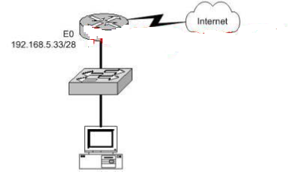
Example 2
Refer to the graphic.
What should be the IP address of the host?
A. 192.168.5.14
B. 192.168.5.32
C. 192.168.5.40
D. 192.168.5.47
E. 192.168.5.55

Slide 37
Example 3
A new network is being designed for your Institution, UCC. Using a Class C IP network. which subnet mask will provide one useable subnet per department while allowing enough usable host addresses for each department specified in the graphic?
UCC Admin
(7 users)
Management
(15 users)
Biological Dept
(13 users)
Computer SC & IT (7 Users)
Physics Dept
(16 users)

Slide 38
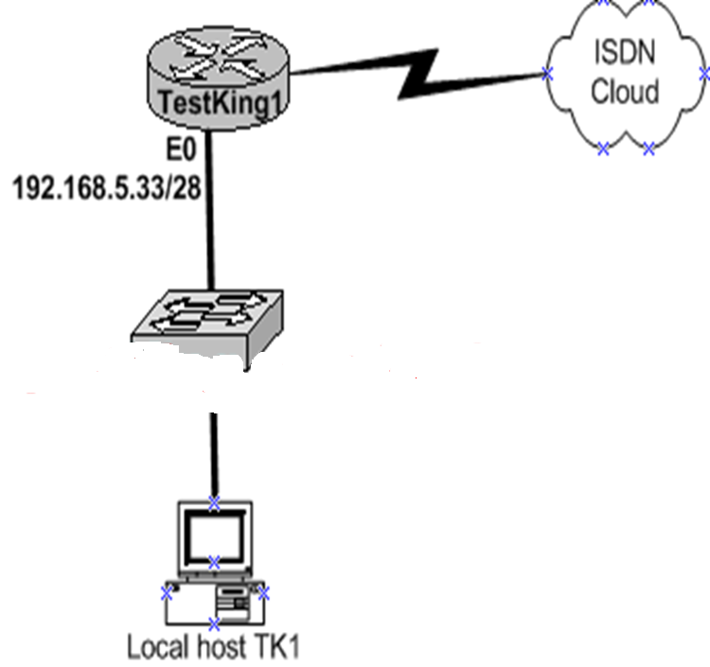
Example
As a network technician at TestKing you are required to troubleshoot the network shown in the exhibit.
The host, TK1, is connected to the TestKing1 LAN is unable to connect to resources on other networks. Assuming that host is configured as follows:
host address: 192.168.5.45
subnet mask: 255.255.255.240
default gateway: 192.168.5.32
Which of the following is the cause of this problem?
A. The default gateway is a subnetwork address.
B. The default gateway is on a different subnet form the host.
C. The host subnet mask does not match the subnet mask of the attached router interface.
D. The IP address of the host is on a different subnet than the default gateway.

Slide 39
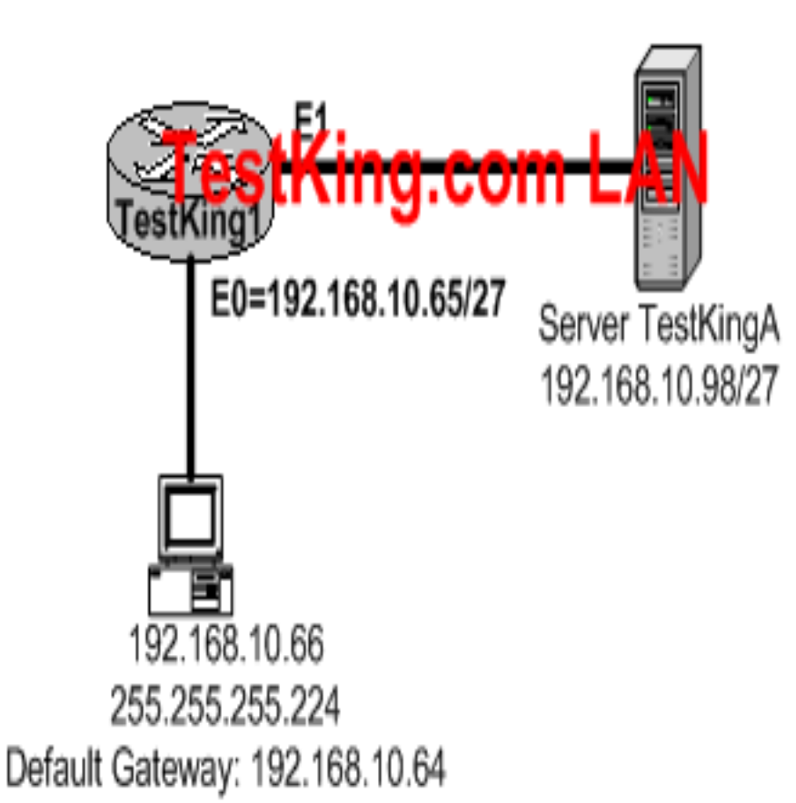
Company XYZ has just added an employee workstation to its network. The employee is unable to connect to the server TestKingA at IP address 192.168.10.98/27.
Identify the incorrectly configured
network parameter in the workstation configuration.
A. Workstation IP address
B. Workstation subnet mask
C. Workstation default gateway
D. IP address of the Ethernet 0 router interface

Slide 40
Another example
You are configuring a subnet on the CGS branch office in Berlin. You need to assign IP addresses to hosts in this subnet. You have been given the subnet mask of 255.255.255.224. Which IP address would be valid? (Choose three)
A. 15.234.118.63
B. 92.11.178.93
C. 134.178.18.56
D. 192.168.16.87
E. 201.45.116.159
F. 217.63.12.192

Slide 41
You work as a network technician at ABC. You are required to divide the 172.12.0.0 network into subnets. Each submit must have the capacity of 458 IP addresses.
Furthermore, according to the requirement you must provide the maximum number of subnets.
Which network mask should you use?
Answer: 255.255.254.0

Slide 42
You have subnetted the 210.106.14.0 network with a /24 mask. Your boss at TestKing wants to know how many usable subnetworks and usable host addresses per subnet this would provide. What should you tell her?
A. 1 network with 254 hosts
B. 2 networks with 128 hosts
C. 4 networks with 64 hosts
D. 6 networks with 30 hosts

Slide 43
You have segmented a network into two separate segments, segment 1 and segment2, with a Cisco router.
Your boss at TestKing is concerned about the cost, and wants to what the purpose of your action is.
What should you tell him?
A. It increases the number of collisions.
B. It decreases the number of broadcast domains.
C. It connects segment 1’s broadcasts to segment 2.
D. It prevents segment 1’s broadcasts from getting to segment 2.

Slide 44
Name resolution
The process of taking a hostname and finding the IP address is called name resolution.
Methods of name resolution the /etc/hosts file, and the Domain Name Service.
/etc/hosts is a text file with one line per host. Each line has the format
  IP_address hostname aliases

Slide 45
Example /etc/hosts file
# every machine has the localhost entry
127.0.0.1 localhost loopback
138.77.36.29 aldur.cqu.edu.au aldur
138.77.1.1 jasper.cqu.edu.au jasper
138.77.37.28 pol.cqu.edu.au pol

Slide 46
Domain name service (DNS)
The DNS is implemented as collection of inter-communicating nameservers. At any given level of the DNS hierarchy, a nameserver for a domain has knowledge of all the immediate sub-domains of that domain.
/etc/resolv.conf
  Most UNIX machines will check their /etc/hosts first for name resolution and then check with their name server.
  How does the machine know where its domain name server is. /etc/resolv.conf file.

Slide 47
/etc/resolv.conf
resolv.conf is a text file with three main types of entries
  # comments
  Anything after a # is a comment and ignored.
  domain name
  Defines the default domain. This default domain will be appended to any hostname that does not contain a dot.
  nameserver address
  This defines the IP address of the machines domain name server. It is possible to have multiple name servers defined and they will be queried in order (useful if one goes down).
    domain cqu.edu.au
    nameserver 138.77.5.6
    nameserver 138.77.1.1

Slide 48
The loopback device/interface
The loopback device is a special case. It is always present and is used to provide access to your own machine. 127.0.0.1

