Slide 1
Analysis on Indego Bike Dataset
By Gabe Klaris

Slide 2
Goal of the Project
Create an interactive application to analyze the trend and demand patterns of of Indego bike rentals at various docking stations and times within the City of Philadelphia. The goal was to display the popularity of bike rentals within certain regions and time slots. As a stretch goal, build and integrate a machine learning model to predict the availability of an Indego bike for the next 24 hours at a user specified location.

Slide 3
Business Outcome
Based on the data shown by the application, a user will be able to tell if a station is likely to have a bike available for when they want to rent a bike. This would increase customer satisfaction as a user could use the app to predict that there would be no bikes available when they want one, and go to another location. This would remove a possible worry of the customer about whether there will be a bike available for them when they need one. This would also inform the company who runs the stations (Indego) at what times and location there is a lot of bikes being taken out or a lot of bikes being docked. They can use this data to allocate their resources better i.e move bikes from a location with a lot of bikes being docked, to a location with a lot of bikes being taken out..

Slide 4
Trip Dataset
The application uses trip data from indego bike stations around the city found here: https://www.rideindego.com/about/data/
From the Dataset I used the files from 2021 q1, 2020 q2 and 2019 q2 and columns:
start_time, end_time, start_station, start_lat, start_lon, end_station

Slide 5
Realtime website
The Application also uses data from a real time website
This website contains data from each station that includes:
The amount of bikes, classic bikes, electric bikes, and docks available
It is found here: https://kiosks.bicycletransit.workers.dev/phl
This data is pulled from the website and displayed on the map

Slide 6
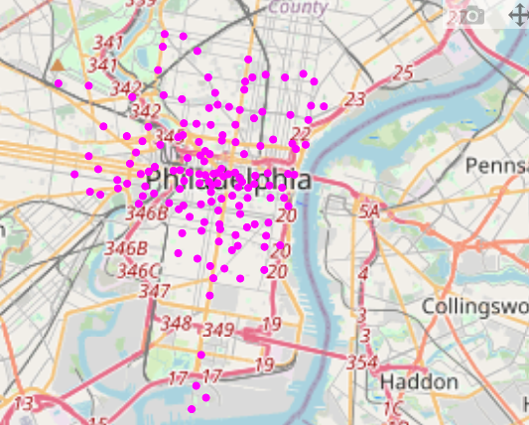
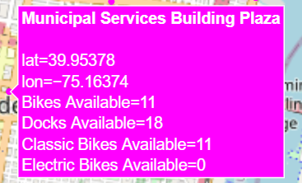
Application Map
Map of all stations: Hover Information:

Slide 7
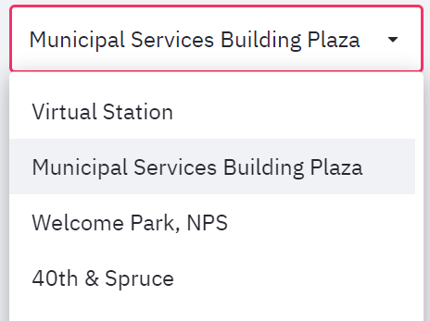
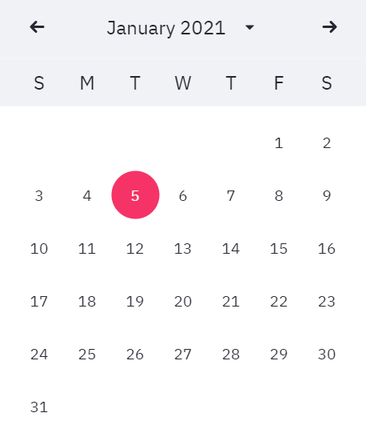
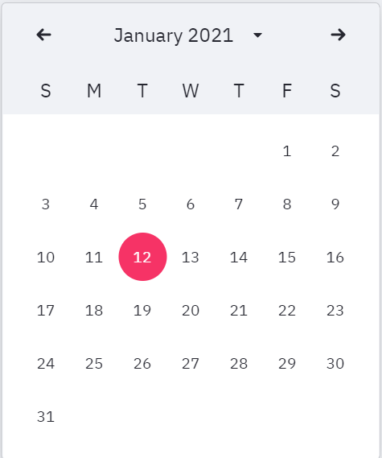
Trip data in a date range
Location: Start date: End Date:

Slide 8
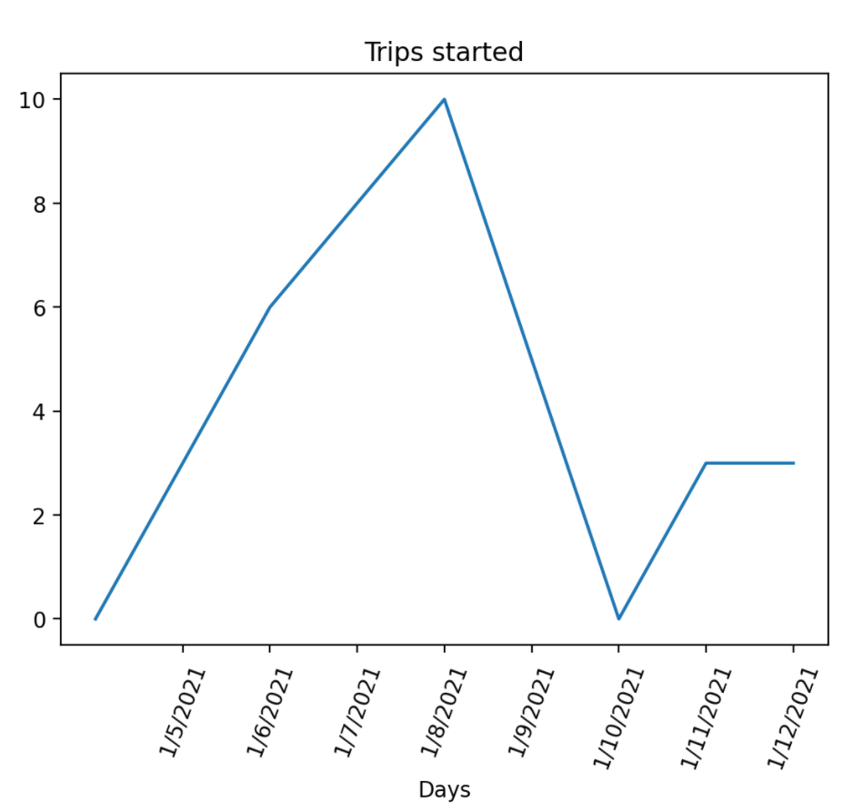
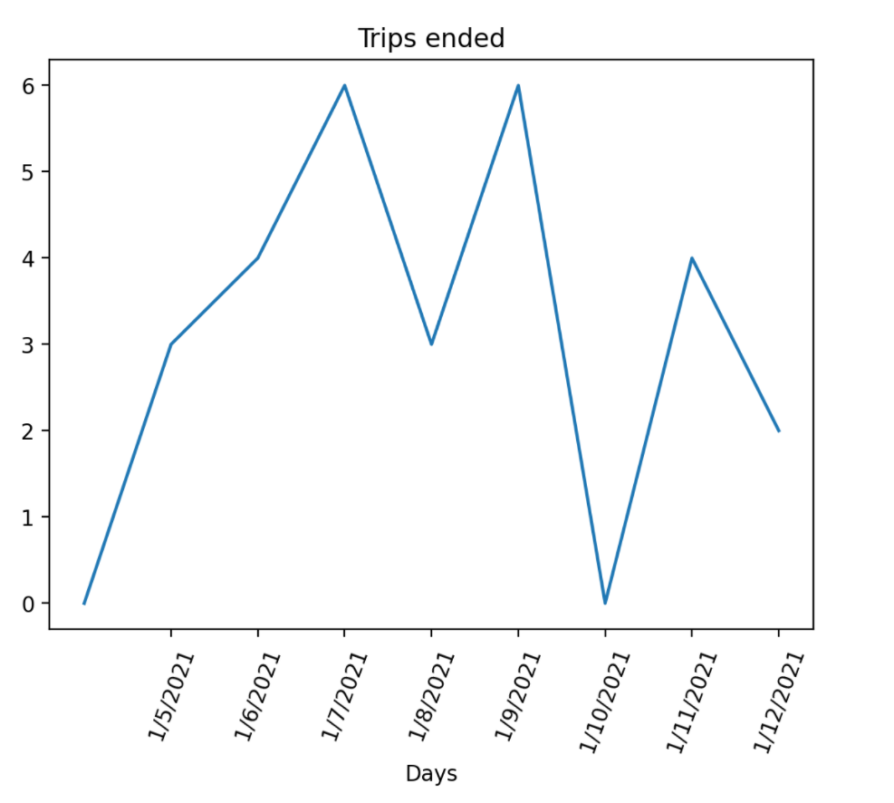
Trip data in date range graphs:
Based on selected Date Range and location, the application shows two graphs.
The x axis of these graphs is each date within the range and the y axis the number of trips started/ended

Slide 9
Data processing
Takes each trip that ends or starts at the selected station (checks start_station or end_station)
Gets the number of trips that occur on the first day during the selected date range using the list of trips at a station and start_time, end_time
The number of trips started/ended on each day is displayed as the line in the chart

Slide 10
Usage of date range graph:
How active the station is for taking out or docking a bike
Shows change in activity of the station over the date range

Slide 11
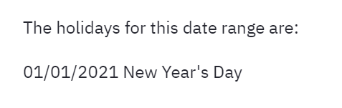
Holidays
In the area above the graphs, the application will display each holidays within the date range
If the date range includes the first of January, the application would show:
If the date being shown in a half-hour chart is a holiday, the holiday name will be displayed below the graph.

Slide 12
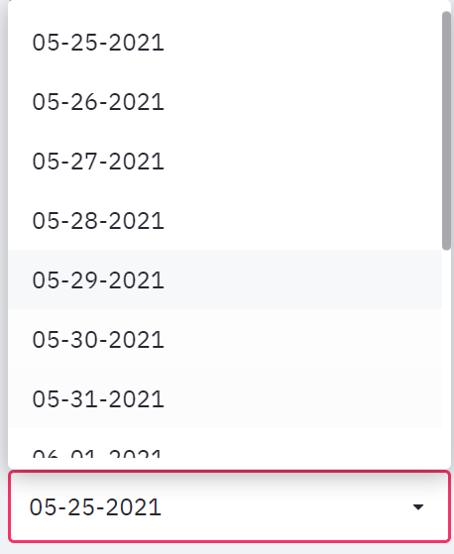
Getting past data based on a future date
Selecting a future date:
(The user can select a date in the following two weeks from the current date.)
Same location:

Slide 13
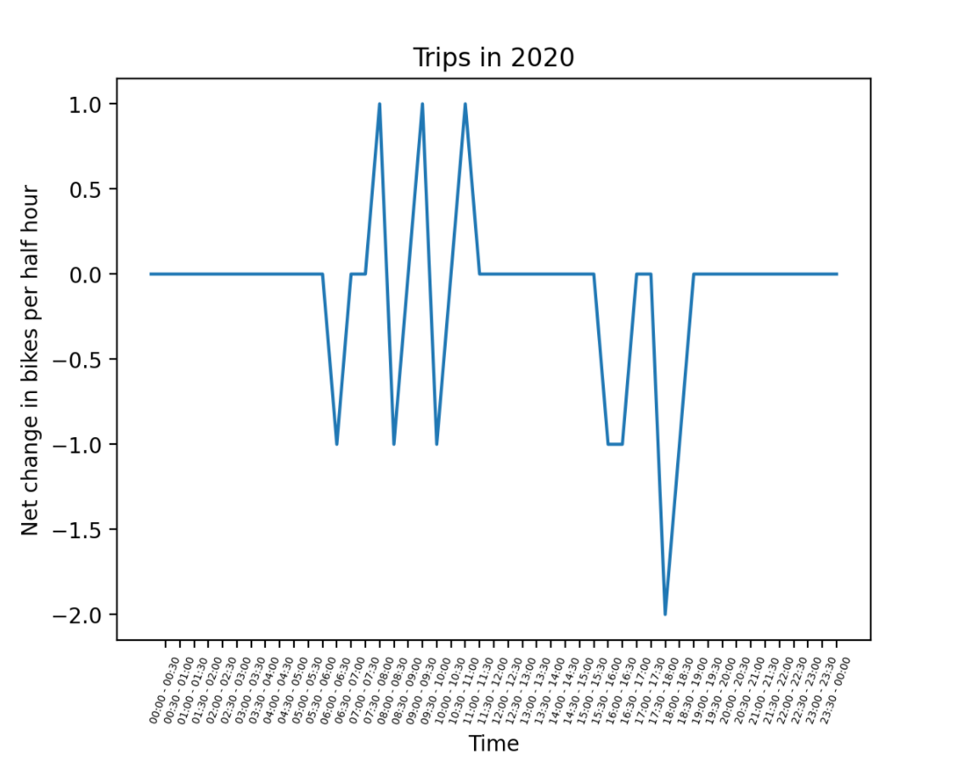
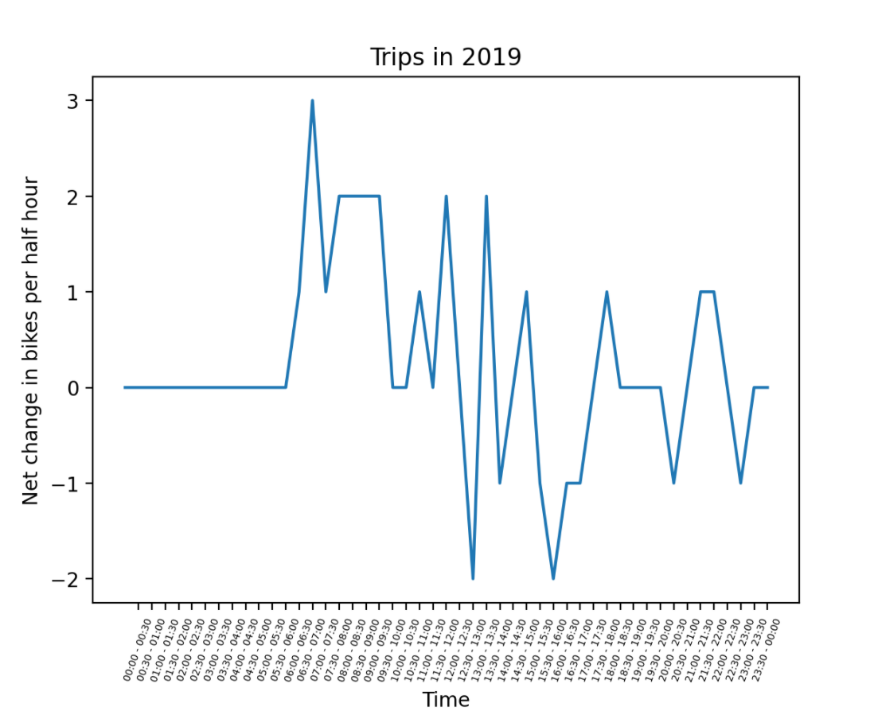
Half-hour data for 2020 and 2019
Based on the date you select, the application will display data for the corresponding day in 2020 and 2019 based on day of the week.
2020 graph based on Location and Date selection:
2019 graph based on location and date selection:
For example if you select Tuesday, 5/25, the graph generated for 2020 will show data from Tuesday 5/26 and 2019 will show Tuesday, 5/28.

Slide 14
Data processing
Trip Data is pulled from q2 of 2020 and 2019
The trips for each half hour is narrowed down using the start_time and end_time of the trip
To calculate the net change the trips started during the half-hour is subtracted from the trips ended.

Slide 15
Usage of half-hour data
Determine which half-hour periods are popular for returning/taking out bikes
Predict net change of bikes in the same half-hour period on the selected day (can be used with the map data to predict the amount of bikes left).

Slide 16
Future directions
Using past demand data to predict the future probability of getting a bike
Tracking weather influence on daily bike activity
Including all available data (from 2015)

Slide 17
Questions?

