Slide 1

Tetris game playing AI using static evaluation function
Gabe Becker

Slide 2
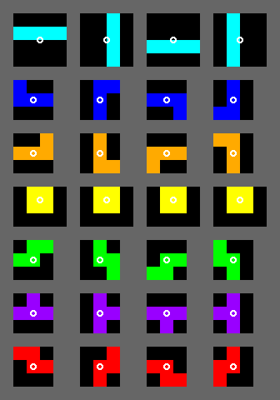
The game
Tetris is a video game where a 4-block piece, called a tetromino, falls at a constant rate from the top of a 10x 20 grid until it touches the bottom of the grid or another block
When a row is full it disappears and all rows above it move down
There are 7 different types of tetrominos, and it is random which one will appear
You can do 3 things with a tetromino:
Move it left
Move it right
Rotate the piece

Slide 3
A quick aside..
Real Tetris uses a scoring system based on points
For example: clearing 3 lines with 1 move is worth more points than clearing 3 lines over 3 moves
This Tetris AI does not focus on points
Too complicated to implement
Instead, I focused on clearing as many lines as possible and surviving for as long as possible
Strategy: If the AI can survive forever, it will score more points

Slide 4
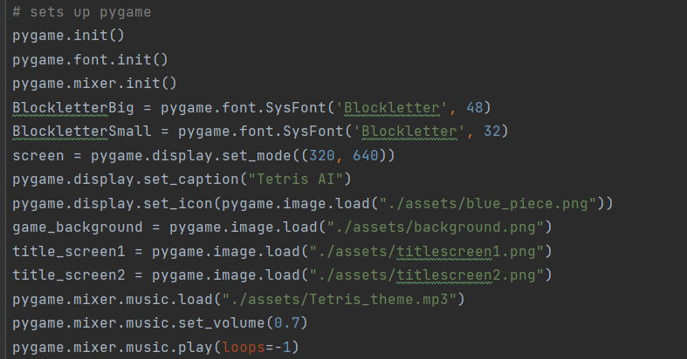
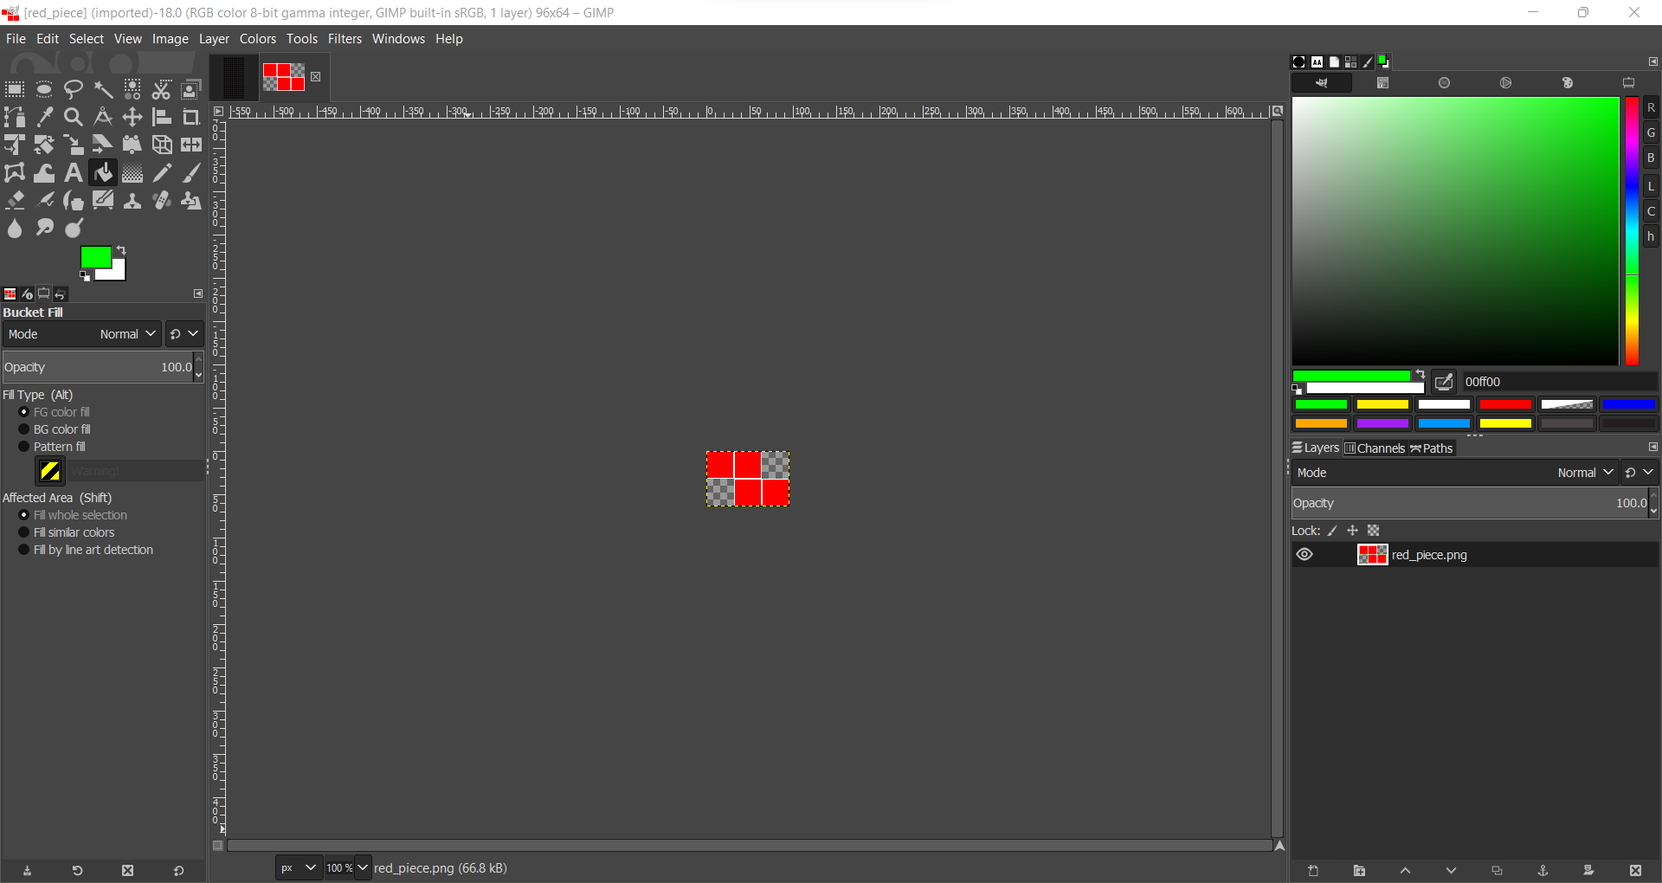
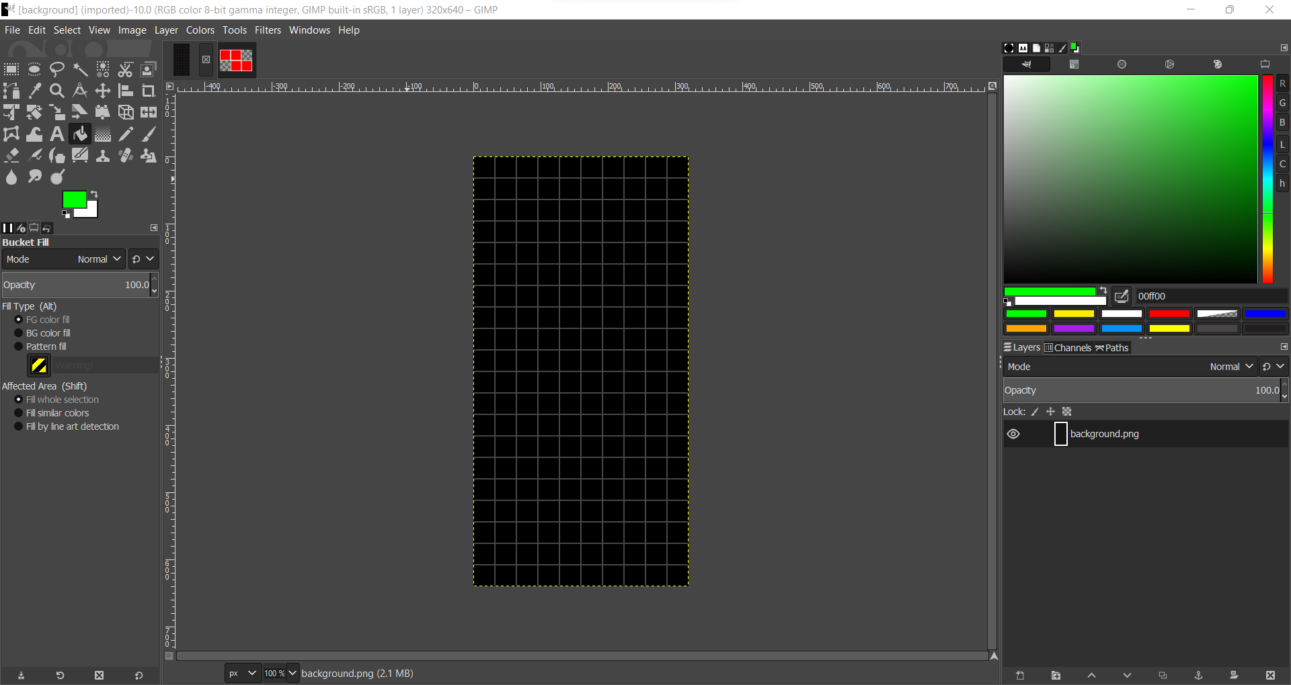
Making the game
All texture assets made in Gimp
10x20 grid
Each square is 32x32 pixels
320x640 pixels
Tetris theme A – GBA
Clear line sound effect – NES
Game made in Python 3 with pygame

Slide 5
Making the evaluation function

Slide 6
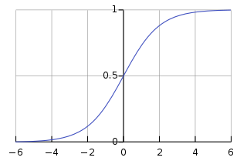

Using the Sigmoid function
By modifying this function and using information from the board, we can create an evaluation function

Slide 7
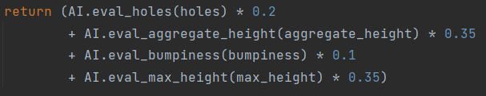

the function
$$E\text{(}\text{board}\text{)}=w_{1}A+w_{2}B+w_{3}C+w_{4}D$$
Where:
$A$, $B$, $C$, $D$ are modified Sigmoid functions that represent an attribute of the board, each of which are evaluated between 0 and 1
$A$ – Holes
$B$ – Aggregate Height
$C$ – Bumpiness
$D$ – Max Height
$w_{1}$, $w_{2}$, $w_{3}$, $w_{4}$ are “weights” where $0<w_{i}<1$ and $\sum{w_{i}=1}$
This makes it so $E$ is between 0 and 1, where 0 is the worst position and 1 is the best position

Slide 8
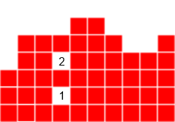
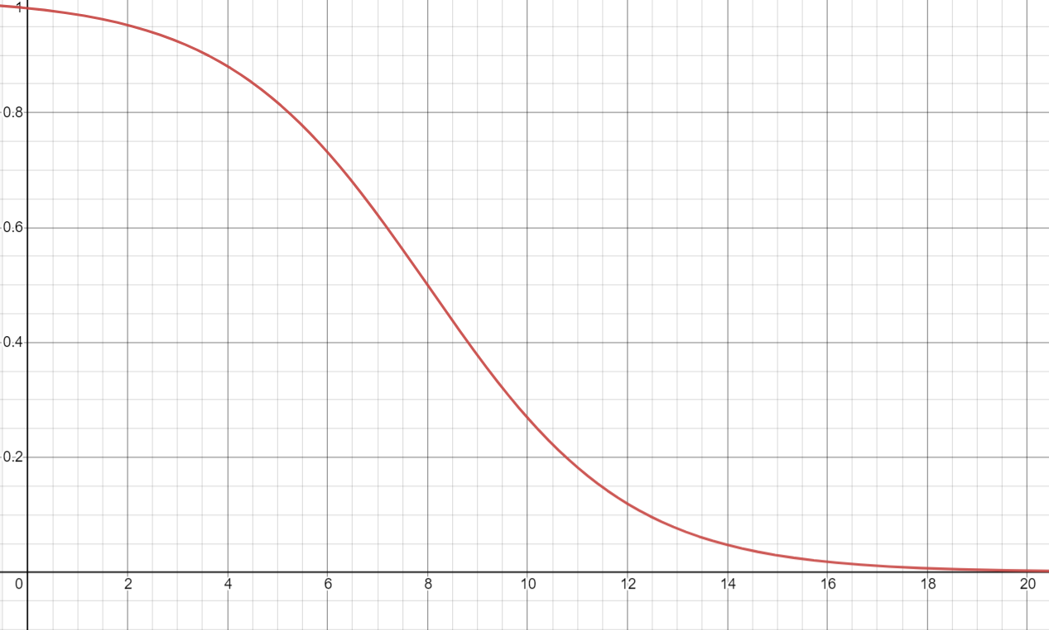
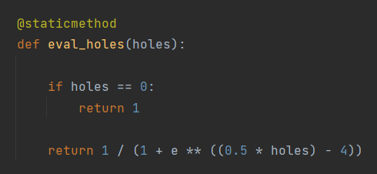

Holes (x = number of holes)
$$A=S\left(−0.5x+4\right)=\frac{1}{1+e^{0.5x−4}}$$
0 holes - 1
8 holes – 0.5
20 holes – basically 0
$w_{1}=0.2$

Slide 9

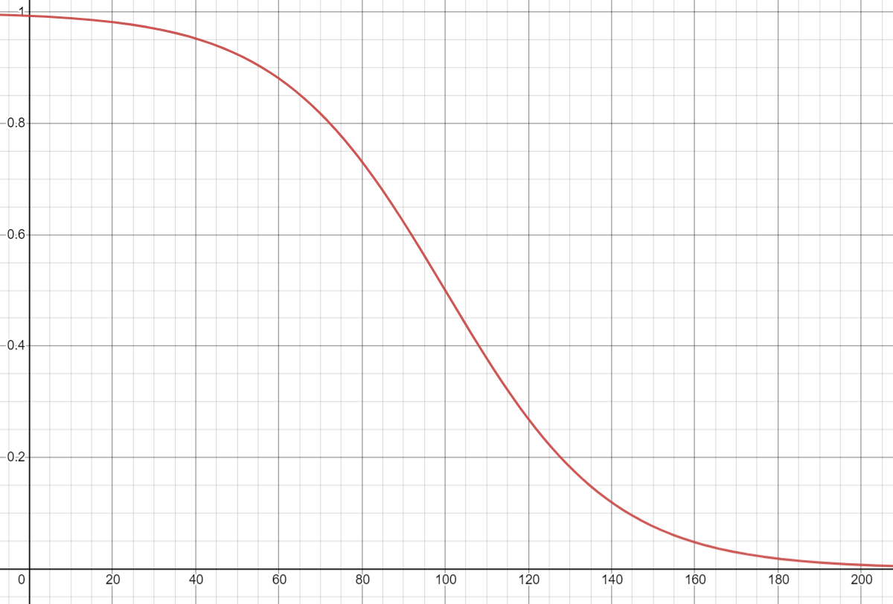
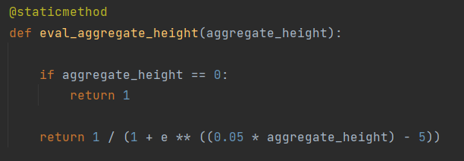

Aggregate Height (x = sum of all column heights)
$$B=S\left(−0.05x+5\right)=\frac{1}{1+e^{0.05x−5}}$$
0 aggregate height - 1
100 aggregate height – 0.5
200 aggregate height – basically 0
$w_{2}=0.3$5

Slide 10
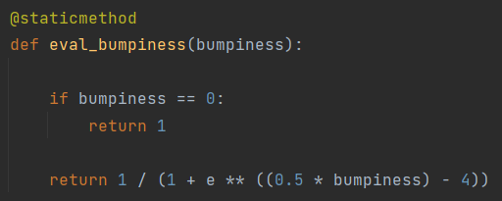

Bumpiness (x = sum of absolute differences between adjacent column heights)
$$C=S\left(−0.5x+4\right)=\frac{1}{1+e^{0.5x−4}}$$
0 bumpiness - 1
8 bumpiness – 0.5
20 bumpiness – basically 0
$w_{3}=0.1$

Slide 11
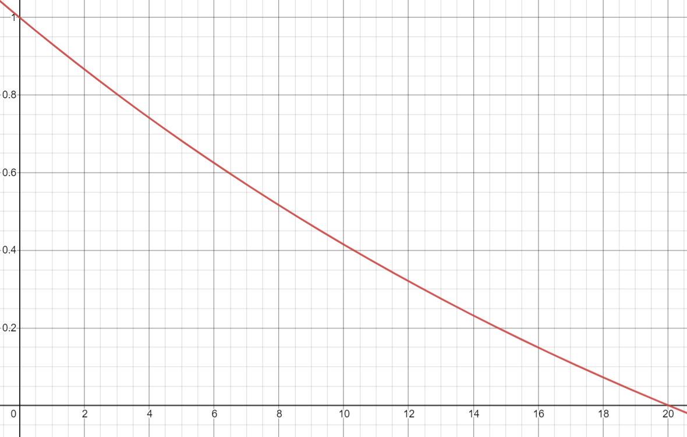
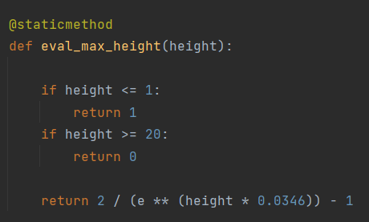

Max Height (x = highest column height)
$$D=\frac{2}{e^{0.0346x}}−1$$
0 max height - 1
8 max height – ~0.5
20 max height – 0
$w_{4}=0.35$

Slide 12
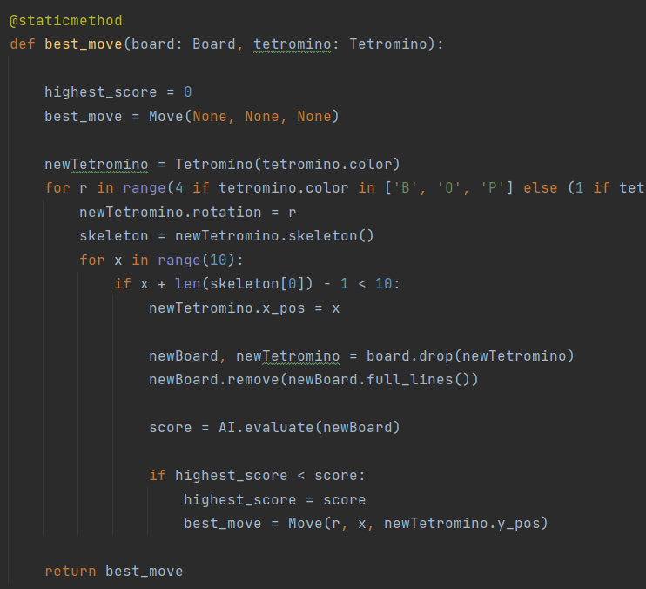
How do we to use this?
First, we loop through possible rotations and placements of the tetromino, and simulate “dropping” the piece
Next, we calculate the evaluation of the board given the tetromino placement
We then choose the placement of the tetromino that gives the best evaluation score
Finally, we convert the best move into actions (rotation x time, move left, move right) and execute the actions

Slide 13
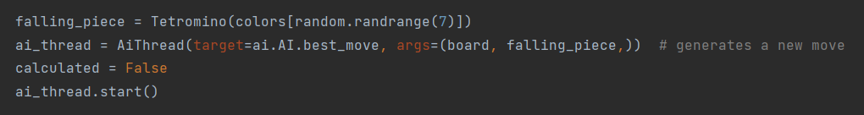
Multithreading
To prevent blocking while deciding the best move, multithreading is used
The main thread continues to drop the piece while a child thread calculates the move
In retrospect, probably not needed (evaluation function is lightning fast)
Approximately 0.0003 seconds per evaluation
Really hard to measure because it’s so fast

Slide 14
So, does it work???

Slide 15
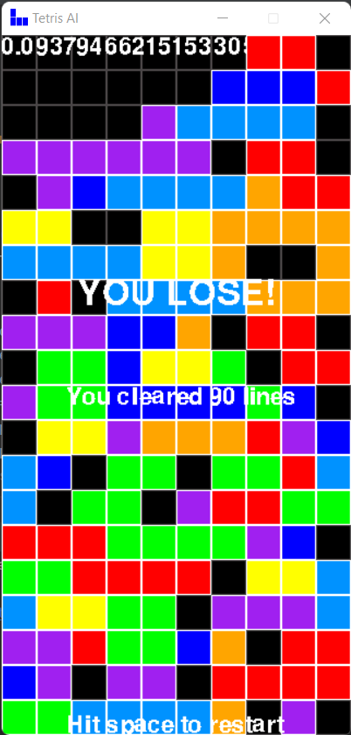
It’s pretty good!
Clears ~23 lines per game
Better approximation: 20-30 lines per game
Highest amount achieved: 90
Making a good evaluation with only “pencil and paper” mathematics is very difficult
Using machine learning to change the values of weights and functions is definitely the way to make a proper Tetris AI
This doesn’t mean the project was a failure – the AI can make decisions usually clear some lines
I’d describe it as a slightly less-than-average Tetris player and better than a first-time human Tetris player
It makes decisions way faster than the average human, meaning it can play much faster
I also learned a lot about creating and using a static evaluation function, which is a success in its own way

