Slide 1
LA LIGA
Player Performance
Analytics
Explaining Goal Scoring Through Data
556
62
3
81.8%
Players analyzed
Variables tracked
Research questions
Model R² (Q1)
Lenoir-Rhyne University | Men’s Soccer | Business Analytics

Slide 2
Agenda
01
Dataset Overview
La Liga player stats — 556 players, 62 variables, one season
02
Research Questions
Three analytical questions guiding our investigation
03
Q1 — Goal Scoring Predictors
Which metrics most strongly influence goals? (Completed)
04
Q2 — Playing Time vs Efficiency
Opportunity or quality? Per-90 analysis
05
Q3 — Team Playing Styles
Collective play vs individual stars
06
Key Findings & Recommendations
Business insights for club decision-making

Slide 3
Dataset Overview
La Liga Player Performance Statistics
Volume metrics
One full La Liga season of competitive match data
Individual player-level (one row = one player)
556 total observations across all positions
62 variables: offense, defense, passing, discipline
Source: Official La Liga match statistics
Minutes, games played, starts
Offensive output
Goals, assists, shots on target
Style indicators
Dribbles, pass types, crosses
Data Limitation
Single season only. No salary, transfer value, or tactical data. Players under 500 minutes filtered out to reduce small-sample noise (Q1).
Disciplinary
Yellow/red cards, fouls

Slide 4
Our Three Research Questions
Each question investigates a different dimension of La Liga performance
Q1
COMPLETED
What player metrics most strongly influence goal scoring?
Regression analysis: shots on target, dribbles, assists tested as predictors of goals. R²=0.818.
Q2
IN PROGRESS
Does more playing time lead to higher output, or are some players more efficient?
Per-90 minute analysis separating volume players from genuinely elite performers.
Q3
IN PROGRESS
How do team playing styles differ — collective vs individual stars?
Team-level aggregation comparing passing vs dribbling sides, and goal concentration ratios.

Slide 5
Q1 — Step 1: Data Preparation
Before any analysis, two cleaning steps were applied to ensure reliable results:
01
Fixed the Minutes Played column
The raw CSV used a non-standard decimal separator (European format). Commas were replaced with periods in Excel using Find & Replace to convert the column into a usable numeric format.
02
Filtered out low-minute players
Players with fewer than 500 minutes were excluded. A player scoring 1 goal in 50 minutes is a statistical outlier. Filtering to 500+ minutes ensures findings reflect consistent, full-season performance rather than small-sample noise.
Result: A clean dataset of qualifying players ready for Tableau visualization and regression analysis.

Slide 6
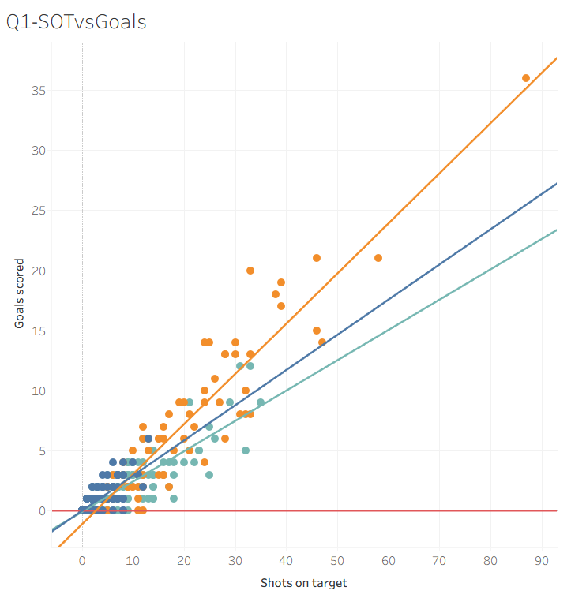
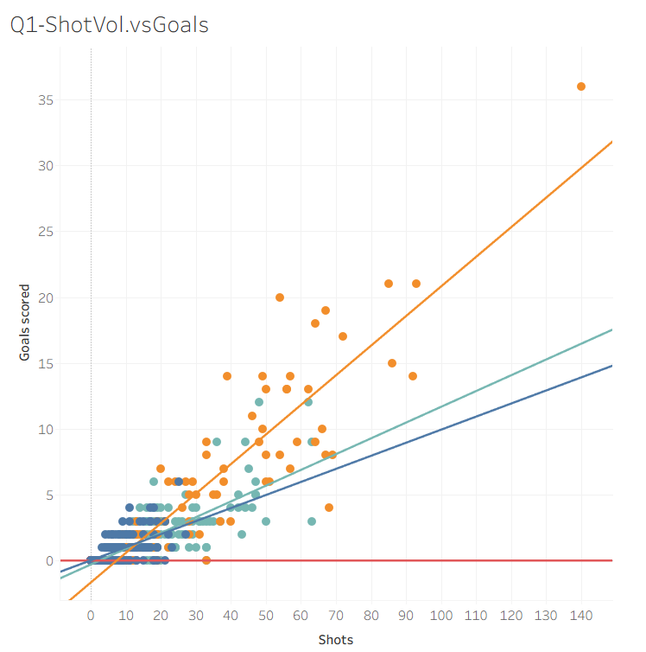
Q1 — Step 2: Tableau Visualizations
Scatter: Shots on Target vs Goals
Scatter: Total Shots vs Goals
[ Insert Tableau scatter plot here ]
[ Insert Tableau scatter plot here ]
Each dot = one player. Trend line + R² shown.
Forwards cluster top-right. Clear positive relationship.
Same layout, different X axis.
Compare R² here vs shot quality chart — quality wins.
Key Takeaway
La Liga clubs should not evaluate attackers on total shots alone. A player with 40 shots on target is more valuable than one with 100 total shots at low accuracy. Shot quality is the metric that matters."

Slide 7
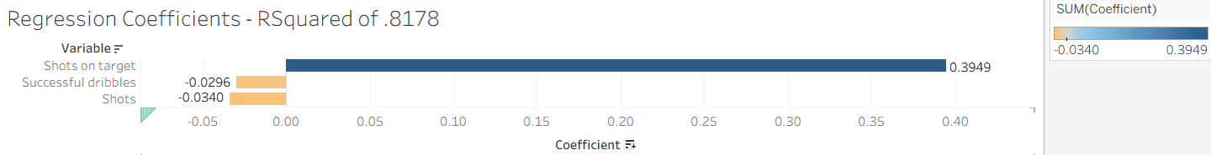
Q1 — Regression Results
Multiple linear regression: Goals ~ Shots on Target + Total Shots + Successful Dribbles + Assists
R² = 0.818
Model explains 81.8% of
variance in goal scoring
Shots on target (+0.395) | Shots (−0.034) | Successful dribbles (−0.030)
Variable | Coefficient | P-value | Verdict
Shots on Target | +0.395 | ≈ 0 (E-39) | Strongest predictor
Total Shots | −0.034 | 0.020 | Significant — negative
Successful Dribbles | −0.030 | ≈ 0 (E-08) | Significant — negative
Assists | +0.061 | 0.204 | Not significant — excluded

Slide 8
Q1 — Key Finding
"Shot quality beats shot quantity. Every additional shot on target predicts 0.395 more goals — while taking more total shots without accuracy slightly hurts performance."
For clubs signing attackers
Dribbling is not the answer
Model strength
Prioritize shot accuracy over total attempts. A striker with 40 shots on target outperforms one with 80 shots at low accuracy.
Higher dribble frequency correlates with fewer goals — excessive ball retention reduces time in shooting positions.
R²=0.818 confirms these metrics genuinely capture goal-scoring ability, not random variation or luck.

Slide 9
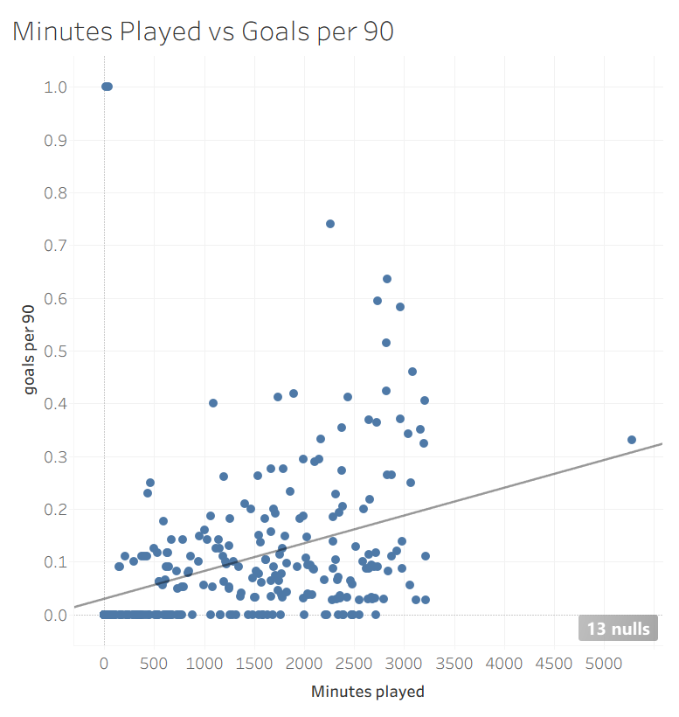
Q2 — Playing Time vs Efficiency
Research Question:
"Does more playing time lead to higher attacking output, or are some players more efficient than others?"
Minutes VS Goals per 90
Based on the La Liga player data, more playing time does not necessarily lead to higher attacking output. While players with more minutes generally accumulate more total goals and assists, this relationship is largely driven by opportunity rather than efficiency.
Each dot = one player
Quadrant analysis identifies super-subs
(high output, low minutes — top-left)

Slide 10
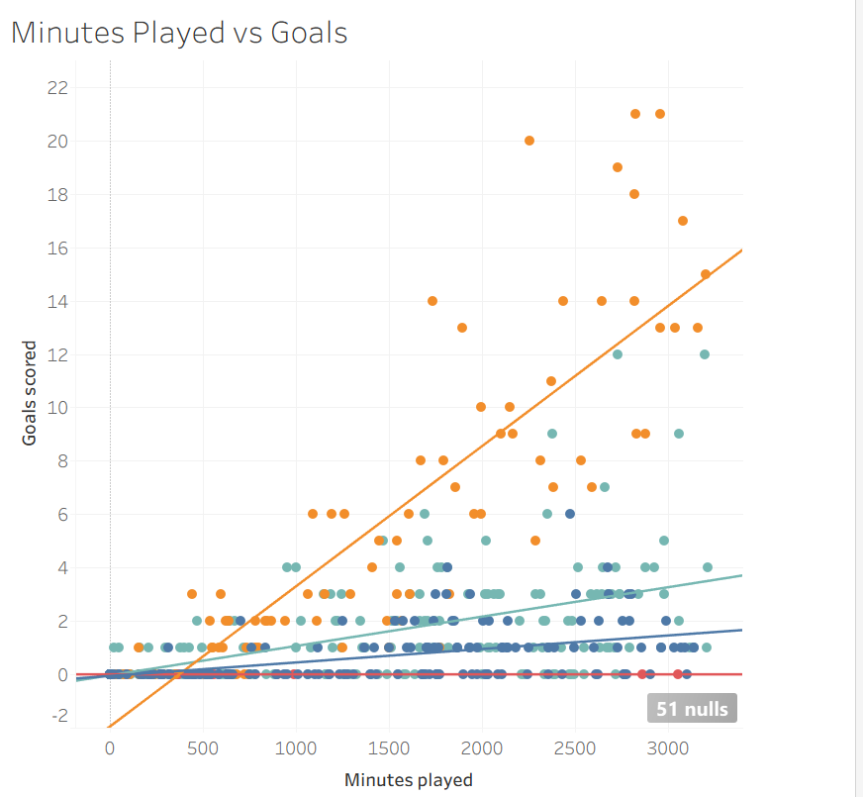
Q2 - Does more playing time lead to higher attacking output, or are some players more efficient than others?
Chart 1

Slide 11
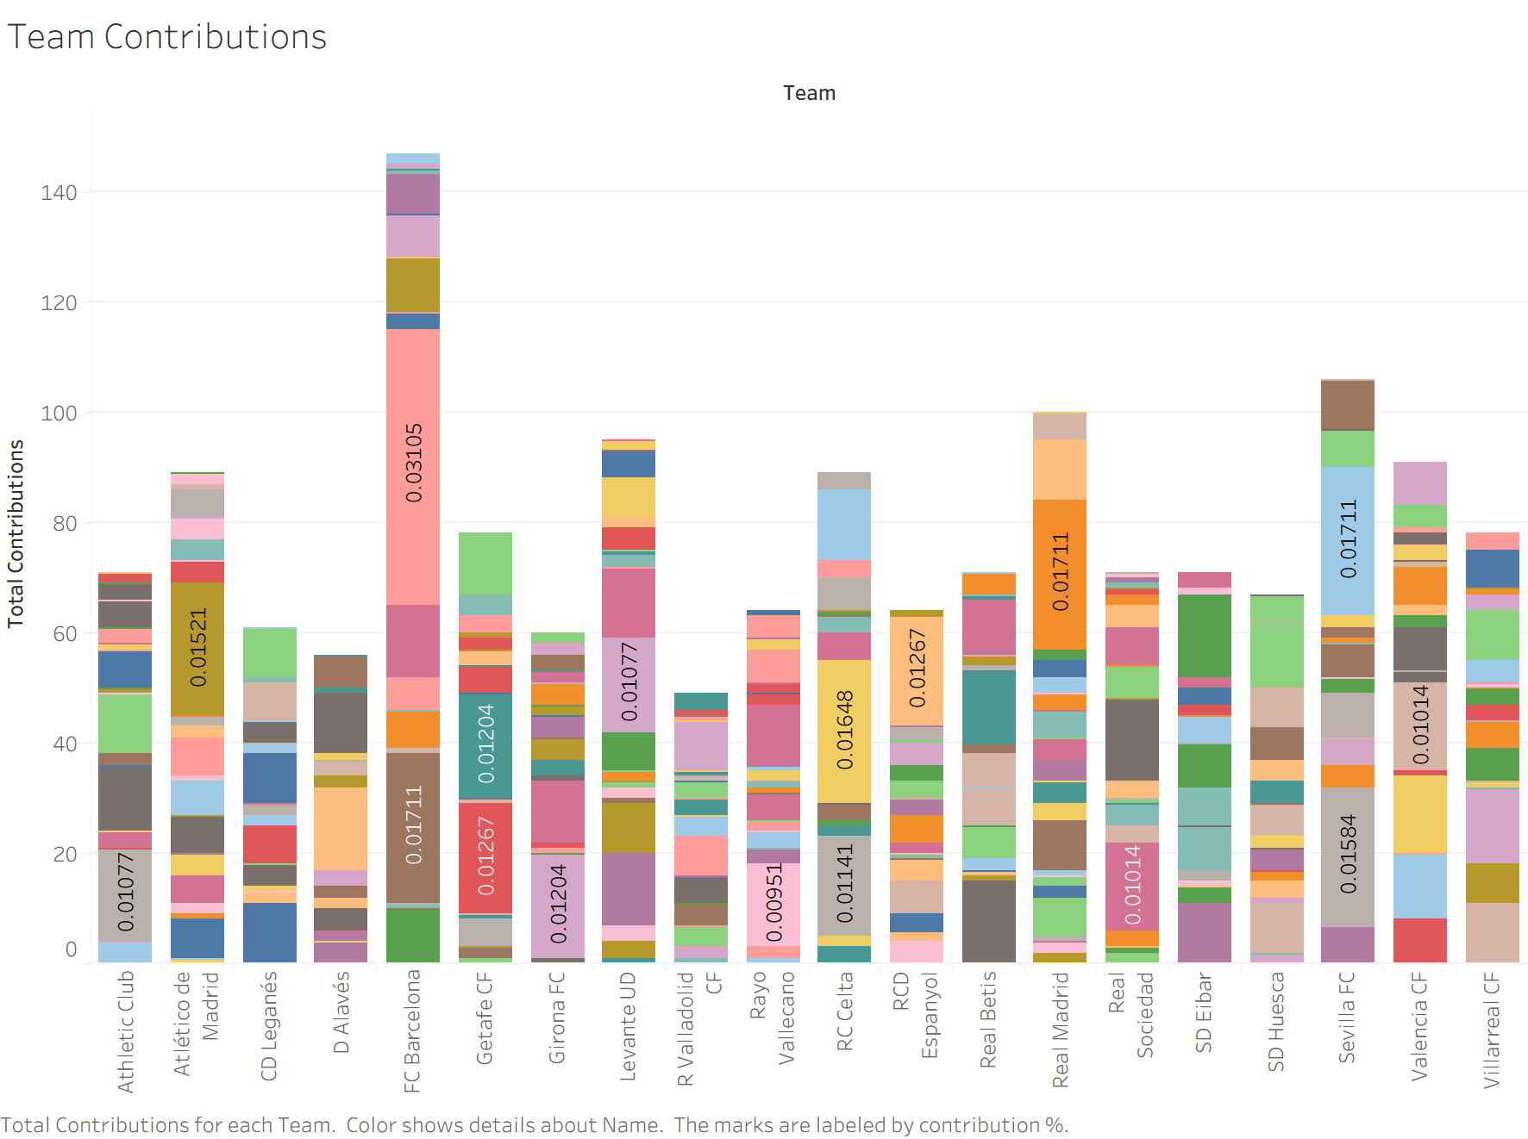
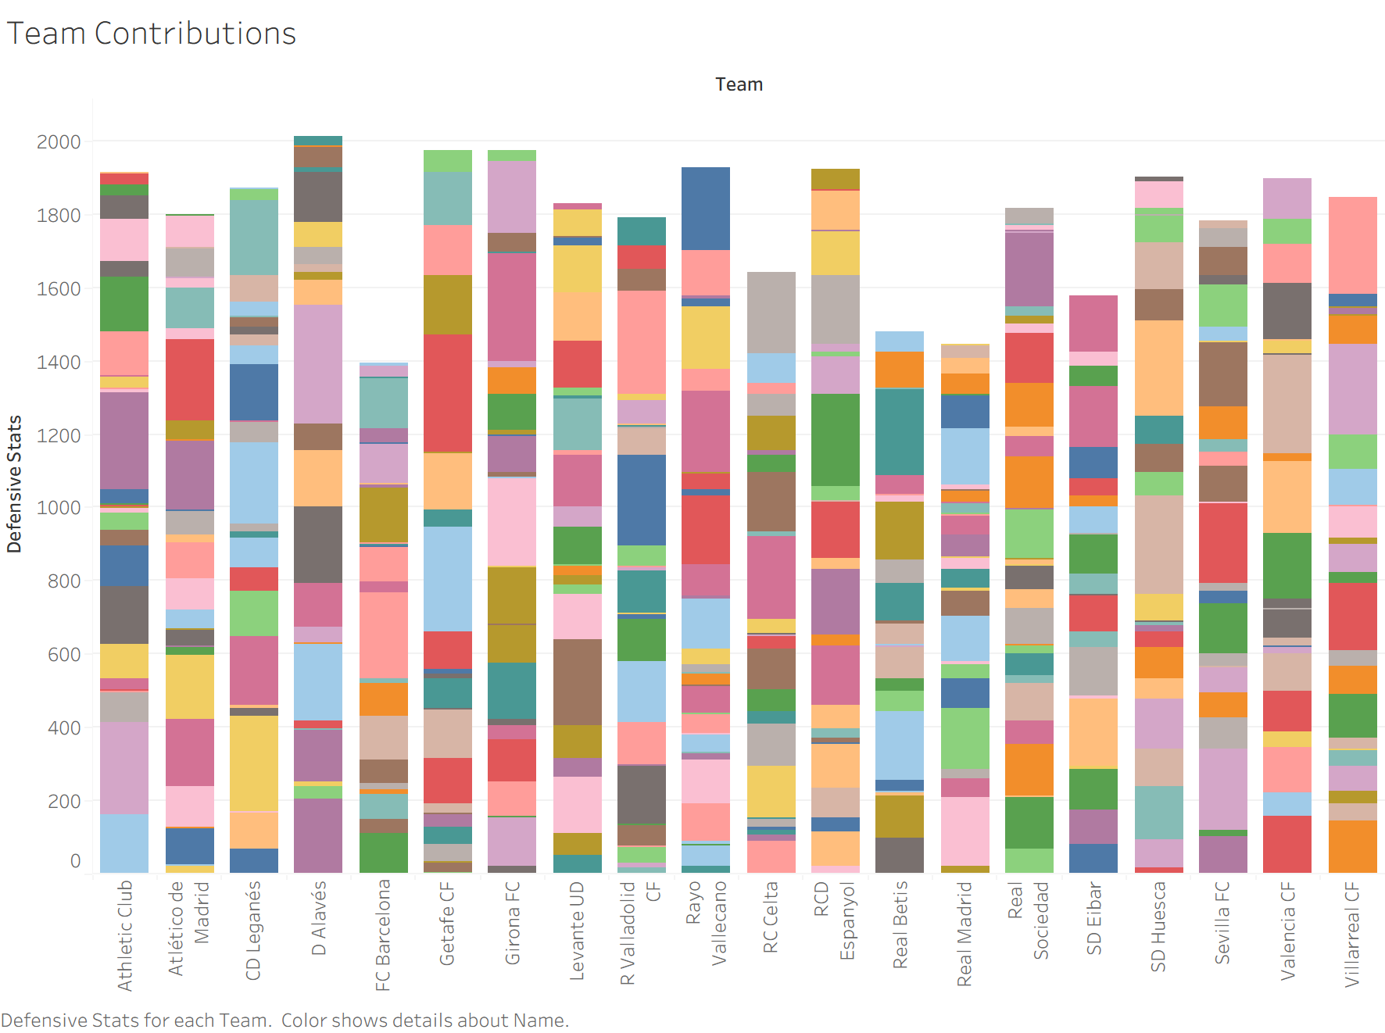
Q3 — Team Playing Styles
Research Question:
"How do team playing styles differ, and which teams rely more on collective play versus individual stars?"
Stacked bar — Offensive Contributions
Stacked bar – Defensive Contributions
Star dependent teams have one dominant color slice
Collective teams show many thin slices
Some teams show a high concentration of contributions from one or two players, indicating a reliance on individual stars. In these cases, a large portion of the team’s goals and assists come from a single player, highlighting a more centralized attacking structure. While in the defensive case teams with less offensive output typically have evenly spread defensive contributions

Slide 12
Key Findings & Business Recommendations
Q1 — Confirmed
Shot accuracy (shots on target) is the dominant predictor of goal scoring (coeff. +0.395, R²=0.818). Clubs should scout and value shot accuracy over raw shooting volume when evaluating attacking players.
Q2
Q3
Clubs such as FC Barcelona & Real Madrid have extremely high attacking input while having low defensive contributions. This is in large due to highly key central players making major contributions for the team while other teams represent evenly structured contributions. In contrast, other teams display a more even distribution of defensive contributions across multiple players, including midfielders and even forwards. This reflects a more collective defensive approach, where pressing and defensive responsibility are shared throughout the team.
Overall: Data analytics can directly inform La Liga club recruitment, training priorities, and tactical planning.

Slide 13
Thank You
Questions?
Dataset: La Liga Player Performance Statistics | 556 players | 62 variables
Lenoir-Rhyne University
Fritz Honors College | Business Management & Entrepreneurship
Analysis completed using Tableau, Excel Regression (R²=0.818), and La Liga player data.

