Slide 1
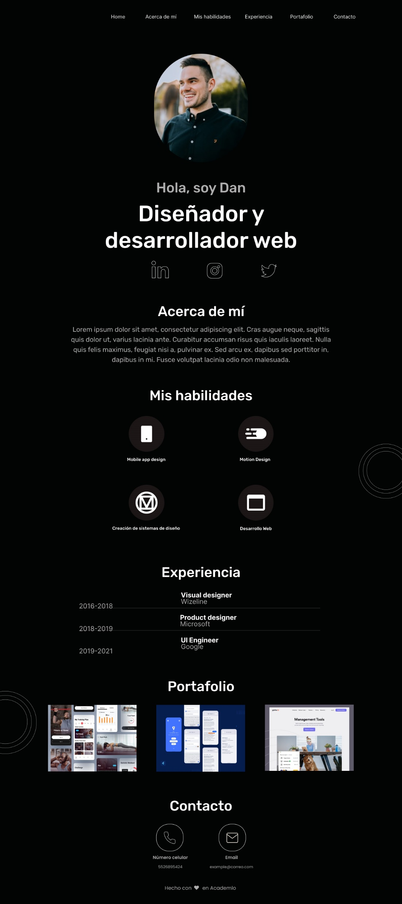
Dimensiones
Desktop
1440px – 3232px

Slide 2


Slide 3
