Slide 1
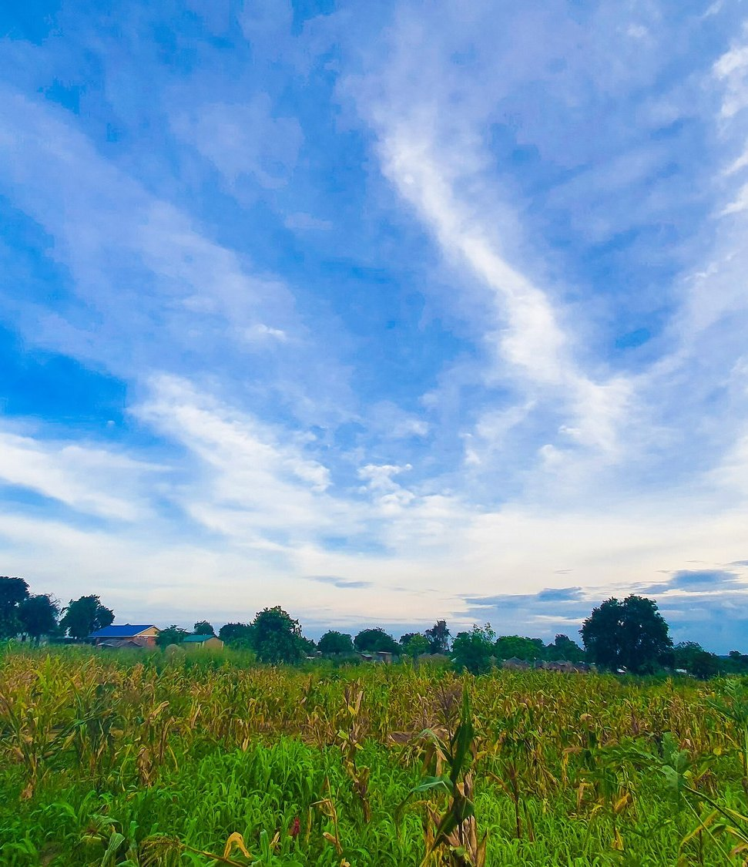


GREEN SOLUTIONS GROUP
REPUBLIC OF SOUTH SUDAN
Juba · 2026
Sorghum, maize, cassava and vegetables in a country of floods and dry spells.
Where hydro-retention helps, and where drainage must come first.
ECOSORB® · ECOFERT® · NAPEMA® · PAULOWNIA
September 2026 · Confidential · For the sole use of the recipient

Slide 2
THE MARKET IN BRIEF
A farming country that cannot yet feed itself
≈ 80 %
≈ 4 %
≈ 25 %
≈ 7.7 M
of households depend on crops or livestock
of the land area is cultivated
cereal deficit after the 2024 harvest
people projected in acute food insecurity (IPC)
South Sudan combines vast arable land, large herds and the White Nile system, yet most production is rain-fed, small-scale and exposed to conflict, poor roads and repeated floods. Oil still provides the large majority of export earnings.
Green Solutions · South Sudan market dossier
1

Slide 3
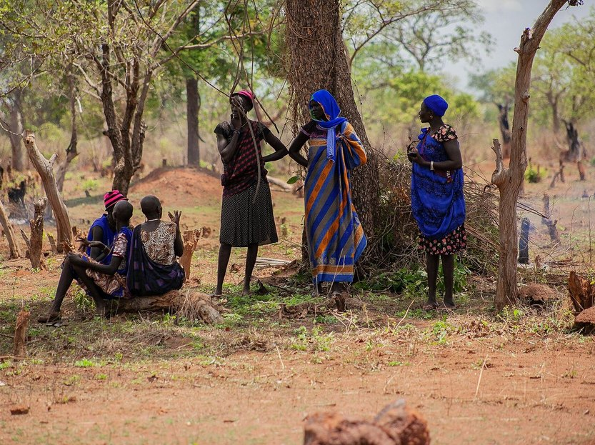
THE CONSTRAINT
Too much water in some places, too little in others
The Greenbelt of Western and Central Equatoria has a long rainy season, while the east and north face shorter rains and dry spells.
The Sudd wetland and the northern flood plains stay inundated for months: several years of major floods have displaced families and destroyed crops.
Most farming is rain-fed on small plots worked by hand, with little access to seed, fertiliser or extension services.
Poor roads cut markets off in the rainy season, and Juba relies heavily on food trucked in from neighbouring countries.
Water retention only makes sense on well-drained, drought-exposed plots. On flood-prone land, drainage and raised planting come first.
Green Solutions · South Sudan market dossier
2

Slide 4
DROUGHT AND WATER STRESS
Pressure is rising, but risk remains local
Two indicators, not a shortcut
Worldwide, the number and duration of droughts have risen by 29% since 2000 compared with the two previous decades.
Water stress measures something different: withdrawals as a share of renewable resources available after environmental needs. This global signal is therefore not a country forecast; it must be read alongside local rainfall, aquifers, seasons and uses.
Green Solutions · South Sudan market dossier
3

Slide 5
THE FOOD BALANCE
Local cereal output covers about three quarters of needs
What this implies
The gap of roughly 25 % is filled by imports from neighbouring countries and by food assistance.
Every tonne produced locally on a reliable basis replaces a trucked-in tonne whose price rises with fuel costs and insecurity.
Green Solutions · South Sudan market dossier
4

Slide 6
ECONOMY AND FOOD SECURITY
An oil economy where most people live from the land
≈ 90 %
≈ 12 M
2011
of export earnings come from oil
inhabitants, most of them in rural areas
independence, with agriculture named a priority for diversification
Imports, humanitarian assistance and trade with Uganda, Kenya and Sudan fill much of the gap between local output and needs. Every stable gain in local production, storage and transport reduces exposure to price shocks and supply interruptions.
Green Solutions · South Sudan market dossier
5

Slide 7
THE MAIN CROPS
Sorghum dominates the cereal area
Reading
Sorghum is grown almost everywhere and underpins household food security.
Maize and cassava lead in the Greenbelt of Western Equatoria, where rainfall and soils respond best to improved practices. Shares are rounded orders of magnitude.
Green Solutions · South Sudan market dossier
6

Slide 8
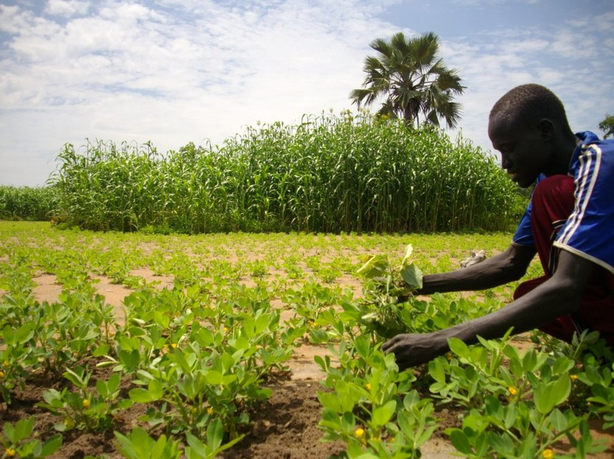
LEADING SECTOR
Maize and cassava: the Greenbelt opportunity
Western Equatoria has the rainfall, soils and season length to supply Juba and regional markets.
Controlled trials near Yambio and Nzara reached 4.7 t/ha of maize with nitrogen and phosphorus, against 2.9 t/ha on control plots.
Cassava is the resilience crop: it stays in the ground through bad years and feeds households between harvests.
Roads, storage and processing, more than rainfall, decide whether a surplus reaches a market.
EVERGREEN® and ECOFERT® are to be trialled on drained plots exposed to dry spells, against an untreated control.
Green Solutions · South Sudan market dossier
7

Slide 9
OUR RESPONSE
Two technologies, for drained land under dry spells
EVERGREEN® — holding the water
ECOFERT® — feeding without depleting
A potassium-based hydro-retainer placed in the root zone of drained, drought-exposed plots.
It captures rain and releases it back to the plant gradually, bridging dry spells at emergence and flowering.
Absorbs on the order of 300 times its own weight; useful effect of 3 to 4 years in the soil.
Breaks down by 20 to 25 % a year, with no build-up and no risk of overdosing.
A micro-dose fertiliser of amino acids, nitrogen, phosphorus and potassium, made from renewable resources.
Non-chelating: it does not strip the clay-humus complex of soils that are often low in organic matter.
Certified SOHISCERT and EU Bio, in use in 60 countries.
1 to 4 bottles of 140 ml per hectare, applied with a knapsack sprayer.
Neither product replaces drainage, good seed or safe storage. They are trialled where water shortage, not waterlogging, limits the crop.
Green Solutions · South Sudan market dossier
8

Slide 10
The rest of the range
Protecting crops, holding soils
NAPEMA® — protection without residue
Paulownia ALTIFOLIA® — the tree for hot regions
Controls diseases, parasites, fungi and pests, with no synthetic molecule.
Foliar and root spraying, working both preventively and curatively.
No residue in soil, plant or air: pollinators and beneficial insects are spared.
Formulated for one precise problem: mealybug, citrus greening (HLB), nematodes.
13 to 15 m in six to eight years, with a wide trunk.
Combined with 100 g of EVERGREEN® per plant, irrigation needs drop by 50%.
Withstands −25 °C to +45 °C; the wood only ignites above 426 °C.
Windbreak, protection against soil erosion, 400 to 700 kg of honey per hectare.
Plants delivered potted (25 to 30 cm), certified disease-free and replaced under warranty in case of loss. First harvest at the end of year six, with wood valued at around €400 to €450 per m³.
Green Solutions · South Sudan market dossier
9

Slide 11
ORDERS OF MAGNITUDE
Expected water saving by irrigation method
Read with caution
These ranges are indicative and based on the savings documented for our hydro-retainers.
The actual result depends on the soil, the climate and the crop. They give an order of magnitude and are in no case a guaranteed, contractual or absolute value.
Green Solutions · South Sudan market dossier
10

Slide 12
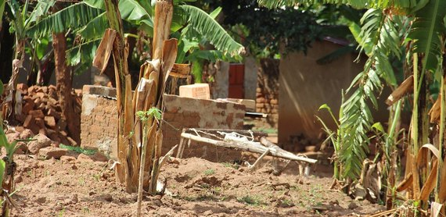
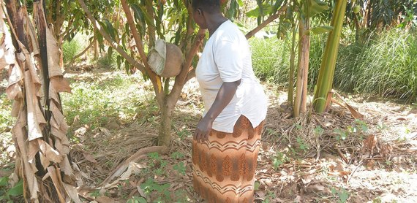
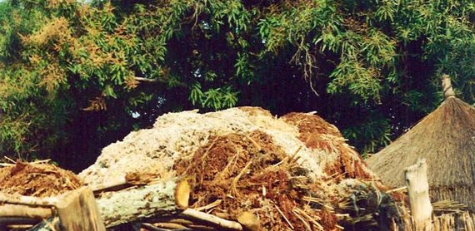
THREE PRIORITY AREAS
Where to run the first trials
Western Equatoria
Central Equatoria — Juba
Northern Bahr el Ghazal
The Greenbelt
Peri-urban vegetables
Sorghum and rice
Maize, cassava, groundnut and vegetables under a long rainy season.
Trials near Yambio and Nzara reached 4.7 t/ha of maize with fertiliser, against 2.9 t/ha on control plots.
Better access and security than most regions for a monitored pilot.
Tomato, onion, okra and leafy vegetables for a city that imports much of its food.
Hand watering and dry-season irrigation from wells and the Nile.
Short cycles and a cash market: a trial shows results in one season.
Rain-fed sorghum, and irrigated rice on the Aweil scheme.
Dry spells early in the season, floods late: plots must be selected with care.
Farmer groups already supported by FAO and NGO programmes.
Green Solutions · South Sudan market dossier
11

Slide 13
HOW WE WORK
A staged rollout, measured at every step
1
2
3
4
Site assessment
Trial plot
Measurement
Extension
Drainage, soil, crop and access are reviewed. No commitment at this stage.
One comparative plot on drained land, against a control plot managed identically.
Emergence, water use and yield recorded over a full season.
Gradual rollout to other plots and sites, on the basis of what was measured.
The dosing rule is the same everywhere: 3 grams per litre of useful soil. What changes from one site to the next is the volume of soil the roots actually explore.
Green Solutions · South Sudan market dossier
12

Slide 14
WHAT TO ANTICIPATE
Identified risks and our answers
Risks
Our answers
Insecurity and poor roads, which limit access to trial sites and raise transport costs.
Flooding: waterlogged land gains nothing from water retention.
Very little cash among smallholders, and dependence on donor-funded programmes.
Import logistics through Uganda or Kenya, with long lead times.
Start with accessible, secure pilot sites around Juba and in Western Equatoria.
Select only drained, drought-exposed plots, after a site assessment.
Work through FAO, NGOs and donor programmes that already supply inputs to farmers.
Group orders and hold a buffer stock in Juba before the planting season.
Acrylamide analysis (Polymex laboratory, ISO 9001, content below 3.0 µg/g) and REACH / SVHC screening (SGS) are available on request, together with the SOHISCERT certificate valid until 4 September 2027.
Green Solutions · South Sudan market dossier
13

Slide 15
Sources
Sources and working assumptions
Main sources
Working assumptions
UNCCD, Drought in Numbers 2022: number and duration of droughts, +29% since 2000 versus 1980–1999.
UN-Water / FAO AQUASTAT, SDG indicator 6.4.2: definition and thresholds of water stress.
Photographs: Vetiverman (CC BY-SA 4.0), Lomoraronald (CC BY-SA 4.0), Kabang Bladina Gideon (CC BY-SA 4.0), Oxfam East Africa (CC BY 2.0) — via Wikimedia Commons.
Figures are rounded orders of magnitude, taken from the latest public data available.
Water and yield gains are indicative and vary with soil, climate and crop.
Commercial working document: figures to be refreshed before any official submission.
Trial reports, certificates (SOHISCERT, Polymex and SGS analyses) and technical sheets: available on request.
Green Solutions · South Sudan market dossier
14

Slide 16


Tell us about your plot
Crop, drainage, soil type and how you water today. We come back with the matching combination of technologies, the dosing, and the trials already run in comparable situations.
A first conversation commits you to nothing.
contact@green-solutions-group.com · Green Solutions Groupe AIM SA, 46, route de la Condémine, 1475 Forel, Switzerland
Green Solutions · South Sudan market dossier
15

