Slide 1
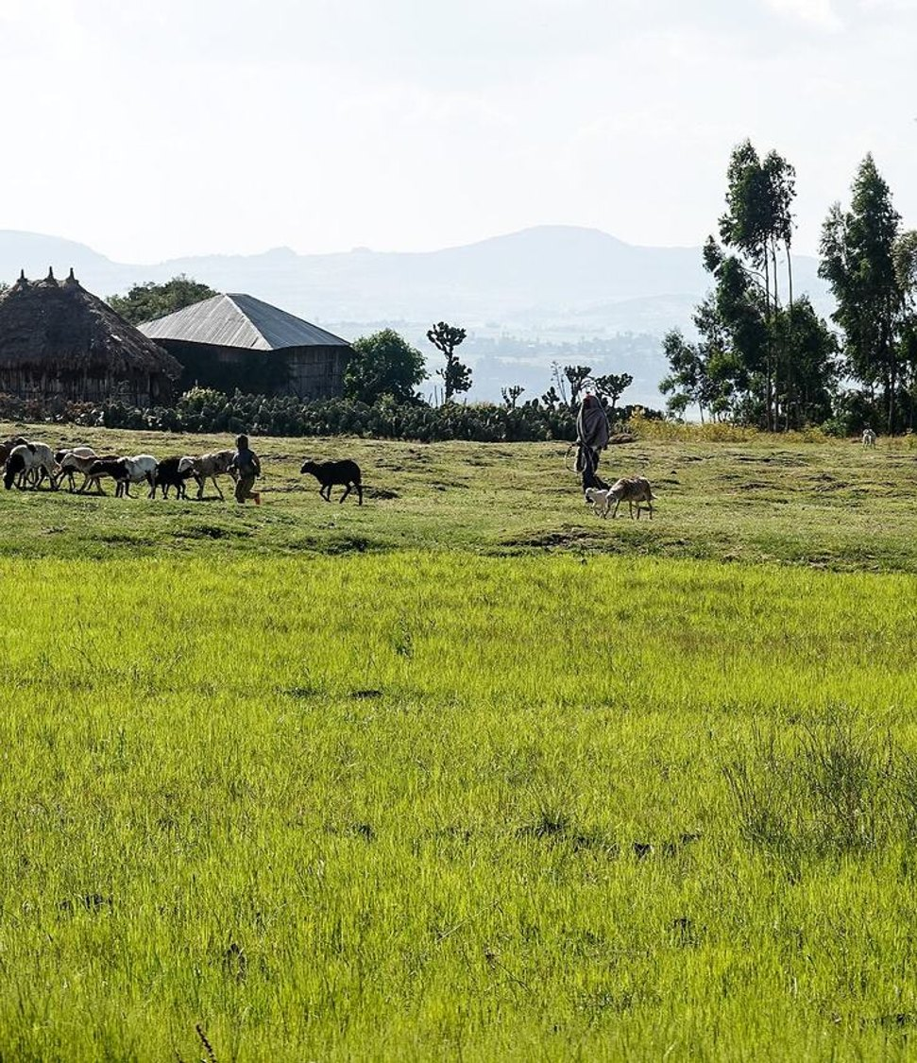


GREEN SOLUTIONS GROUP
FEDERAL DEMOCRATIC REPUBLIC OF ETHIOPIA
Addis Ababa
A rain-fed granary of 135 million people, where irrigation grows plot by plot.
What hydro-retention changes when the rains come late or stop early.
EVERGREEN® · ECOSORB® · ECOFERT® · PAULOWNIA
Confidential · For the sole use of the recipient

Slide 2
THE MARKET IN BRIEF
A farm economy that still runs on rain
135.5 M
9.7 km³
858,160 ha
547,262 t
Inhabitants in 2025. Agriculture provides 33% of GDP and 60% of jobs
Of water withdrawn each year for agriculture, 92% of all withdrawals
Equipped for irrigation in 2023, for a potential of 5.3 million hectares
Of mineral nitrogen used in 2023, almost all of it imported through Djibouti
Smallholders harvested 32.8 million tonnes of grain in 2021/22, excluding Tigray, and Oromia and Amhara produce 88% of it. Irrigation is still small: 1,228,082 smallholders irrigate 165,111 ha in the main season, mainly maize, khat, onion and banana.
Green Solutions · Ethiopia market dossier
1

Slide 3
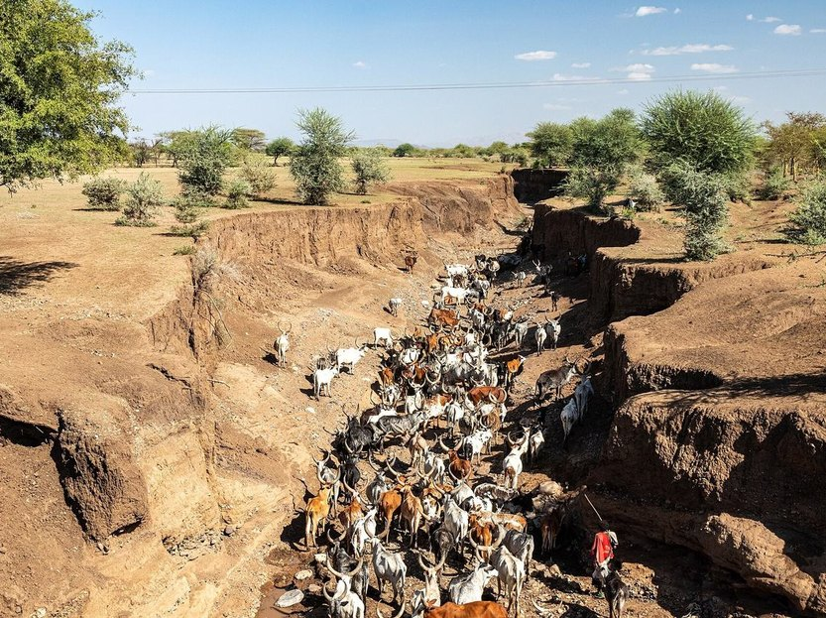
THE CONSTRAINT
Rains that come late, stop early or fail
Rainfall ranges from 149 mm a year at Semera, in Afar, to 2,745 mm at Bonga, in the South West (ERA5, 1991-2020 mean).
In the centre and north, the long rains (kiremt) last from June to September and carry the main harvest: A late start or an early end cuts the yield of maize, sorghum and teff.
The lowlands are warming: At Semera, the mean temperature has risen by 0.33 °C per decade since 1981.
The 2020-2023 drought in the south and east killed about 6.85 million head of livestock (OCHA).
Irrigation grows plot by plot, from rivers, wells and ponds. Holding each watering in the root zone lets the same water serve a larger area.
Herd in a dry riverbed, Afar region
Green Solutions · Ethiopia market dossier
2

Slide 4
DROUGHT AND WATER STRESS
Pressure is rising, but risk remains local
Two indicators, not a shortcut
Worldwide, the number and duration of droughts have risen by 29% since 2000 compared with the two previous decades.
Water stress measures something different: withdrawals as a share of renewable resources available after environmental needs. This global signal is therefore not a country forecast; it must be read alongside local rainfall, aquifers, seasons and uses.
Green Solutions · Ethiopia market dossier
3

Slide 5
WHERE THE WATER GOES
Agriculture takes more than nine litres in ten
What this implies
The World Bank puts agricultural withdrawals at 9.7 km³ a year, out of 10.5 km³ in all.
In the central scenario of our dossier, hydro-retention saves 1.46 km³ a year, 15% of agricultural water: Enough to irrigate about 129,000 more hectares at today's average use.
Green Solutions · Ethiopia market dossier
4

Slide 6
ECONOMY AND FOOD SECURITY
Coffee pays for the imports
$2.65 bn
$2.26 bn
$950 M
96.7%
Of coffee exports in 2024/25, a record
Of agricultural exports in 2023, including $1.22 bn of coffee
Minimum spending on mineral fertilisers in 2022, then $630 M in 2023
Of Ethiopia's external freight handled by the ports of Djibouti in 2025/26
Fertilisers, wheat, sugar and edible oils arrive through the Djibouti corridor. Horticulture earned $565 M in 2024/25, and a urea plant of 3 million tonnes a year was announced at Gode in 2025. Every cubic metre of water and every kilo of fertiliser used better reduces this dependence.
Green Solutions · Ethiopia market dossier
5

Slide 7
THE MAIN CROPS
Cereals cover most of the harvested land
Reading
Maize, teff, wheat, sorghum and barley cover most of the harvested area (FAOSTAT). Teff is counted by FAOSTAT among other cereals.
Irrigated plots follow another order: Maize, khat and coffee, then onion and potato. Maize and the onion, garlic and potato group give half of the water saved in our central scenario.
Green Solutions · Ethiopia market dossier
6

Slide 8
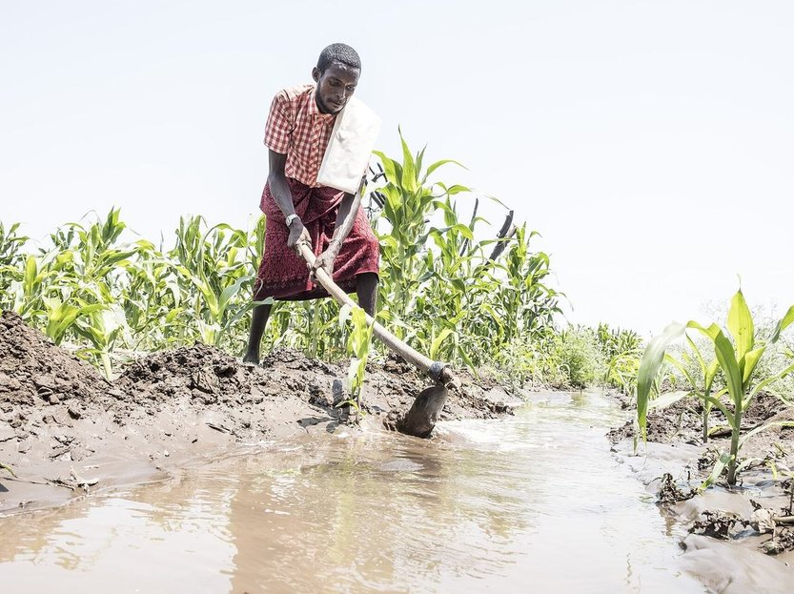
PRIORITY SECTOR
Irrigated maize, onion and potato
Maize: 189,237 irrigated hectares and 2,136 million m³ of water a year, of which 417 million m³ are saved in the central scenario.
Onion, garlic and potato: 104,970 irrigated hectares, and 308 million m³ saved a year.
Together they give half of the water saved in the central scenario.
Published trials of EVERGREEN® cover maize and potato, the two crops that carry the result.
EVERGREEN® placed in the furrow at sowing or planting holds each watering around the roots.
Green Solutions · Ethiopia market dossier
7

Slide 9
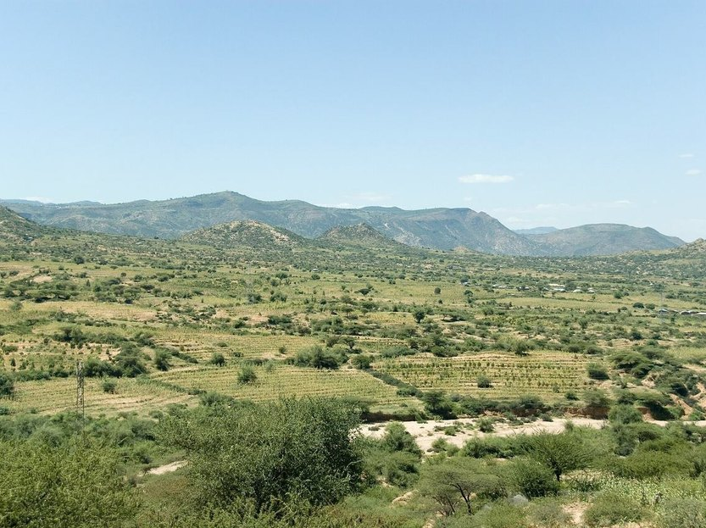
EXPORT SECTOR
Coffee, khat and fruit: Perennial crops
Coffee exports reached a record $2.65 bn in 2024/25, and horticulture earned $565 M.
Khat, coffee and gesho: 207,160 irrigated hectares, and 234 million m³ saved a year in the central scenario.
Banana, mango, citrus and avocado: 65,400 irrigated hectares, and 74 million m³ saved a year.
For perennial crops, the retainer goes into the planting pit: Young trees establish before the dry season.
ECOFERT® is certified SOHISCERT and EU Organic, an asset for buyers who check how a crop is grown.
Green Solutions · Ethiopia market dossier
8

Slide 10
OUR RESPONSE
Two technologies, two different constraints
EVERGREEN® — holding the water
ECOFERT® — feeding without depleting
A potassium-based hydro-retainer placed in the root zone at sowing, planting or replanting.
It captures rain or irrigation water and releases it back to the plant gradually, bridging the dry spells of the rainy season.
Absorbs on the order of 300 times its own weight; useful effect of 3 to 4 years in the soil.
Breaks down by 20 to 25% a year, with no build-up and no risk of overdosing.
A micro-dose fertiliser of amino acids, nitrogen, phosphorus and potassium, made from renewable resources.
Non-chelating: It does not strip the clay-humus complex and adds neither salinity nor nitrate load.
Certified SOHISCERT and EU Organic, in use in 60 countries: An asset for coffee and horticulture exporters.
1 to 4 bottles of 140 ml per hectare: A small volume to carry, where imported fertiliser is costly.
The two products are sold separately but were designed to reinforce each other: The hydro-retainer extends how long water stays available, the fertiliser puts that water to work without degrading the soil.
Green Solutions · Ethiopia market dossier
9

Slide 11
The rest of the range
Protecting crops, holding soils
NAPEMA® — protection without residue
Paulownia ALTIFOLIA® — the tree for hot regions
Controls diseases, parasites, fungi and pests, with no synthetic molecule.
Foliar and root spraying, working both preventively and curatively.
No residue in soil, plant or air: pollinators and beneficial insects are spared.
Formulated for one precise problem: mealybug, citrus greening (HLB), nematodes.
13 to 15 m in six to eight years, with a wide trunk.
Combined with 100 g of EVERGREEN® per plant, irrigation needs drop by 50%.
Withstands −25 °C to +45 °C; the wood only ignites above 426 °C.
Windbreak, protection against soil erosion, 400 to 700 kg of honey per hectare.
Plants delivered potted (25 to 30 cm), certified disease-free and replaced under warranty in case of loss. First harvest at the end of year six, with wood valued at around €400 to €450 per m³.
Green Solutions · Ethiopia market dossier
10

Slide 12
ORDERS OF MAGNITUDE
Water saved each year, three scenarios
How it is calculated
The central scenario applies the savings measured in published trials to each irrigated crop group, then adds them up for the country. The cautious and strong scenarios take half and twice that saving.
The central scenario saves 1.46 km³ a year, 15% of agricultural water. At today's average use of 11,288 m³ per hectare, that is about 129,000 more irrigable hectares.
Green Solutions · Ethiopia market dossier
11

Slide 13
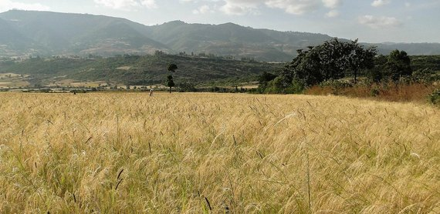
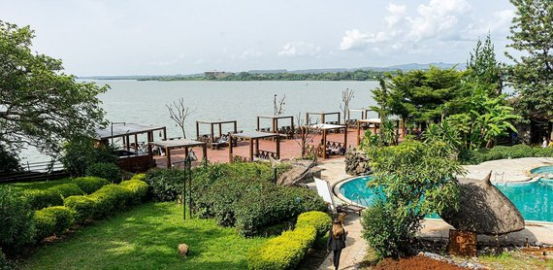
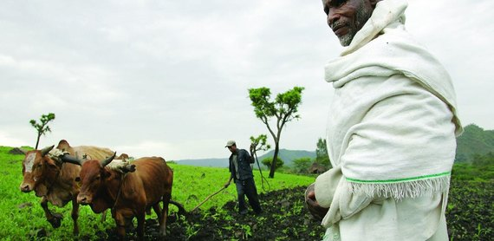
THREE PRIORITY AREAS
Where to run the first trials
Oromia
Amhara
South (former SNNP)
73,762 irrigated hectares
45,966 irrigated hectares
28,682 irrigated hectares
The largest region, with 41.8 million inhabitants in 2024.
East and West Hararghe alone irrigate more than a fifth of smallholder areas, mostly khat and vegetables.
652 million m³ saved a year in the central scenario.
23.6 million inhabitants in 2024. With Oromia, it produces 88% of the country's grain.
West Gojjam, East Gojjam and North Wollo are its main irrigated zones.
406 million m³ saved a year in the central scenario.
22.4 million inhabitants in 2024, in the regions born from the former SNNP, Sidama included.
Gamo zone, around Arba Minch, irrigates banana groves and orchards: 18,566 ha, the second zone in the country.
253 million m³ saved a year in the central scenario.
Green Solutions · Ethiopia market dossier
12

Slide 14
HOW WE WORK
A staged rollout, measured at every step
1
2
3
4
Assessment
Trial block
Measurement
Extension
Soil, irrigation method and crop are reviewed. No commitment at this stage.
One comparative trial block, against a control block managed identically.
Water use and yield recorded over a full season, dry spells included.
Gradual rollout to the remaining blocks, on the basis of what was measured.
The dosing rule is the same everywhere: 3 grams per litre of useful soil. What changes from one site to the next is the volume of soil the roots actually explore.
Green Solutions · Ethiopia market dossier
13

Slide 15
WHAT TO ANTICIPATE
Identified risks and our answers
Risks
Our answers
Very small plots: A smallholder irrigates less than a seventh of a hectare on average.
Rains vary widely from one year to the next: A trial must cover a full season to be convincing.
Inputs travel a long way, from the port of Djibouti to the farm.
Registration of fertilisers and soil conditioners with the Ministry of Agriculture before commercial sale.
Work through cooperatives, unions and irrigation schemes, to reach many growers at once.
Run trials over a full season against a control block, so the gain is documented in figures.
Store and ship through Djibouti, the gateway that already handles 96.7% of Ethiopia's external freight.
Prepare the regulatory file early: Analyses and certificates before negotiation starts.
Acrylamide analysis (Polymex laboratory, ISO 9001, content below 3.0 µg/g) and REACH / SVHC screening (SGS) are available on request, together with the SOHISCERT certificate valid until 4 September 2027.
Green Solutions · Ethiopia market dossier
14

Slide 16
Sources
Sources and working assumptions
Main sources
Working assumptions
Ethiopian Statistics Service (ESS): Agricultural Sample Survey 2021/22 and population projection 2024.
FAOSTAT, AQUASTAT and World Bank (WDI); IWMI for the irrigation potential.
ERA5 (Copernicus): Climate 1991-2020 and trends since 1981; OCHA for the 2020-2023 drought; Ethiopian Coffee and Tea Authority.
UNCCD, Drought in Numbers 2022: number and duration of droughts, +29% since 2000 versus 1980–1999.
UN-Water / FAO AQUASTAT, SDG indicator 6.4.2: definition and thresholds of water stress.
Figures are rounded orders of magnitude, taken from the latest public data available.
Photographs: Timothy A. Gonsalves (CC BY-SA 4.0), Sonjamariavienna (CC BY-SA 4.0), Menschen für Menschen Schweiz (CC BY-SA 4.0), A. Davey from Where I Live Now: Pacific Northwest (CC BY 2.0), Bernard Gagnon (CC BY-SA 3.0), Nina R from Africa (CC BY 2.0), Photo: ILRI/Stevie Mann (CC BY 2.0), Bjvisser (CC BY-SA 4.0) — via Wikimedia Commons.
Trial reports, certificates (SOHISCERT, Polymex and SGS analyses) and technical sheets: available on request.
Green Solutions · Ethiopia market dossier
15

Slide 17
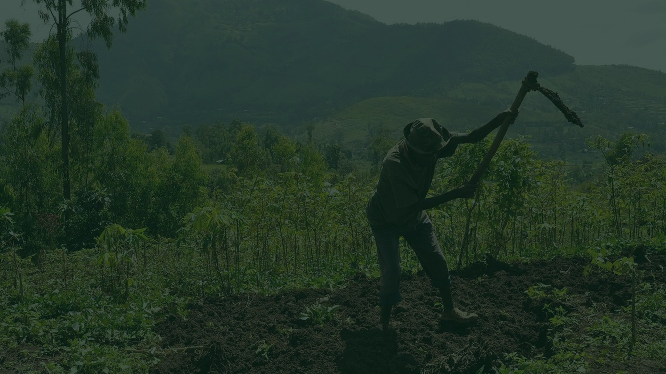

Tell us about your farm
Crop, irrigation method, soil type, the volume of water you use today. We come back with the matching combination of technologies, the dosing, and the trials already run in comparable situations.
A first conversation commits you to nothing.
contact@green-solutions-group.com · Green Solutions Groupe AIM SA, 46, route de la Condémine, 1475 Forel, Switzerland
Green Solutions · Ethiopia market dossier
16

