Slide 1
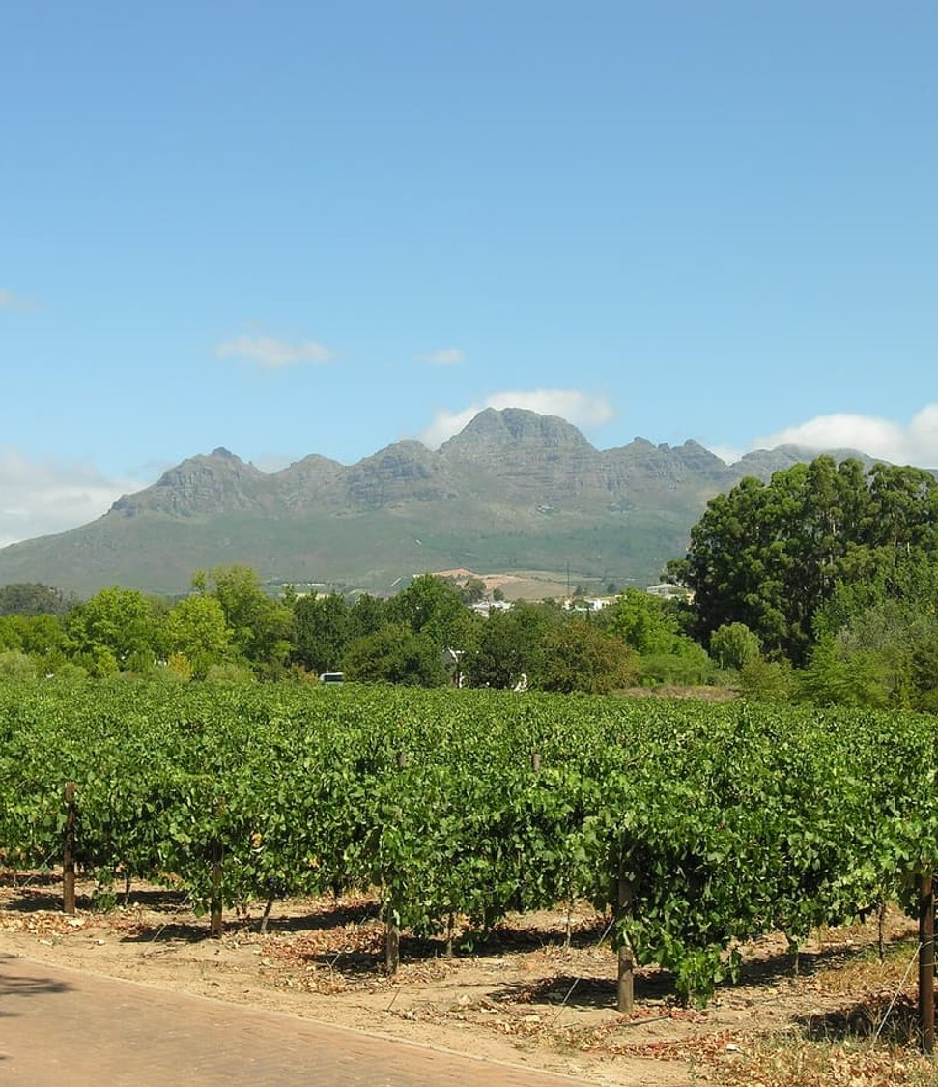

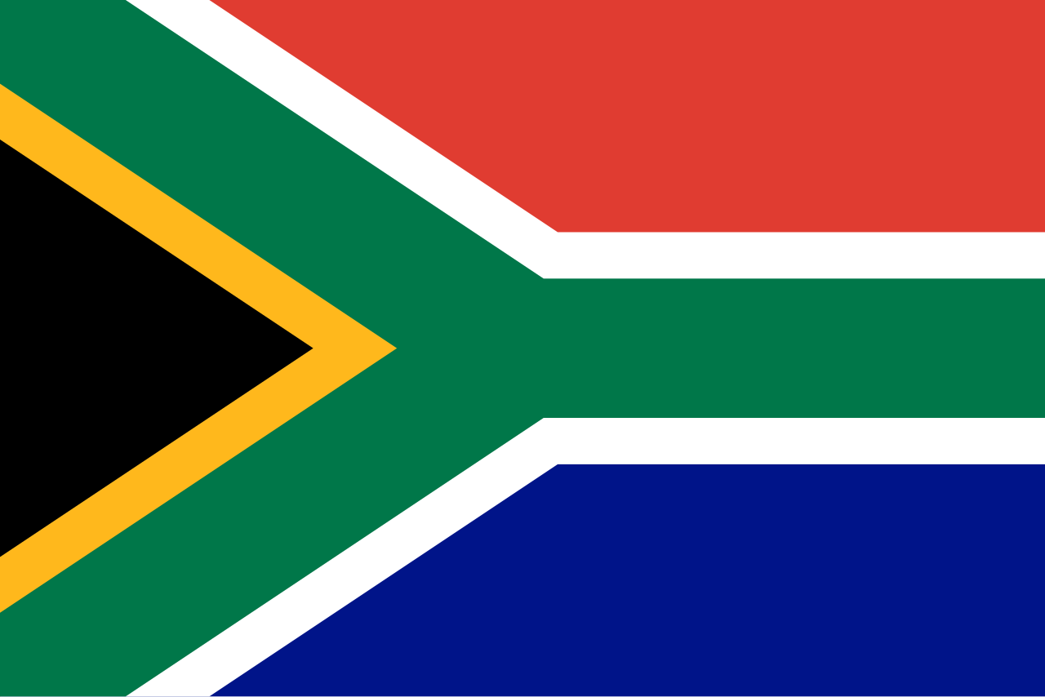
GREEN SOLUTIONS GROUP
REPUBLIC OF SOUTH AFRICA
Pretoria · 2026
Citrus, deciduous fruit and wine grapes grown on half the world's average rainfall.
What hydro-retention changes for an export-led sector.
ECOSORB® · ECOFERT® · NAPEMA® · PAULOWNIA
September 2026 · Confidential · For the sole use of the recipient

Slide 2
THE MARKET IN BRIEF
A small share of GDP, a large export earner
≈ 2.5 %
≈ 1.6 M ha
≈ 465 mm
US$ 13 bn
of GDP from agriculture, forestry and fishing
under irrigation, out of some 12 M ha of arable land
of rain a year, about half the world average
of farm exports a year — a consistent net exporter
Agriculture is a modest share of national output but employs roughly 5 % of the workforce, close to 900,000 people, and feeds an agro-processing chain worth several times the farm-gate value. Output comes from some 40,000 commercial farms alongside a much larger smallholder base.
Green Solutions · South Africa market dossier
1

Slide 3
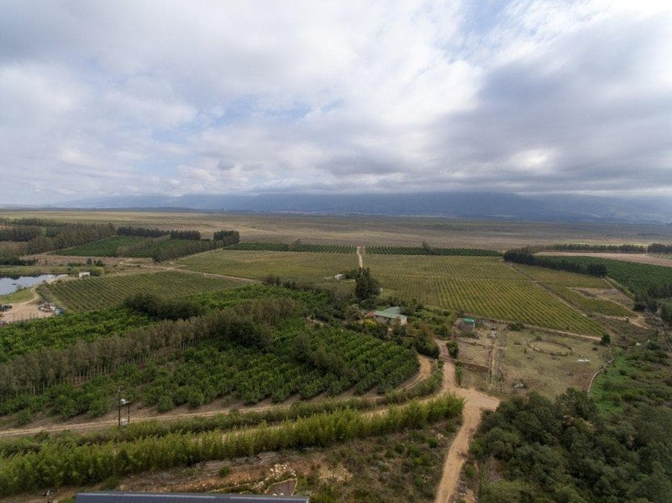
THE CONSTRAINT
A dry country, and rainfall it cannot count on
Mean annual rainfall is around 465 mm, roughly half the world average, and potential evaporation exceeds it across most of the interior.
Irrigation takes about 60 % of the water withdrawn each year: when the resource tightens, the restriction reaches the field before it reaches the city.
Rainfall is unevenly spread — under 200 mm a year in the Northern Cape, more than 1,000 mm on the KwaZulu-Natal coast — and it arrives in short, intense events.
Drought is a recurring line item: the 2015/16 El Niño season cut the commercial maize crop to under 8 million tonnes; the 2015-2018 Western Cape drought forced irrigation quota cuts.
Public plans — new dams, water reuse, coastal desalination — act on supply. Hydro-retention acts on demand, in the root zone, block by block.
Orchards and vineyards, Western Cape
Green Solutions · South Africa market dossier
2

Slide 4
DROUGHT AND WATER STRESS
Pressure is rising, but risk remains local
Two indicators, not a shortcut
Worldwide, the number and duration of droughts have risen by 29% since 2000 compared with the two previous decades.
Water stress measures something different: withdrawals as a share of renewable resources available after environmental needs. This global signal is therefore not a country forecast; it must be read alongside local rainfall, aquifers, seasons and uses.
Green Solutions · South Africa market dossier
3

Slide 5
WHERE THE WATER GOES
Irrigation takes six litres in every ten
What this implies
A 10 % cut in irrigation demand releases close to half the volume used by industry, mining and every other non-municipal use combined.
That is why the effort belongs in the field rather than in the other uses.
Green Solutions · South Africa market dossier
4

Slide 6
ECONOMY AND FOOD SECURITY
A net food exporter with a two-speed farm economy
No. 2
≈ 0.9 M
≈ 40,000
≈ 2.3 M
exporter of fresh citrus in the world
people employed in primary agriculture
commercial farming units in the latest census
households farming on a small scale, mostly for their own food
Commercial agriculture earns foreign exchange from fruit, wine, nuts and sugar, while millions of households farm small plots with little access to water. Water-use licensing, electricity load-shedding and land reform all weigh on investment decisions.
Green Solutions · South Africa market dossier
5

Slide 7
THE MAIN CROPS
Five crops carry the volume and the value
Reading
Citrus and grapes are irrigated, export-bound and priced per carton: there, a litre saved converts into margin. The country ships about 2.6 million tonnes of citrus a year, second only to Spain.
* Maize is mostly rain-fed and swings by several million tonnes between seasons.
Green Solutions · South Africa market dossier
6

Slide 8
FIRST SECTOR
Citrus: an export leader on a tight water allocation
Citrus is grown in Limpopo, the Eastern Cape, Mpumalanga and the Western Cape, mostly under micro-irrigation.
Orchards draw on allocated river and dam water, which is cut back in drought years.
Load-shedding interrupts pumping schedules, so trees can miss irrigations during hot, dry spells.
Export markets pay for size and appearance: steady soil moisture protects both at fruit set and sizing.
NAPEMA® treats pests without residue, which matters under strict European maximum residue limits.
Green Solutions · South Africa market dossier
7

Slide 9
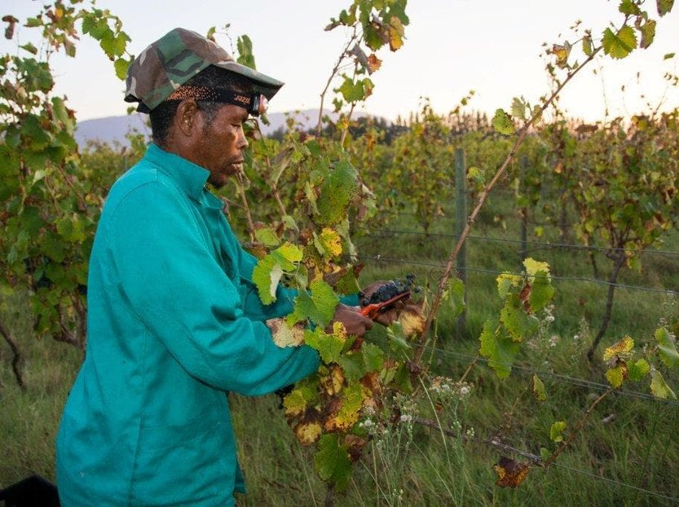
SECOND SECTOR
Wine and table grapes in the Western Cape
The Western Cape holds most of the vineyard area, from Stellenbosch to the Breede and Olifants river valleys.
The 2015–2018 drought brought Cape Town close to 'Day Zero', and farms lost much of their water allocation.
Table-grape growers in the Hex and Orange River valleys depend on long, hot seasons and dependable irrigation.
Replanting a vineyard costs several years of income: young vines must be kept free of water stress to establish.
EVERGREEN® placed in the planting furrow holds water around young roots between irrigations.
Green Solutions · South Africa market dossier
8

Slide 10
Yield potential
Expected yield gain by crop
Read with care
Ranges used by our dose calculator, for a normally managed crop with EVERGREEN® applied at planting.
Actual results depend on soil, climate and management. For cereals, no gain is claimed without a field trial.
Green Solutions · South Africa market dossier
9

Slide 11
OUR RESPONSE
Two technologies, two different constraints
EVERGREEN® — holding the water
ECOFERT® — feeding without depleting
A potassium-based hydro-retainer placed in the root zone at planting or at replant.
It captures rain and irrigation water and releases it back to the plant gradually, removing water stress through the critical stages.
Absorbs on the order of 300 times its own weight; useful effect of 3 to 4 years in the soil.
Breaks down by 20 to 25 % a year, with no build-up and no risk of overdosing.
A micro-dose fertiliser of amino acids, nitrogen, phosphorus and potassium, made from renewable resources.
Non-chelating: it does not strip the clay-humus complex and adds neither salinity nor nitrate load.
Certified SOHISCERT and EU Bio, in use in 60 countries — the entry condition for European buyers' specifications.
1 to 4 bottles of 140 ml per hectare, compatible with existing fertigation equipment.
The two products are sold separately but were designed to reinforce each other: the hydro-retainer extends how long water stays available, the fertiliser puts that water to work without degrading the soil.
Green Solutions · South Africa market dossier
10

Slide 12
The rest of the range
Protecting crops, holding soils
NAPEMA® — protection without residue
Paulownia ALTIFOLIA® — the tree for hot regions
Controls diseases, parasites, fungi and pests, with no synthetic molecule.
Foliar and root spraying, working both preventively and curatively.
No residue in soil, plant or air: pollinators and beneficial insects are spared.
Formulated for one precise problem: mealybug, citrus greening (HLB), nematodes.
13 to 15 m in six to eight years, with a wide trunk.
Combined with 100 g of EVERGREEN® per plant, irrigation needs drop by 50%.
Withstands −25 °C to +45 °C; the wood only ignites above 426 °C.
Windbreak, protection against soil erosion, 400 to 700 kg of honey per hectare.
Plants delivered potted (25 to 30 cm), certified disease-free and replaced under warranty in case of loss. First harvest at the end of year six, with wood valued at around €400 to €450 per m³.
Green Solutions · South Africa market dossier
11

Slide 13
ORDERS OF MAGNITUDE
Expected water saving by irrigation method
Read with caution
These ranges are indicative and based on the savings documented for our hydro-retainers.
The actual result depends on the soil, the climate and the crop. They give an order of magnitude and are in no case a guaranteed, contractual or absolute value.
Green Solutions · South Africa market dossier
12

Slide 14
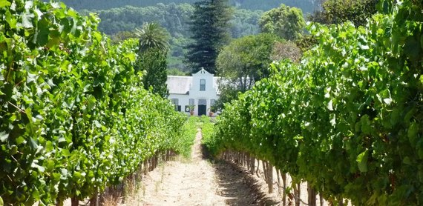
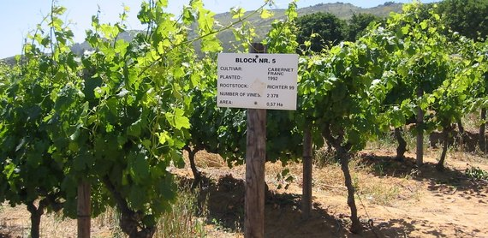
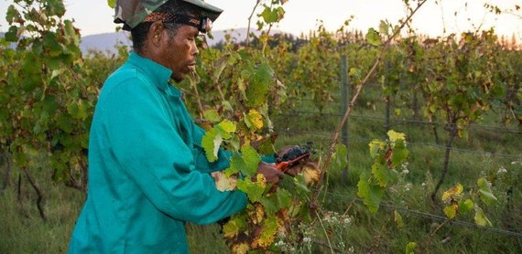
THREE PRIORITY AREAS
Where to run the first trials
Western Cape
Limpopo
KwaZulu-Natal
≈ 90,000 ha of vineyard
≈ 450 mm of rain a year
≈ 300,000 ha of cane
Nearly all of the national vineyard, plus the deciduous fruit of the Breede and Olifants valleys.
Winter rainfall of 250 to 400 mm inland, and the 2015-2018 quota cuts are a live memory.
Export blocks already on drip or micro-sprinkler, with buyers asking for organic certification.
The leading citrus province, with macadamia and avocado on sandy, low-retention soils.
High summer evaporation and a long dry winter: irrigation carries the whole season.
Orchards planted for twenty years or more — planting is exactly when the retainer goes in.
A sugar belt from the North Coast to Zululand, carrying most of a national crop of roughly 18 million tonnes.
Largely rain-fed: the gain is in holding the rain that falls, not in trimming a dose.
Around twenty thousand growers organised around mills — one route to a coordinated trial.
Green Solutions · South Africa market dossier
13

Slide 15
HOW WE WORK
A staged rollout, measured at every step
1
2
3
4
Assessment
Trial block
Measurement
Extension
Soil, irrigation method and crop are reviewed. No commitment at this stage.
One comparative trial block, against a control block managed identically.
Water use and yield recorded over a full growing season.
Gradual rollout to the remaining blocks, on the basis of what was measured.
The dosing rule is the same everywhere: 3 grams per litre of useful soil. What changes from one site to the next is the volume of soil the roots actually explore.
Green Solutions · South Africa market dossier
14

Slide 16
Working together
A local partner for South Africa
1
2
3
4
Distribution
Training
Joint trials
Institutions
Territorial exclusivity and launch stock for the first commercial season.
Technical training for field teams, dosing protocols and seasonal updates.
Demonstration plots with a control, results shared with growers.
Dialogue with the Ministry of Agriculture and food-security programmes.
The framework adapts to the territory: an importer, an input distributor or a growers' group can lead the partnership.
Green Solutions · South Africa market dossier
15

Slide 17
WHAT TO ANTICIPATE
Identified risks and our answers
Risks
Our answers
Rainfall variability: one good La Niña season is enough to mask the value of the product.
Registration: fertilisers and soil amendments fall under Act 36 of 1947 and must be registered before commercial sale.
The memory of cheap sodium-based polymers, which left a poor reputation in several regions.
Farm cash flow after successive droughts, high input costs and a rand that raises the price of every imported input.
Run the trial over a full season against a control block, so the gain is measurable even in a favourable year.
Open the registration file in parallel with the first trials rather than after them.
Document the formulation: potassium, never sodium, and compatible with food crops.
Spread the commitment: a useful life of 3 to 4 years amortises the cost over several seasons.
Acrylamide analysis (Polymex laboratory, ISO 9001, content below 3.0 µg/g) and REACH / SVHC screening (SGS) are available on request, together with the SOHISCERT certificate valid until 4 September 2027.
Green Solutions · South Africa market dossier
16

Slide 18
Sources
Sources and working assumptions
Main sources
Working assumptions
Statistics South Africa: GDP by industry, Quarterly Labour Force Survey, Census of Commercial Agriculture.
Department of Agriculture: Abstract of Agricultural Statistics.
Citrus Growers' Association; SAWIS for vineyard area.
Department of Water and Sanitation; FAO (FAOSTAT, AQUASTAT); World Bank (WDI).
UNCCD, Drought in Numbers 2022: number and duration of droughts, +29% since 2000 versus 1980–1999.
UN-Water / FAO AQUASTAT, SDG indicator 6.4.2: definition and thresholds of water stress.
Figures are rounded orders of magnitude, taken from the latest public data available.
Water and yield gains are indicative and vary with soil, climate and crop.
Commercial working document: figures to be refreshed before any official submission.
Trial reports, certificates (SOHISCERT, Polymex and SGS analyses) and technical sheets: available on request.
Green Solutions · South Africa market dossier
17

Slide 19
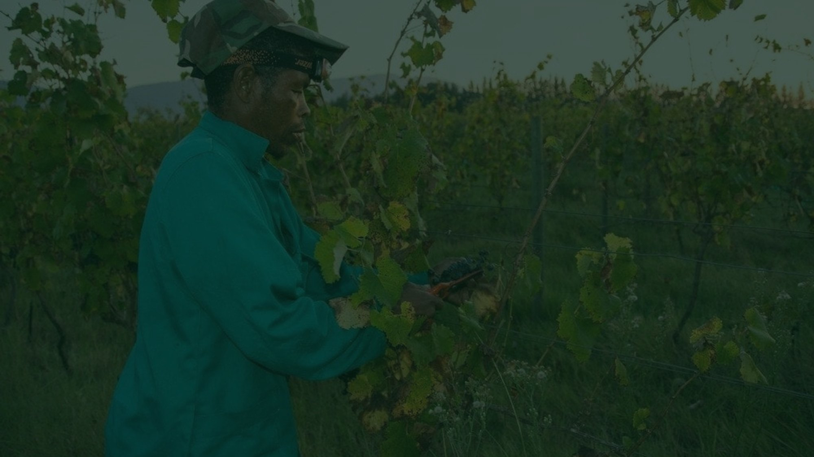

Tell us about your block
Crop, irrigation method, soil type, the volume of water you use today. We come back with the matching combination of technologies, the dosing, and the trials already run in comparable situations.
A first conversation commits you to nothing.
contact@green-solutions-group.com · Green Solutions Groupe AIM SA, 46, route de la Condémine, 1475 Forel, Switzerland
Green Solutions · South Africa market dossier
18

