Slide 1
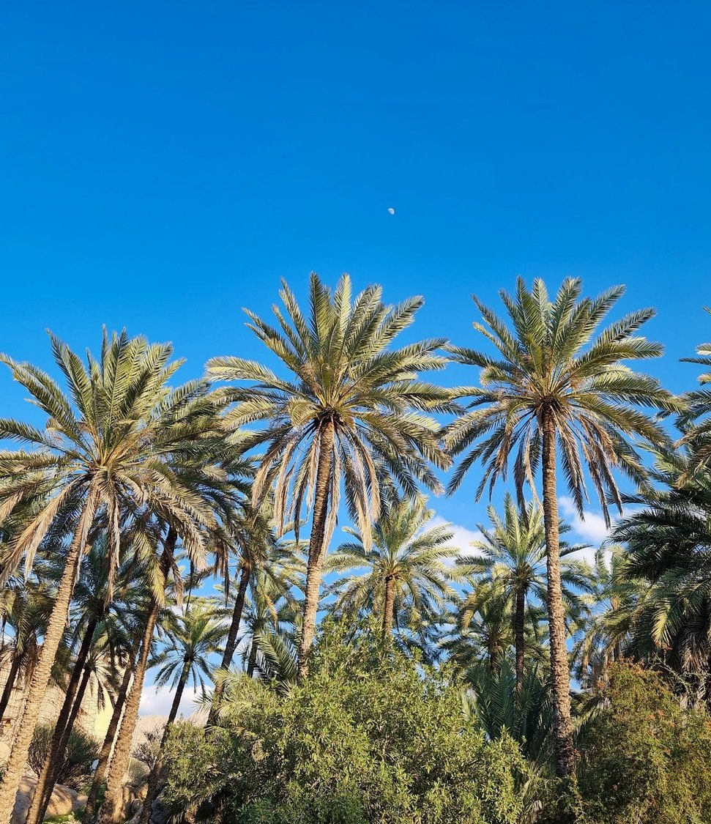


GREEN SOLUTIONS GROUP
SULTANATE OF OMAN
Muscat · 2026
Dates, vegetables and fodder grown on shrinking aquifers and under 100 mm of rain.
What hydro-retention changes when every cubic metre is pumped.
ECOSORB® · ECOFERT® · NAPEMA® · PAULOWNIA
September 2026 · Confidential · For the sole use of the recipient

Slide 2
THE MARKET IN BRIEF
Irrigated farming on a very tight water budget
≈ 2 %
≈ 83 %
< 100 mm
≈ 370,000 t
of GDP from agriculture and fisheries
of water withdrawals go to agriculture
of rain a year across most of the country
of dates harvested a year
Farming is concentrated on the Al Batinah coastal plain, the interior oases and the monsoon-fed Dhofar region. Most irrigation water comes from aquifers and from some 3,000 active aflaj, traditional channels that are themselves fed by groundwater.
Green Solutions · Oman market dossier
1

Slide 3
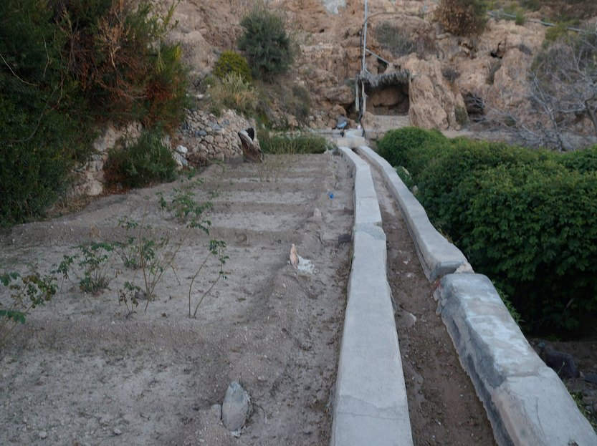
THE CONSTRAINT
Groundwater is the farm, and it is running down
Outside Dhofar and the Hajar mountains, rainfall averages well under 100 mm a year, while potential evaporation is many times higher.
Agriculture draws the large majority of the water withdrawn each year, almost all of it from aquifers and aflaj.
Along Al Batinah, decades of pumping have lowered water tables and let seawater intrude: salinity has taken farmland out of production.
In long droughts many aflaj run weaker or dry up, and the oasis date groves they feed suffer first.
Desalination supplies the cities, but its cost rules it out for most irrigation. Hydro-retention works on demand, in the root zone, where every pumped cubic metre is paid for.
Green Solutions · Oman market dossier
2

Slide 4
DROUGHT AND WATER STRESS
Pressure is rising, but risk remains local
Two indicators, not a shortcut
Worldwide, the number and duration of droughts have risen by 29% since 2000 compared with the two previous decades.
Water stress measures something different: withdrawals as a share of renewable resources available after environmental needs. This global signal is therefore not a country forecast; it must be read alongside local rainfall, aquifers, seasons and uses.
Green Solutions · Oman market dossier
3

Slide 5
WHERE THE WATER GOES
Irrigation takes eight litres in every ten
What this implies
A 10 % cut in irrigation demand saves several times the volume used by the whole of industry.
That is why the effort belongs in the field: dates, fodder and vegetables on the coastal plain.
Green Solutions · Oman market dossier
4

Slide 6
ECONOMY AND FOOD SECURITY
Strong purchasing power, a narrow food base
≈ 5 M
> 100 %
≈ 3,000
2040
residents, with food demand rising every year
self-sufficiency in dates and in fresh fish
active aflaj, five of them on the UNESCO World Heritage list
horizon of Oman Vision, with food security as a priority
Oman imports most of its cereals, sugar, dairy and meat, and part of its vegetables. Food security plans favour local production of high-value crops and a more efficient use of every cubic metre of groundwater.
Green Solutions · Oman market dossier
5

Slide 7
THE MAIN CROPS
Date palms hold half of the cropped area
Reading
Date palms occupy about half of the cropped area and carry cultural as well as economic weight.
Fodder, mostly Rhodes grass and alfalfa, is the thirstiest use per hectare and the first target of water rationing. Shares are rounded orders of magnitude.
Green Solutions · Oman market dossier
6

Slide 8
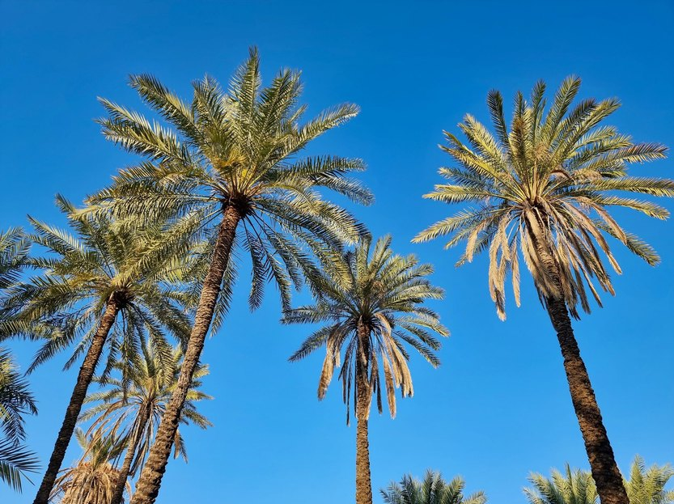
LEADING SECTOR
Dates: a heritage crop with a modern water problem
Date palms cover about half of Oman's cropped area, from the Al Batinah coast to the interior oases.
Many groves are still irrigated in basins, with high losses on sandy soils in summer heat.
Saline groundwater along the coast lowers yields and fruit quality, and weakens young palms.
Public programmes distribute offshoots of premium varieties: planting is the moment to act on water.
EVERGREEN® placed in the planting pit holds irrigation water around the roots through the first hot season.
Green Solutions · Oman market dossier
7

Slide 9
OUR RESPONSE
Two technologies, two different constraints
EVERGREEN® — holding the water
ECOFERT® — feeding without depleting
A potassium-based hydro-retainer placed in the root zone at planting or at replant.
It captures irrigation water and releases it back to the plant gradually, removing water stress through the hottest months.
Absorbs on the order of 300 times its own weight; useful effect of 3 to 4 years in the soil.
Breaks down by 20 to 25 % a year, with no build-up and no risk of overdosing.
A micro-dose fertiliser of amino acids, nitrogen, phosphorus and potassium, made from renewable resources.
Non-chelating: it does not strip the clay-humus complex and adds neither salinity nor nitrate load.
Certified SOHISCERT and EU Bio, in use in 60 countries — an entry condition for premium buyers.
1 to 4 bottles of 140 ml per hectare, compatible with existing fertigation equipment.
The two products are sold separately but were designed to reinforce each other: the hydro-retainer extends how long water stays available, the fertiliser puts that water to work without degrading the soil.
Green Solutions · Oman market dossier
8

Slide 10
The rest of the range
Protecting crops, holding soils
NAPEMA® — protection without residue
Paulownia ALTIFOLIA® — the tree for hot regions
Controls diseases, parasites, fungi and pests, with no synthetic molecule.
Foliar and root spraying, working both preventively and curatively.
No residue in soil, plant or air: pollinators and beneficial insects are spared.
Formulated for one precise problem: mealybug, citrus greening (HLB), nematodes.
13 to 15 m in six to eight years, with a wide trunk.
Combined with 100 g of EVERGREEN® per plant, irrigation needs drop by 50%.
Withstands −25 °C to +45 °C; the wood only ignites above 426 °C.
Windbreak, protection against soil erosion, 400 to 700 kg of honey per hectare.
Plants delivered potted (25 to 30 cm), certified disease-free and replaced under warranty in case of loss. First harvest at the end of year six, with wood valued at around €400 to €450 per m³.
Green Solutions · Oman market dossier
9

Slide 11
ORDERS OF MAGNITUDE
Expected water saving by irrigation method
Read with caution
These ranges are indicative and based on the savings documented for our hydro-retainers.
The actual result depends on the soil, the climate and the crop. They give an order of magnitude and are in no case a guaranteed, contractual or absolute value.
Green Solutions · Oman market dossier
10

Slide 12
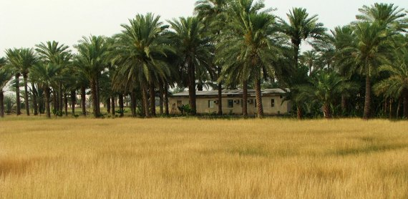
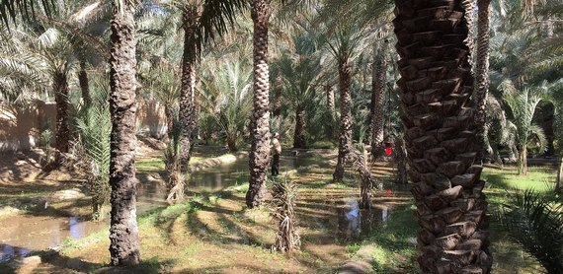
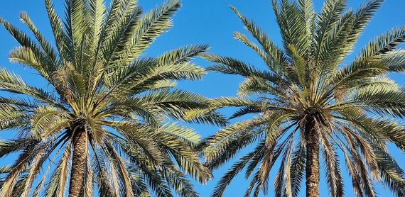
THREE PRIORITY AREAS
Where to run the first trials
Al Batinah
Interior oases
Dhofar — Salalah
Oman's main farm belt
Aflaj-fed date groves
Monsoon from June to September
Vegetables, dates and fodder on a coastal plain where aquifers are over-drawn and turning saline.
Farms already on drip, with pumps running daily: the saving shows on the power bill.
Many commercial farms able to host a trial block quickly.
Historic date groves around Nizwa and Bahla, irrigated by shared falaj rotations.
Weaker flows in drought years mean longer intervals between turns.
Young offshoots planted with a retainer establish before the summer heat.
The only region with a monsoon: coconut, banana, papaya and vegetables near Salalah.
Eight dry months outside the khareef: holding the monsoon water in the soil is the whole question.
Soils poor in organic matter, where ECOFERT® adds value alongside the retainer.
Green Solutions · Oman market dossier
11

Slide 13
HOW WE WORK
A staged rollout, measured at every step
1
2
3
4
Assessment
Trial block
Measurement
Extension
Soil, irrigation method and crop are reviewed. No commitment at this stage.
One comparative trial block, against a control block managed identically.
Water use and yield recorded over a full season, summer included.
Gradual rollout to the remaining blocks, on the basis of what was measured.
The dosing rule is the same everywhere: 3 grams per litre of useful soil. What changes from one site to the next is the volume of soil the roots actually explore.
Green Solutions · Oman market dossier
12

Slide 14
WHAT TO ANTICIPATE
Identified risks and our answers
Risks
Our answers
Summer heat above 45 °C and sandy soils: results vary strongly from one block to the next.
Saline irrigation water in coastal areas, and caution toward any new soil input.
Registration of fertilisers and soil conditioners before commercial sale.
Long decision cycles at large agricultural companies and public bodies.
Run trials over a full season against a control block, so the gain is documented in figures.
A potassium formulation, never sodium: it adds no salinity and is safe for food crops.
Prepare the regulatory file early: analyses and certificates before negotiation starts.
Work through farmer associations and model farms to reach many growers at once.
Acrylamide analysis (Polymex laboratory, ISO 9001, content below 3.0 µg/g) and REACH / SVHC screening (SGS) are available on request, together with the SOHISCERT certificate valid until 4 September 2027.
Green Solutions · Oman market dossier
13

Slide 15
Sources
Sources and working assumptions
Main sources
Working assumptions
UNCCD, Drought in Numbers 2022: number and duration of droughts, +29% since 2000 versus 1980–1999.
UN-Water / FAO AQUASTAT, SDG indicator 6.4.2: definition and thresholds of water stress.
Photographs: albinfo (CC BY-SA 4.0), Okhtyartist (CC BY-SA 4.0), Altaf Habib (CC BY-SA 4.0), Omar AV (CC BY 3.0), Prof. Mortel (CC BY 2.0) — via Wikimedia Commons.
Figures are rounded orders of magnitude, taken from the latest public data available.
Water and yield gains are indicative and vary with soil, climate and crop.
Commercial working document: figures to be refreshed before any official submission.
Trial reports, certificates (SOHISCERT, Polymex and SGS analyses) and technical sheets: available on request.
Green Solutions · Oman market dossier
14

Slide 16
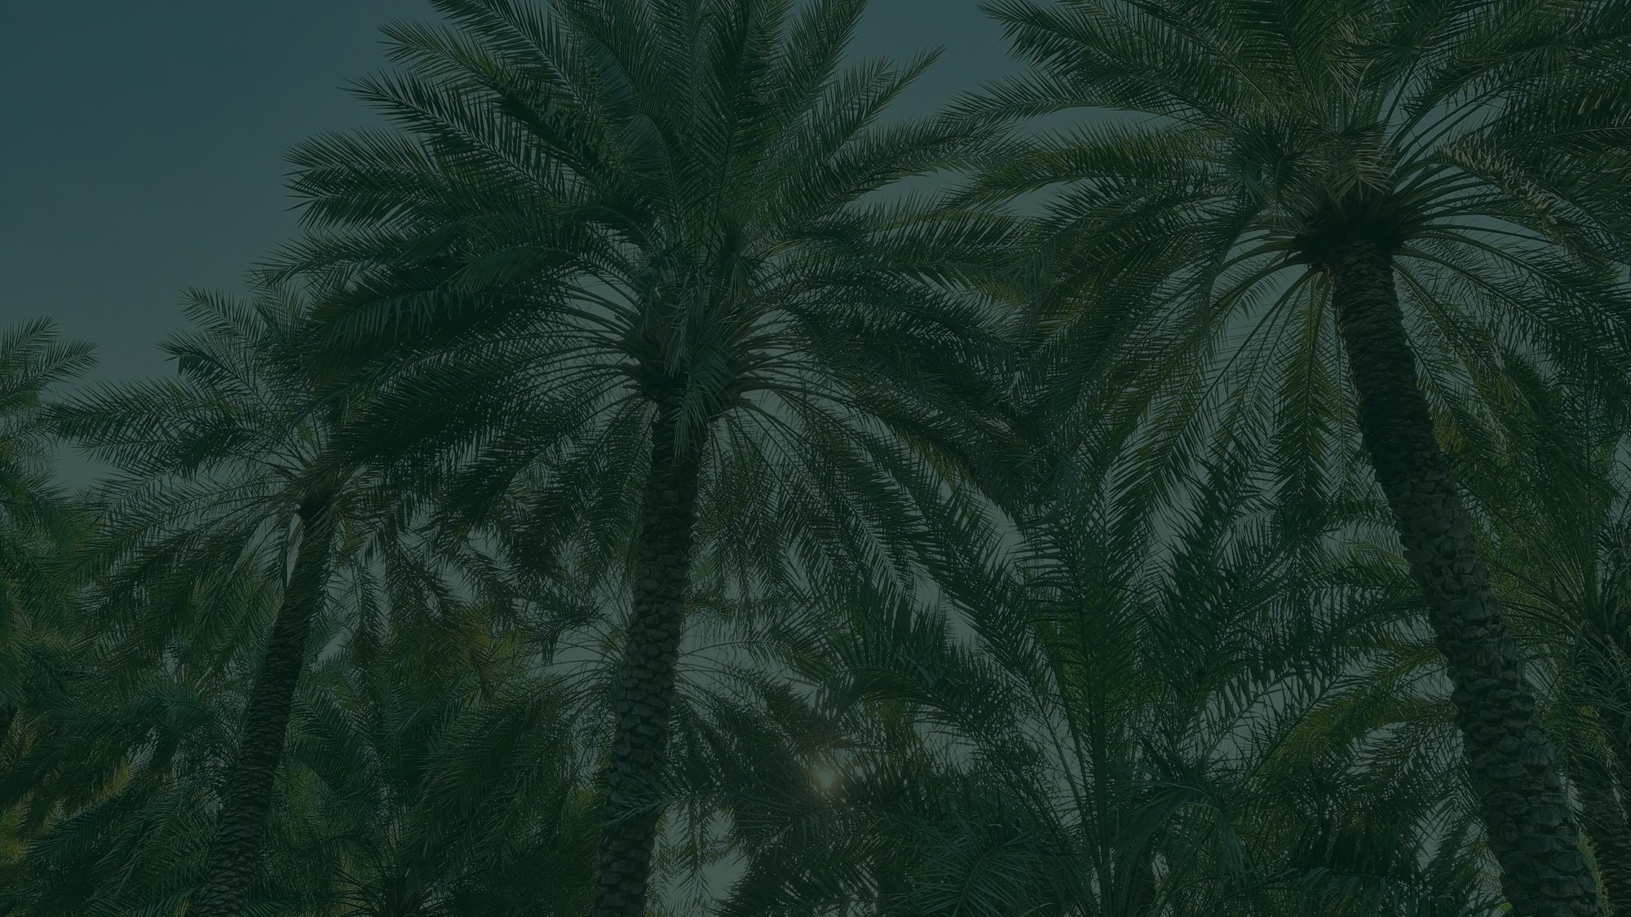

Tell us about your farm
Crop, irrigation method, soil type, the volume of water you use today. We come back with the matching combination of technologies, the dosing, and the trials already run in comparable situations.
A first conversation commits you to nothing.
contact@green-solutions-group.com · Green Solutions Groupe AIM SA, 46, route de la Condémine, 1475 Forel, Switzerland
Green Solutions · Oman market dossier
15

