Slide 1
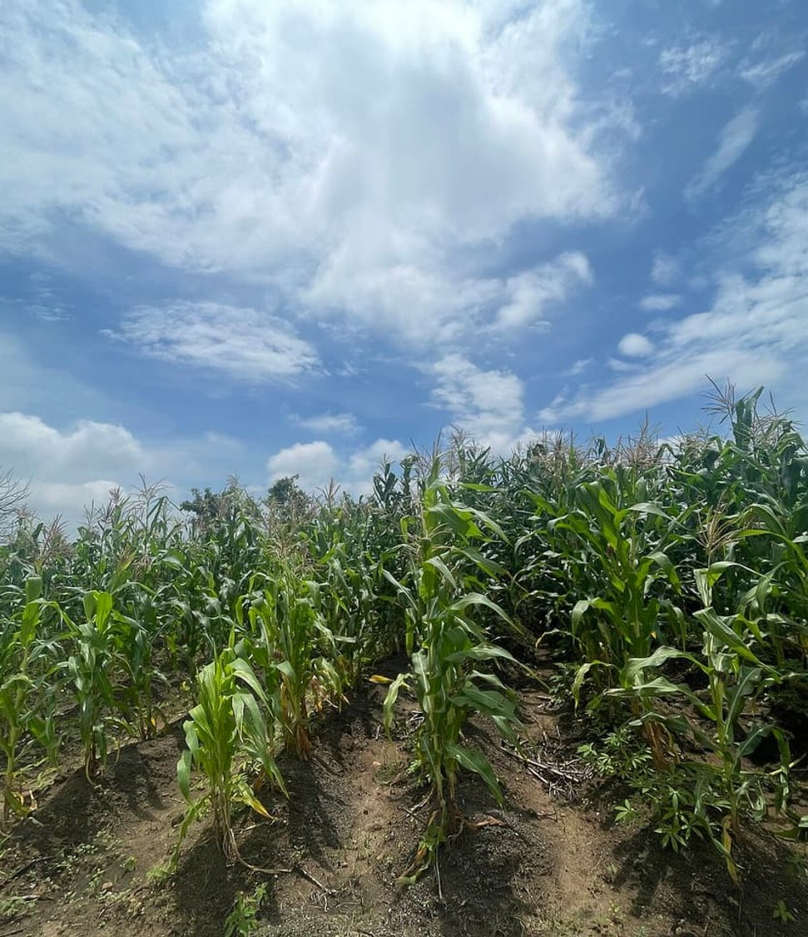


GREEN SOLUTIONS GROUP
UNITED STATES OF AMERICA
Washington · 2026
Row crops, permanent plantings and specialty produce on a shrinking water budget.
What hydro-retention changes for irrigated acres.
ECOSORB® · ECOFERT® · NAPEMA® · PAULOWNIA
September 2026 · Confidential · For the sole use of the recipient

Slide 2
THE MARKET AT A GLANCE
A large export sector working on a tighter water budget
880M acres
≈ 55M acres
≈ $180 B
≈ 2.6 M
of land in farms, about 40% of the land area
under irrigation, three quarters of it in the West
in annual agricultural and food exports
people working on farms, near 1.4% of all U.S. jobs
Farming contributes roughly 1% of GDP on its own, and close to 5% once processing and distribution are counted. Output is concentrated: a small share of operations generates most of the production value, and irrigated acres deliver far more than their proportion of that total.
Green Solutions · United States Market Dossier
1

Slide 3
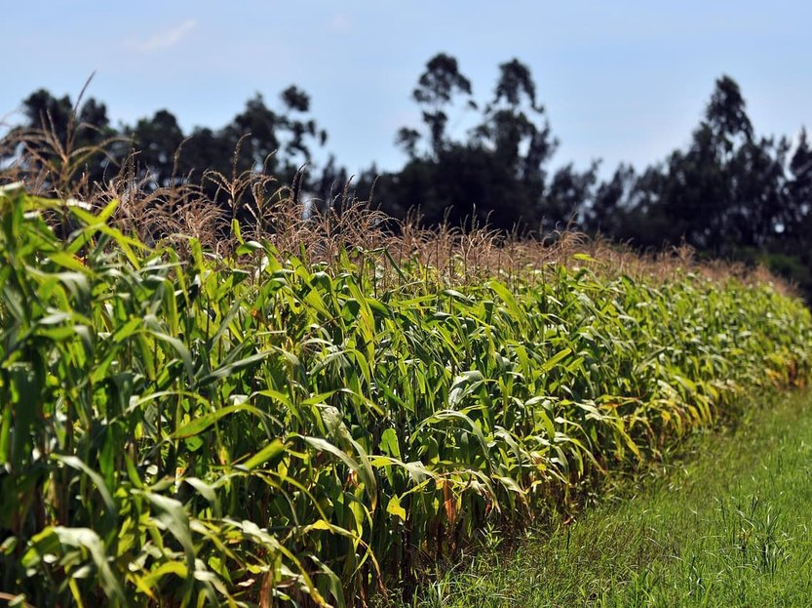
THE CONSTRAINT
Water scarcity here is regional, and it is structural
Annual precipitation runs from under 10 inches (≈ 250 mm) in the Desert Southwest to more than 50 inches (≈ 1,270 mm) in the Southeast. Irrigation follows that gradient.
About three quarters of irrigated acreage sits in the 17 western states, where most crops cannot be brought to harvest without applied water in a normal season.
The Colorado River serves some 40 million people and roughly 5 million irrigated acres. Lake Mead and Lake Powell have operated near a third of capacity in recent years.
The Ogallala Aquifer supports close to 12 million irrigated acres across eight states. In parts of Kansas and the Texas Panhandle, water levels have fallen by more than 100 feet.
Public policy works on supply — storage, recycling, fallowing payments, groundwater plans California basins must balance by 2040. Hydro-retention works on demand, in the root zone.
Center-pivot irrigation, Great Plains
Green Solutions · United States Market Dossier
2

Slide 4
DROUGHT AND WATER STRESS
Pressure is rising, but risk remains local
Two indicators, not a shortcut
Worldwide, the number and duration of droughts have risen by 29% since 2000 compared with the two previous decades.
Water stress measures something different: withdrawals as a share of renewable resources available after environmental needs. This global signal is therefore not a country forecast; it must be read alongside local rainfall, aquifers, seasons and uses.
Green Solutions · United States Market Dossier
3

Slide 5
WHERE THE WATER GOES
Irrigation and power cooling dominate withdrawals
What this means
The industrial share is inflated by once-through cooling at power plants, which returns most of its water to the river.
Irrigation is different: most of what is applied is consumed. In consumptive terms, farming accounts for the large majority of U.S. freshwater use.
Green Solutions · United States Market Dossier
4

Slide 6
ECONOMY AND FOOD SYSTEM
The largest farm exporter, on a tightening water ledger
≈ 1.9 M
≈ 0.7 %
≈ $59 B
≈ 80 %
farms, averaging about 460 acres each
of GDP from farms alone, over 5 % with food industries
in 2023 farm cash receipts for California, the top state
of the world's almonds grown in California
Fruit, nuts and vegetables cover a small share of cropland but a large share of farm value, and most of them are irrigated in the West. California's Sustainable Groundwater Management Act and falling water tables on the High Plains now cap how much water those acres can draw.
Green Solutions · United States Market Dossier
5

Slide 7
THE MAJOR CROPS
Five outputs carry the bulk of farm volume
Reading
Corn and soybeans carry the volume, largely rain-fed across the Midwest.
Hay and forage are the single largest consumer of irrigation water in the West; alfalfa alone takes a significant share of Colorado River deliveries. Potatoes and specialty crops carry the highest value per acre.
Green Solutions · United States Market Dossier
6

Slide 8
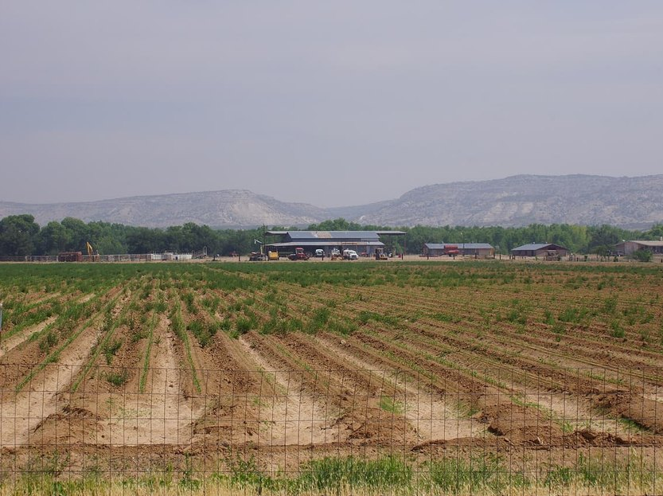
FIRST SECTOR
California specialty crops: every acre-foot is margin
California grows most U.S. almonds, pistachios, table grapes, strawberries and processing tomatoes, all under irrigation.
In drought years surface-water allocations have fallen close to zero, pushing growers onto groundwater.
SGMA requires groundwater basins to reach sustainable pumping by the early 2040s: less water per acre, or fewer acres.
Orchards cannot be rotated out in a dry year; keeping the root zone moist protects a multi-decade investment.
A water retainer placed at planting, or when an orchard is renewed, lengthens the interval between irrigations.
Green Solutions · United States Market Dossier
7

Slide 9
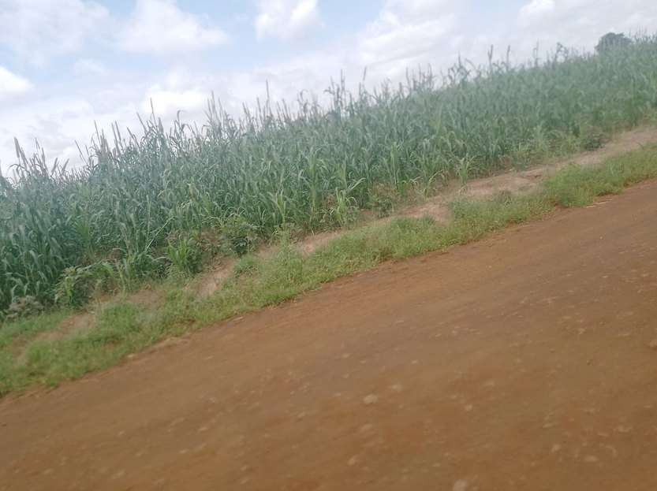
SECOND SECTOR
High Plains corn above a shrinking Ogallala
The Ogallala aquifer underlies parts of eight states and carries much of the irrigated corn, sorghum and cotton of the High Plains.
In southwest Kansas and the Texas Panhandle, some wells no longer yield enough for full irrigation.
Local districts now set pumping limits, and growers are shifting to fewer pivot acres or limited irrigation.
For grain crops we claim no yield gain without a field trial: the case rests on the water saved per acre.
Trials pair a treated pivot sector with an untreated one, measured over a full season with soil-moisture probes.
Green Solutions · United States Market Dossier
8

Slide 10
Yield potential
Expected yield gain by crop
Read with care
Ranges used by our dose calculator, for a normally managed crop with EVERGREEN® applied at planting.
Actual results depend on soil, climate and management. For cereals, no gain is claimed without a field trial.
Green Solutions · United States Market Dossier
9

Slide 11
OUR ANSWER
Two technologies for two different constraints
EVERGREEN® — hold the water
ECOFERT® — feed without depleting
Potassium-based hydro-retainer, placed in the root zone at planting or at the first pass of the season.
Captures rain and irrigation water, then releases it back to the plant as demand arises, removing water stress during the critical growth stages.
Absorbs on the order of 300 times its own weight; useful life of 3 to 4 years in the soil.
Degrades by 20 to 25% per year, with no accumulation and no risk of overdose.
Microdose fertilizer built on amino acids, nitrogen, phosphorus and potassium, sourced from renewable inputs.
Non-chelating: it does not strip the clay-humus complex and does not raise soil salinity or nitrate load.
SOHISCERT and EU Organic certified — the condition of entry to organic and export buyer programs.
1 to 4 bottles of 140 ml per hectare, compatible with existing fertigation equipment.
The two products are sold separately but were designed to reinforce one another: the hydro-retainer extends how long water stays available, the fertilizer converts that available water into growth without degrading the soil.
Green Solutions · United States Market Dossier
10

Slide 12
The rest of the range
Protecting crops, holding soils
NAPEMA® — protection without residue
Paulownia ALTIFOLIA® — the tree for hot regions
Controls diseases, parasites, fungi and pests, with no synthetic molecule.
Foliar and root spraying, working both preventively and curatively.
No residue in soil, plant or air: pollinators and beneficial insects are spared.
Formulated for one precise problem: mealybug, citrus greening (HLB), nematodes.
13 to 15 m in six to eight years, with a wide trunk.
Combined with 100 g of EVERGREEN® per plant, irrigation needs drop by 50%.
Withstands −25 °C to +45 °C; the wood only ignites above 426 °C.
Windbreak, protection against soil erosion, 400 to 700 kg of honey per hectare.
Plants delivered potted (25 to 30 cm), certified disease-free and replaced under warranty in case of loss. First harvest at the end of year six, with wood valued at around €400 to €450 per m³.
Green Solutions · United States Market Dossier
11

Slide 13
ORDERS OF MAGNITUDE
Expected water savings by irrigation method
Read with care
These ranges are indicative and rest on documented gains from our hydro-retainers.
Actual results depend on the soil, the climate and the crop. The figures give an order of magnitude only: they are in no case a guaranteed, contractual or absolute value.
Green Solutions · United States Market Dossier
12

Slide 14
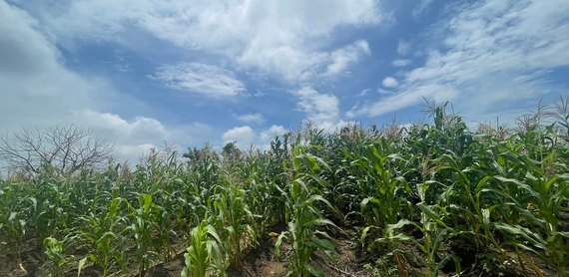
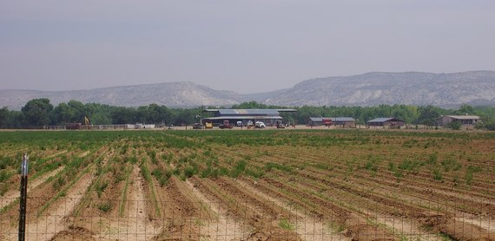
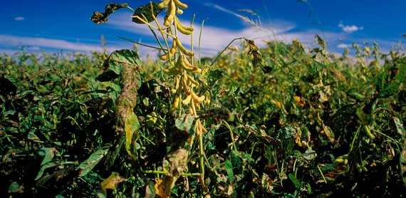
THREE PRIORITY AREAS
Where to run the first trials
Central Valley, CA
High Plains
Columbia Basin
≈ 5M irrigated acres
≈ 12M irrigated acres
≈ 700k irrigated acres
More than 250 crops on one valley floor — almonds, pistachios, grapes, processing tomatoes. Permanent plantings cannot simply be fallowed in a dry year.
State groundwater plans tighten pumping allowances through 2040: growers need savings per acre, not new supply.
Drip and micro-sprinkler are already standard, so the remaining gain has to come from the soil itself.
Corn, sorghum, cotton and alfalfa across Nebraska, Kansas, Colorado and the Texas Panhandle, almost entirely on center pivot.
Aquifer levels have declined for decades; well yields fall and pumping lift rises, pushing up energy cost per acre-inch applied.
Sandy and sandy-loam soils hold little water — retention in the root zone has a direct, measurable effect.
Potatoes, apples, hops, onions and wine grapes on sandy volcanic soils with very low water-holding capacity.
Under 10 inches of rain a year: every acre depends on delivered water from the Columbia River system.
High value per acre and strict packer quality specifications justify spending on per-acre inputs.
Green Solutions · United States Market Dossier
13

Slide 15
HOW WE PROCEED
A staged rollout, measured at every step
1
2
3
4
Assessment
Trial block
Measurement
Rollout
Review of the soil, the irrigation method and the crop. No commitment at this stage.
A comparative trial on one block, against a control block managed identically.
Water use and yield recorded across a full production cycle.
Gradual extension to the remaining acres on the basis of the results observed.
The dosing rule is the same everywhere: 3 grams per liter of usable soil. What changes from one field to the next is the volume of soil the roots actually explore.
Green Solutions · United States Market Dossier
14

Slide 16
Working together
A local partner for the United States
1
2
3
4
Distribution
Training
Joint trials
Institutions
Territorial exclusivity and launch stock for the first commercial season.
Technical training for field teams, dosing protocols and seasonal updates.
Demonstration plots with a control, results shared with growers.
Dialogue with the Ministry of Agriculture and food-security programmes.
The framework adapts to the territory: an importer, an input distributor or a growers' group can lead the partnership.
Green Solutions · United States Market Dossier
15

Slide 17
WHAT TO ANTICIPATE
Identified risks and how we answer them
Risks
Answers
Year-to-year rainfall variability: a wet season masks the value of the product.
Long purchasing cycles and agronomist sign-off on large operations, plus dealer and co-op channels to qualify.
Memory of low-grade sodium-based polymers, which left a poor reputation among growers.
Tight margins on row crops when input costs rise faster than commodity prices.
Run the trial over a full cycle with a control block, so the gain is documented even in a favorable season.
Work through dealers, co-ops and crop consultants rather than farm by farm, and supply the trial protocol in advance.
Document the formulation: potassium, never sodium, compatible with food crops and with soil health.
Spread the outlay: a 3 to 4 year useful life amortizes the cost across several seasons.
Acrylamide analysis (Polymex laboratory, ISO 9001, content below 3.0 µg/g), REACH / SVHC screening (SGS) and the SOHISCERT certificate valid to 4 September 2027 are all available on request.
Green Solutions · United States Market Dossier
16

Slide 18
Sources
Sources and working assumptions
Main sources
Working assumptions
USDA NASS: 2022 Census of Agriculture, state farm cash receipts.
USDA ERS: agriculture and food sectors in the economy, farm exports.
USGS: estimated water use in the United States, High Plains aquifer monitoring.
California Department of Water Resources (SGMA); Almond Board of California.
UNCCD, Drought in Numbers 2022: number and duration of droughts, +29% since 2000 versus 1980–1999.
UN-Water / FAO AQUASTAT, SDG indicator 6.4.2: definition and thresholds of water stress.
Figures are rounded orders of magnitude, taken from the latest public data available.
Water and yield gains are indicative and vary with soil, climate and crop.
Commercial working document: figures to be refreshed before any official submission.
Trial reports, certificates (SOHISCERT, Polymex and SGS analyses) and technical sheets: available on request.
Green Solutions · United States Market Dossier
17

Slide 19
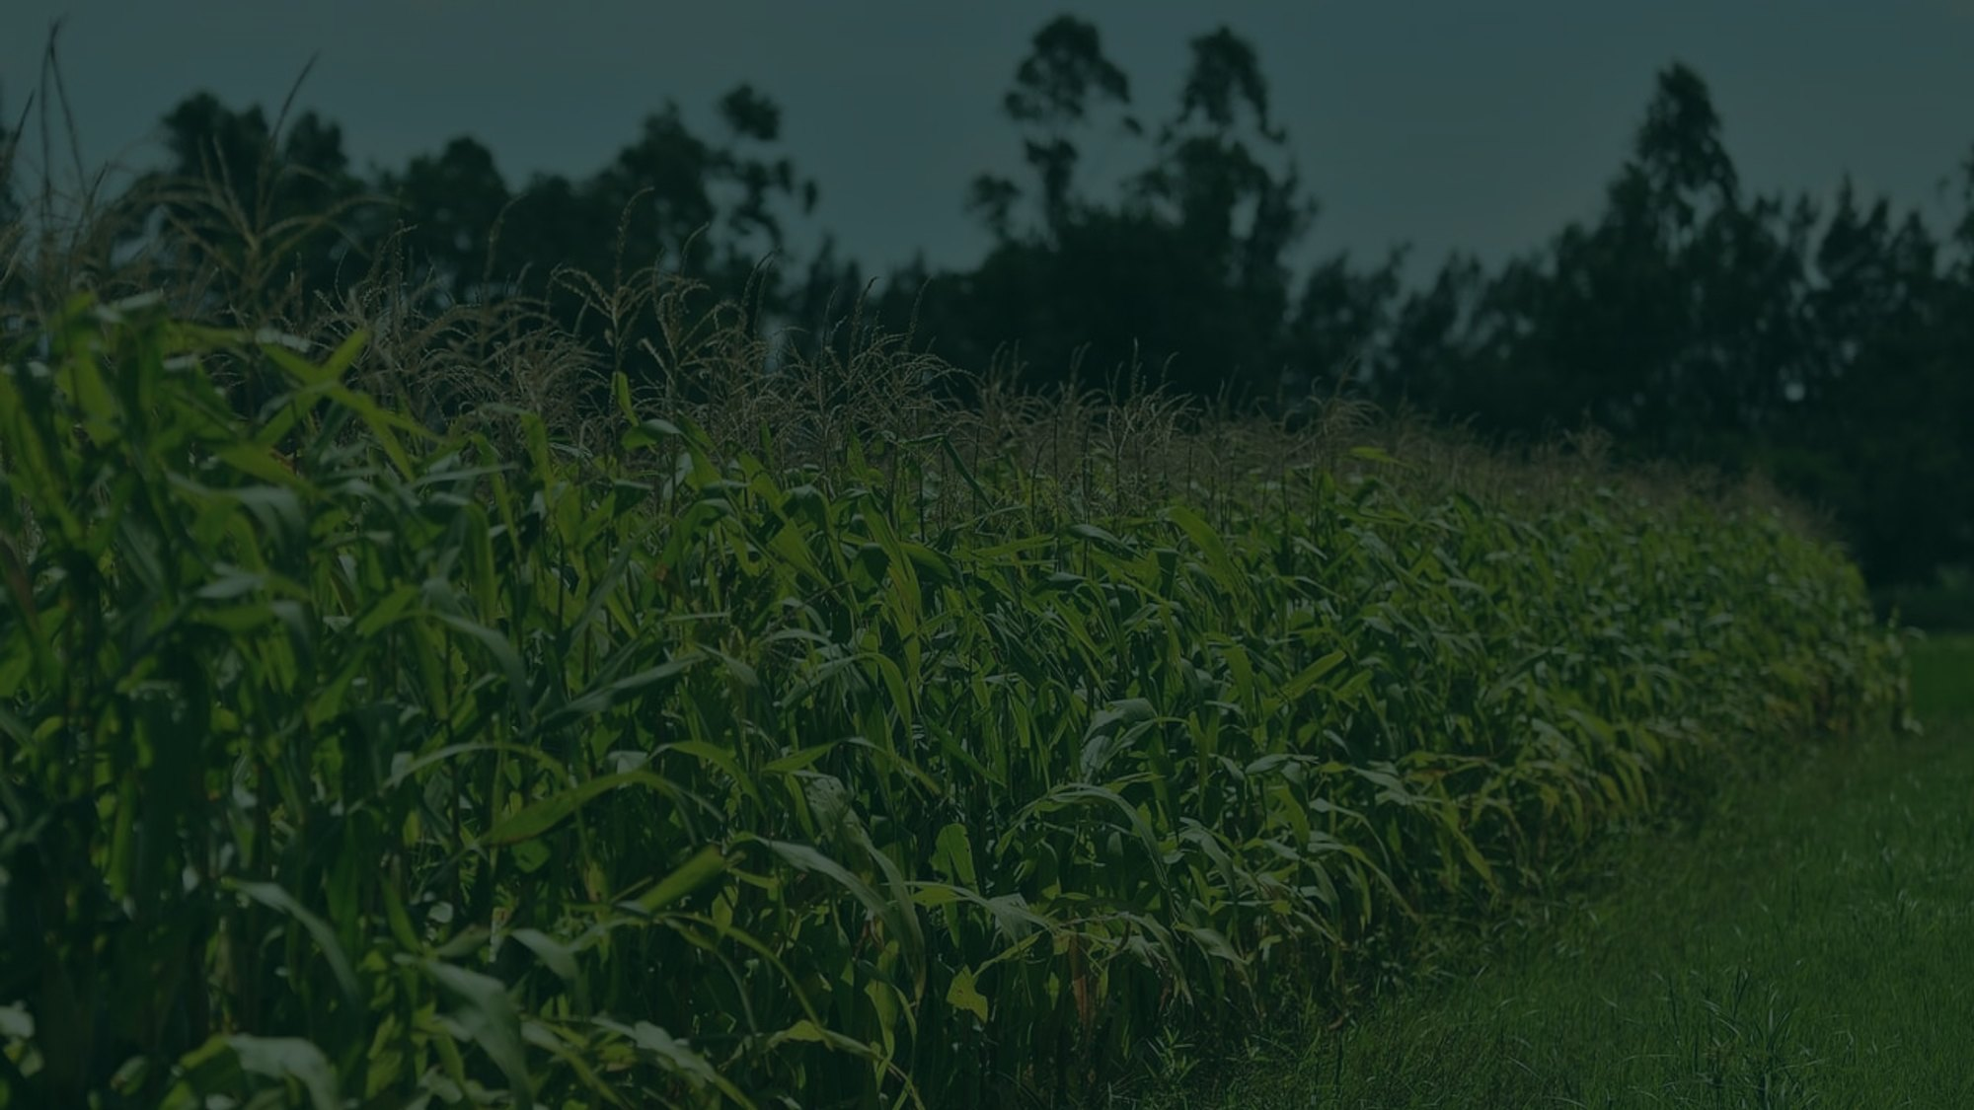

Tell us about your field
Crop, irrigation method, soil type, and the water volume you apply today. We come back with the matching combination of technologies, the dosing, and the trials already run in comparable conditions.
A first conversation commits you to nothing.
contact@green-solutions-group.com · Green Solutions Groupe AIM SA, 46, route de la Condémine, 1475 Forel, Switzerland
Green Solutions · United States Market Dossier
18

