Slide 1

The Last
Aborigene

Slide 2

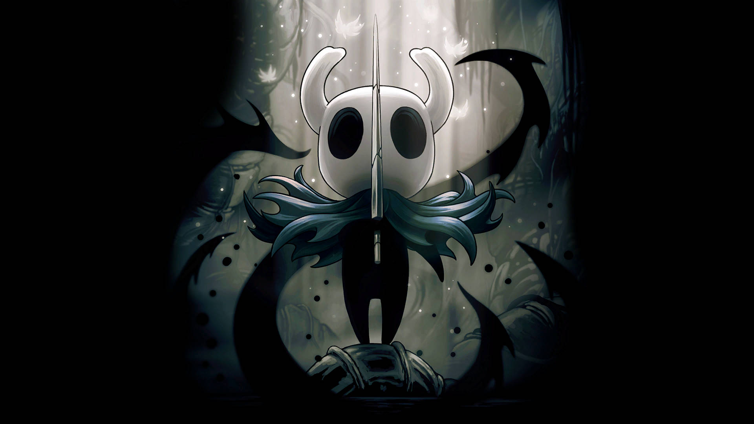
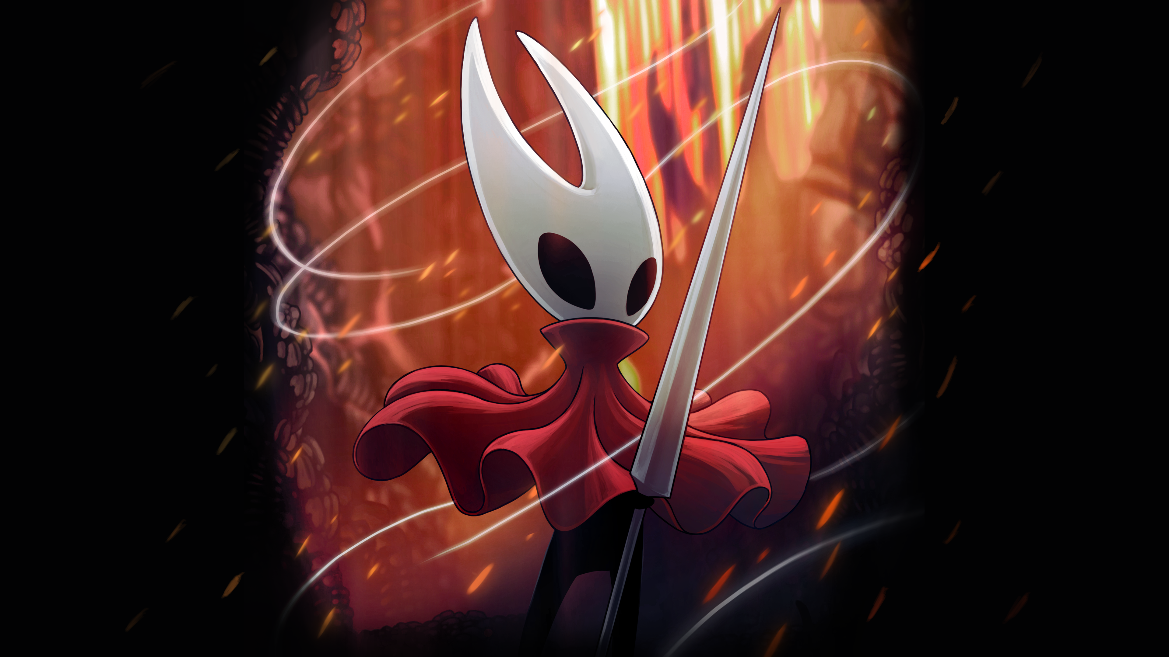
Team Cherry
~18.33 M by PlayTracker
97 % Positive review on steam
Many awards
~7.99 M by PlayTracker
96 % Positive review on steam
Many awards

Slide 3
PLACEHOLDER

Slide 4

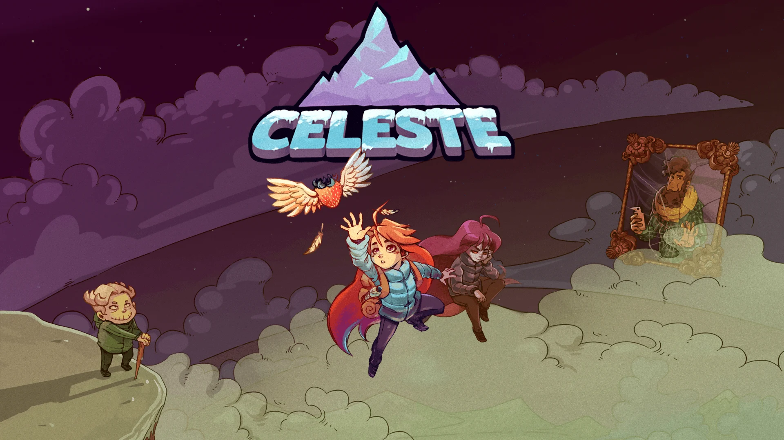
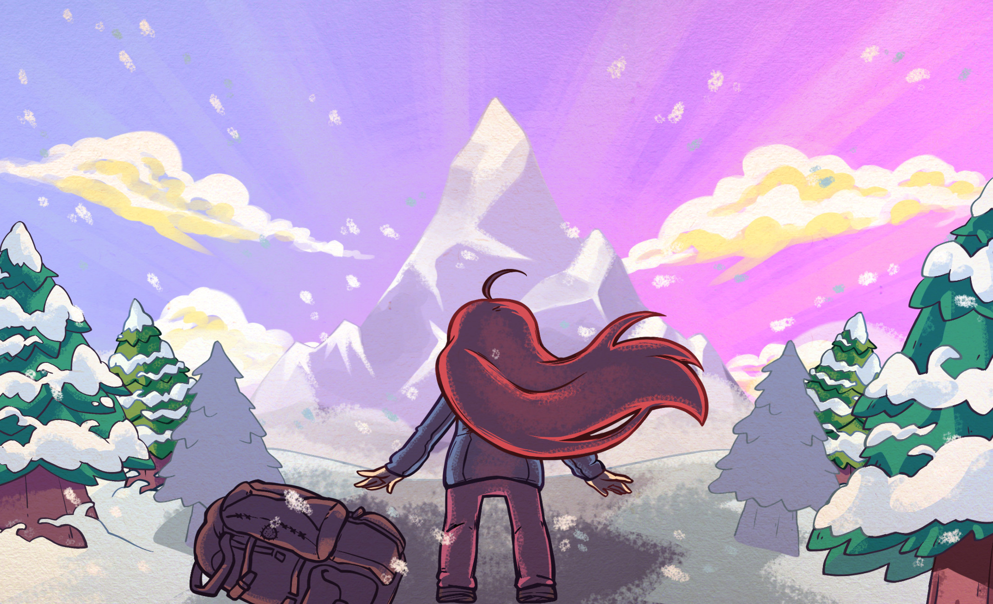
Extremely OK Game
~1.86 M by PlayerTracker
97 % Positive review on steam
Many awards

Slide 5
PLACEHOLDER

Slide 6

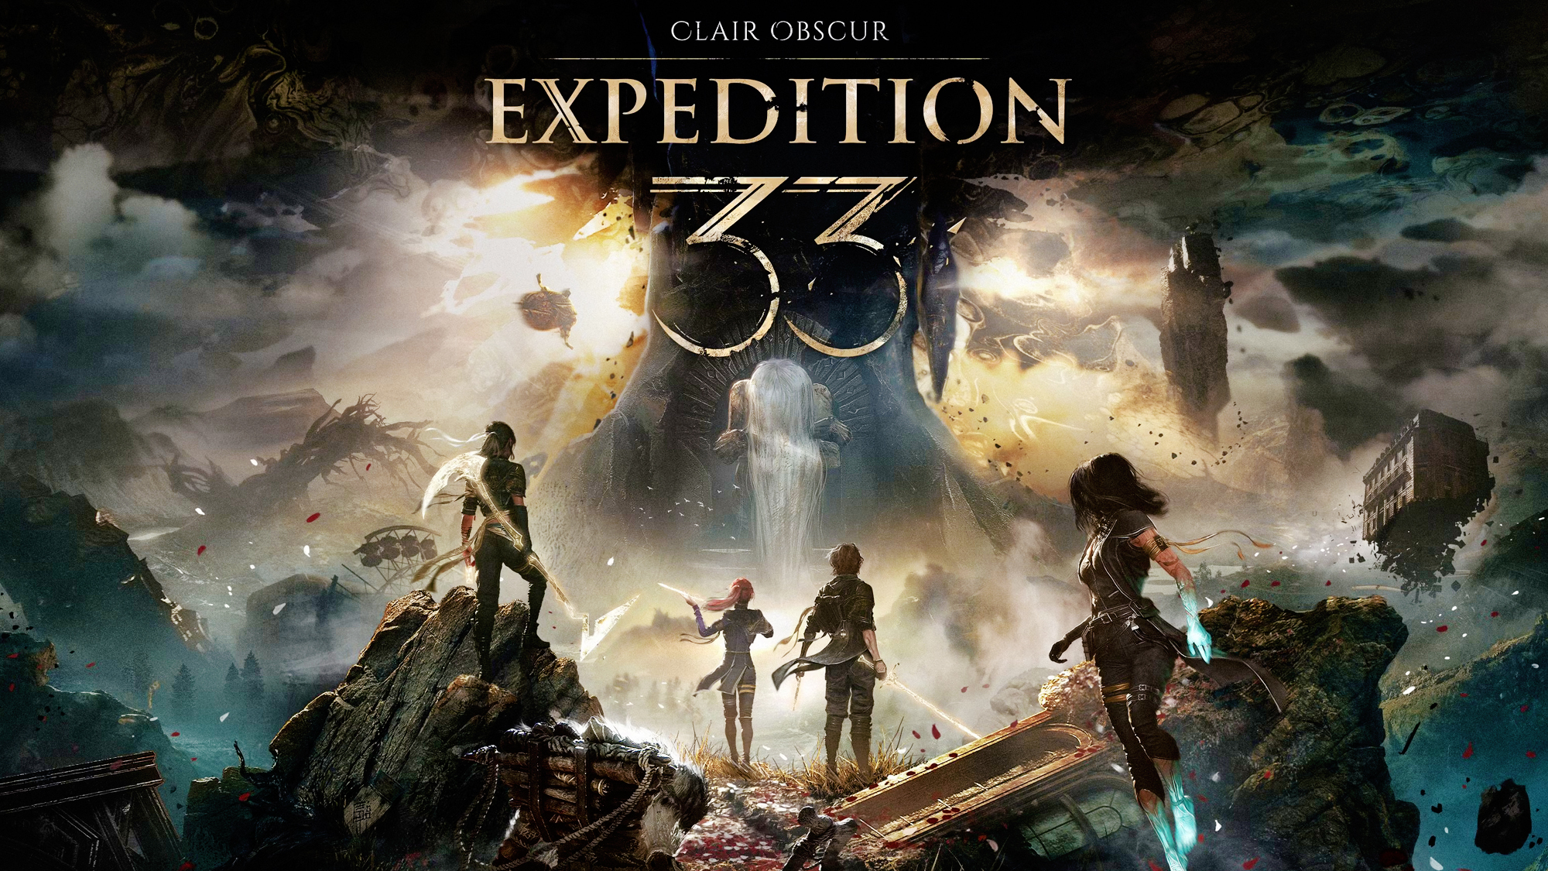
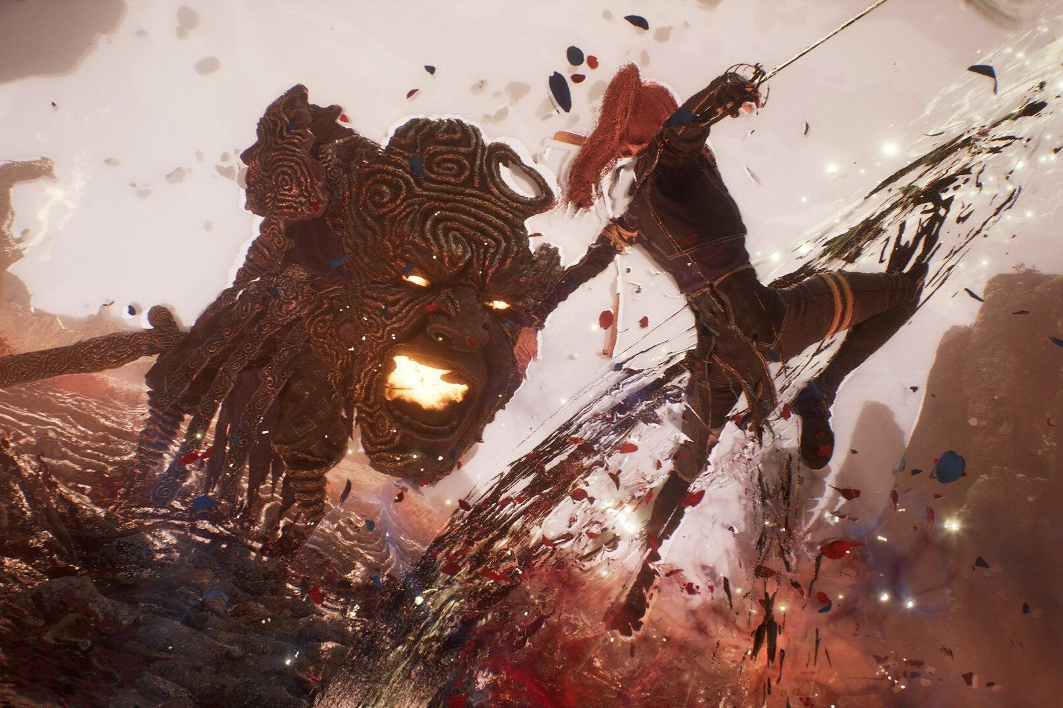
Sandfall Interactive
Sanfall interactive is a french indie games studio.

Slide 7
Software that we used
GIMP
Git
Visual Studio Code
Godot
LibreOffice
Firefox
Our game is open source and available on github

Slide 8

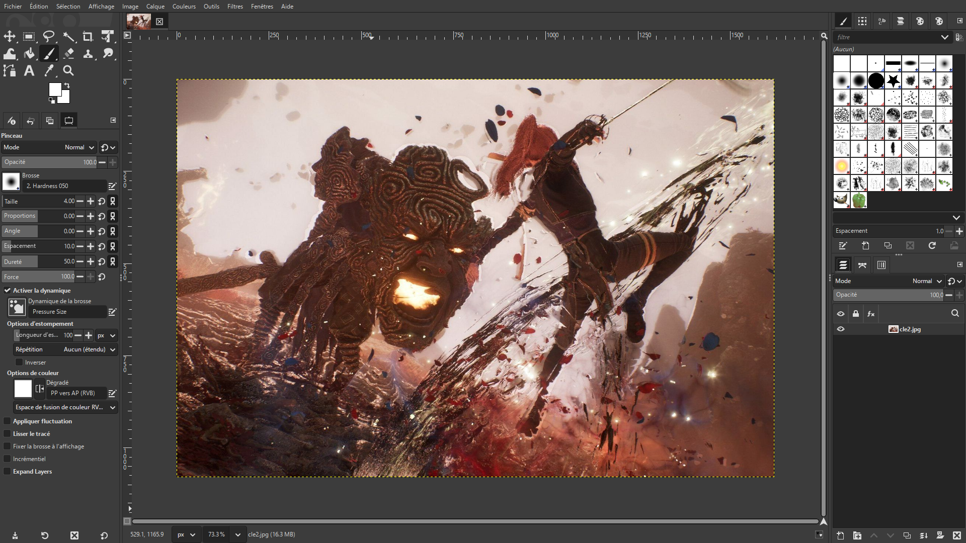
Gimp

Slide 9

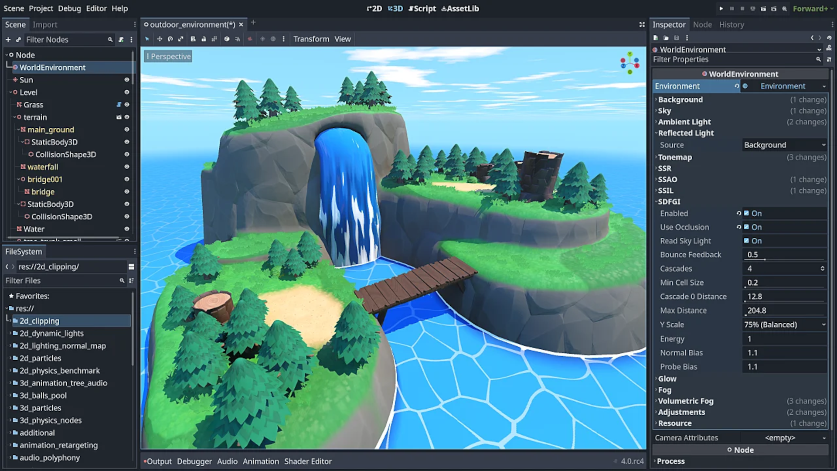
Godot

Slide 10

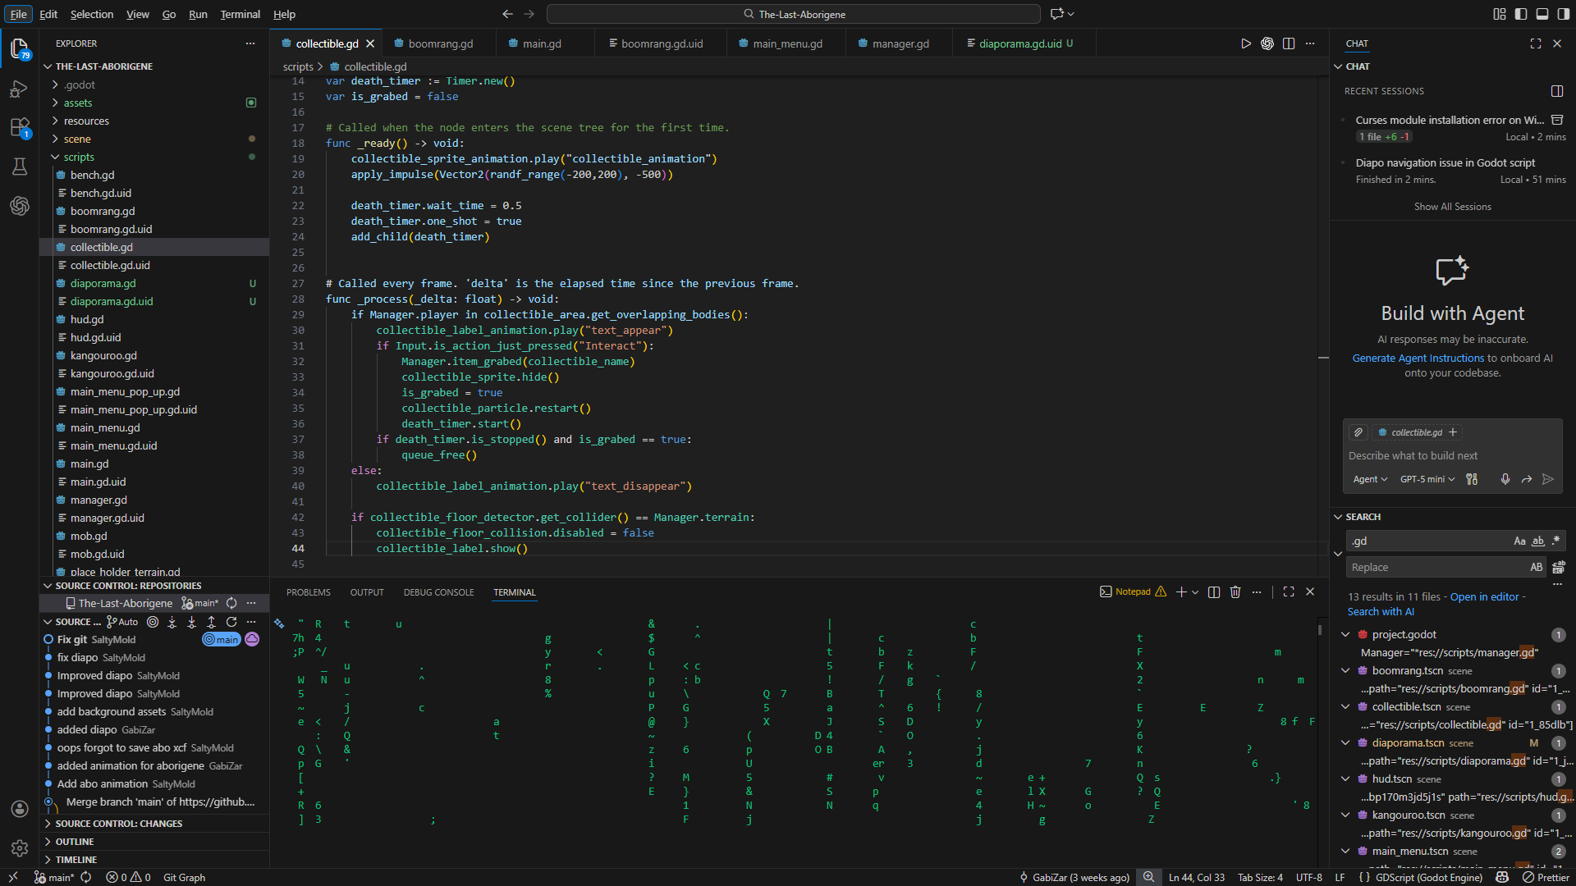
Visual Studio Code

Slide 11

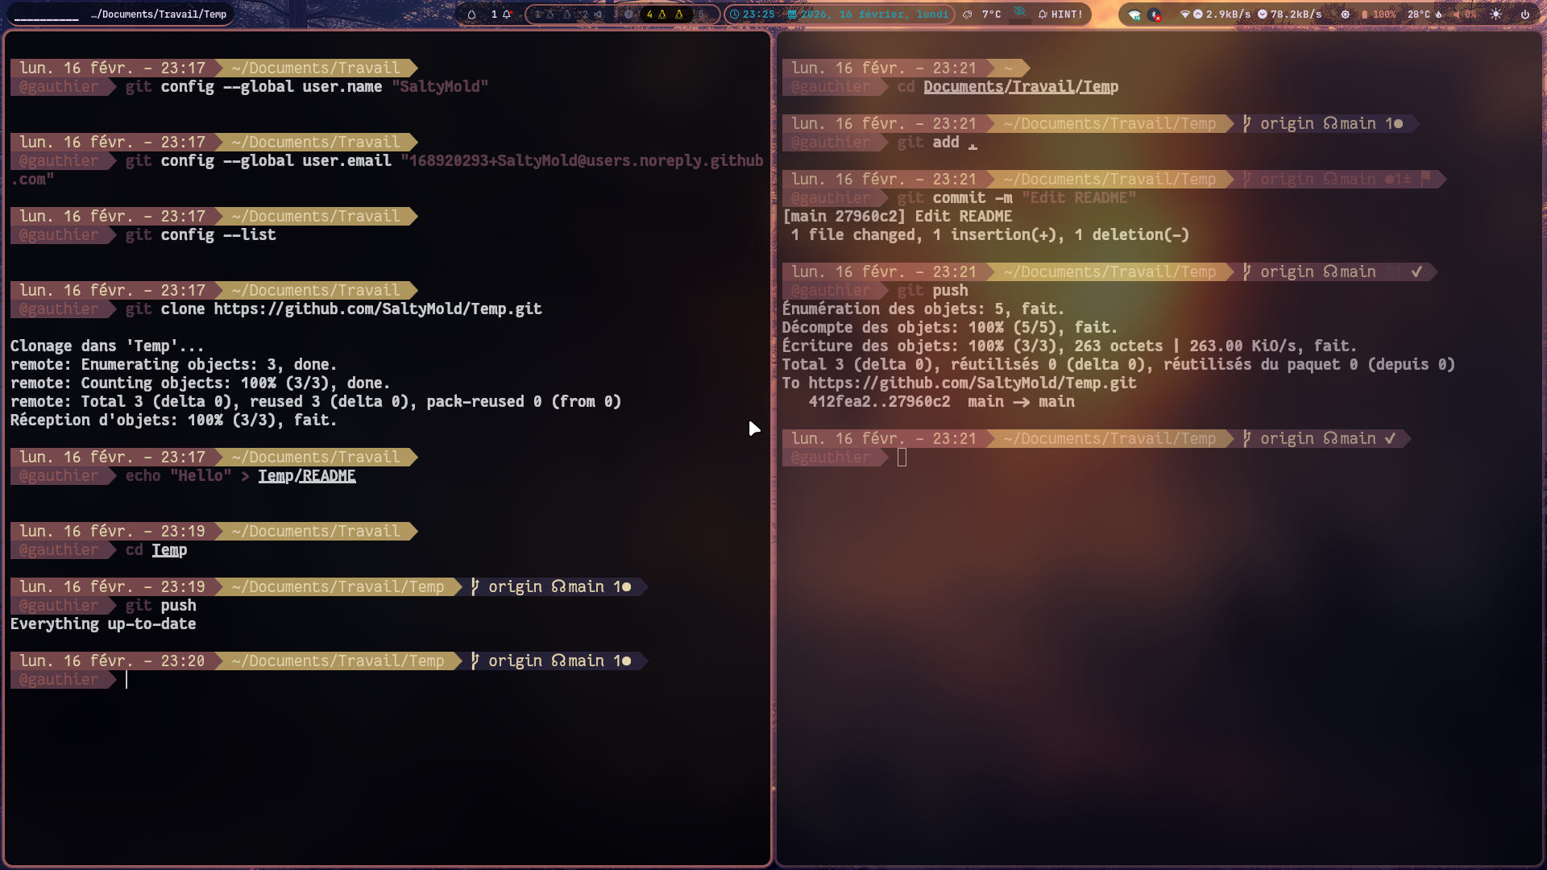
Git

Slide 12

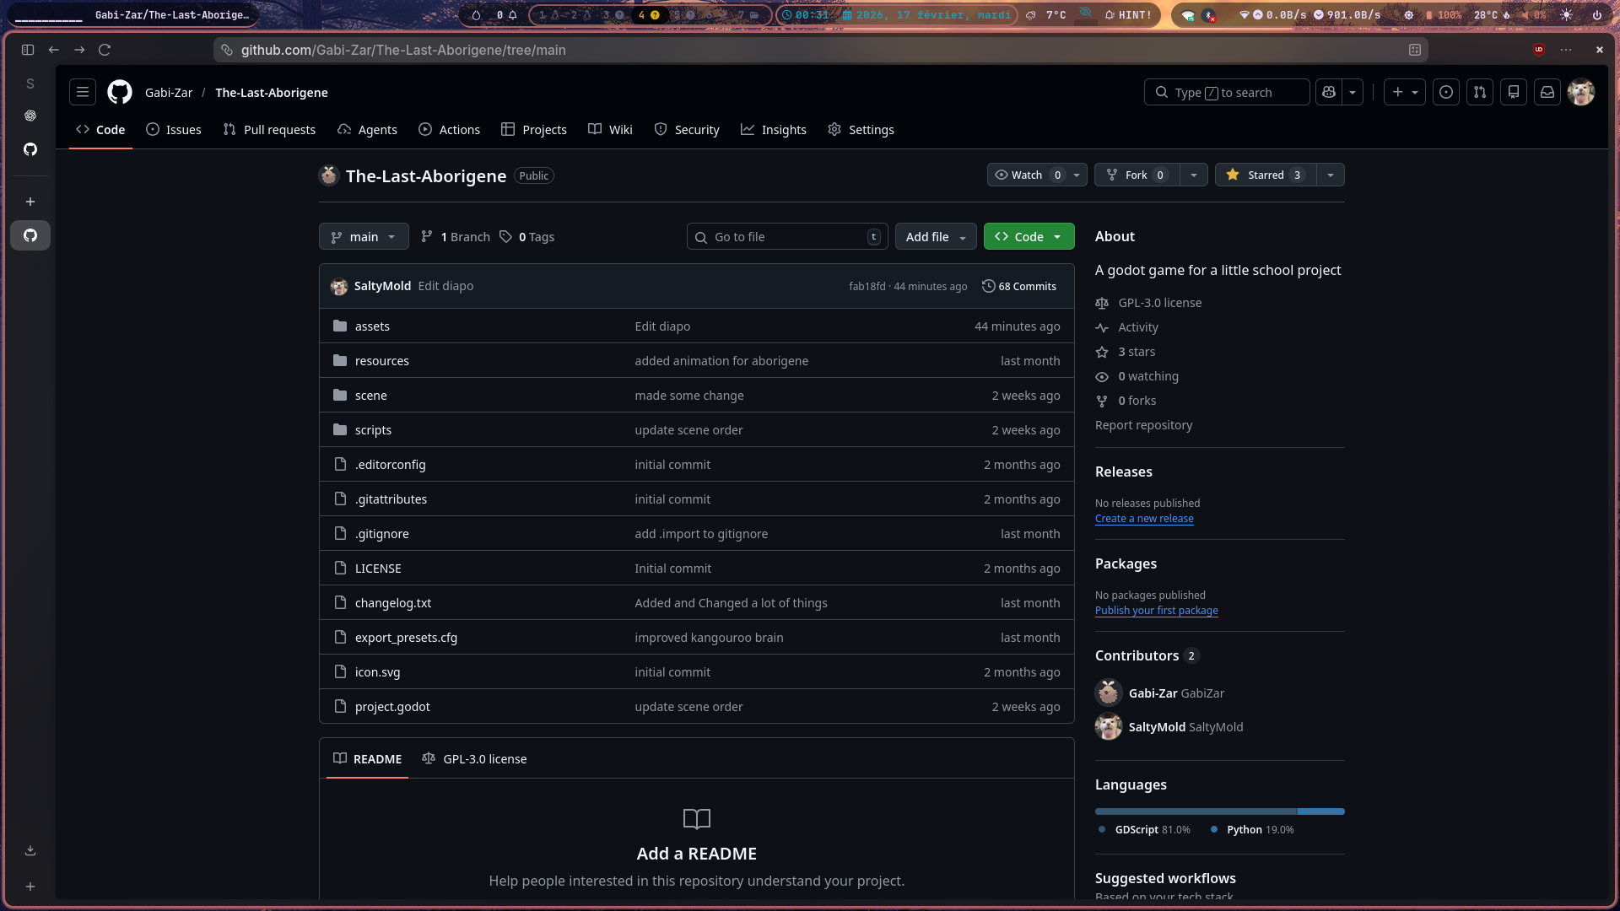
Firefox

Slide 13

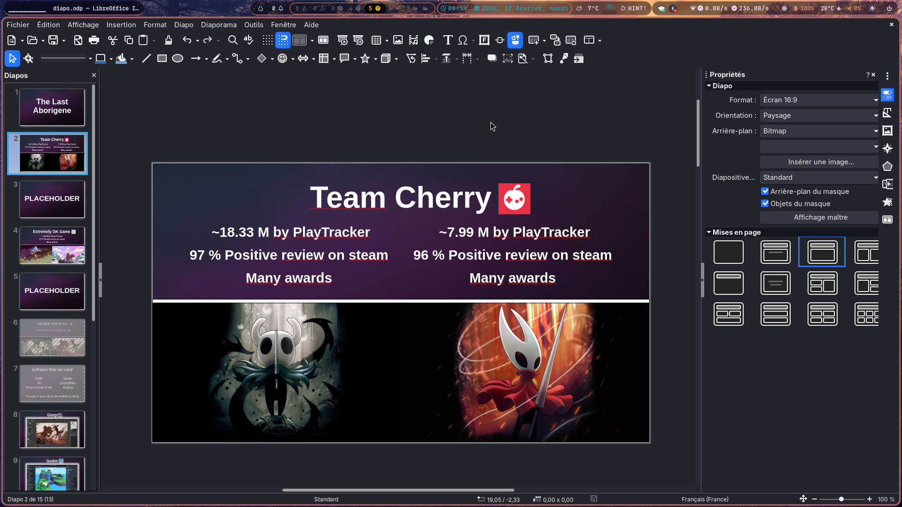
LibreOffice

Slide 14
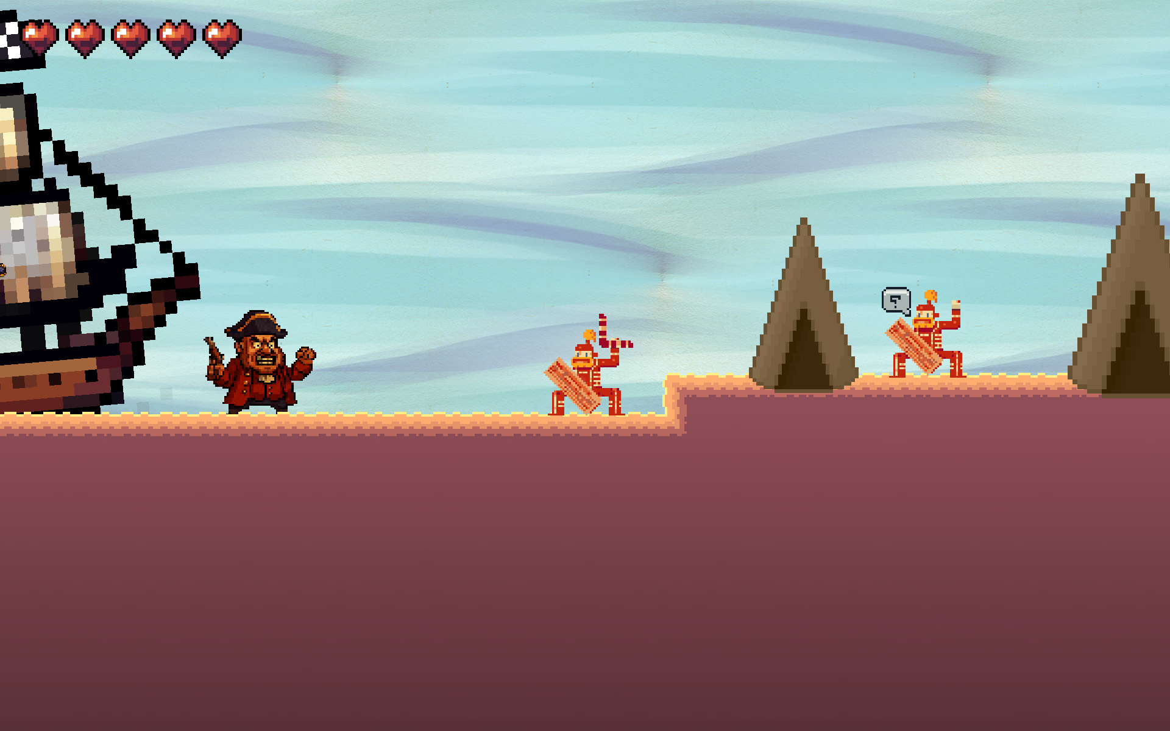
Our game

Slide 15
Glossary
Metroidvania = A video game genre based on exploration, backtracking, and progression through unlocked abilities
Souls like = A type of gameplay inspired by the Dark Souls games, known for difficulty and demanding combat
Platforming = Gameplay based on jumping, movement, and precision
Open source = Software whose source code is publicly available and modifiable
Game engine = Software used to create video games
Version control = System used to manage file changes
Artistic direction = Overall visual style of a project
CLI = Command Line Interface = A software that brings together tools to write, edit, and debug code in one place
IDE = Integrated Development Environment = A text-based interface that allows users to interact with a computer by typing commands

