Slide 1

The Last Aborigene

Slide 2

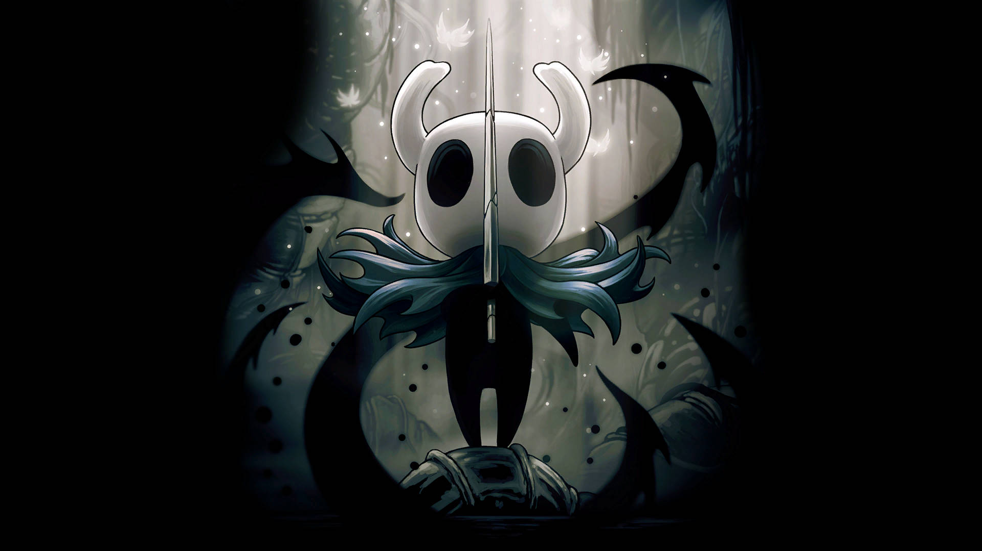
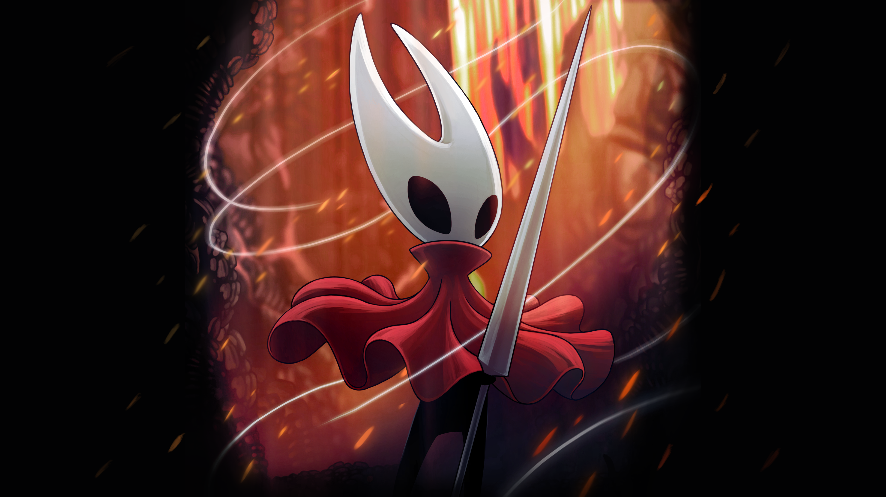
Team Cherry
Team Cherry is a small indie games team in Adelaide, South Australia.
They are known to have created one of the most popular and succesfull indie game of all time Hollow Knight in 2017 and Hollow Knight : Silksong 2025

Slide 3
OpenSource Software
GIMP
Git
VS code
Godot

