Slide 1
POWER BI PROJECT
“Happy Insurance”
Technion - Israel Institute of Technology
Continuing and Professional Education
Course: Big Data Analyst
Handed by: Haim Zimbovsky, Slava Bakman, Gabriel Halimi

Slide 2
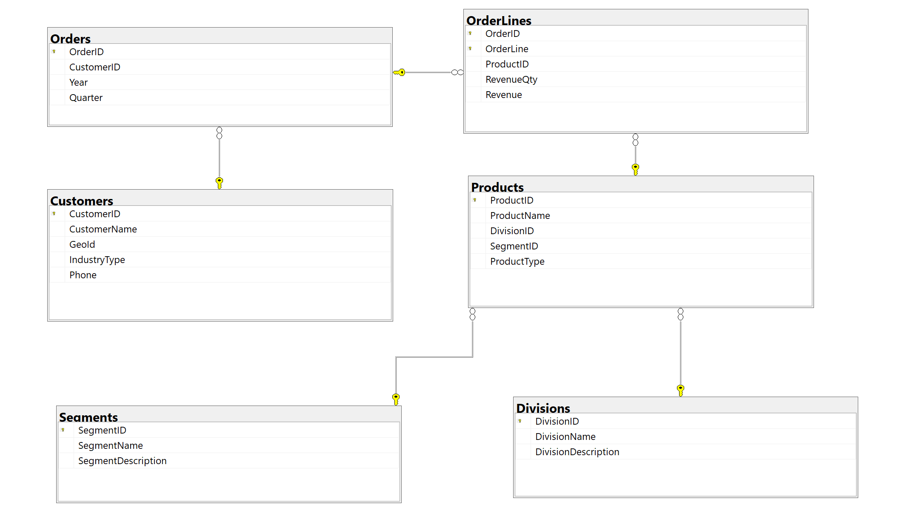
Project Analysis
Data Source
SQL Data Base: Happy_Insurance
Excel File: Happy_Insurance.xlsx
GeoID_SK | GEO Region | Country
1 | Americas | Canada
2 | Americas | Guam
3 | Americas | USA
4 | APAC | Australia
5 | APAC | Bangladesh
6 | APAC | China
7 | APAC | Hong Kong
8 | APAC | India
9 | APAC | Indonesia
10 | APAC | Macau
11 | APAC | Malaysia
12 | APAC | Mauritius
13 | APAC | Nepal
14 | APAC | New Zealand
15 | APAC | Philippines

Slide 3



Project Analysis
ETL
Customers
Divisions
Dim_Orders
Dim_Customers
Dim_Products
OrderLines
Orders
ETL
Dim_Divisions
Dim_Segments
Fact_OrderLines
Products
Segments
Dim_Date
Dim_Region
Region

Slide 4
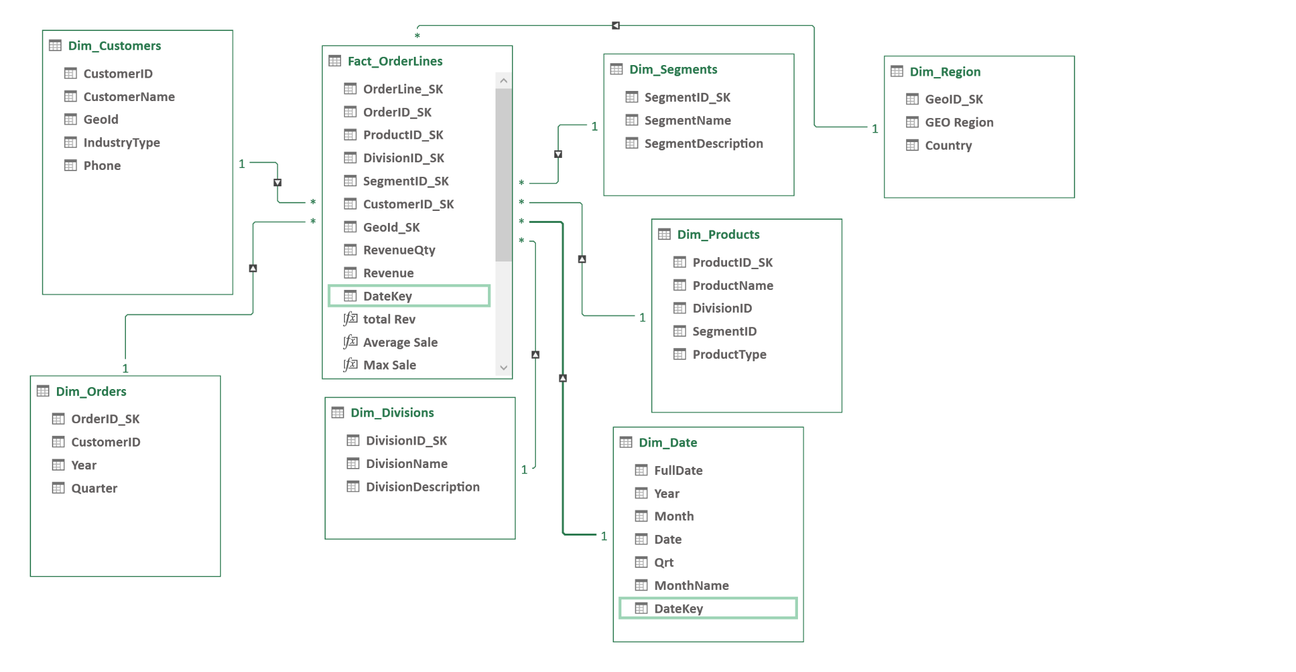
Project Analysis
Star Scheme

Slide 5
Project Analysis
Relationship between Fact_OrderLines and Dim_Date
Merge between Fact_OrderLines and Dim_Orders
Extract columns “Year” and “Quarter”
Replace quarter to first month of each quarter
Add first date to each month, for example 1.4.2012
Create DateKey as combination of year, month and date
Create relationship between Fact_OrderLines and Dim_Date

Slide 6
Project Analysis
DAX Code Examples
EVALUATE(
row("All Revenue By Country",
CALCULATE( sum(Fact_OrderLines[Revenue]),
//Dim_Products[ProductName] = "Health Care",
//Dim_Customers[CustomerName] = "Debra",
Dim_Region[Country] = "USA",
ALL(Dim_Orders)
)
)
)
EVALUATE (
SUMMARIZE(
Fact_OrderLines,
Fact_OrderLines[ProductID_SK],
"Sum Revenue", sum(Fact_OrderLines[Revenue])
)
)
EVALUATE(
row("Same Period Last Year",
CALCULATE(SUM(Fact_OrderLines[Revenue]),SAMEPERIODLASTYEAR('Dim_Date'[FullDate]))
)
)
define
Var CustAmt = COUNT(Dim_Customers[CustomerID])
EVALUATE(
row("Avg Customer Rev",
Sum(Fact_OrderLines[Revenue]) / CustAmt
)
)

Slide 7
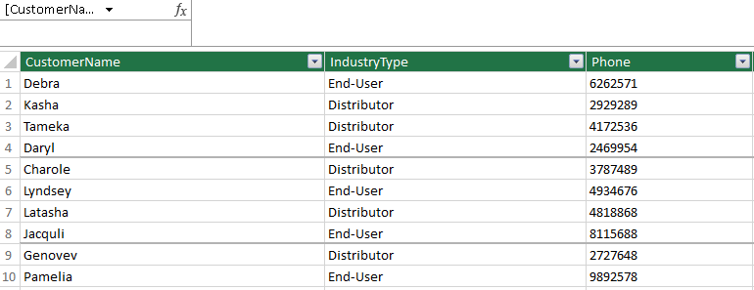
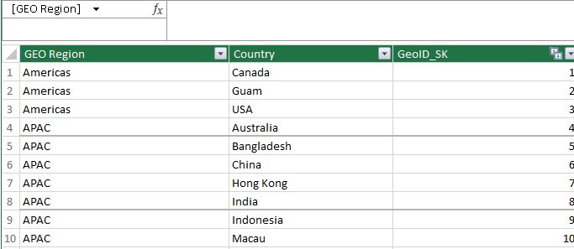
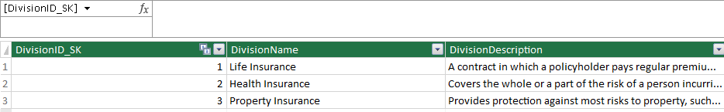
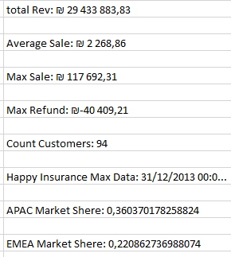
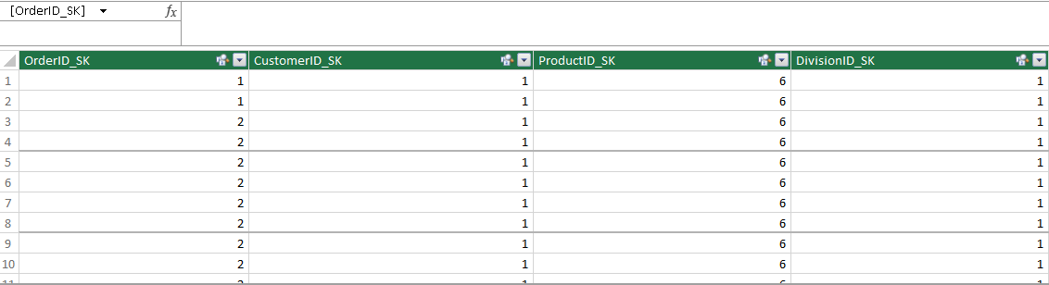
Project Analysis
Tabular Model
Files Power Pivot
Files Power Pivot Tabular
Measures

Slide 8
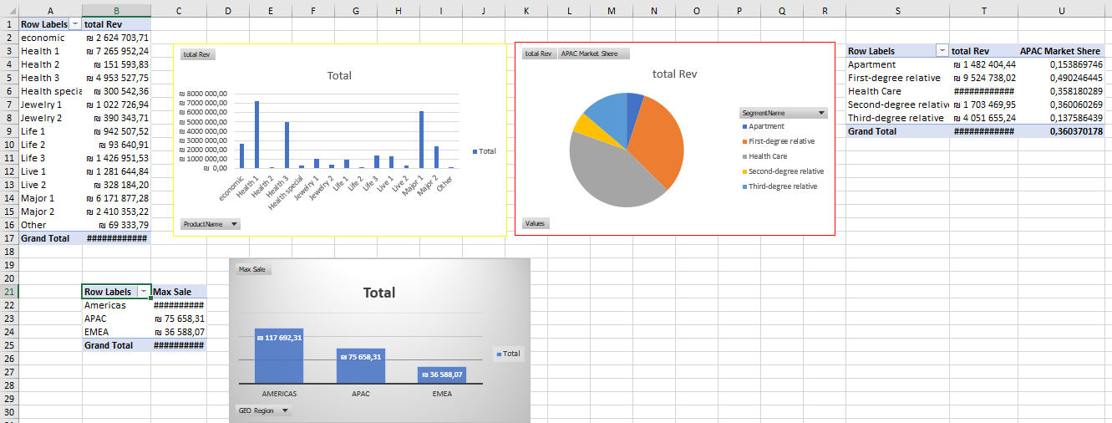
Project Analysis
Visualization Power Pivot
Revenue by segment and region
Maximum sales by region

Slide 9
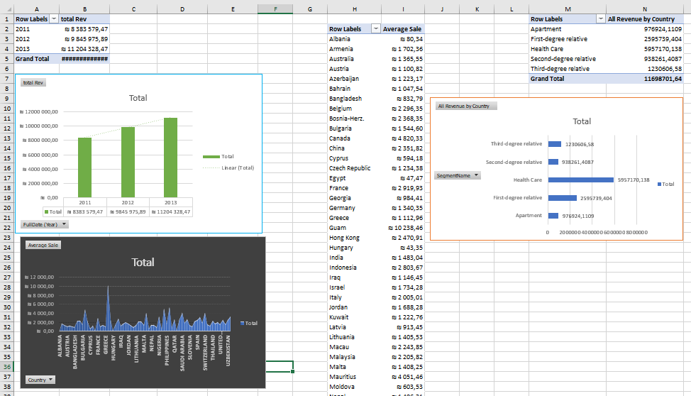
Project Analysis
Visualization Power Pivot
Average Sale by Country
Revenue By Country And Date

Slide 10
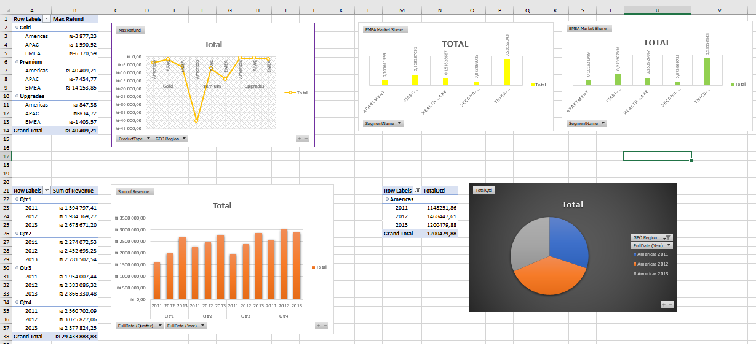
Project Analysis
Visualization Power Pivot
Market Research

Slide 11








Project Analysis

Slide 12
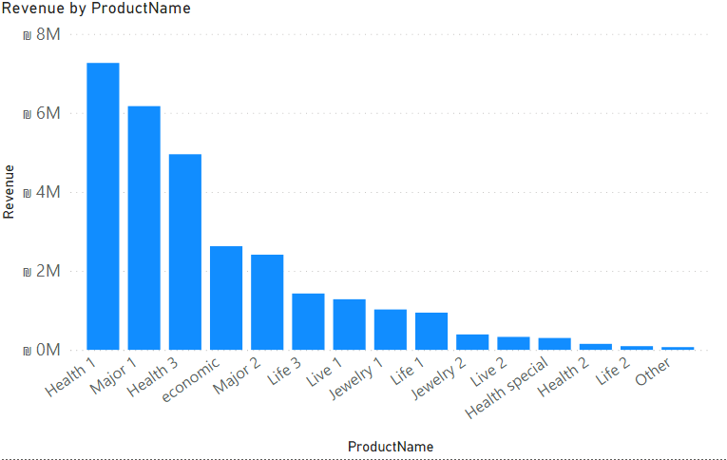
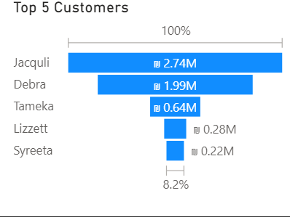
Project Analysis
Tooltip
The product that has generated the most revenue over the years is Health 1.
The top 5 customers first names how bought that product: Jacquli, Debra, Tameka, Lizzett, and Syreeta.

Slide 13
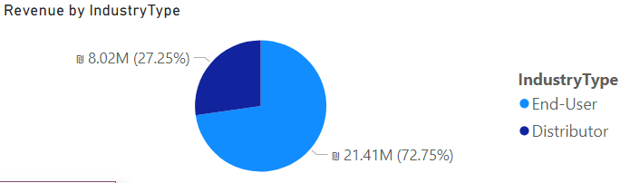
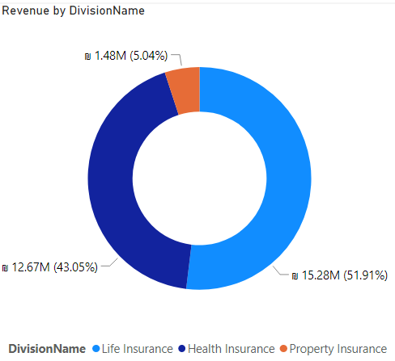
Project Analysis
72.75% of the revenue over the years came from from the End-User industry while only 27.25% generated from the distributor industry.
Over the years, Life Insurance and Health Insurance have generated the most revenue out of the three division, 15.28M and 12.67M respectively. Property Insurance generated only 1.48M.

Slide 14
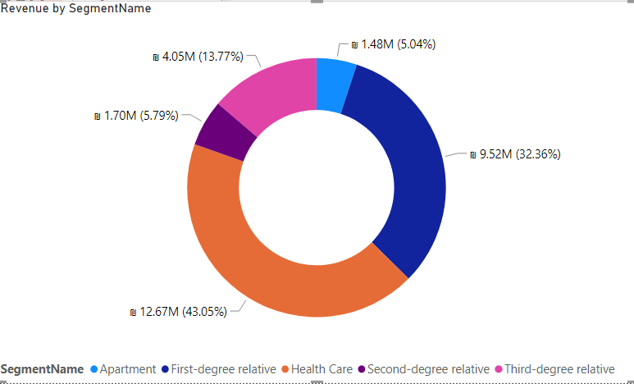
Project Analysis
The most revenued segment over the years is Health Care when the Apartments least.

Slide 15

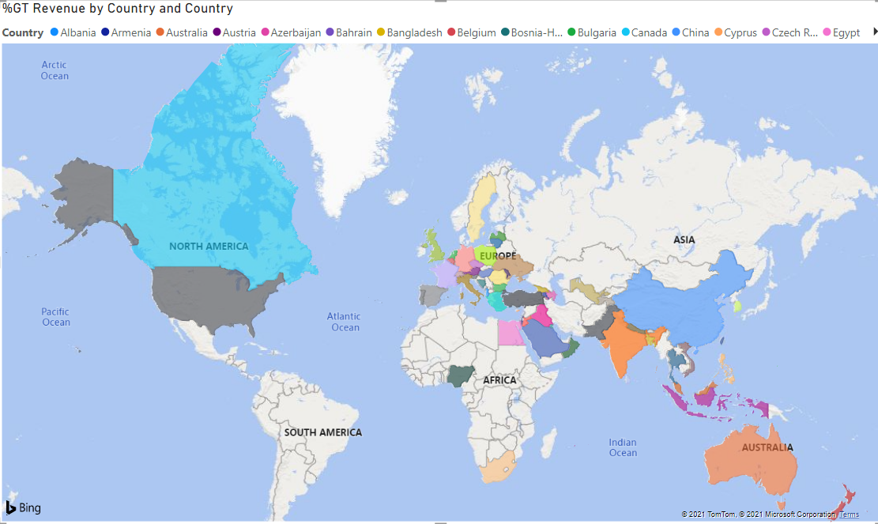
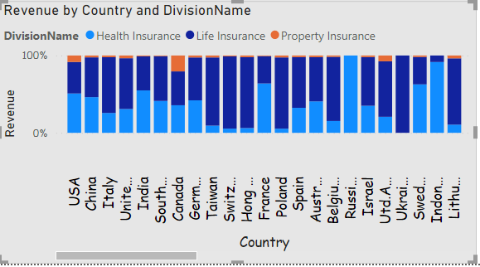
Project Analysis
The Companies’ region market as the following:
The visualization below present distribution by division within the countries. For instance almost all the revenue in Taiwan are generated from the Life insurance division (88.2%) when in Russian Fed. all of the revenue came from the Health Care division.

Slide 16
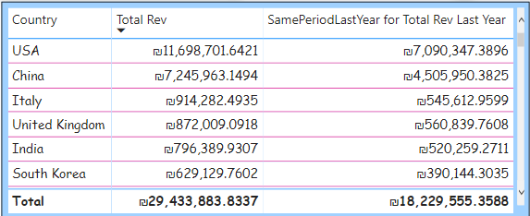
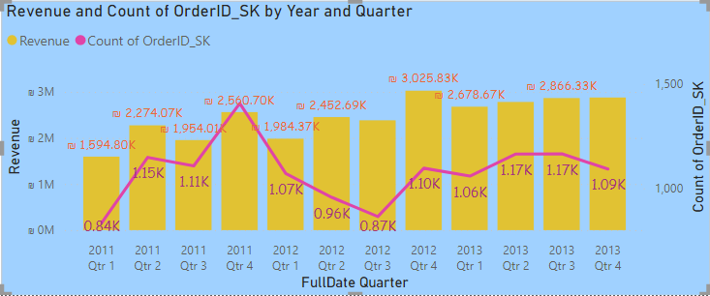
Project Analysis
In the following table can see that the most revenue of the company generated in USA totally. At the same period last year it’s also was USA.
Companies’ highest revenue was in the 4th quarter in the year 2012 while the highest number of counted order was in the 4th quarter in the year 2011.

Slide 17
Project Analysis
In the next slide you can see a KPIs dashboard with two separated analysis. One analysis represent the total YTD and the parallel period -1 year as an indication and a what if parameter as a function of the growth rate. The second referring to the the QTD analysis. In addition there is a column visualization that shows what is scenarios with the option to zoom in by a product type and also to switch between the yearly or the quarterly analysis.

Slide 18
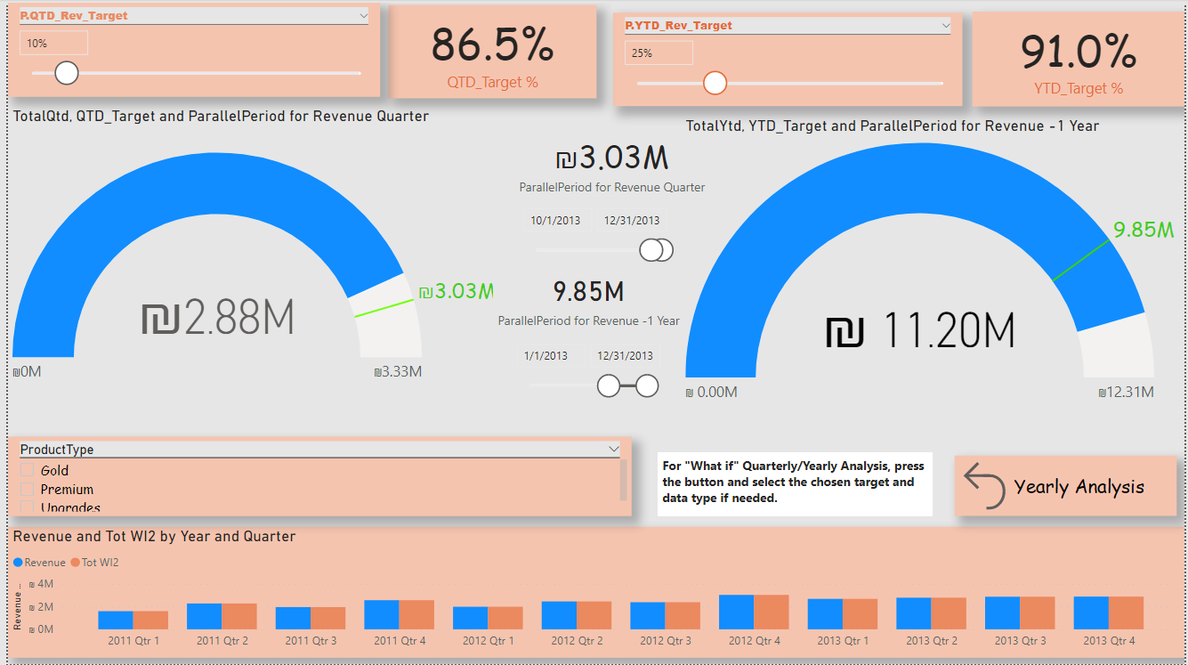
Project Analysis

Slide 19

Thank You

