Slide 1
SchoolSpirit
Gabi Jaapar

Slide 2
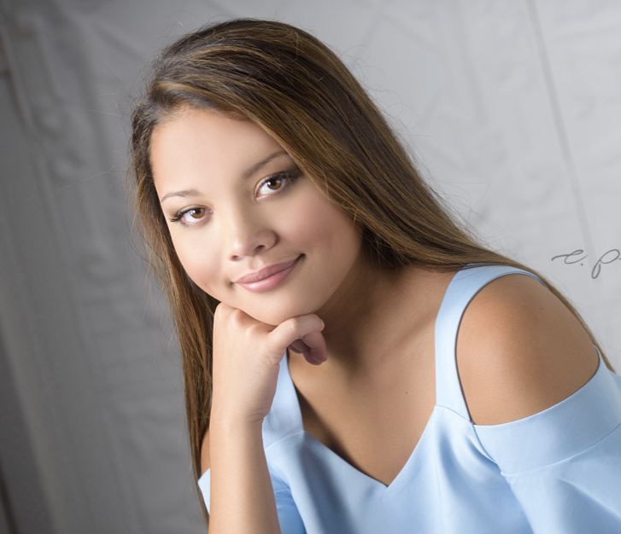
Gabi Jaapar
Senior at Omaha Burke High School
Fourth year in GETHIP
Top Five:
Ideation
Intellection
Input
Learner
Responsibility

Slide 3
Problem
School administration was trying to increase school pride
Kickoff Day, Pep Rallies, #YearOfTheDawg, Popcorn Friday
Poorly received by students
Negative opinions from students
Felt administration was trying to hard

Slide 4
Solution
Incentivize participation
Collect survey data
Make school spirit increase naturally
Build alumni base

Slide 5
Features
For Schools
Monitored School Page
Customizable Page
Yearly Subscription
Dashboard to see data gathered from page
On School Pages
Blog Layout
List of Activities/Sports
Calendar
Check-In to Events
Point/Reward System
Profiles for organizations/students
Surveys

Slide 6
Demo

Slide 7
Future Plans
Add complete functionality to check-in and calendar
Create a space where schools can customize their page
Be able to upload content easily

