Slide 1
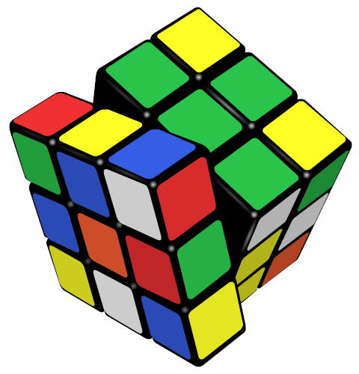
Counting the Permutations of the Rubik’s Cube
Scott Vaughen
Professor of Mathematics
Miami Dade College North Campus

Slide 2
More than Three Billion
When the Ideal Toy Company first started selling the Rubik’s cube in the United States in the early 1980s the original packaging claimed that there were more than 3 billion possible states that the Rubik’s cube could attain.
This is true - there are more than 3 billion possible states that the cube can attain.
Actually, there are about 4.3 x 10¹⁹ different possible states that it can attain!

Slide 3
Give or Take a Few Billion
4.3 x 10¹⁹ is a really … big … number!
To say there are more than 3 billion different states of the Rubik’s cube is an estimate that is about 10 billion times smaller than the actual number!
Imagine other statements that are also true but underestimate by a factor of 10 billion…
Population of New York City: more than 0.008 people
Population of the World: more than .6 people
In over fifty years McDonalds has sold more than 10 hamburgers
Age of the universe: more than 1 year and 3 months
Distance from Earth to the Sun: more than 49 feet
Distance from New York to Los Angeles: more than 0.01 inches

Slide 4
What was that number?
4.3 x 10¹⁹ is 43 followed by 18 zeros…
4.3 x 10¹⁹ = 43 x 10¹⁸ = 43,000,000,000,000,000,000
That’s 43 quintillion! Here are some names of other very large numbers…
1 x 10³ = 1 thousand
1 x 10⁶ = 1 million
1 x 10⁹ = 1 billion
1 x 10¹² = 1 trillion
1 x 10¹⁵ = 1 quadrillion
1 x 10¹⁸ = 1 quintillion
1 x 10²¹ = 1 sextillion
1 x 10²⁴ = 1 septillion
1 x 10²⁷ = 1 octillion
1 x 10³⁰ = 1 nonillion
1 x 10³³ = 1 decillion
1 x 10³⁶ = 1 undecillion
1 x 10³⁹ = 1 duodecillion
1 x 10⁴² = 1 tredecillion
1 x 10⁴⁵ = 1 quattuordecillion
1 x 10⁴⁸ = 1 quindecillion
1 x 10⁵¹ = 1 sexdecillion
1 x 10⁵⁴ = 1 septendecillion
1 x 10⁵⁷ = 1 octodecillion
1 x 10⁶⁰ = 1 novemdecillion
1 x 10⁶³ = 1 vigintillion
1 x 10⁶⁶ = 1 unvigintillion
1 x 10⁶⁹ = 1 duovigintillion
1 x 10⁷² = 1 trevigintillion
1 x 10⁷⁵ = 1 quattuorvigintillion
1 x 10⁷⁸ = 1 quinvigintillion
1 x 10⁸¹ = 1 sexvigintillion
1 x 10⁸⁴ = 1 septenvigintillion
1 x 10⁸⁷ = 1 octovigintillion
1 x 10⁹⁰ = 1 novemvigintillion
1 x 10⁹³ = 1 trigintillion
1 x 10⁹⁶ = 1 untrigintillion
1 x 10⁹⁹ = 1 duotrigintillion
1 x 10¹⁰⁰ = 1 googol

Slide 5
How do you say that?
The total number of different possible states of the Rubik’s cube is actually
  43,252,003,274,489,856,000
  That is 43 quintillion, 252 quadrillion, 3 trillion, 274 billion, 489 million, 856 thousand.
  Imagine that, to solve the cube, there is : 1 correct answer and 43,252,003,274,489,855,999 incorrect answers.
  How is it possible that a little cube can have so many different possible states?
  Let’s start counting…

Slide 6
1, 2, 3, …. 43 quintillion
If we were to physically count every possible permutation of the cube
- moving from one permutation to another every second –
it would take longer than the age of the universe to reach every possible position!
Let’s consider some other ways to count the number of permutations…
Notes:
the number of seconds since the big bang is estimated to be about 4.3 x 10^17 according to wikipedia

Slide 7
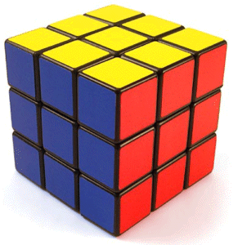

The Rubik’s Cube
We can imagine the Rubik’s cube as being made of 27 smaller cubes.
To avoid confusion, we’ll call each smaller cube a “cubie”.
Notice we could imagine a cubie at the very center of the cube, but it is never visible, so really there are always 26 visible cubies.
The Rubik’s cube has 6 faces, but each cubie also has faces. We’ll use the word “facelet” for each face of a cubie.
A “move” of the Rubik’s cube is a rotation of one of the faces. After a few moves, the facelets become quite scrambled. Of course, the challenge is to get it back to the initial state – the “solved state” – where all facelets are the same color on each side. Our goal here is to count the total number of possible permutations (or rearrangements) of the facelets.

Slide 8
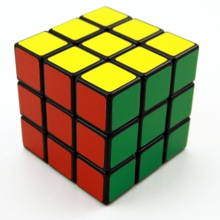
A First Approximation
There are 6 faces of the cube, each of which has 9 facelets, so there are a total of 54 facelets.
After devising some scheme as to where to begin and how to proceed around the cube, we could label the facelets 1 through 54. Then each move creates a new permutation of the 54 facelets.
The total number of possible permutations of 54 different facelets is 54! = 2.3 x 10⁷¹
That’s approximately 230 duovigintillion!! Here we are getting close to a value estimated to be the total number of atoms in the entire universe!
With this approximation we have actually over counted. We’ve treated each facelet as different, also, as we’ll see later, there are some permutations of the facelets that can never occur.
Notes:
according to a reference on wikipedia – the number of atoms in the universe has been estimated to be 10^80

Slide 9
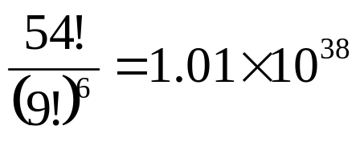
A Second Approximation
Note 54! = 2.3 x 10⁷¹ is the total number of permutations of 54 different facelets.
This is actually the number of permutations possible if we were allowed to peel off all of the stickers and rearrange them (and it assumes 54 different stickers.)
But certain permutations would be indistinguishable because there are 9 identical stickers for each of the 6 colors. So if we were allowed to peel off the stickers, and wanted to count distinguishable permutations of those 54 stickers, we would divide the original value by the number of indistinguishable permutations of each of the colors.
That is, the number of distinguishable permutations of the stickers is
which is about 101 undecillion.

Slide 10
What was the Question?
The Rubik’s cube can be in how many different states?!
2.3 x 10⁷¹ is not the right answer
1.01 x 10³⁸ is not really the right answer either
Why not!?
These first approximations are counting permutations of the stickers. When we look at how the facelets move as we turn sides of the cube we will discover that not every permutation of the stickers is possible…

Slide 11
Legal Moves
A legal move is any rotation of any of the 6 faces of the cube. We can arbitrarily assign a name to each face: U (up), D (down), L (left), R (right), B (back) and F (front). We use these names to refer to rotations of the corresponding faces.
An illegal move can result from breaking the cube apart and re-assembling it into a different permutation of the facelets, or peeling off and rearranging the stickers.
In general, when we say “any move of the cube” we will mean any legal move.
We use the apostrophe to distinguish between clockwise and counter clockwise rotations. Also, we’ll always assume clockwise is taken from the perspective of someone looking directly at that face.
For example, UFB’ is a legal move of the cube which means a clockwise turn of the “up” face, a clockwise turn of the “front” face and a counterclockwise turn of the “back” face.

Slide 12
What Are We Counting?
We are going to count the total number of distinguishable permutations of the facelets of the cube that can result from any legal move of the cube.
The total possible number of sequences of legal moves is infinite, of course. We could string any number of legal moves together, of any length, and generate an infinite list of moves.
Some such combinations of moves may look different when written on paper, or as they are performed, but when completed they may actually produce indistinguishable permutations of the facelets.
For example, UUU is the same as U’ when judging by the final resulting permutation of facelets that each produces . Thus, these two sequences of moves is really the same permutation of facelets. We will count that as just one permutation.

Slide 13
Types of Cubies
Notice that as movements of the cube are performed, the cubies at the corner of the cube move to other corners. Also, notice that the cubies at the center of each face remain in place. And finally, there are cubies with two facelets that always remain between the corners.
We’ll call the cubies with three facelets “corner cubies”.
We’ll call the cubies with two facelets
“edge cubies”
And cubies with only one facelet are
called “center cubies”

Slide 14
A Third Approximation
There are 8 corner cubies, 12 edge cubies and 6 center cubies.
8 + 12 + 6 = 26 total visible cubies.
With any move of the cube, corners remain corners, edges remain edges and centers remain centers.
Notice that all of the center cubies remain fixed relative to each other, so, in fact, there are no distinguishable permutations of the center cubies that will result from any move of the cube.
So there are 8! permutations of the corners and 12! permutations of the edges. Therefore, applying the multiplication principle, there are
8! * 12! = 1.9 x 10¹³ total permutations of cubies.

Slide 15
A Third Approximation, continued
Now each corner cubie has three facelets, which could conceivably be in any of three orientations at each corner. Further, each edge could conceivably be in any of two possible orientations at each of the twelve edge positions.
Applying the multiplication principle, the number of distinguishable orientations of the 3 facelets after any permutation of the 8 corners cubies is 3⁸ (ie, 3 possibilities at each of 8 corners.) Likewise, the number of orientations of 2 edge facelets for each permutation of the 12 edge cubies is 2¹². Therefore, the total number of distinguishable permutations of facelets would be
8! * 3⁸ *12!* 2¹² = 5.19 x 10²⁰ possible permutations
We’re getting closer to the right answer, but this is still not exactly it. The correct answer is less than this by a factor of 12. Understanding where that factor of 12 comes from reveals some more interesting details about the cube and the mathematics of permutations …

Slide 16
Twelve Parallel Universes
There are three additional restrictions that limit both the number of permutations of cubies and the orientations of facelets that are actually reachable under any legal move.
Imagine the entire universe of possible permutations of facelets that can be reached using any legal move of the cube. There are actually permutations of facelets that are outside of that universe. In fact, there are 12 such distinct universes, “parallel” in the sense that they have no intersection, no permutations in common, that would result from legal moves of the cube.
If we took apart the Rubik’s cube and then reassembled it, it would be reassembled into one of those twelve distinct possible universes. And in only one of those twelve universes is it possible for the cube to reach the solved state. This implies that, starting from a solved cube, only 1/12th of the permutations we counted in our last approximation are reachable with any move of the cube.

Slide 17
Permutations
A permutation is a rearrangement of elements of a set.
We can further define a permutation as being either even or odd.
For example, consider the permutation below of the numbers 1 through 8.
To determine whether it is even or odd, we can count the number pairs out of their natural order.
To do this, start with the second row and, for each number x, count how many numbers follow that are out of the natural order with x.
12345678
21385674

Slide 18
Permutations
In this case, with the permutation
12345678
21385674
Starting on the second row, with the number 2…
2 is followed by 1 (1 reversal)
1 is followed by only larger numbers (0 reversals)
3 followed by only larger (0 reversals)
8 is followed by 5, 6, 7 and 4 (4 reversals)
5 is followed by 4 (1 reversal)
6 is followed by 4 (1 reversal)
7 is followed by 4 (1 reversal)
That’s 8 total reversals which is an even number. So this is an even permutation.
It can be proven that every permutation must be either even or odd.

Slide 19
Permutations
A visual way to determine whether a permutation is even or odd, is to connect the numbers in each row as shown. The number of times the lines cross is called the crossing number for the permutation. If this number is even, the permutation is even, otherwise its odd.
1 2 3 4 5 6 7 8
2 1 3 8 5 6 7 4
In the permutation above, the lines cross 8 times so the crossing number is 8 and therefore the permutation is even.

Slide 20
Every Move is an Even Permutation
Every legal move on the Rubik’s cube is an even permutation of the cubies.
Imagine the figure at right represents one face of the Rubik’s cube.
Turning that face clockwise creates the permutation shown below.
1
5
2
8
6
2 3 4 5 6 7 8
2 3 4 1 6 7 8 5
4
7
3
2 3 4 5 6 7 8
For this permutation, the crossing number is 6. Therefore, it is an even permutation.
2 3 4 1 6 7 8 5

Slide 21
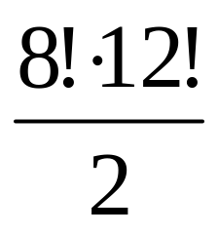
Permutations of the Cubies
It can be shown that every move of Rubik’s cube always produces another even permutation of the cubies.
Also, it can be shown that half of all permutations of a given set of elements are even, while half are odd.
Therefore, while the total number of permutations of the 8 corner cubies and 12 edge cubies is 8! * 12!, only half of these permutations are even permutations and only even permutations can be reached by legal moves of the cube.
Therefore, the number of permutations of the cubies (without counting orientations of the facelets) is

Slide 22
Orientations of the Edge Cubie Facelets
While we permute the cubies, we also change the orientations of the facelets. To understand the changes in edge facelet orientations, we establish an initial orientation for each facelet.
There are 12 edge cubies and we can establish an orientation for each at the initial state as shown in the diagram.
The orientation for each edge is equivalent to the direction of one of the arrows.

Slide 23
Orientations of the Edge Cubie Facelets
Notice that flipping an edge cubie (that is, changing the orientation of the facelets) will result in reversing the direction of one arrow.
Further, notice that any legal move of the cube will always change the direction of a pair of arrows.
For example, a clockwise rotation of the red face shown above will change the current orientation of two arrows pointing right and two pointing up, into an orientation with two arrows pointing right and two pointing down.
The implication is that it will be impossible to change the direction of only one arrow when following any combination of legal moves.
We may conclude that with any orientation of 11 out of 12 edge cubies, the orientation of the 12th edge cubie must be determined. This suggests that for any permutation of the edge cubies, there are 2¹¹ possible orientations of the edge facelets. (And this can be proven to be correct).

Slide 24
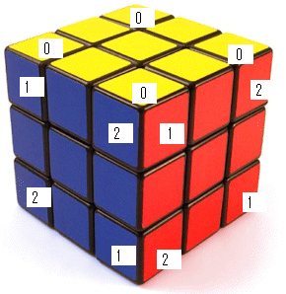
Permutations of the Corner Cubie Facelets
To understand how the corner cubie facelets move, we will label them as shown in the picture below.
Choose any face to be the “up” face. Label each corner facelet of the up face with a “0”. Opposite that face, is the “down” face, underneath the cube in the picture. We will label each of those corner facelets with a “0”, as well.
Now, looking at each corner cubie along a line of sight through the tip of the corner and extending to center of the cube, label the corner cubie facelets as follows:
“1” if it is clockwise from “0”
“2” if is counterclockwise from “0”
Notice how the “1” and “2” labels are reversed when looking at the cube from a side.

Slide 25
Permutations of the Corner Cubie Facelets
The claim is that the sum of the 8 values on the labels on opposite faces of the cube will always be 0 or a multiple of 3 after any legal move of the cube.
Equivalently, dividing the sum of the 8 values on opposite faces by 3 will always result in a 0 remainder.
The significance is that there are 3 different possible “twist states” corresponding to a remainder of 0, 1 or 2 and we will see the cube will remain in the same twist state after any legal move.

Slide 26
Modular Arithmetic
To understand why the total twist of the corners remains the same, we use modular arithmetic.
By definition, we say “ r = a mod b “ when dividing a by b gives remainder r.
For example, 4 = 10 mod 6 and 3 = 38 mod 5.
We use modular arithmetic when we tell time… For example, at 10 o’clock if we add 5 hours we get 15 but we say it’s 3 o’clock because 3 = 15 mod 12. Looking at each corner cubie labeled as shown is like looking at a clock with hours 0, 1, and 2.
We define the “total twist value of the corner cubies” to be the sum of the values on the 8 corner cubie facelets on opposite sides of the cube mod 3.
As we have labeled these facelets the total twist is 0 mod 3. We will see that it remains 0 mod 3 after any legal move of the cube.

Slide 27
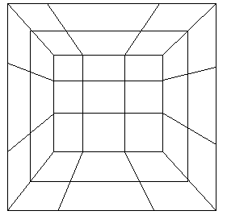
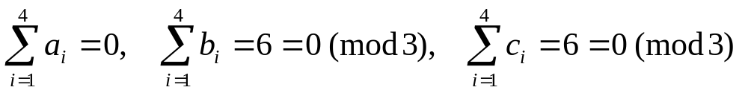
Permutations of the Corner Cubie Facelets
Here is a different view of the cube, looking down from above, with the sides flattened out so we can see them.
c₄
c₁
b₄
a₄
a₁
b₁
Take any face of the cube and name the corner cubie facelets as shown in the diagram.
a₃
a₂
b₃
b₂
If we look at the “up” face, based on the number labels we have already placed, we will have…
c₃
c₂

Slide 28
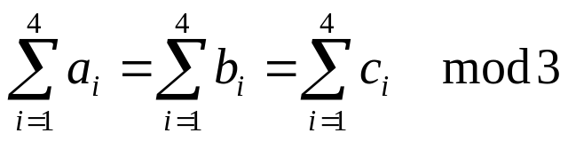

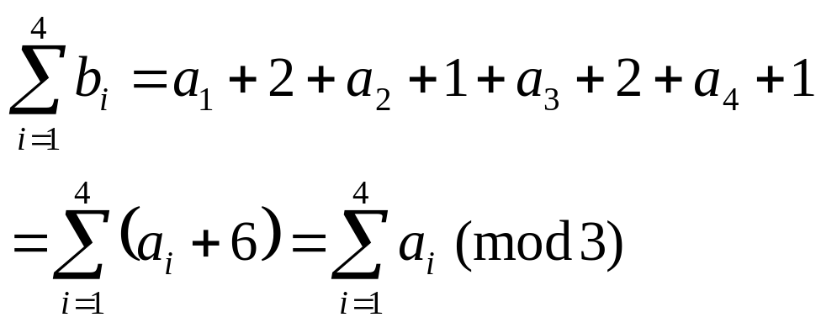
Permutations of the Corner Cubie Facelets
Notice that for any face of the cube,
The reason this is true, for any face, is that, based on our clockwise numbering,
it is always true that
b₁ = a₁ + 2 b₂ = a₂ + 1
b₃ = a₃ + 2 b₄ = a₄ + 1
Thus, for example,
c₄
c₁
b₄
a₄
a₁
b₁
a₃
a₂
b₃
b₂
c₃
c₂

Slide 29
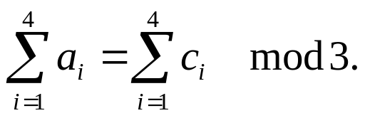
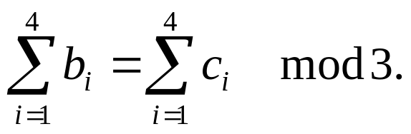
Permutations of the Corner Cubie Facelets
The same reasoning can be used to show
And therefore,
Now the argument is simply that rotating a face of the cube will interchange the c_{i} and b_{i}.
Because these are equal (mod 3), the sum on opposite faces of the cube remains equal (mod 3).
c₄
c₁
b₄
a₄
a₁
b₁
a₃
a₂
b₃
b₂
c₃
c₂

Slide 30
Permutations of the Corner Cubie Facelets
For example, imagine the a_{i} in the diagram at left are the corner facelets of the “up” face, and now make a clockwise 90º rotation.
The a_{i} remain in place and c_{i} replace b_{i}.
Now the sum of values on the facelets named a_{i} and the 4 facelets on the down face are still 0 mod 3.
And because the sum of the c_{i} equal the sum of the b_{i} (mod 3) the sum of values on the left, right, front and back side are all still equal (mod 3).
c₄
c₁
b₄
a₄
a₁
b₁
a₃
a₂
b₃
b₂
c₃
c₂

Slide 31
Permutations of the Corner Cubie Facelets
The total twist value of the corner cubies will stay equal to 0 (mod 3) after any legal move of the cube.
This implies twisting just one corner cubie is impossible with any combination of legal moves of the cube because twisting just one corner cubie would change the total twist value from 0 (making it either 1 or 2).
Therefore, as the corners permute through legal moves of the cube, the orientation of the facelets of 7 of the corners determines the orientation of the facelets of the 8th corner cubie.
This suggests that for each of the permutations of the 8 corner cubies,
the number of possible orientations of the facelets of the corners is 3⁷.
(Again, this can be more rigorously proven to be actually correct.)

Slide 32
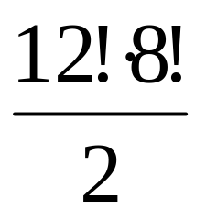
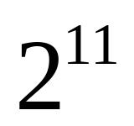
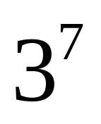
To Summarize
We have…
= the number of even permutations of the cubies
= the number of possible orientations of the edge facelets
= the number of possible orientations of the corner facelets

Slide 33
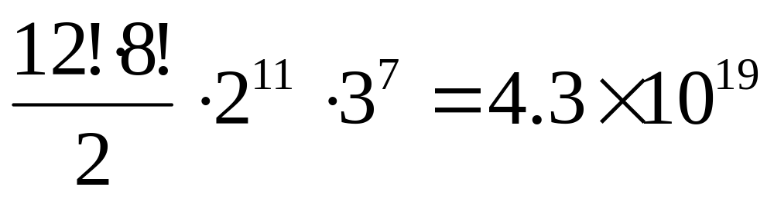
The final answer
Putting this all together, we have
is the total number of possible permutations of the facelets that can result from any move of the cube.

