Slide 1
CONNECTICUT SALES ANALYSIS At EmporiUm
Store performance.
Sales growth.
Product categories.
Gbolahan Abidemi

Slide 2
Connecticut revenue and reporting period
$2,392,222.44
January 1, 2022 through December 31, 2025
Connecticut in-store sales across all eight stores

Slide 3
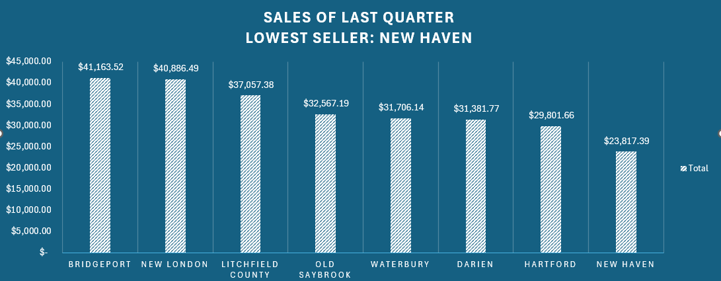
New Haven had the lowest Q4 2025 revenue
$23,817.39
New Haven’s Q4 revenue
Bridgeport led with $41,163.52.

Slide 4
Chart 1 Query
FULL QUERY
SELECT SUM(store_sales.Sale_Amount) AS Sales, store_sales.Store_ID, store_locations.Storelocation, store_locations.State
FROM store_sales
JOIN store_locations
ON store_sales.Store_ID = store_locations.StoreID
WHERE store_locations.State = 'Connecticut'
GROUP BY store_sales.Store_ID, store_locations.State, store_locations.StoreLocation
ORDER BY Sales DESC;

Slide 5
Chart 1: query summary and recommendation
How the query works
Recommendation
Matches sales to store locations, keeps Connecticut stores, and adds each store’s sales. It sorts the totals from highest to lowest.
Queries Used:
SELECT, SUM() and JOIN
I would suggest that we prioritize New Haven for a Sales Review and check local demand. After we find out what went wrong with the quarterly sales during the October, November and December period, we should test a targeted promotion before expanding it to other stores. If that doesn’t work, we could shuffle around our products or run an ad campaign to figure out what people want to see in our stores there

Slide 6
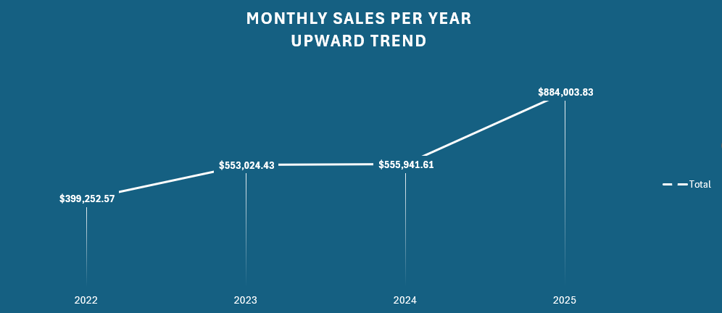
Annual sales rose sharply in 2025
+59.0%
2025 revenue increased by 59.0% from 2024.

Slide 7
Monthly revenue by year
Month | 2022 | 2023 | 2024 | 2025
January | $29,958.25 | $38,351.45 | $57,974.76 | $68,601.89
February | $25,563.98 | $53,435.37 | $49,206.33 | $55,131.75
March | $33,995.57 | $50,828.54 | $46,044.68 | $69,261.43
April | $31,587.12 | $45,747.20 | $38,918.30 | $58,288.72
May | $37,953.48 | $39,215.78 | $41,203.81 | $66,996.15
June | $32,008.85 | $39,754.07 | $48,142.95 | $60,671.67
July | $30,656.27 | $49,592.69 | $48,445.34 | $88,590.03
August | $42,881.99 | $48,445.34 | $49,633.16 | $77,048.51
September | $30,369.64 | $49,175.79 | $44,890.28 | $71,032.14
October | $43,646.37 | $45,347.65 | $43,061.44 | $115,828.46
November | $25,950.41 | $42,683.73 | $50,069.11 | $59,762.07
December | $34,680.64 | $50,446.82 | $38,351.45 | $92,791.01

Slide 8
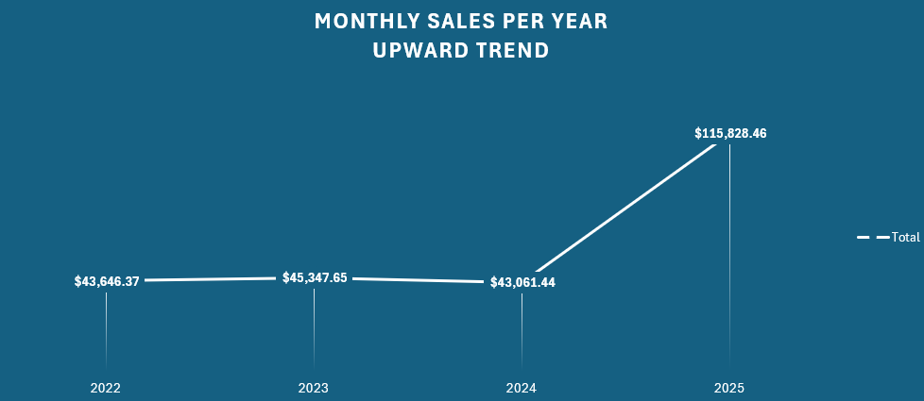
October sales rose 169.0% in 2025
2024–2025 increase: $72,767.02

Slide 9
Chart 2 Query
FULL QUERY
SELECT SUM(Sale_Amount) AS CombinedSales, MONTHNAME(Transaction_Date) AS TransactionMonth, YEAR(Transaction_Date) AS TransactionYear
FROM store_sales
JOIN store_locations
ON store_sales.Store_ID = store_locations.StoreID
WHERE store_locations.State = 'Connecticut'
GROUP BY TransactionYear, MONTH(Transaction_Date), TransactionMonth
ORDER BY MONTH(Transaction_Date) ASC, TransactionYear ASC;

Slide 10
Chart 2: query summary and recommendation
How the query works
Recommendation
Adds Connecticut sales for each month and year, then used Excel to combine those monthly results into the yearly totals shown in the chart.
Queries Used:
SELECT, JOIN and DATE conversions
We should investigate which stores and products drove the 2024 - 2025 increase and use those monthly results to plan inventory to meet the growing customer demands. If we find the source of said growth, we should then apply that strategy to our low performing stores to try and help bolster sales and possibly catch those up to speed for the first quarter of 2026.
Annual revenue growth
2022 - 2023 |+38.5%|
2023 - 2024 |+0.5%|
2024 - 2025 |+59.0%|

Slide 11
Connecticut within the East region
Sales Area | Revenue
Connecticut | $2,392,222.44
East region, including Connecticut | $6,723,039.53
35.6%
of East region revenue came from Connecticut.
The East region includes Connecticut and New York.

Slide 12
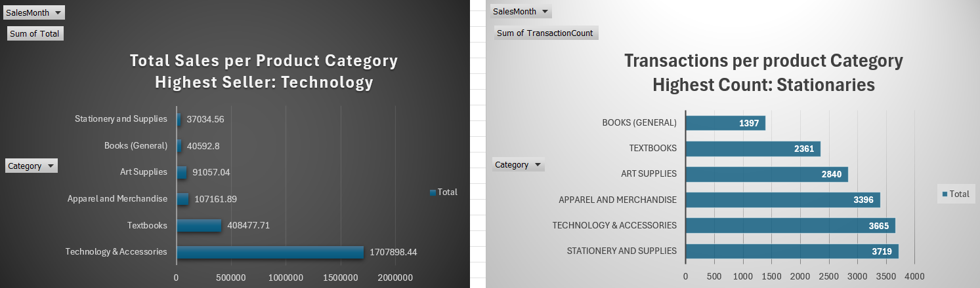
Category by revenue and sales count
71.4%
of total revenue came from Technology & Accessories.

Slide 13
Chart 3 Query
FULL QUERY
SELECT MONTHNAME(store_sales.Transaction_Date) AS SalesMonth, products.CategoryID, inventory_categories.Category, COUNT(*) AS TransactionCount,
CONCAT('$', ROUND(SUM(store_sales.Sale_Amount),2)) AS Total
FROM store_sales
JOIN store_locations
ON store_sales.Store_ID = store_locations.StoreId
JOIN products
ON store_sales.Prod_Num = Products.ProdNum
JOIN inventory_categories
ON products.Categoryid = inventory_categories.Categoryid
WHERE store_locations.State = 'Connecticut'
GROUP BY SalesMonth, products.CategoryID, inventory_categories.Category;

Slide 14
Chart 3: query summary and recommendation
How the query works
Recommendation
Links sales to stores, products and categories. It totals revenue and counts sales rows by category and month across all four years.
Queries used:
SELECT, COUNT(*), SUM() and JOIN
Keep popular technology products available and test related-product offers but maintain stationery availability because it has the highest sales count. We should also keep an eye on Textbooks as it is our 2nd Highest selling product and keep availability high as well while trying to push more into stores.
Why do the rankings differ?
Average recorded sale: technology $466.00; stationery $9.96.

Slide 15
Store revenue ranking across all four years
Rank | Store | Store ID | Revenue
1 | New London | 870 | $331,116.76
2 | Bridgeport | 865 | $322,100.07
3 | Hartford | 867 | $309,592.06
4 | Waterbury | 872 | $295,651.17
5 | New Haven | 869 | $286,779.43
6 | Litchfield County | 868 | $286,217.15
7 | Darien | 866 | $283,455.62
8 | Old Saybrook | 871 | $277,310.18
New London led. Old Saybrook and Darien had the lowest total revenue.

Slide 16
Overall recommendation for next quarter
- Focusing sales attention on Old Saybrook and Darien because they generated the lowest total revenue among Connecticut stores during the 4 years analyzed.
- Last quarter, New Haven had the lowest sales across all the stores and we should focus on increasing ads and products in that store to increase sales.
- Management should find opportunities to improve sales at these locations and compare what worked with New London which was the highest-revenue store.
- The company should also investigate October’s unusually high growth rate from 2024 – 2025 and find out what happened and what worked during that month to replicate its tactics.

