Slide 1
TOMATODOC
🍅
An Integrated AI System for Tomato Plant Health Monitoring, Disease Detection & Market Price Forecasting
Helping Sri Lankan tomato farmers detect problems earlier and sell smarter
R26-SE-032
Farmer · AI · Market
Final Presentation
Gabilan S. · Farthas A.L.M. · Vithusha P. · Rashad M.P.M
SLIIT Faculty of Computing | 2026

Slide 2
Panel Comments on PP2 and How We Addressed
PANEL COMMENT (all four members)
“Most comments were addressed with good improvement. Each member should further improve their research component, particularly the implementation, validation, and clear explanation of the results.”
Student | Action taken | Evidence and impact
IT22060426 Gabilan S | Compared 4 architectures (CNN scratch, VGG16, ResNet50, MobileNetV2) and chose MobileNetV2 for accuracy, 14 MB size and 0.8 s inference. Linked RAG advice to every result. | Test accuracy: leaf 93.30%, fruit 93.14% (vs CNN scratch 43%, VGG16 89%, ResNet50 91%). Scan, result and history screens live.
IT22190734 A.L.M. Farthas | Implemented YOLOv8s with an EfficientNet gate for leaf disease, including Early + Late Blight and Leaf Miner together. Backend API is live. | mAP@0.5 0.737, F1 0.723, Precision 0.758. Output shows bounding boxes plus RAG treatment advice.
IT22208262 Vithusha P. | Built U-Net severity segmentation and a 7-day TRR engine on Day 1/3/7 photos, behind a photo quality gate. | U-Net test accuracy 89.02%, Quality Gate 91.21%. Verdict is shown as Success, Partial or Failure.
IT22295842 Rashad M.P.M | Built price forecasting with LSTM against GRU, XGBoost and RF baselines. SHAP explains every sell/hold advice. | Validated with MAE, RMSE and MAPE against the ARIMA baseline. SHAP chart shows the reasons.

Slide 3
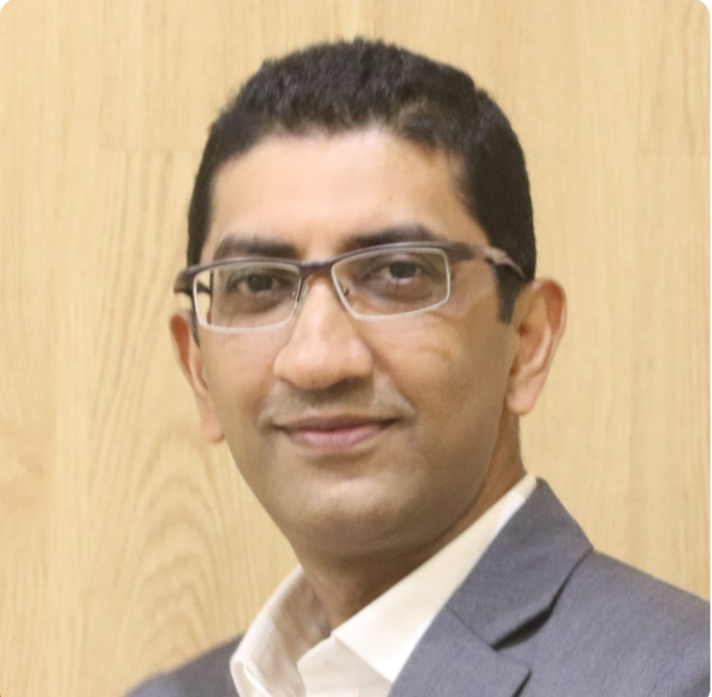

Research Supervision
SUPERVISOR
CO-SUPERVISOR
Bimal Gunapala
Eishan Weerasinghe
Department of Software Engineering
Faculty of Computing, SLIIT
Department of Software Engineering
Faculty of Computing, SLIIT

Slide 4
Four components, one app: diagnose, treat, monitor, sell
Design excellence: four components
Problem in brief
Problem: Tomato problems look alike and prices swing wildly, so farmers diagnose late and sell badly.
Who: Sri Lankan smallholder tomato farmers, supported by agri officers.
Why it matters: Fruit disease causes 30–40% post-harvest loss. Prices range LKR 7 to 220 per kg.
A
B
Nutrient deficiency + fruit disease
Leaf disease detection
MobileNetV2 reads 6 leaf and 5 fruit classes and gives fertilizer or treatment advice.
YOLOv8s locates diseases, including Early Blight ,Late Blight and Leaf Miner together.
C
D
Treatment monitoring
Price forecasting
U-Net severity and a 7-day TRR engine show if the treatment works.
LSTM forecasts with SHAP-explained sell/hold advice.
Inventive step: detect, treat, monitor and forecast in one mobile app, from spotting the problem to deciding when to sell.

Slide 5
Design Excellence over Existing Solutions
Criteria | Existing solutions | TomatoDoc
Nutrient deficiency detection | ✗ Not covered | ✓ 6 classes detected
Fruit disease detection | ✗ Not covered | ✓ 5 classes detected
Co-occurrence detection | ✗ Single label only | ✓ YOLOv8s spatial detection
Treatment efficacy tracking | ✗ Single-shot only | ✓ 7-day TRR monitoring
Price forecasting + selling advice | ✗ Forecast only | ✓ SHAP-explained sell/hold decision
Sri Lanka field conditions | ✗ Lab images only | ✓ Real field datasets
Gap: no existing system covers nutrient deficiency, co-occurring leaf disease, treatment monitoring and price forecasting together for Sri Lankan farmers in one mobile platform.

Slide 6
System Architecture Diagram
Farmer
Sends leaf / fruit photo
TomatoDoc mobile app (React Native) + Flask / FastAPI REST APIs
Scan · Diagnose · Monitor · Forecast
Nutrient + fruit disease
Leaf disease
Treatment monitoring
Price forecasting
MobileNetV2 transfer learning
YOLOv8s + EfficientNet gate
U-Net + 7-day TRR engine
LSTM + Weather + News
6 leaf + 5 fruit classes
Boxes + co-occurrence
Success · Partial · Failure
Sell / Hold + SHAP
Shared RAG advice: ChromaDB + Groq Llama 3 8B, grounded in verified DOA Sri Lanka sources
Data and security: MongoDB Atlas· JWT + bcrypt · Render.com deployment

Slide 7
Technologies, AI Models and Engineering
Technologies
AI Models
Quality and security
Mobile: React Native (Android + iOS)
Backend: Flask / FastAPI microservices
Data: MongoDB Atlas
RAG: ChromaDB + Groq Llama 3 8B
Deploy: Render.com
Leaf + fruit: MobileNetV2
Leaf disease: YOLOv8s + EfficientNet gate
Severity: U-Net + TRR engine
Price: LSTM + Weather + News, Explainability: SHAP
Under 3 s end-to-end response
MobileNetV2: 0.8 s inference
JWT authentication + bcrypt hashing
Early stopping to limit overfitting
RAG base updatable without retraining

Slide 8
Business Case
Target market
Value delivered
Sri Lankan tomato farmers and smallholders
Agricultural extension officers
Agri-tech platforms and cooperatives
One app for deficiency, disease, monitoring and pricing
Specific dosage and treatment, not generic advice
Sell/hold advice with reasons
Revenue model
IP and partnerships
Free: 10 scans per month
Premium: unlimited scans, history, trends
Enterprise: API for agri-platforms
DOA Sri Lanka: approvals and field data
HORDI: horticultural research validation
First documented Phosphorus dataset gap

Slide 9
Milestones to Market
1
2
3
4
5
DONE
NOW
NEXT
NEXT
LATER
PHASE 1
PHASE 2
PHASE 3
PHASE 4
PHASE 5
Build and validate
Integrate and field-test
Partnerships
Public launch
Scale
Four AI components trained and APIs live
Finish integration, collect Sri Lankan field data, validate with farmers
Work with DOA, HORDI and extension officers
Release free and premium tiers on Android and iOS
Sinhala, offline mode, more classes, other crops
Release path: farmer pilot → partners → public launch

Slide 10
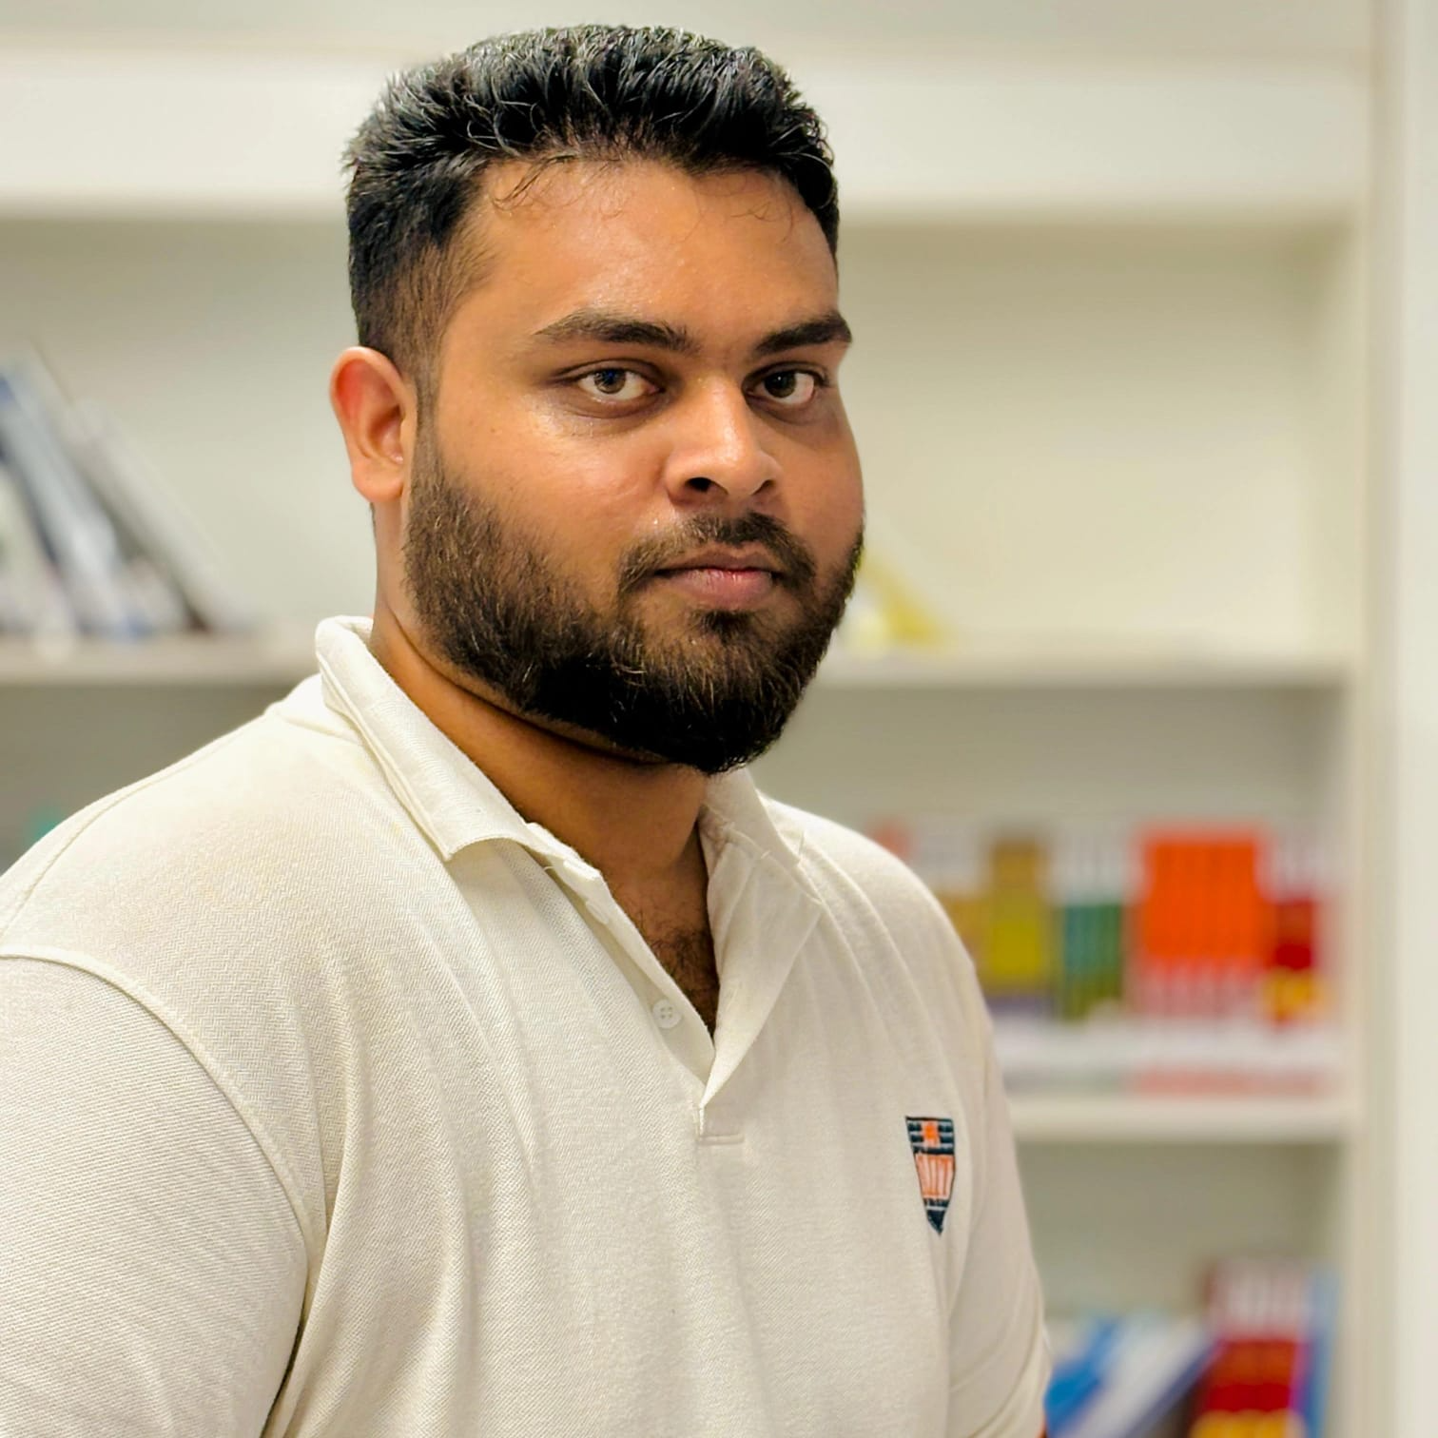
IT22060426 | Sivanesangabilan Gabilan
COMPONENT 01
NUTRIENT DEFICIENCY + FRUIT DISEASE DETECTION + RAG
Purpose
Tells the farmer which nutrient is missing from a leaf photo, or which disease affects a fruit, then recommends the fertilizer or treatment. It is the first diagnostic layer of TomatoDoc.
Technical approach
MobileNetV2 transfer learning: leaf model (6 classes) 93.30% and fruit model (5 classes) 93.14% test accuracy. Chosen over CNN scratch 43%, VGG16 89%, ResNet50 91%.
RAG advice: ChromaDB.
Mobile app: React Native scan, result and history screens, with MongoDB Atlas storage.
IT22060426 | Sivanesangabilan Gabilan | R26-SE-032

Slide 11
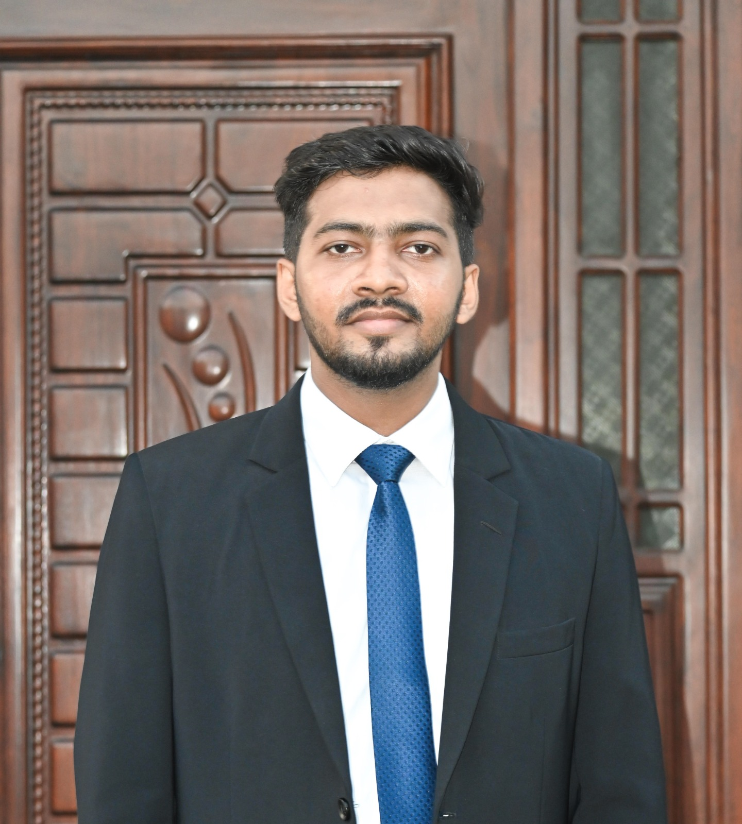
IT22190734 | A.L.M. Farthas
COMPONENT 02
CO-OCCURANCE LEAF DISEASE DETECTION + RAG
Purpose
Finds and locates leaf diseases in a single photo, including Early, Late Blight and Leaf Miner appearing together, then gives treatment advice for each one.
Technical approach
YOLOv8s detection: spatial detection with bounding boxes, real-time at 640×640. mAP@0.5 0.737, F1 0.723, Precision 0.758.
EfficientNet Validator: screens the image before detection, so only usable leaf photos are analysed.
RAG treatment advice: guidance for every detected disease from verified DOA sources.
IT22190734 | A.L.M. Farthas | R26-SE-032

Slide 12
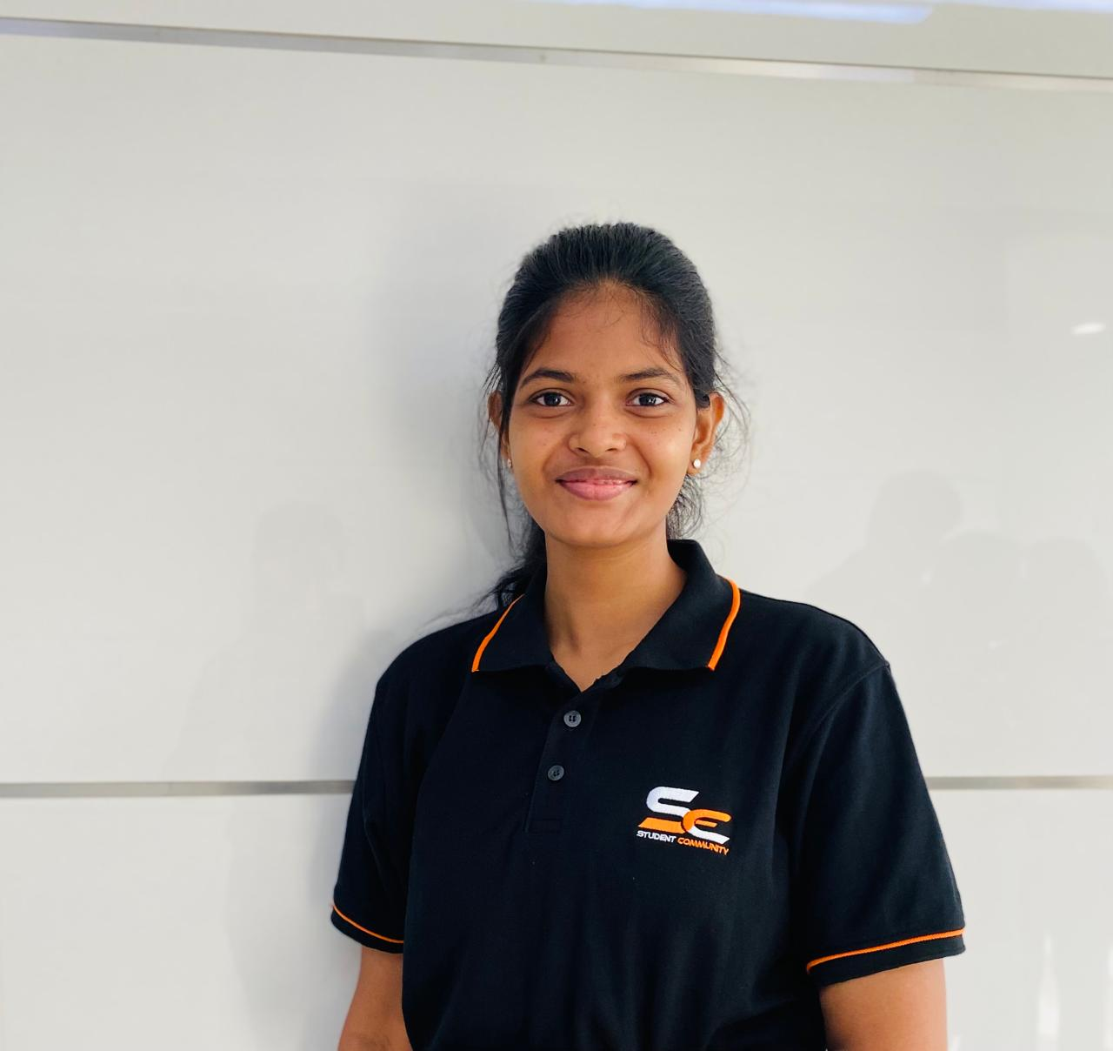
IT22208262 | Vithusha Pathmanathan
COMPONENT 03
TREATMENT EFFICACY MONITORING
Purpose
Tracks over 7 days whether a treatment is working, and suggests an alternative treatment when it is not.
Technical approach
Quality gate (MobileNetV2): PASS or REJECT for each photo, 91.21% test accuracy.
U-Net severity segmentation: measures disease severity % on Day 1, 3 and 7 photos, 89.02% test accuracy.
Severity Trend Analysis: Compares severity scores across observations to identify whether the condition is improving, worsening, or stable, and tracks a software-defined recovery status.
IT22208262 | Vithusha Pathmanathan | R26-SE-032

Slide 13

IT22295842 | Rashad M.P.M
COMPONENT 04
MARKET PRICE FORECASTING
Purpose
Forecasts tomato market prices and tells the farmer whether to sell or hold, with clear reasons. Prices swing from LKR 7 to 220 per kg.
Technical approach
Forecast models: Bi-LSTM compared with XGBoost, GRU, Random Forest and an ARIMA baseline.
Evaluation: MAE, RMSE and MAPE against the ARIMA baseline, with an anomaly flag.
SHAP Explanation: shows which factors drive each sell or hold recommendation.
IT22295842 | Rashad M.P.M | R26-SE-032

Slide 14
Results, User Acceptance and Limitations
LEAF + FRUIT CLASSIFIERS
LEAF DISEASE (YOLOv8s)
TREATMENT MONITORING
PRICE FORECASTING
93.3%
0.737
89.0%
MAE :33.71/kg
RMSE :51.19/kg
MAPE :13.86%
leaf 93.30% · fruit 95.14%
mAP@0.5 · F1 0.723 · P 0.758
U-Net · gate 91.21%
User evidence
Limitations
Next steps
Tasks: scan a leaf, read the advice, track a treatment, check a price forecast.
No public Phosphorus dataset exists; only 20 images were available.
Online only for now.
English only.
Price forecast not yet field-tested.
Collect a verified Sri Lankan field dataset.
Add Magnesium and Calcium classes.
Offline TFLite mode and Sinhala support.
Publish the Phosphorus dataset.

