Slide 1
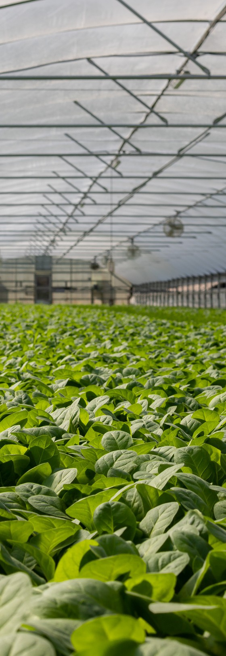


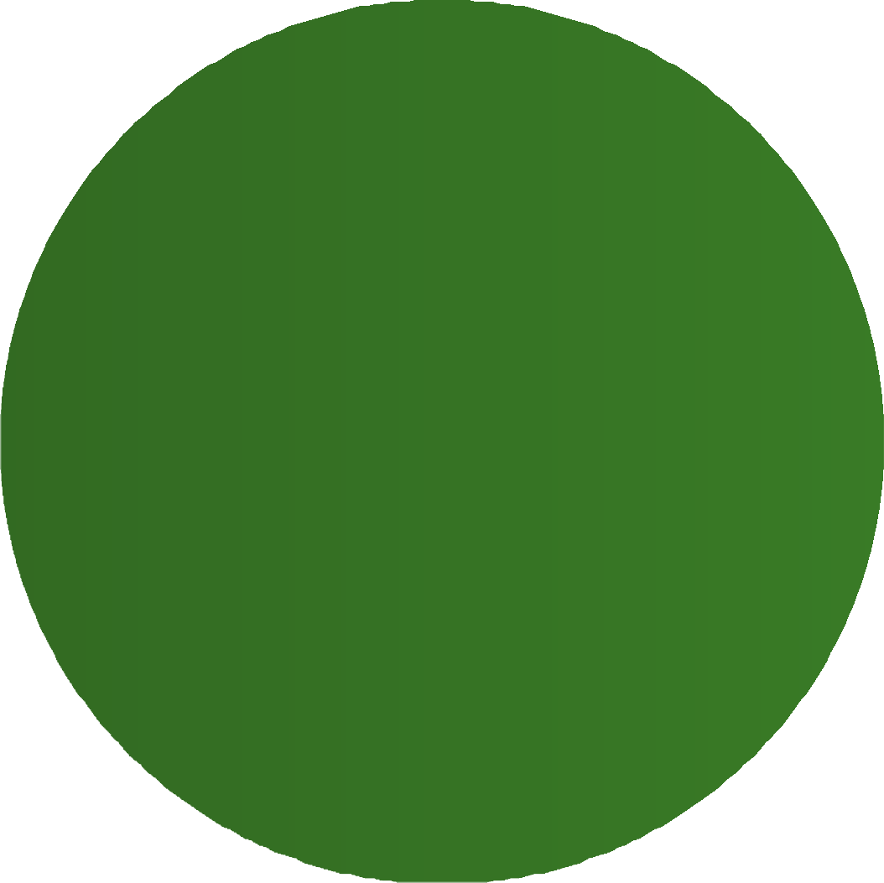
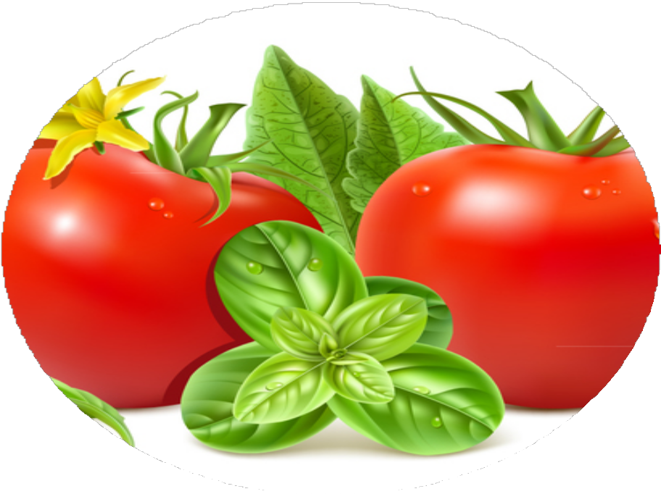


An AI-Driven Decision Support System for Tomato Cultivation in srilanka

Slide 2


IT22060426 | IT22190734 | IT22295842 | IT22208262
Ask to add Nutrient Deficiency Identification Module. | Co-Occurrence Detection | System must be validated against real-world agricultural expertise | System must be validated against real-world agricultural expertise

Slide 3
DESIGN EXCELLENCE OF THE OVERALL SOLUTION
PROBLEM AND IMPACT
Farmers cannot identify nutrient deficiencies (N, K, P, Fe) — all cause similar yellowing symptoms
Tomato fruit diseases cause 30–40% post-harvest losses annually
Leaf disease co-occurrence (Early + Late Blight) leads to missed diagnosis and wrong treatment
Unpredictable market prices cause financial losses from poor harvest timing
No affordable automated tool exists in Sri Lanka covering all these problems
BENEFICIARIES
Tomato farmers and smallholder agricultural workers Agricultural extension officers
Online agri-platforms and mobile app users Government agriculture departments and research institutions
Nutrient Deficiency Detection — MobileNetV2 CNN + Transfer Learning — 6 classes (N, K, N+K, P, Fe, Healthy) + fertilizer advice Fruit Disease Detection — MobileNetV2 CNN + Transfer Learning — 5 classes (Anthracnose, Bacterial Spot, Blossom End Rot, Spotted Wilt, Healthy) + treatment plan
Leaf Disease Detection — YOLOv8m — detects Early Blight, Late Blight and co-occurrence + RAG treatment recommendation
Price Forecasting — predicts market prices to help farmers decide harvest timing
Single mobile app — React Native + Flask API + MongoDB — all four components in one platform for Sri Lankan farmers
R26-SE-032

Slide 4



NUTRIENT DEFICIENCY DETECTION & TOMATO FRUIT DISEASE DETECTION
COMPONENT 01
TomatoDoc |R26-SE-032
Model 1: Nutrient Deficiency
Model 2: Tomato Fruit Disease Detection
IT22060426 | Gabilan | R26-SE-032

Slide 5
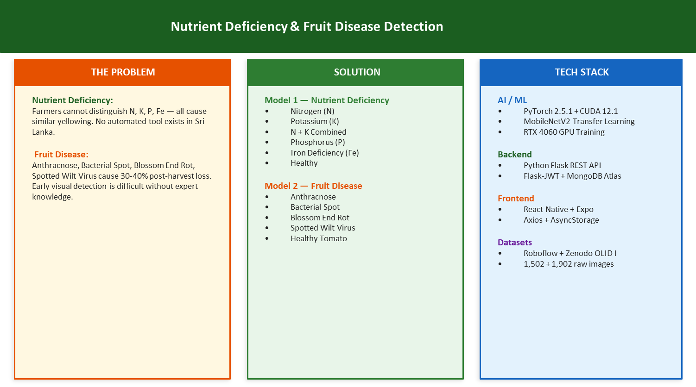

IT22060426 | Gabilan | R26-SE-032

Slide 6
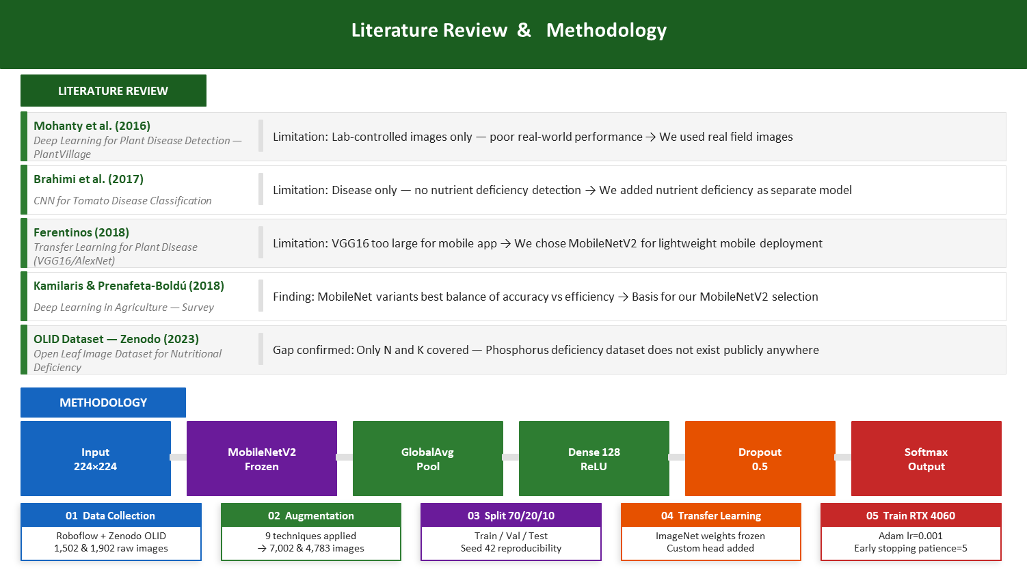
IT22060426 | Gabilan | R26-SE-032

Slide 7
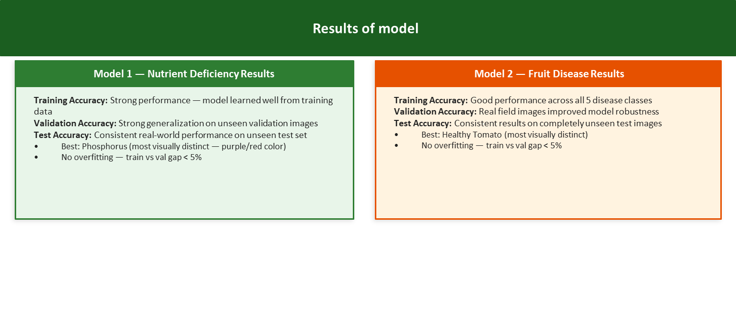
IT22060426 | Gabilan | R26-SE-032

Slide 8




Component 02:
Multi-Disease Co-occurrence Detection in Tomato Leaves
FARTHAS ALM | IT22190734
IT22190734 | FARTHAS | R26-SE-032

Slide 9
PROBLEM AND HOW ADDRESSED
THE PROBLEM
Existing systems detect one disease at a time
Multiple disease can occur on one leaf Co-occurrence may cause:
missed disease detection
wrong treatment decision
incomplete farmer guidance
Limited co-occurrence dataset availability Only one disease class per image Symptom-level detection
Treatment recommendation
SOLUTION
YOLOv8m symptom-level disease detection Detects:
Early Blight
Late Blight
Early Blight + Late Blight (Co-occurrence) Hybrid YOLO + Patch classifier tested for verification
RAG-based treatment recommendation
IT22190734 | FARTHAS | R26-SE-032

Slide 10



Design Excellence / Contribution
KEY CONTRIBUTION
End-to-end tomato disease detection system Symptom-level detection
Verified treatment recommendation Leaf validation gate
MODEL EVALUATION
YOLOv8s Baseline — F1: 64.73% YOLOv8m Best — F1: 70.35%
Hybrid YOLO+Patch — F1: 66.57% Patch Classifier — F1: 87.36%
Final selected model: YOLOv8m Best Hybrid kept as experimental verification pipeline
Final Output: Co-occurrence Detected → Bounding Boxes → Verified Treatment
IT22190734 | FARTHAS | R26-SE-032

Slide 11



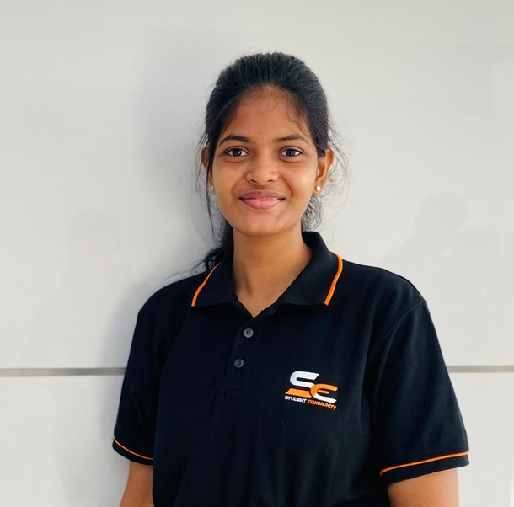
AI-driven Disease Monitoring and Treatment Efficacy platform
IT22208262 | Vithusha .P
IT222208262| Vithusha| R26-SE-032

Slide 12
The Solution & Flow
The Core Objective
Disease Severity Trends Environmental Impact Treatment monitoring
Gatekeeper Check (Image Validation): Base Model: models.mobilenet_v2 (both leaf and fruit)
Severity check: The U-Net models identify the exact pixels of the disease and calculate the Severity Percentage .(low/high) (both leaf and fruit)
Rule-Based Engine: severity + Weather + History
Treatment Uncertainty: Farmers apply expensive fungicides but have no automated way to track if the disease is actually shrinking or spreading after the application.
Efficacy Tracking Gap: There is a lack of tools that mathematically calculate the Treatment Response Rate (TRR) over a 7-day period.
Problems

Slide 13

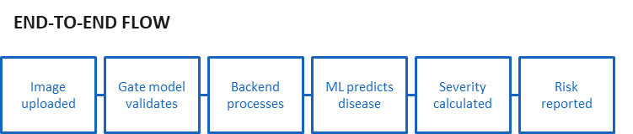
Architecture: U-Net (Semantic Segmentation). Job: Precision Measurement of Leaf Diseases.
Action: It looks at the leaf and identifies every single pixel infected by Early Blight or Late Blight.
Output: It gives an exact Severity Percentage (e.g., "12.4% of this leaf is infected" visible to (low/high). This
percentage is what the TRR engine uses to track recovery over 7 days.
Early Blioftht -A ,Late Blioftht-B
Architecture: Multiclass U-Net (Semantic Segmentation).
Job: Multitask Fruit Disease Analysis.
Action: This model is more complex because it scans for multiple different diseases
Output: It identifies the Dominant Disease (the one that is most severe) and calculates its precise Severity Percentage on the fruit.
Blossom End Rot,Spotted Wilt Virus
Gate Model asks: "Is this a valid tomato leaf/fruit?" (YES/NO) -->> If YES, Model 1 or Model 2 asks: "Where exactly is the disease and how much of the area is covered?" (Calculates %) -->> The Engines (TRR/RAG)

Slide 14


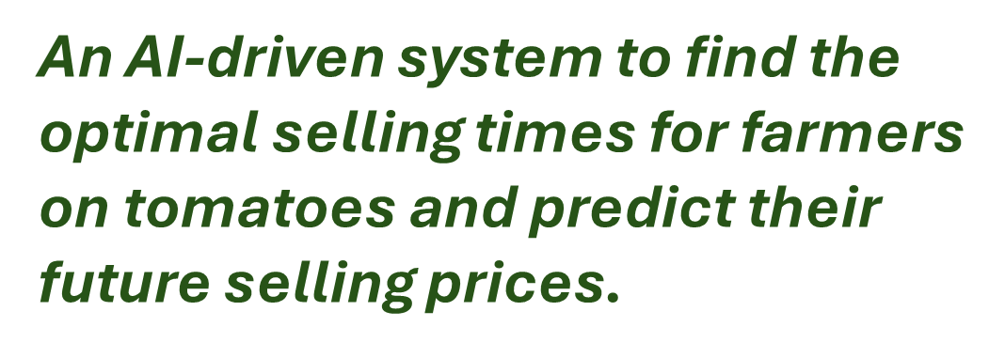


Rashad M.P.M |IT22295842

Slide 15


PROBLEM
SOLUTION
What will be the price on this particular day What is the best day to sell?
How does the weather affect the price? What are the latest market news signals? How confident is the prediction?
Prices change dramatically every
Farmers sell at wrong time and lose money No system connecting weather + market data Black box price prediction
IT22295842 | Rashad M.P.M | R26-SE-032

Slide 16
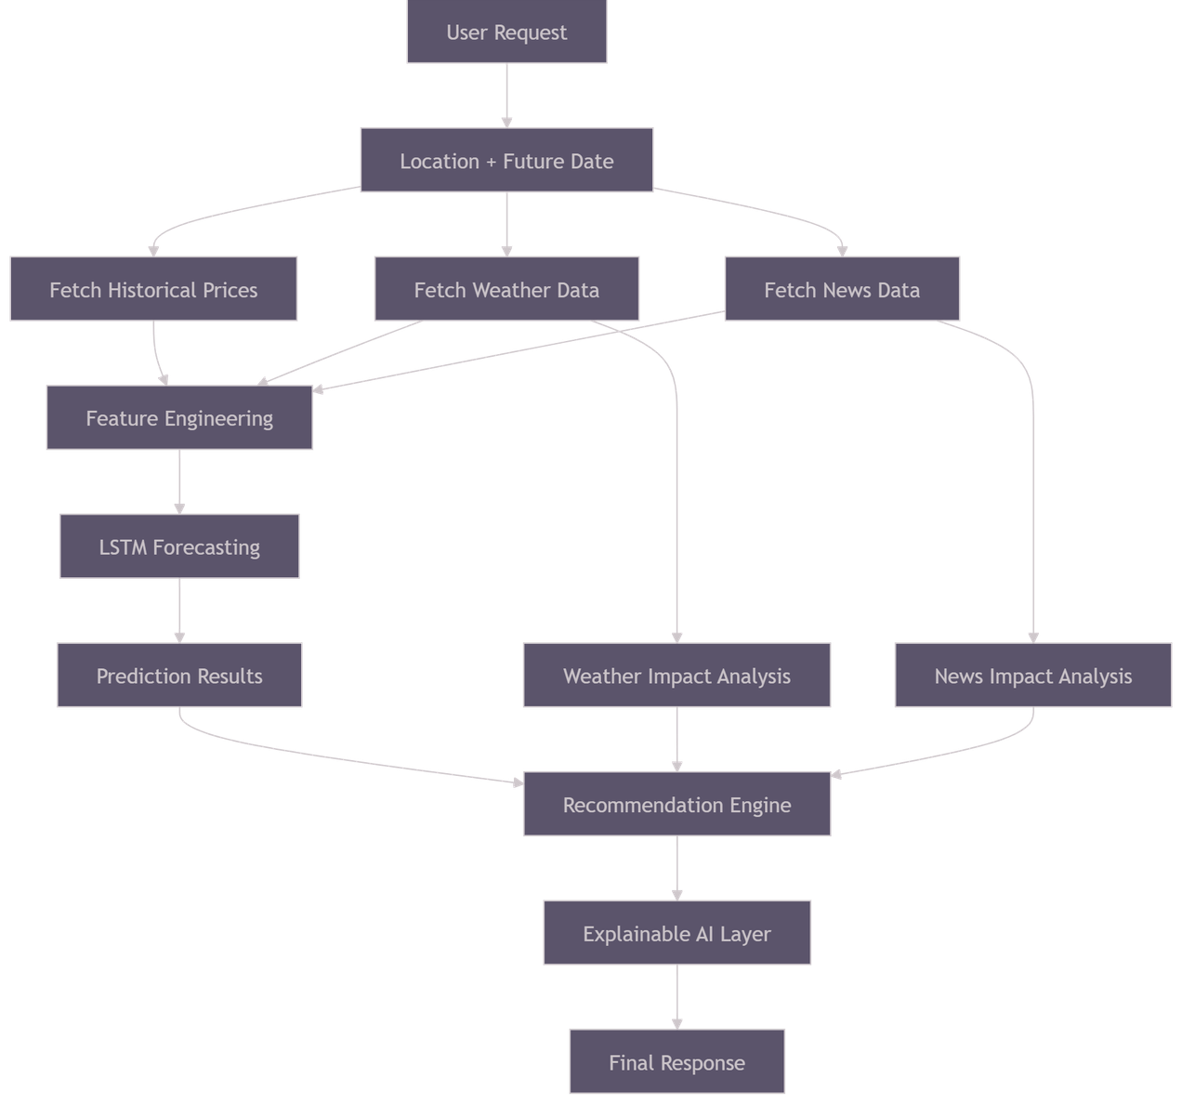
Work Flow
Advantages gained and the problem solved
In Sri Lanka, tomato prices can change by 50% or more within a single week due to weather, seasonal patterns and market conditions.
Farmers who have access to accurate price forecasts can earn significantly more from the same harvest simply by choosing the right time to sell.
Our Tomato Price Advisor puts that information directly in the hands of the farmer , in simple language, on their mobile phone.
IT22295842 | Rashad M.P.M | R26-SE-032

Slide 17


Thank You

