Slide 1
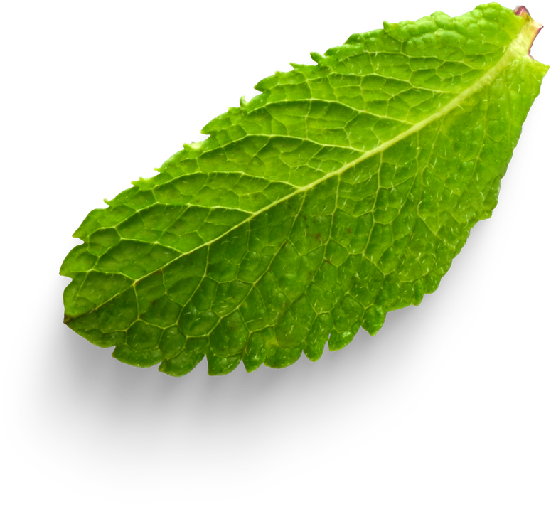
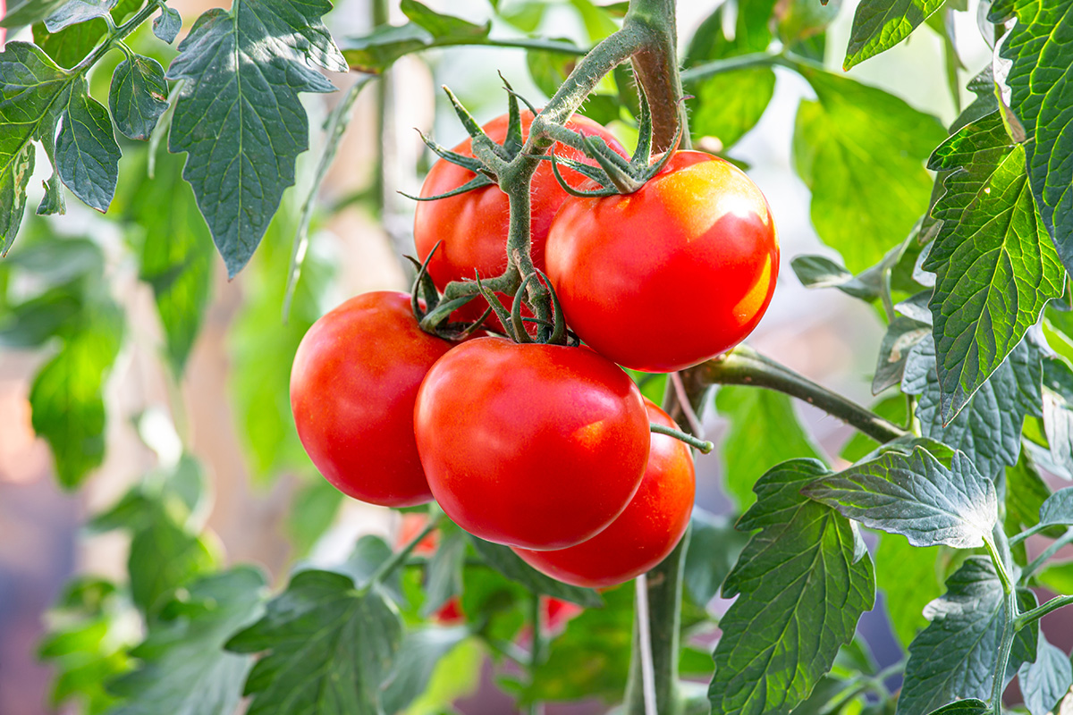
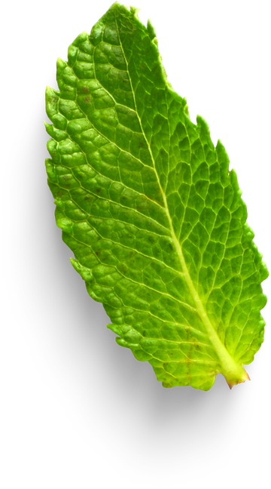
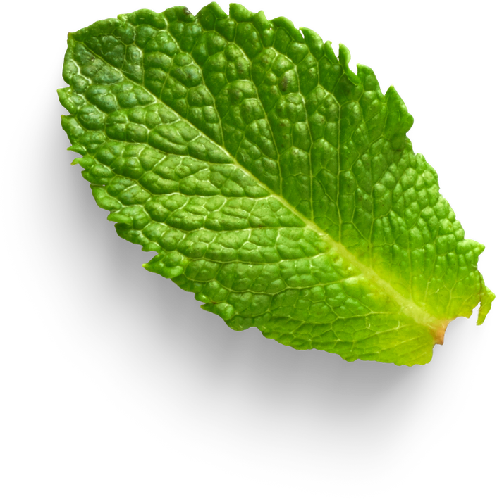
An AI-Driven Decision Support System for Tomato Cultivation in srilanka
RP-R26-SE-032 - SLIIT Research Project

Slide 2
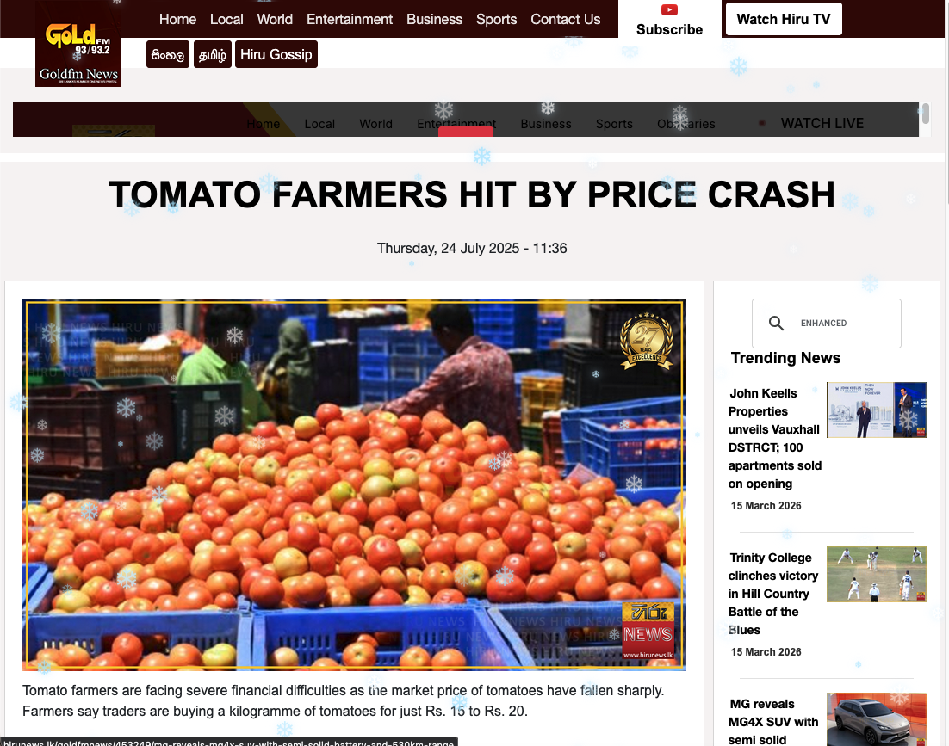
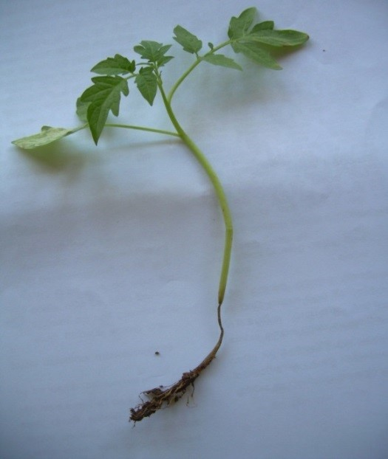
The Problem
Sri Lanka has suitable climate conditions for tomato cultivation, but production is still low. Tomato farmers face several challenges that reduce crop yield and income.
Click here to watch a simple video explaining the problem.
Key Problems
Soil Issue: Farmers cannot assess soil suitability before planting (pH, nutrients, NPK).
Disease Issue: Farmers cannot correctly identify tomato leaf diseases and often use excessive pesticides.
Tracking Issue: No system exists to monitor whether treatments are working.
Price Issue: Farmers lack market price forecasting and often sell at low prices.

Slide 3
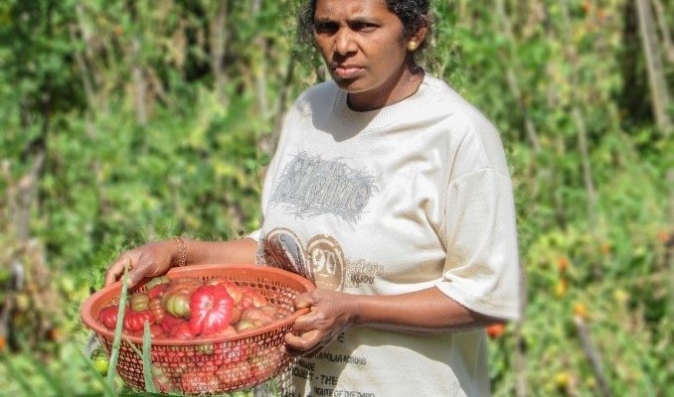
Users and Stakeholders
Primary Users
Secondary Stakeholders
Tomato Farmers – Use mobile dashboard to monitor soil, detect diseases and get diagnosis recommendation, monitoring the plant, and check price forecasts.
Agricultural Inspectors – Validate system outputs and provide expert guidance.
System Administrators – Manage sensors and AI models
Consumers – Benefit from safer tomato production
Export Companies – Access higher quality tomatoes
Supervisors – Monitor research progress

Slide 4
Impact on Users and Society
Economic Impact
Health Impact
Social Impact
Environmental Impact
Low tomato productivity
Farmers lose income due to crop failures
Missed export opportunities
Excessive pesticide use harms consumers
Unsafe tomatoes reach the market
Farmers struggle to sustain livelihoods
Younger generations leaving farming
Overuse of chemicals damages soil and water ecosystems

Slide 5
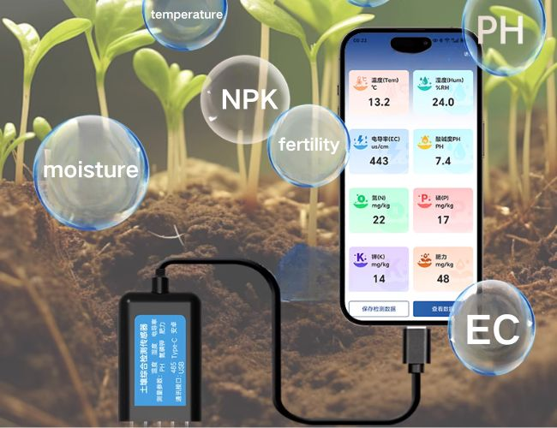
Existing Systems and Limitations
Existing research systems address only individual problems.
Examples from literature:
Disease detection systems
Soil monitoring IoT systems
Price recommendation systems
Key Limitations
Research Gap
No soil suitability verification
No explanation for ML predictions
Limited explainability for disease detection.
No diagnosis recommendation aligned with DoA.
No treatment tracking
No price forecasting
No unified platform integrates soil assessment, disease detection, treatment tracking, and price prediction for tomato farmers.

Slide 6
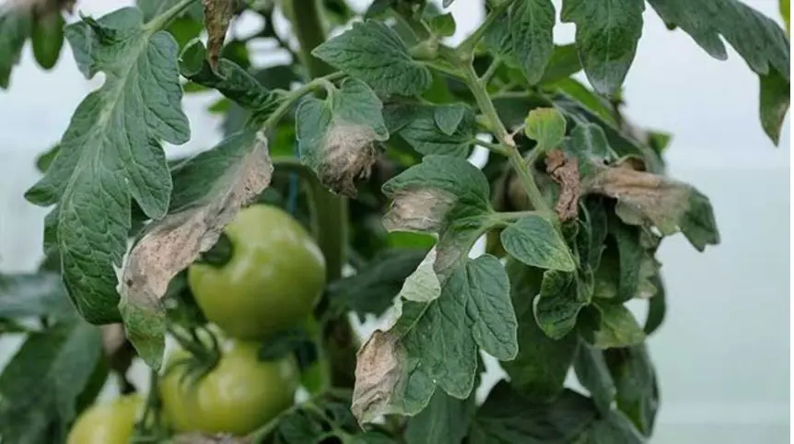
1. Smart Soil Health Assessment
2. Tomato Disease Detection
IoT sensors collect soil data
Random Forest predicts soil suitability
SHAP explains soil problems
RAG generates corrective recommendations
AI computer vision detects leaf diseases.
Provide explainability about the detection.
Recommends correct medicine and dosage
3. Disease Treatment Tracking
4. Tomato Price Forecasting
Monitors treatment progress over time
Generates improved recommendations if needed
AI predicts future tomato market prices
Helps farmers choose the best time to sell
Main Components

Slide 7
How Our System Overcomes Limitations
Our System Provides
Novel Contributions
Soil suitability prediction using IoT + ML
Explainable AI (SHAP) to identify soil problems
Intelligent recommendations using RAG
Treatment tracking and adaptive re-recommendation
AI-based tomato disease detection
Market price forecasting
Single mobile platform for farmers
Time-series soil tracking (Improving / Declining)
Adaptive recommendation system when initial fixes fail
Research Gap
Existing systems do not provide a complete cycle:
Assess → Explain → Fix → Track → Verify

Slide 8

IoT-Based Smart Soil Health Assessment System for Tomato Cultivation
Contribution to the overall Solution
IoT-based smart soil health assessment module for tomato cultivation that collects real-time soil data using sensors, classifies soil suitability using Random Forest machine learning, and provides intelligent corrective recommendations with adaptive tracking for farmers.
Novelty
Time-series soil quality tracking system that monitors soil condition week by week after a corrective fix is applied and automatically generates a revised recommendation using RAG architecture when soil quality is not improving — the first system to provide a complete soil health feedback loop for tomato farmers.

Slide 9
IoT-Based Smart Soil Health Assessment System for Tomato Cultivation
Problem
Objective
Sub-Objectives
Tomato farmers in Sri Lanka find it difficult to check soil suitability before planting.
Existing systems only classify soil or recommend crops.
They do not explain why soil is unsuitable.
They do not give solutions to improve the soil.
They also do not track if soil improvements are working.
Predicts soil suitability using Machine Learning
Explains the results using Explainable AI (XAI)
Provides soil improvement recommendations using RAG
Tracks soil quality changes over time
Collect soil data using ESP32 and sensors (NPK, pH, moisture, temperature, humidity)
Train a Random Forest model to classify soil suitability
Use SHAP (XAI) to identify problematic soil parameters
Generate soil improvement recommendations using RAG
Monitor soil quality changes using time-series analysis
Provide adaptive recommendations if soil does not improve

Slide 10
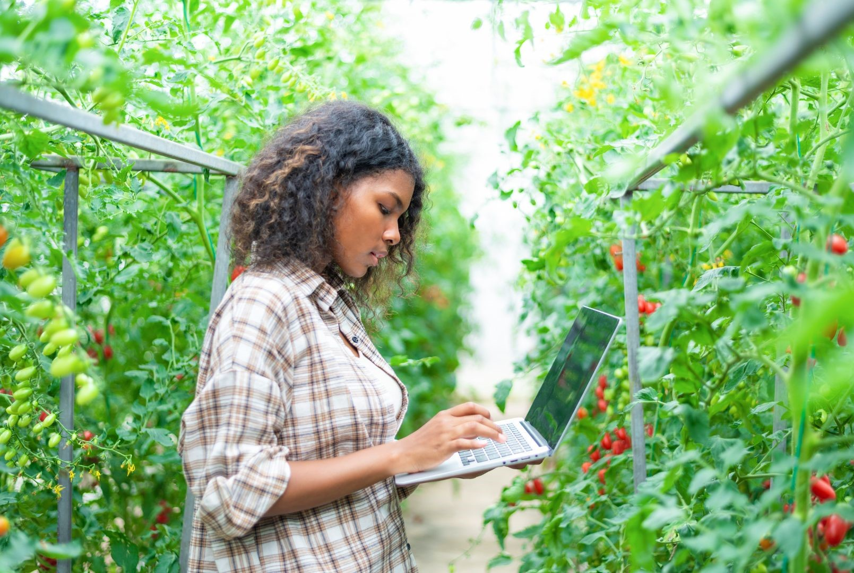
Knowledge Domains
Internet of Things (IoT)
Machine Learning
Explainable AI (XAI)
Time-Series Analysis
Cloud Computing
Technologies Used
IoT-Based Smart Soil Health Assessment System for Tomato Cultivation
ESP32
NPK, pH, Moisture Sensors
DHT11
Python
Firebase

Slide 11
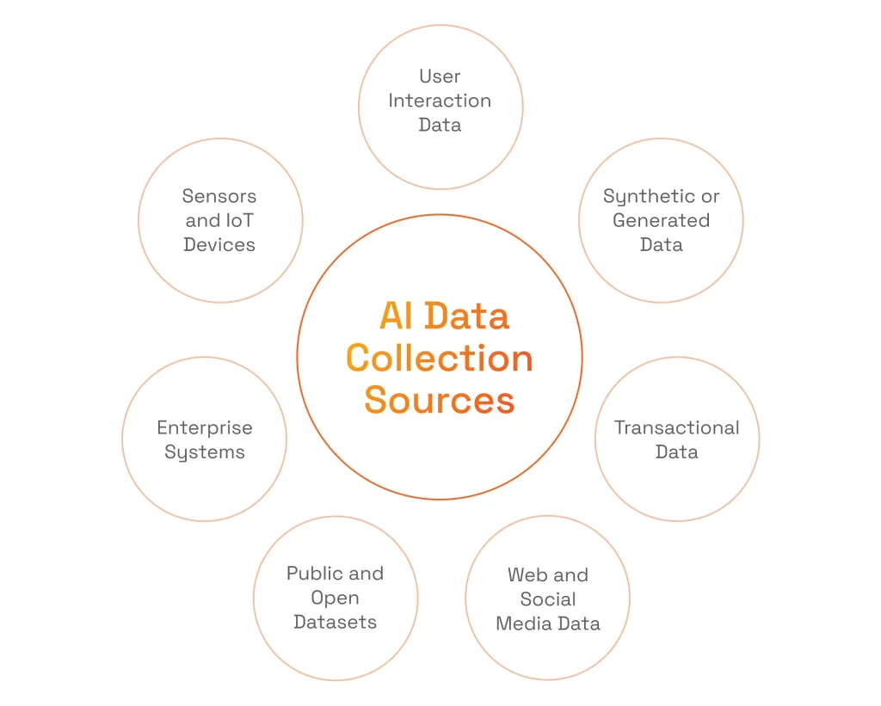
Validation Strategy
Data Sources
Random Forest Model: Train–test split (80/20), target accuracy ≥ 95%
Model Performance: Precision, Recall, F1 Score ≥ 90%
SHAP Explanations: Verified by agricultural experts
RAG Recommendations: Evaluated for relevance and usefulness
Real-time IoT sensor data from farms
Synthetic dataset for additional training
Security Measures
Ethical Considerations
encryption for secure communication
authentication for data access
Farmer login authentication for dashboard
Farmer consent before data collection
Data privacy and anonymization
Voluntary participation
Sensors safe for soil and crops
IoT-Based Smart Soil Health Assessment System for Tomato Cultivation

Slide 12
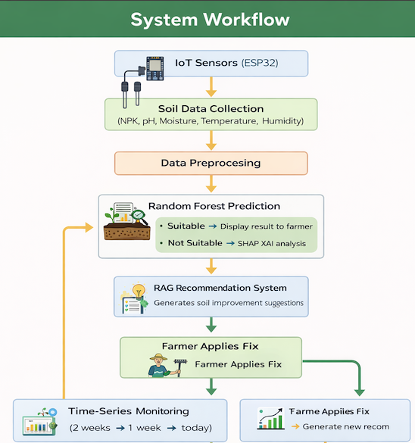
Component Dependencies
IoT-Based Smart Soil Health Assessment System for Tomato Cultivation
Component Dependencies
IoT Layer: ESP32, NPK, pH, Moisture, DHT11
ML Model: Python, Scikit-learn
Explainable AI: SHAP Library
Recommendation System: LangChain, ChromaDB, LLM
Database: Firebase
Farmer Dashboard: Flutter Mobile App

Slide 13

AI Based Tomato Leaf Disease Detection with Explainable AI
Contribution to the overall Solution
AI-based disease detection and diagnosis module for tomato leaves that identifies diseases from leaf images and provides treatment guidance for farmers.
IT22190734
FARTHAS A L M
Novelty
CNN-based tomato disease detection system that improves disease identification and explores the potential disease co-occurrence, integrated with Grad-CAM explainability and DoA advisory knowledge

Slide 14
AI Based Tomato Leaf Disease Detection with Explainable AI
Problem Definition
Early detection of major tomato diseases remains difficult for Sri Lankan farmers.
Disease symptoms may co-occur on a single leaf, making identification challenging.
Many AI models do not clearly explain their predictions.
Farmers lack accessible diagnosis and treatment guidance aligned with the Sri Lankan Department of Agriculture (DoA).
Objectives
Develop an AI-based system to detect tomato leaf diseases and provide explainable diagnosis with DoA-aligned treatment guidance through a mobile application.
Investigate CNN architectures for tomato disease detection.
Evaluate multi-class and parallel classifier approaches.
Integrate Grad-CAM explainable AI for visual interpretation and DoA-aligned treatment guidance.

Slide 15
AI Based Tomato Leaf Disease Detection with Explainable AI
Application of Domain Knowledge
Knowledge Domain Contribution
CNN Models → Disease detection (e.g., MobileNetV2, ResNet, EfficientNet)
Grad-CAM → Visual explanation
DoA Knowledge → Verified treatment guidance
LLM → Farmer-friendly explanation
Mobile App → Farmer access

Slide 16
AI Based Tomato Leaf Disease Detection with Explainable AI
Technology used
CNN-based image classification models (TensorFlow / PyTorch).
Grad-CAM for explainable AI visualization.
LLM for generating farmer-friendly explanations of diagnosis and treatments.
React Native mobile application and Node.js backend.
Validation and Evaluation
Evaluate performance using Accuracy, Precision, Recall, and F1-score.
Compare multi-class CNN vs parallel binary classifiers to identify the best approach.
Validate system predictions using real tomato leaf images and DoA treatment guidance.
Data Availability
Public tomato leaf disease datasets (e.g., PlantVillage / Kaggle).
Disease diagnosis and treatment guidelines collected from Sri Lankan Department of Agriculture (DoA) resources.

Slide 17
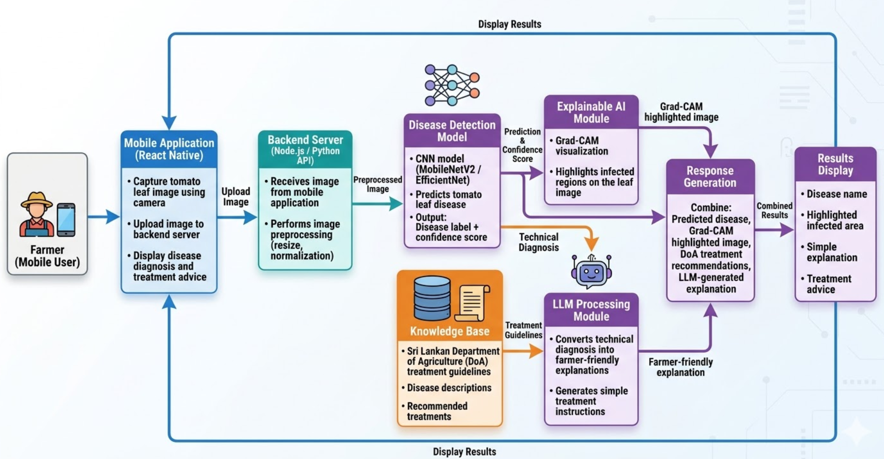
AI Based Tomato Leaf Disease Detection with Explainable AI

Slide 18

AI-Based Disease Treatment Efficacy Monitoring System
for Tomato Cultivation

Slide 19
AI-Based Disease Treatment Efficacy Monitoring System for Tomato Cultivation
Problem
Objective
Sub- Objectives
Monitor disease severity using U-Net segmentation across Day 1, Day 3, Day 5
Calculate Treatment Response Rate (TRR) — a novel metric
Integrate real-time weather + pH context via API
Provide resistance-aware alternative solutions using RAG when treatment fails
Use Component 2 via microservice for disease re-confirmation
Train U-Net CNN for pixel-level leaf disease segmentation (IoU ≥ 0.90)
Define TRR metric and build Rule-Based efficacy classifier (F1 ≥ 0.90)
Integrate OpenWeatherMap API and pH input for contextual alerts
Build RAG engine with FAISS backed by 100+ DOA Sri Lanka approved medicines
Invoke Component 2 microservice on FAILURE for fresh disease re-detection
Validate with farmer usability testing (SUS ≥ 75)
Farmers rely on visualinspection after applying treatment only 60%accurate
Existing systems only detect disease and stop no follow-up they do not check if medicine worked after application
They do not explain why treatment failed (weather, pH)
They do not provide a resistance-aware alternative when treatment fails

Slide 20
Knowledge Domains
Deep Learning (U-Net CNN)
Retrieval-Augmented Generation (RAG)
Real-Time Weather Integration
Microservice Architecture
Mobile Application Development
AI-Based Disease Treatment
Efficacy Monitoring System
for Tomato Cultivation
Technologies Used
U-Net CNN (PyTorch) — severity segmentation
OpenWeatherMap API — weather + humidity
LangChain + FAISS — RAG engine
Nodejs — backend
React Native — mobile app

Slide 21
Validation Strategy
U-Net Model: IoU ≥ 0.90, Dice ≥ 0.92 on held-out test set
TRR Classifier: F1 Score ≥ 0.90
RAG Recommendations: 100% DOA verified by agronomist review
Farmer Usability: SUS score ≥ 75 (10 farmers)
AI vs Human: AI 95% vs Human 60% accuracy
Security Measures
HTTPS encryption for all API communications
Token-based authentication for data access
Field-level encryption in Firebase for images and GPS data
Anonymised session IDs — no personal data stored
Novel Metrics
TRR >20% = SUCCESS
TRR 5-20% = PARTIAL
TRR <5% = FAILURE
TRR = (Day1 − Day5) ÷ Day1 × 100
First quantitative treatment efficacy metric in plant disease research
Ethical Considerations
Farmer consent before collecting any images or location data
Data privacy and anonymisation
Voluntary participation
Data Sources
Plant Village
Tomato-Village
Local Sri Lanka farms
DOA Sri Lanka
AI-Based Disease Treatment Efficacy Monitoring System for Tomato Cultivation

Slide 22
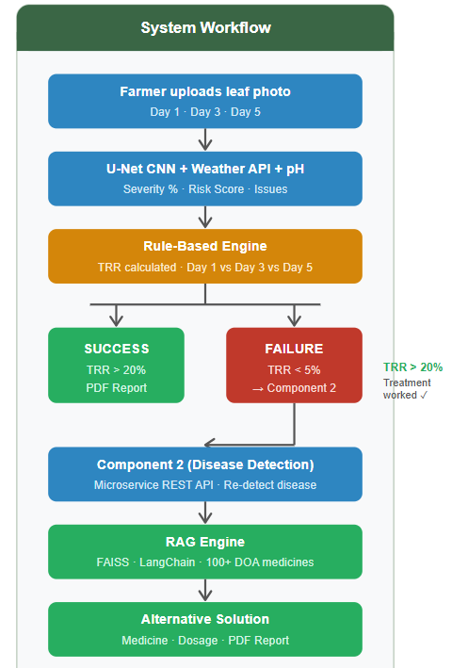
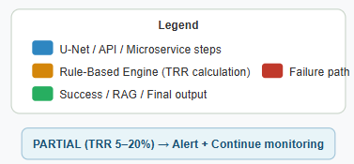
AI-Based Disease Treatment Efficacy Monitoring System for Tomato Cultivation
Component Dependencies
AI Model: U-Net CNN (PyTorch) — pixel-level severity segmentation
Efficacy Classifier: Rule-Based Engine (Python)
Weather Layer: OpenWeatherMap API + pH farmer input
Alternative Treatment: RAG + FAISS + LangChain + DOA knowledge base
Microservice: Component 2 (Disease Detection) via REST API
Mobile App: react native (Android + iOS)
Backend: Nodejs
Training: Google map location + Roboflow
annotations

Slide 23

An AI-driven system to find the optimal selling times for farmers on tomatoes and predict their future selling prices.

Slide 24
An AI-driven system to find the optimal selling times for farmers on tomatoes and predict their future selling prices.
Problem
Objective
Sub-Objectives
Tomato farmers in Sri Lanka face high market price volatility, making it difficult to decide the best time to sell their harvest.
Existing systems mainly focus on price forecasting accuracy, but they do not provide practical selling recommendations for farmers.
Sudden factors such as weather changes, supply disruptions, and market events can cause unexpected price fluctuations.
As a result, farmers often sell at the wrong time, leading to financial losses and reduced income stability.
Therefore, there is a need for an AI-driven decision-support system that can predict future tomato prices and recommend the optimal selling time for farmers.
Develop an AI-based predictive decision-support system that analyze any uneven changes and forecasts tomato prices and identifies the optimal selling time to help farmers maximize profit and reduce market uncertainty.
Collect and preprocess historical tomato price data from reliable market sources.
Analyze historical data to identify seasonal trends and price patterns.
Develop machine learning and deep learning models (LSTM, GRU, ARIMA, XGBoost) to forecast future prices.
Integrate external influencing factors such as weather data and news events.
Implement anomaly detection techniques to identify unusual price spikes or sudden market disruptions.
Evaluate model performance using metrics such as MAE, RMSE, and MAPE.
Develop a decision-support recommendation system to suggest the optimal time to sell tomatoes.
Provide Explainable AI insights to help farmers understand the reasoning behind predictions.

Slide 25
Knowledge Domains
• Artificial Intelligence (AI)
• Machine Learning
• Deep Learning
• Time Series Forecasting
• Agricultural Data Analytics
• Decision Support Systems
• Explainable Artificial Intelligence (XAI)
Technologies Used
Python — data processing and model development
XGBoost, TensorFlow — machine learning and deep learning models
Statsmodels (ARIMA/SARIMA) — time-series forecasting
Pandas & NumPy — data preprocessing and analysis
Isolation Forest (PyOD) — anomaly detection
SHAP / LIME — explainable AI for prediction interpretation
Weather & News APIs — external factor data integration
An AI-driven system to find the optimal selling times for farmers on tomatoes and predict their future selling prices.

Slide 26
Validation Strategy
• Mean Absolute Error (MAE)
• Root Mean Square Error (RMSE)
• Mean Absolute Percentage Error (MAPE)
Security Measures
• Role-based authentication for administrators
• Secure APIs for external data sources
• Encrypted data storage and communication
• System monitoring and logging
Ethical Considerations
Use only public and legally accessible datasets
• Ensure no personal farmer data is exposed
• Maintain transparency using Explainable AI
• Clearly communicate prediction uncertainty to users
Data Sources
• Central Bank of Sri Lanka (CBSL) price datasets
• Dambulla Wholesale Market price reports
• Weather data from Meteorological APIs
• Agricultural news and event data from news APIs
An AI-driven system to find the optimal selling times for farmers on tomatoes and predict their future selling prices.

Slide 27
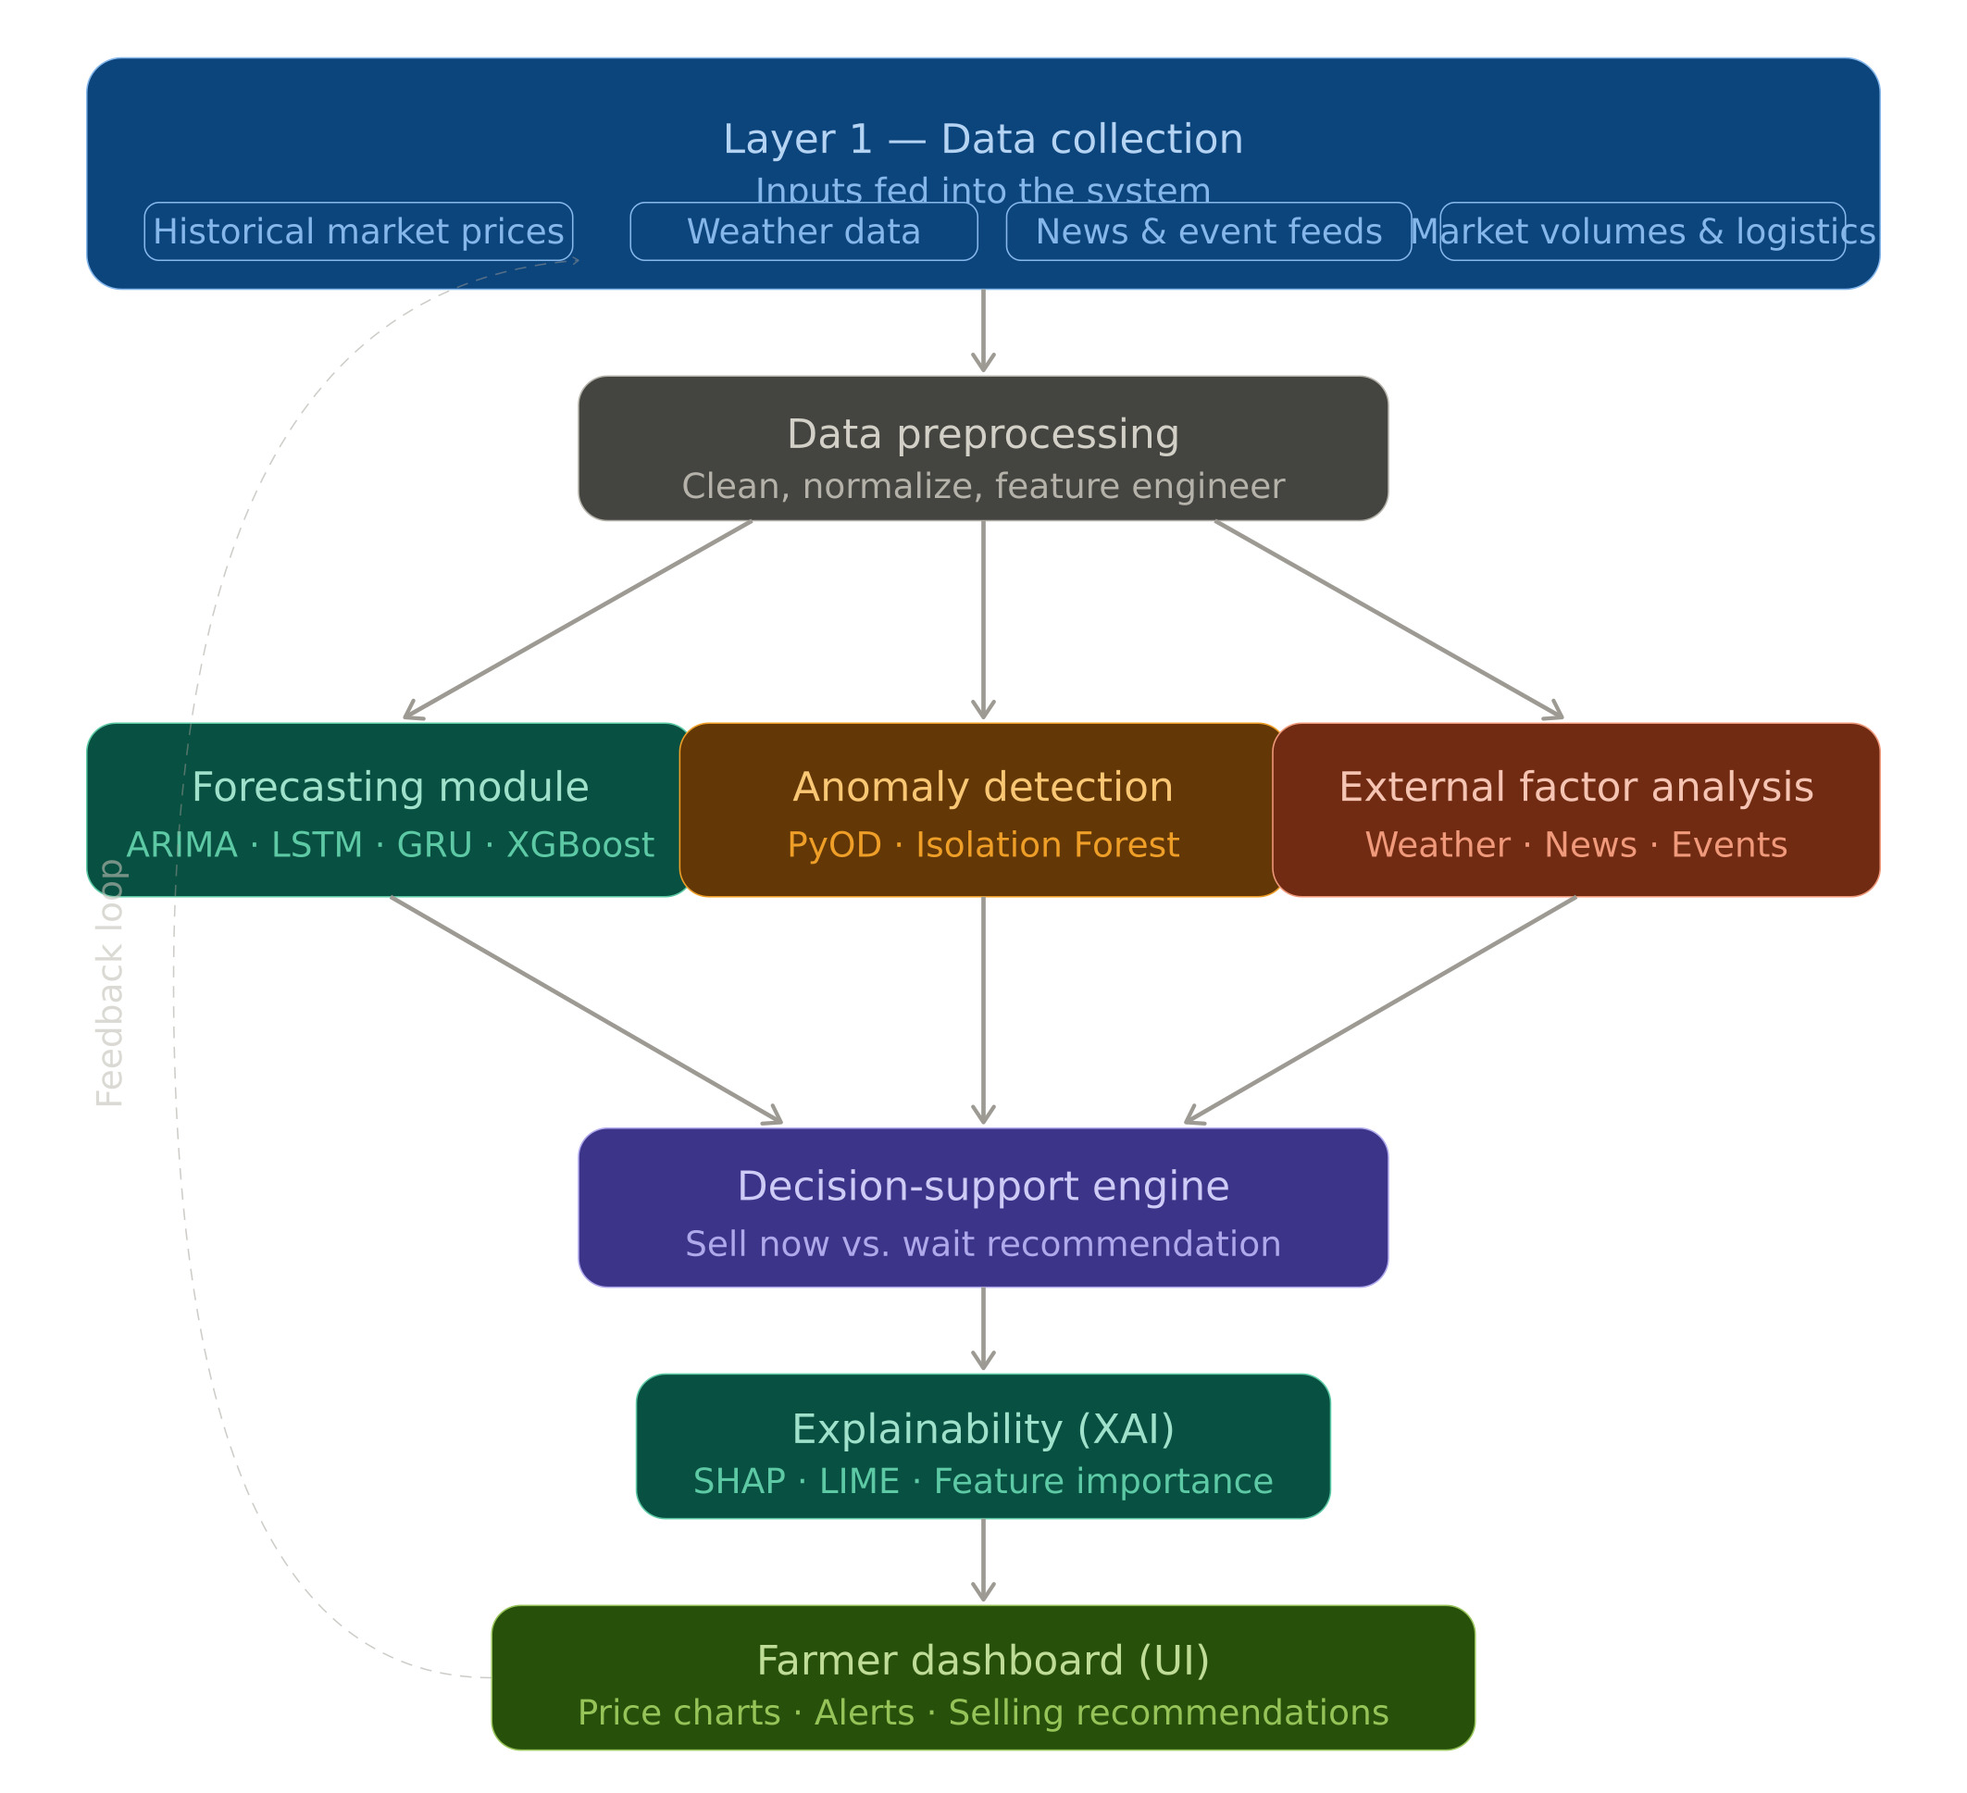
An AI-driven system to find the optimal selling times for farmers on tomatoes and predict their future selling prices.
Component Dependencies
Price Prediction Model: LSTM / XGBoost / ARIMA (Python, TensorFlow, Scikit-learn) — tomato price forecasting
Anomaly Detection Engine: Isolation Forest (PyOD, Python) — detect unusual price spikes and market shocks
External Data Layer: Weather APIs + News APIs — integrate environmental and market events
Decision Support Engine: Rule-based recommendation system determine optimal selling time
Explainable AI Module: SHAP / LIME — interpret predictions and recommendation factors
Mobile Application: Flutter — farmer interface and visualization dashboard
Database: Firebase Firestore — store price data, forecasts, and user queries

Slide 28
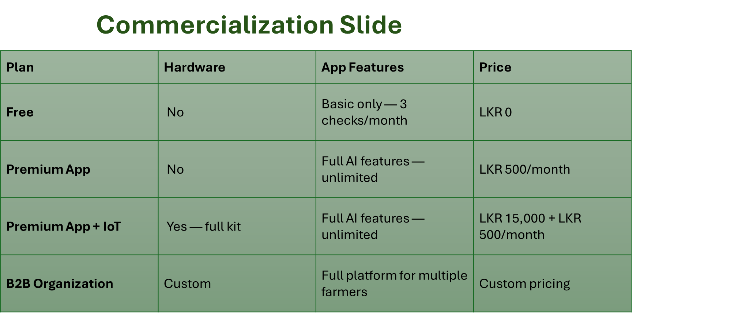

Slide 29
THANK YOU
Get In Touch
0776914430
IT22060426@my.slit.lk

