Slide 1
Eclipse MDT Papyrus Collaborative Work
tristan.faure@atos.net

Slide 2
Agenda
Collaborative work within Papyrus
Split your model
Work with restrictions on the model
Reassemble your model
Model loading policies
Handle UML profiles and stereotypes

Slide 3
Collaborative work within Papyrus
MDT Papyrus provides a way to
  Split a model into multiple parts
  Manage resources loading
These points allow users to
  Make team work possible on a model
  Work on huge models
  Adapt model loading according to their context

Slide 4
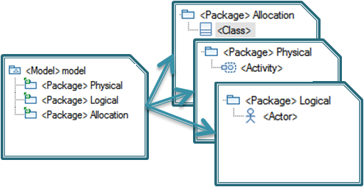
Split your model
Control action
  Comes from EMF
  Enables exporting a part of the model into a new file
  Several files for several users, still one model

Slide 5
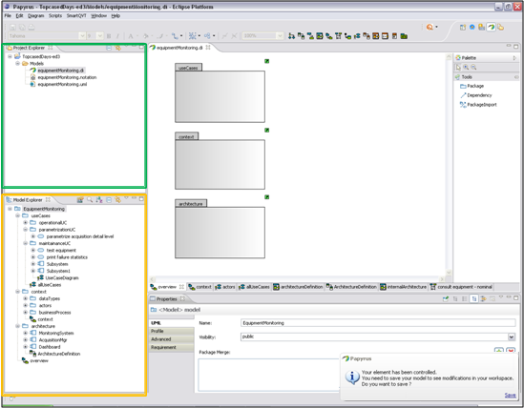
Papyrus environment
Some relevant views for collaborative work
Project Explorer view:
Physical view of the model
Model Explorer view:
Logical view of the opened file
Papyrus notification

Slide 6
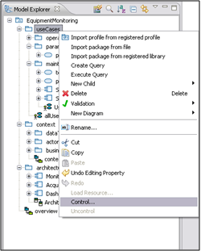
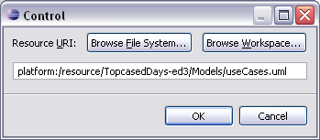
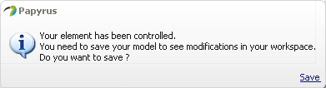
Control action
  Activated on structural element such as Package
  Perform control action to export the model part

Slide 7
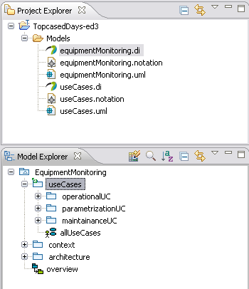
Control action
Once control is done, model part is exported
  New files are created
  Icon appears on the exported package

Slide 8
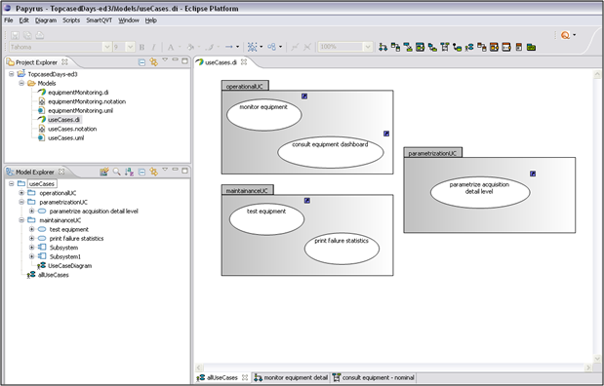
Open part of the model
You can open the model part as a single part
  Part’s content is visible only

Slide 9
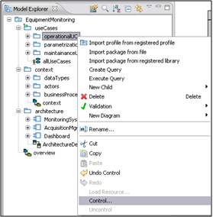
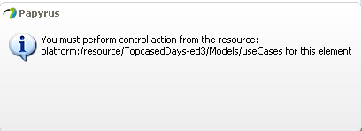
Notification with control
Notification to be aware of
  You can’t control a model part from a file that does not contain this part

Slide 10
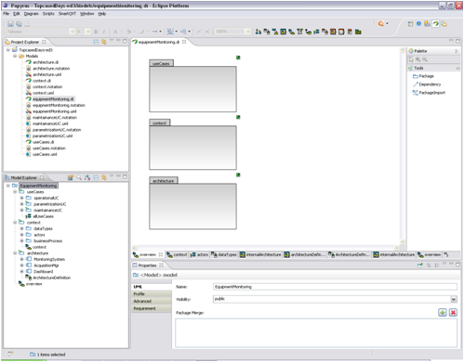
Split the model
You are now able to split your model
  Each user works on a model part
  Add restrictions to go beyond on the team work

Slide 11
Restrictions on model parts
Adding restrictions enables to
  Forbid modifications on a wrong model part
  Avoid conflict situation with model merging
There are several ways to add restrictions
  A possible choice is the pessimistic mode with SVN

Slide 12
Work in pessimistic mode with SVN
The aim is to use locks for synchronization
  A user needs to lock files to work on it
  Locked files are read-only for other team members

Slide 13
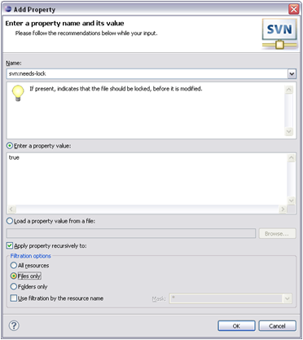
Configure lock on SVN
Right click on the folder in the Project Explorer view
  Team menu and Set Property menu item
  Then commit changes

Slide 14
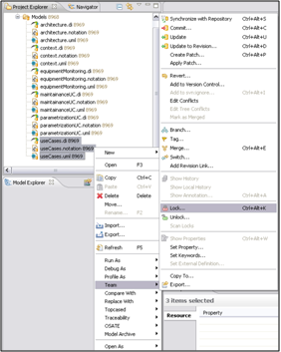
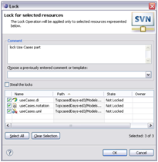
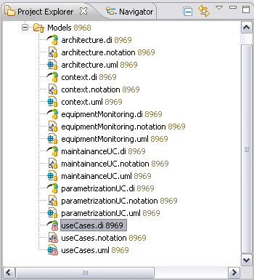
Work on model part
You need to lock files you want to work on

Slide 15
Model restrictions
If you try to modify an unlocked file
Change the name

Slide 16
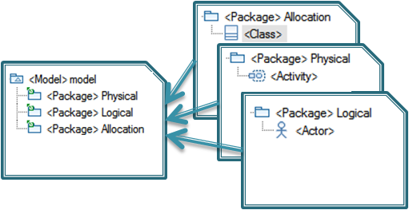
Reassemble your model
Uncontrol action
  Enables to reassemble a part of the model into the initial file
  One file for one model

Slide 17
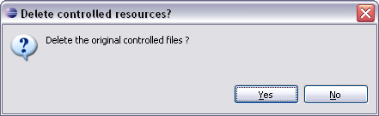
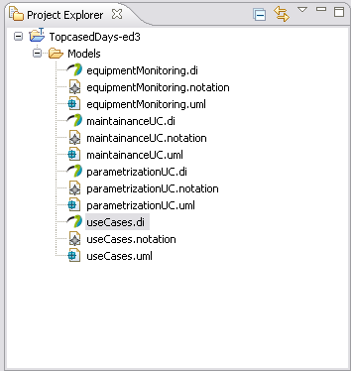
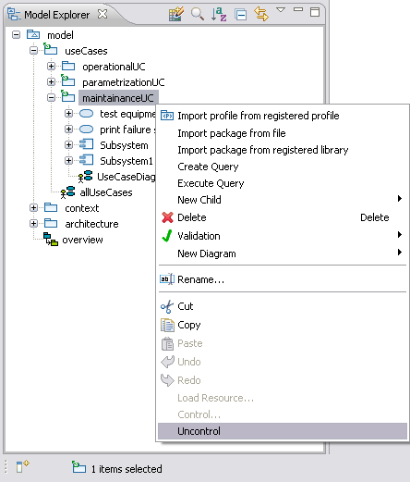
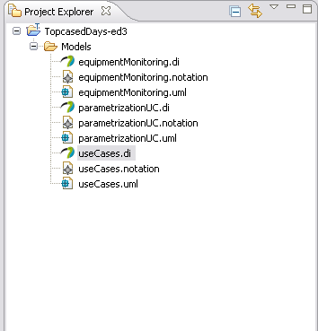
Uncontrol action
Available on controlled element only
Reassemble element content into the initial file

Slide 18
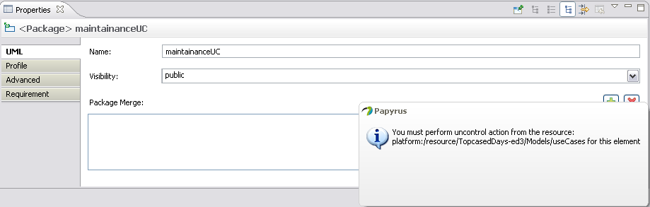
Notification with uncontrol
Notification to be aware of
  You can’t uncontrol a model part from a file that did not contain this part

Slide 19
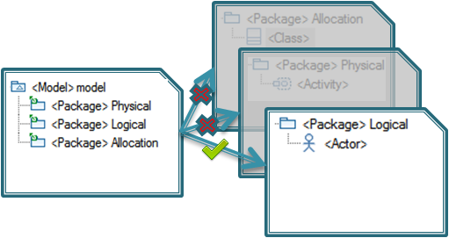
Model loading
Why change model loading ?
  Avoid unneeded model part loading
  Improve model loading performance
  Quickly open a part of a huge model

Slide 20
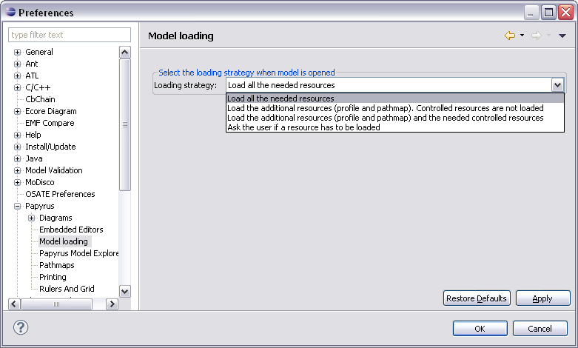
Loading policies
Several model loading policies
  Available in papyrus preferences (window menu)

Slide 21
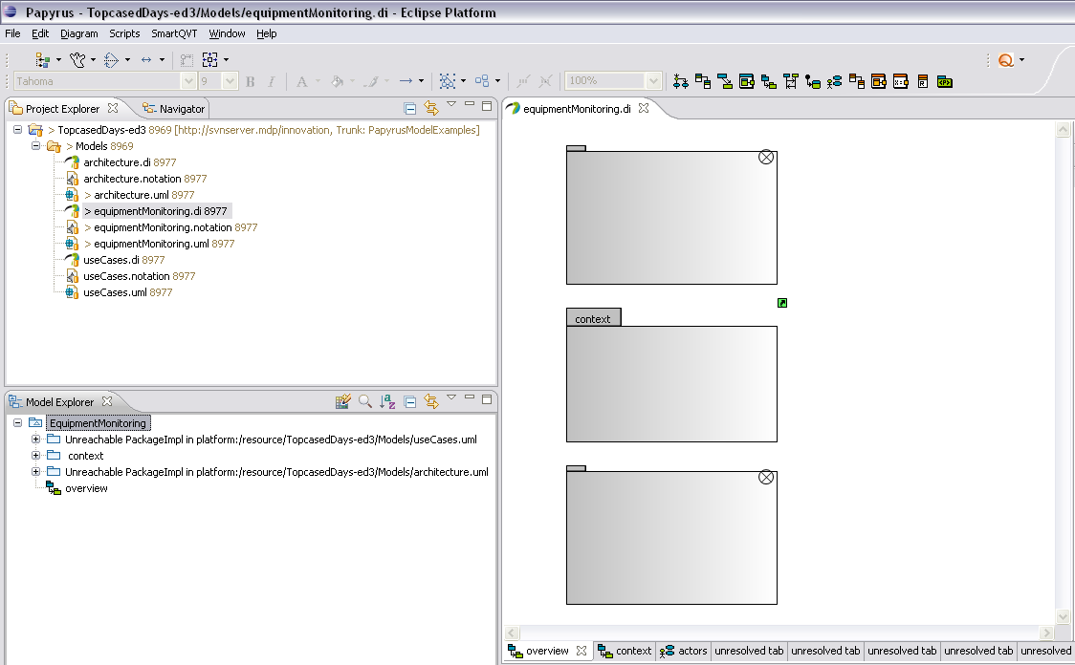
Loading policies: example 1
A sneak peek at loading policies
  Try with a relevant case:
    Load the additional resources. Controlled resources are not loaded
Unable to display shapes in the editor
Unreachable elements in Model Explorer view
Unresolved tabs for unloaded diagrams

Slide 22
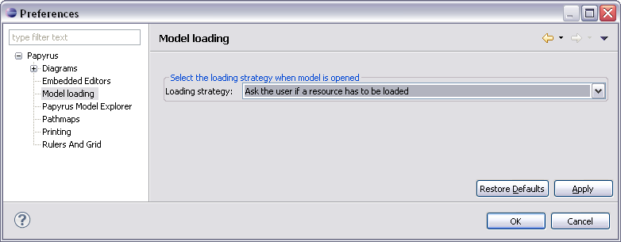
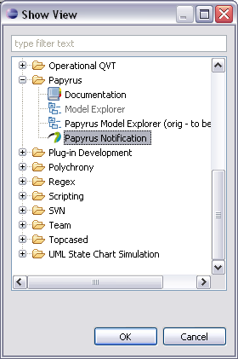
Loading policies: example 2
Another relevant case
  Ask the user if a resource has to be loaded
    First set this policy in preferences
    Then open the notification view: Window > Show View > Other

Slide 23
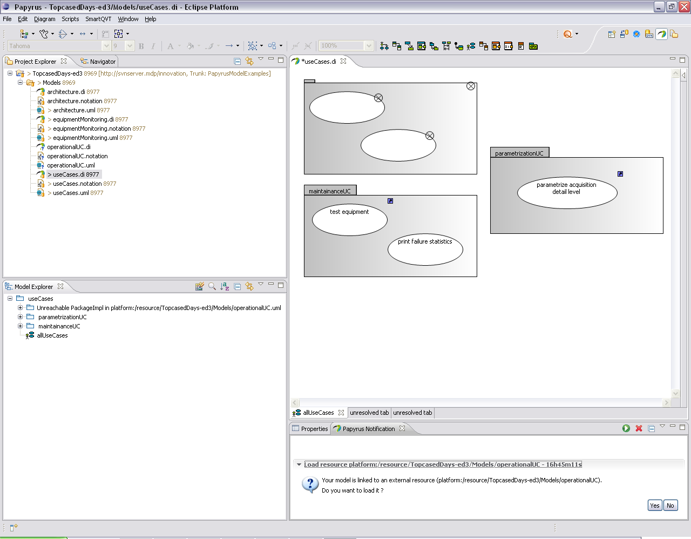
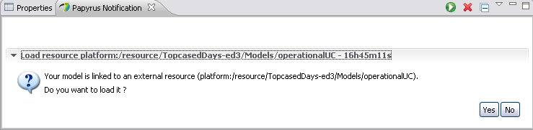
Loading policies: example 2
Open the model
  All the referenced resources are listed in notification view
  Choose “Yes” to load the resource you want

Slide 24
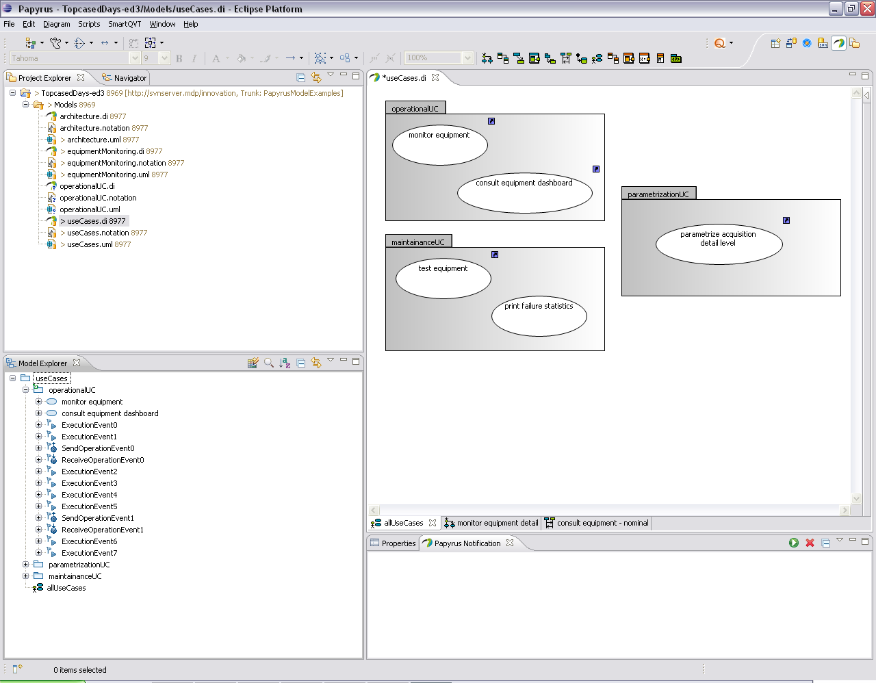
Loading policies: example 2
Resource is loaded on the fly and model is updated

Slide 25
Manage UML profiles
Some constraints exist on UML profiles
  Profile application must be visible from stereotype elements
  Profile application on a model is not visible from a model part
  Profile application is duplicated on controlled element to handle this constraint

Slide 26
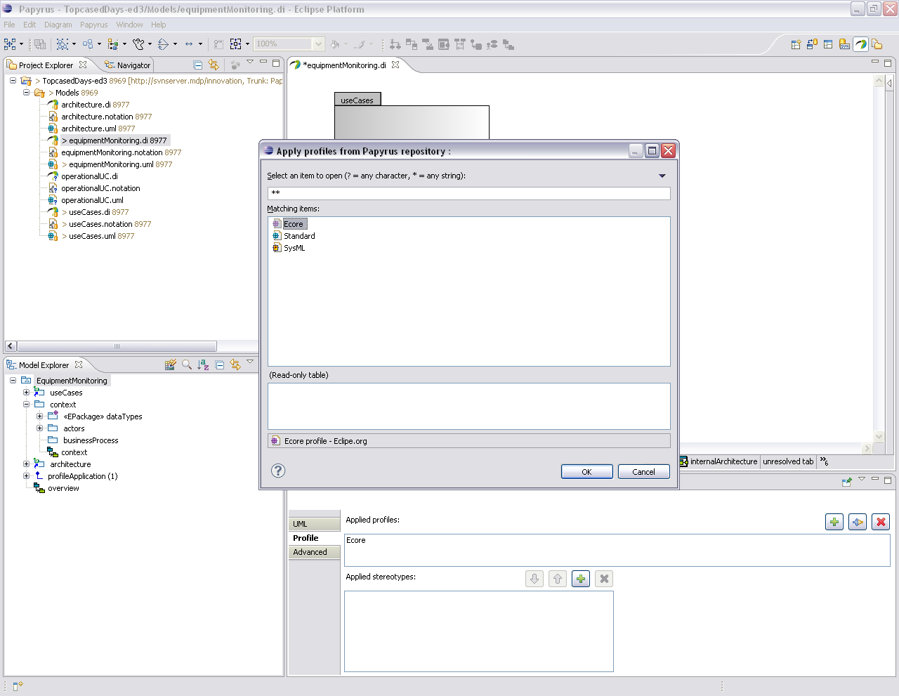
Apply UML profile
Let’s start applying Ecore profile on a model
3
Select Profile
2
Apply Profile
Select Profile tab
1
4
Profile is applied

Slide 27
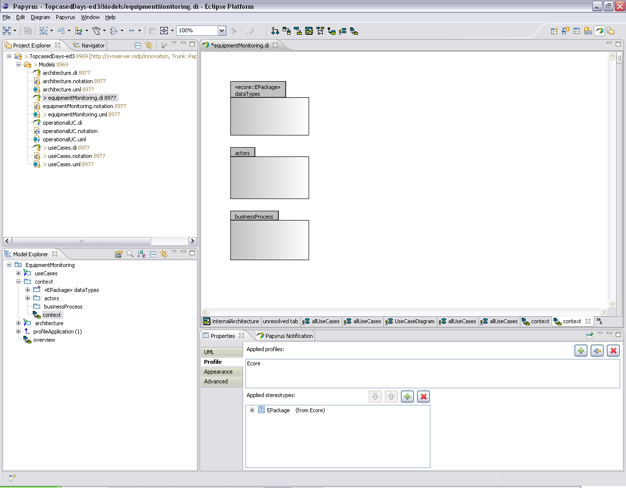
Apply stereotype
Then apply stereotype on the element

Slide 28
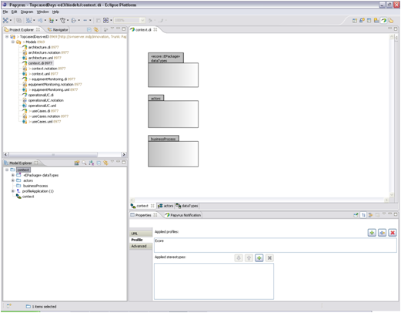
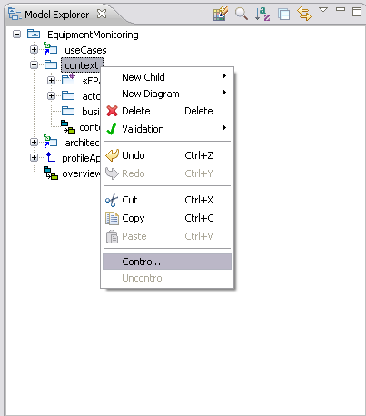
Control model part with stereotypes
Controlled model part now has profile applied
Stereotype is still visible on the element

Slide 29
Manage UML profiles
Duplicated profiles are unapplied when uncontrol action is performed
The tool asks the user to load all the needed resources if policy is not suitable for profile duplication

Slide 30
Additional information
All these features are coming with papyrus 0.8.0 release
Have a look at the other tutorials
  Papyrus tutorials page
Visit MDT Papyrus home page
  Papyrus home page

