Slide 1
Sequence diagram
How to

Slide 2
Guards

Slide 3
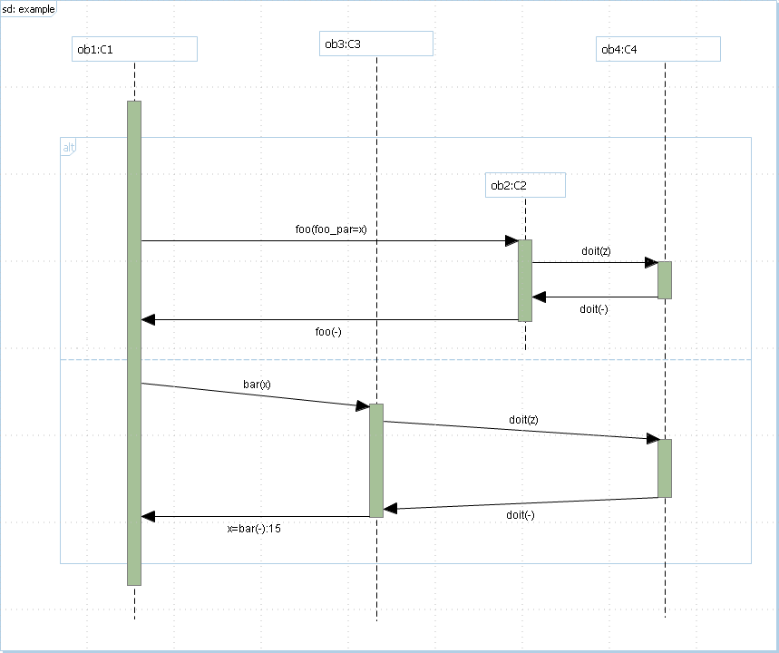
Sequence diagram with combined fragments and messages
Sequence diagram based on 14.11 figure of UML specification
It remains only to add guards

Slide 4
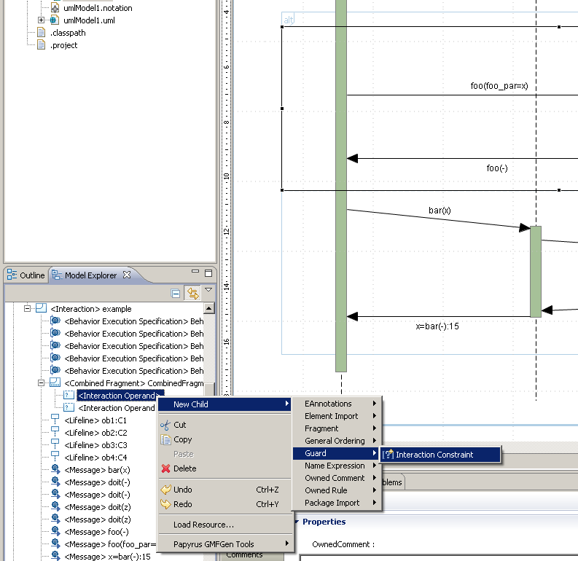
Sequence diagram with guard
Add guard (Interaction Constraint) by the Model Explorer

Slide 5
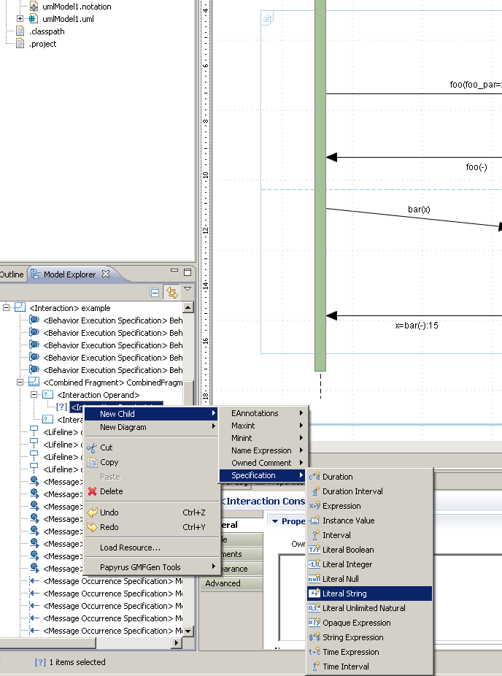
Sequence diagram with specification
Add constraint (Specification : Literal String) on guard in the Model Explorer

Slide 6
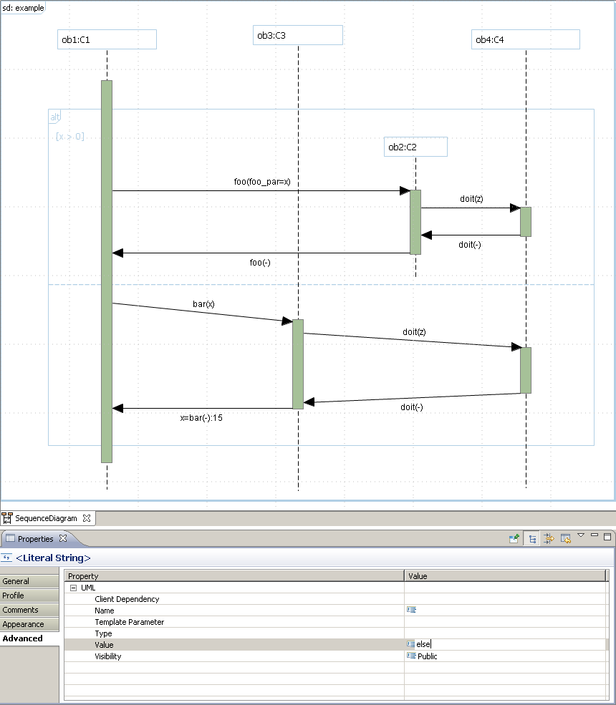
Sequence diagram with criteria on constraint
Change the criteria (Value) by Properties view (Advanced) of the constraint

Slide 7
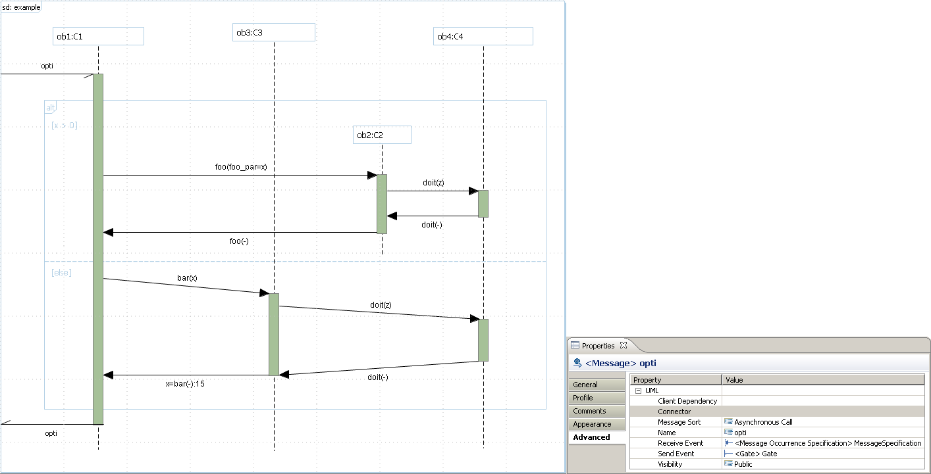
Sequence diagram with gate
Add asynchronous message from and to the Interaction
The input message has a gate for send event
The ouput message has a gate for receive event

