Slide 1
Slide Show
(Downhill)
Gabriel A. Molina

Slide 2
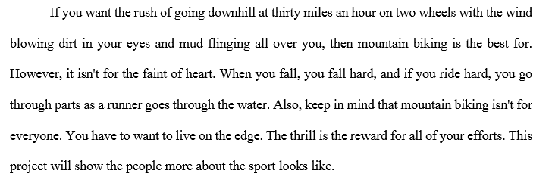
Bike Mountain

Slide 3
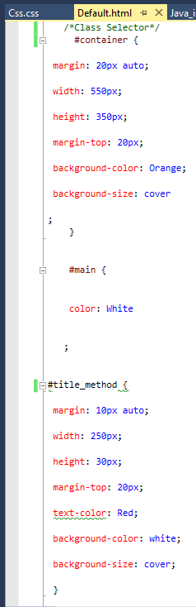
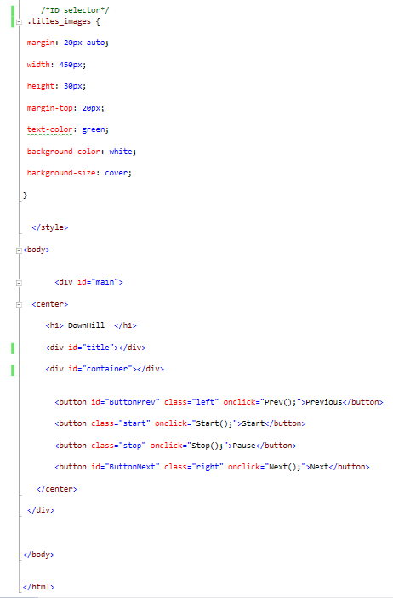
Default Page (Main)
<html>
<head>
<title>
<body>
<style>
<button>
<div>

Slide 4
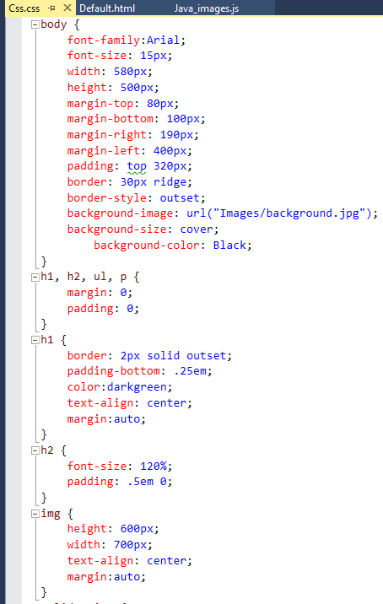
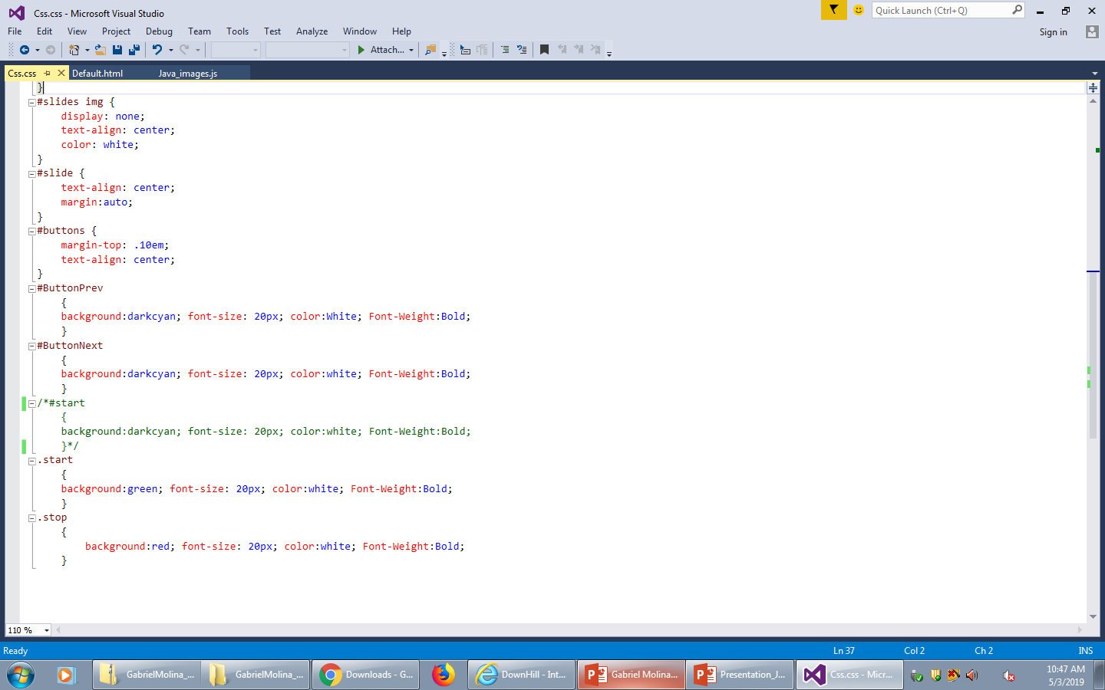
css
(Properties)

Slide 5
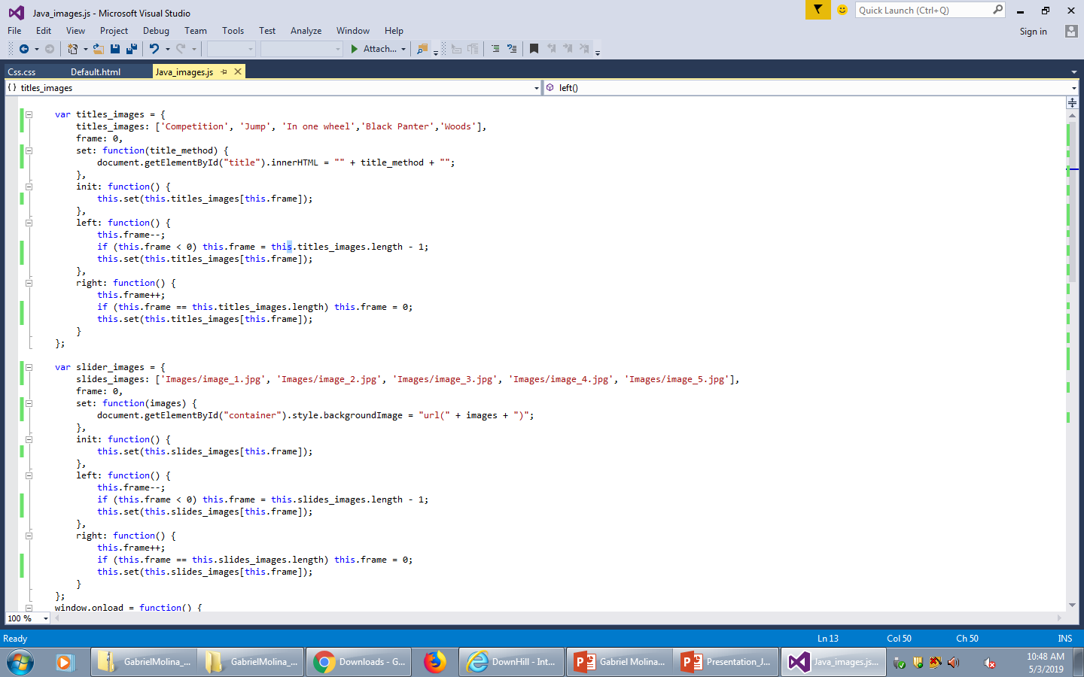
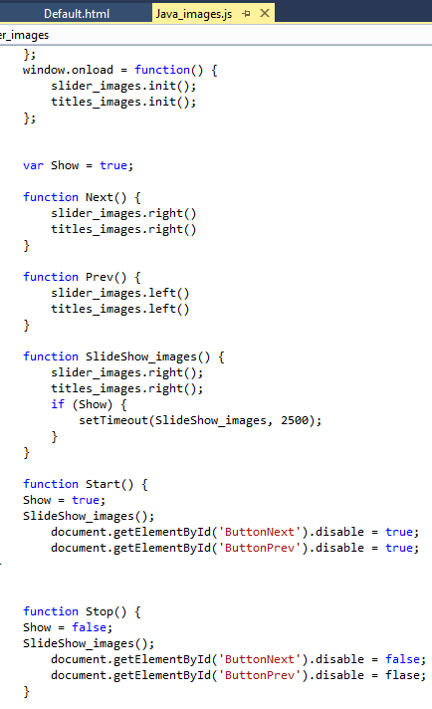
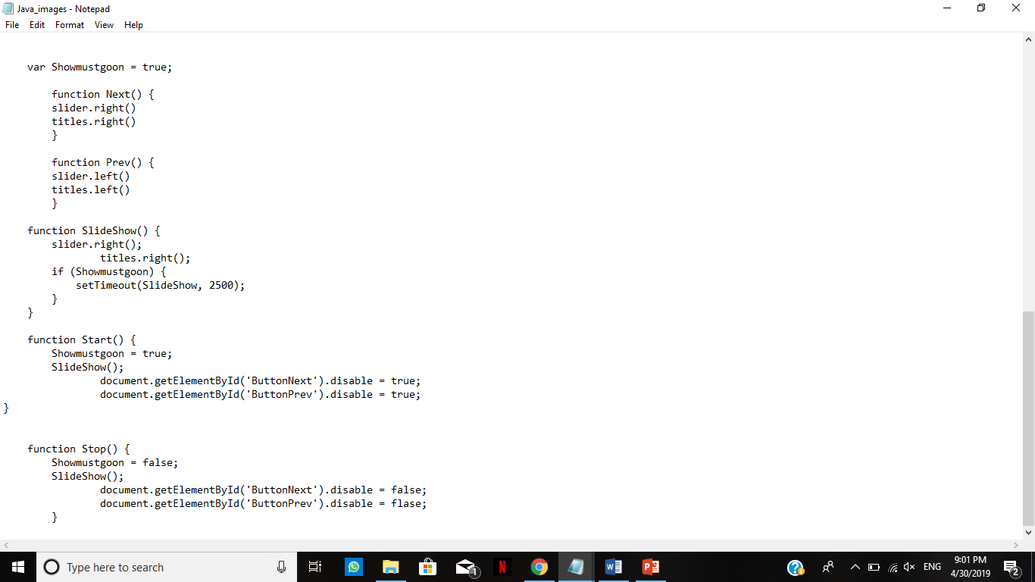
JavaScript
(Functions)
Function()

