Slide 1


Teaching Assembly Effectively Or: How I Learned To Stop Worrying And Love The Machine Code
Widberg - Jared_Widberg@student.uml.edu

Slide 2
What Do Students Need To Learn?

Slide 3
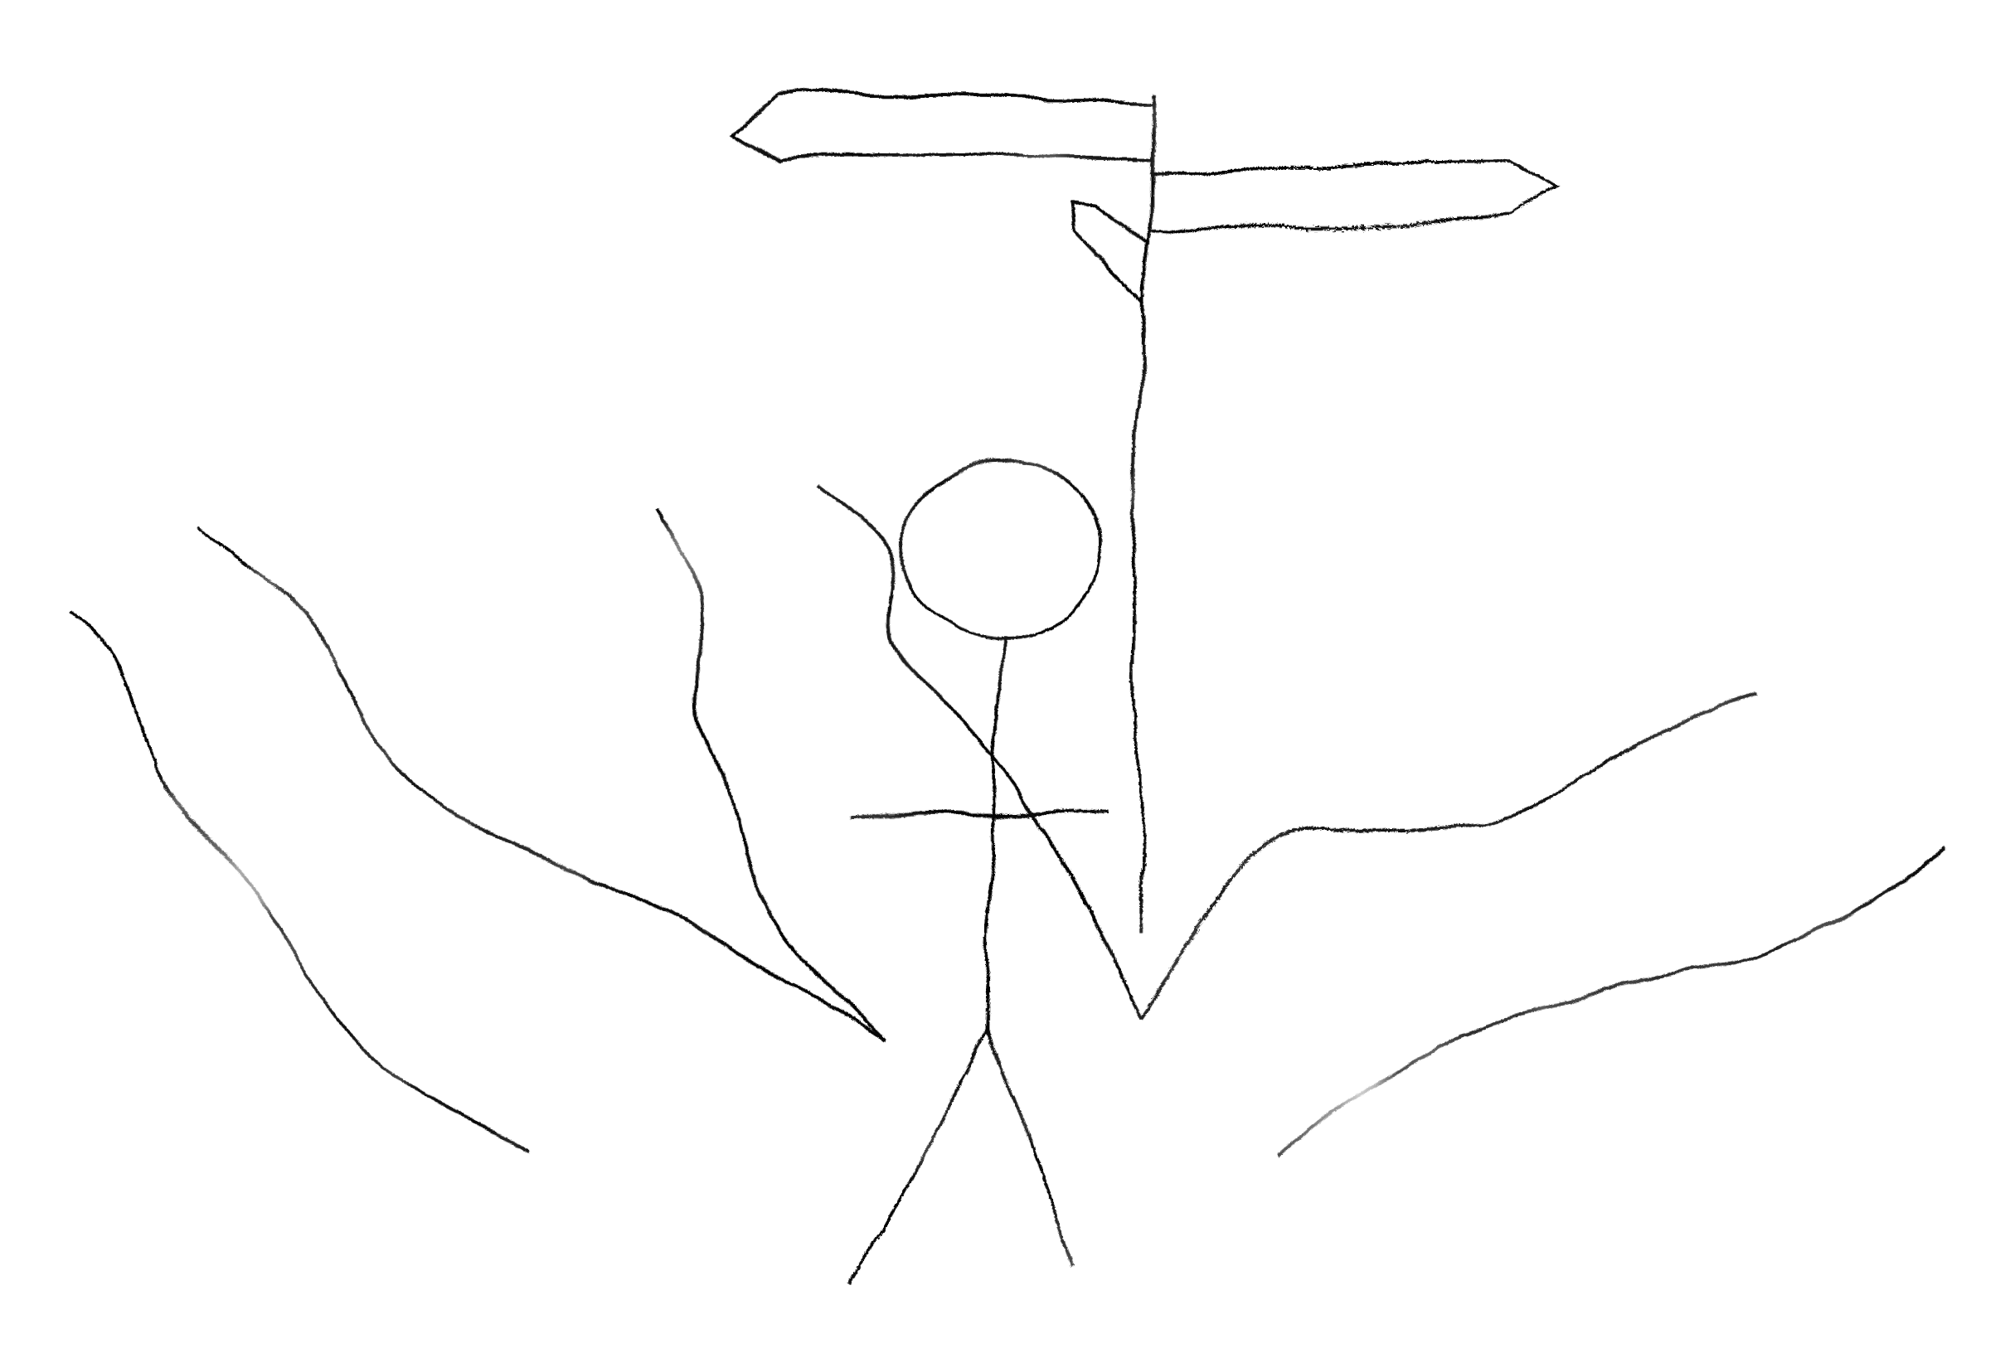
3 Roads Diverged in a Yellow Wood
Pseudo-Assembly
CISC
RISC

Slide 4

A Case Against Pseudo-Assembly Languages
Y86 Sucks
Can’t run the code in a meaningful way

Slide 5
Why Not CISC Assembly Languages?
1| # “Hello, world” in x86 GAS syntax for 64-bit Linux
2| .global _start
3| .text
4| _start:
5| # write(1, message, 13)
6| mov $1, %rax # system call 1 is write
7| mov $1, %rdi # file handle 1 is stdout
8| mov $message, %rsi # address of string to output
9| mov $13, %rdx # number of bytes
10| syscall # invoke operating system to do the write
11|
12| # exit(0)
13| mov $60, %rax # system call 60 is exit
14| xor %rdi, %rdi # we want return code 0
15| syscall # invoke operating system to exit
16| .data
17| message:
18| .ascii "Hello, world\n"
Complex
“Don’t teach it ALL”
Hand wavy
Background noise

Slide 6
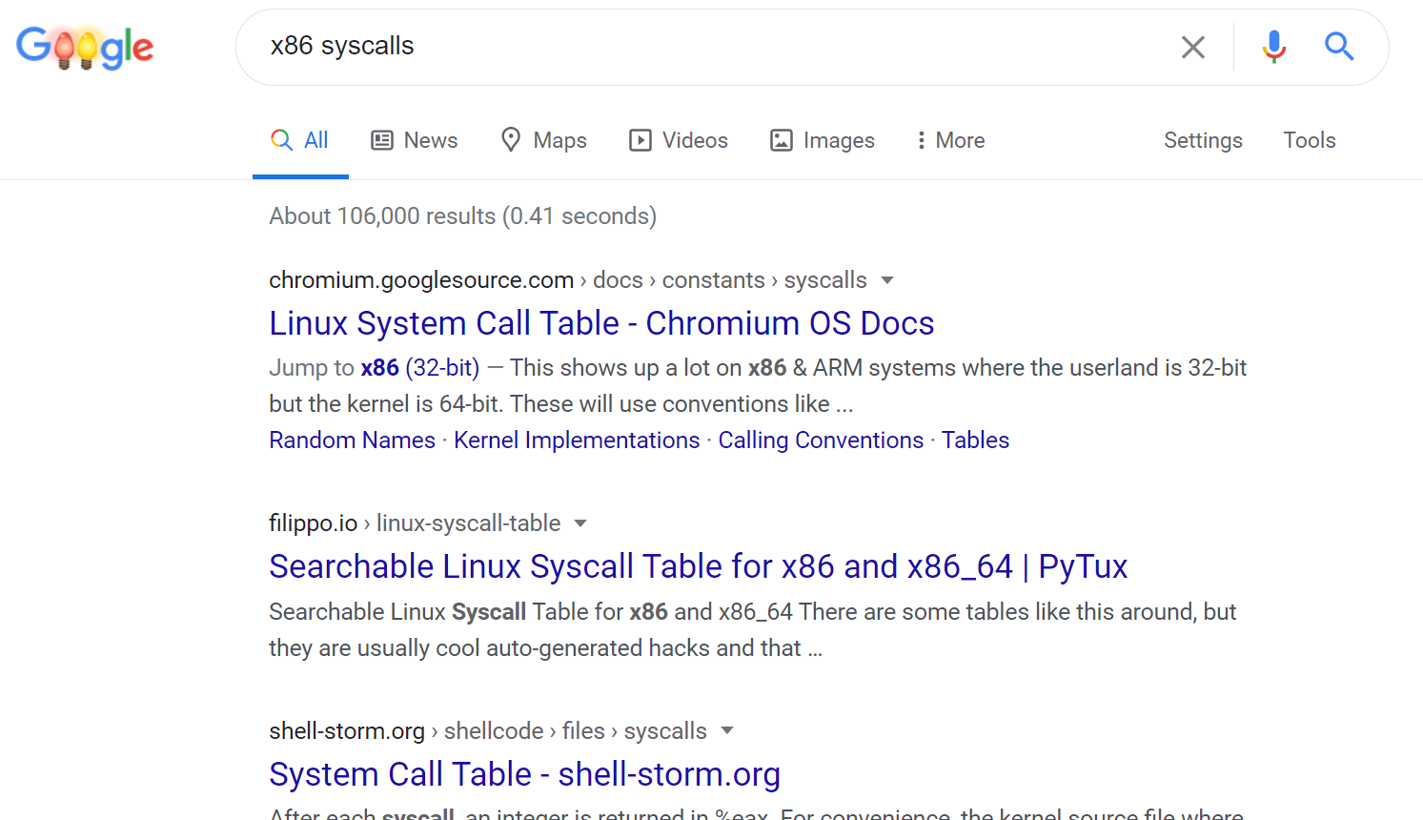

Slide 7
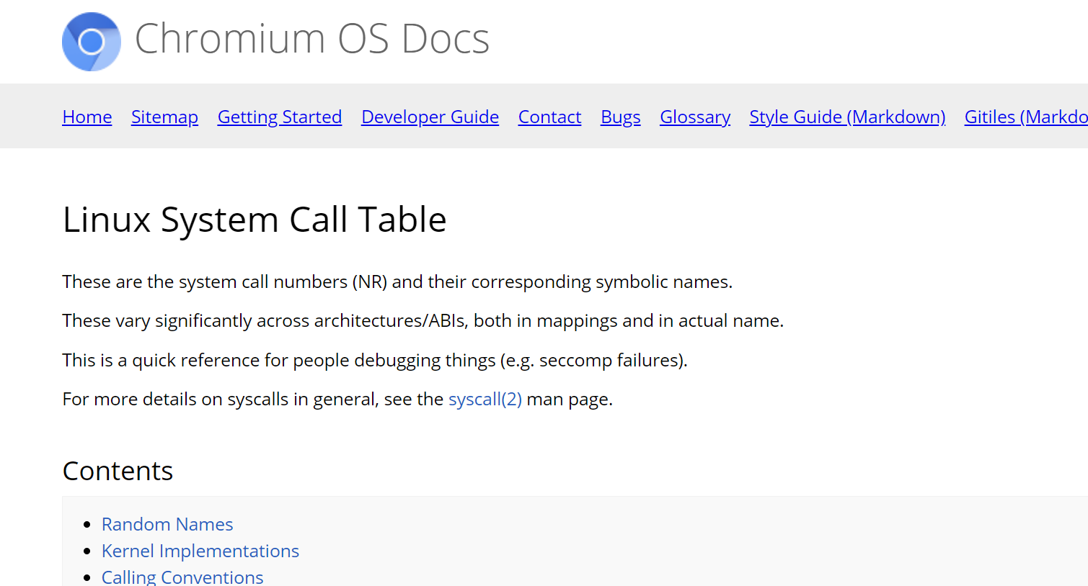

Slide 8
15232 words
No uniformity

Slide 9
Maybe RISC Assembly Languages…
Easy to memorize

Slide 10
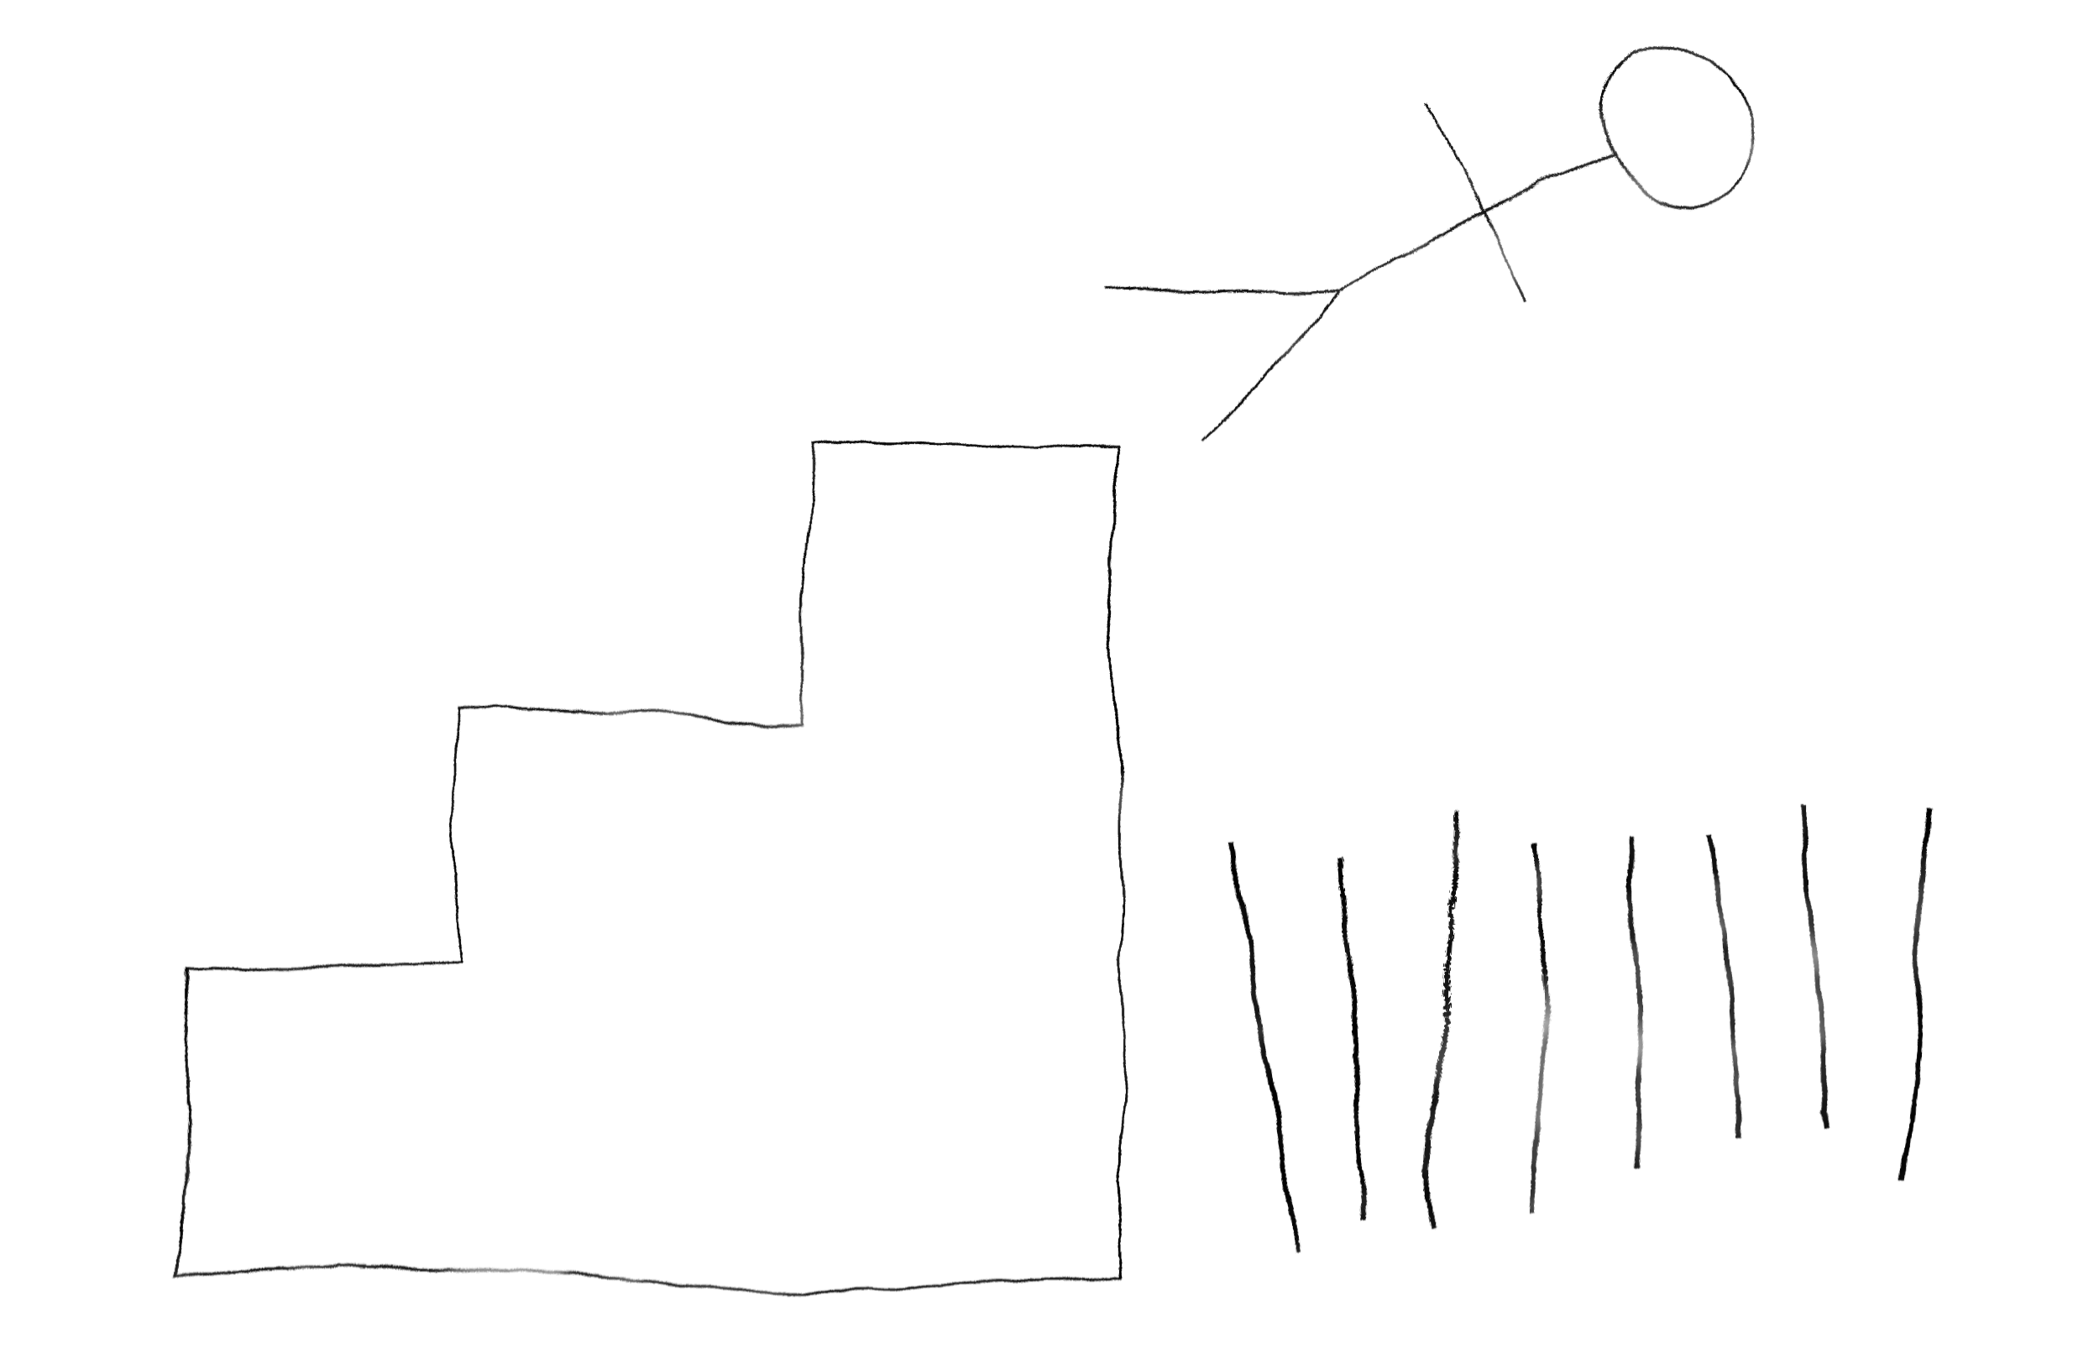
Something Isn’t Working
I mean really; what the fuck is this shit?
Y86
x86
MIPS
x86 Again

Slide 11
Somewhere in Between
Instruction set emulation
All the concepts without all the mess
Unified knowledge base

Slide 12

Bridging the KASM
KASM

Slide 13
KASM Toolchain
Assembler
Linker
Disassembler
Debugger
Instruction Set Emulator
Documentation
Graphical IDE
C/++ Compilers

Slide 14
Halt and Catch Fire
92|
93|; Links
94|; -----
95|; https://github.com/widberg/kasm
96|; https://widberg.github.io/
97|
98|hcf ; questions?
99|
100|

