Slide 1


Teaching Assembly Effectively Or: How I Learned To Stop Worrying And Love The Machine Code
Widberg - Jared_Widberg@student.uml.edu

Slide 2
What Do Students Need To Learn?

Slide 3
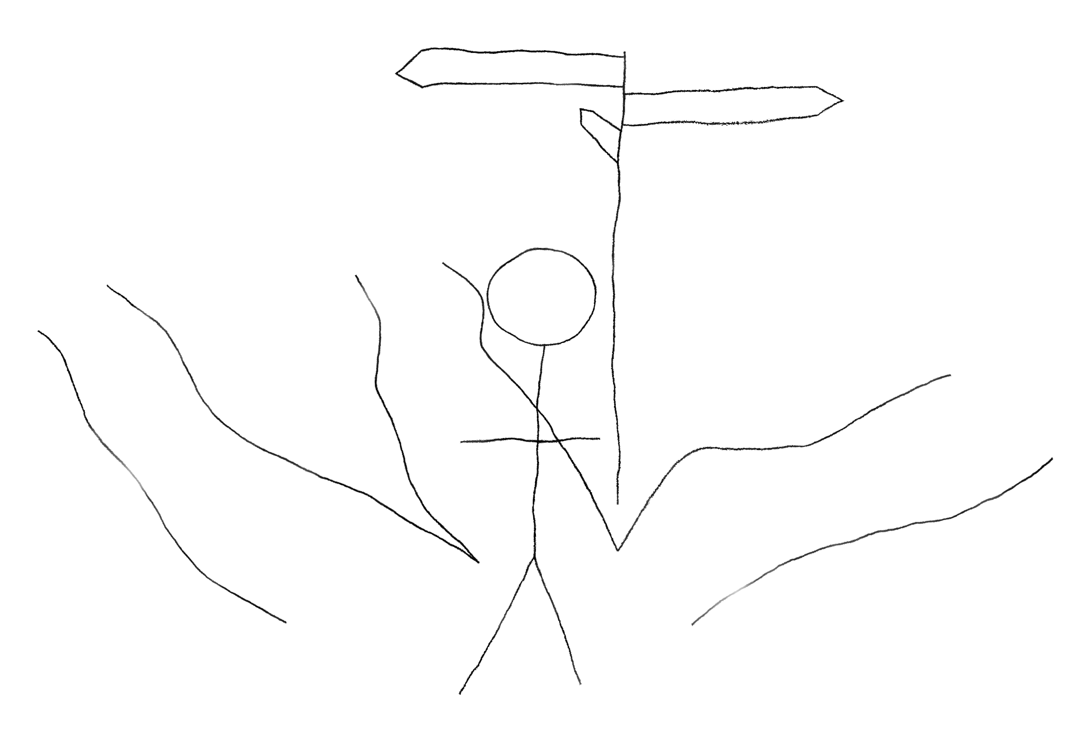
3 Roads Diverged in a Yellow Wood
Pseudo-Assembly
CISC
RISC

Slide 4

A Case Against Pseudo-Assembly Languages
Y86 Sucks
Can’t run the code

Slide 5
Why Not CISC Assembly Languages?
Complex

Slide 6
Maybe RISC Assembly Languages…
Easy to memorize

Slide 7
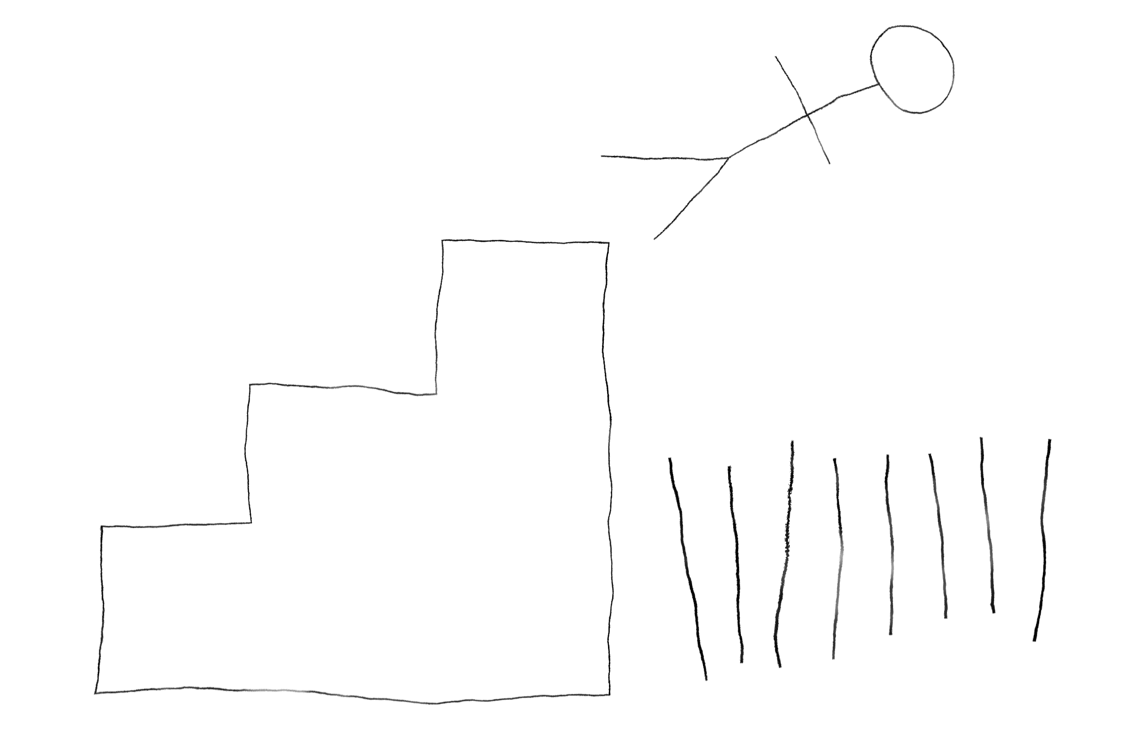
Something Isn’t Working
I mean really; what the fuck is this shit?
Y86
x86
MIPS
x86 Again

Slide 8
Somewhere in Between
Instruction set emulation
Training wheels

Slide 9

Bridging the KASM
KASM

Slide 10
KASM Toolchain
Assembler
Linker
Disassembler
Debugger
Instruction Set Emulator

Slide 11
Halt and Catch Fire
92|
93|; Links
94|; -----
95|; https://github.com/widberg/kasm
96|; https://widberg.github.io/
97|
98|hcf ; questions?
99|
100|

