Slide 1
Introduction to NGS
Hubert Rehrauer

Slide 2
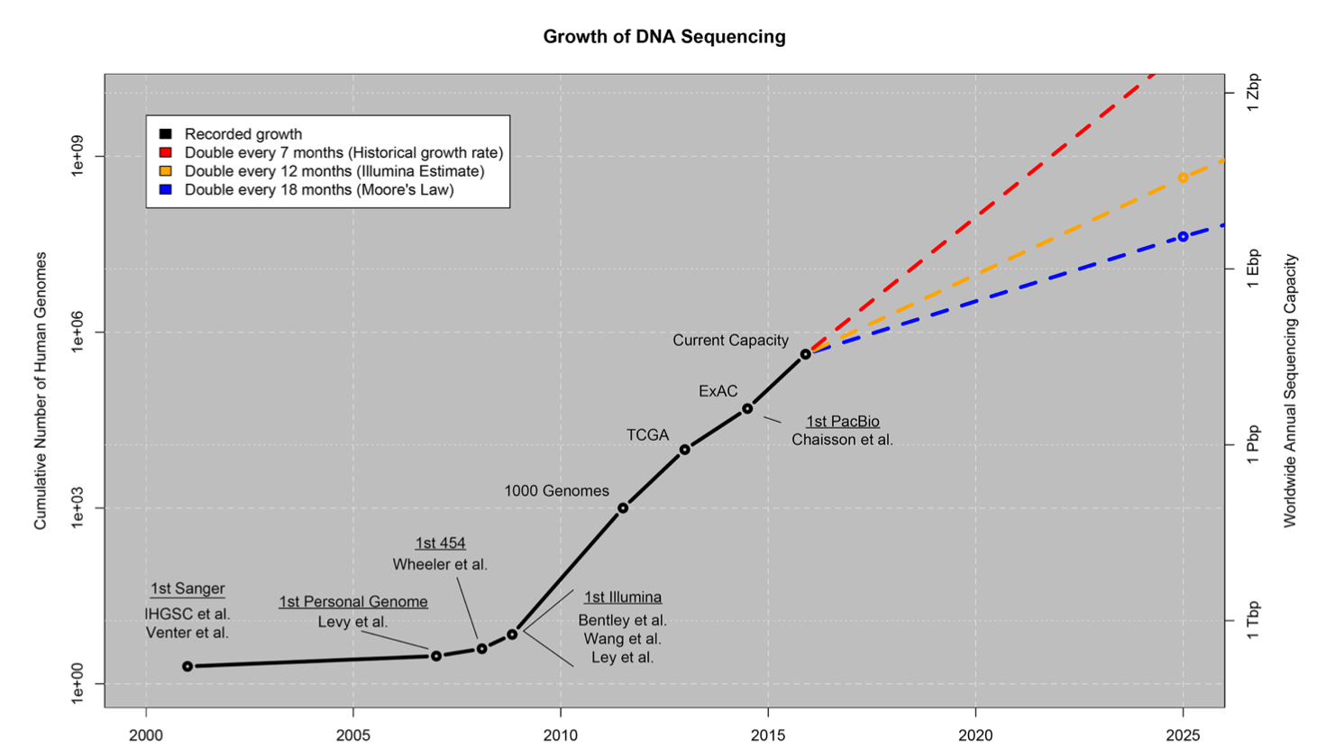
NGS Data Increase
NGS data increases faster than computer speed
Stephens ZD etal. (2015) Big Data: Astronomical or Genomical? PLoS Biol 13(7): e1002195.

Slide 3
Ingredients for the success
Evolution has yielded DNA and RNA molecules for information storage and transfer. They have good properties to be read (measured)
NGS technologies rely on
massive parallelization
measurement process is done by individual molecules (cheap and fast)

Slide 4
2nd generation sequencers
3rd generation sequencers
Illumina
optical
Illumina
Pac Bio
Ion Torrent
Oxford Nanopores
non- optical

Slide 5
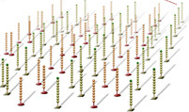
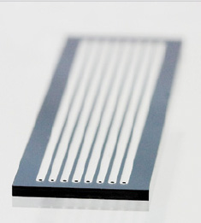
Illumina Flow cell
Notes:
Flow cell is coated with a lawn of 2 types of oligonucleotides.

Slide 6
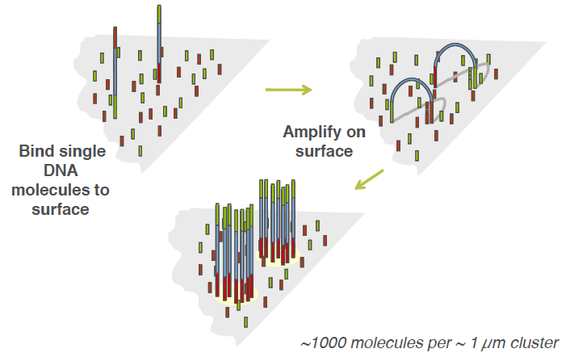
Cluster generation overview

Slide 7
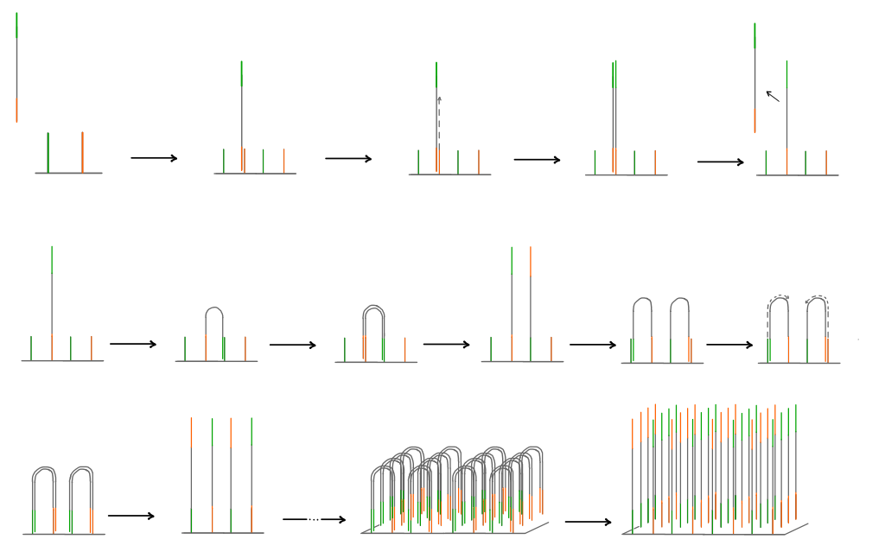
annealing
elongation
denaturation
bridge amplification
annealing
elongation
denaturation

Slide 8
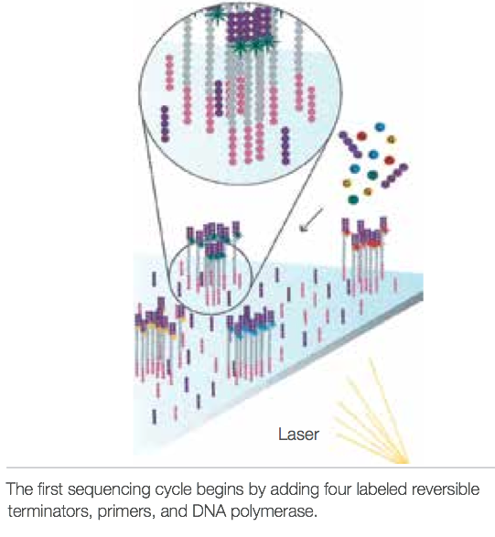
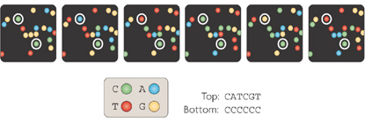
Illumina Sequencing
Notes:
A flow cell containing millions of unique clusters is now loaded into the Illumina sequencer for automated cycles of extension and imaging.
The sequencing primers anneals to the adapter and the sequencing by synthesis reaction starts.
In each cycle of sequencing, all the 4 nucleotides, labeled with different dyes, are flowed into the flow cell.
These nucleotides are 3‘ blocked reversible terminators. They have a chemical protecting group that does not allow the incorporation of another nucleotide, within the same cycle.
Only one nucleotide per cycle will be incorporated, the fluorescent emission identifies which of the four bases was incorporated at that position.
After imaging, the chemical blocking group is removed and the second synthesis cycle starts.

Slide 9
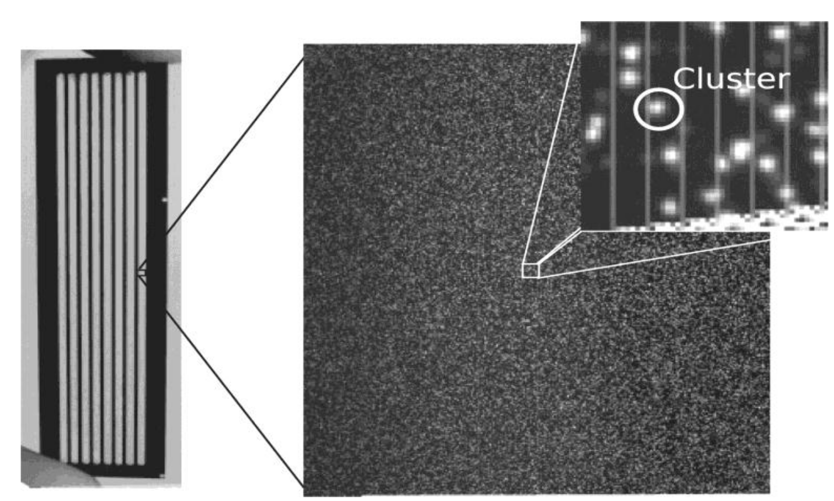

Slide 10

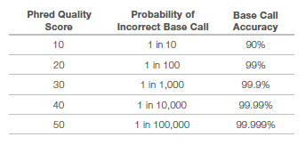
Phred scores measure base call accuracy
P
error probability of a given base call
Q
-10log₁₀P
Assign to each base
Range from 0-41

Slide 11
Phred scores are stored with sequences
FASTQ
4 lines:
Header line for Read (starts with “@” and the sequence ID)
Sequence
Header line for Qualities (starts with “+”)
Quality score (represented in ASCII format)
@HWI-ST1034:40:C08PJACXX:2:1101:20681:1994 1:N:0:ATCACG CTCGNAGACTGGCAACTTGTTCTGGTTTACTGCACCTTCTTTTAAAGGCAGAAAGGC + CCCF#2ADHHHGHJJJIJJHIIIJJHIJJJJJJJJJBGIIJJJJJJJJJJJJJJJIJ

Slide 12
Phred scores can be ASCII encoded
Add an offset and convert the sum to ASCII
Current format
Illumina 1.9 ( i.e. Sanger format)
Phred scoring: 0-41;
Offset: 33
41+33=74 (J)
All current sequencers

Slide 13
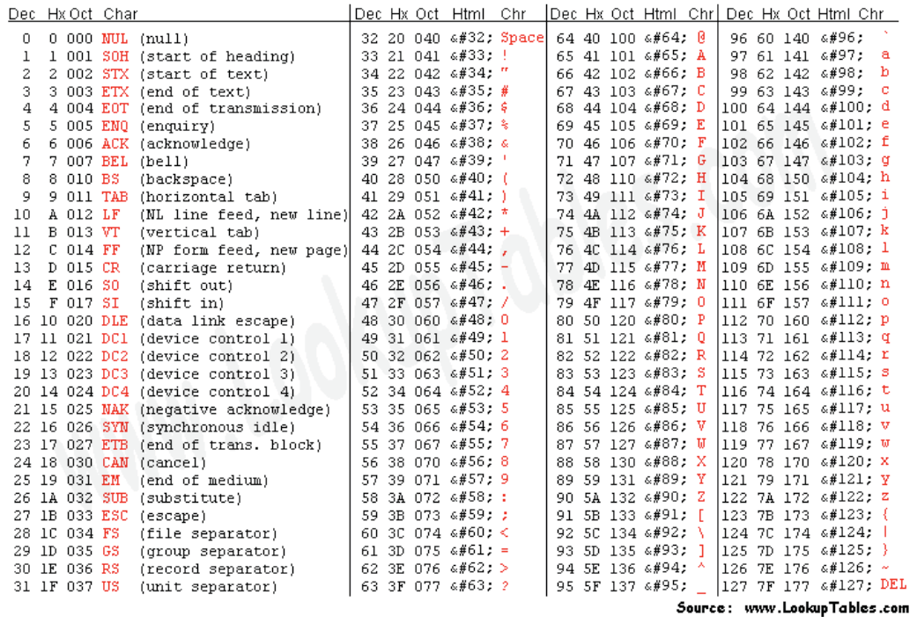

Slide 14

Quality control is to know your reads
Library construction could introduce bias
Fragmentation, ligation, amplification
GC bias
Over-amplification
Contamination
Sequencing errors
Chemical, optical, computational
Platform | Primary error | Error rate (%)
Illumina | Substitution | 0.1
PacBio | Indel | 12
PGM | Indel | 1
454 | Indel | 1
Oxford Nanopore | Indel | 20-40
Glenn, TC. 2011. Molecular Ecology Resources.
Carneiro , MO. 2012. BMC Genomics

Slide 15
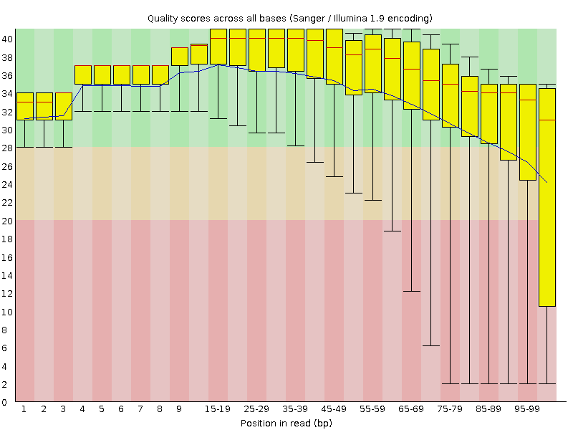

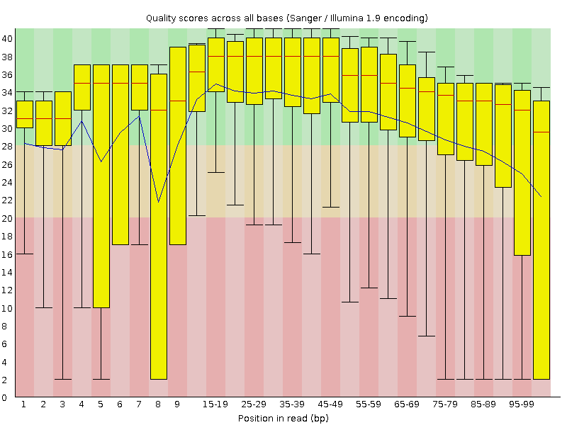

Per base sequence quality - FastQC
Range of quality values across all bases at each position
Green: >Q28, good
Orange: >Q20, reasonable
Red:<Q20, poor
Median > Q25
Median < Q20
High and relatively consistent quality along the reads
Quality degrades with increasing length is normal – quality trimming
Poor quality at the beginning – per tile sequence quality
Large variance – per sequence quality scores

Slide 16
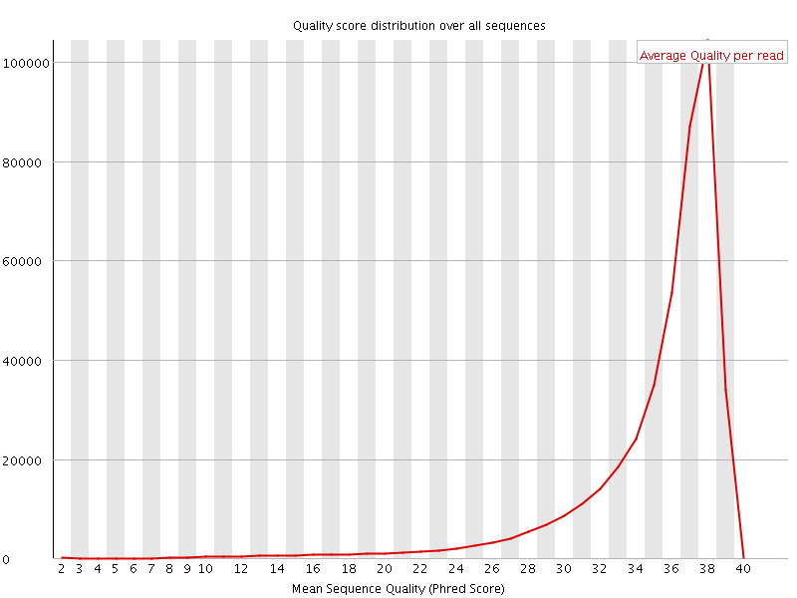
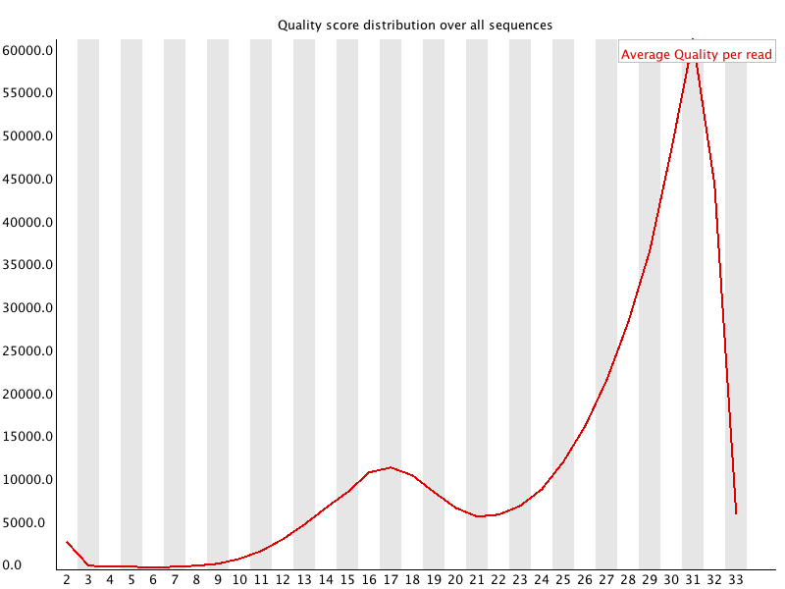
Per sequence quality scores - FastQC
Subset of sequences with universally low quality values
Single sharp peak
Mean > Q27
Bi-modal distribution – per tile sequence quality
Mean < Q20
Notes:
The per sequence quality score report allows you to see if a subset of your sequences have universally low quality values. It is often the case that a subset of sequences will have universally poor quality, often because they are poorly imaged (on the edge of the field of view etc), however these should represent only a small percentage of the total sequences.
If a significant proportion of the sequences in a run have overall low quality then this could indicate some kind of systematic problem - possibly with just part of the run (for example one end of a flowcell).

Slide 17
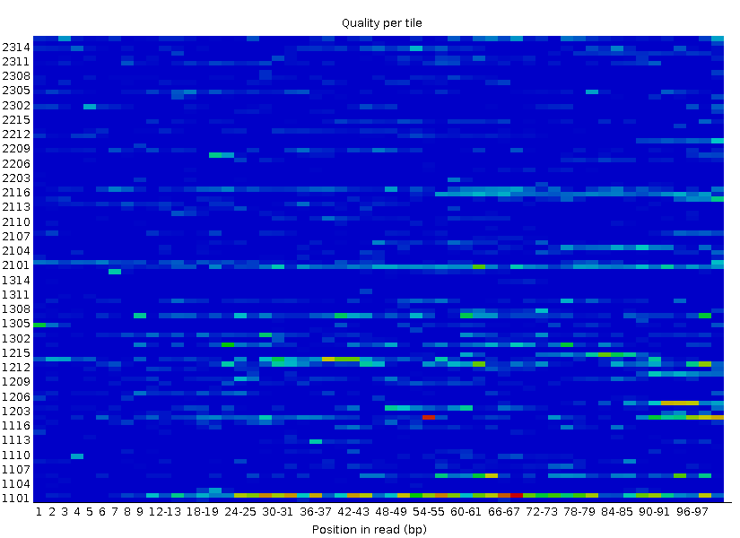
Per tile sequence quality - FastQC
Quality scores from each tile across all bases - loss in quality associated with only one part of the flowcell
Deviation from average quality
Cold colors: ≥ average
Hotter color: worse quality
Good: universal blue
Failure: < average - 5

Slide 18
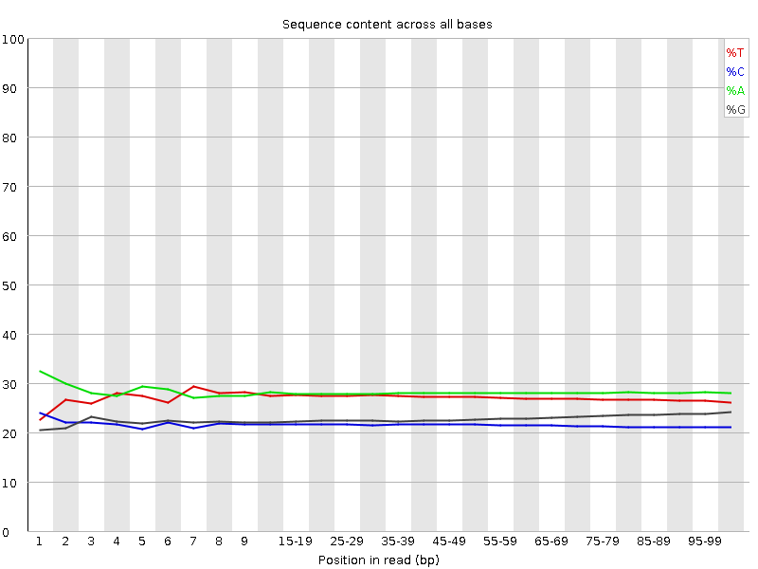
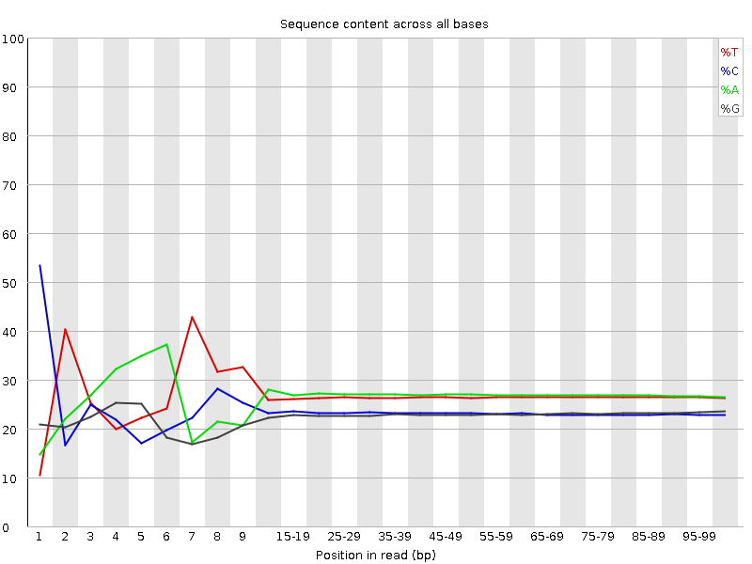
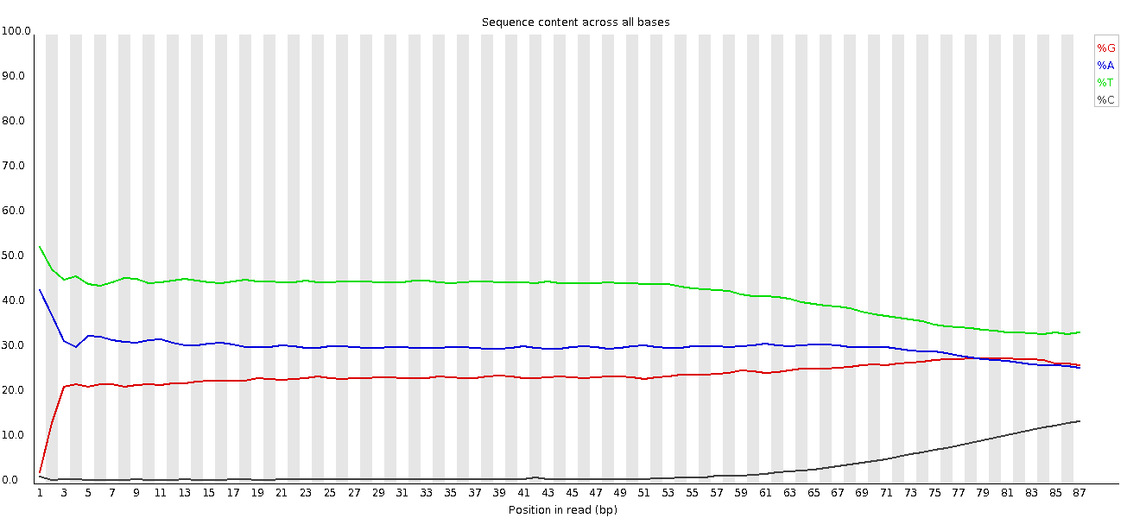
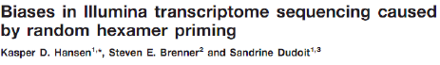
Per base sequence content - FastQC
The portion of A, T, G, and C at each position
AT (or GC) differ more than 20%
Biased composition at the read beginning
Expected with biased priming protocols, i.e. RNA-seq
A=T, G=C
GC content of the sample
Smooth over length
Expected with biased composition libraries, i.e bisulfite sequencing
Treatment of DNA with bisulfite converts cytosine to uracil, but leaves methylated cytosine unaffected. Therefore, DNA that has been treated with bisulfite retains only methylated cytosines.
Notes:
Bisulfite sequencing is the use of bisulfite treatment of DNA to determine its pattern of methylation.

Slide 19
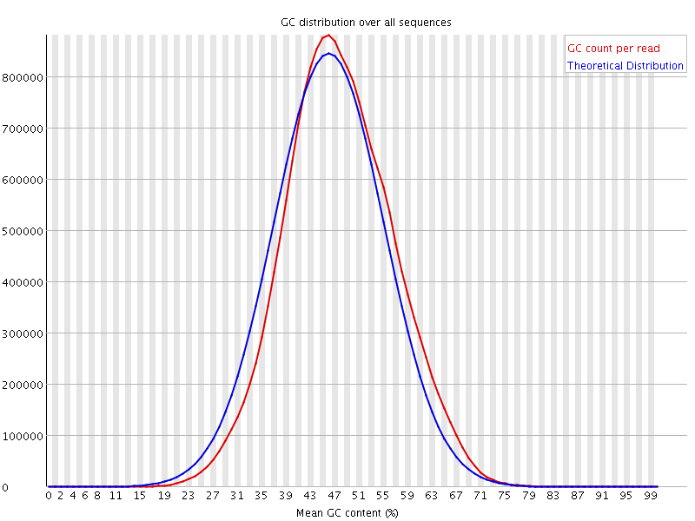
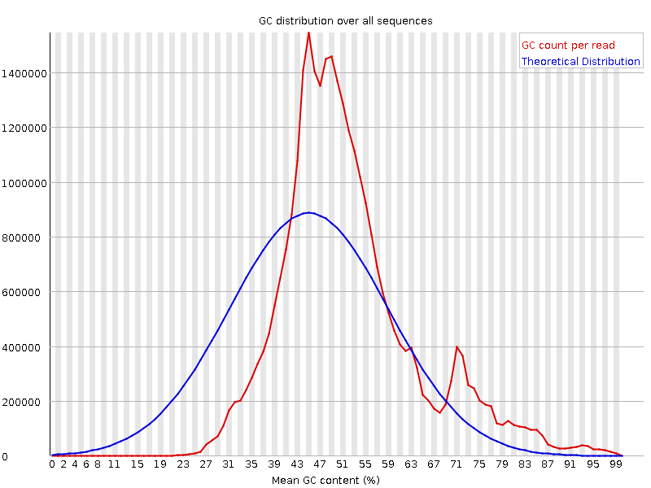
Per sequence GC content - FastQC
Distribution of average GC in all reads
we expect to see a roughly normal distribution of GC content
the peak corresponds to the overall GC content of the underlying genome
Bi-modal/unusual distribution
Contaminated/biased subset, i.e. adaptor dimmers, rRNA etc
Notes:
this module measures the GC content across the whole length of each sequence in a file and compares it to a modelled normal distribution of GC content.
In a normal random library you would expect to see a roughly normal distribution of GC content where the central peak corresponds to the overall GC content of the underlying genome. Since we don't know the the GC content of the genome the modal GC content is calculated from the observed data and used to build a reference distribution.
An unusually shaped distribution could indicate a contaminated library or some other kinds of biased subset. A normal distribution which is shifted indicates some systematic bias which is independent of base position.

Slide 20
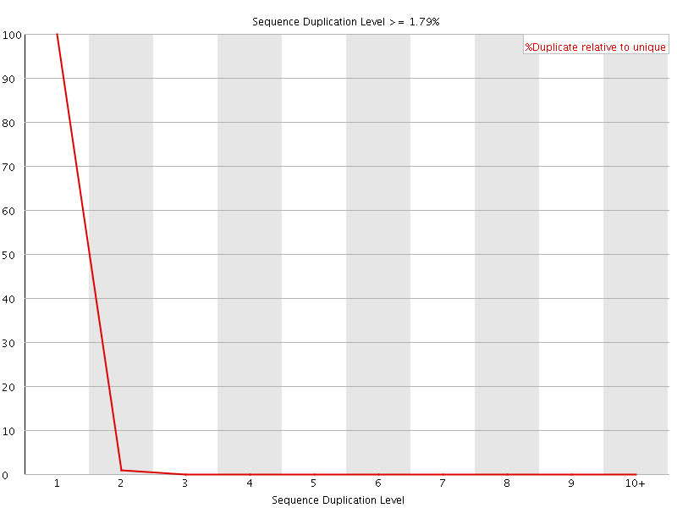
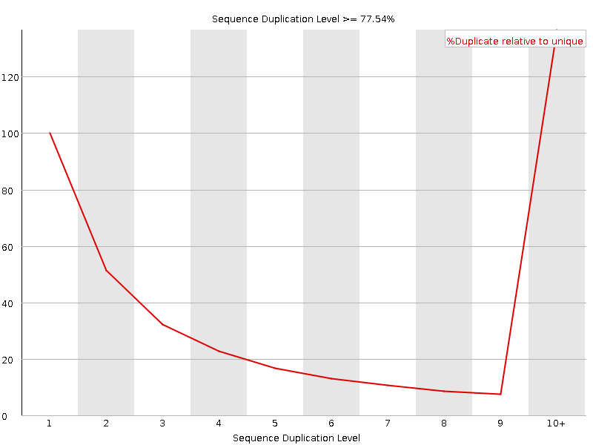
Sequence duplication - FastQC
Relative number of sequences with different degrees of duplication
Essentially no duplication
High duplication levels:
DNA-seq: PCR over amplification, too little input material
Normal in RNA-seq: high expression

Slide 21
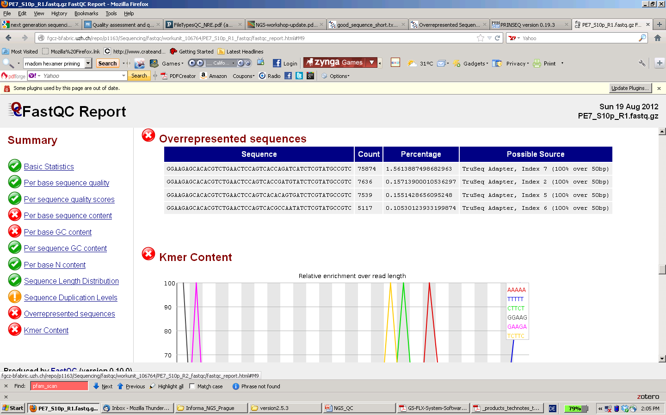
Overrepresented sequences - FastQC
Sequences make up >0.1 % of the total
Compare those with a contamination database for finding contamination (i.e. adaptor dimmers)
Can be normal and biologically meaningful
highly expressed transcripts
high copy number repeats
Less diverse library (amplicons)

Slide 22
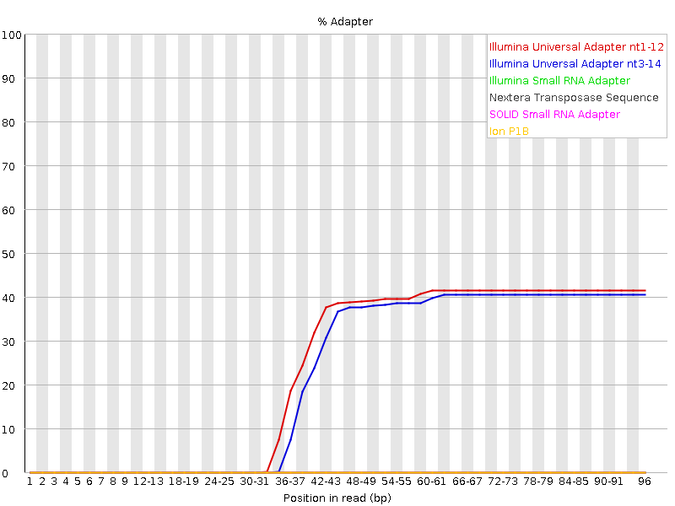
Adapter Content - FastQC
Adapter 1
Inserted DNA/RNA
Adapter 2
100nt read

Slide 23
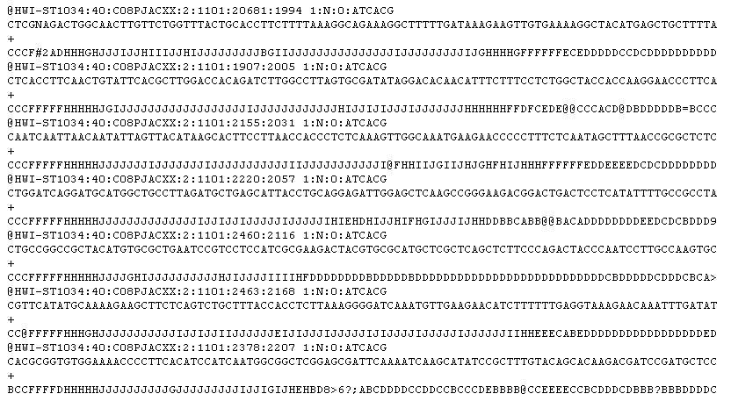
Millions of reads with base resolution
Are they from my samples? -> FastqScreen
How accurate are they? -> FastQC

Slide 24
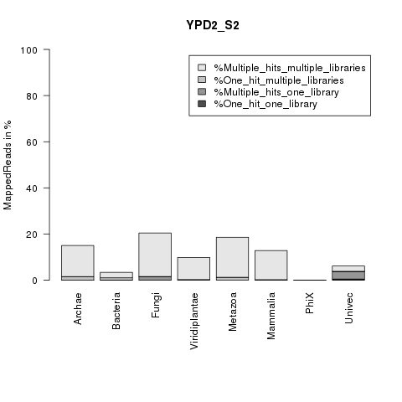
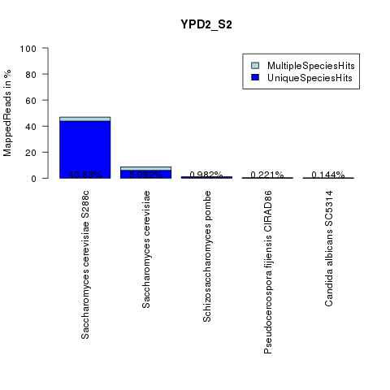
Contamination Check - FastqScreen
rRNA-Content (Silva)
Mapping to RefSeq mRNAs
(all species)

Slide 25
Data preprocessing common tasks
Trimming: remove bad bases from (end(s) of) reads
Adaptor sequence
Low quality bases
Filtering: remove bad reads
Low quality reads
Contaminating sequences
Low complexity reads (repeats)
Short (<20bp) reads – they slow down mapping software

Slide 26
Data preprocessing software
PRINSEQ
http://prinseq.sourceforge.net/
Quality/hard trimming, quality filtering, reformat, ...
Trimmomatic
http://www.usadellab.org/cms/?page=trimmomatic
Adaptor trimming, quality trimming &filtering, ...
FlexBar (FAR)
http://sourceforge.net/projects/theflexibleadap/
Flexible barcode detection and adapter removal
FASTX
http://hannonlab.cshl.edu/fastx_toolkit/
Reformat, stats, collapse duplicated reads, trim, filter, reverse compliment
TagCleaner
http://tagcleaner.sourceforge.net
Trim MIDs or adaptors, demultiplexing
DeconSeq
http://deconseq.sourceforge.net
Remove potential contaminants

Slide 27
Recommendations
Always generate quality plots for all libraries
Trim and/or filter data if needed
always trim and filter for de-novo transcriptome assembly

