Slide 1
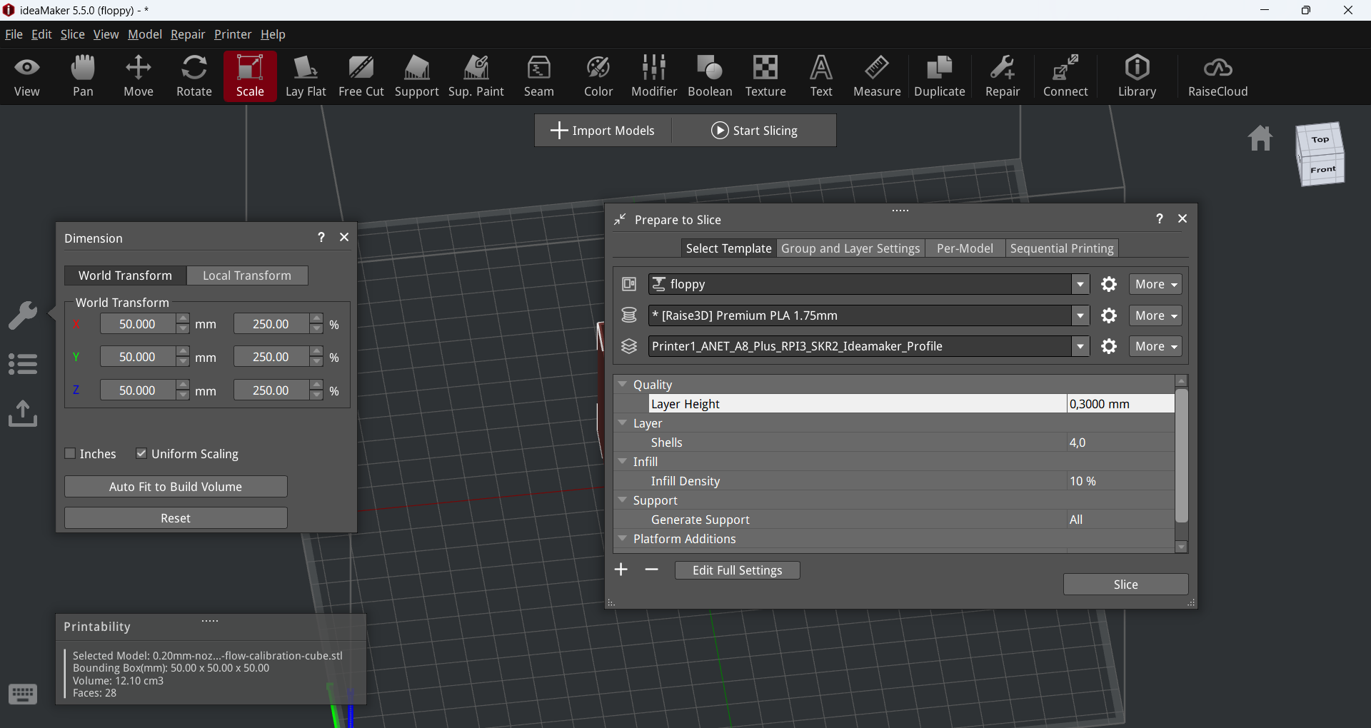

Slide 2
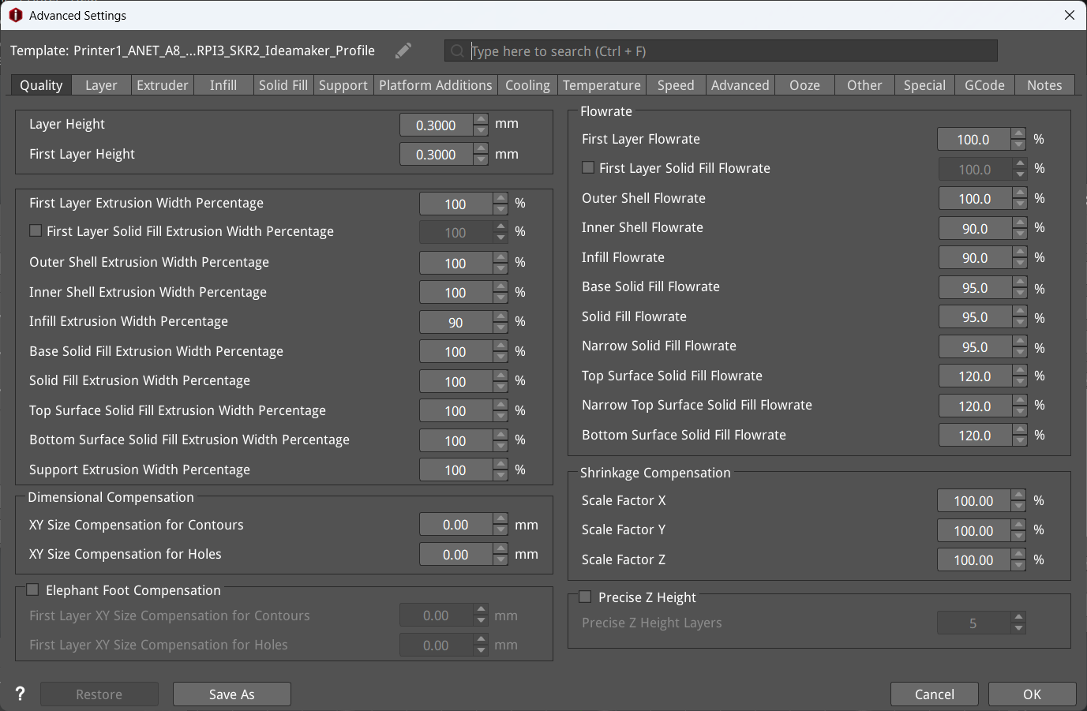

Slide 3
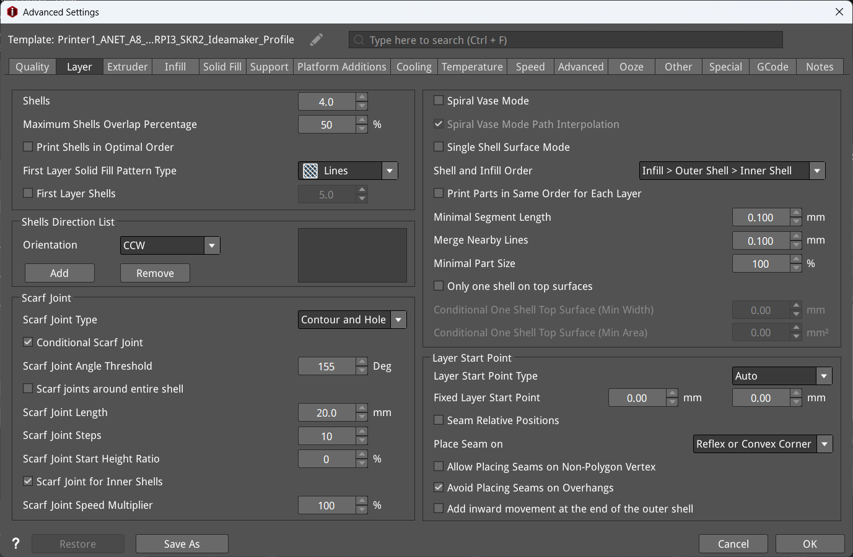

Slide 4
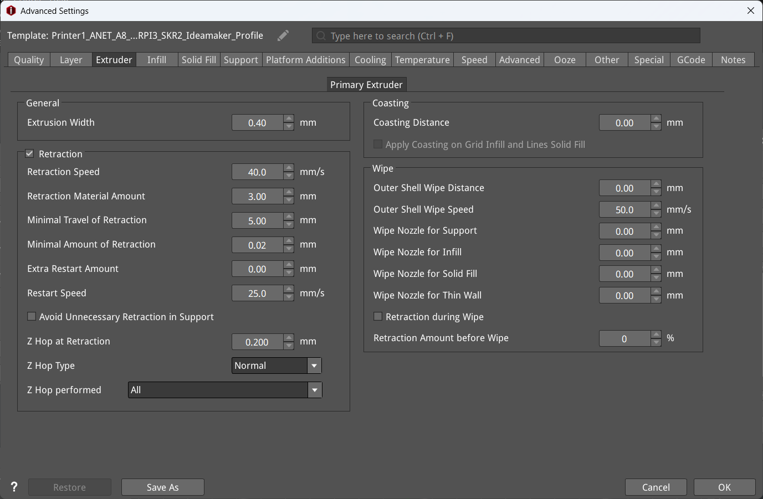

Slide 5
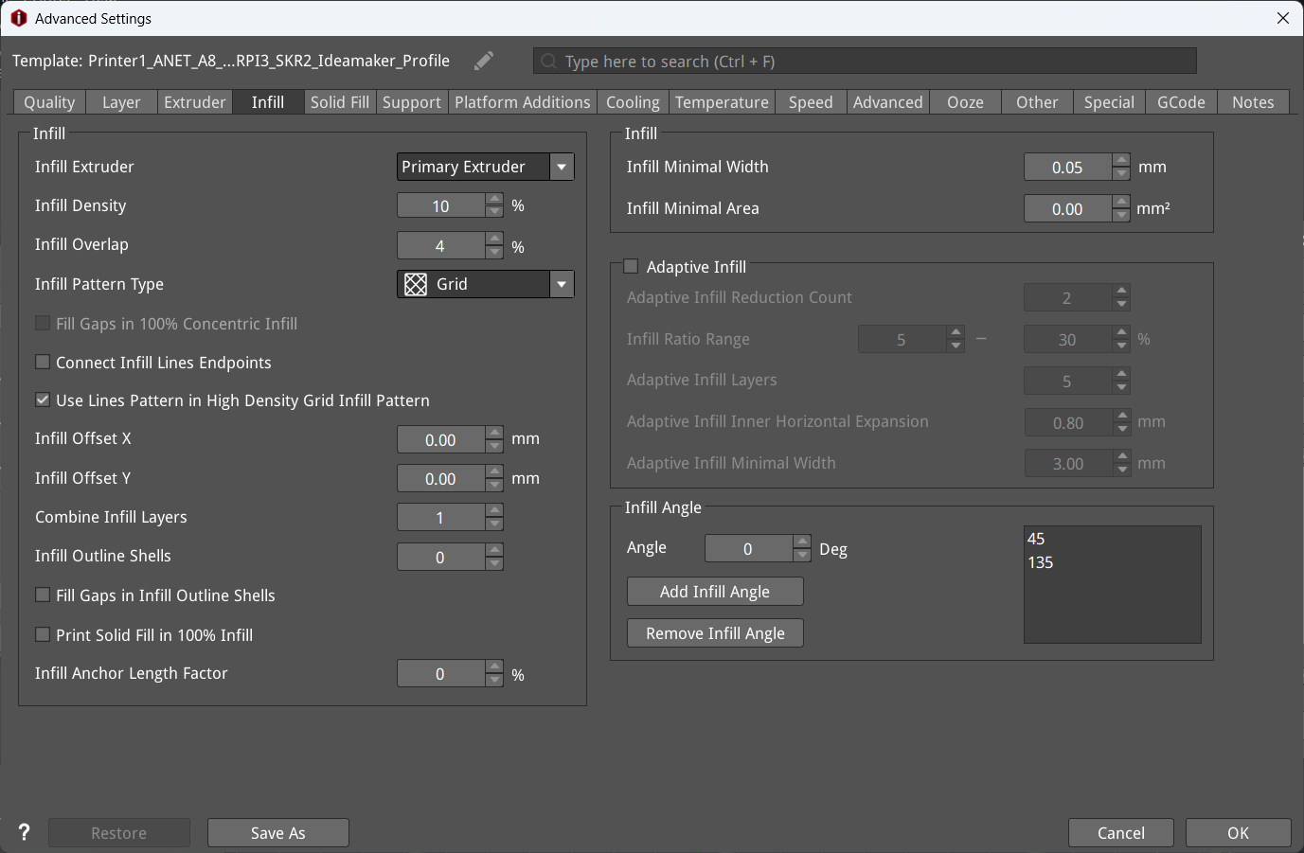

Slide 6
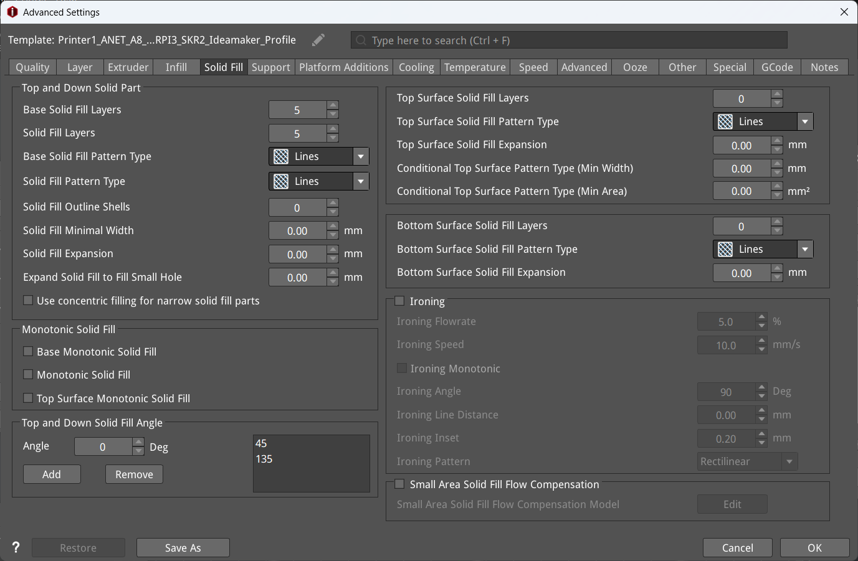

Slide 7
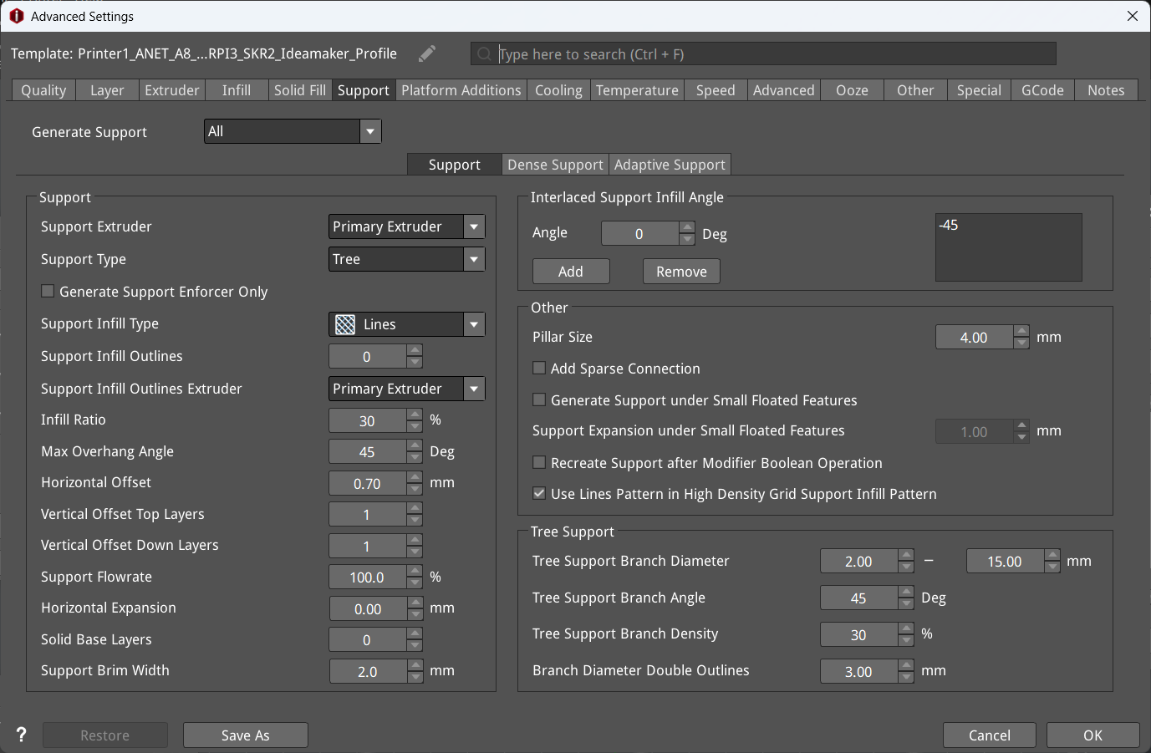

Slide 8
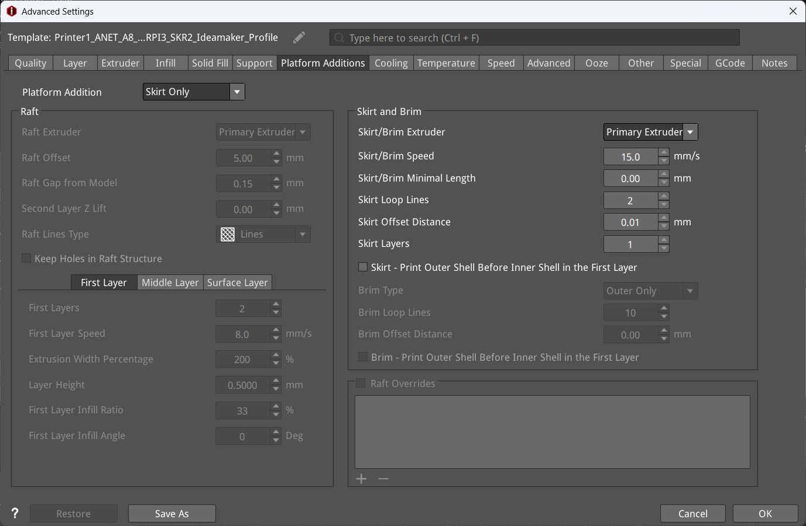

Slide 9
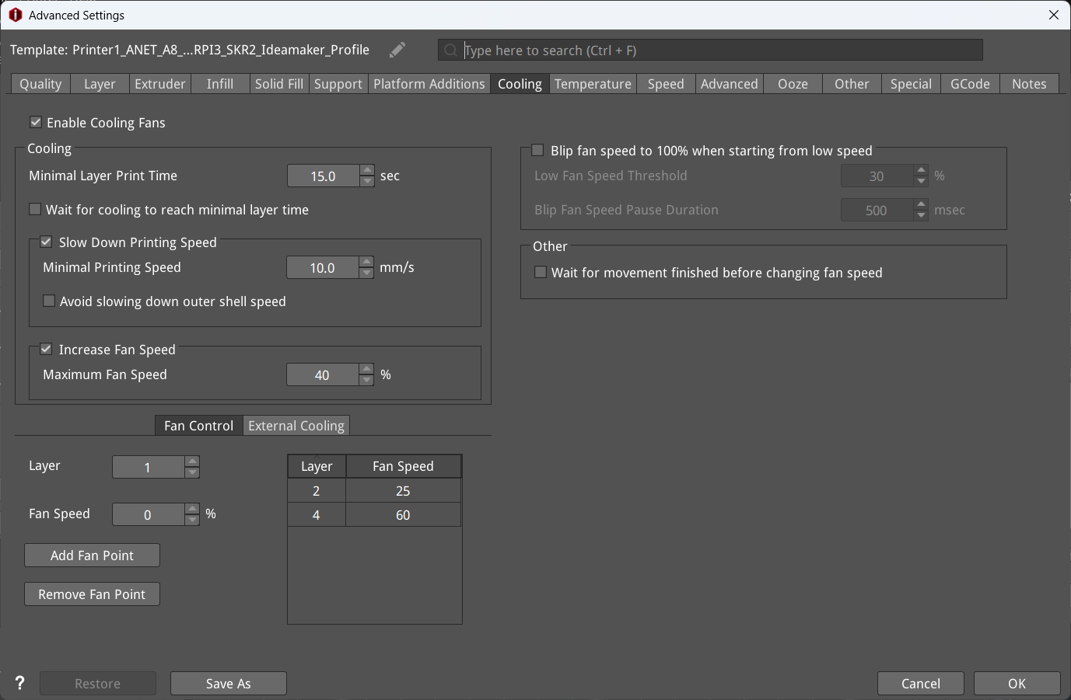

Slide 10
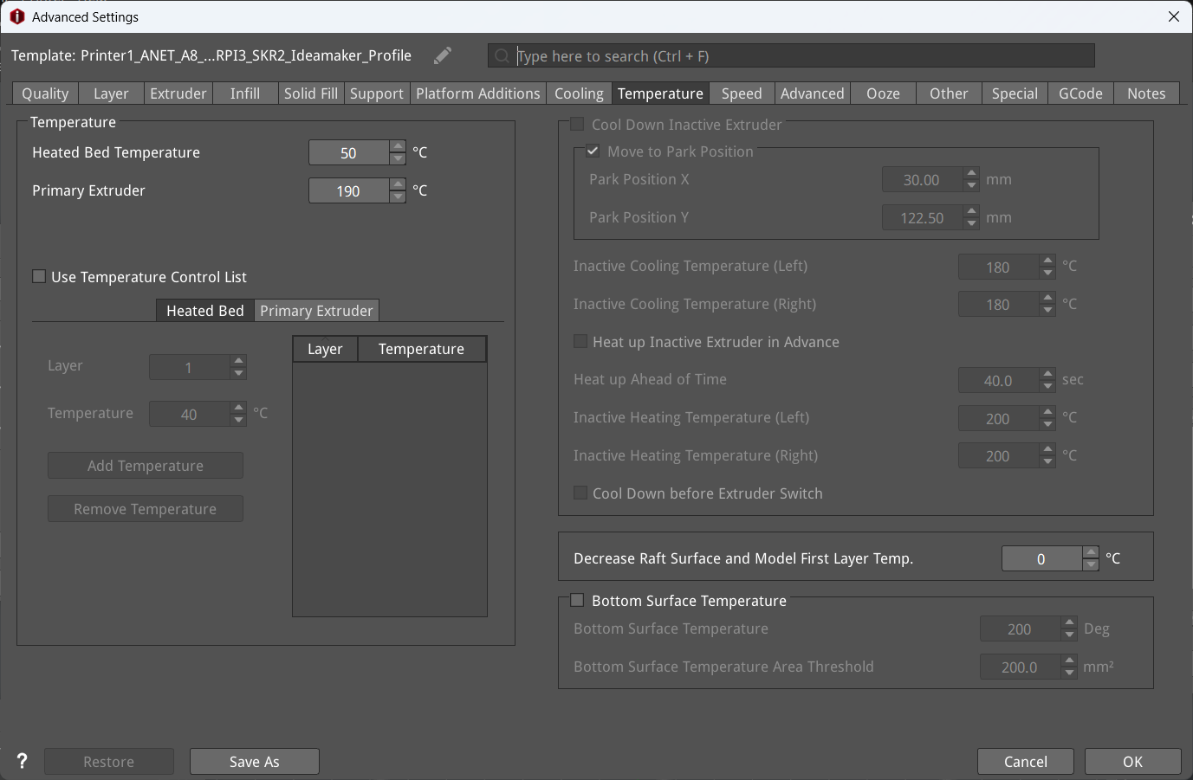

Slide 11
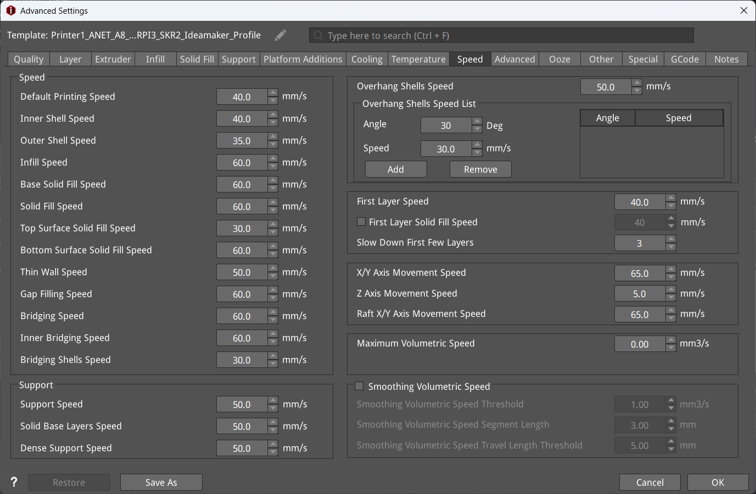

Slide 12
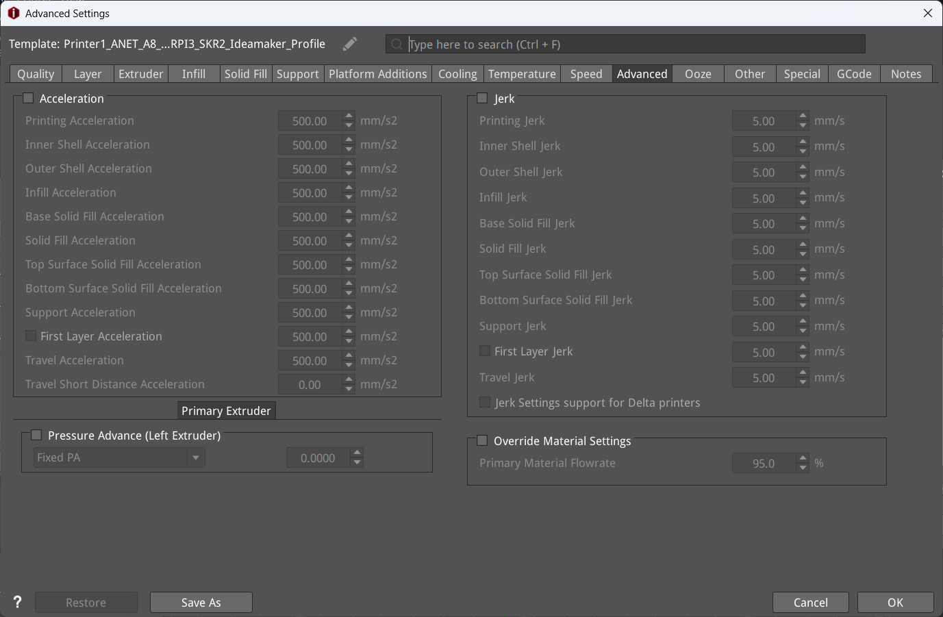

Slide 13
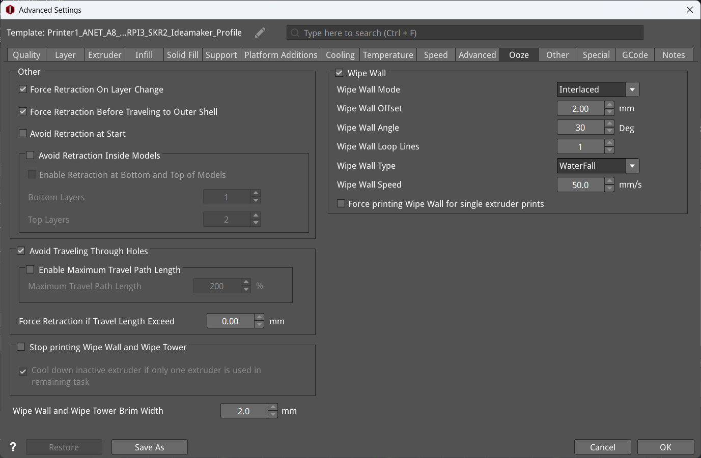

Slide 14
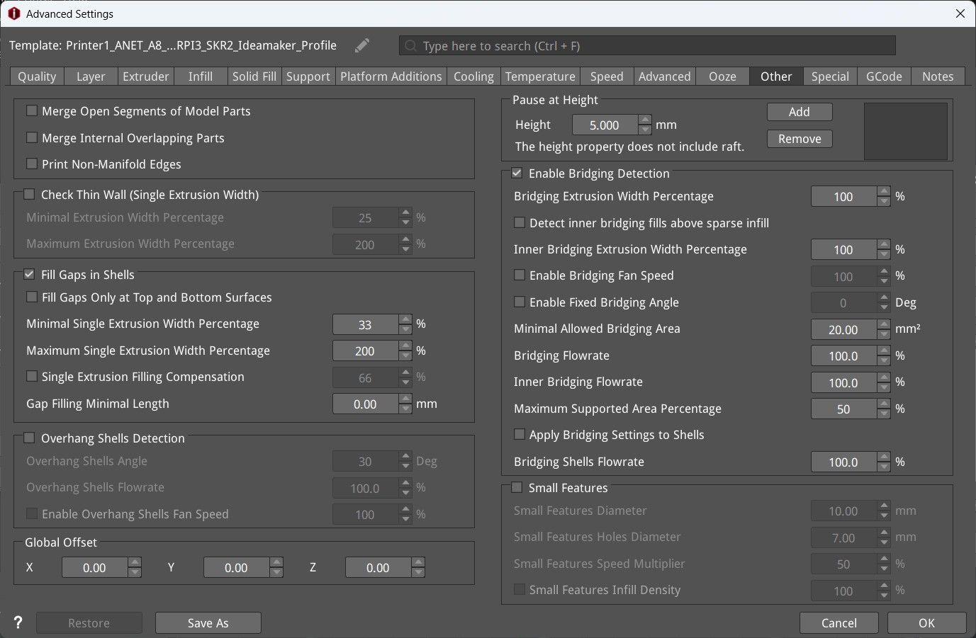

Slide 15
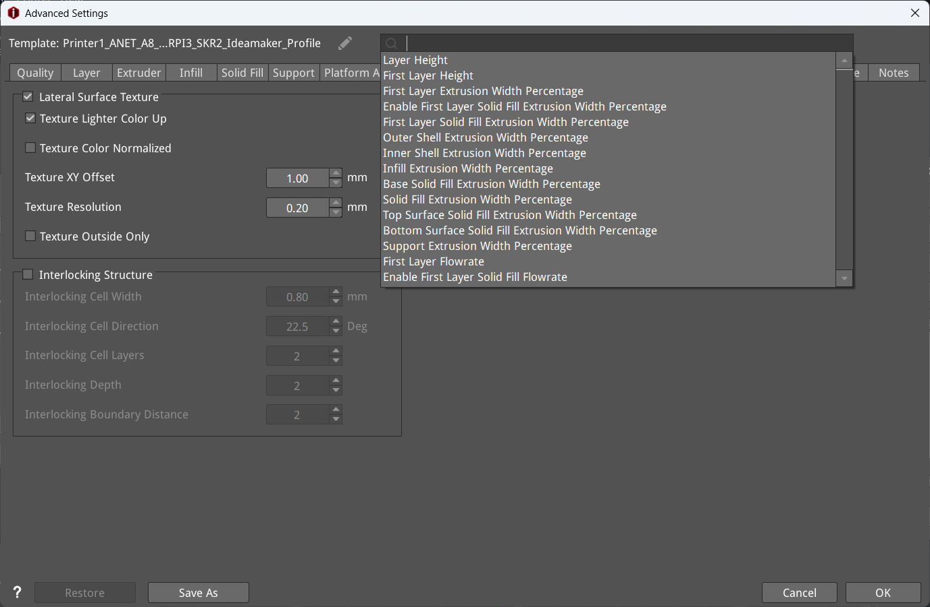

Slide 17
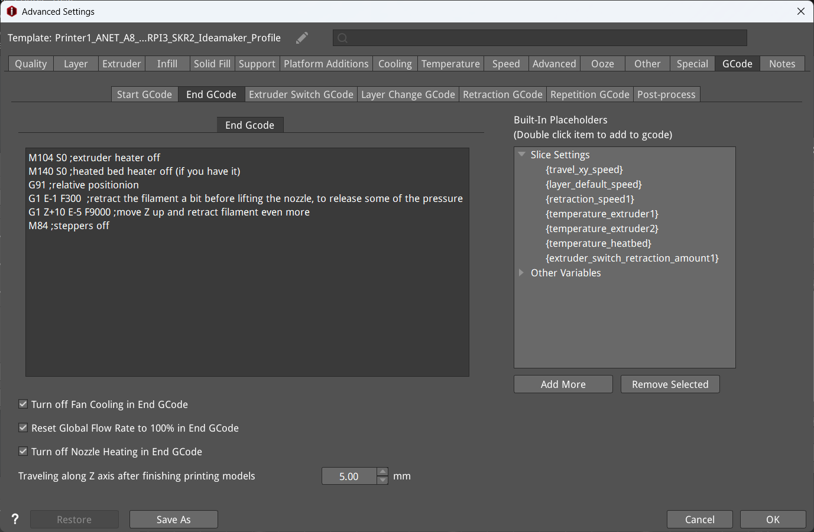

Slide 18
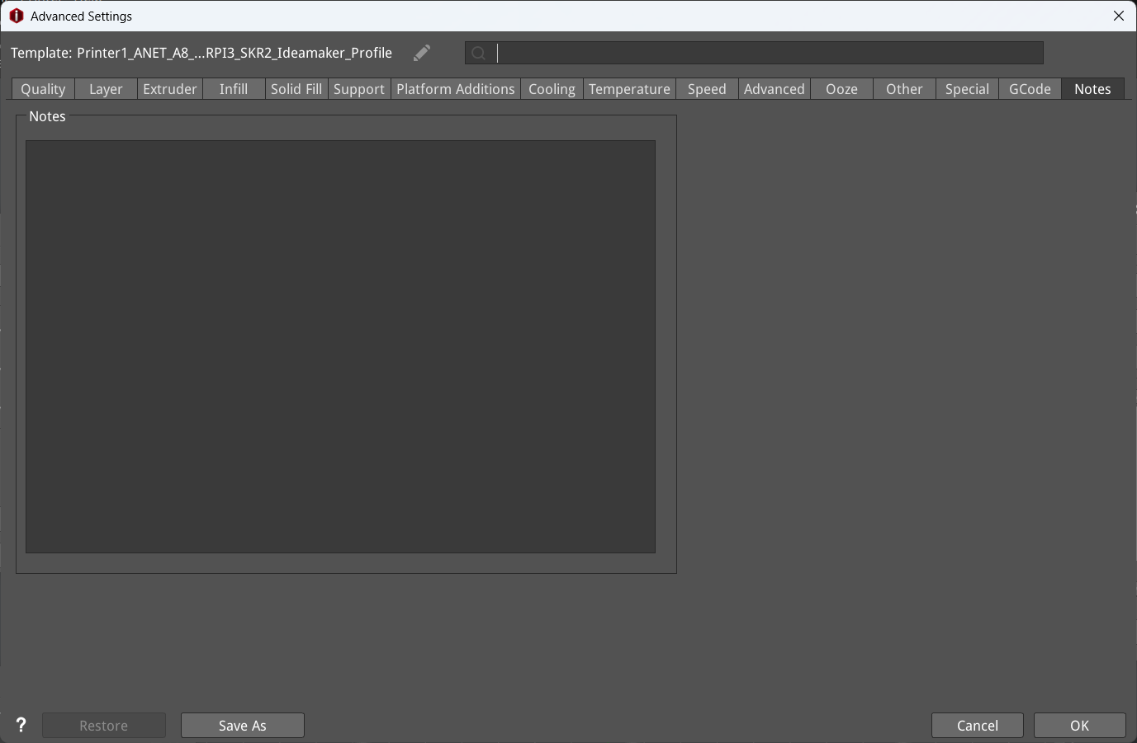

Slide 19
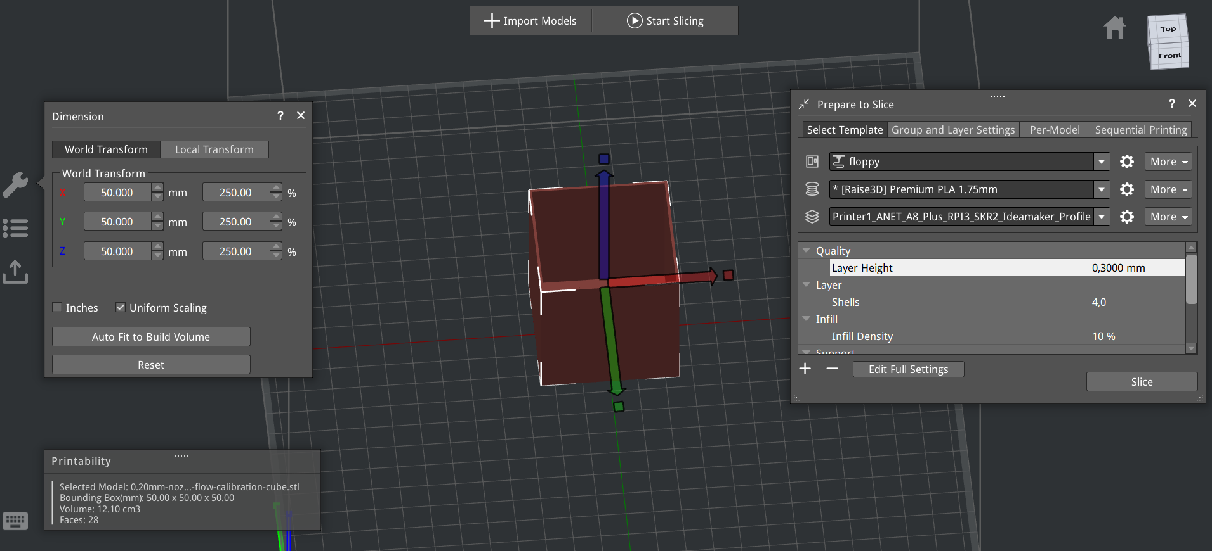
Printer1_ANET_A8_Plus_RPI3_SKR2_Ideamaker_Current_Profile.bin

Slide 20
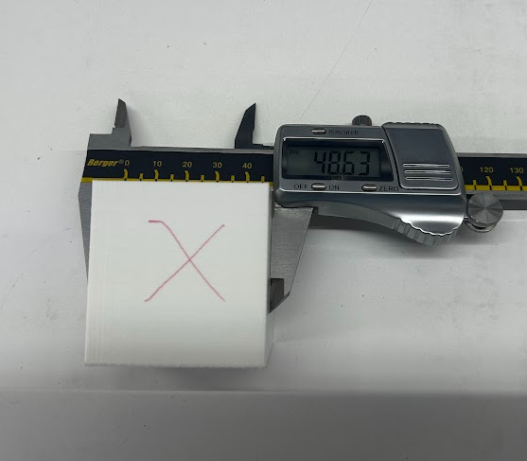
Printer1_ANET_A8_Plus_RPI3_SKR2_Ideamaker_Current_Profile
X axle 48,63mm instead of 50mm

Slide 21
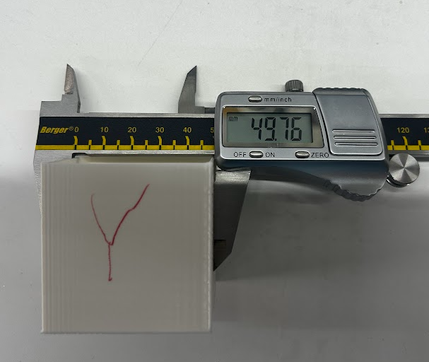
Printer1_ANET_A8_Plus_RPI3_SKR2_Ideamaker_Current_Profile
Y axle 49,76mm instead of 50mm

Slide 22
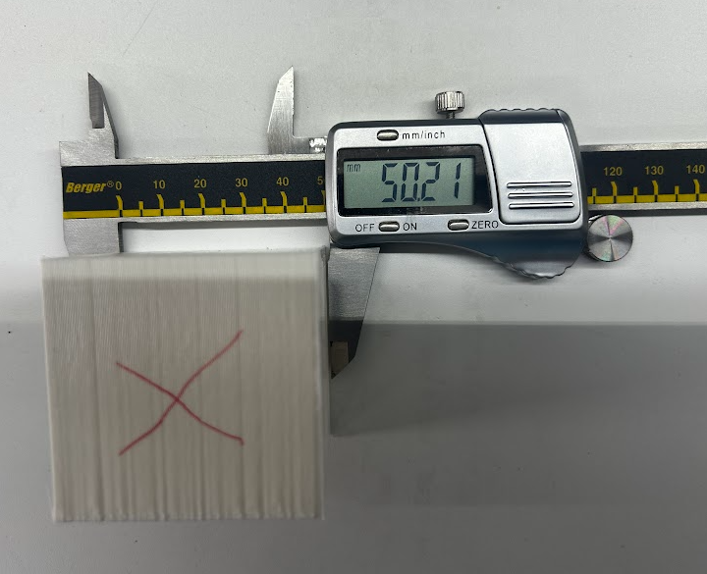
Printer1_ANET_A8_Plus_RPI3_SKR2_Ideamaker_Current_Profile.bin
Z axle 50,21mm instead of 50mm
Z

Slide 23
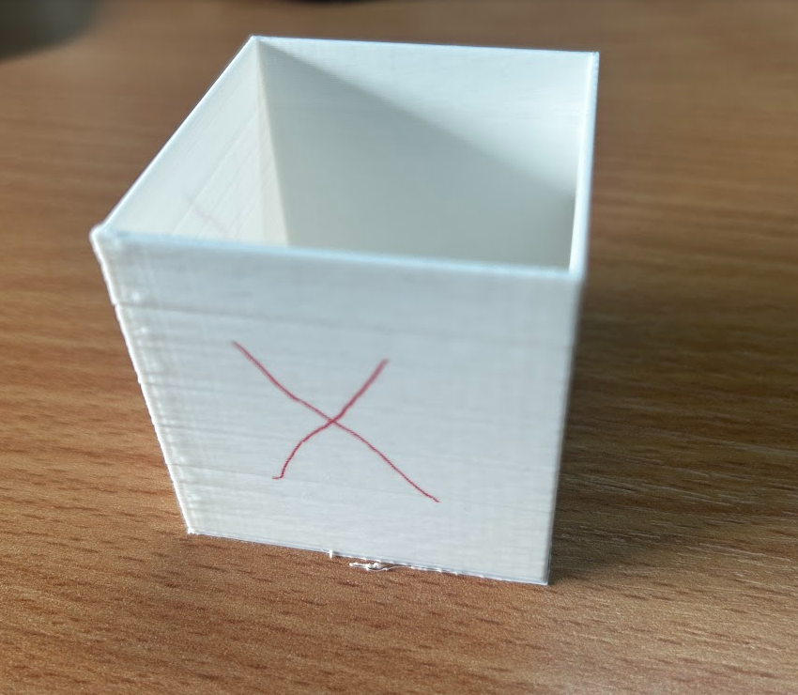
Printer1_ANET_A8_Plus_RPI3_SKR2_Ideamaker_Current_Profile.bin
Edge problem overflow

Slide 24
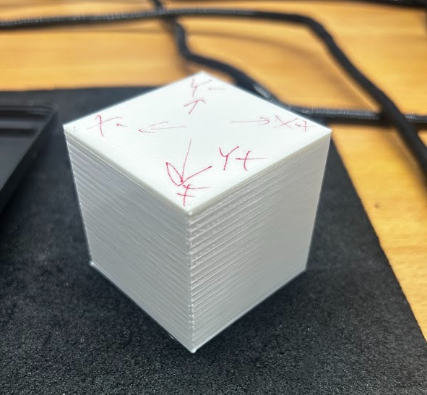
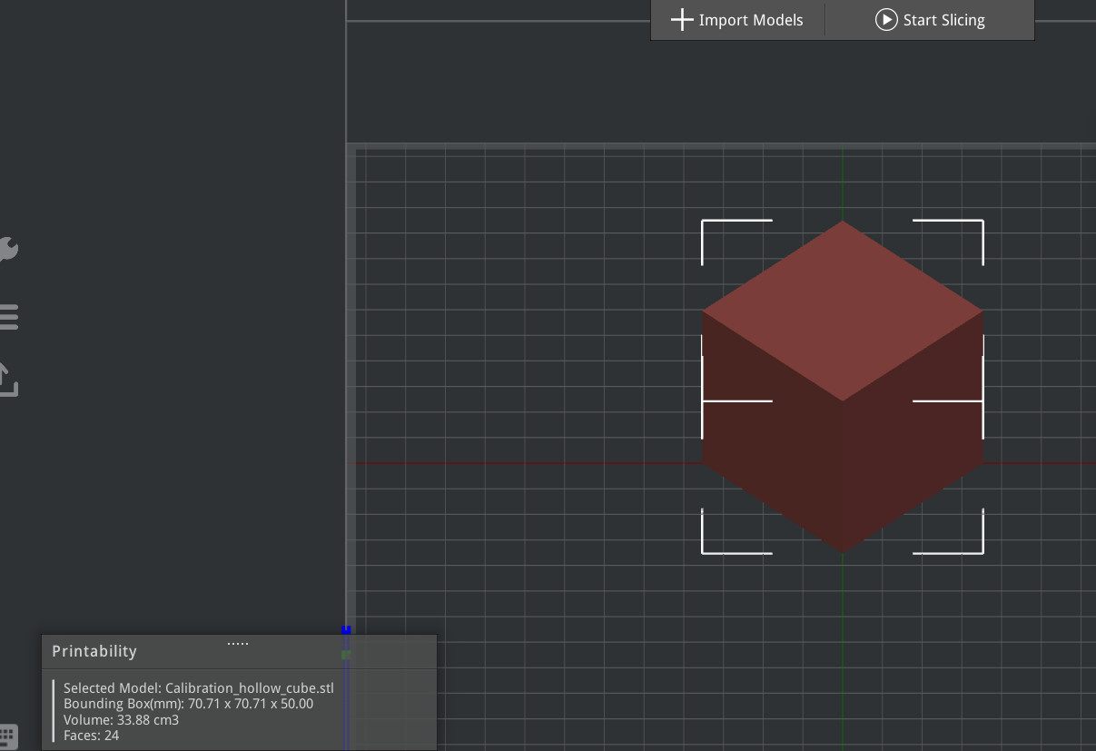
Printer1_ANET_A8_Plus_RPI3_SKR2_Ideamaker_Current_Profile.bin
Edge problem. 0,3mm layer height, first layer height 0,3mm

Slide 25
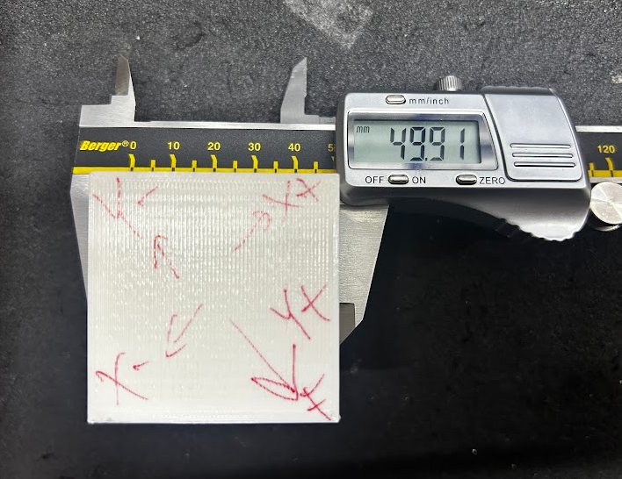
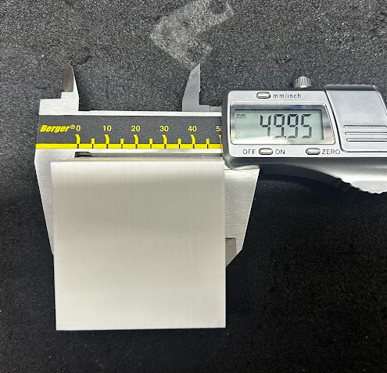
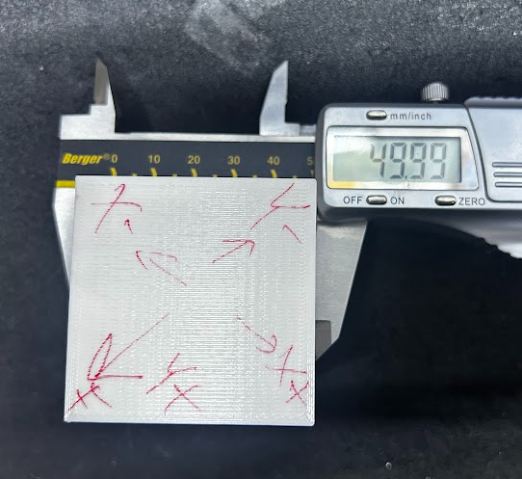
Printer1_ANET_A8_Plus_RPI3_SKR2_Ideamaker_Current_Profile.bin
Edge problem. 0,3mm layer height, first layer height 0,3mm. Hotend PID calibration,extruder calibration

