Slide 1


Slide 2
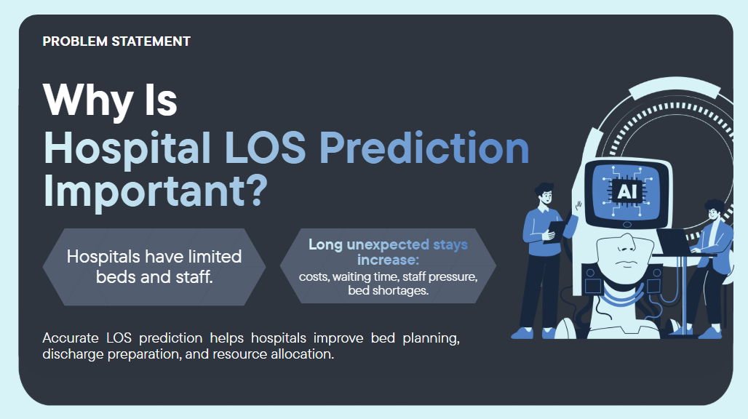

Slide 3
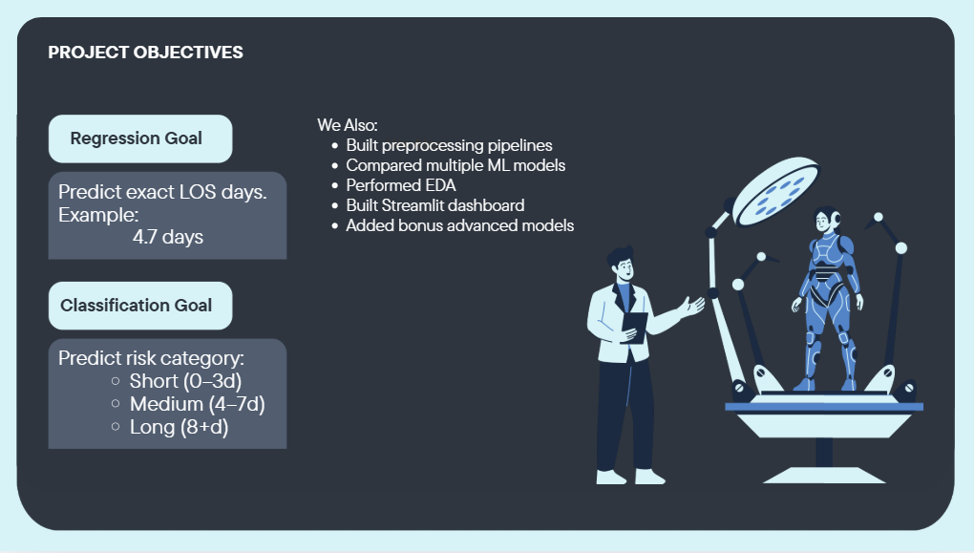

Slide 4
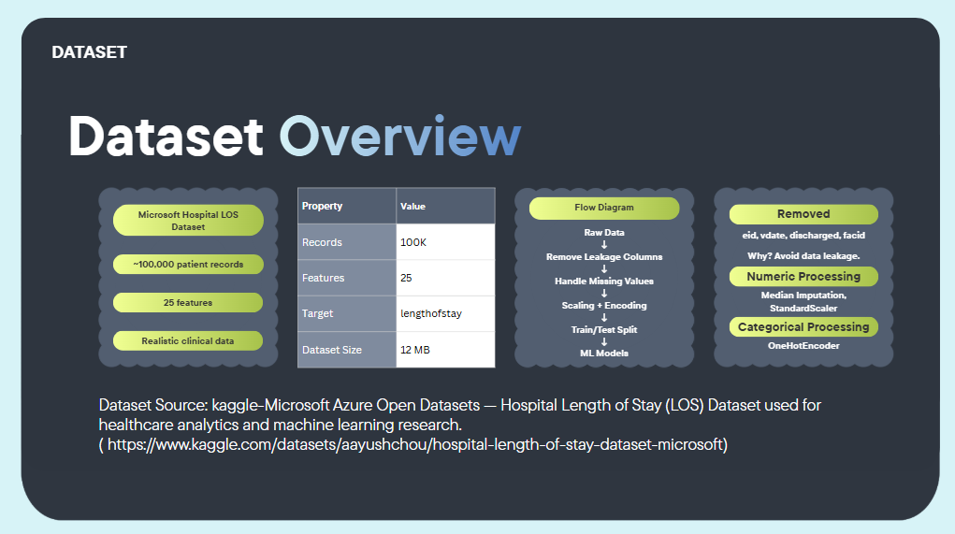

Slide 5
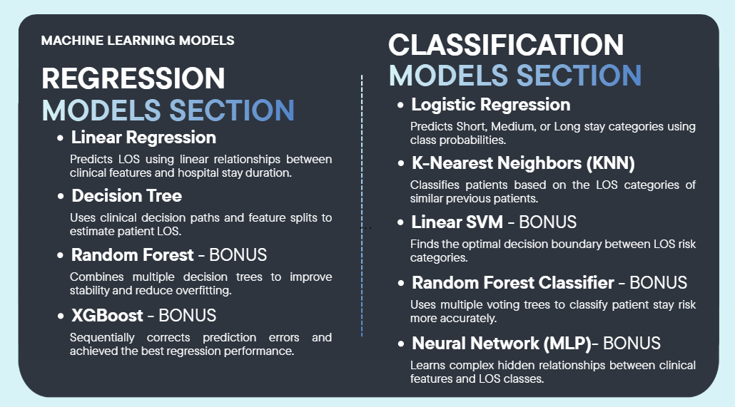

Slide 6
MODEL TRAINING & EVALUATION
Training Pipeline
Raw Data
Preprocessing
Train/Test Split
Model Training
Evaluation
Save Best Model
Regression Metrics
Classification Metrics
MAE - Mean Absolute Error
RMSE - Root Mean Squared Error
R-squared - Coefficient of Determination
5-fold Cross-Validation for robust estimates
Accuracy - Overall correctness
Precision - Positive predictive value
Recall - Sensitivity / True positive rate
F1-Score - Harmonic mean of Precision & Recall

Slide 7
REGRESSION RESULTS
Performance
Model | MAE | RMSE | R-squared
Linear Regression | 2.41 | 3.12 | 0.42
Decision Tree | 1.85 | 2.67 | 0.56
Random Forest | 1.52 | 2.23 | 0.68
XGBoost | 1.28 | 1.89 | 0.78
Key Insight: XGBoost achieved the best regression performance with the lowest RMSE (1.89 days) and highest R-squared (0.78), outperforming all other models.

Slide 8
CLASSIFICATION RESULTS
Performance
Model | Accuracy | F1-Score | Precision
Logistic Regression | 72.3% | 0.71 | 0.73
KNN | 68.5% | 0.67 | 0.69
Linear SVM | 71.8% | 0.70 | 0.72
Random Forest | 78.6% | 0.77 | 0.79
Neural Network (MLP) | 75.2% | 0.74 | 0.75
Key Insight: Random Forest Classifier achieved the highest accuracy (78.6%) and F1-score (0.77). Ensemble methods consistently outperformed single classifiers.

Slide 9
FEATURE IMPORTANCE
Top Predictors
Clinical Insights
Age is the strongest predictor - older patients require longer recovery
Lab results (hematocrit, glucose) reflect overall health status
Admission history indicates chronic conditions
Vitals (BP, heart rate) show acute condition severity
Feature importance aligns with clinical knowledge, validating model reliability.

Slide 10
STREAMLIT DASHBOARD
Interactive App
Single Prediction
Batch Upload
FUTURE WORK
Metrics Viewer
Input patient clinical features through an interactive form and get instant LOS prediction with risk classification.
Upload a CSV file with multiple patient records to process bulk predictions and export results.
View comprehensive model performance metrics including confusion matrices, ROC curves, and comparison tables.
Feature Importance Viz
EDA Explorer
Dynamic Loading
Interactive bar charts showing which clinical features most influence length-of-stay predictions.
Browse exploratory data analysis visualizations including distributions, correlations, and category breakdowns.
Dashboard loads saved models and metrics dynamically - no hardcoded values. Re-train models, refresh dashboard.

Slide 11
CONCLUSION
Key Takeaways
What We Achieved
Future Work
Built and compared 9 ML models for LOS prediction
XGBoost achieved best regression performance (RMSE: 1.89 days)
Random Forest topped classification (Accuracy: 78.6%)
Deployed interactive Streamlit dashboard for real-time predictions
Feature importance aligns with clinical knowledge
Deep learning: LSTM and Transformer architectures
Real-time EHR integration from hospital systems
Multi-hospital generalization studies
Explainable AI with SHAP values
-
Thank You
Questions & Answers

