Slide 1
Fog to cloud and network coded based architecture:
Minimizing data download time for smart mobility
Industry 4.0

Slide 2
Industry 4.0 – Fourth industrial revolution
Smart cities
Smart manufacturing
Cognitive computing
E-Health
Smart mobility
Robotic guidance

Slide 3
Industry 4.0 – Fourth industrial revolution
Characterised by: Applications where real-time monitoring and processing is critical for an immediate decision making process, in particular low latency communication, and high reliability and availability

Slide 4
Industry 4.0 – Fourth industrial revolution
5G aims at coping with the requirements of Ultra-Reliable Low-Latency Communication (URLLC) systems, reducing the latency to 1 ms and providing up to 10 Gbps data rates
Besides applying new and advanced technologies, it is crucial to deploy an architecture that supports these requirements, thus, an architecture based on the combination of both fog and cloud computing paradigms is emerging as one possible solution

Slide 5
Industry 4.0 – Fourth industrial revolution
Taking smart mobility applications as our driving use-case, the main objective presentation is to provide a highly reliable, yet flexible and dynamic architecture, which aims at minimizing the time that the end node or user, for instance a car, spends in downloading the required data

Slide 6
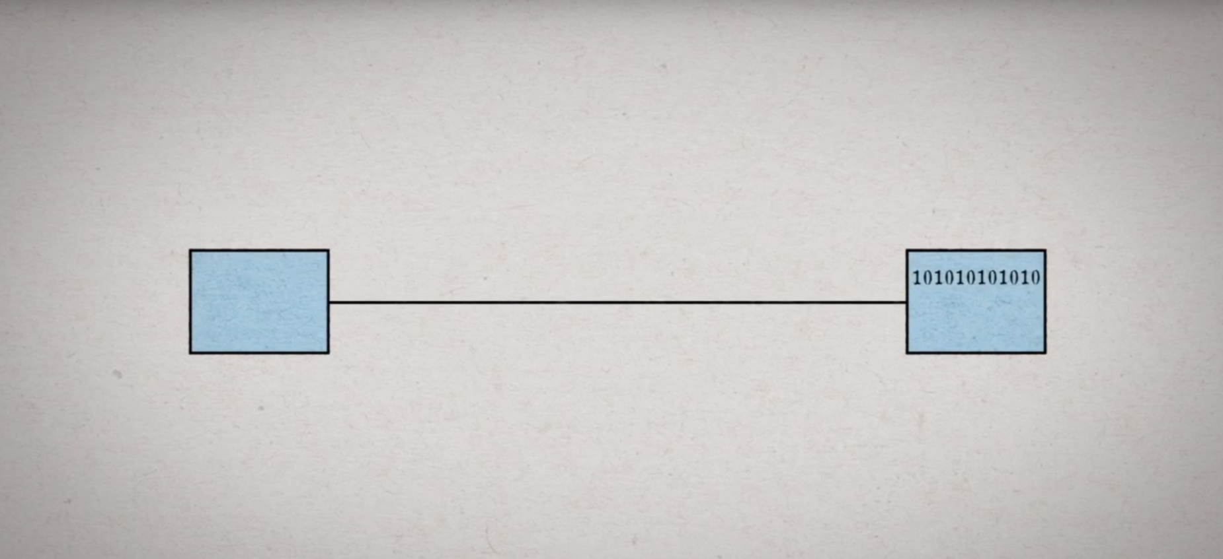
Network Coding (NC)

Slide 7
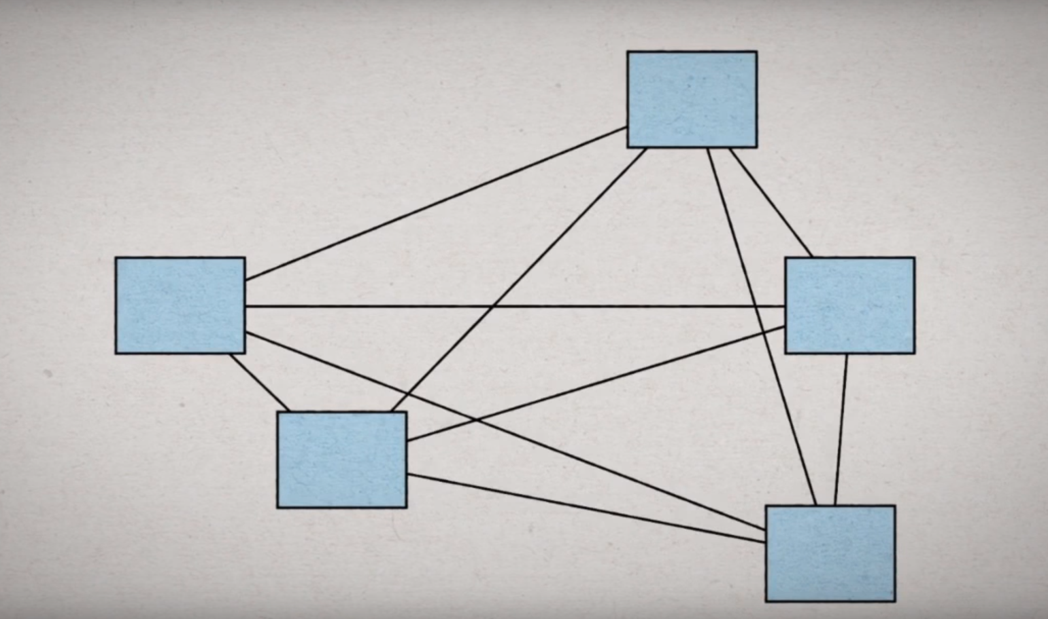
Network Coding

Slide 8
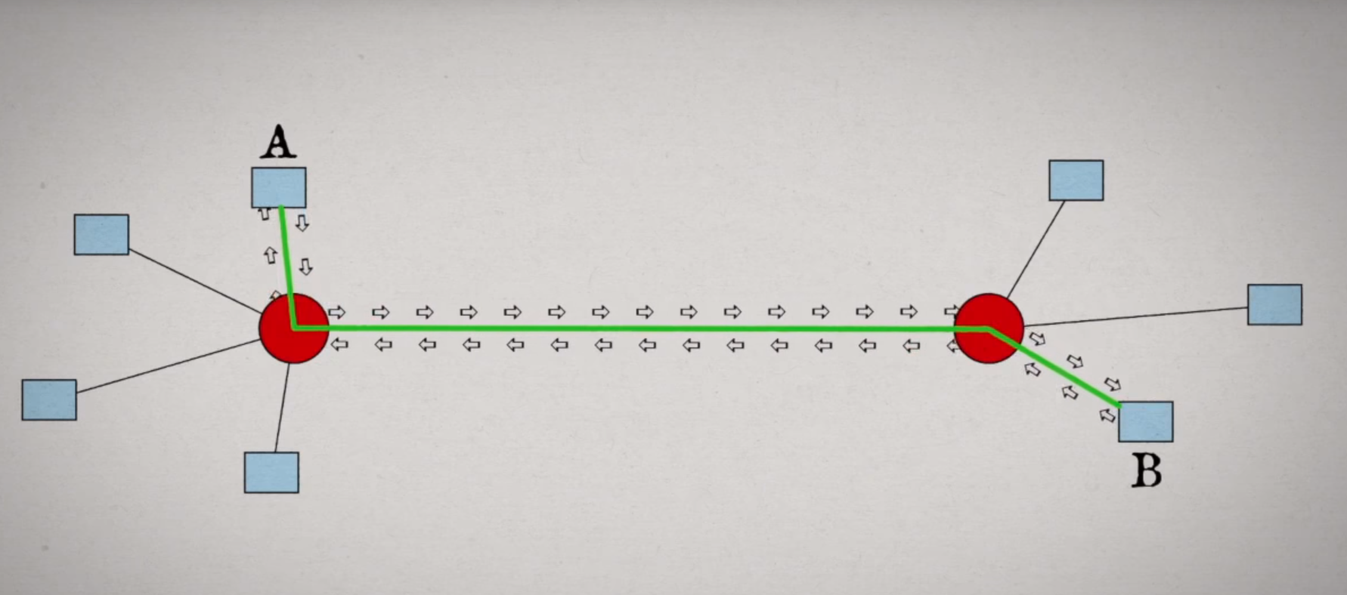
Network Coding

Slide 9
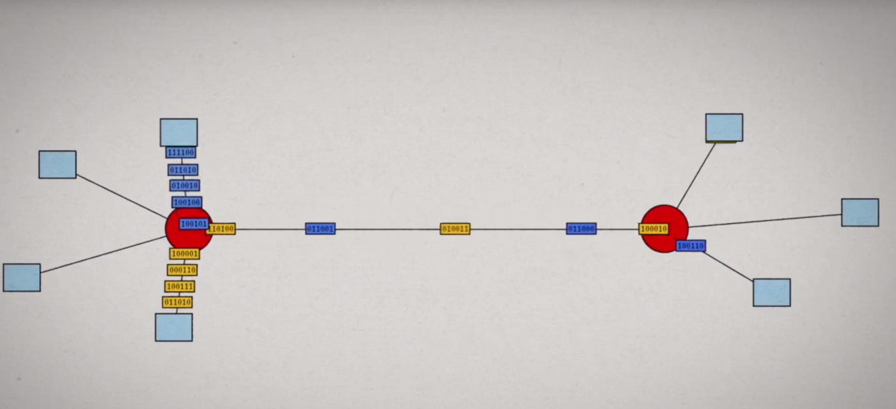
Network Coding

Slide 10
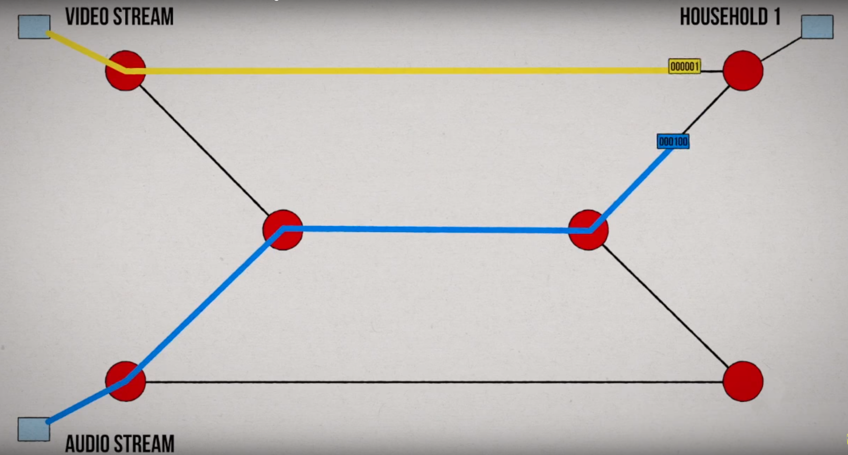
Network Coding

Slide 11
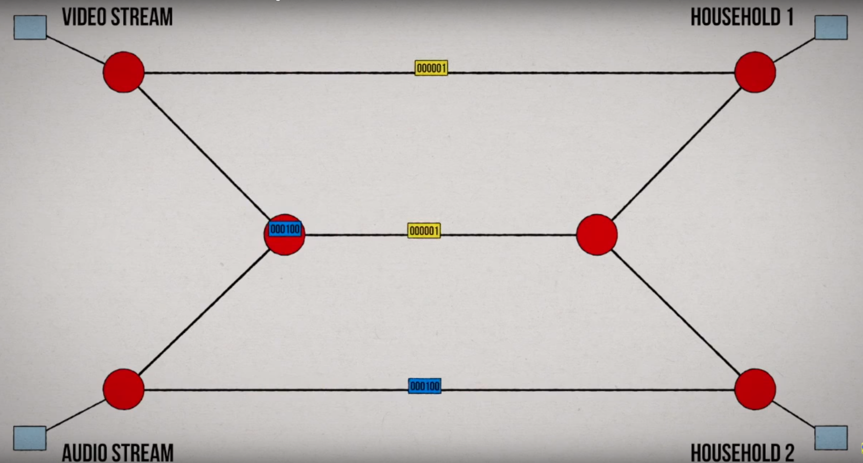
Network Coding

Slide 12
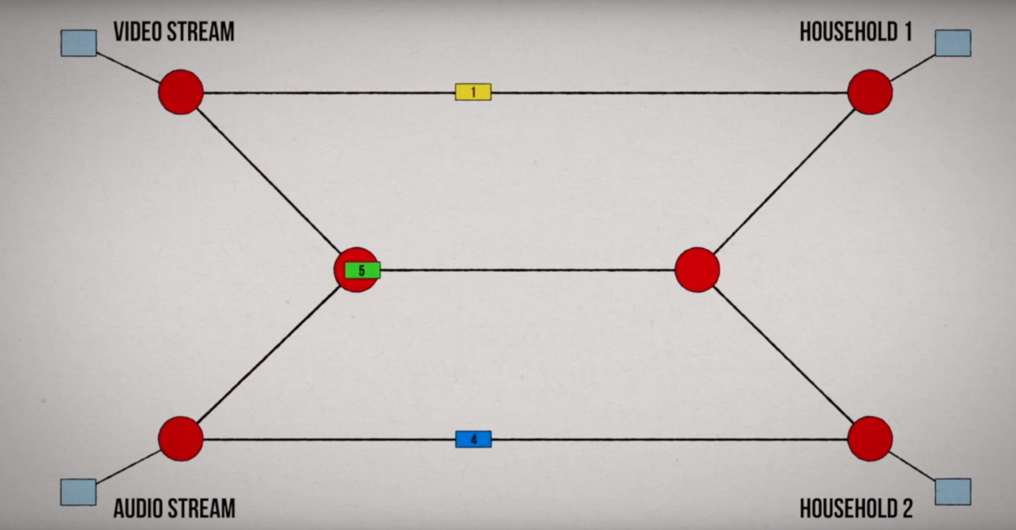
Network Coding

Slide 13

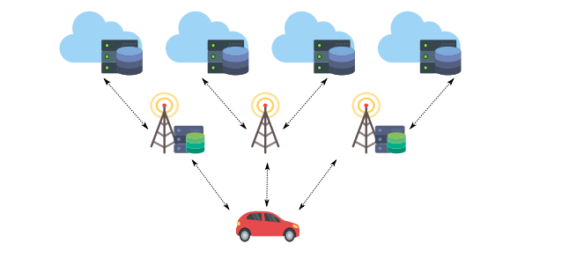
Fog

Slide 14
FOG Computing
Compared to cloud computing, fog computing emphasizes proximity to end-users and client objectives, dense geographical distribution and local resource pooling, latency reduction, backbone bandwidth savings and and redundancy in case of failure
Minuses: It does not have as much computing power as the cloud computing and it cannot store as much data as the clouds, so we have to take care how do we distribute the data between nodes.

Slide 15
System model
To be able to make a comparaison between different models we will take into consideration 3 important parameters
The download rate - Rb
Te communication delay - Dlink
The service time – The time required to process the data request - Dservice

Slide 16
System model
To be able to understand the upsides of using a multi-tier architecture (fog and cloud) targeted to distributed data storage we will take a look on a simulation that should reflect the real life case when we want to achieve the lowest latency and download time in various scenarios, in particular for vehicular application.

Slide 17
System model
The system is composed of 5 cloud nodes and 3 fog nodes on which different data architectures will be tested.
Single configuration - the whole data is retrieved from the node having the best conditions
Multi-Eq - data is evenly stored in every node and so the terminal gets the same amount of information from all nodes
Multi-Rb – the data distribution is performed based on the download rate of each node

Slide 18
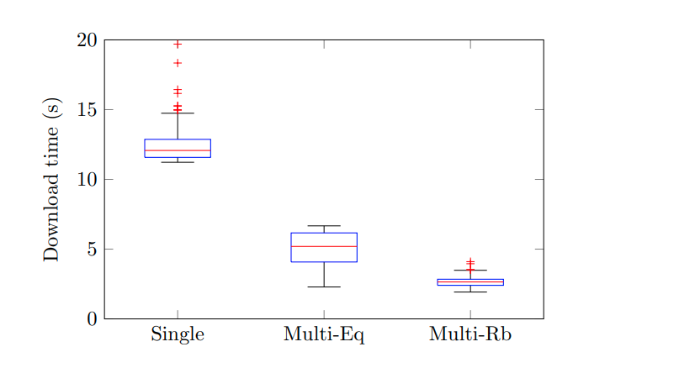
System model

Slide 19
System model
The traditional single server solution is clarly not that great in a new environment where the low latency and high data transfer are prioritised.
The new requirements are appearing because of the new devices that can support new transfer technologies - 5G
The simulation that we have seen was done on 200 independent snap-shots for 3 different configurations.
Taking into consideration the poor performance of the traditional single server solution we can just drop down that model and focus on the newer ones and we will introduce a new model

Slide 20
Optimal model
The new proposed scheme, which we will refer to as Opt, will calculate the amount of data to store in (retrieve from) each node considering, not only the download rate, but also the communication and service delays.
We will take a look on another scenario where we introduce the Optimal solution
We will increase the number of Fog nodes from 0 to 10 and we will analyse again the download time

Slide 21
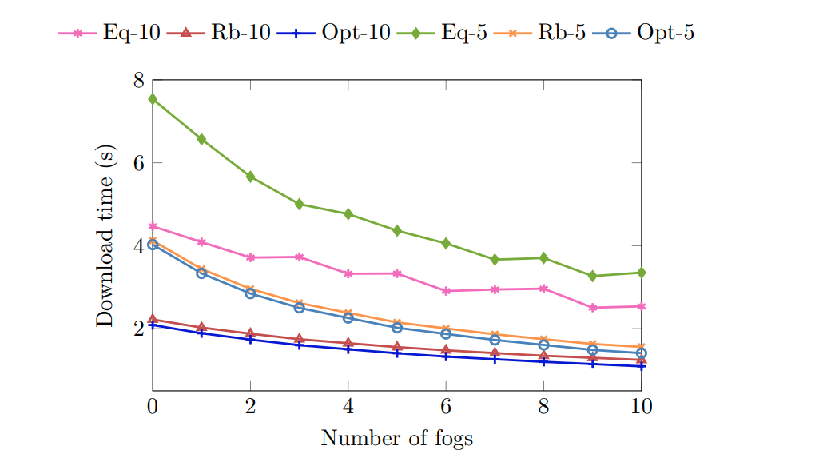
Optimal model

Slide 22
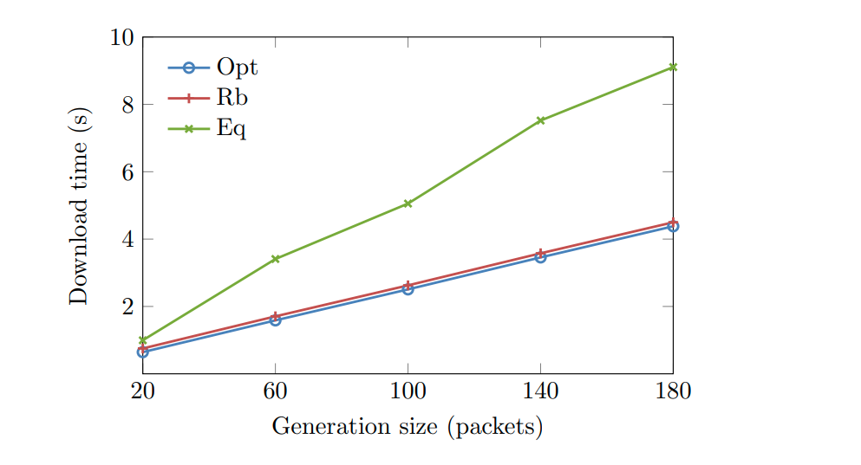
Increasing the nr of packets and so the amount of data to be stored in the system

Slide 23
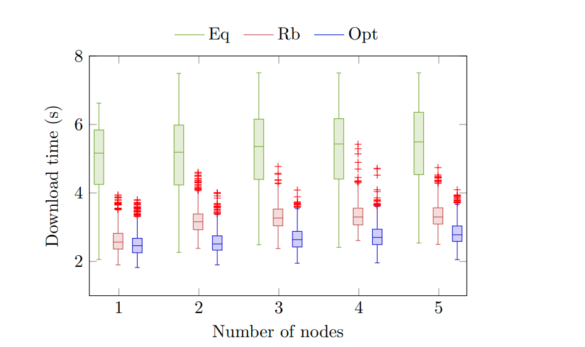
Increase the number of nodes suffering from such connectivity issues

Slide 24
Conclusions
We have studied the required time to download the data stored in a fog/cloud architecture. We have modeled the corresponding multi-tier architecture by introducing different performance parameters.
The use of multi-tier distributed data storage system clearly outperforms traditional single server solutions. On the other hand, when the distribution strategy considers system parameters, the download time is much lower than when an even distribution is applied. We have also seen that the proposed scheme is able to keep a reasonable behavior even when some nodes suffer from rather poor conditions (either connectivity or overload).

