Slide 1

ONLINE LEARNING applications PROJECT
Stefano Arcaro
Gabriele Farace
Antonio Napolitano
Davide Remondina
Sofia Yang

Slide 2
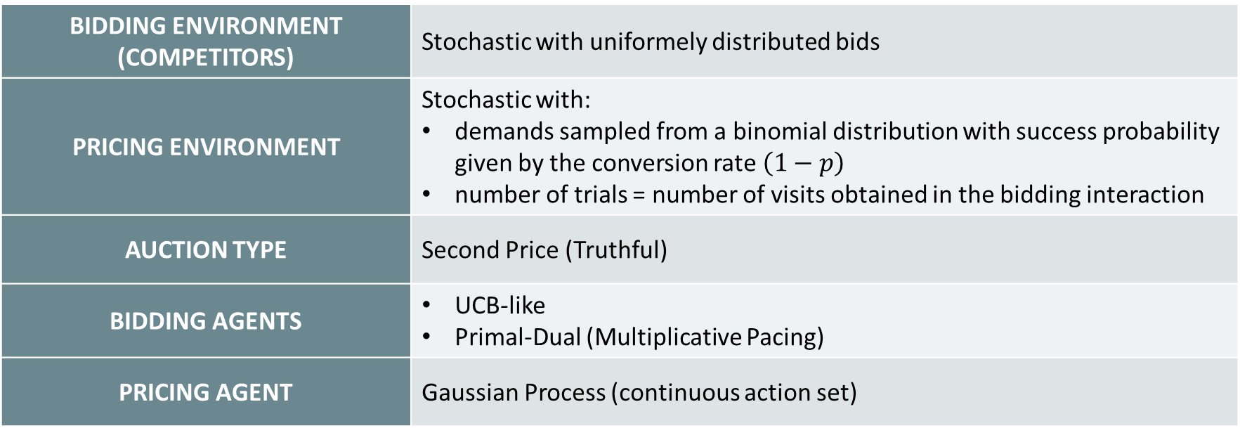
REQUIREMENT 1
BIDDING ENVIRONMENT (COMPETITORS) | Stochastic with uniformely distributed bids
PRICING ENVIRONMENT | Stochastic with: demands sampled from a binomial distribution with success probability given by the conversion rate $\left(1−p\right)$ number of trials = number of visits obtained in the bidding interaction
AUCTION TYPE | Second Price (Truthful)
BIDDING AGENTS | UCB-like Primal-Dual (Multiplicative Pacing)
PRICING AGENT | Gaussian Process (continuous action set)

Slide 3
INTERACTION
COMPANY
PUBLISHER
Pricing Agent
Bidding Agent
Auction
Pricing Environment
Bidding Environment
(competitors)

Slide 4
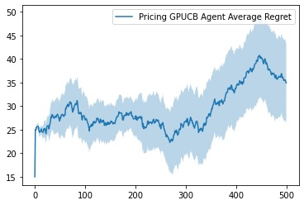
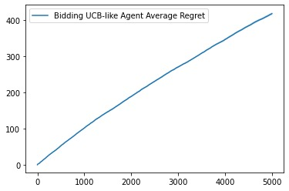
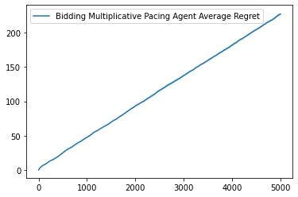
PRICING ONLY
BIDDING ONLY
NUMBER OF INTERACTIONS | 500
NUMBER OF CUSTOMERS | 50
PRODUCT COST | 0.1
NUMBER OF TRIALS | 10
NUMBER OF INTERACTIONS | 5000
BUDGET | 1000
VALUATION | 1
CTRs | [0.8 0.5 0.9 1]
NUMBER OF TRIALS | 10
GPUCB
UCB-like
Multiplicative Pacing

Slide 5
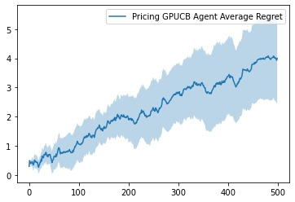
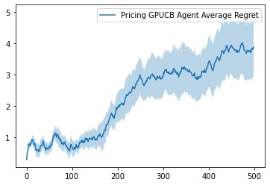
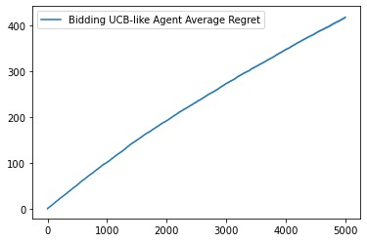
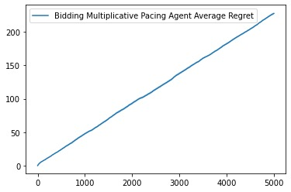
Pricing AND BIDDING
UCB-LIKE BIDDER
PRIMAL-DUAL BIDDER

Slide 6
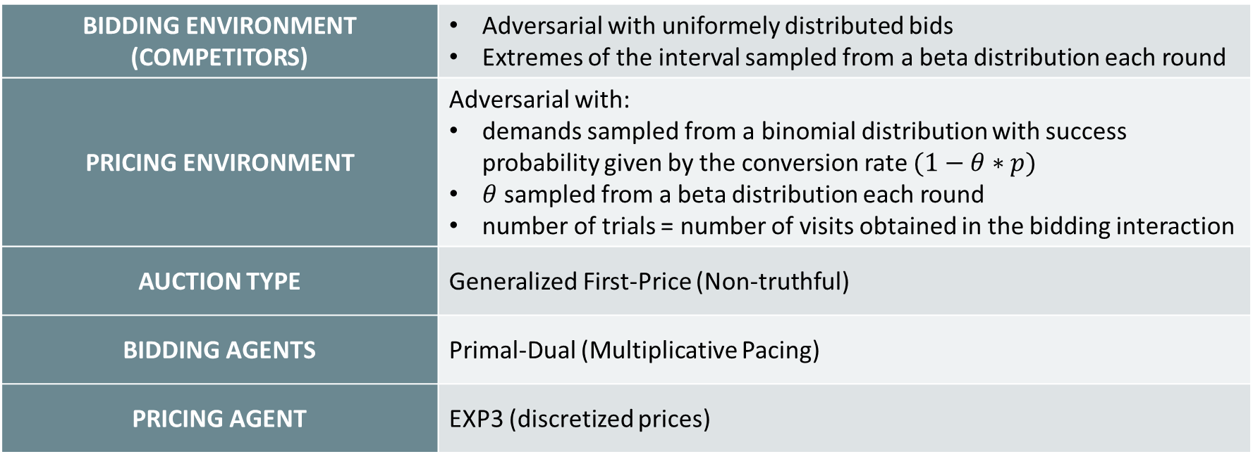
REQUIREMENT 2
BIDDING ENVIRONMENT (COMPETITORS) | Adversarial with uniformely distributed bids Extremes of the interval sampled from a beta distribution each round
PRICING ENVIRONMENT | Adversarial with: demands sampled from a binomial distribution with success probability given by the conversion rate $(1−θ∗p)$ $θ$ sampled from a beta distribution each round number of trials = number of visits obtained in the bidding interaction
AUCTION TYPE | Generalized First-Price (Non-truthful)
BIDDING AGENTS | Primal-Dual (Multiplicative Pacing)
PRICING AGENT | EXP3 (discretized prices)

Slide 7
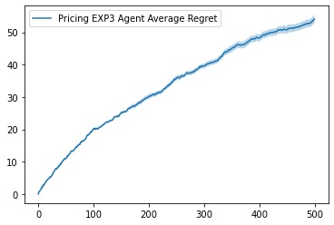
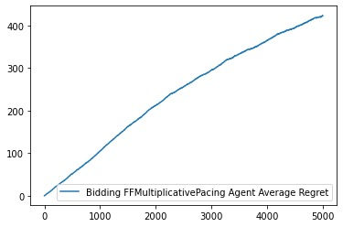
PRICING ONLY
BIDDING ONLY
NUMBER OF INTERACTIONS | 500
NUMBER OF CUSTOMERS | 50
PRODUCT COST | 0.1
NUMBER OF TRIALS | 10
NUMBER OF INTERACTIONS | 5000
BUDGET | 1000
VALUATION | 1
CTRs | [0.8 0.5 0.9 1]
LAMBDAs | [1 0.9]
NUMBER OF TRIALS | 10
FF Multiplicative Pacing
EXP3

Slide 8


Pricing AND BIDDING

Slide 9
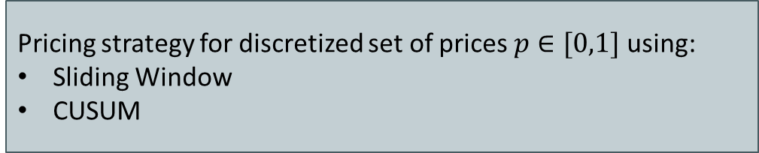
REQUIREMENT 3
Focus on the pricing problem
Non-stationary environment
Abrupt changes
Noisy demand curve changes each interval
GOAL
Pricing strategy for discretized set of prices $p∈[0,1]$ using:
Sliding Window
CUSUM

Slide 10
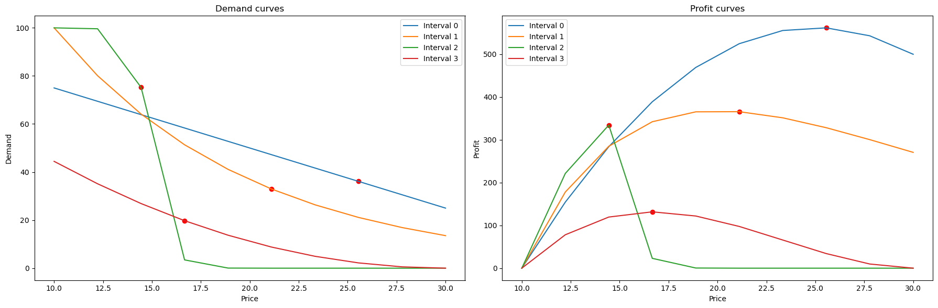
SETUP
Defined demand curves for each interval
Derived respective profit curves

Slide 11
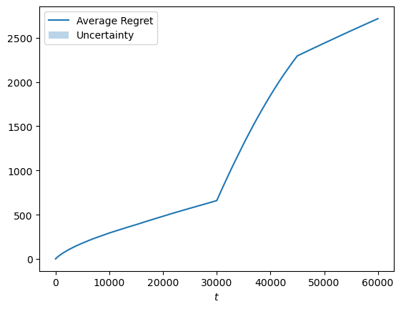
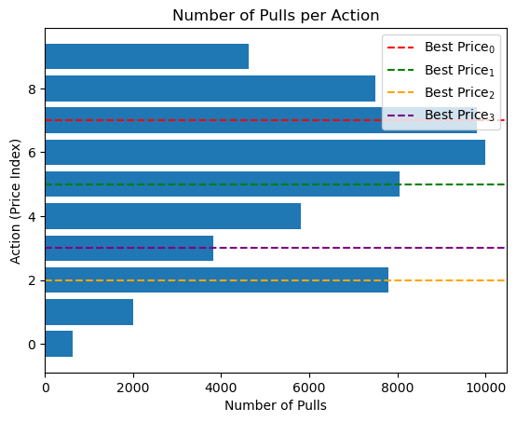
NON-STATiONARITY CHECK
Tested UCB1 on the environment
Results indicate presence of non-stationarity

Slide 12
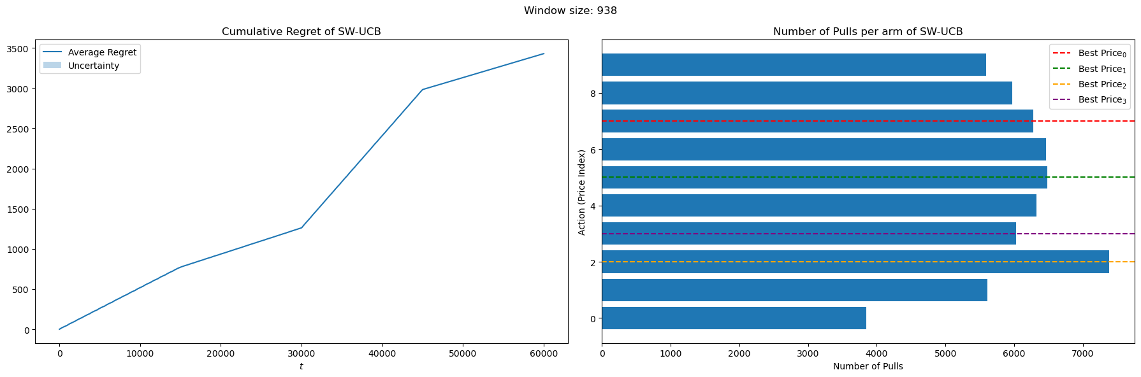
SLIDING WINDOW
Sliding Window UCB
Initial trial failed
Decided to test different window sizes

Slide 13
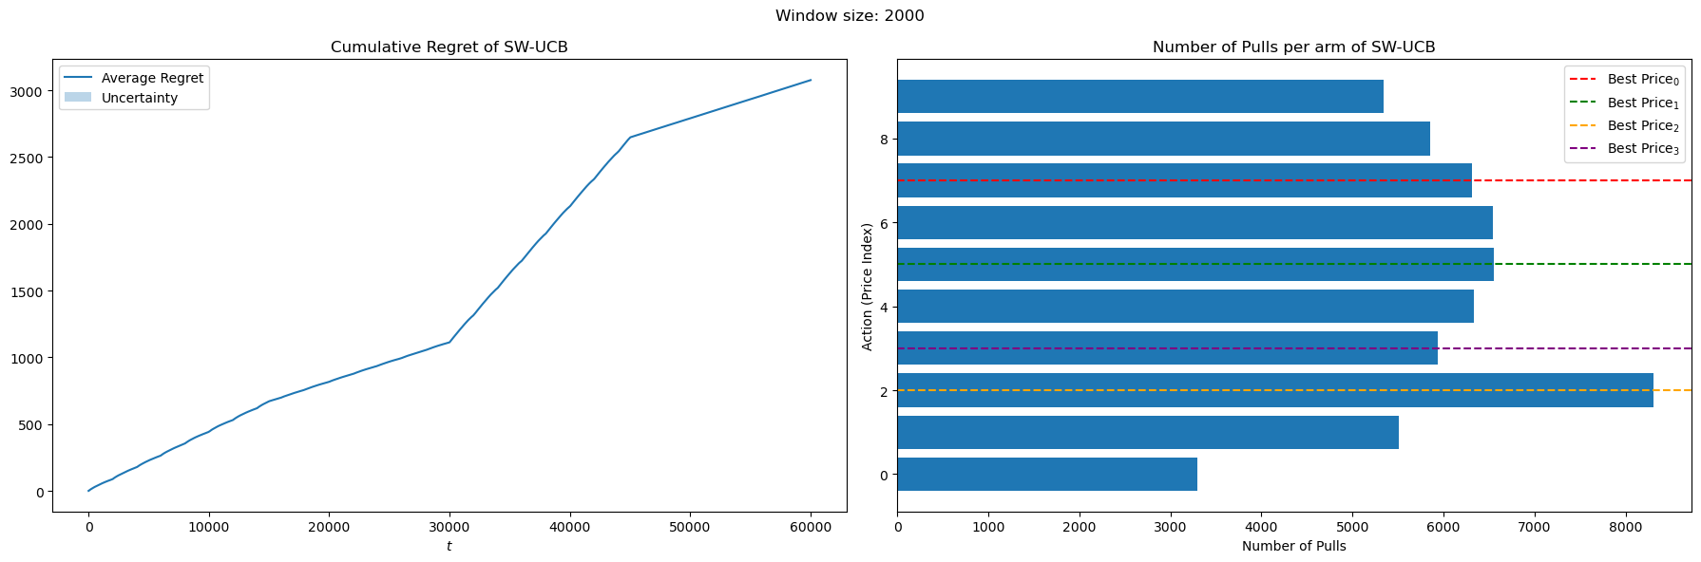
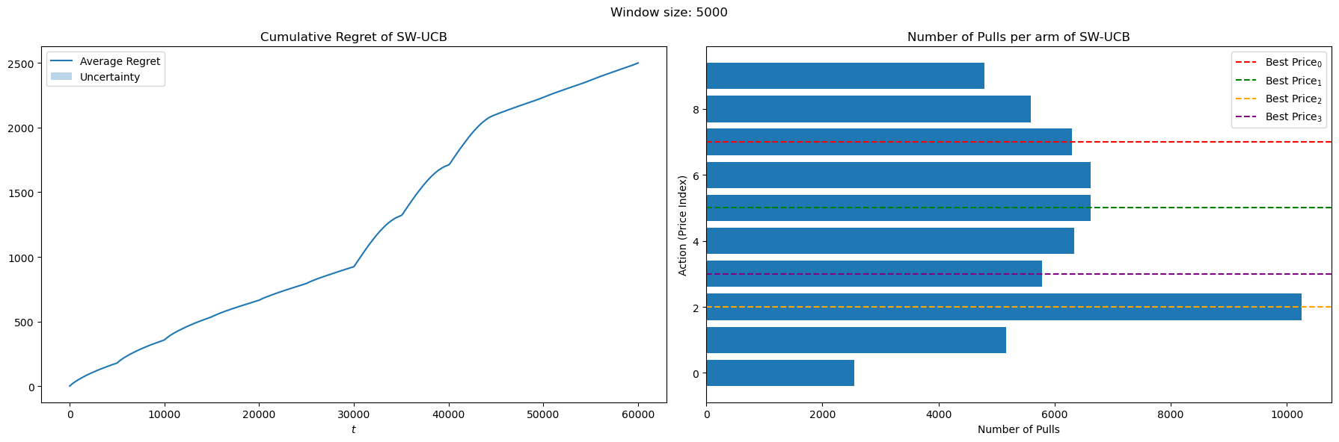

Slide 14
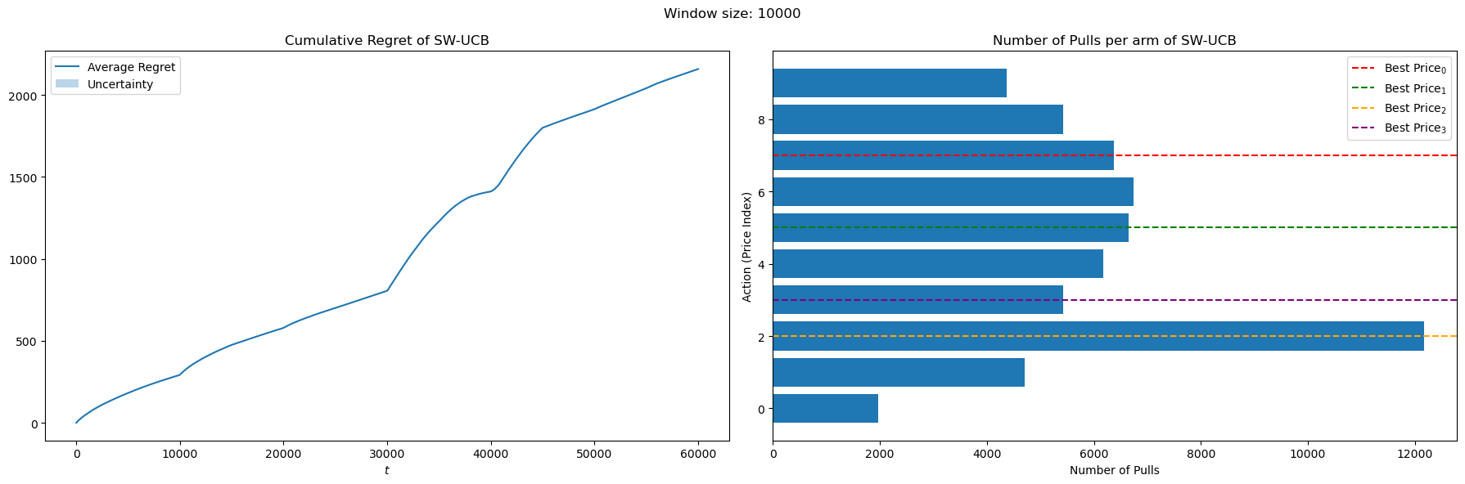
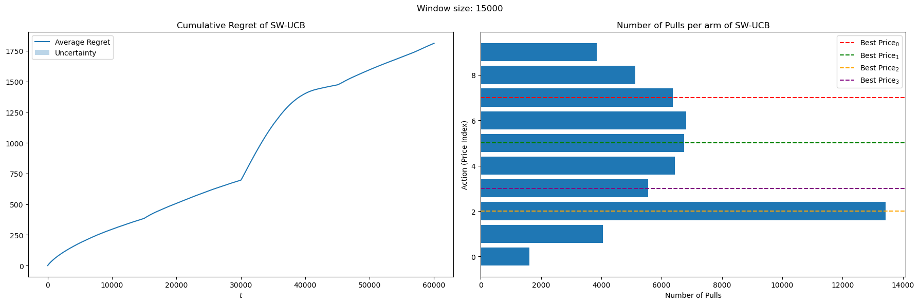

Slide 15
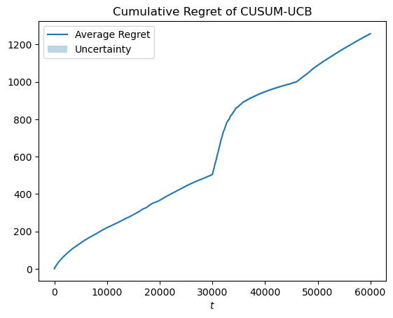
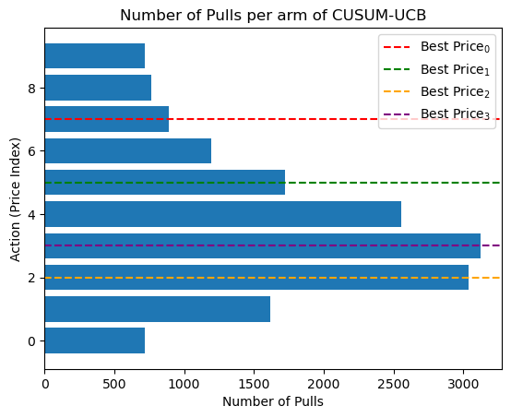
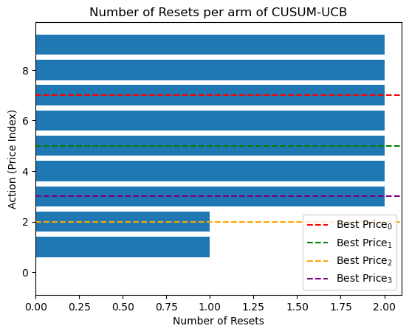
Change detection
CUSUM UCB
Best performing method overall

Slide 16
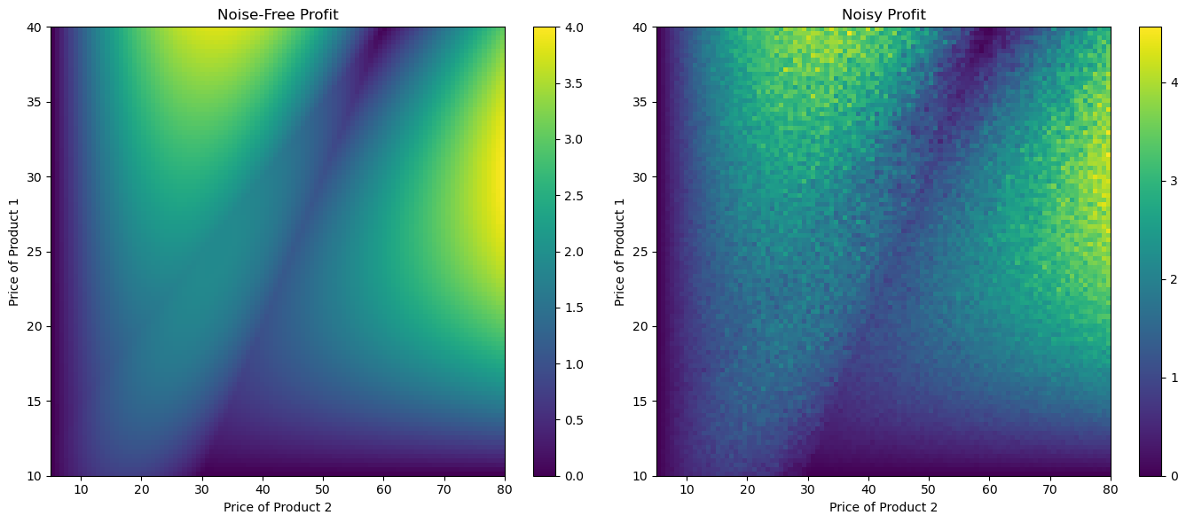
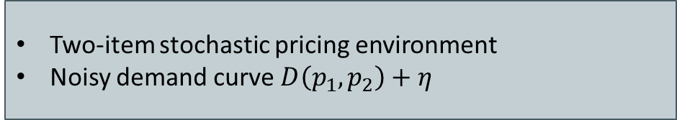
BONUS POINT
Two-item stochastic pricing environment
Noisy demand curve $D\left(p_{1},p_{2}\right)+η$
GOAL
Build a regret minimizer for the continuous action set ${[0,1]}^{2}$ using 2D Gaussian Processes

Slide 17
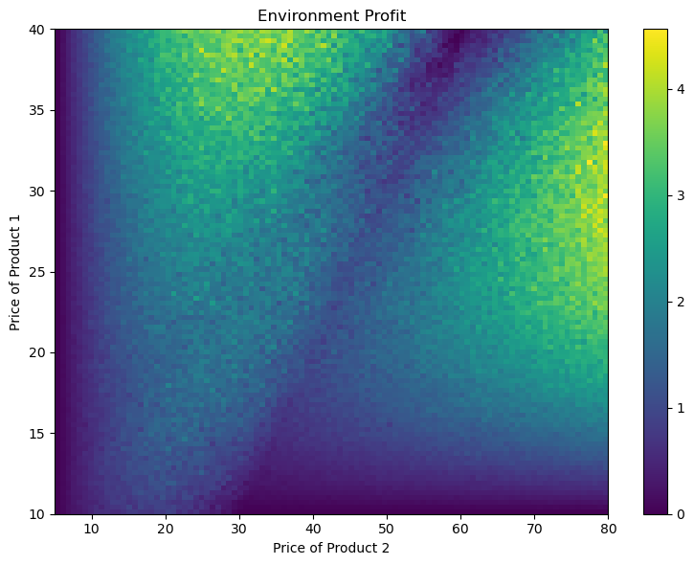
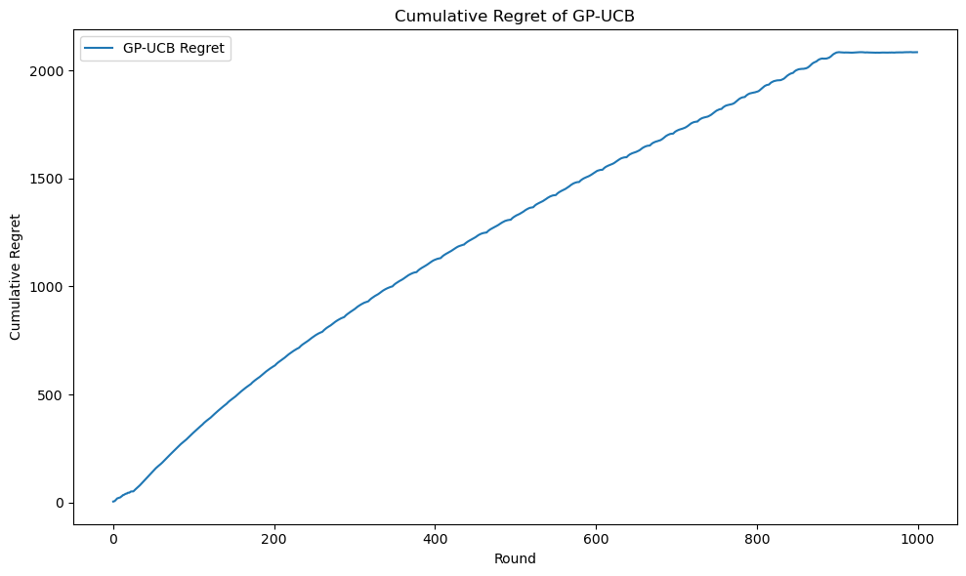
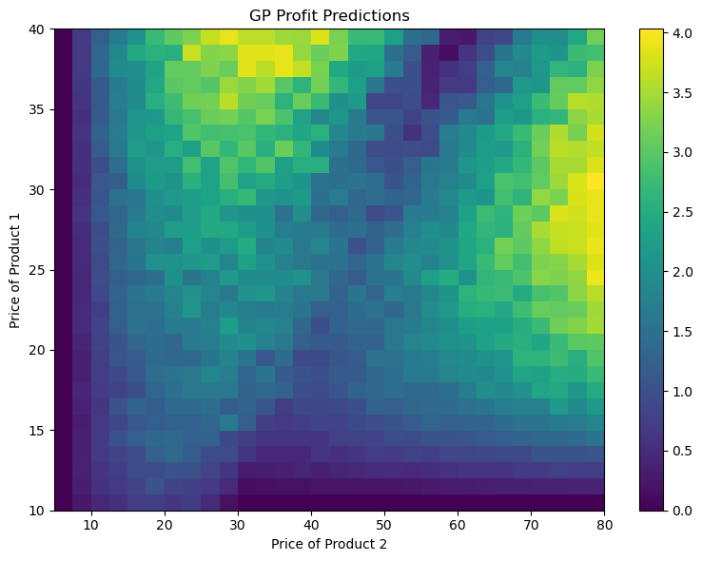
results
GP UCB
Great results obtained

Slide 18
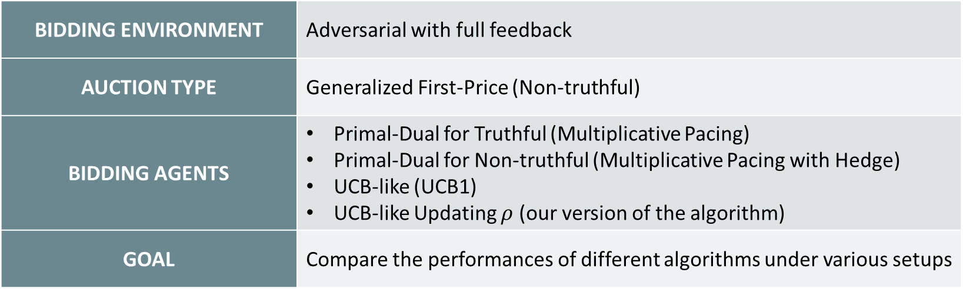
REQUIREMENT 4
BIDDING ENVIRONMENT | Adversarial with full feedback
AUCTION TYPE | Generalized First-Price (Non-truthful)
BIDDING AGENTS | Primal-Dual for Truthful (Multiplicative Pacing) Primal-Dual for Non-truthful (Multiplicative Pacing with Hedge) UCB-like (UCB1) UCB-like Updating $ρ$ (our version of the algorithm)
GOAL | Compare the performances of different algorithms under various setups

Slide 19
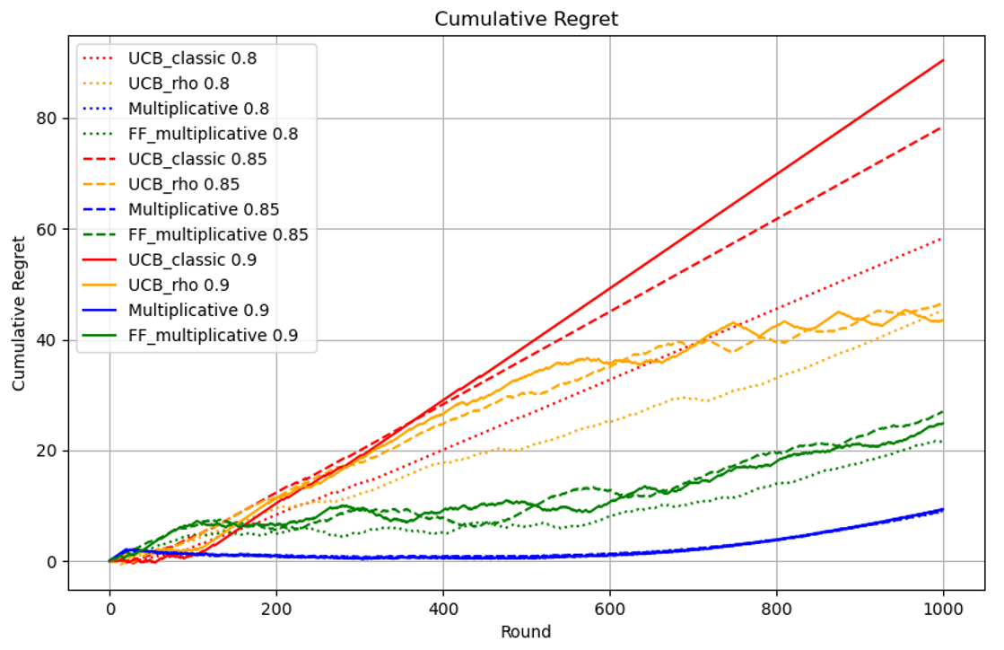
STANDARD CASE
SETUP
BIDDERS PER TYPE | 3
VALUATIONS | [0.80 0.85 0.90]
NUMBER OF SLOTS | 3
SLOT PROMINENCE | [0.8 0.9 1.0]
BUDGET | 250
OBSERVATION
UCB_classic has linear regret
Multiplicative pacing has the smoothest curve

Slide 20
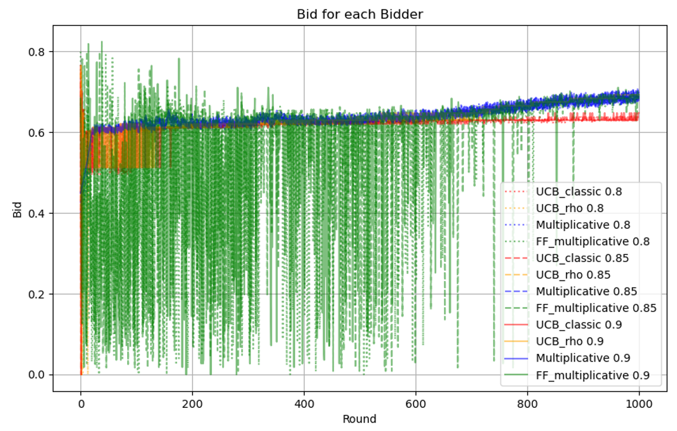
STANDARD CASE
SETUP
BIDDERS PER TYPE | 3
VALUATIONS | [0.80 0.85 0.90]
NUMBER OF SLOTS | 3
SLOT PROMINENCE | [0.8 0.9 1.0]
BUDGET | 250
OBSERVATION
Bids increase over rounds
UCB_classic stops winning after round 500
FF_multiplicative needs time to be consistent with bids

Slide 21
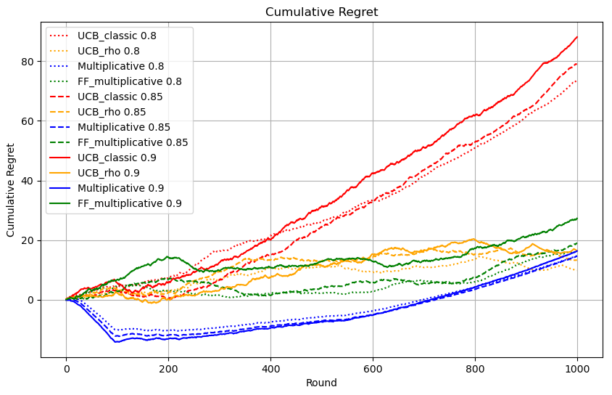
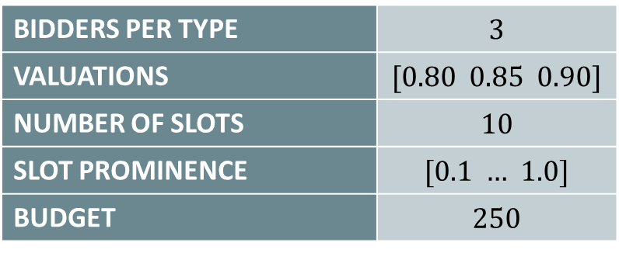
MANY SLOTS CASE
SETUP
BIDDERS PER TYPE | 3
VALUATIONS | [0.80 0.85 0.90]
NUMBER OF SLOTS | 10
SLOT PROMINENCE | [0.1 $…$ 1.0]
BUDGET | 250
OBSERVATION
All algorithms have more or less the same regret except for standard UCB_like algorithm

Slide 22
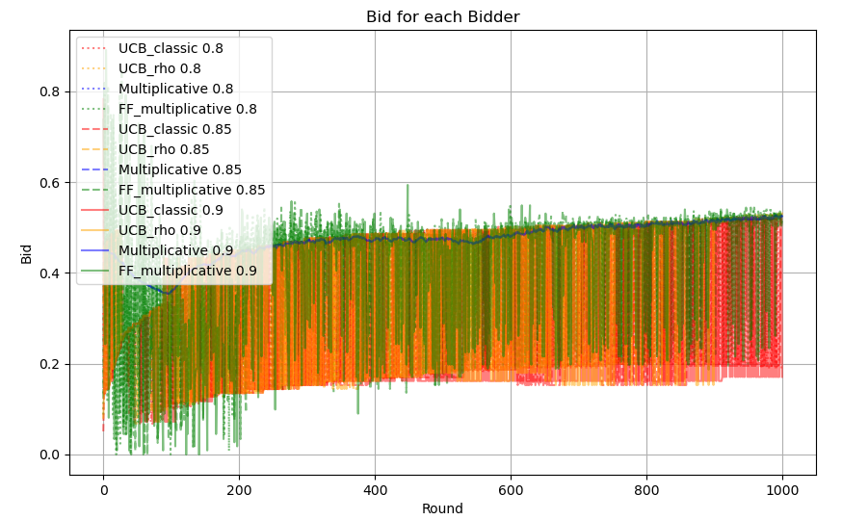
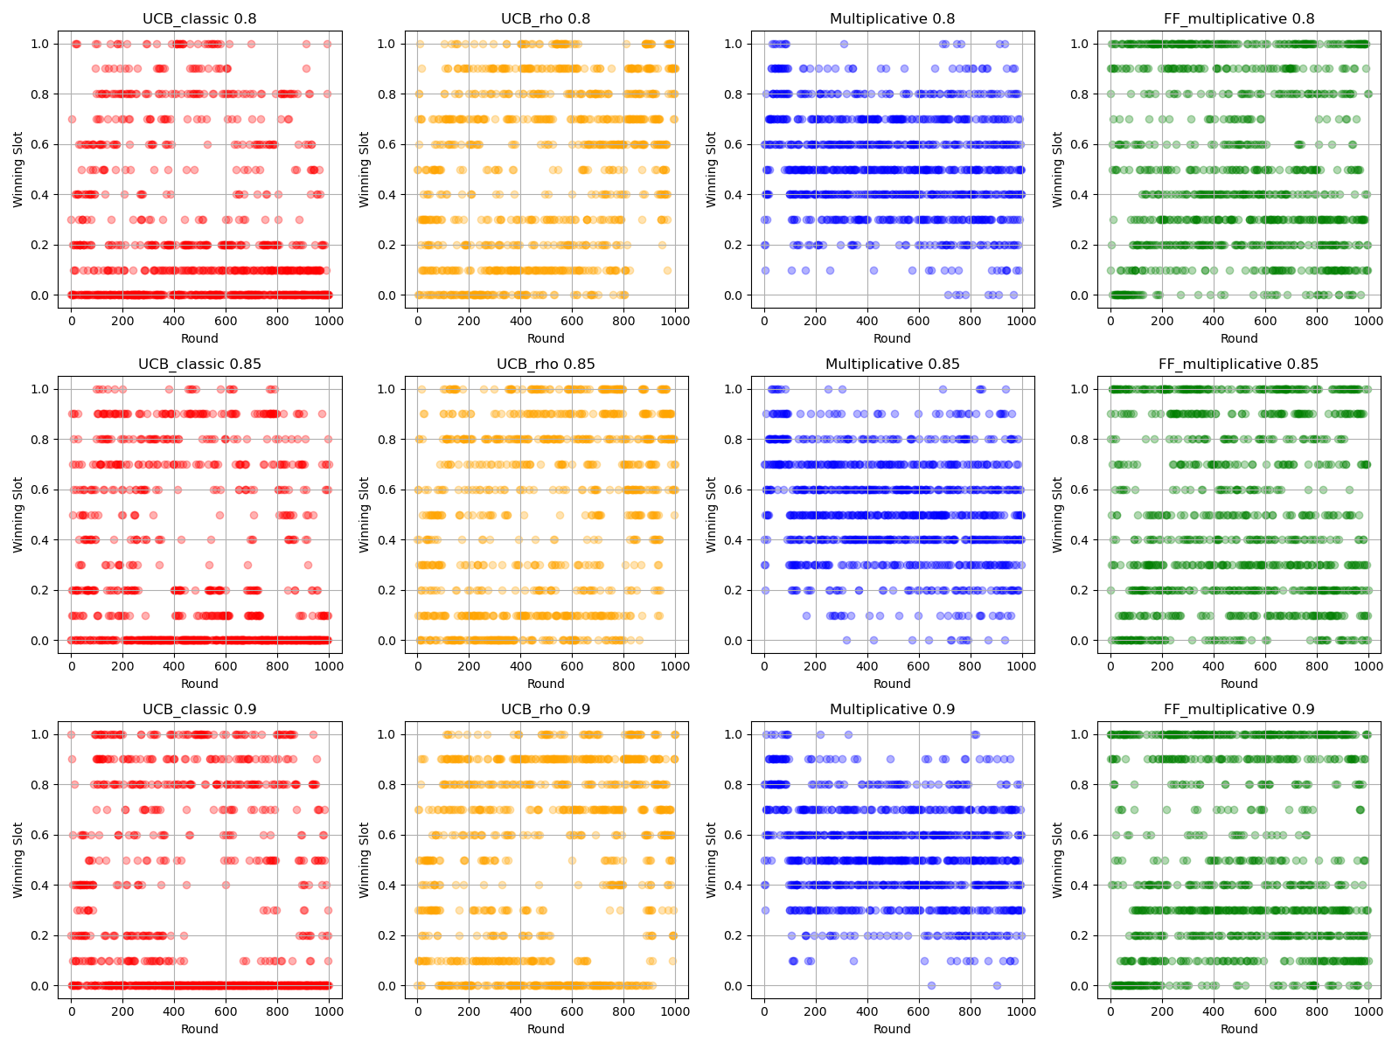
MANY SLOTS CASE
OBSERVATION
Multiplicative algorithm wins middle slots
FF_multiplicative prefers going all or nothing, winning the best slot more often

Slide 23
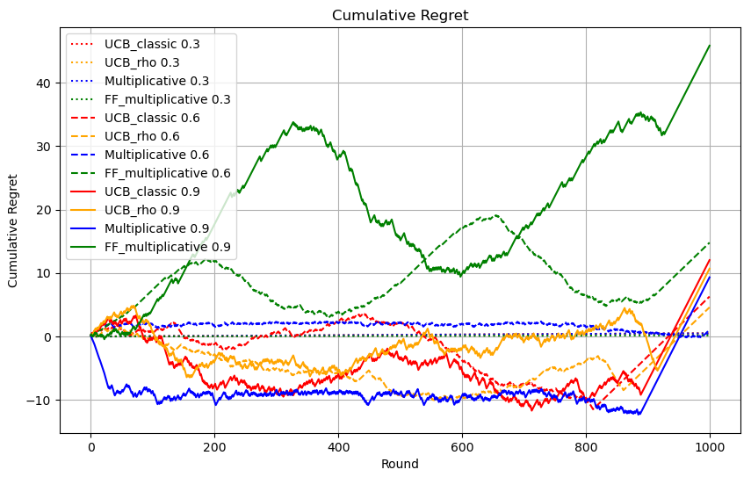
LOW BUDGET - DIFFERENT VALUATION
SETUP
BIDDERS PER TYPE | 3
VALUATIONS | [0.3 0.6 0.9]
NUMBER OF SLOTS | 3
SLOT PROMINENCE | [0.8 0.9 1.0]
BUDGET | 100
OBSERVATION
UCB_like performs better than FF_multiplicative
Our modification to the UCB_like algorithm performs slightly better than the original
Many agents deplete the budget about 100 rounds before the end

Slide 24
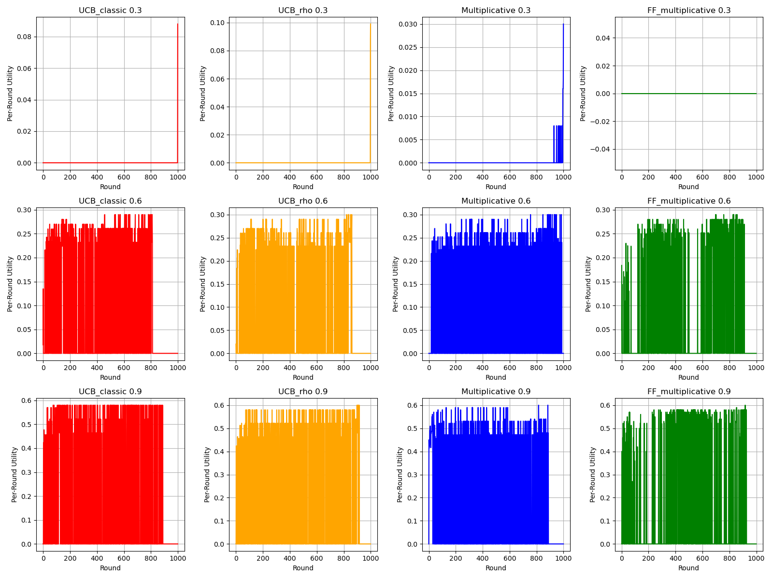
LOW BUDGET - DIFFERENT VALUATION
SETUP
BIDDERS PER TYPE | 3
VALUATIONS | [0.3 0.6 0.9]
NUMBER OF SLOTS | 3
SLOT PROMINENCE | [0.8 0.9 1.0]
BUDGET | 100
OBSERVATION
Bidder with valuation of 0.3 have regret 0 since minimum bid for winning a slot is 0.4
Unclear why FF_multiplicative performs badly

Slide 25
REQUIREMENT 4
FINAL CONSIDERATIONS
Best performing algorithm is:
Multiplicative, despite
FF_multiplicative having better theoretical guarantees
Our version of UCB-like algorithm for expert feedback worked well:
Almost always much better than UCB1
Slightly better in a single case

Slide 26
Thank you
Source code available at this GitHub repository

