Slide 1

ONLINE LEARNING PROJECT
AY: 2023-2024
Professor: Castiglioni Matteo
Teching Assistant: Gianmarco Genalti
Antonio Napolitano;
Davide Remondina;
Stefano Arcaro;
Gabriele Farace;
Sofia Yang;

Slide 2
Requirement 1
BIDDING ENVIRONMENT (COMPETITORS) : Stochastic with uniformely distributed bids
PRICING ENVIRONMENT : Stochastic with demands sampled from a binomial distribution with success probability given by the conversion rate (1-p) and number of trials equal to the number of visits obtained in the bidding interaction
AUCTION TYPE: Second Price (Truthful)
BIDDING AGENTS:
ucb like
primal-dual (multiplicative pacing)
PRICING AGENT: gaussian processes

Slide 3
interaction
bidding environment
(competitors)
COMPANY
pricing
agent
bidding agent
pricing environment
PUBLISHER
auction

Slide 4
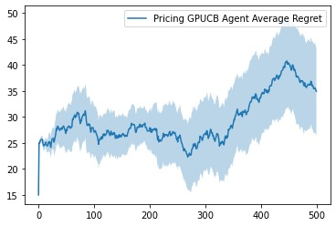
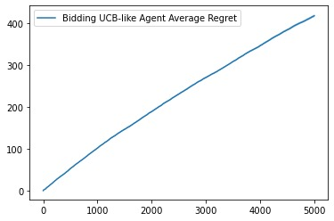
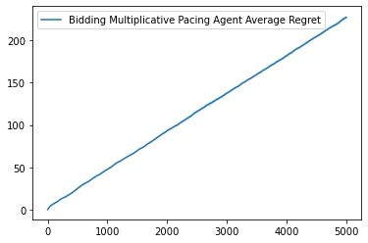
ONLY PRICING
ONLY BIDDING
NUMBER OF INTERACTIONS = 500
NUMBER OF CUSTOMERS = 50
PRODUCT COST = 0.1
NUMBER OF TRIALS = 10
NUMBER OF INTERACTIONS = 5000
BUDGET= 1000
VALUATION = 1
CTRs = [0.8 0.5 0.9 1]
NUMBER OF TRIALS = 10
UCB LIKE
MULTIPLICATIVE PACING

Slide 5
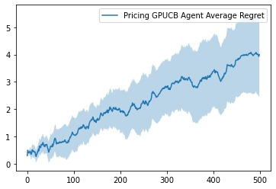
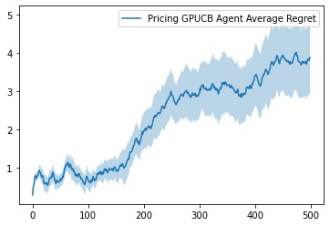
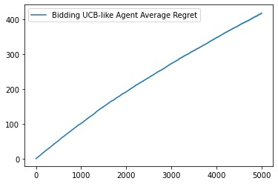
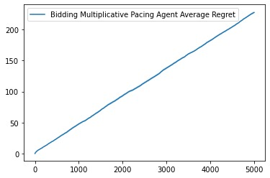
PRICING&BIDDING
UCB-LIKE BIDDER
PRIMAL-DUAL BIDDER

Slide 6
Requirement 2
BIDDING ENVIRONMENT (COMPETITORS) : Adversarial with bids uniformely distributed with the extremes of the interval sampled from a beta distribution for each round
PRICING ENVIRONMENT : Adversarial with demands sampled from a binomial distribution with success probability given by the conversion rate (1- θ*p), where θ is sampled from a beta distribution for each round, and the number of trials is equal to the number of visits obtained in the bidding interaction
AUCTION TYPE: Generalized first-price auction (Non-truthful)
BIDDING AGENTS:
Primal-dual (Multiplicative Pacing)
PRICING AGENT: Discretized prices (EXP3)

Slide 7
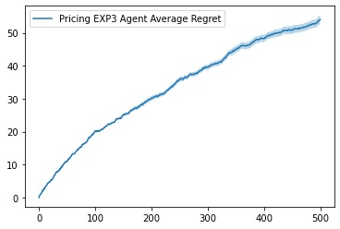
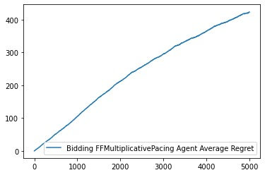
ONLY PRICING
ONLY BIDDING
NUMBER OF INTERACTIONS = 500
NUMBER OF CUSTOMERS = 50
PRODUCT COST = 0.1
NUMBER OF TRIALS = 10
NUMBER OF INTERACTIONS = 5000
BUDGET= 1000
VALUATION = 1
CTRs = [0.8 0.5 0.9 1]
LAMBDAS = [1 0.9]
NUMBER OF TRIALS = 10

Slide 8


PRICING&BIDDING

Slide 9
Requirement 3
Focus on pricing problem
Non-stationary environment (abrupt changes)
Noisy demand curve changes each interval
GOAL
Pricing strategy for discretized set of prices p in [0, 1] using:
Sliding Window
CUSUM

Slide 10
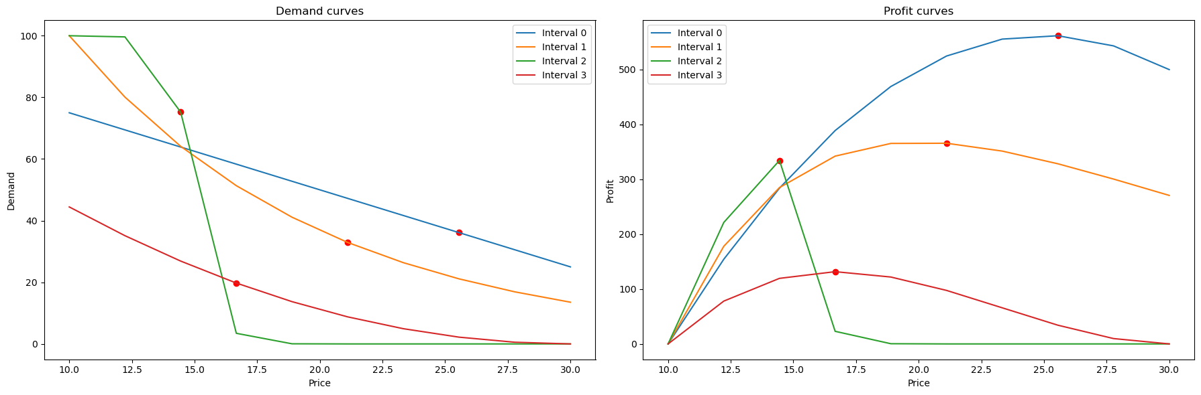
setup
Definition of demand curves for each interval (add formulas)
Derivation of profit curves

Slide 11
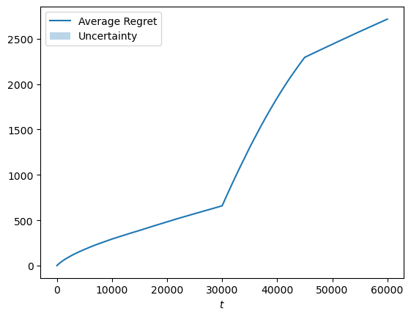
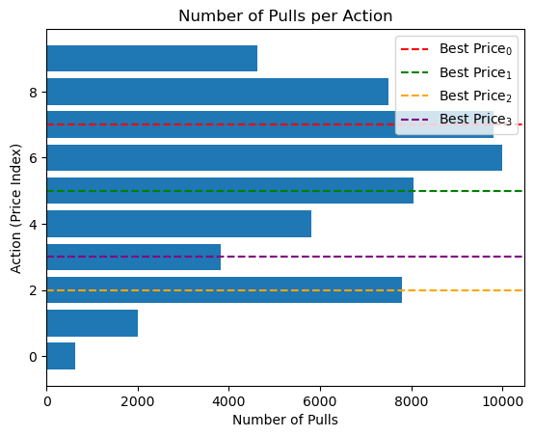
Non-stationarity check
Tested UCB1 on the environment
Results indicate presence of non-stationarity

Slide 12
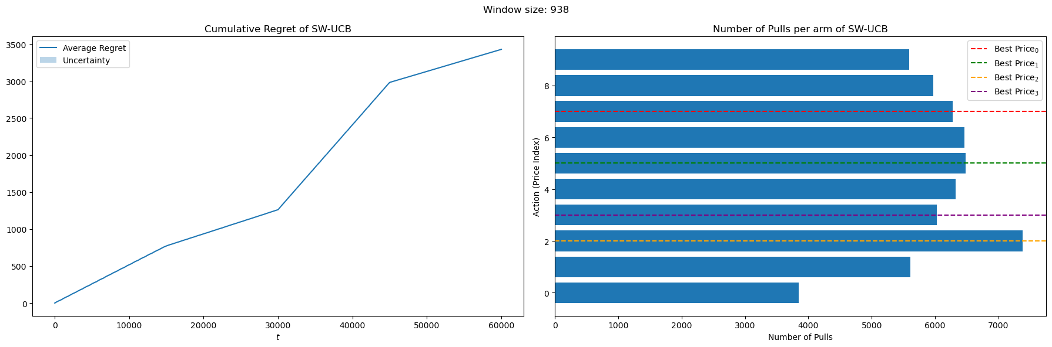
Sliding window
Algorithm: Sliding Window UCB
Initial trials failed
Decided to test different window sizes

Slide 13
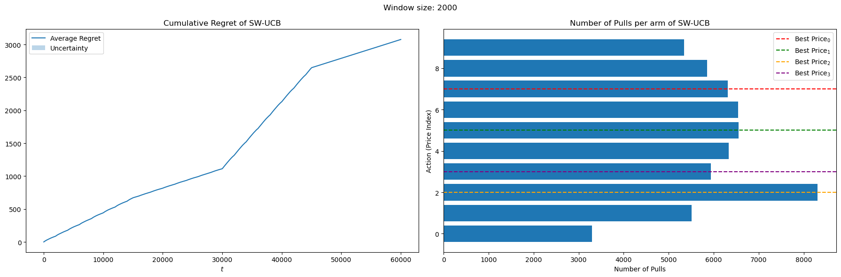
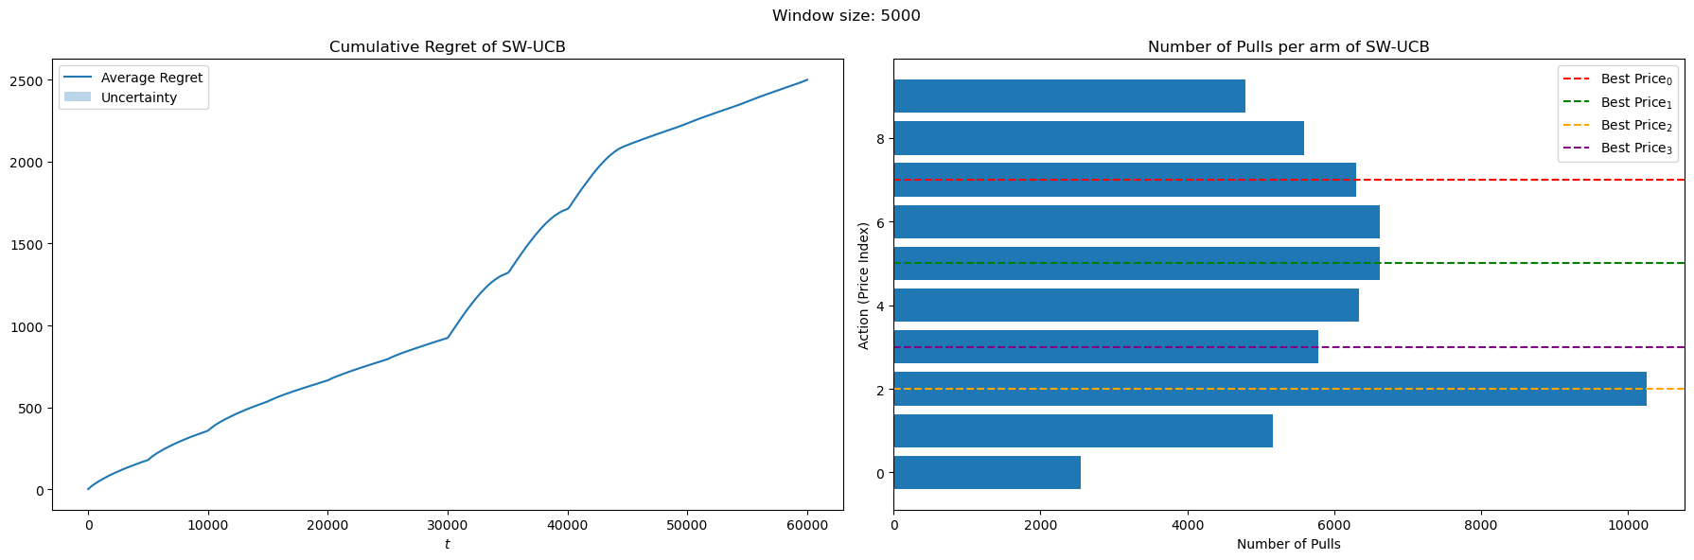

Slide 14
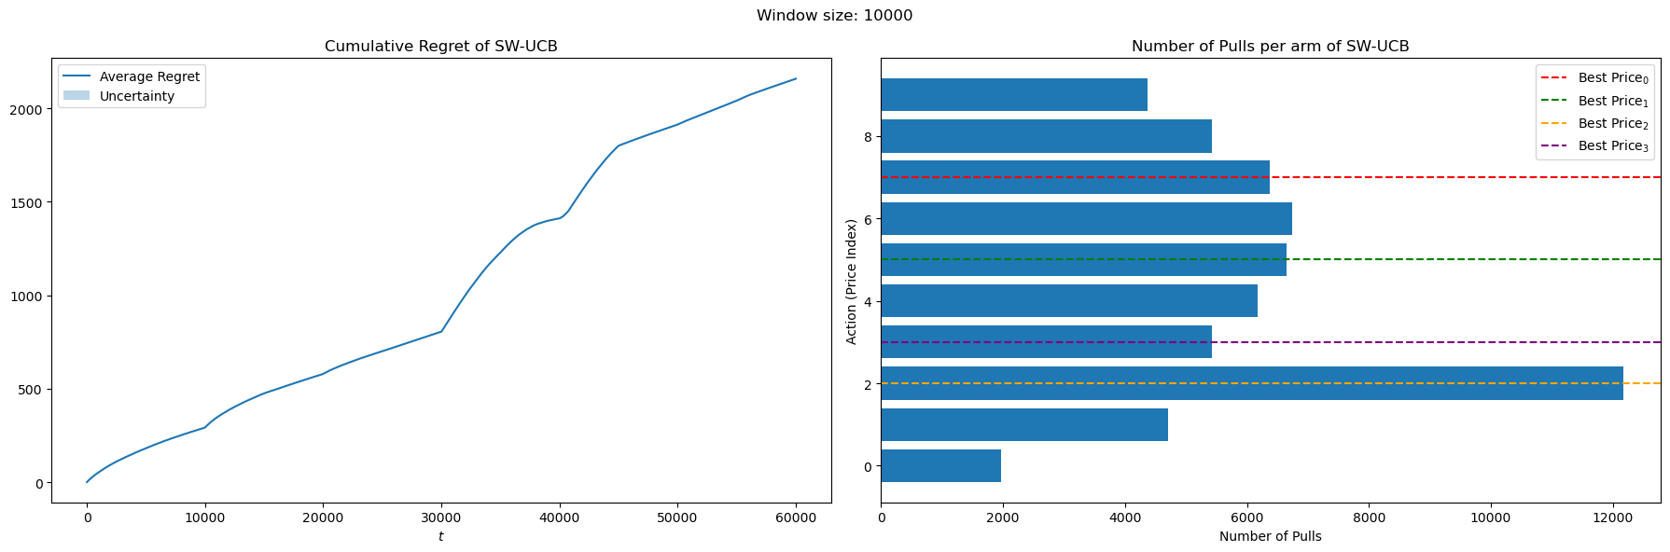
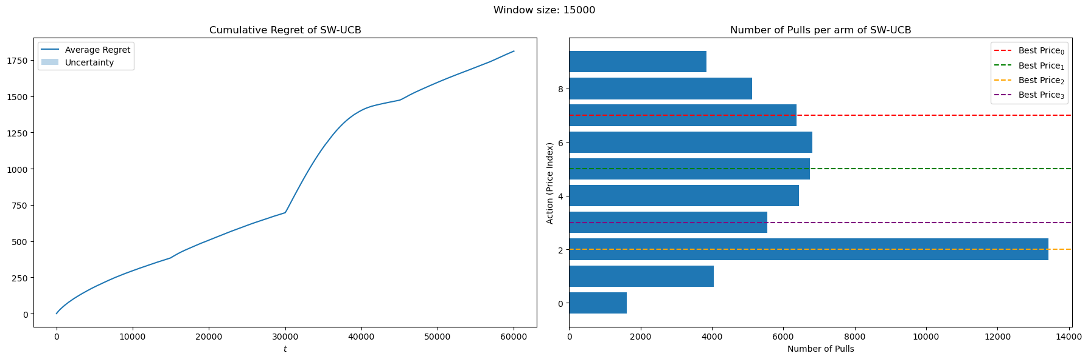

Slide 15
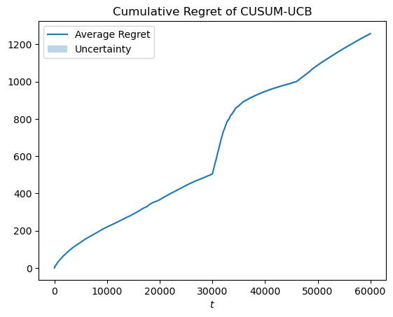
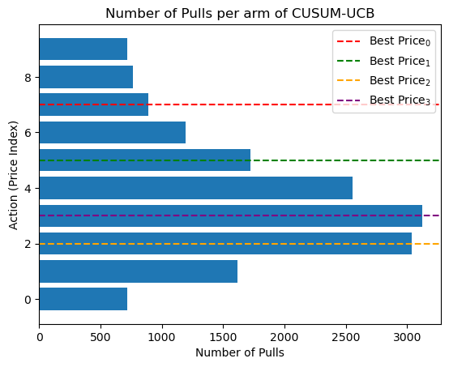
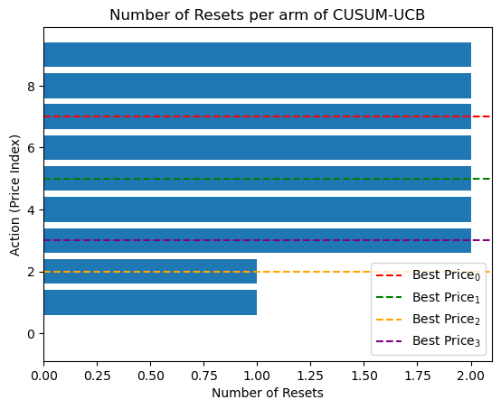
Change detection
Algorithm: CUSUM UCB
Overall, best performing method

Slide 16
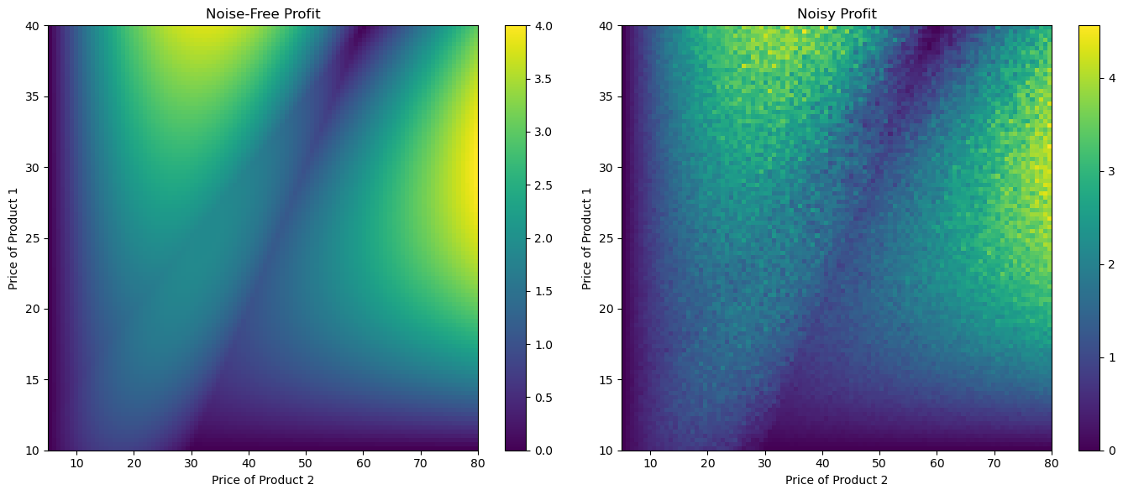
Bonus point
Two-item stochastic pricing environment
Noisy demand curve D(p1, p2) + eta
GOAL
Build a regret minimizer for the continuous action set [0,1]^2 using 2D Gaussian Processes

Slide 17
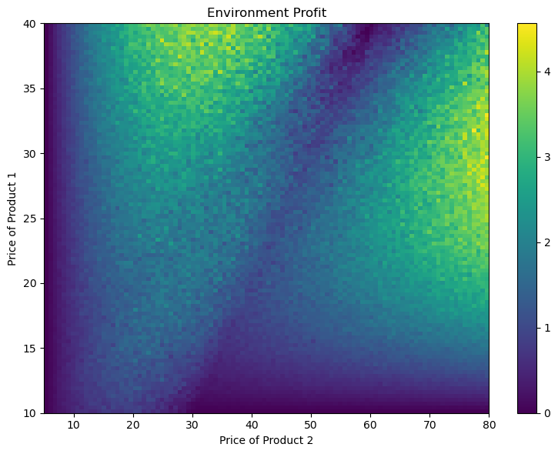
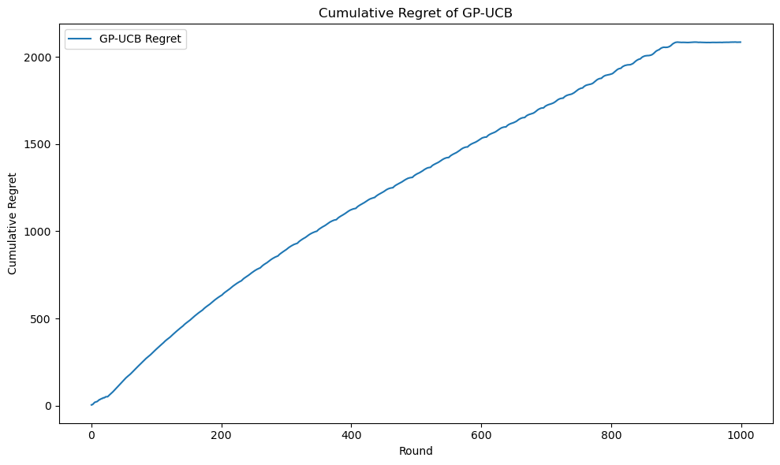
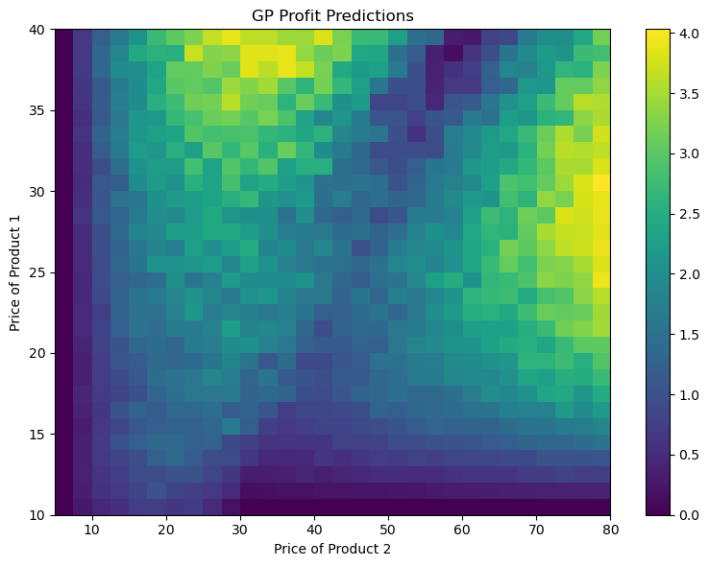
results
Algorithm: GP UCB
Great results

Slide 18
Requirement 4
BIDDING ENVIRONMENT: Adversarial with full feedback
AUCTION TYPE: Generalized first-price auction (Non-truthful)
BIDDING AGENTS:
Primal-dual for truthful (Multiplicative Pacing)
Primal-dual for non-truthful (Multiplicative Pacing with Hedge)
UCB-like (UCB1)
UCB-like Updating rho (our take on the algorithm)
GOAL: Compare the performances of different algorithms under various setups

Slide 19
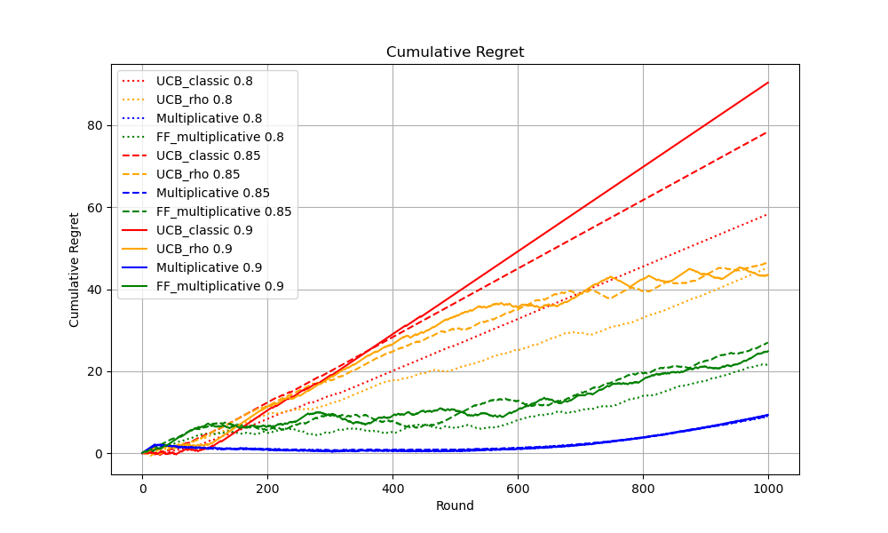
STANDARD CASE
SETUP:
3 Bidders per type (with valuation 0.80 0.85 0.90)
3 Slots (with prominance 0.8 0.9 1.0)
Budget: B = 250
OBSERVATION:
UCB_classic has linear regret
Multiplicative pacing has the smoothest curve

Slide 20
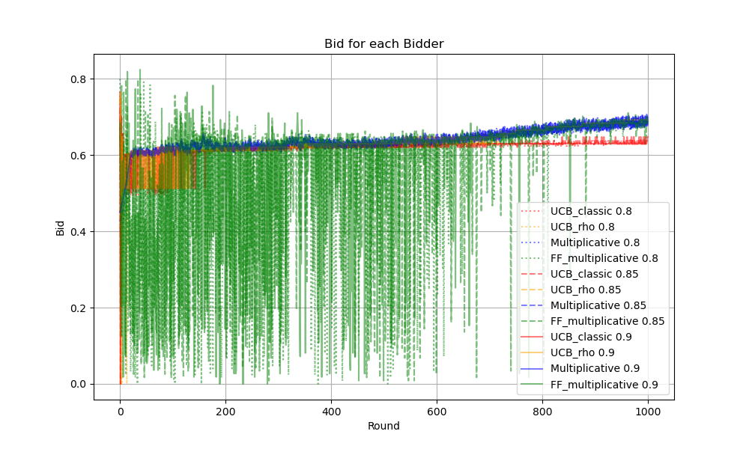
STANDARD CASE
SETUP:
3 Bidders per type (with valuation 0.80 0.85 0.90)
3 Slots (with prominance 0.8 0.9 1.0)
Budget: B = 250
OBSERVATION:
Bids increase over rounds
UCB_classic do not keep up with their bids, they stop winning slots after round 500
FF_multiplicative need time to be consistent with bids

Slide 21
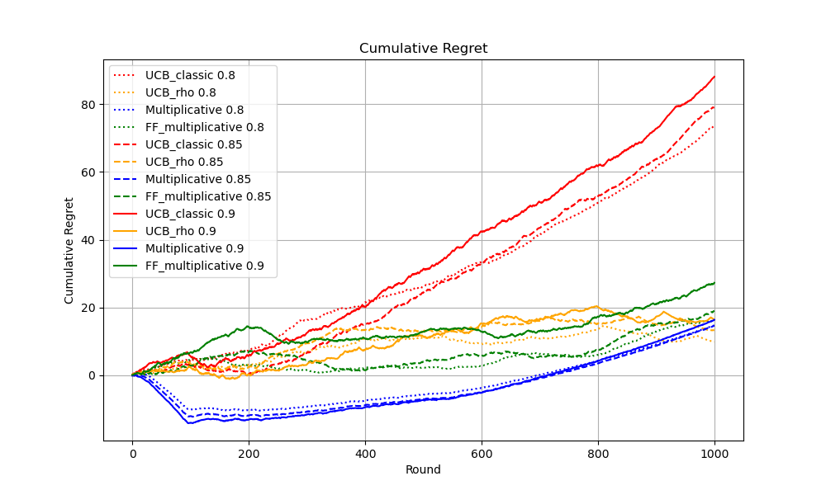
MaNY SLOTS CASE
SETUP:
3 Bidders per type (with valuation 0.80 0.85 0.90)
10 Slots (with prominance from 0.1 to 1.0)
Budget: B = 250
OBSERVATION:
All algorithms have more or less the same regret except for standard UCB_like algorithm

Slide 22
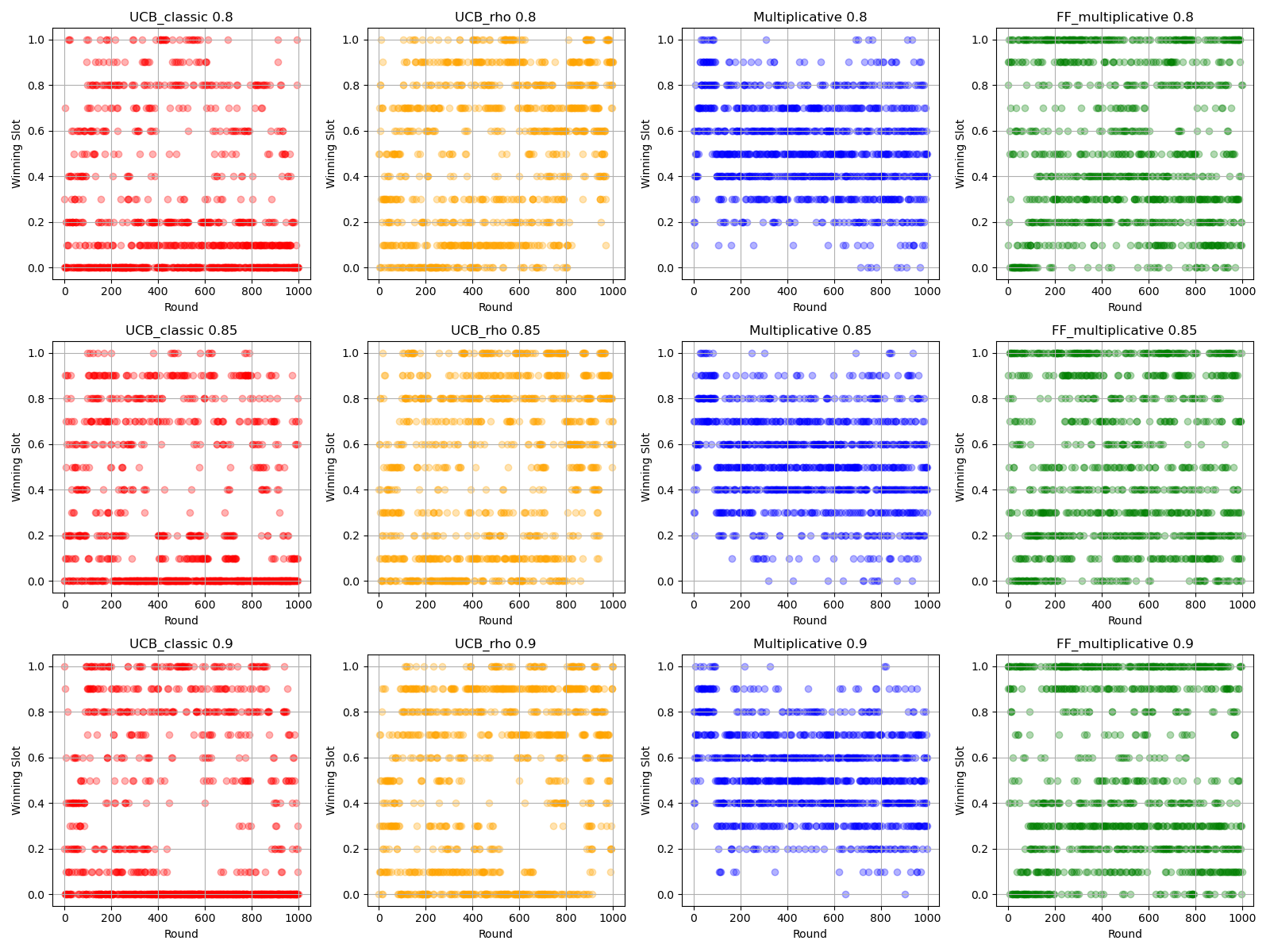
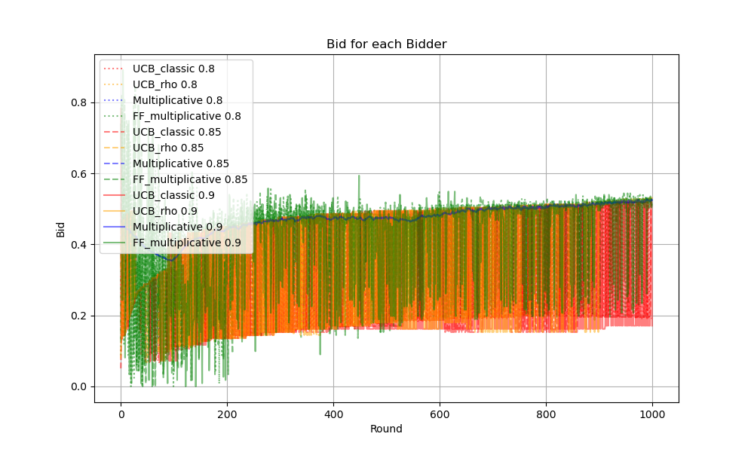
Many SLOTS CASE
OBSERVATION:
Multiplicative algorithm wins middle slots, while FF_multiplicative prefer to goes all or nothing, winning best slot more often

Slide 23
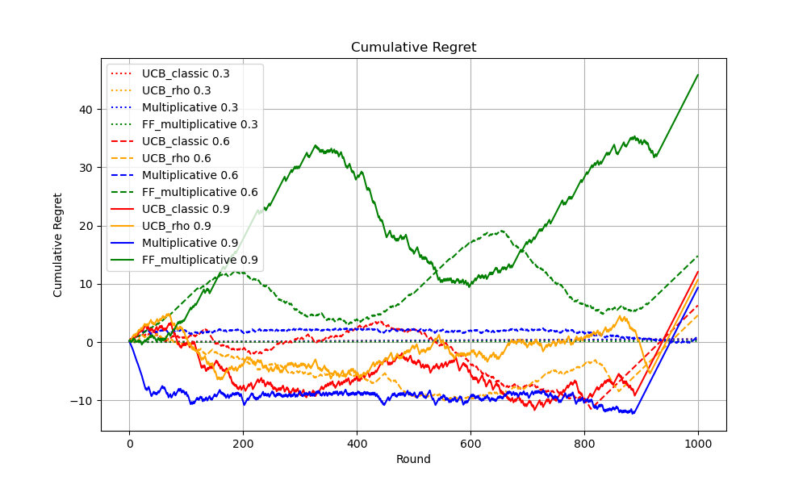
Low budget and different valuation
SETUP:
3 Bidders per type (with valuation 0.3 0.6 0.9)
10 Slots (with prominance 0.8 0.9 1.0)
Budget: B = 100
OBSERVATION:
UCB_like perform better than FF_multiplicative
Our modification to the UCB_like algorithm still perform slightly better
Many agents deplete the budget about 100 rounds before the end

Slide 24
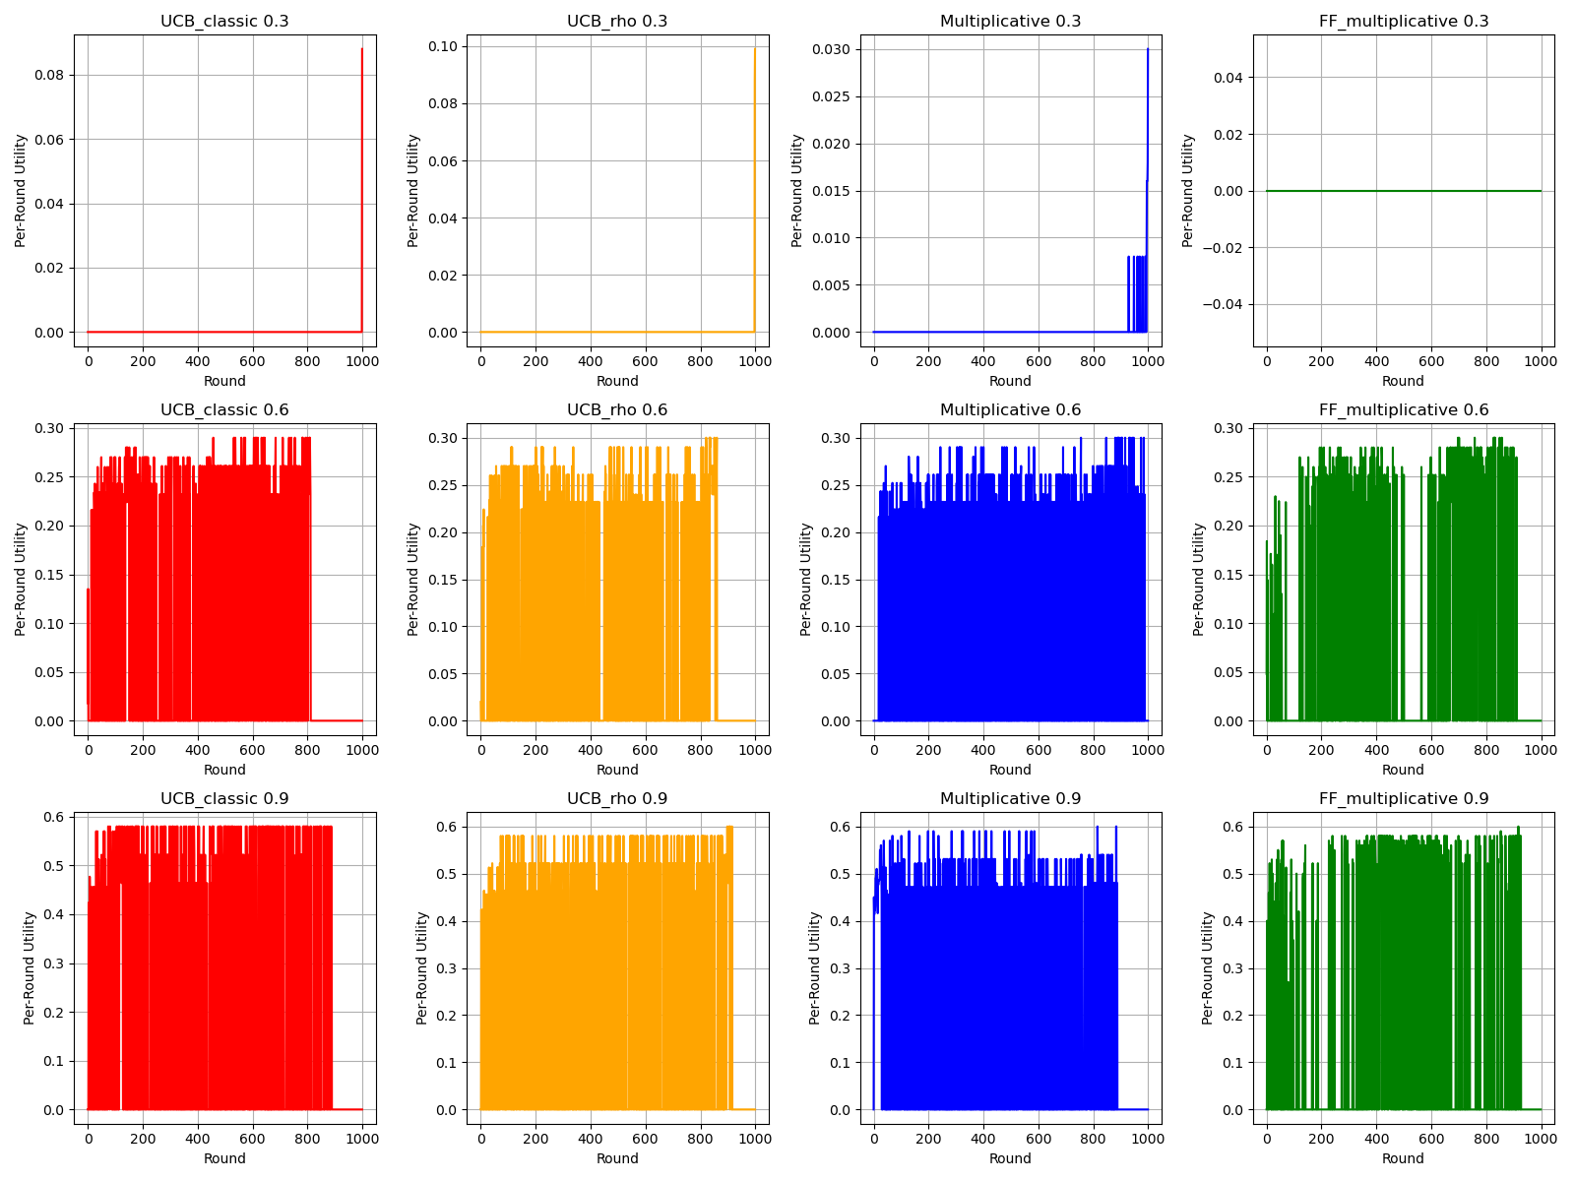
Low budget and different valuation
SETUP:
3 Bidders per type (with valuation 0.3 0.6 0.9)
10 Slots (with prominance 0.8 0.9 1.0)
Budget: B = 100
OBSERVATION:
Bidder with valuation of 0.3 have regret 0 because to minimum bid for winning a slot is 0.4
It's unclear why FF_multiplicative perform this bad

