Slide 1


DigiServices
Gabriele Castaldi
Samuel Santos Araujo S
People’s Trust through Technology
4.Oct.2021

Slide 2
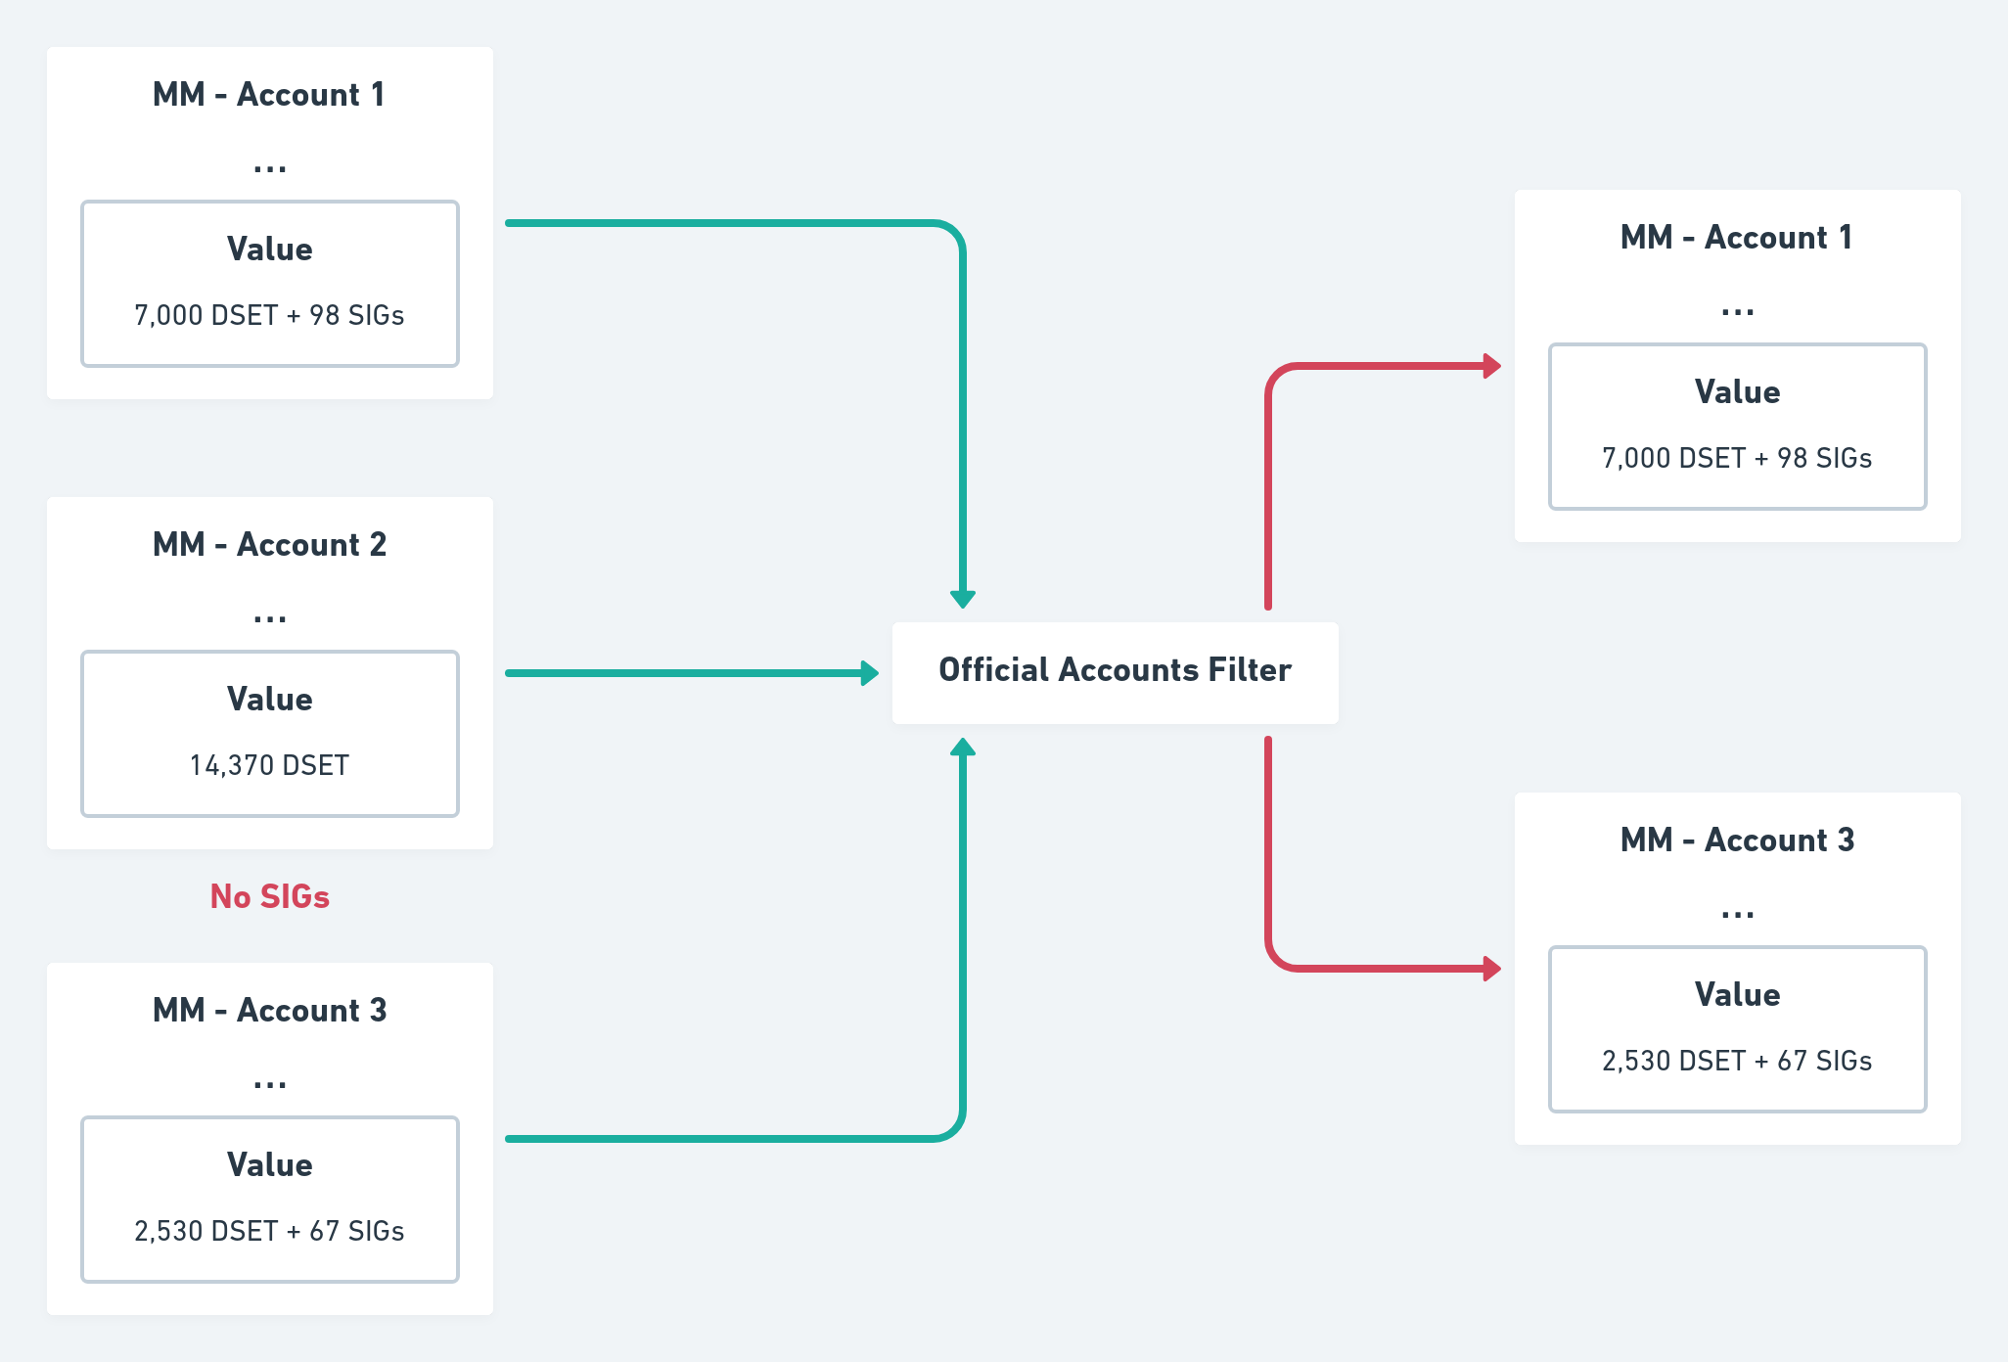
Accounts Acknowledgment
Unique sig: public key hash + validator hash

Slide 3
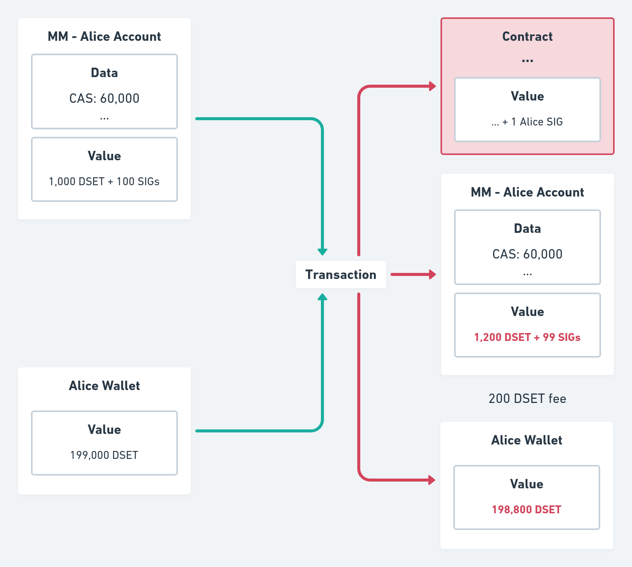
Account Creation - UTxO model
Membership Market (MM) UTxO uses a minting policy as a script validator that handles service offers and requests

Slide 4
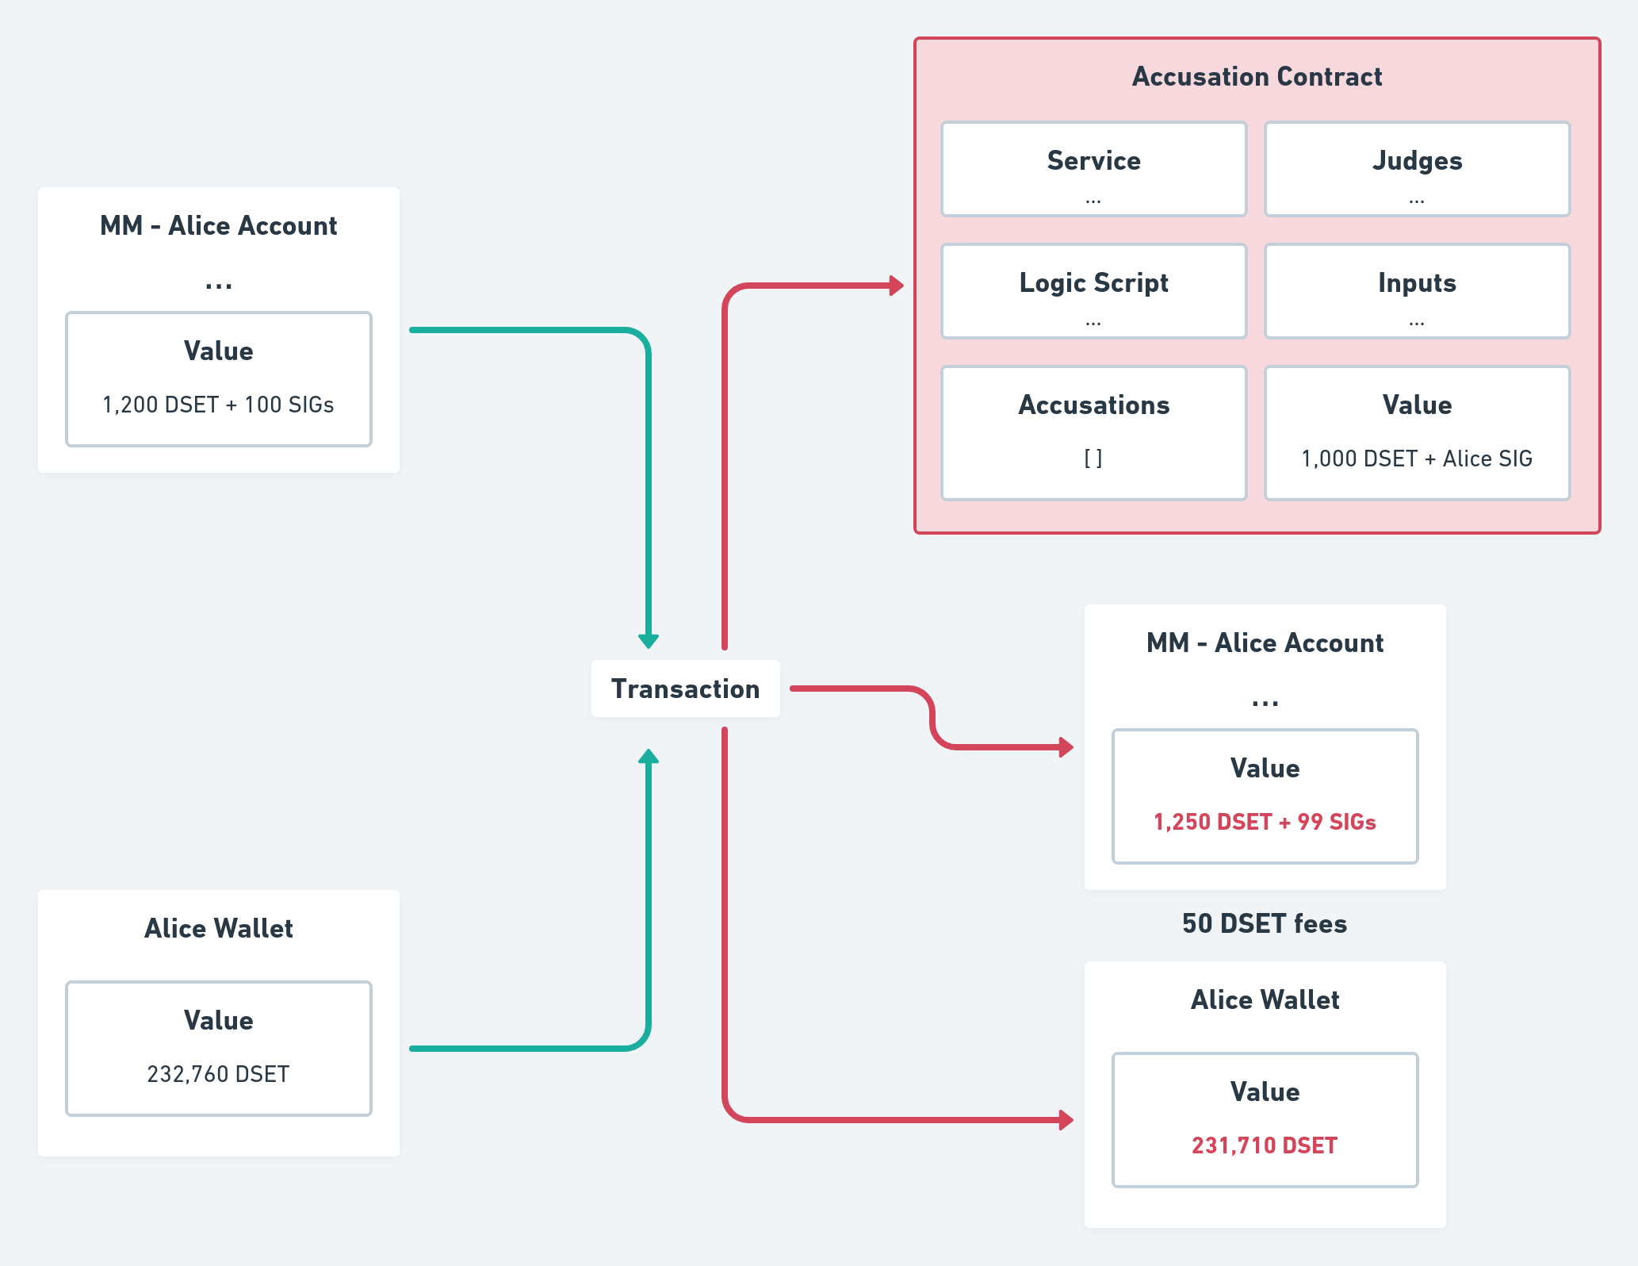
Contract Creation - EUTxO model
The contract validator can receive four redeemers: Open Integer, Close, Sign and Accuse PubKeyHash

Slide 5
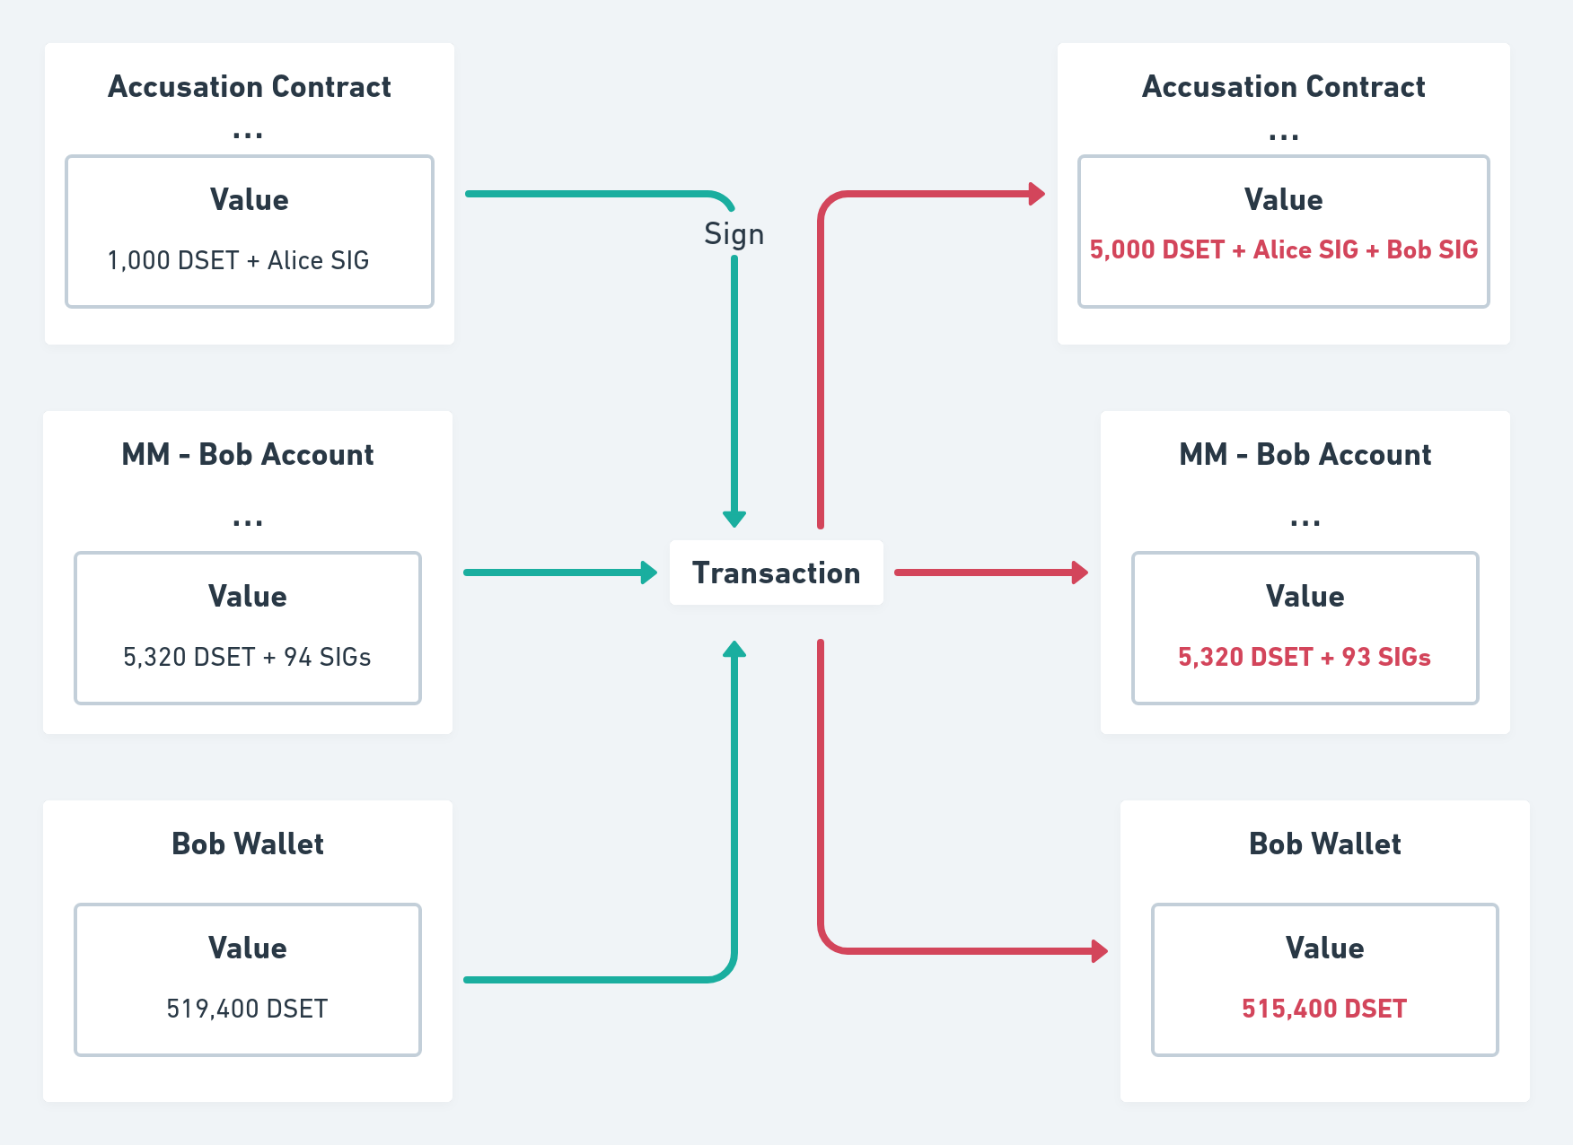
Service Tx - EUTxO model
Bob signs for a service provided by Alice: an accusation contract event is called

Slide 6
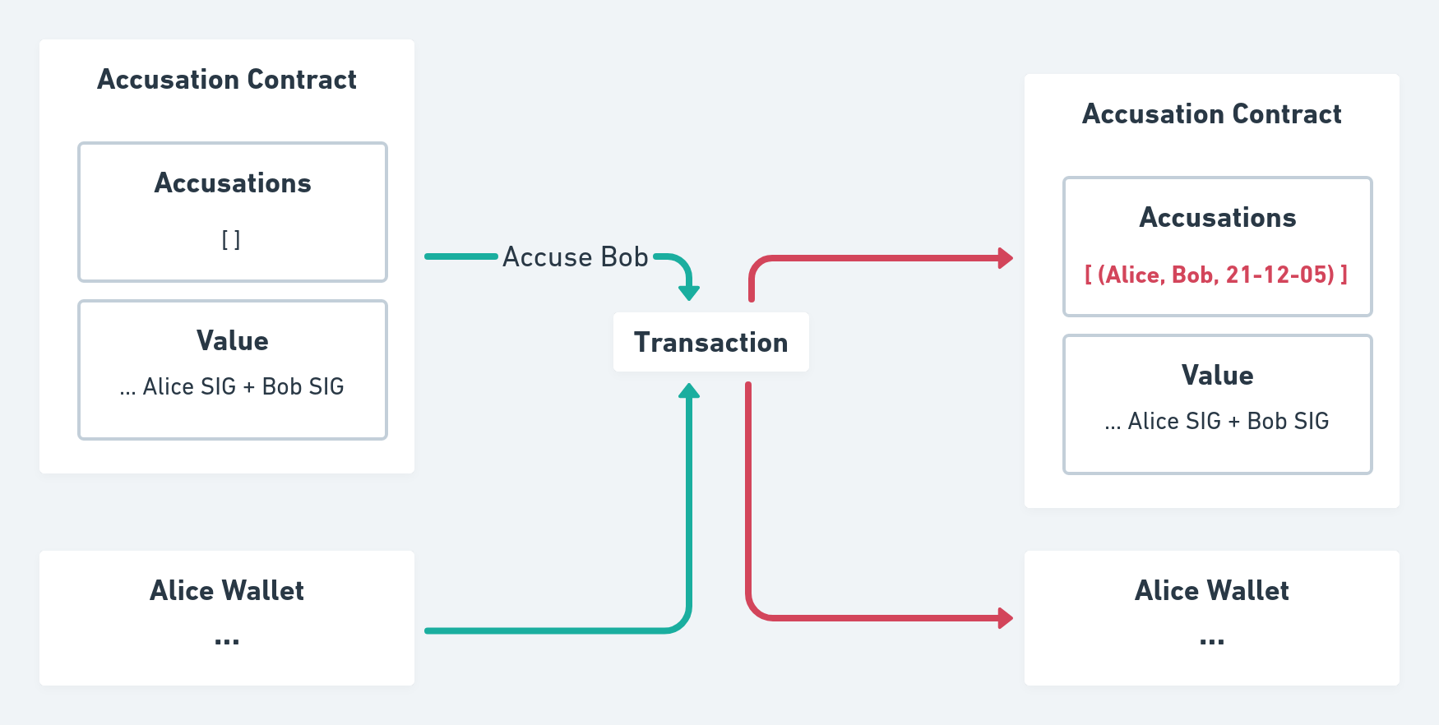
Accusation Contract
Any user who signed the contract can trigger the Accusation contract by consuming the signed contract UTxO using the accuse redeemer

Slide 7
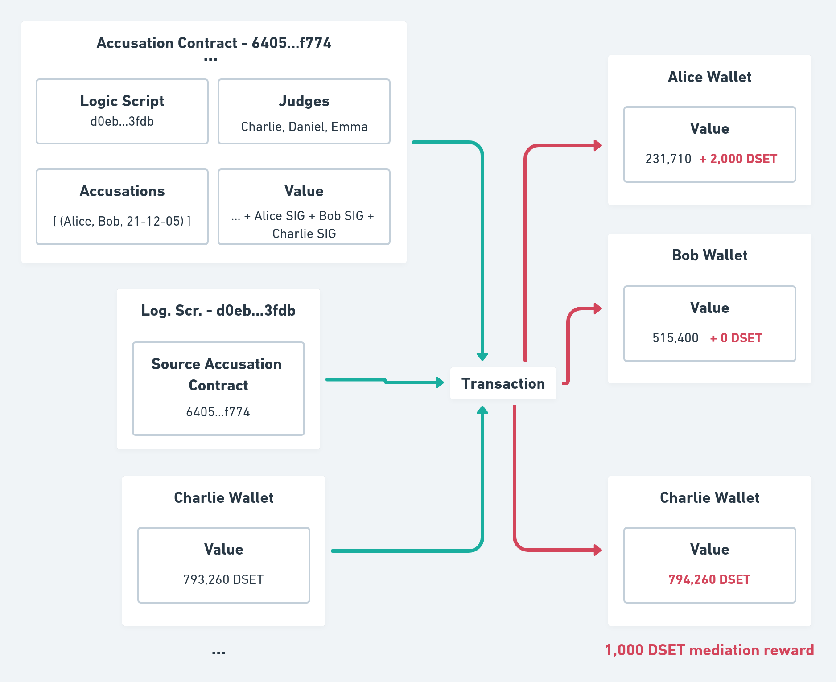
Accusation Contract Logic
Bob being declared guilty and losing 2,000 DSET trust tokens deposited

Slide 8
Rewards & Penalties
DigiServices strives for trustworthy platform excellence.
For this purpose strict policies are implemented to support just behavior and strongly penalize failures in fulfilling set agreements
CAS: Credit Assessment Score
Rewards
Service Deals
Conflict Resolutions
Reviews
Penalties

Slide 9
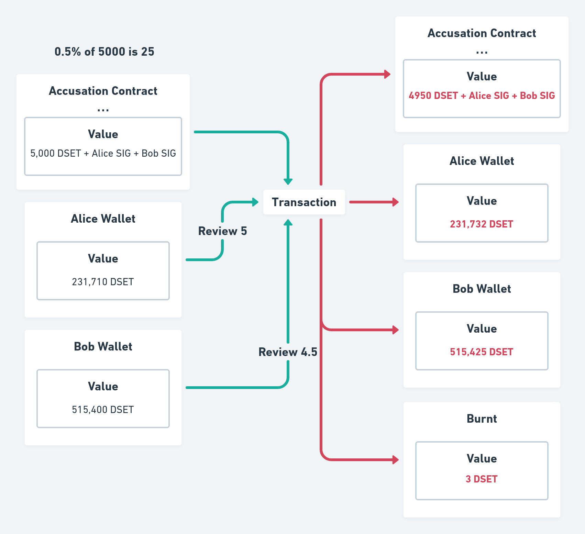
DSET Credit Reviews EUTxO model
Alice reviews Bob with 5 stars, Bob receives 25 DSET 0.5% of service value. 3 DSET tokens are burnt.

Slide 10
Main aux functions under development
Membership registration
Entrance and Tx fees collection
Judges registration
Shame Token
Rewards distribution logic
CAS rewards and penalties

