Slide 1
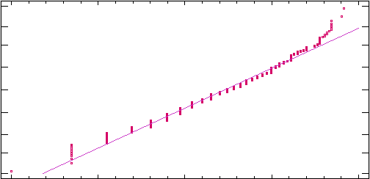
Normal Probabilistic Plot Treated
99,9
n:494
99
Media:2,45163
Sigma:0,675393
95
W:0,97915
P:0,0000
80
Percentage
50
20
5
1
0,1
0
1
2
3
4
Logarithm of YearsCode

