Slide 1
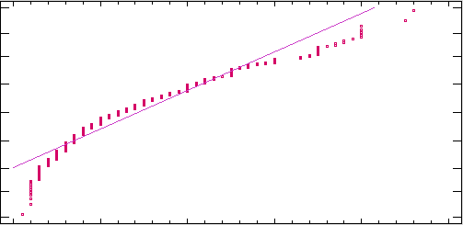
Normal Probabilistic Plot
99,9
n:494
99
Media:14,2389
Sigma:8,80874
95
W:0,923803
P:0,0000
80
Percentage
50
20
5
1
0,1
0
10
20
30
40
50
YearsCode

