Slide 1
MACHINE LEARNING
UNSUPERVISED ANALYSIS
ON VAX ANOMALIES
VAX BREAKDOWN
A CLUSTERING ANALYSIS
GROUP 9
FRANCESCO BORRI
GABRIELE SARTOR
MATTEO CANALE
FEDERICO POME’
MATTEO GATTO

Slide 2
DATA PIPELINE
Exploratory Analysis
Pandas Dataset Profiling
Variables Exploration
Feature Engineering
Data Dropping, Cleaning & Splitting
Feature Extraction from Unstructured Data
Clustering Analysis
Approach & K-Means Clustering
Results Analysis & Interpretation
Symptoms Topic Modeling
Text Analysis & WordCloud
LDA Topic Modeling for “Symptoms Text”

Slide 3
DATA PROFILING
DATASET: 27955 US VAERS reports for adverse events concerning the administration of the COVID-19 VACCINE
HOSPITAL
AGE_YRS
AVERAGE AGE: 52 Years Old
L_THREAT
NUMDAYS
48 VARIABLES including ALLERGIES, the MEDICAL HISTORY of the patient, SYMPTOMS emerging after the vaccine, LIFE THREATENING illnesses.
27%
71%

Slide 4
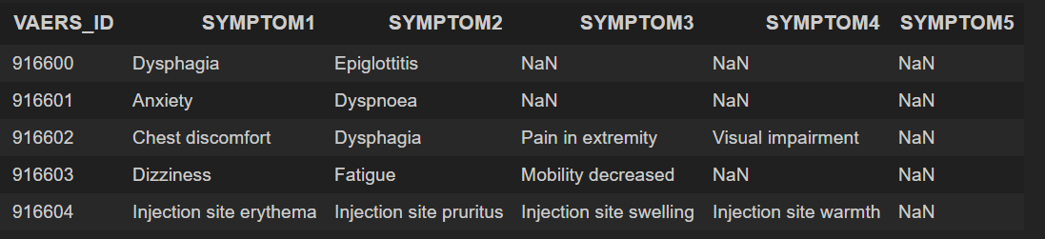
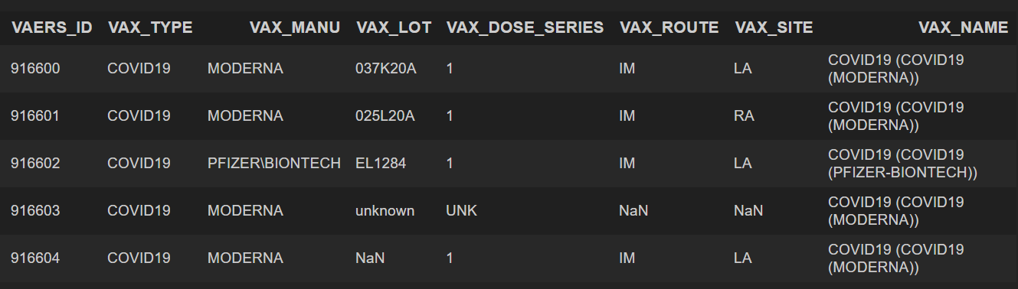
DATASET JOIN
2021VAERSSYMPTOMS.csv
We decided to join the 2021VAERSDATA dataframe with 2021VAERSSYMPTOMS and 2021VAERSVAX.
The goal was to obtain a GLOBAL DATAFRAME with unique records representing each one and only one distinct report.
2021VAERSVAX.csv contains information regarding every single vaccination. DUPLICATE IDs due to multiple vaccinations were transformed so to retain the VACCINATION TYPE, MANUFACTURER NAME and their COUNT.
2021VAERSVAX.csv
2021VAERSSYMPTOMS.csv contains terms regarding the symptoms encoded with the MedDRA DICTIONARY. Duplicates in VAERS_ID are present where, for a specific report. We obtained a UNIQUE column of KEYS that we will use to join the three dbs.

Slide 5
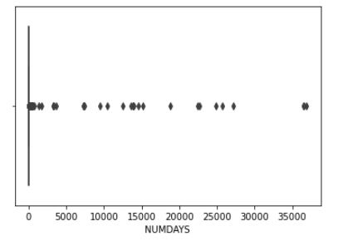
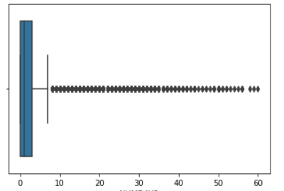
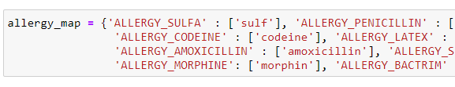
EDA & Feature Engineering
Null values
Outlier detection
Text cleaning
Feature extraction
Column selection
Filled with MEDIAN for numerical columns
Filled with FALSE for Boolean column
NUMDAYS column has 78 records with values > 2 months which have been DROPPED
TEXT COLUMNS have been cleaned and normalized and most common TERMS identified
For each common TERM in text columns, we created a BOOLEAN FEATURE and MAPPED unstructured text to bools
Only well formatted NUMERICAL and BOOLEAN columns have been selected for the clustering stage

Slide 6
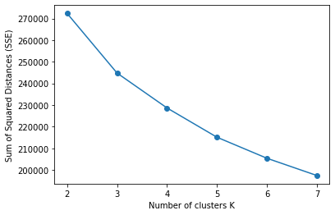
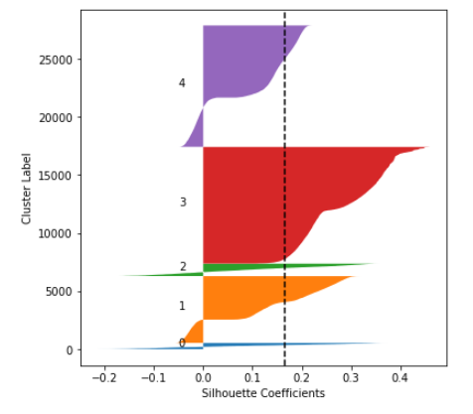
CLUSTERING
Our goal was to obtain well defined MACRO CLUSTERS with the aim to extract useful insights and HIDDEN PATTERNS
SCALING
K-MEANS
We scaled our numerical features with the STANDARD SCALER
We evaluated the SILHOUETTE SCORES obtained with several initial parameters to find the OPTIMUM
Without scaling the algorithm wrongly creates clusters based only on AGE.
The optimum K CLUSTERS are 5

Slide 7
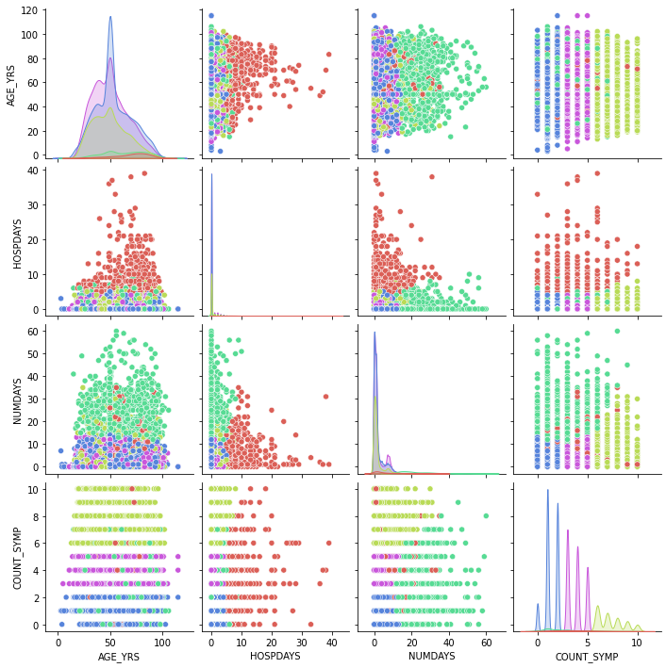
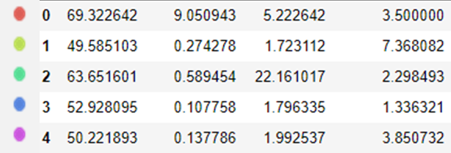
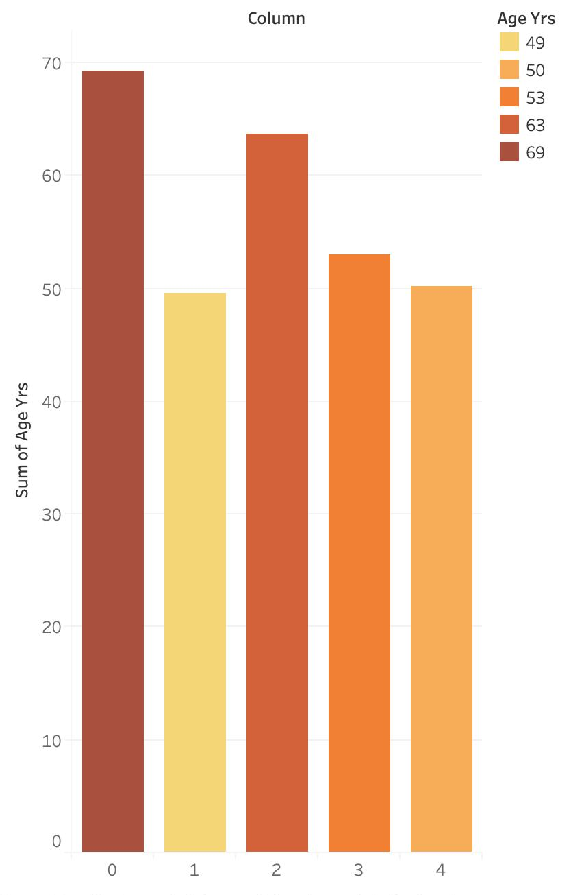
PAIRPLOT NUMERICAL VALUES
AGE
HOSPDAYS
NUMDAYS
COUNT_SYM

Slide 8
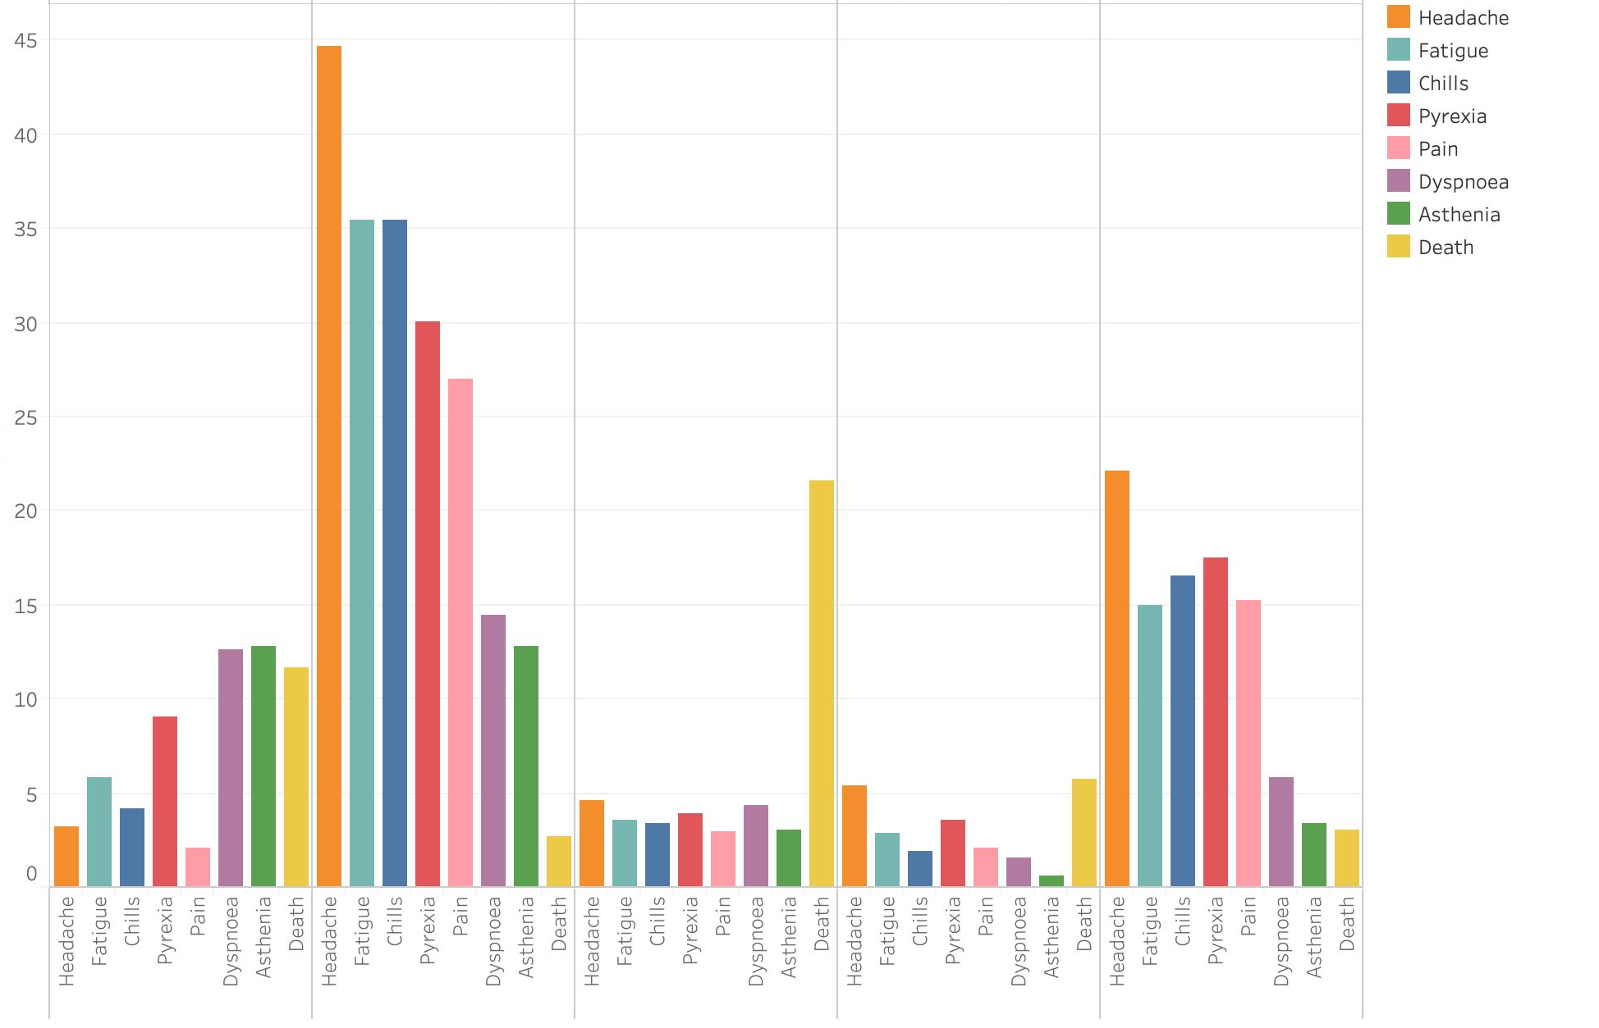
SYMPTOM CLUSTERS
To visually inspect our clusters, we selected SEVEN SYMPTOMS.
For every cluster we plotted the PERCENTAGES of PATIENTS with that specific symptom in the SEGMENT.​
Value %

Slide 9
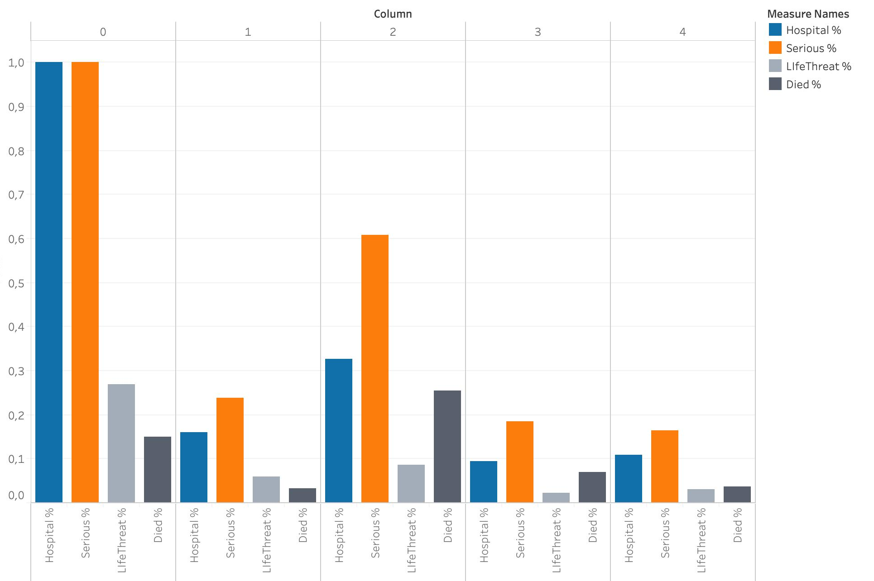
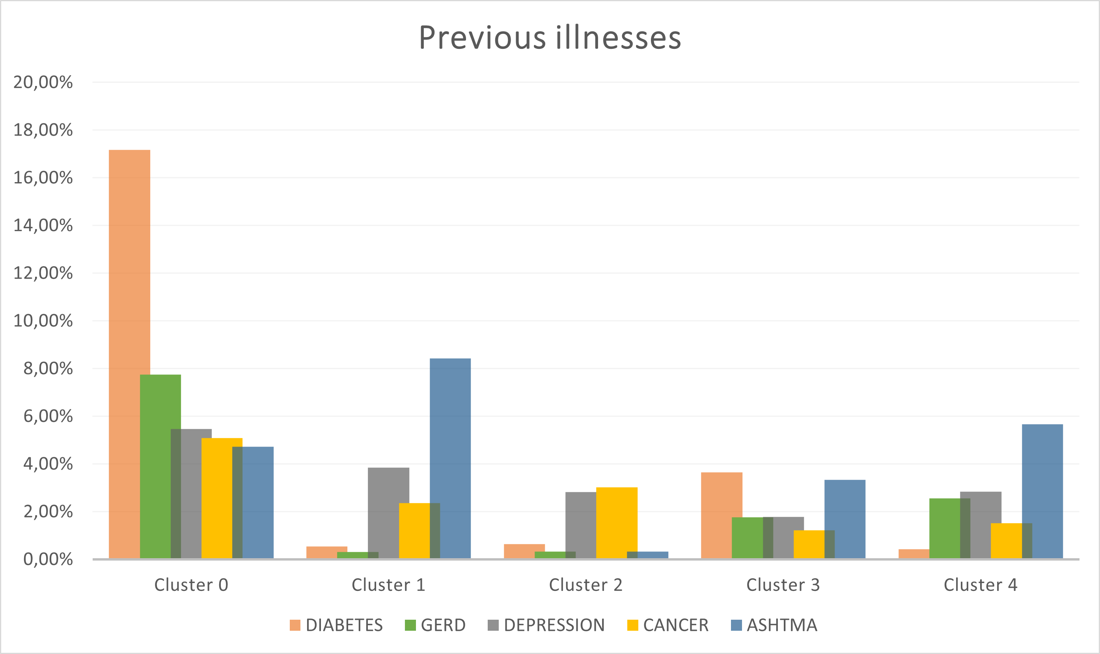
OUTCOME AND HISTORY CLUSTERS
Same visual concepts applied with the SEVERITY of the CASES and the PREVIOUS ILLNESSES of the patients

Slide 10
RESULT ANALYSIS
Cluster 0
Cluster 1
Cluster 2
Cluster 3
Cluster 4
THE WEAKS
COMMON
DEATHFUL
SPREAD SYMPTOMS
SLIGHT BUT FREQUENT
HIGHEST AGE
High number of deaths
Average hospitalization of 9 days
Patients with presence of previous diseases
MEN MAJORITY
Common and FREQUENT SYMPTOMS
Low seriousness
LOWEST MORTALITY
Strong MAJORITY of WOMEN
HIGHEST MORTALITY
Strong presence of covid infections
High average age
SERIOUS SYMPTOMS like facial paralysis
Longest time between vaccination date and onset date
Late seeking of medical assistance
Cluster with many different HETEROGENEOUS SYMPTOMS
Macro patterns are not identifiable
WEAK SYMPTOMS like Headache, fever and chills that are pretty frequent.
This cluster is in the middle between cluster 1 and cluster 3.

Slide 11
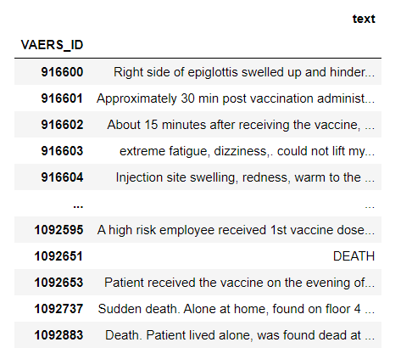
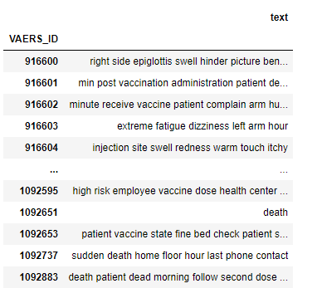
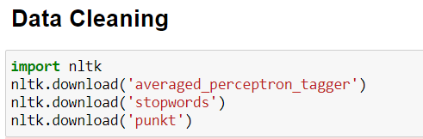
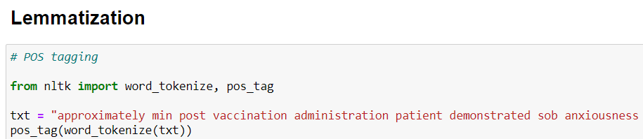
UNSTRUCTURED DATA
Pre Cleaning and Lemmatization
Post Cleaning and Lemmatization
The Symptom Text Column comes in unstructured NATURAL LANGUAGE so we CLEANED the data in Python and LEMMATIZED the text to visualize it properly
LOWERCASE:
PUNCTUATION AND NUMBERS:
STOPWORDS:
LEMMATIZING:
NOUNS AND ADJECTIVES:

Slide 12
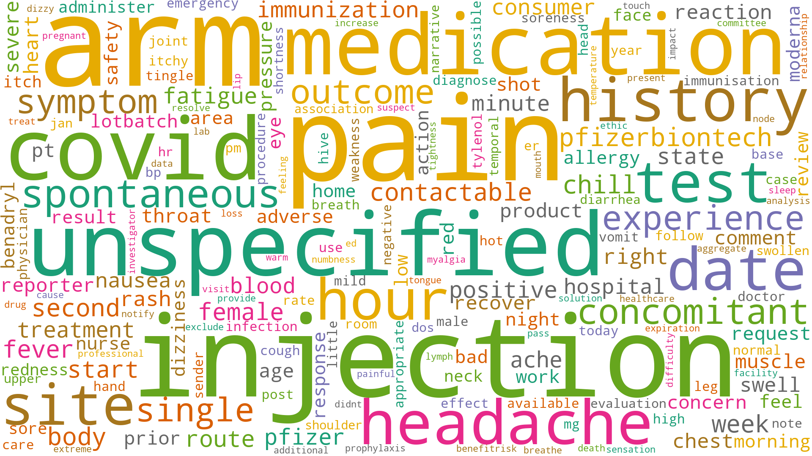

Slide 13
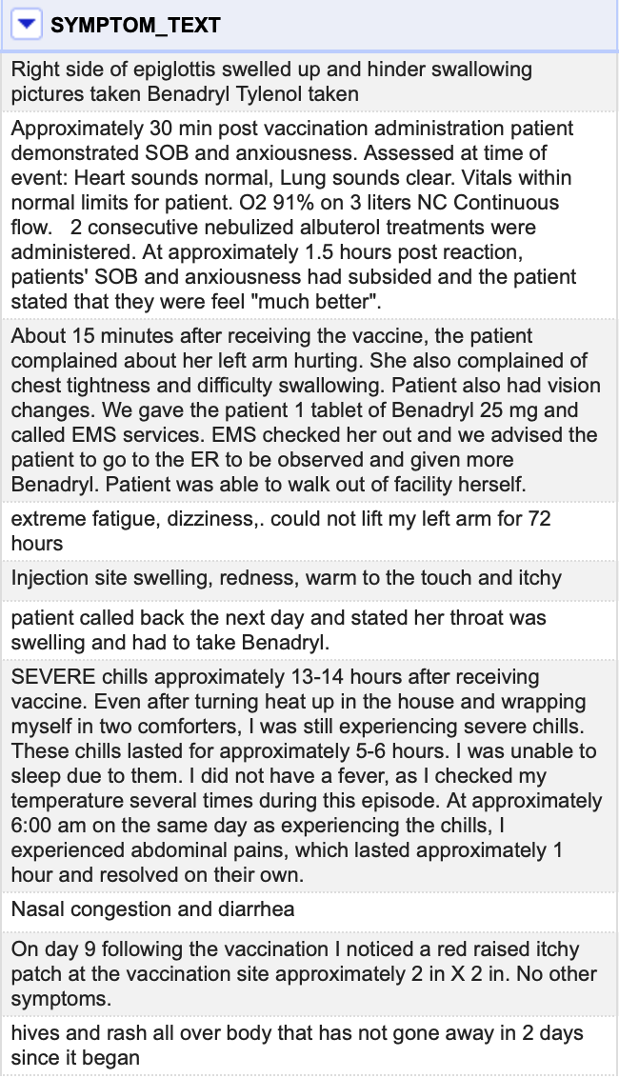

WHY TOPIC MODELING?
The SYMPTOM TEXT COLUMN reports textual description of patients condition in the moment they asked for medical assistance
The unstructured nature of the data required an unsupervised NLP approach able to identify, when possible, common topic and clinical situation
A first attempt of preliminary data cleaning it has been tried with OPENREFINE, with modest but helping results

Slide 14
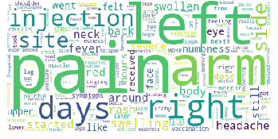
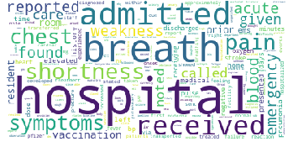
LDA RESULTS
Topic 1
"pain" + "left" + ”arm" + "right" + "days" + "injection" + "site" + "side" + "swelling" + “rash”’
This topic seems to describe pretty well the symptoms of those patients that feel pain in the arm after the injection. Quite common.
Topic 2
"hospital" + "breath" + "admitted" + "received" + "shortness" + "chest" +
"pain" + "symptoms" + "reported" + "acute”
This topic depicts patients that following the vaccination present the typical COVID19 respiratory disease symptoms.

Slide 15
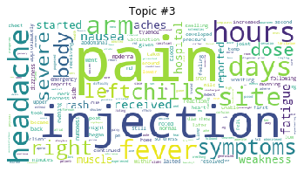
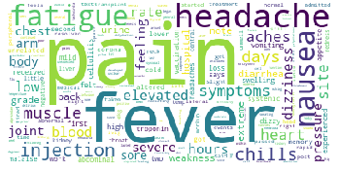
LDA RESULTS
Topic 3
"pain" + "injection" + "hours" + "headache" + "days" + "fever" + "site" + "arm" + "symptoms" + "chills”
Topic 3 shows patients who faced light side effects in the days that followed the vaccination.
Topic 4
"pain" + "fever" + "headache" + "fatigue" + "nausea" + "injection" + "chills" + "days" + "muscle" + "symptoms”
Topic 4, instead, tries to address the medical record of those patient that felt hard side effects for multiple days following the vaccination.

Slide 16
THANK YOU!
And remember to vaccinate!

