Slide 1

Lecture 02 Elimination with matrices
Elimination
Back Substitution
Elimination matrices
Matrix multiplications
Attribution-NonCommercial-ShareAlike 4.0 International (CC BY-NC-SA 4.0)

Slide 2
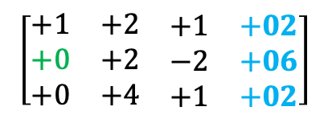
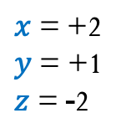
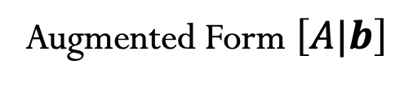
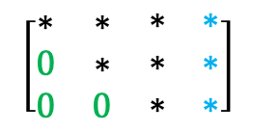
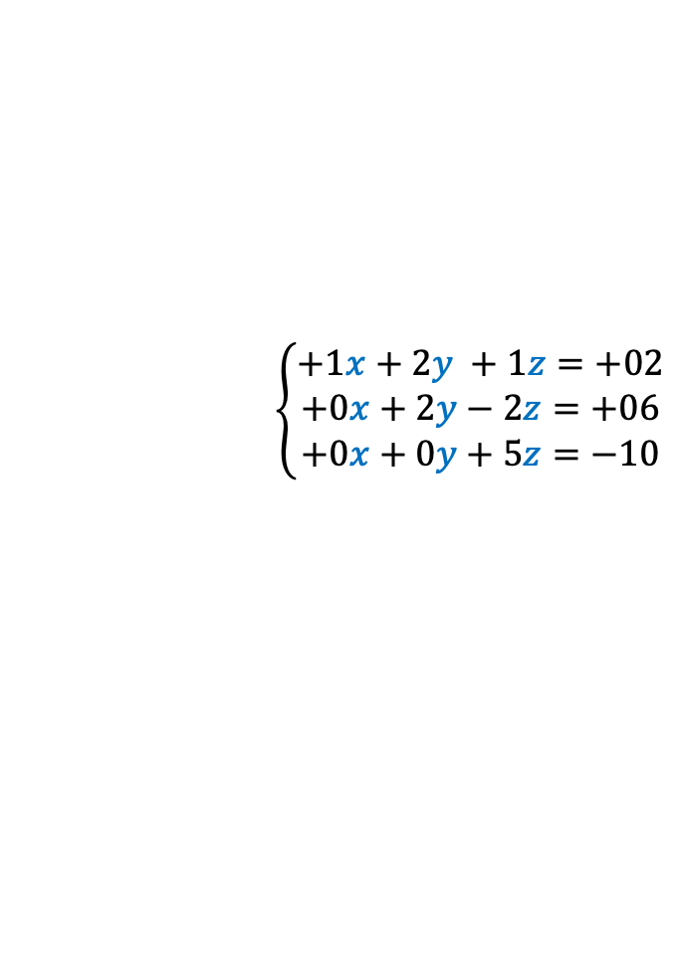
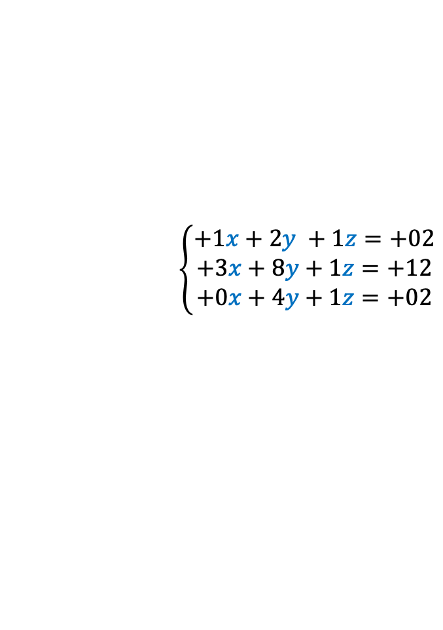

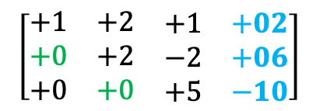
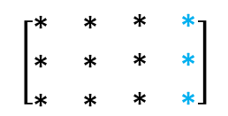
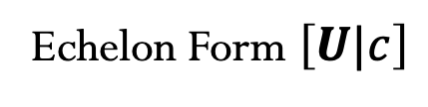
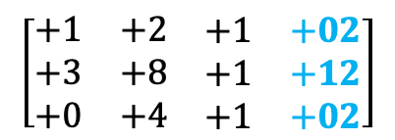

Elimination
$\left[A|b\right]$ $→$ $\left[U|c\right]$
Augmented Form $\left[A|b\right]$
Echelon Form $\left[U|c\right]$
$$\left\{\begin{matrix}+1x+2y +1z=+02 \\ +3x+8y+1z=+12 \\ +0x+4y+1z=+02\end{matrix}\right.$$
$$\left[\begin{matrix}∗ & ∗ & \begin{matrix}∗ & ∗\end{matrix} \\ ∗ & ∗ & \begin{matrix}∗ & ∗\end{matrix} \\ ∗ & ∗ & \begin{matrix}∗ & ∗\end{matrix}\end{matrix}\right]$$
$$\left[\begin{matrix}∗ & ∗ & \begin{matrix}∗ & ∗\end{matrix} \\ 0 & ∗ & \begin{matrix}∗ & ∗\end{matrix} \\ 0 & 0 & \begin{matrix}∗ & ∗\end{matrix}\end{matrix}\right]$$
Pivot
Zero in never allowed as pivot!
$$\left[\begin{matrix}+1 & +2 & \begin{matrix}+1 & +02\end{matrix} \\ +3 & +8 & \begin{matrix}+1 & +12\end{matrix} \\ +0 & +4 & \begin{matrix}+1 & +02\end{matrix}\end{matrix}\right]$$
(2,1)
$$\left[\begin{matrix}+1 & +2 & \begin{matrix}+1 & +02\end{matrix} \\ +0 & +2 & \begin{matrix}−2 & +06\end{matrix} \\ +0 & +4 & \begin{matrix}+1 & +02\end{matrix}\end{matrix}\right]$$
(3,2)
$$\left[\begin{matrix}+1 & +2 & \begin{matrix}+1 & +02\end{matrix} \\ +0 & +2 & \begin{matrix}−2 & +06\end{matrix} \\ +0 & +0 & \begin{matrix}+5 & −10\end{matrix}\end{matrix}\right]$$
Step 1
Substract (3*Row₁) from Row₂
Step 2
Substract (2*Row₂) from Row₃
Step 3
Back Substitution
Back Substitution
$$\left[\begin{matrix}+1 & +2 & \begin{matrix}+1 & +02\end{matrix} \\ +0 & +2 & \begin{matrix}−2 & +06\end{matrix} \\ +0 & +0 & \begin{matrix}+5 & −10\end{matrix}\end{matrix}\right]$$
$$\left\{\begin{matrix}+1x+2y +1z=+02 \\ +0x+2y−2z=+06 \\ +0x+0y+5z=−10\end{matrix}\right.$$
$x$= +2
$y$ = +1
$z$ = -2

Slide 3
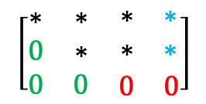

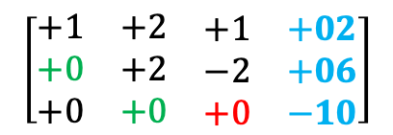



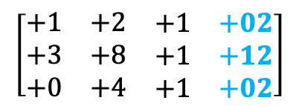
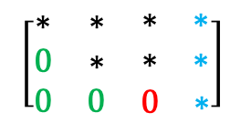
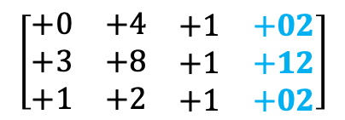
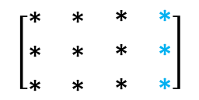

Elimination
$$\left[\begin{matrix}∗ & ∗ & \begin{matrix}∗ & ∗\end{matrix} \\ 0 & ∗ & \begin{matrix}∗ & ∗\end{matrix} \\ 0 & 0 & \begin{matrix}0 & ∗\end{matrix}\end{matrix}\right]$$
PERMANENT FAILURE
NO SOLUTION
$$\left\{\begin{matrix}+1x+2y +1z=+02 \\ +3x+8y+1z=+12 \\ +0x+4y−4z=+02\end{matrix}\right.$$
$$\left[\begin{matrix}∗ & ∗ & \begin{matrix}∗ & ∗\end{matrix} \\ ∗ & ∗ & \begin{matrix}∗ & ∗\end{matrix} \\ ∗ & ∗ & \begin{matrix}∗ & ∗\end{matrix}\end{matrix}\right]$$
$$\left[\begin{matrix}∗ & ∗ & \begin{matrix}∗ & ∗\end{matrix} \\ 0 & ∗ & \begin{matrix}∗ & ∗\end{matrix} \\ 0 & 0 & \begin{matrix}0 & 0\end{matrix}\end{matrix}\right]$$
INFINITELY
MANY
SOLUTIONES
$$\left[\begin{matrix}+1 & +2 & \begin{matrix}+1 & +02\end{matrix} \\ +3 & +8 & \begin{matrix}+1 & +12\end{matrix} \\ +0 & +4 & \begin{matrix}−4 & +02\end{matrix}\end{matrix}\right]$$
(2,1)
$$\left[\begin{matrix}+1 & +2 & \begin{matrix}+1 & +02\end{matrix} \\ +0 & +2 & \begin{matrix}−2 & +06\end{matrix} \\ +0 & +4 & \begin{matrix}−4 & +02\end{matrix}\end{matrix}\right]$$
(3,2)
$$\left[\begin{matrix}+1 & +2 & \begin{matrix}+1 & +02\end{matrix} \\ +0 & +2 & \begin{matrix}−2 & +06\end{matrix} \\ +0 & +0 & \begin{matrix}+0 & −10\end{matrix}\end{matrix}\right]$$
Step 1
Substract (3*Row₁) from Row₂
Step 2
Substract (2*Row₂) from Row₃
Step 3
FAILURE
TEMPORARY FAILURE – (Zero in Pivot!)
Sol.: PERMUTATION – Exchange row_{i}
$$\left\{\begin{matrix}+0x+4y+1z=+02 \\ +3x+8y+1z=+12 \\ +1x+2y +1z=+02\end{matrix}\right.$$
$$\left[\begin{matrix}+0 & +4 & \begin{matrix}+1 & +02\end{matrix} \\ +3 & +8 & \begin{matrix}+1 & +12\end{matrix} \\ +1 & +2 & \begin{matrix}+1 & +02\end{matrix}\end{matrix}\right]$$
$$\left[\begin{matrix}+1 & +2 & \begin{matrix}+1 & +02\end{matrix} \\ +3 & +8 & \begin{matrix}+1 & +12\end{matrix} \\ +0 & +4 & \begin{matrix}+1 & +02\end{matrix}\end{matrix}\right]$$
${Row}_{3}$ $↔{Row}_{1}$
Step 0
Exchange Row₃ and Row₁

Slide 4
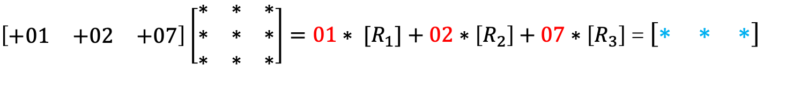
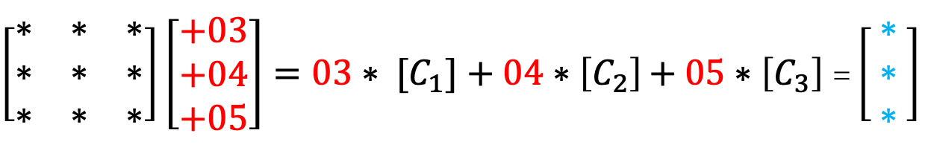
Matrix Mutliplications
Matrix * Column = Colum
$\left[\begin{matrix}∗ & ∗ & ∗ \\ ∗ & ∗ & ∗ \\ ∗ & ∗ & ∗\end{matrix}\right]\left[\begin{matrix}+03 \\ +04 \\ +05\end{matrix}\right]=03∗ [C_{1}]+04∗\left[C_{2}\right]$ $+ 05∗\left[C_{3}\right]$= $\left[\begin{matrix} ∗ \\ ∗ \\ ∗\end{matrix} \right]$
3 x 3
3 x 1
3 x 1
Row * Matrix = Row
$\left[\begin{matrix}+01 & +02 & +07\end{matrix}\right]\left[\begin{matrix}∗ & ∗ & ∗ \\ ∗ & ∗ & ∗ \\ ∗ & ∗ & ∗\end{matrix}\right]=01∗ [R_{1}]+02∗\left[R_{2}\right]$ $+ 07∗\left[R_{3}\right]$= $\left[\begin{matrix}∗ & ∗ & ∗\end{matrix}\right]$
1 x 3
3 x 3
1 x 3

Slide 5
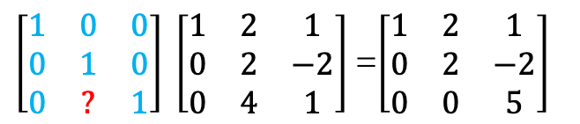
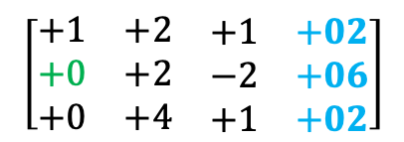
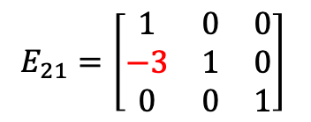

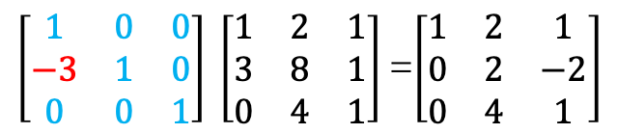
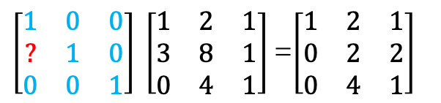
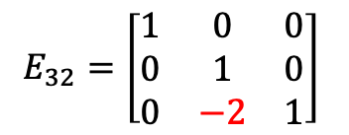
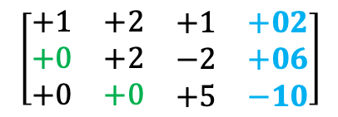
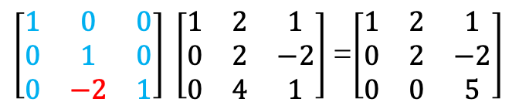
Elimination Matrices (E)
$$\left[\begin{matrix}+1 & +2 & \begin{matrix}+1 & +02\end{matrix} \\ +3 & +8 & \begin{matrix}+1 & +12\end{matrix} \\ +0 & +4 & \begin{matrix}+1 & +02\end{matrix}\end{matrix}\right]$$
(2,1)
$$\left[\begin{matrix}+1 & +2 & \begin{matrix}+1 & +02\end{matrix} \\ +0 & +2 & \begin{matrix}−2 & +06\end{matrix} \\ +0 & +4 & \begin{matrix}+1 & +02\end{matrix}\end{matrix}\right]$$
(3,2)
$$\left[\begin{matrix}+1 & +2 & \begin{matrix}+1 & +02\end{matrix} \\ +0 & +2 & \begin{matrix}−2 & +06\end{matrix} \\ +0 & +0 & \begin{matrix}+5 & −10\end{matrix}\end{matrix}\right]$$
Step 1
Step 2
Step 3
Back Substitution
Step 1
Substract (3*Row₁) from Row₂
Step 2
Substract (2*Row₂) from Row₃
$\left[\begin{matrix}1 & 0 & 0 \\ ? & 1 & 0 \\ 0 & 0 & 1\end{matrix}\right] \left[\begin{matrix}1 & 2 & 1 \\ 3 & 8 & 1 \\ 0 & 4 & 1\end{matrix}\right]$=$\left[\begin{matrix}1 & 2 & 1 \\ 0 & 2 & 2 \\ 0 & 4 & 1\end{matrix}\right]$
$\left[\begin{matrix}1 & 0 & 0 \\ 0 & 1 & 0 \\ 0 & ? & 1\end{matrix}\right] \left[\begin{matrix}1 & 2 & 1 \\ 0 & 2 & −2 \\ 0 & 4 & 1\end{matrix}\right]$=$\left[\begin{matrix}1 & 2 & 1 \\ 0 & 2 & −2 \\ 0 & 0 & 5\end{matrix}\right]$
$\left[\begin{matrix}1 & 0 & 0 \\ −3 & 1 & 0 \\ 0 & 0 & 1\end{matrix}\right] \left[\begin{matrix}1 & 2 & 1 \\ 3 & 8 & 1 \\ 0 & 4 & 1\end{matrix}\right]$=$\left[\begin{matrix}1 & 2 & 1 \\ 0 & 2 & −2 \\ 0 & 4 & 1\end{matrix}\right]$
$\left[\begin{matrix}1 & 0 & 0 \\ 0 & 1 & 0 \\ 0 & −2 & 1\end{matrix}\right] \left[\begin{matrix}1 & 2 & 1 \\ 0 & 2 & −2 \\ 0 & 4 & 1\end{matrix}\right]$=$\left[\begin{matrix}1 & 2 & 1 \\ 0 & 2 & −2 \\ 0 & 0 & 5\end{matrix}\right]$
$$E_{21}=\left[\begin{matrix}1 & 0 & 0 \\ −3 & 1 & 0 \\ 0 & 0 & 1\end{matrix}\right]$$
$$E_{32}=\left[\begin{matrix}1 & 0 & 0 \\ 0 & 1 & 0 \\ 0 & −2 & 1\end{matrix}\right]$$

Slide 6

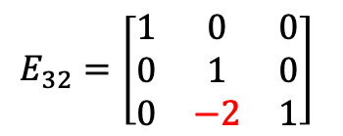




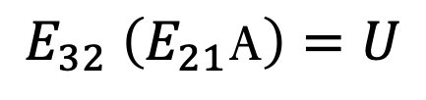
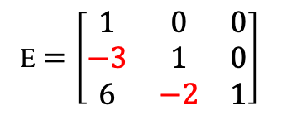
Elimination Matrices (E)
$\left[A|b\right]$ $→$ $\left[U|c\right]$
$$E_{32}=\left[\begin{matrix}1 & 0 & 0 \\ 0 & 1 & 0 \\ 0 & −2 & 1\end{matrix}\right]$$
$$E_{32} \left(E_{21}\text{A}\right)=U$$
$$\left({E_{32}E}_{21}\right)\text{A}=U$$
$$E_{21}=\left[\begin{matrix}1 & 0 & 0 \\ −3 & 1 & 0 \\ 0 & 0 & 1\end{matrix}\right]$$
$$E\text{A}=U$$
E $=\left[\begin{matrix}1 & 0 & 0 \\ −3 & 1 & 0 \\ 6 & −2 & 1\end{matrix}\right]$
$E=$ ${E_{32}E}_{21}$

Slide 7

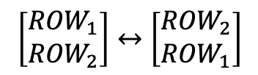







Permutation Matrices (P)
Echange rows 1 and 2.
Echange Columns 1 and 2.
$$\left[\begin{matrix}{ROW}_{1} \\ {ROW}_{2}\end{matrix}\right]↔\left[\begin{matrix}{ROW}_{2} \\ {ROW}_{1}\end{matrix}\right]$$
$$\left[\begin{matrix}C_{1} & C_{2}\end{matrix}\right]↔\left[\begin{matrix}C_{2} & C_{1}\end{matrix}\right]$$
$\left[\begin{matrix}? & ? \\ ? & ?\end{matrix}\right]\left[\begin{matrix}a & b \\ c & d\end{matrix}\right]$ = $\left[\begin{matrix}c & d \\ a & b\end{matrix}\right]$
$\left[\begin{matrix}a & b \\ c & d\end{matrix}\right]$ $\left[\begin{matrix}? & ? \\ ? & ?\end{matrix}\right]$= $\left[\begin{matrix}b & a \\ d & c\end{matrix}\right]$
$\left[\begin{matrix}0 & 1 \\ 1 & 0\end{matrix}\right]\left[\begin{matrix}a & b \\ c & d\end{matrix}\right]$ = $\left[\begin{matrix}c & d \\ a & b\end{matrix}\right]$
$\left[\begin{matrix}a & b \\ c & d\end{matrix}\right]$ $\left[\begin{matrix}0 & 1 \\ 1 & 0\end{matrix}\right]$= $\left[\begin{matrix}b & a \\ c & d\end{matrix}\right]$
$P_{21}=$ $\left[\begin{matrix}0 & 1 \\ 1 & 0\end{matrix}\right]$
$$P_{21}\left[\begin{matrix}a & b \\ c & d\end{matrix}\right]\text{ = }\left[\begin{matrix}c & d \\ a & b\end{matrix}\right]$$
$$\left[\begin{matrix}a & b \\ c & d\end{matrix}\right]P_{21}\text{= }\left[\begin{matrix}b & a \\ c & d\end{matrix}\right]$$

Slide 8
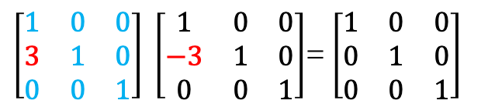
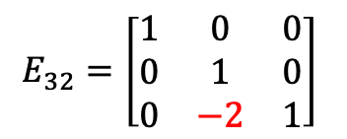


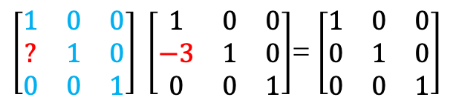
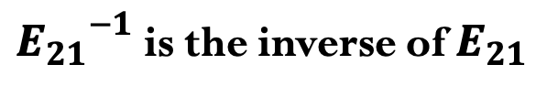


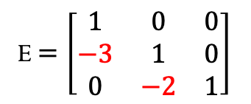
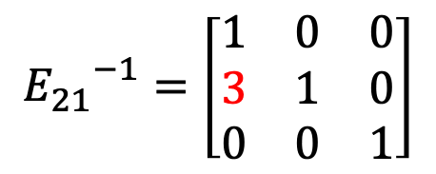
Inverses
$$E_{32}=\left[\begin{matrix}1 & 0 & 0 \\ 0 & 1 & 0 \\ 0 & −2 & 1\end{matrix}\right]$$
$$E_{21}=\left[\begin{matrix}1 & 0 & 0 \\ −3 & 1 & 0 \\ 0 & 0 & 1\end{matrix}\right]$$
E $=\left[\begin{matrix}1 & 0 & 0 \\ −3 & 1 & 0 \\ 0 & −2 & 1\end{matrix}\right]$
$${E_{21}}^{−1}=?$$
Step 1 Substract (3*Row₁) from Row₂
$\left[\begin{matrix}1 & 0 & 0 \\ ? & 1 & 0 \\ 0 & 0 & 1\end{matrix}\right] \left[\begin{matrix}1 & 0 & 0 \\ −3 & 1 & 0 \\ 0 & 0 & 1\end{matrix}\right]$= $\left[\begin{matrix}1 & 0 & 0 \\ 0 & 1 & 0 \\ 0 & 0 & 1\end{matrix}\right]$
$$?{∗E}_{21}=I$$
$${E_{21}}^{−1}E_{21}=I$$
$\left[\begin{matrix}1 & 0 & 0 \\ 3 & 1 & 0 \\ 0 & 0 & 1\end{matrix}\right] \left[\begin{matrix}1 & 0 & 0 \\ −3 & 1 & 0 \\ 0 & 0 & 1\end{matrix}\right]$= $\left[\begin{matrix}1 & 0 & 0 \\ 0 & 1 & 0 \\ 0 & 0 & 1\end{matrix}\right]$
$${E_{21}}^{−1}=\left[\begin{matrix}1 & 0 & 0 \\ 3 & 1 & 0 \\ 0 & 0 & 1\end{matrix}\right]$$
INVERSE - Add (3*Row₁) to Row₂
${E_{21}}^{−1}$ is the inverse of $E_{21}$

Slide 9
Credits
Ariel Guerrero
Lic. Electrónica
ariel.guerrero@uc.edu.py
(+595) 981-425 040
Hernandarias – Paraguay
@2020
Attribution-NonCommercial-ShareAlike 4.0 International (CC BY-NC-SA 4.0)
GitHub
https://github.com/aegiloru/linearAlgebra
Lec 02 –MIT 18.06
https://www.youtube.com/watch?v=QVKj3LADCnA
MIT 18.06
https://ocw.mit.edu/courses/mathematics/18-06-linear-algebra-spring-2010/
Prof. Gilbert Strang
http://www-math.mit.edu/~gs/

