Slide 1




Lecture 18 Properties of determinants
Determinants
Properties
Signs
$$\det{A=}\left|A\right|$$
$$1,2,3,4−10$$
$$∓$$
Attribution-NonCommercial-ShareAlike 4.0 International (CC BY-NC-SA 4.0)

Slide 2


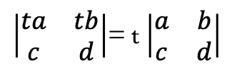

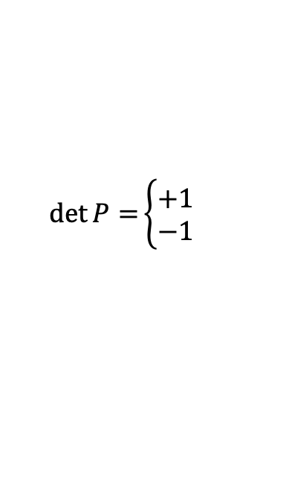

Determinants
It’s a number associated with a matrix
Properties
P-01
$$\left|\begin{matrix}1 & 0 \\ 0 & 1\end{matrix}\right|=1$$
$$\det{I=}\left|I\right|=1$$
P-02
$$Exchange rows = reverse sign of the determinant$$
$$\det{P=}\left\{\begin{aligned}+1 \\ −1\end{aligned}\right.$$
Even
$$\left|\begin{matrix}0 & 1 \\ 1 & 0\end{matrix}\right|=−1$$
odd
P-03
A)
$\left|\begin{matrix}ta & tb \\ c & d\end{matrix}\right|$= t $\left|\begin{matrix}a & b \\ c & d\end{matrix}\right|$
Linear of each row
B)
$\left|\begin{matrix}a+a′ & b+b′ \\ c & d\end{matrix}\right|$= $\left|\begin{matrix}a & b \\ c & d\end{matrix}\right|$+ $\left|\begin{matrix}a′ & b′ \\ c & d\end{matrix}\right|$

Slide 3


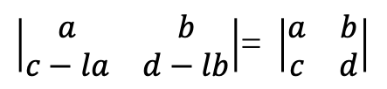

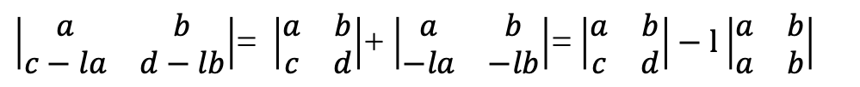

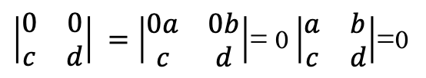
Properties
P-04
$$2 equals rows →determinant zero$$
$$\left|\begin{matrix}a & b \\ a & b\end{matrix}\right|=0$$
Exchange those rows $→$same matrix
P-05
$$Substract l∗{row}_{i} from{ row}_{k}→ Det dosn’t change$$
$\left|\begin{matrix}a & b \\ c−la & d−lb\end{matrix}\right|$= $\left|\begin{matrix}a & b \\ c & d\end{matrix}\right|$+ $\left|\begin{matrix}a & b \\ −la & −lb\end{matrix}\right|$= $\left|\begin{matrix}a & b \\ c & d\end{matrix}\right|−l$ $\left|\begin{matrix}a & b \\ a & b\end{matrix}\right|$
$\left|\begin{matrix}a & b \\ c−la & d−lb\end{matrix}\right|$= $\left|\begin{matrix}a & b \\ c & d\end{matrix}\right|$
QED
P-06
$$Rows of zeros→\det{A=}0$$
$\left|\begin{matrix}0 & 0 \\ c & d\end{matrix}\right| =\left|\begin{matrix}0a & 0b \\ c & d\end{matrix}\right|$= 0 $\left|\begin{matrix}a & b \\ c & d\end{matrix}\right|$=0

Slide 4
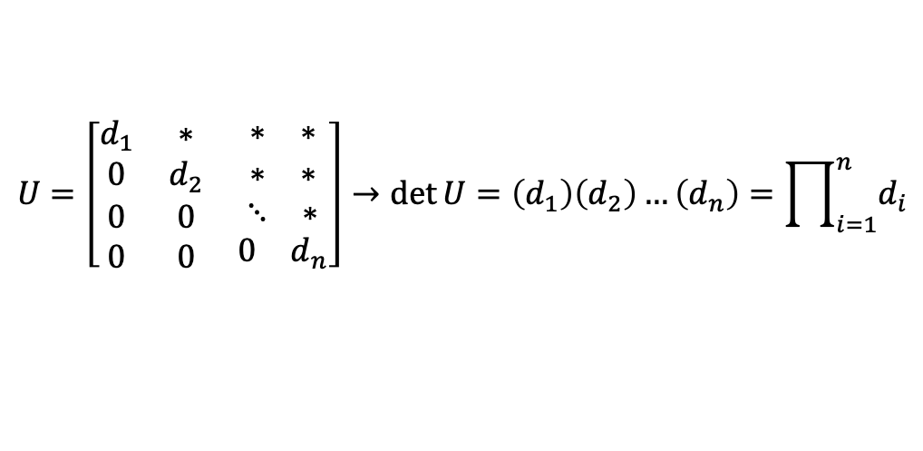
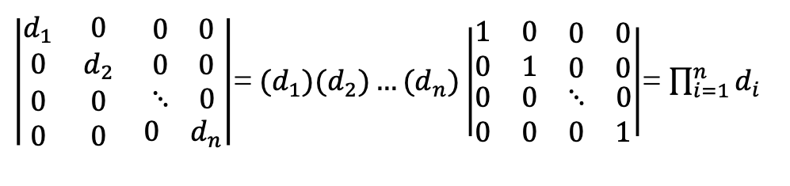
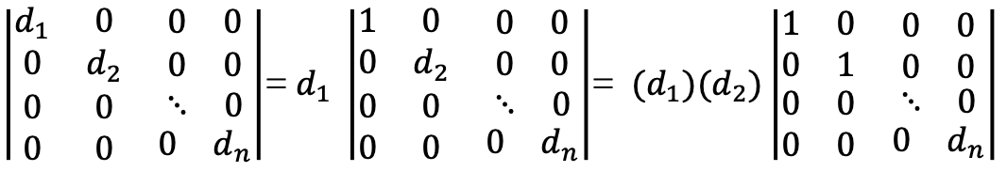
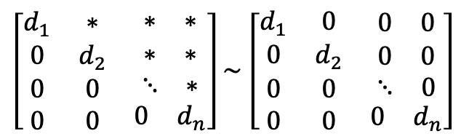
Properties
P-07
$$The determinant of a triangular matrix is the product of pivots.$$
$$U=\left[\begin{matrix}d_{1} & ∗ & \begin{matrix}∗ & ∗\end{matrix} \\ 0 & d_{2} & \begin{matrix}∗ & ∗\end{matrix} \\ \begin{matrix}0 \\ 0\end{matrix} & \begin{matrix}0 \\ 0\end{matrix} & \begin{matrix}\begin{matrix}⋱ & ∗\end{matrix} \\ \begin{matrix}0 & d_{n}\end{matrix}\end{matrix}\end{matrix}\right]→\det{U=\left(d_{1}\right)\left(d_{2}\right)…\left(d_{n}\right)=\prod_{i=1}^{n}{d_{i}}}$$
No row exchanges!
$\left[\begin{matrix}d_{1} & ∗ & \begin{matrix}∗ & ∗\end{matrix} \\ 0 & d_{2} & \begin{matrix}∗ & ∗\end{matrix} \\ \begin{matrix}0 \\ 0\end{matrix} & \begin{matrix}0 \\ 0\end{matrix} & \begin{matrix}\begin{matrix}⋱ & ∗\end{matrix} \\ \begin{matrix}0 & d_{n}\end{matrix}\end{matrix}\end{matrix}\right]\sim$ $\left[\begin{matrix}d_{1} & 0 & \begin{matrix}0 & 0\end{matrix} \\ 0 & d_{2} & \begin{matrix}0 & 0\end{matrix} \\ \begin{matrix}0 \\ 0\end{matrix} & \begin{matrix}0 \\ 0\end{matrix} & \begin{matrix}\begin{matrix}⋱ & 0\end{matrix} \\ \begin{matrix}0 & d_{n}\end{matrix}\end{matrix}\end{matrix}\right]$
$\left|\begin{matrix}d_{1} & 0 & \begin{matrix}0 & 0\end{matrix} \\ 0 & d_{2} & \begin{matrix}0 & 0\end{matrix} \\ \begin{matrix}0 \\ 0\end{matrix} & \begin{matrix}0 \\ 0\end{matrix} & \begin{matrix}\begin{matrix}⋱ & 0\end{matrix} \\ \begin{matrix}0 & d_{n}\end{matrix}\end{matrix}\end{matrix}\right|$= $d_{1} \left|\begin{matrix}1 & 0 & \begin{matrix}0 & 0\end{matrix} \\ 0 & d_{2} & \begin{matrix}0 & 0\end{matrix} \\ \begin{matrix}0 \\ 0\end{matrix} & \begin{matrix}0 \\ 0\end{matrix} & \begin{matrix}\begin{matrix}⋱ & 0\end{matrix} \\ \begin{matrix}0 & d_{n}\end{matrix}\end{matrix}\end{matrix}\right|$= ${ (d}_{1}){(d}_{2})\left|\begin{matrix}1 & 0 & \begin{matrix}0 & 0\end{matrix} \\ 0 & 1 & \begin{matrix}0 & 0\end{matrix} \\ \begin{matrix}0 \\ 0\end{matrix} & \begin{matrix}0 \\ 0\end{matrix} & \begin{matrix}\begin{matrix}⋱ & 0\end{matrix} \\ \begin{matrix}0 & d_{n}\end{matrix}\end{matrix}\end{matrix}\right|$
$\left|\begin{matrix}d_{1} & 0 & \begin{matrix}0 & 0\end{matrix} \\ 0 & d_{2} & \begin{matrix}0 & 0\end{matrix} \\ \begin{matrix}0 \\ 0\end{matrix} & \begin{matrix}0 \\ 0\end{matrix} & \begin{matrix}\begin{matrix}⋱ & 0\end{matrix} \\ \begin{matrix}0 & d_{n}\end{matrix}\end{matrix}\end{matrix}\right|$=${ (d}_{1}){(d}_{2})…{(d}_{n})\left|\begin{matrix}1 & 0 & \begin{matrix}0 & 0\end{matrix} \\ 0 & 1 & \begin{matrix}0 & 0\end{matrix} \\ \begin{matrix}0 \\ 0\end{matrix} & \begin{matrix}0 \\ 0\end{matrix} & \begin{matrix}\begin{matrix}⋱ & 0\end{matrix} \\ \begin{matrix}0 & 1\end{matrix}\end{matrix}\end{matrix}\right|$= $\prod_{i=1}^{n}{d_{i}}$
QED

Slide 5
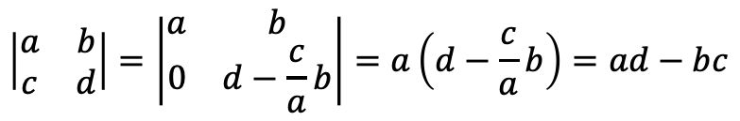

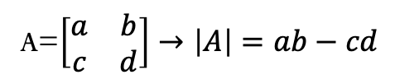
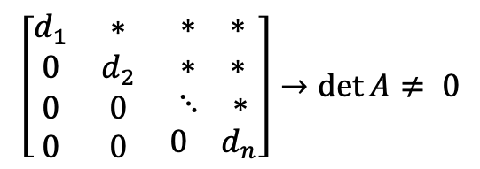
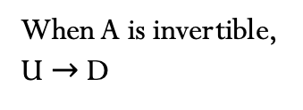
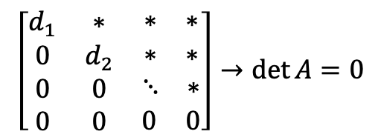
Properties
P-08
$$The determinant of A is zero when A is singular.$$
$A$ $→U$
By elimination
$$\left[\begin{matrix}d_{1} & ∗ & \begin{matrix}∗ & ∗\end{matrix} \\ 0 & d_{2} & \begin{matrix}∗ & ∗\end{matrix} \\ \begin{matrix}0 \\ 0\end{matrix} & \begin{matrix}0 \\ 0\end{matrix} & \begin{matrix}\begin{matrix}⋱ & ∗\end{matrix} \\ \begin{matrix}0 & 0\end{matrix}\end{matrix}\end{matrix}\right]→\det{A=0}$$
When A is singular,
row of U with zeros
$$\left[\begin{matrix}d_{1} & ∗ & \begin{matrix}∗ & ∗\end{matrix} \\ 0 & d_{2} & \begin{matrix}∗ & ∗\end{matrix} \\ \begin{matrix}0 \\ 0\end{matrix} & \begin{matrix}0 \\ 0\end{matrix} & \begin{matrix}\begin{matrix}⋱ & ∗\end{matrix} \\ \begin{matrix}0 & d_{n}\end{matrix}\end{matrix}\end{matrix}\right]→\det{A≠ 0}$$
When A is invertible,
U $→$D
Example:
A=$\left[\begin{matrix}a & b \\ c & d\end{matrix}\right]→\left|A\right|=ab−cd$
$$\left|\begin{matrix}a & b \\ c & d\end{matrix}\right|=\left|\begin{matrix}a & b \\ 0 & d−\frac{c}{a}b\end{matrix}\right|=a\left(d−\frac{c}{a}b\right)=ad−bc$$

Slide 6
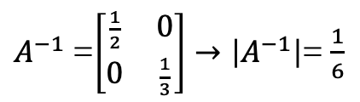

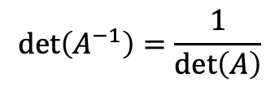







Properties
P-09
$$\det\left(AB\right)=\det\left(A\right)det⁡(B)$$
$$\det\left(A^{−1}\right)=?$$
$AA^{−1}=I=A^{−1}$ $A$
$$\det\left({AA}^{−1}\right)=\det\left(I\right)$$
$$\det\left(A^{−1}\right)\det\left(A\right)=1$$
$$\det\left(A^{−1}\right)=\frac{1}{\det\left(A\right)}$$
Example:
A=$\left[\begin{matrix}2 & 0 \\ 0 & 3\end{matrix}\right]→\left|A\right|$=6
$A^{−1}$=$\left[\begin{matrix}\frac{1}{2} & 0 \\ 0 & \frac{1}{3}\end{matrix}\right]→\left|A^{−1}\right|$= $\frac{1}{6}$
$\left|A^{2}\right|$= ${\left|A\right|}^{2}$
$\left|2A\right|$= $2^{n}$ $\left|A\right|$

Slide 7
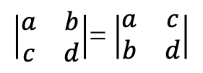





Properties
P-10
$$\det\left(A^{T}\right)=\det\left(A\right)$$
$\left|\begin{matrix}a & b \\ c & d\end{matrix}\right|$= $\left|\begin{matrix}a & c \\ b & d\end{matrix}\right|$
$$\left|A^{T}\right|=\left|A\right|$$
$$\left|U^{T}L^{T}\right|=\left|LU\right|$$
$$\left|U^{T}\right|\left|L^{T}\right|=\left|L\right|\left|U\right|$$
The matrix L has ones in his diagonal
$$\left|U^{T}\right|=\left|U\right|$$
QED

Slide 8
Credits
Ariel Guerrero
Lic. Electrónica
ariel.guerrero@uc.edu.py
(+595) 981-425 040
Hernandarias – Paraguay
@2020
Attribution-NonCommercial-ShareAlike 4.0 International (CC BY-NC-SA 4.0)
GitHub
https://github.com/aegiloru/linearAlgebra
Lec 18 –MIT 18.06
https://www.youtube.com/watch?time_continue=3&v=srxexLishgY
MIT 18.06
https://ocw.mit.edu/courses/mathematics/18-06-linear-algebra-spring-2010/
Prof. Gilbert Strang
http://www-math.mit.edu/~gs/

